Slide 1
Protect Chicago Vaccine Equity /
Healthy Chicago Equity Zones RFP
May 4, 2021

Slide 2
HOUSEKEEPING
  Please put name, organization, communities served, and email in the chat.
  Please mute throughout the presentation.
  Place any questions for Q&A in the chat and we will address at the end.
  Please take note of any potential subcontractors or partnerships you may want to pursue with fellow attendees. CDPH will not provide a list of attendees to this bidder’s conference.
  Note that meeting is being recorded. Presentation will be provided through FMPS after the conference.

Slide 3
AGENDA
  Introduction to Healthy Chicago 2025 and Equity Zones
  Overview of RFP: Timeline, Structure, Activities, Funding
  Application Requirements & Evaluation
  Technical Assistance Opportunities
  Questions & Answers

Slide 4
GOALS
  Healthy Chicago Equity Zones will lead hyper-local strategies to confront the social and environmental factors that contribute to health and racial equity – with the ultimate goal of closing Chicago’s life expectancy gap.
  Building on the successful Protect Chicago Plus vaccine equity pilot, these efforts will begin with community leadership of COVID-19 vaccination campaigns, including outreach and engagement during 2021.

Slide 5
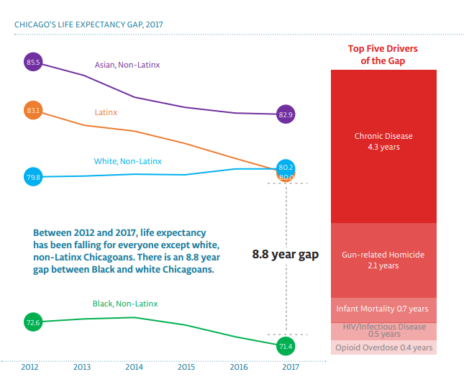
CHICAGO’S LIFE EXPECTANCY GAP, 2017
National projections estimate COVID-19 will reduce life expectancy in 2020 by 1.13 years,
with reductions for Black and Latinx populations at 3 to 4 times that for whites.
Andrasfay T, Goldman N. Reductions in 2020 US life expectancy due to COVID-19 and the disproportionate impact on the Black and Latino populations.

Slide 6
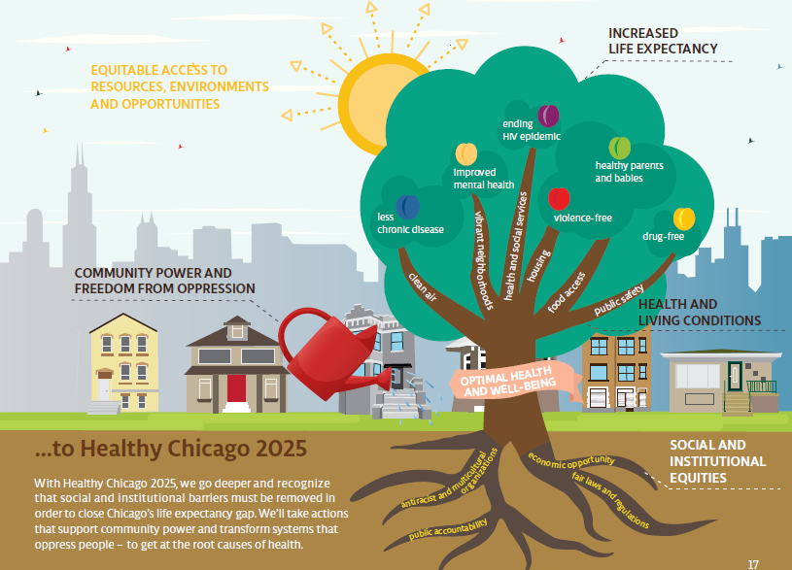
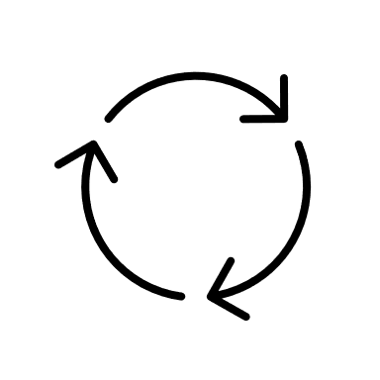

HEALTHY CHICAGO 2025
Citywide Health Improvement Plan
To Close Our
Life Expectancy Gap
Identify Local Priorities
Community
Co-Led
Evaluate
Progress
Take
Action
Notes:
The life Expectancy Gap between White and Black Chicagoans is over 8 years, and life expectancy is falling for many of people of color.
Healthy Chicago 2025 focuses on implementing community co-led strategies to identify and addresses issues and barriers to access to care, healthy and vibrant neighborhoods, and creating antiracist policies and systems
The community has identified priority areas in housing, food access, public safety, environment, and the public health system as a whole
By ensuring everyone has equitable access to resources, environments and opportunities, by building communities that have power and are free from oppression, and by ensuring our strategies not just focus on the health and living conditions of Chicagoans, but also fight the social and institutional inequities, we can close the life expectancy gap and create a Chicago that provides optimal health and well-being to all.

Slide 7
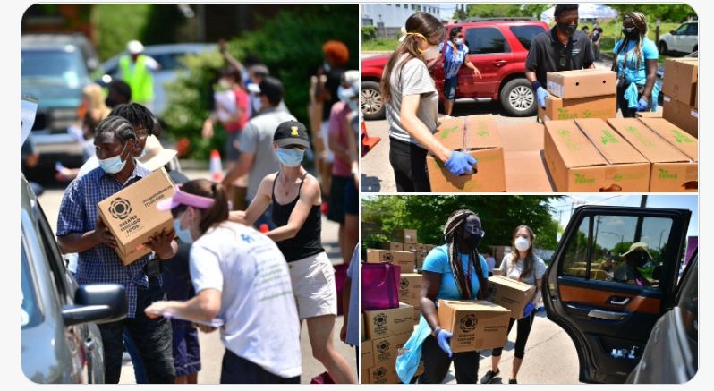
RACIAL EQUITY RAPID RESPONSE

Slide 8
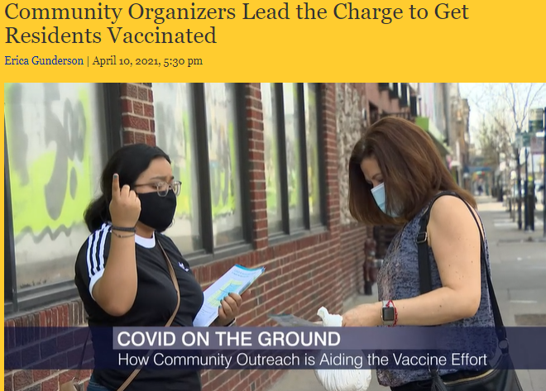
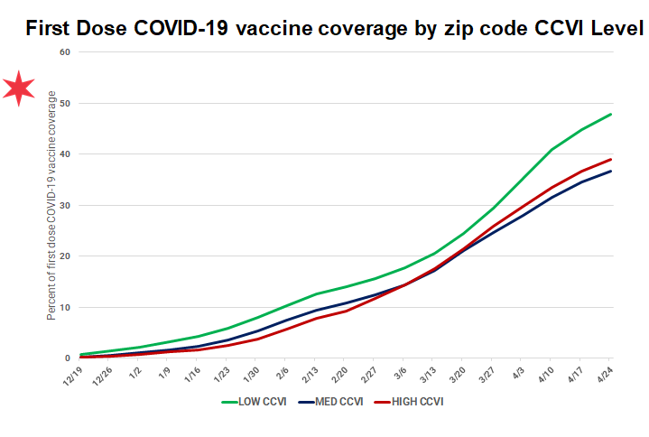
PROTECT CHICAGO PLUS
After the first six weeks of Protect Chicago Plus implementation, vaccine coverage in priority areas increased over 300% – nearly twice the citywide increase in the same period.
Healthy Chicago Equity Zones will scale these successful vaccine equity partnerships across all of Chicago’s hardest hit communities.

Slide 9
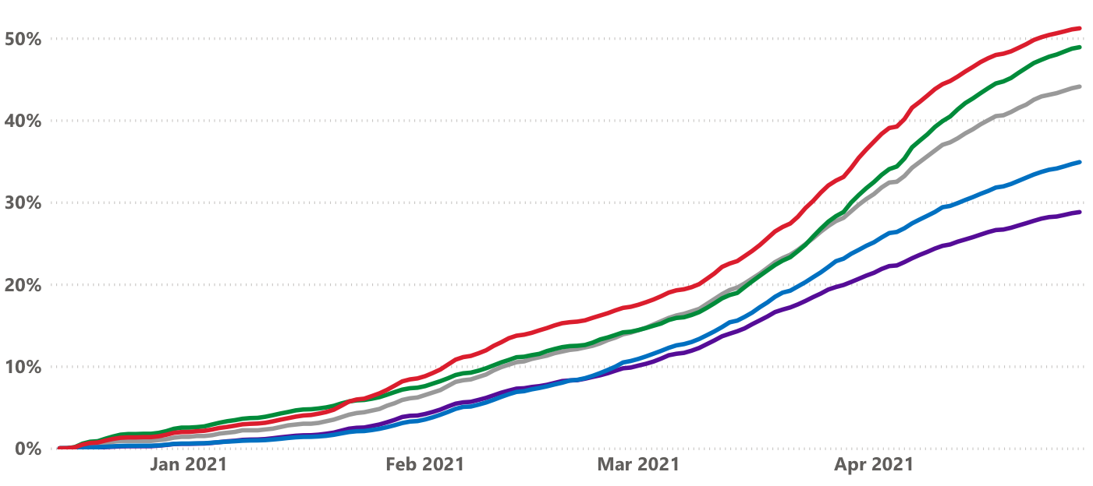
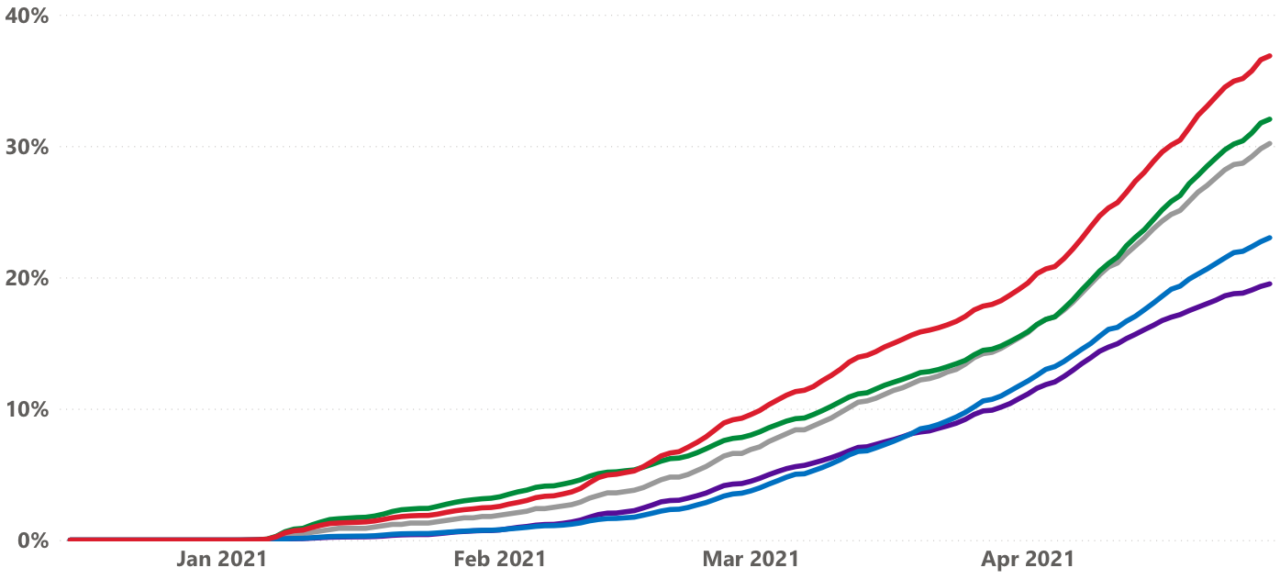
…BUT MORE TO DO FOR VACCINE EQUITY
Percent of population with
at least one dose of vaccine
Percent of population with a completed series
51.2
48.9
36.9
44.1
32
34.9
30.2
28.8
23
19.5

Slide 10
HEALTHY CHICAGO EQUITY ZONES TIMELINE
RFP/Contracting
April – July 2021
Vaccine Equity Initiative
July – December 2021
Equity Zones
2021 - 2025
  May 28: RFP closes
  June 15: Target date for award announcements
  June 21: Target for kickoff meetings with Regional Leads, contracting
  July 1: Vaccine equity initiatives under way
  INITIAL AWARD
  Build/expand cross-sector community table
  Create neighborhood engagement and communications plan
  With community members and trusted messengers, conduct direct vaccine outreach, education, and registration activities
  FUTURE AWARDS
  Collect ana analyze local data
  Identify community health priorities
  Lead grassroots initiatives to improve health awareness, link community members with resources, and drive policy/system/environmental changes to prevent disease and address the root causes of health, including structural racism.

Slide 11
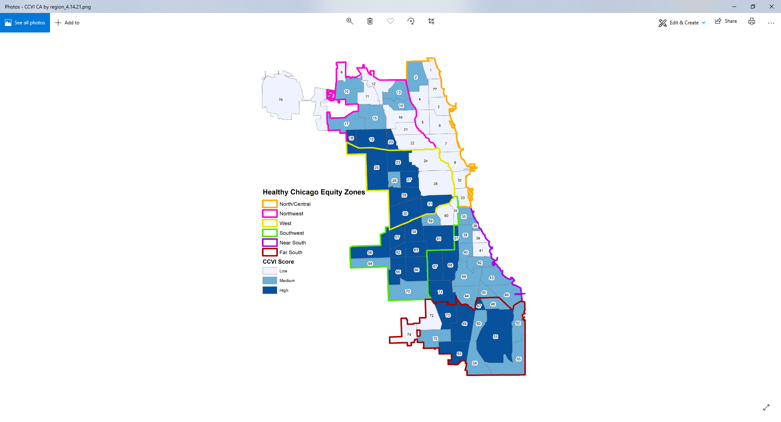
EQUITY ZONES MAP
  Six Equity Zones, covering the entire geography of Chicago
  Generally track with the City’s planning regions (Dept. of Planning and Development), Family Connects
  Within Equity Zones, different community areas will be prioritized based on issue – starting with COVID vulnerability

Slide 12







EQUITY ZONES STRUCTURE
CDPH
Funding and support for Equity Zones
Near South Regional Lead
Funding and support for Community Leads
Community Leads
Funding and support for community network and activations
  EXAMPLE: Near South Equity Zone
  1 Regional Lead (applicant)
  16 Community Leads (designated at time of application), one for each neighborhood in the region
  Each Community Lead coordinates a hyper-local network of partners, including:
    Other community groups
    Health providers
    Schools
    Faith-based organizations
    Businesses
Community Network
Community Network
Community Network

Slide 13
INITIAL ACTIVATION (2021): VACCINE EQUITY
  For the first activation of the Heathy Chicago Equity Zones (Jul–Dec 2021), community organizations will receive resources to:
  Build vaccine confidence through outreach and education
  Coordinate and publicize local opportunities for people to get vaccinated
  Overcome barriers to make it easier for community members to access vaccine
  …with the ultimate goal of maximizing the vaccine uptake in communities that have been disproportionately affected by COVID-19.

Slide 14
REGIONAL LEADS
  Through this RFP, the City will select one Regional Lead organization for each of the six Healthy Chicago Equity Zones.
  Regional Leads will oversee and coordinate Protect Chicago vaccine outreach and engagement in 2021, as well as support neighborhood-level planning and implementation for other health and racial equity initiatives.
  An organization may apply to be a Regional Lead for up to two Healthy Chicago Equity Zones; however, the respondent must meet all the required competencies described for both Healthy Chicago Equity Zones and submit a separate application for each.
  Must be a nonprofit agency in good standing with the City of Chicago.

Slide 15
REGIONAL LEADS: CAPACITIES
  Regional Lead are responsible for developing region-wide program management systems and infrastructure, and for supporting Community Leads to carry out all program activities, including:
    Rapidly execute vaccine equity initiatives
    Manage subcontracts with Community Leads
    Support Community Leads to track expenses and submit required documentation
    Provide fiscal and administrative support/capacity building for Community Leads
    Deliver ongoing training and supportive learning to ensure all Community Leads follow program protocols, guidance, and standards
    Provide access to and encourage collaborations with cross-sector partners
    Create communication systems and platforms, convene Community Leads in a learning cohort
    Prepare and submit required program reports that summarize key performance indicators and activities

Slide 16
REGIONAL LEADS: CHARACTERISTICS
  Prior leadership of community-driven initiatives to address health and racial equity, preference for previous experience working in coordination with local or state government entities
  Physical location/site and history of delivering services in the region served
  Track record of successfully executing large-scale, multi-component programs
  Experience serving as a community hub organization, including managing grants and distributing stipends/subawards
  Ability to leverage existing relationships in designated community area(s)
  Demonstrated track record of providing learning and skill-building opportunities to smaller organizations
  Ability to interact effectively and sensitively with residents from diverse backgrounds

Slide 17
COMMUNITY LEADS
  Each Regional Lead must subcontract with at least one community-based organization for each of the community areas within their region.
  Regional Leads must identify an initial set of Community Leads at the time of application and describe how they were selected. Going forward, the Regional Leads will be expected to maintain and grow these collaborations.
  Community-based organizations that are interested in serving as a Community Lead may choose to join one or more Regional Lead applications.
  If a Regional Lead respondent itself has locations in community areas within the region, it may additionally serve as the Community Lead organization for those neighborhoods. However, the Regional Lead respondent will be evaluated based in part on its ability to engage other local partners in its proposed scope of work.

Slide 18
COMMUNITY LEADS: CHARACTERISTICS
  Physical location and history of providing services in the community
  Ability to coordinate with local cross-sector partners
  Successful leadership of community planning and outreach activities
  Experience leading local policy, system, and environmental change strategies to address health and racial equity
  Ability to reach and serve residents with limited access to healthcare and/or who have other needs that may compromise health
  Ability to interact effectively and sensitively with residents from diverse backgrounds
  Interest in local data collection, analysis, interpretation and dissemination, and willingness to engage in community-based participatory research
  Interest in knowledge sharing and community storytelling

Slide 19
COMMUNITY LEADS
  Four organizations are already funded as Community Leads to conduct vaccine equity initiatives in their community as participants in the Protect Chicago Plus pilot:
    Austin Coming Together (Austin)
    Enlace (South Lawndale/Little Village)
    Northwest Side Housing Center (Belmont Cragin)
    Southwest Organizing Project (Gage Park)
  The Regional Lead respondent is not required to identify an additional Community Lead for these neighborhoods; however, they are required to collaborate with these organizations as they would any other Community Leads in their designated region.

Slide 20
INITIAL ACTIVATION (2021): VACCINE EQUITY
  From July to December 2021, Regional Leads will support Community Leads to conduct vaccine equity campaigns, which may include (but is not limited to) the following activities:
    Identify and convene a community table
    Create a neighborhood profile, engagement plan, and communication materials
    Recruit and deploy community volunteers to support vaccine outreach and education, registration, transportation, etc.
    Conduct outreach activities (e.g., door knocking, distribution of marketing materials and bags, neighborhood town hall, direct mail campaign)
    Organize community events to vaccinate neighborhood residents
    Identify community members who have received the vaccine that wish to be trained as community ambassadors
    Host "community convenor" events during which trusted community members will receive the vaccine and engage others in a conversation about why they chose to get vaccinated
    Maintain and publicize a comprehensive list of neighborhood vaccination sites.
    Propose strategies that target high-risk populations throughout the Equity Zone, including essential workers, people over the age of 65, and Black and Latinx Chicagoans.

Slide 21
Evaluate
Progress
Notes:
The life Expectancy Gap between White and Black Chicagoans is over 8 years, and life expectancy is falling for many of people of color.
Healthy Chicago 2025 focuses on implementing community co-led strategies to identify and addresses issues and barriers to access to care, healthy and vibrant neighborhoods, and creating antiracist policies and systems
The community has identified priority areas in housing, food access, public safety, environment, and the public health system as a whole
By ensuring everyone has equitable access to resources, environments and opportunities, by building communities that have power and are free from oppression, and by ensuring our strategies not just focus on the health and living conditions of Chicagoans, but also fight the social and institutional inequities, we can close the life expectancy gap and create a Chicago that provides optimal health and well-being to all.

Slide 22
CONTINUING ACTIVATIONS (2022-2025)
  Expand or maintain a neighborhood network
  Develop assessments and measurements to understand challenges and opportunities in neighborhood health
  Establish, implement, and monitor the success of health and racial equity action plans
  Recruit, train, and deploy community members and trusted messengers to disseminate public health materials and messages, improve health literacy, and improve health care access for community members
  Coordinate outreach, education, and engagement strategies to link people to health and social services
  Build local systems to regularly collect, analyze, and interpret community health data
  Develop and execute a community-based participatory research agenda Assist in building support for City-wide efforts and initiatives
  Identify and propose policy and systems changes that address barriers to community health and well-being

Slide 23
FUNDING MODEL
  All funding will be awarded from CDPH to the Regional Leads, to be distributed as follows. Budget must match award amount listed in the RFP for your Equity Zone.
  INITIAL FUNDING ROUND (Total: ~$9.6M)
  Initial Regional Allocation → Direct award to Regional Lead, subcontractors
    Up to $250K for each Regional Lead to carry out program coordination activities at regional level
  Initial Community Allocations → Subawarded to Community Leads, subcontractors
    Community Lead Allocation: Up to $75K for each Community Lead in the prioritized neighborhoods to carry out program coordination activities at local level
    Vaccine Equity Community Activation: Average $50-125K allocation for each of the prioritized neighborhoods in the region to lead vaccine equity strategies
  FUTURE FUNDING ROUNDS (Total: TBD, up to ~$10M/year)
  Healthy Chicago Equity Zones Allocations
    Additional regional and community allocations to improve health and racial equity

Slide 24
IS MY ORGANIZATION A POTENTIAL REGIONAL OR COMMUNITY LEAD?
REGIONAL LEAD
RFP Application Required? Yes.
Location? Must have a physical location anywhere within the Equity Zone that the organization represents.
Contract Relationship? Contracts directly with CDPH; must be prepared to fulfill all City and grantor contract requirements (vouchering, insurance, etc.) on behalf of the organization and all subcontracted partners, including Community Leads.
Key Capacities? Able to organize and support community organizations throughout the region to achieve Equity Zone deliverables, including through financial/administrative support, capacity building, and program management.
Funding? Awarded all funding for the Equity Zone. May retain up to $250K as Initial Regional Allocation. Initial Community Allocations must be sub-awarded to Community Leads and their proposed subcontractors.
COMMUNITY LEAD
RFP Application Required? No. Provide vaccine equity plan and letter of commitment for Regional Lead respondent in your Equity Zone.
Location? Must have a physical location in the neighborhood within the Equity Zone that the organization represents.
Contract Relationship? Subcontracts with Regional Lead.
Key Capacities? Able to organize stakeholders, assess community needs, and plan/implement strategies to promote health and racial equity at the local level.
Funding? Receives funding through the Regional Lead. Only Community Leads in neighborhoods that are ranked as High or Medium on the Chicago COVID-19Vulnerability Index will receive an Initial Community Allocation, which includes $75K for the Community Lead and an additional Vaccine Equity Community Allocation (varies by neighborhood size).

Slide 25
SUBMISSION REQUIREMENTS
  Staffing Plan
    Include list of Community Leads, letters of commitment preferred
  Budget & Justification
    Must reflect the Initial Regional Allocation and Initial Community Allocations for the Equity Zone
  Operational Plan
    Focus is on how Regional and Community Leads will rapidly organize to lead vaccine equity initiatives this summer
  Required Competencies
    Clearly describe how the Regional and Community Leads demonstrate competencies, especially their prior experience and relationship to the community served
  Alignment with CDPH Principles
    Clearly describe how the Regional and Community Leads demonstrate CDPH principles
  Fiscal Capacity
    Provide audited financial statements for the Regional Lead for the last three years

Slide 26
EVALUATION
Category | Available Points
Staffing Plan | 15
Budget and Justification | 10
Operational Plan | 35
Required Competencies | 15
Alignment with CDPH Principles | 5
Fiscal Capacity | 20
Total Points | 100

Slide 27
CDPH GUIDING PRINCIPLES
  Deconstructing Racist Systems – actively working to reframe and dismantle systems that perpetuate privilege, including through hiring, contracting and purchasing
  Trauma Prevention and Trauma-informed Services – services address trauma and healing
  Cultural Responsiveness – services are culturally and linguistically appropriate
  Health Equity in All Communities – allocating resources and services to people and areas with the greatest need

Slide 28
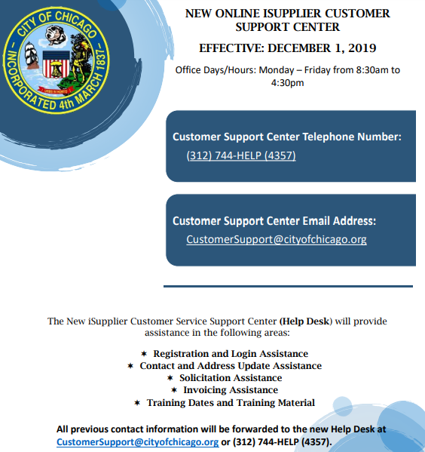
HOW TO APPLY
  Register for iSupplier NOW!
    https://www.chicago.gov/city/en/depts/dps/isupplier/vendor-registration.html
  Carefully review the RFP (Solicitation #8032)
    https://www.chicago.gov/city/en/depts/dps/isupplier/current-bids.html
  Follow steps in the “How to Submit an Application in the eProcurement System” (p. 48-58 of RFP)

Slide 29
TECHNICAL ASSISTANCE
  AMPT: Advancing Nonprofits
    Office hours to discuss RFP application requirements
    Two sessions: Friday, 5/14 at 2pm and Friday, 5/21 at 2pm (will be recorded and posted on eProcurement
        Link: https://zoom.us/j/8621310100?pwd=RUZaWVZ4Ykw2cEU2bWxrZXB0ZFpadz09
        Meeting ID: 862 131 0100
        Passcode: 671750
        Dial-in: (312) 626-6799

Slide 30
REMINDERS AND KEY DATES
  APPLICATION TIPS
    DO NOT WAIT UNTIL THE LAST DAY TO UPLOAD MATERIALS
    Emphasize readiness/capacity for rapid implementation on vaccine equity
    Respond to all questions and submit all required materials
    Include letters of commitment from Community Leads
    Budget must match total available for your Equity Zone
  KEY DATES
    Friday, May 7: Written questions due
    Friday, May 28: RFP closes, all applications due by noon
    June: Award announcements, contracting, kickoff meetings
    July 1: Get started on vaccine equity!

Slide 31
QUESTIONS & ANSWERS

