Slide 1


HOW TO BECOME CERTIFIED
DPS Workshop Series | Hosted by: Jackie Umbles

Slide 2
Welcome
The Department of Procurement Services is committed to Communications and Outreach, which is key to keeping citizens informed of bid opportunities, new programs, and innovations.
Also, ensure that you download a copy of our most recent Consolidated Buying Plan. This is a 15-month forecast including hundreds of upcoming opportunities for 12 city agencies. To download, go to: www.chicago.gov/dps.
We encourage you to follow us on our website www.chicago.gov/dps for the latest news, updates, and our calendar of events. Go online, www.chicago.gov/DPS and click on the letter icon and sign-up for our Email Newsletter: DPS Alerts full of news that you can use.
Follow us on social media to stay informed:
Facebook: www.facebook.com/ChicagoDPS
Twitter: www.twitter.com/ChicagoDPS
LinkedIn: www.linkedin.com/company/chicagodps
Youtube: www.YouTube.com/ChicagoDPS
NOTE: Legal advertisements for the City of Chicago Department of Procurement Services (DPS) appear in the Chicago Tribune. Information about DPS contracting opportunities will be available at www.chicago.gov/bids.

Slide 3

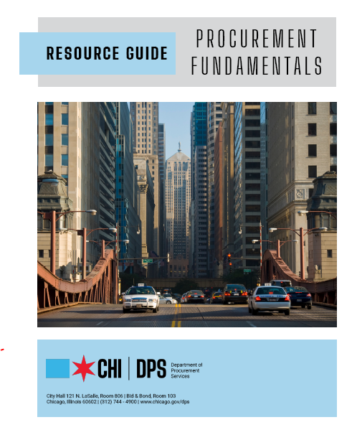
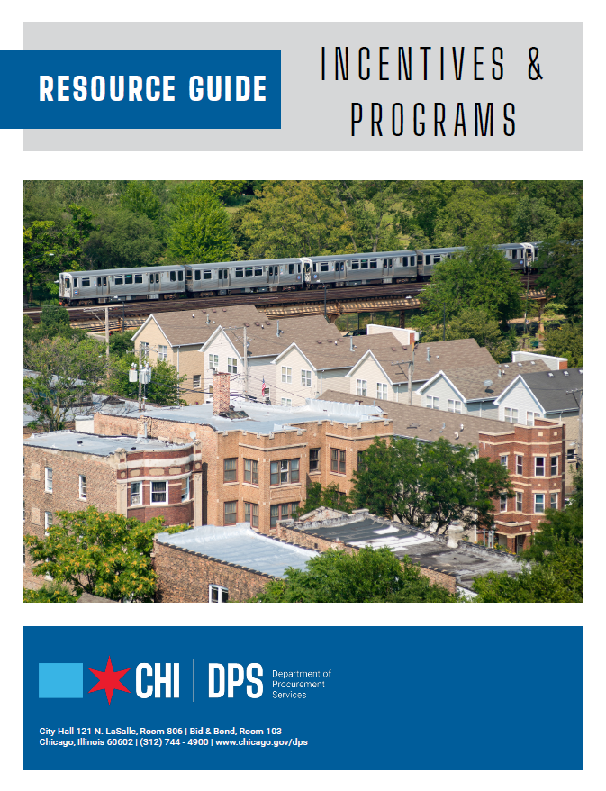
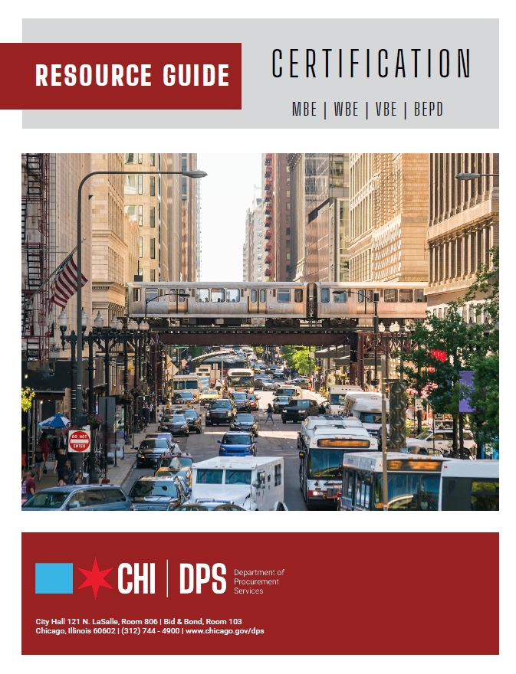
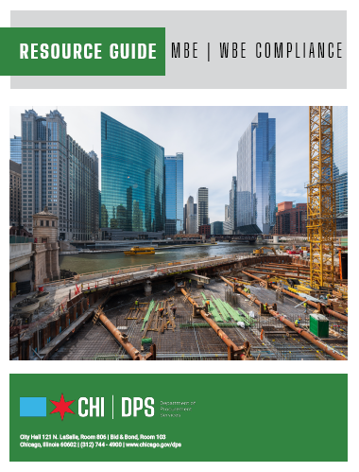




RESOURCE GUIDES
DPS has published a four-volume set of Resource Guides, expanding on the guiding principle of transparency.
The Resource Guides were divided into key areas of the procurement process:
  Contract Administration
  Incentives and Programs
  Certification
  Compliance
Download now at www.chicago.gov/dpsguides
@CHICAGODPS

Slide 4
Everyone is muted upon entry for the presentation portion of the workshop
We ask that you hold your questions to the end of the presentation. You can use the chat feature to type out your question and the speaker will answer the questions at the end of the presentation.
To Send a Question: Use only the Q & A panel to ask your question. Do not use the chat panel
  Use the Q & A panel on the right side of your screen.
  In the Send to or To drop-down list, select the recipient of the message.
  Enter your message in the chat text box, then press Enter on your keyboard.
  Note: If you join a meeting, session, or event in progress, you can see only the Q & A that participants send after you join.
Today’s Workshop

Slide 5
HOW TO BECOME CERTIFIED
Today’s Workshop | Presented by: Regence Norwoods

Slide 6
OUR GOALS AT A GLANCE
Benefits of Certification
Who Qualifies for Certification
Certification Requirements
The Application Process
Required Information/Documents
After Applications are Submitted

Slide 7
DPS is the contracting authority for the procurement of goods and services for the City of Chicago. We work together as a team and with our customers to guarantee an open, fair, and timely process by establishing, communicating and enforcing superior business practices.
DEPARTMENT OVERVIEW

Slide 8
City of Chicago
Certification
Programs
MBE – Minority-Owned Business Enterprise
WBE – Women Owned Business Enterprise
VBE – Veteran-Owned Business Enterprise
BEPD – Business Enterprise for People with Disabilities
DBE – Disadvantaged Business Enterprise
ACDBE – Airport Concessions Disadvantaged Business Enterprise

Slide 9

Benefits of
Certification

Slide 10
The Benefits
Provides visibility – Once Certified your firm is listed in a directory which is accessible to the general public and all Prime Contractors.
There are minority, women, and disadvantaged business participation goals on City of Chicago projects and sister agencies.
There are businesses in the private sector that seek out certified firms for products and/or services.

Slide 11
The Benefits
The City of Chicago has a Target Market program which provides exclusive bidding to certified minority and women owned business enterprises. This allows certified businesses to take 100% of the contract because there are no subcontractor goals associated with the project.

Slide 12
Qualifying
Groups
African Americans
Hispanic
Asian
Asian-Indian
Women
Veterans
Persons with Disabilities
Other Individuals who can prove social and economic disadvantages

Slide 13
Veteran-Owned Business Enterprises
VBE – Veteran-Owned Business Enterprise
“Veteran” means a person who has served in the United States armed forces and was discharged or separated under honorable conditions.
DD214 or DD215 needed as supporting evidence. (Required)
If vendor does not have their DD214 or DD215, the applicant should contact the Veterans Administration (VA).

Slide 14
Certification
Requirements

Slide 15
What’s Required
Local Business: principal place of business should be in the counties of Cook, DuPage, Kane, Lake, McHenry or Will (Applies to MBE/WBE/VBE/BEPD)
DBE/ACDBE – Can be located anywhere in Illinois
Must be 51% owned, controlled, and managed by a minority, woman, veteran and/or person(s) with a disability. For DBE/ACDBE, owner must be socially or economically disadvantaged individuals

Slide 16
What’s
Required
Business Size Standard
MBE/WBE/VBE: Gross Receipts must not exceed $43,229,869.51 averaged over 3 years for non-construction firms. Construction firms are subject to SBA* size standards averaged over 7 years.
DBE: The firm’s 5-year average annual gross receipts must not exceed the SBA size limit for the firm’s primary line of business or the three-year average maximum of $28.48 million for Federal Highway Administration/Federal Transit Administration (FHWA/FTA) assisted contracts. Federal Aviation Administration (FAA) assisted contracts must not exceed the SBA* size limit for the firm’s primary line of business.
ACDBE: Not to exceed $56.42M averaged over 3 years for most firms – some exceptions do exist.
*Ref: https://www.sba.gov/document/support--table-size-standards

Slide 17
What’s Required
Personal Net Worth Standard
MBE/WBE/VBE: The threshold only applies to construction companies. The PNW is currently $2,491,482.51. This is evaluated annually by the City of Chicago.
DBE/ACDBE: The threshold applies to all people seeking certification and is currently at $1,320,000. This is adjusted periodically by the U.S. Department of Transportation.
The calculation of personal net worth excludes business ownership, equity in any real estate and fixtures/furnishings, value in pensions/401(k) or other retirement savings or investment programs.

Slide 18
Business
Formations that
Qualify
Sole Proprietor – Typically owned by only one person, has no legal existence apart from the person him/herself
  Owner must submit Assumed Name Certificate if operating in name other than owner
  General Partnership – Two or more people go into business together without any formalities
  Partnership Agreement required

Slide 19
Business
Formations that
Qualify
Corporations
A corporation is treated as an entity that is completely separate from its shareholders. It allows others to invest in the business without being liable for the debts of that business.
The firm must be in Good Standing with the State
Must have Articles of Incorporation
Must have a Certificate of Incorporation
Must have By-laws of Corporation
Must have copies of all stock certificates (front/back)
Must have Meeting Minutes

Slide 20
Business
Formations that
Qualify
Limited Partnership
The limited partners are more like stakeholders in a corporation. They are not liable for the debts beyond their own ownership.
  Assumed Name Certification or Certificate of Limited Partnership
Limited Liability Company (LLC)
Partnerships that have a Managing Member/Partner
Must have an Operating Agreement
Must have Articles of Organization

Slide 21
Suppliers
Distributors
Brokers
Suppliers
A supplier must be a regular dealer which is a firm that owns, operates or maintains a store, warehouse or other establishment in which materials, supplies, articles or equipment are bought, kept in stock and regularly sold or leased to the public in the usual course of business.
Distributors
Firms operating as a Distributor are identified as having a direct relationship with a manufacturer to distribute its goods and products within a specified territory, or region. The goods and/or products are not available or sold to the general public.

Slide 22
Suppliers
Distributors
Brokers
Brokers
  Firms acting as a Broker are not eligible for certification as an MBE/WBE/VBE/BEPD but can be eligible for certification as a DBE.
A person or entity that fills orders by purchasing or receiving supplies from a third-party supplier rather than out of its own existing inventory and provides no substantial service other than acting as a conduit between his or her supplier and his or her customer is considered a broker.

Slide 23
Online
Application Process

Slide 24
The Process
Online
Submit applications online at:
www.Chicago.mwdbe.com
The Application Fee is $250.
  (No Fee for DBE/ACDBE or BEPD)
After Submission
You will receive an emailed invoice.
  We will not review your application until you pay the $250 application fee.
  You can pay the $250 at any of the City’s Payment Centers. You must bring the invoice when paying at the payment centers.
* 2nd page of invoice has website address to make an online payment.

Slide 25
Information
Needed
Contact Information
Type of Certification You Are Seeking
  MBE/WBE/VBE/BEPD/DBE/ACDBE
  BEPD requires Schedule G Form
  VBE requires DD214 or DD215
  Ownership Information
  Employee Information
  Facility Information
  Financial Information
  Licenses (for applicant and business)

Slide 26
Information
Needed
Proof of Eligibility Documents
Resume(s)
Evidence of Executed Contracts and/or invoices
Driver’s License and Birth Certificate or Passport
Proof of Equity Contribution
Business Bank Account Signatory Card
Organization Chart
Equipment List
Loan Information

Slide 27
Information
Needed
Financial Documents
  Federal Business and Individual Tax Returns
    Three Years for Non-construction Firms MBE/WBE/VBE/BEPD
    Seven Years for Construction Firms MBE/WBE/VBE/BEPD
    Five Years for DBE/ACDBE Firms
  W-2s/1099s
  Personal Net Worth Statements (construction firms, all new DBE/ACDBE)

Slide 28
After
Applications are
Submitted
The process can take approximately 90 days from the day we receive “all” documents.
Your application is checked to make sure we have all documentation
Documents are thoroughly audited.
You may receive a site visit. All construction, supplier, and distributors will receive a site-visit.

Slide 29
Maintaining
Certification
  All Vendors must submit an Annual “No Change Affidavit.”
  You must notify the Certification Division of the Department of Procurement Services regarding organization changes, business name changes, and ownership changes within 10 business days of the change. You can report material changes online in the portal via the Expansion application with a follow-up email to dps.certification@cityofchicago.org

Slide 30
Maintaining
Certification
Expansion of Services:
Submit your request in writing online in the portal via the Expansion application.
Include the added category NAICS code(s), description and supporting documentation.
You must include:
  Required Licenses
  Copies of past or present contracts
  Any needed insurance
  Current resume

Slide 31
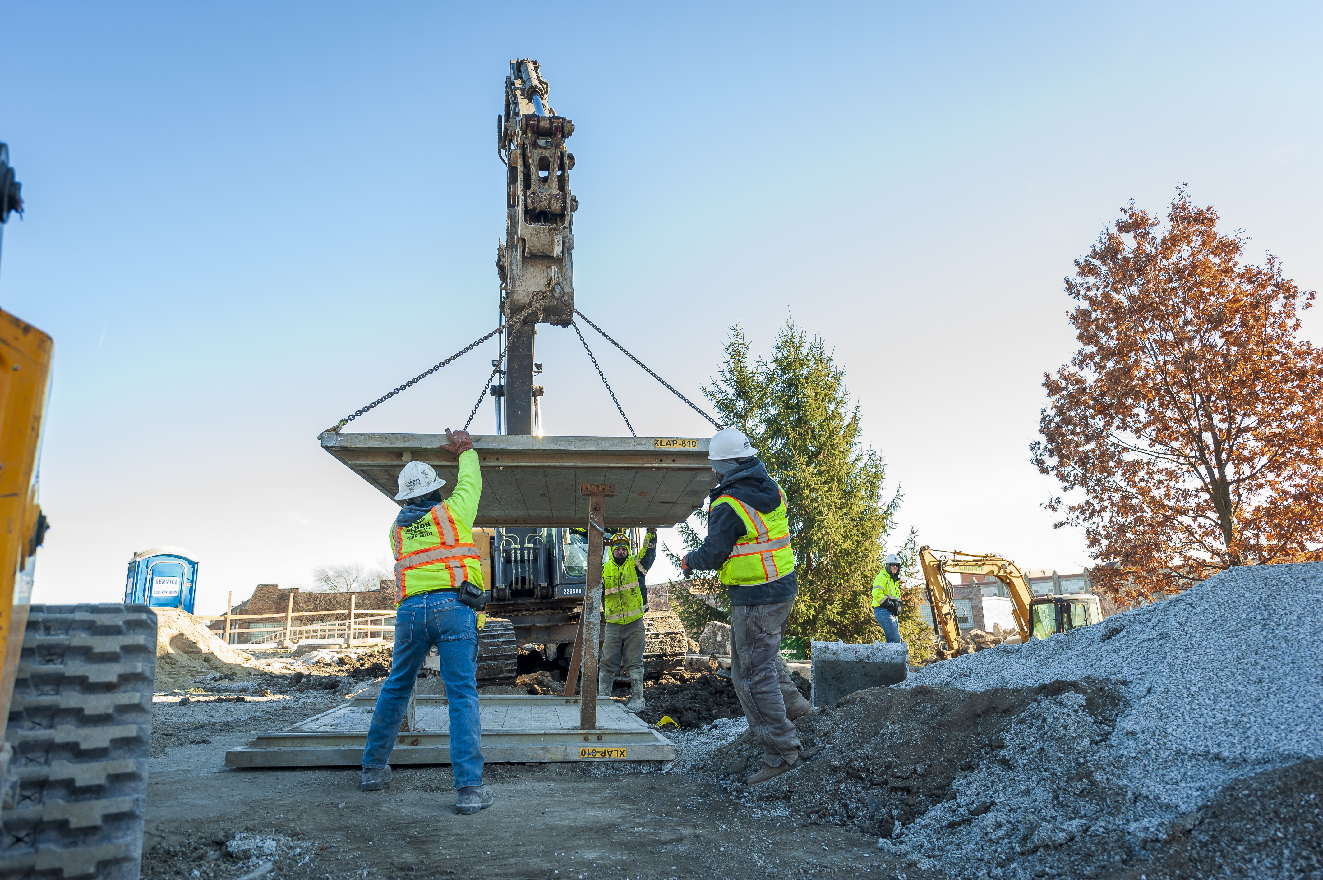
What you
Need
To Know
Top 10 Reasons Applications are Denied
Unsubstantiated or questionable ownership/control.
Unclear description of critical functions and who is responsible.
Company cannot substantiate where and/or how start-up funds/expansion capital was initiated.
Outside secondary employment takes the majority of the MBE/WBE/VBE/BEPD/DBE Enterprise’s time each day.
The company is not located in one of the six county regions (MBE/WBE/VBE/BEPD).
Point of Contact did not respond to requests for information in a timely manner.
Inconsistencies with the Applicant firm name among various documents.
Problems with contracts: missing, incomplete, not signed & executed by qualifying owners, or have no corresponding proof of payments.
Required documents are not attached or no explanation is given as to why the documents are not available.
Three/Seven years of tax returns were not submitted (signed) as required.

Slide 32

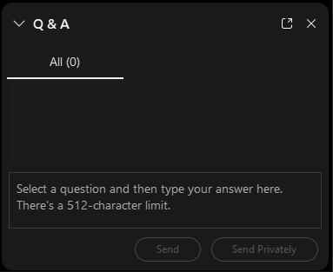
QUESTIONS?
Do you have a question? Please use the WebEx Q&A feature as shown.

Slide 33


FOLLOW US ON SOCIAL MEDIA
@CHICAGODPS
Did you find this workshop helpful? Share it on social media using #DPSWorkshops and spread the word to help the City business community learn about the programs and initiatives available at the City of Chicago.

