Slide 1

TODAY’S WORKSHOP
Hosted By: DPS Public Affairs
Today’s Host: Jackie Umbles

Slide 2
WELCOME
The Department of Procurement Services is committed to Communications and Outreach, informing citizens of bid opportunities, new programs, and innovations.
Also, download a copy of our most recent Consolidated Buying Plan. This is a 15-month forecast including hundreds of upcoming opportunities for 12 city agencies. To download, go to: www.chicago.gov/dps
We encourage you to follow our website, www.Chicago.gov/dps, for the latest news, updates, and our calendar of events. Go online to www.chicago.gov/DPS, click on the letter icon, and sign up for our Email Newsletter, DPS Alerts, which is full of useful news.
Follow us on social media to stay informed:
Facebook: www.facebook.com/ChicagoDPS
LinkedIn: www.linkedin.com/company/chicagodps
Youtube: www.YouTube.com/ChicagoDPS
NOTE: Legal advertisements for the City of Chicago Department of Procurement Services (DPS) appear in the Chicago Tribune. Information about DPS contracting opportunities will be available at www.chicago.gov/bids.

Slide 3



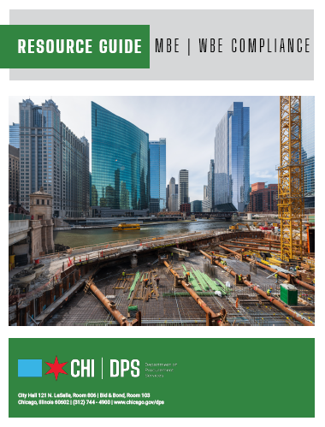



RESOURCE GUIDES
DPS has published a four-volume set of Resource Guides, expanding on the guiding principle of transparency.
The Resource Guides were divided into key areas of the procurement process:
  Contract Administration
  Incentives and Programs
  Certification
  Compliance
Download now at www.chicago.gov/dpsguides
@CHICAGODPS

Slide 4
Today’s Workshop
Everyone is muted upon entry for the presentation portion of the workshop
We ask that you hold your questions to the end of the presentation. You can use the chat feature to type out your questions, and the speaker will answer the questions at the end of the presentation.
To Send a Question: Use only the Q & A panel to ask your question. Do not use the chat panel
  Use the Q & A panel on the right side of your screen.
  In the Send to or To drop-down list, select the message recipient.
  Enter your message in the chat text box, then press Enter on your keyboard.
  Note: If you join a meeting, session, or event in progress, you can see only the Q&A that participants send after you join.

Slide 5

Building Chicago! Construction Contracting Overview
Presented By:
Department of Procurement Services
The Gordian Group

Slide 6
Programs & Bid Incentives
Programs for:
Small Business Initiative (SBI) Construction
Mid-sized Business Initiative (MBI) for Construction
Equal Employment Opportunity (EEO)
Apprentice Utilization Bid Preference

Slide 7
Small Business Initiative for Construction
Program Goal: Designed to encourage small businesses to participate in City-funded construction projects with a total cost under $3 million.
Key Points:
Small local (six-county) businesses are exclusive bidders.
Two Tiers – Small Business Initiative (SBI) I and II
SBI I – Project Cost $ 2 million - $ 10 million (SBA size standards)
SBI II – Project Cost less than $2 million (1/2 SBA size standards)
Municipal Code: 2-92-710

Slide 8
Mid-Sized Business Initiative for Construction
Program Goal: Designed to increase small and mid-sized business participation in City-funded construction projects between $ 10 million and $ 20 million in total cost.
Key Points:
Small and mid-sized local (six-county) businesses are exclusive bidders.
Estimated project cost is $10,000,000 - $20,000,000
Eligible bidder size limitation is 1 ½ times the SBA size standard
Municipal Code: 2-92-800 et seq.

Slide 9
Equal Employment Opportunity (EEO) Bid Incentive
Program Goal: This Bid Incentive is available on contracts for construction projects valued at $100,000 or more and is designed to increase the utilization of minority and women journey workers, apprentices and laborers.
Key Points:
Any Bidder proposing to utilize minority and/or women journey workers, apprentices, and laborers on a contract for a construction project may apply for this Incentive.
The Bidder must show its commitment to utilize minority and female workers in any of the three categories by completing the canvassing formula in its Bid.
Municipal Code: 2-92-390

Slide 10
Apprentice Utilization Bid Incentive
Program Goal: Designed as an incentive for City prime contractors to utilize apprentices for construction projects.
Key Points:
“Apprentice” means any person who is: (1) sponsored into an apprenticeship training program by a contractor that is authorized by a union to sponsor apprentices; and (2) enrolled in, or has graduated from, a construction technology training program administered by the City Colleges of Chicago, or is a graduate of a high school operated by Chicago Public Schools.
Contracts for $100,000 or more.
Incentive for future contracts.
Tiered Incentive:
  5-10% work performed by apprentice results in ½% bid incentive.
  11-15% project-area subcontractor work results in 1% bid incentive.
Municipal Code: 2-92-335

Slide 12


City of Chicago - Department of Procurement Services
Introduction to Job Order Contracting (JOC)

Slide 13

Objectives
Job Order Contracting (JOC) Overview
City of Chicago JOC Process
Benefits of JOC
How to bid JOC - Prime Contractors
Getting Involved - Subcontractors
Diversity and Inclusion
Review and Key Points
Q&A

Slide 14
Who is Gordian?
Gordian is the leading provider of facility and construction data, software and expertise.
Data
Owner specific Construction Task Catalog® (CTC).
CTC has over 275,000 construction tasks with preset prices.
Price research facilitated by RSMeans data Engineering Team.
Software
Built from decades of industry experience, used by thousands of contractors daily.
Easily manage the functions of the construction procurement process.
Allows collaboration between the contractor and Gordian Account Manager.
Expertise
Gordian’s founder created the original Job Order Contracting process in the USACE in 1981.
Implemented and administered hundreds of programs.
Dedicated onsite field personnel, review proposals to ensure project success.

Slide 15
Gordian JOC Overview
Total JOC Programs
305
Total Contracts
8,715
Contract Types
28
Total Contractors
1,359
More than $3B in construction volume is completed through
Gordian’s Job Order Contracting programs annually.
As of 12/2022

Slide 16


Construction Procurement Challenges
Staff limitations
Meeting inclusion requirements
Cost control and change orders
Lack of transparency/auditability
Time
Procurement burden relative to job size and scope

Slide 17
Construction Delivery Methods
In-House Staff
Construction Management (CM) at Risk
Unit Price Contracts
Design-Bid-Build
Time and Materials
Design-Build
Job Order Contracting

Slide 18

Overview of Job Order Contracting
JOC is another delivery method for the City to procure construction services
JOC is not meant to replace any procurement method - it is another tool for the City to accomplish work.

Slide 19
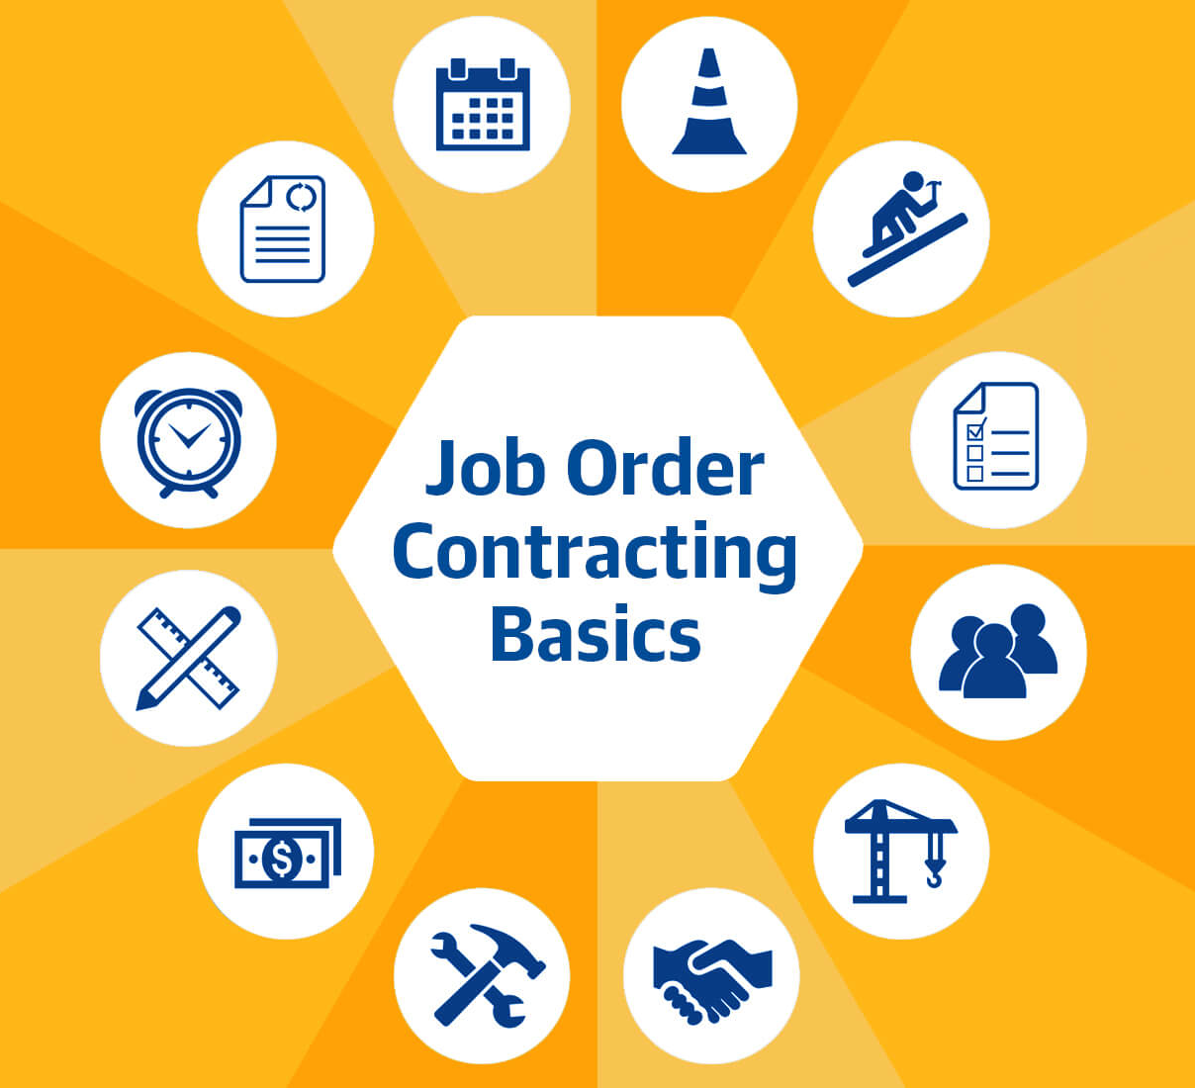
Overview of Job Order Contracting
Job Order Contracts are: Firm, fixed price, competitively bid, indefinite quantity, delivery method designed to produce a large number of multi-traded, repair and rehabilitation projects, as well as minor new construction projects quickly.
Firm, Fixed Price: Construction Task Catalog® of pre-priced work tasks.
Competitively Bid: all bidders submit a set of adjustment factors to the fixed prices in the Construction Task Catalog®.
Offers a fundamentally different construction procurement relationship.
  Fosters collaborative relationship between the contractor and the owner
  Allows contractors to work with clients without the risk of being outbid
  Contractors and owners build lasting partnerships

Slide 20
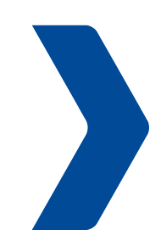
Typical Construction Procurement Process
Prepare design
Develop scope
Create contract documents
Upload contract documents for distribution
Conduct pre-bid
meeting and walk through
Answer RFIs via addendum
Conduct formal bid opening
Verify lowest, responsive, responsible bidder
Collect bonds and insurance certificates from low bidder
Finalize contract
Office renovation
Office renovation contract
Prepare design
Develop scope
Create contract documents
Upload contract documents for distribution
Conduct pre-bid
meeting and walk through
Answer RFIs via addendum
Conduct formal bid opening
Verify lowest, responsive, responsible bidder
Collect bonds and insurance certificates from low bidder
Finalize contract
LED lighting updates
LED lighting update contract
Prepare design
Develop scope
Create contract documents
Upload contract documents for distribution
Conduct pre-bid
meeting and walk through
Answer RFIs via addendum
Conduct formal bid opening
Verify lowest, responsive, responsible bidder
Collect bonds and insurance certificates from low bidder
Finalize contract
Parking lot paving
Parking lot paving contract
= Time & Money

Slide 21
JOC Construction Procurement Process
Create contract documents
Upload contract documents for distribution via solicitation
Conduct pre-bid meeting
Answer RFIs via addendum
Conduct formal bid opening
Verify lowest, responsive, responsible bidder
Collect bonds and insurance certificates from low bidder(s)
Finalize contract
Classroom renovation
LED lighting update
Parking lot paving
HVAC replacement
Security system installation
Window replacement
Roof and gutter replacement
ADA compliance upgrade
One contract for
many projects

Slide 22









Types of Projects
With one competitively-awarded contract, you are able to complete an indefinite number of projects
Straightforward
new construction
Repairs
Renovations
Replacement
in-kind
Maintenance
Emergency
work
Time sensitive
projects
Alterations

Slide 23

Performance-Based
Job Order Contracts are a performance-based contracting system.
Responsiveness of the contractor
  Performance is rated from the project development phase through construction—start-up to close-out
Project development phase
  Scope definition
  Timely and accurate price proposals
Construction phase
  Timely start-up
  Effective management of work crew
  Ensuring project is constructed according to the specifications
Success in developing a partnership relationship with the contractor

Slide 24
Performance-Based
JOC contracts include measurable performance standards
Quality Price Proposals: accurate price proposals that can be approved on the first or second submission.
Timely Price Proposals: timely price proposals that are submitted on or before the due date indicated on the Request for Proposal.
Timely Construction: rapid mobilization to start work, adherence to the agreed upon construction schedule and timely completion of any punch list items.
Quality Construction: good quality construction where projects are constructed according to the specifications and require minimal punch list items.
Achievement of M/WBE Goals: meet or exceed the M/WBE goals set forth in the contract documents.
Achievement of Self Performance Goals: meet or exceed the self performance goals set forth in the contract documents.

Slide 25

Benefits to JOC - Prime
Prime Contractor’s benefits with Job Order Contracting
JOC can be profitable
  Profit is a function of volume
  Volume is driven by performance
  JOC provides a steady flow of work
  Do not have to chase the next project
Long-term relationship with the City
  Non-adversarial relationship
  Develop partnership with the City
Professionally rewarding
  Different types of projects (varying scope)
  Ability to provide input during scope development

Slide 26


Benefits to JOC - Subcontractor
Subcontractor’s benefits with Job Order Contracting
No projects are identified at the time of bidding, so Prime Contractor cannot staff up to self perform.
Increased subcontracting opportunities because Prime Contractors must utilize the subcontracting community.
Simplified procurement process for the City allowing them to procure more work in a shorter period of time.
Multiple projects on multiple sites simultaneously.

Slide 27
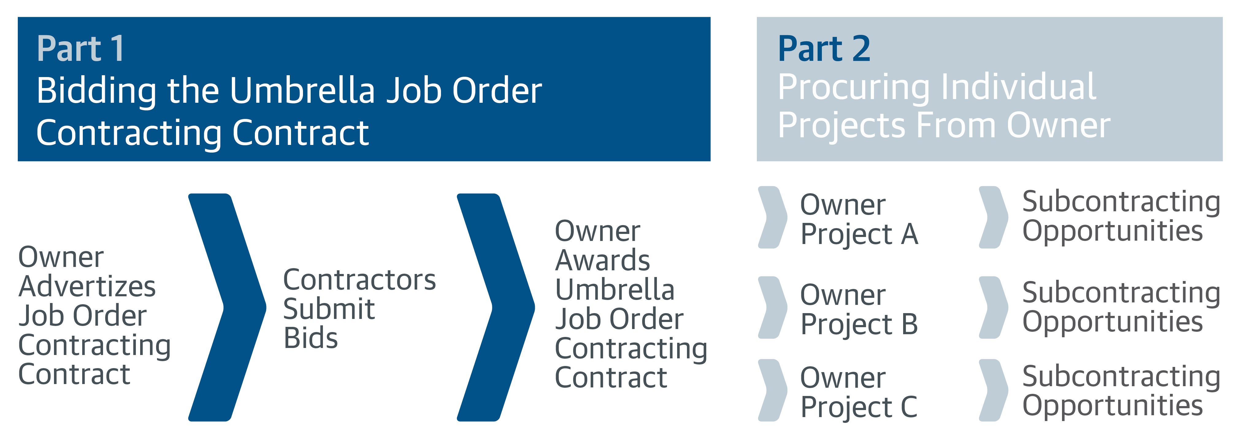
Bidding as a Prime Contractor
Prime Contractors Prime & Subcontractors

Slide 28
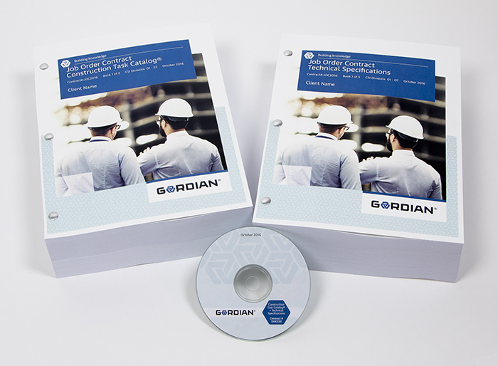
Part 1 - Bidding as a Prime Contractor
Gordian Documents
Book 1: Instructions to Bidders and Execution Documents
Book 2: City’s General Conditions and JOC Special Conditions
Book 3: Construction Task Catalog®
Book 4: Technical Specifications
Book 5: Clients’ Specifications

Slide 29
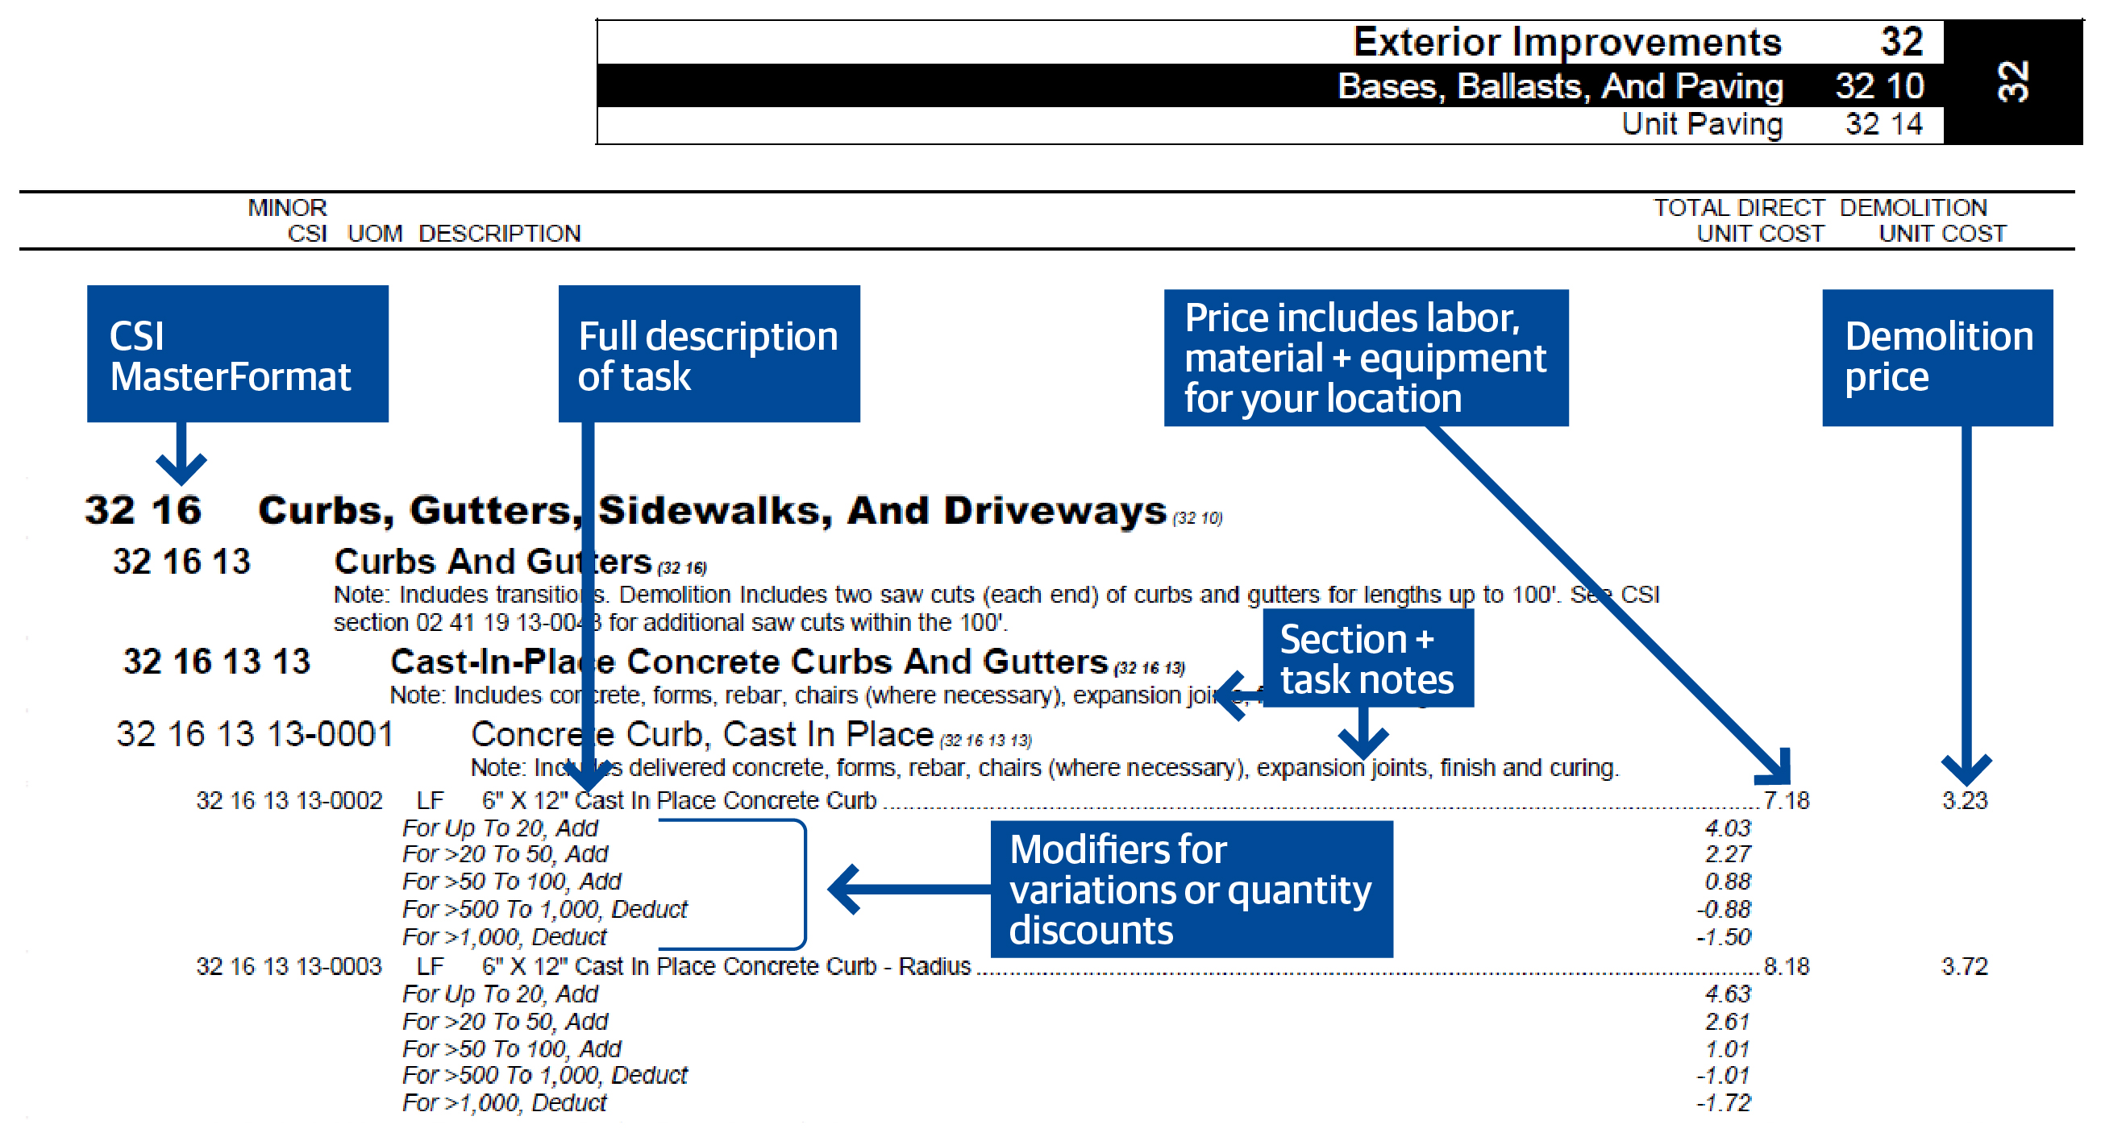
Construction Task Catalog (CTC)
Book 3: Construction Task Catalog® (CTC) (Link in eProcurement)
Catalog of pre-priced construction tasks
Organized by CSI MasterFormat
Prices include local labor, equipment and material (LEM) costs
Customized for City’s tasks and standards
Prices in the CTC are fixed for the duration of the contract.

Slide 30

Bidding as a Prime Contractor
Step 1: Determine direct costs
  Analyze the CTC and specifications
  Completeness and clarity
  Review the CTC price against the direct cost for accomplishing the work
  Prices in the CTC do not include subcontractor OH & P
  Do you have to increase prices to cover your direct costs?
  Depends on the amount of self-performance versus subcontracting
Step 2: Determine overhead costs & profit expectations
  Bonding, insurance, etc.
  Main overhead is staffing
  How much will it cost to employ the required staff?
Step 3: Bid normal hours and other than normal hours factors to the prices quoted in the CTC
  Applied to all work tasks in the CTC
  Must cover direct costs, overhead, and profit
  Cannot exclude any tasks
Step 4: Specify EEO commitments and determine the award criteria figure
  The bid forms will walk bidders through the calculations
  * Low bidder is based on the lowest award criteria figure

Slide 31
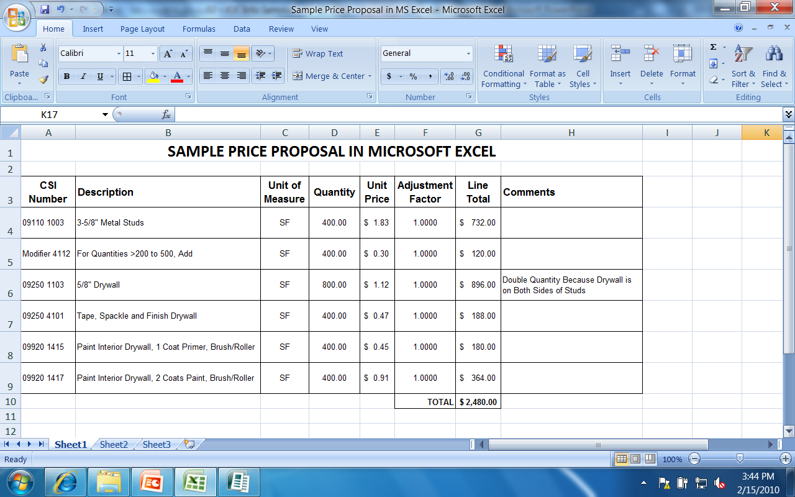
Bidding as a Prime Contractor
Preferred method for analyzing the price in the CTC versus your costs
Select a comparable project from your files (more than one)
  Example: The project you selected paid you $82,323.00
Build a price proposal from the CTC at a factor of 1.0000 (i.e., no adjustment)
  Price from the CTC = $75,746.00
Calculate the adjustment factor
  If you were satisfied with the $82,323.00 (i.e., covers your direct costs, OH & profit)
  You would need an adjustment factor of: ($82,323.00 / $75,746.00) = 1.0868
Don’t Stop There – Select More Than One Project!
Dollar amounts and adjustment factor used above are for example
purposes only.

Slide 32
Bidding as a Prime Contractor
Tips for being a successful JOC Contractor
Bid correctly
  Anticipate the type of work the City expects to complete using JOC
  Depends on the contract.
  At the pre-bid meeting, there are slides detailing the type of work used under the previous JOC contract.
  Analyze the prices in the CTC versus your costs
  Run sample projects.
  Determine factors required to adjust prices in CTC to cover your direct costs, overhead, and profit.
Staff correctly
The bid factors and quality of staff affect whether or not a contractor can meet the performance standards

Slide 33
Getting Involved!
Getting involved in the JOC program
Analyze the JOC programs in the Chicago area and any other areas you are willing to work.
Identify those programs whose Scope of Work relates to your work.
For Prime Contractors, analyze the prices in the CTC and develop accurate adjustment factors at the time of bidding.
For Subcontractors, establish a relationship with Prime Contractors.

Slide 34

Subcontractors – Getting Involved!!
Contact the Awarded JOC Contractors!
  Illustrate your portfolio and previous projects completed
  Provide contacts and/or references who would champion your performance
  Show off your work!
Attend Outreach Events & Network
  Some Contractors host their own outreach events
Contractors will contact you in several ways:
  Emails, BuildingConnected, The Blue Book Network, Cold Calls
  Contractors may ask for Project references
Word of Mouth - JOC Contractors will ask other JOC Contractors

Slide 35

Subcontractors – Getting Involved!!
Tips for things to keep in mind when you are talking with a JOC Prime:
FAST and RESPONSIBLE pricing
  JOC Contractor may request pricing in a matter of days
  Understanding the Scope of Work thoroughly to price accurately
Obtain and Hold M/WBE Certifications
  JOC Contractors look online for potential M/WBE Subcontractors
Agreement and Understanding JOC Contractor Contract Terms
  Completing Compliance Paperwork accurately and timely
  Bonding & Insurance Capacity Requirements

Slide 36
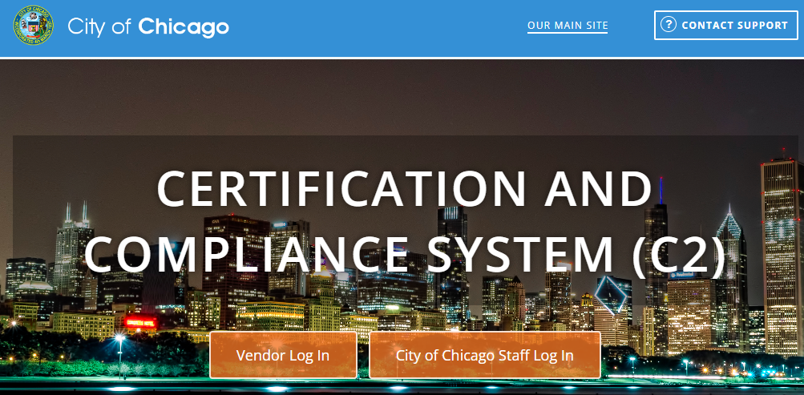
Subcontractors – Getting Involved!!
Payment Timelines & Capacity –
    Payments are NOT made to the JOC Contractor immediately and takes time
    Retainage is held on a project by project basis
    Subcontractor upkeep of Certified Payroll.
    Providing all waivers (Partial & Final) accurately and timely

Slide 37





Getting Involved!
JOC Programs within the City of Chicago
Department of Fleet and Facilities Management (2FM)
  Bureau of Architecture, Engineering & Construction (AEC)
  Bureau of Environmental, Health & Safety Management (EHS)
Department of Aviation (CDA)
Department of Water Management (DWM)
Department of Transportation (CDOT)
Office of Emergency Management and Communications (OEMC)

Slide 38
Getting Involved!
Chicagoland Area JOC Programs
Chicago Public Schools
Chicago Transit Authority
Public Building Commission
City Colleges of Chicago
University of Illinois at Chicago
Cook County
Lake County
Naperville
United States Postal Service
Equalis Group – ezIQC
Sourcewell IL ezIQC
Identification of other agency's JOC programs is for informational purposes only.
All discussions in this workshop pertain to the City of Chicago only.
Procedures at other agencies identified on this slide may be different.
To find advertisements for agencies listed on this slide, look on the agency’s website.
The City’s website does not advertise contracts for agencies listed on this slide.

Slide 39
Diversity, Equity & Inclusion
Gordian provides best practices around establishing M/WBE contract goals by:
Developing and maintaining relationships with affiliated organizations and construction industry partners to provide Informational Meetings on Job Order Contracting (JOC) and upcoming JOC opportunities
Leveraging relationships our clients have already established with local Minority Contractor Associations and provide Informational Meetings highlighting client-specific JOC opportunities
Creating targeted contractor lists for outreach, which are developed through local associations, client reference, web research, Gordian’s contractor database and companies expressing interest in Gordian’s JOC programs
Tracking M/WBE contractor participation through our JOC platforms/programs
Providing networking opportunities with Primes/Sub-Contractors
Providing on-going support to contractors after contract award to ensure they succeed in the program
Notes:
Diversity, Equity, and Inclusion is important to Gordian and the clients we service. Gordian has created a channel to promote Job Order Contracting awareness among the Diverse Contractor Community to ensure Diverse contractors have the knowledge to participate in a JOC solicitation. Kellie Erickson heads up this initiative by collaborating with D&I, Sales and Operations, and the client in the early stages of a contract kick off. Our goal is to ensure that clients meet and exceed their diverse goals through Job Order Contracting. Here are some of the ways we achieve success….

Slide 40
Organizations and Associations
National Association of Minority Contractors
U.S. Minority Contractors Association
Black Contractors United
Hispanic American Construction Industry Association
Chicago Minority Supplier Development Council
African American Contractors Association
National Association of Women in Construction
Chicago Urban League
Notes:
This is an example of some of the diverse organizations and associations that we partner with at the local level to create awareness. This is not an all inclusive list. This changes based on the location in which we’re conducting the solicitation.

Slide 41
Review/Key Points
JOC is an established procurement system used by several types of public agencies nationwide.
JOC has benefits for all parties: Owner, Prime Contractor, & Subcontractors.
Performance based contracting system that determines the amount of work to be issued.
Be aware of the tips and methods to connect with the JOC Prime Contractors
Be ready to perform at a high level.

Slide 42
To Find More Information…
To find out about current advertisements (applies to all City contracts)
Sign up for DPS alerts!
Check the DPS website
  Go to www.cityofchicago.org/dps
  Under Bid Proposal Information, click on the link for “Current Bids and Requests for Proposal”
Check the newspaper (Chicago Tribune)

Slide 43
Key Contacts
Job Order Contracting Process
Jezieel Cortes
Deputy Procurement Officer
Department of Procurement
e: jezieel.cortes@cityofchicago.org
312-744-4926
Job Order Contracting Process
Cristiane Jobes
Account Manager
Gordian
e: c.jobes@gordian.com
p: 312-579-8627
Job Order Contracting Process
Michael Judd
Regional Director
Gordian
e: m.judd@gordian.com
p: 312-489-7277

Slide 44

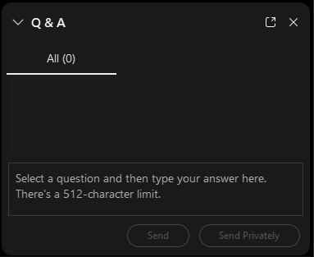
Do you have a question? Please use the WebEx Q&A feature as shown.

Slide 45


FOLLOW US ON SOCIAL MEDIA
@CHICAGODPS
Did you find this workshop helpful? Share it on social media using #DPSWorkshops and spread the word to help the City business community learn about the programs and initiatives available at the City of Chicago.

