Slide 1


CONTRACTING 101: HOW TO RESPOND TO A REQUEST FOR PROPOSAL (RFP)

Slide 2
Welcome
The Department of Procurement Services is committed to Communications and Outreach, which is key to keeping citizens informed of bid opportunities, new programs, and innovations.
Also, ensure that you download a copy of our most recent Consolidated Buying Plan. This is a 15-month forecast including hundreds of upcoming opportunities for 12 city agencies. To download, go to: www.chicago.gov/dps.
We encourage you to follow us on our website www.chicago.gov/dps for the latest news, updates, and our calendar of events. Go online, www.chicago.gov/DPS and click on the letter icon and sign-up for our Email Newsletter: DPS Alerts full of news that you can use.
Follow us on social media to stay informed:
Facebook: www.facebook.com/ChicagoDPS
Twitter: www.twitter.com/ChicagoDPS
LinkedIn: www.linkedin.com/company/chicagodps
Youtube: www.YouTube.com/ChicagoDPS
NOTE: Legal advertisements for the City of Chicago Department of Procurement Services (DPS) appear in the Chicago Tribune. Information about DPS contracting opportunities will be available at www.chicago.gov/bids.

Slide 3

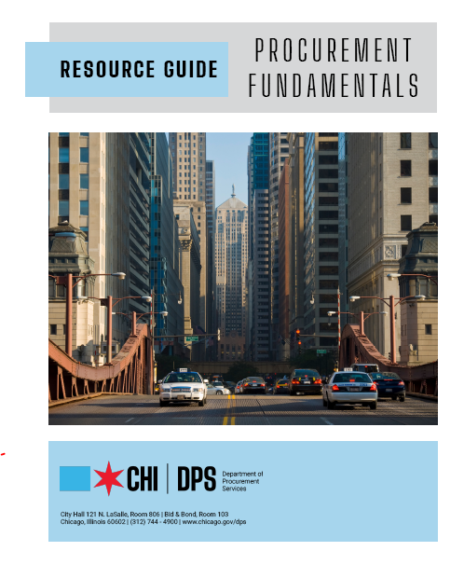







RESOURCE GUIDES
DPS has published a four-volume set of Resource Guides, expanding on the guiding principle of transparency.
The Resource Guides were divided into key areas of the procurement process:
  Contract Administration
  Incentives and Programs
  Certification
  Compliance
Download now at www.chicago.gov/dpsguides
@CHICAGODPS

Slide 4
DPS is the contracting authority for the procurement of goods and services for the City of Chicago. We work together as a team and with our customers to guarantee an open, fair, and timely process by establishing, communicating and enforcing superior business practices.
DEPARTMENT OVERVIEW

Slide 5
OUR GOALS AT A GLANCE
Department Overview
Tips for Finding Opportunities
RFP vs Competitive Bid?
RFP Proposal Format
RFP Proposal Content
RFP Evaluation Criteria
Tips for Preparing RFP Proposal
eProcurement Submission
Proposal Evaluation and Award

Slide 6
Tips for Finding Bid Opportunities
Bids valued over $100,000.00 and RFP’s are publicly advertised in Chicago Tribune.
Bids and RFPs are posted weekly to view and download on the CoC Department of Procurement Services (DPS) website: www.chicago.gov/bids and www.chicago.gov/city/en/depts/dps/isupplier/current-bids.html
Bid opportunities are posted in CoC DPS Bid & Bond Room 103, City Hall, 121 N. LaSalle St.
See CoC Buying Plan and register your company for DPS Alerts on the DPS website at www.chicago.gov/Procurement.
Attend Pre-Bid Conferences. Network with other potential bidders to partner on the bid, subcontract or submit as prime.
Check Bid Take Out List posted on DPS website.

Slide 7

RFP vs
Competitive Bid

Slide 8

Use of RFP vs. Competitive Bid?
REQUEST FOR PROPOSAL (“RFP”)
Method of procurement to hire a professional services consultant to implement a new project in various professional service disciplines.
Project specific.
Used when the City does not have in-house technical experts or resources to implement a project or provide services.
COMPETITIVE BID (“BID”)
Method of procurement to purchase supplies, equipment, maintenance, and/or repair services and construction.
Detailed bid specification prepared.
Structured as project-specific with specific quantities (One Time) or “blanket” indefinite quantity usage (aka Depends Upon Requirements (DUR) Term Agreement) for goods and/or services.
Proposal Page line items include the defined unit of measures and specific or estimated quantities.

Slide 9
RFP vs
Competitive Bid?
Bid specification details every aspect of product or services. An RFP defines project objectives and scope of service parameters but does not specify in detail every aspect of how to accomplish or perform the required services. The City seeks proposals from qualified vendors detailing their proposed plan to implement and complete the project.
An RFP entails a detailed evaluation of proposals by an Evaluation Committee (“EC”) based on the evaluation criterion published in the RFP. The EC is comprised of various stakeholder departments.
For a competitive bid, the contract award is to the “lowest responsive and responsible bidder,” meeting City specifications based on department review of Bid Tabulation & recommendation of award.
For an RFP, vendor selection is to the highest-rated or ranked Respondent to the RFP, not the lowest price. Price can be negotiated.

Slide 10
RFQ Additional Information
RFP content is standardized but may vary depending upon the project, for example, City-funded or State/Federal Grant funding.
MBE/WBE vs. DBE Goals
Minority Business Enterprise (MBE) and Women Business Enterprise (WBE) participation goals typically are in all City-funded projects.
Disadvantaged Business Enterprise (DBE) participation goals may be required for State or Federal grant-funded projects.
If DBE goals, Local Preference terms (e.g., Chicago Based Business Preference, MBE/WBE, etc.) will be removed if prohibited by the grantor.

Slide 11
RFP Proposal Format
eProcurement Electronic Proposals
Proposals must be word-searchable
Sections of the proposal should be organized in subject matter sequence in the Required Content of Proposal section of the RFP. Each page should be numbered in a manner to be uniquely identified.
Proposals must be clear, concise, and well organized.
A redacted Proposal must be submitted.

Slide 12
RFP
Proposal Content
Proposal Content
Cover Letter
Executive Summary
Professional Qualifications and Specialized Experience of Respondent and Team Members
Professional Qualifications and Specialized Experience of Key Personnel
Implementation or Work Plan
Cost Proposal (Submit on City form for equitable comparisons)
MBE/WBE or DBE Plan (Schedules C-1 and D-1)
Financial Statements (Audited last 3 years or equivalent)
Online Economic Disclosure Statement Certificate of Filing and Affidavit (“EDS”)
Legal Actions (Last 5 years)
Insurance (Required at time of contract award)

Slide 13
RFP
Evaluation Criteria
RFP evaluation criterion will vary depending upon the project, but the most
common ones are as follows:
Professional Qualifications & Specialized Experience, Local Availability of Team (Prime, joint venture partners or subcontractors, if any).
  Current and Past Performance Record + References
  Certifications and/or Licenses
Professional Qualifications & Specialized Experience, Local Availability of Key Personnel.
  Resumes/Role on Project + Organization Chart/Dedicated Resources
Implementation or Work Plan
Cost Proposal
MBE/WBE Commitment (25% MBE and 5% WBE Participation Goals or Other Goals Set) DBE may apply if federally funded project.
Financial Statements
Compliance with Laws, Ordinances, and Statutes. EDS Certifications.
Legal Actions
Conflict of Interest

Slide 14
Tips for Preparing RFP Proposals

Slide 15
Tips for Preparing RFP Proposal
Exhibit forms that must be completed as part of the proposal submission will vary depending upon the RFP, but the following exhibit forms are universal to every RFP:
  Company Profile Information
  Company References/Client Profile Information
  MBE/WBE or DBE Compliance Plan (Schedule C-1 and D-1) and/or Waiver?
  Online Economic Disclosure Statement and Affidavit (“EDS”), which includes Disclosure of Retained Parties and Familial Relationships with Elected City Officials and Department Heads and Other Certifications. For online EDS instructions, go to: http://webapps.Chicago.gov/EDSWeb.
  Insurance Certificate (Required at Contract Award)
Review City Standard Contract Terms and Conditions if attached as an RFP exhibit to determine if your firm can perform under those terms & conditions.
Verify the existence of any Addendum issued by the City before submitting a proposal.

Slide 16
Tips for Submitting
RFP Proposal
eProcurement Submissions
The City has transitioned from paper proposal submissions to online submissions of RFPs and RFQs via eProcurement. Vendors must register in iSupplier to submit electronic submissions through eProcurement. Proposals cannot be submitted via eProcurement after the published due date.
  "iSupplier" refers to the City's eProcurement computer system for electronic bidding and providing Contractors with access to contract, ordering, and payment information for their City contracts.
  Allow three business days to complete registration.
Pay attention to the RFP instructions for proposal submission requirements.
Cover letter must be signed by an authorized officer and acknowledge any Addendum issued.
Make a checklist of all submittal requirements per the Proposal Required Content section to verify completeness of proposal before submitting to DPS.

Slide 17
eProcurment Submission Resources
The eProcurement RFP document can be viewed and downloaded using the following link: https://www.chicago.gov/city/en/depts/dps/isupplier/current-bids.html
Register in iSupplier: https://www.chicago.gov/city/en/depts/dps/isupplier/login-register.html
Addendum: http://www.chicago.gov/eprocurement
Pre-Proposal Conference Attendees: https://www.chicago.gov/city/en/depts/dps/supp_info/2017PreBidandPreSubmittalConferenceAttendees.html
Takeout list: www.chicago.gov/TOL
eProcurement Workshop Schedule: https://www.chicago.gov/city/en/depts/dps/provdrs/eprocurement.html
eProcurement Instructional Documents: https://www.chicago.gov/city/en/depts/dps/isupplier/online-training-materials.html

Slide 18
Proposal Evaluation and Award
Respondents to the RFP are posted on the website. No other information about proposals or evaluation is available until after completion of the contract award.
All Freedom of Information Act (FOIA) requests received are held until after contract award. Debriefing meetings can be requested in writing to CPO.
Evaluation Committee (“EC”) evaluates proposals in 3 Phases:
  Preliminary Proposal Assessment (Checklist for “Responsiveness?”)
  Proposal Evaluation
  Site Visits, Demonstrations, Oral Presentations, if necessary
Vendor selection and declination letters sent to Respondents, as applicable. The city is not obligated to select any vendor.
Contract award contingent on the successful negotiation of terms and pricing. City not obligated to award a contract. RFP may allow multiple awards by Service Category or separate Projects.

Slide 19

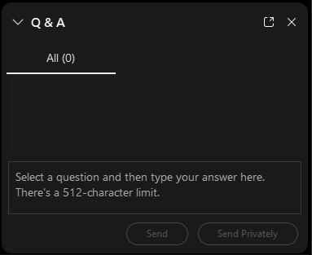
QUESTIONS?
Do you have a question? Please use the WebEx Q&A feature as shown.

Slide 20


FOLLOW US ON SOCIAL MEDIA
@CHICAGODPS
Did you find this workshop helpful? Share it on social media using #DPSWorkshops and spread the word to help the City business community learn about the programs and initiatives available at the City of Chicago.

