Slide 1


DPS Incentives & Programs: Getting the Most From Your Bids

Slide 2
Welcome
The Department of Procurement Services is committed to Communications and Outreach, which is key to keeping citizens informed of bid opportunities, new programs, and innovations.
Also ensure that you download a copy of our most recent Consolidated Buying Plan. This is a 15-month forecast including hundreds of upcoming opportunities for 12 city agencies. To download go to: www.chicago.gov/dps
We encourage you to follow on our website www.chicago.gov/dps for the latest news, updates, and our calendar of events. Go online www.chicago.gov/DPS and click on the letter icon and sign-up for our Email Newsletter: DPS Alerts full of news that you can use.
Follow us on social media to stay informed:
Facebook: www.facebook.com/ChicagoDPS
LinkedIn: www.linkedin.com/company/chicagodps
Youtube: www.YouTube.com/ChicagoDPS
NOTE: Legal advertisements for the City of Chicago Department of Procurement Services (DPS) appear in the Chicago Tribune. Information about DPS contracting opportunities will be available at www.chicago.gov/bids.

Slide 3

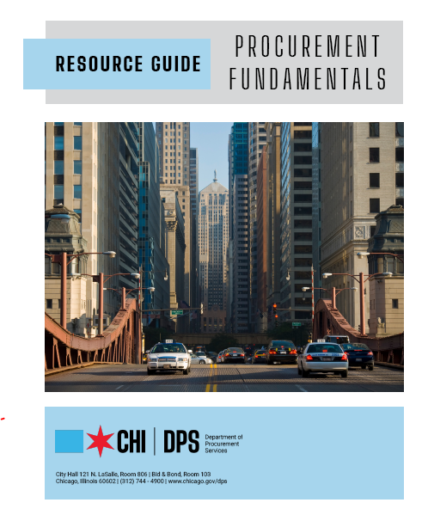
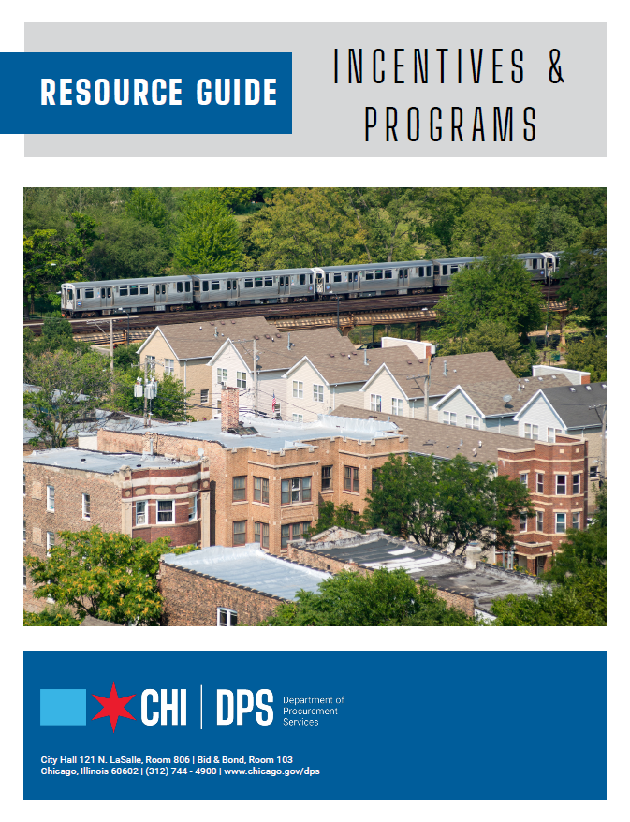
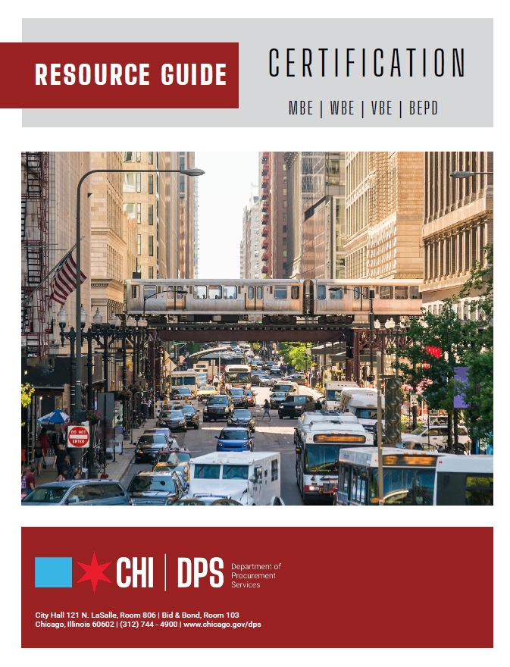
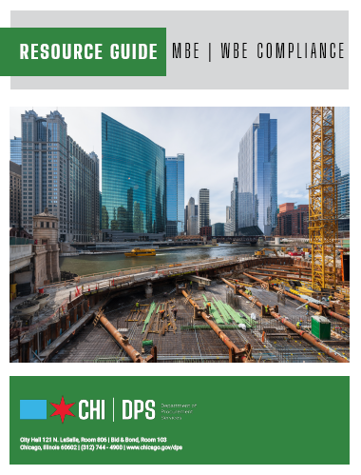




RESOURCE GUIDES
DPS has published a four-volume set of Resource Guides, expanding on the guiding principle of transparency.
The Resource Guides were divided into key areas of the procurement process:
  Contract Administration
  Incentives and Programs
  Certification
  Compliance
Download now at www.chicago.gov/dpsguides
@CHICAGODPS

Slide 4
DPS is the contracting authority for the procurement of goods and services for the City of Chicago. We work together as a team and with our customers to guarantee an open, fair, and timely process by establishing, communicating and enforcing superior business practices.
DEPARTMENT OVERVIEW

Slide 5
OUR GOALS AT A GLANCE
City Programs
Bid Incentives
Diversity Reporting

Slide 6

Programs

Slide 7
Overview of City Programs
Small Business Initiative (SBI) for Construction
Mid-sized Business Initiative (MBI) for Construction
Non-Construction Mid-Sized Business Initiative (NMBI)
Diversity Credit
Mentor/Protégé
Target Market Program
Phased Graduate Program

Slide 8
Small Business Initiative for Construction
Municipal Code: 2-92-710
Program Goal: Designed to encourage small businesses to participate in City-funded construction projects up to $10 million in total cost
Key Points:
  Small local businesses are exclusive bidders
    The principal place of business must be located in Six-County Region (Cook, DuPage, Will, McHenry, Lake, Kane)
  Two Tiers: Small Business Initiative (SBI) I and II
    SBI I- Estimated Project Cost between $2,000,000- $10,000,000
      Bidders may not exceed 1.5 times Small Business Administration (SBA) size standards and 1.5 times certification personal net worth (PNW) limits
    SBI II- Estimated Project Cost less than $2,000,000
      Bidders may not exceed ½ SBA size standards and ½ certification PNW limits
  Small business must perform the majority of the work with its own forces and/or subcontractors who are local businesses

Slide 9
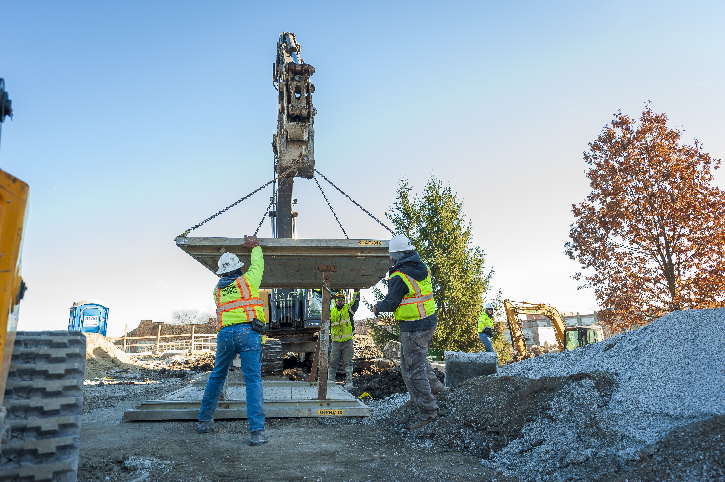
Mid-Sized Business Initiative for Construction
Program Goal: Designed to increase small and mid-sized business participation in City funded construction projects between $10 million and $20 million in total cost
Key Points:
  Small and mid-sized local businesses are exclusive bidders
    The principal place of business must be located in Six-County Region
    Estimated project cost between $10,000,000-$20,000,000
    Bidder may not exceed 2 times SBA size standard and 2 times certification PNW limits
  At least 51% of the work must be performed by the mid-sized business enterprise’s own forces or subcontractors who are mid-sized local businesses
Municipal Code:
2-92-800 et seq.

Slide 10
Non-Construction Mid-Sized Business Initiative (NMBI)
Municipal Code: 2-92-1000 et seq.
Program Goal: Designed to increase small and mid-sized business participation in City-funded non-construction projects between $3 million and $10 million in total cost
Key Points
  Small and mid-sized local businesses are exclusive bidders
    The principal place of business must be located in Six-County Region
  Bidders may not exceed 1.5 times Small Business Administration (SBA) size standards
  Estimated project cost between $3,000,000-$10,000,000
  Mid-sized business enterprise must perform at least 51% of the work with its own forces or subcontractors who are mid-sized local businesses

Slide 11
Diversity Credit Program
Municipal Code: 2-92-530 and 2-92-720(e)
Program Goal: Designed to increase the participation of MBEs and WBEs in private contracts (not funded by a governmental entity) by making such participation eligible for credit toward M/WBE goals on City contracts
Key Points:
  M/WBE must perform direct, commercially useful function
  M/WBE work must be in area of specialty certified by City
  Private sector contract cannot have affirmative action goals
  $1 of credit for every $3 earned by M/WBE vendors
  When a vendor has been awarded credits, can indicate intent to use credits on bid documents at time of bidding
  Maximum amount of credit for a City contract is 5% of the total dollar value on any City contract
  Credits may only be used once and expire after 1 year

Slide 12
Mentor/
Protégé Program
Program Goal: Designed to increase the participation and capacity of MBEs and WBEs in City contracting by making M/WBE utilization and mentoring eligible for credit toward M/WBE goals on a City contract
Key Points:
  Written mentor/protégé agreement must be approved by CPO
  0.5% participation credit can be earned for every 1% performed by the protégé up to 5%
  Mentor/protégé agreement must be designed to assist protégé in becoming self-sustaining, competitive, and profitable
  Prime can mentor an MBE/WBE or its subcontractor(s) can mentor an MBE/WBE
  Use of Mentor-Protégé Program must be indicated on bid/proposal
  Prime may also receive a 1% bid incentive
Municipal Code:
2-92-535

Slide 13
Target Market Program
Municipal Code: 2-92-460
Program Goal: Designed to provide opportunities for MBEs and WBEs to be the exclusive bidders on City non-construction contracts
Key Points:
  MBEs or WBEs or joint ventures consisting exclusively of MBEs, WBEs, or both are exclusive bidders
  Must be certified by the City as a MBE or WBE prior to bidding
  The prime contractor may subcontract up to 50% of the dollar value of the contract to subcontractors who are not MBEs or WBEs

Slide 14
MBE/WBE Phased Graduation Program
Program Goals: Designed to maximize diversity in the City’s contracting by making established businesses eligible for continued participation in the City’s MBE/WBE Construction and Non-Construction Programs for at least three additional years
Key Points:
  Applies when a firm has exceeded the gross receipts/employee size limits for a certification or its owners’ PNW exceed the PNW limits for certification, making the firm no longer eligible for certification as an MBE or WBE
  The firm will be considered a “participating established business” for a period of three years
    75% credit for participation in new City contracts during the first year (i.e., for each dollar ($1.00) paid to such firms, the prime contractor will be credited for seventy-five cents ($0.75) of participation)
    50% credit during the second year, and
    25% credit during the third year if starting a new contract
Municipal Code: 2-92-470 and 2-92-725

Slide 15
Bid
Incentives

Slide 16
Bid
Incentives
Construction Only
  Apprentice Utilization
  Equal Employment Opportunity
  Returning Resident Apprentice Utilization
  Project Area Subcontractors
  Veteran-owned Subcontractor Utilization
Non-Construction Only
  City-Based Manufacturers
Both Construction and Non-Construction
  Mentor/Protégé
  Alternatively Powered Vehicles
  Business Enterprises Owned or Operated by People with Disabilities
  City-Based Businesses
  Incentive to Encourage Utilization of MBE/WBEs
  Veteran-owned and Small Businesses JV +VBE
  Diverse Work Force and Management

Slide 17
How Incentives Work

Slide 18
How Incentives Work
Applicable incentives will be listed in the bid package
Bidders will be required to submit an affidavit and all requested documentation in order to be considered for the incentive
  The incentive will not be applied if you fail to submit any requested documentation
If eligible, your bid will be reduced in the amount of the incentive(s) for evaluation purposes only

Slide 19
How Incentives Work
Some incentives cannot be combined
Bid Incentive | Incompatible Incentives
City-Based Bid Incentive (4%) | Cannot be used with the 6% or 8% City-Based Bid Incentives or the City-Based Manufacturer Utilization Incentive
City-Based Bid Incentive (6%) | Cannot be used with the 4% or 8% City-Based Bid Incentives or the City-Based Manufacturer Utilization Incentive
City-Based Bid Incentive (8%) | Cannot be used with the 4% or 6% City-Based Bid Incentives or the City-Based Manufacturer Utilization Incentive
City-Based Manufacturer Utilization Bid Incentive | Cannot be used with the 4%, 6%, or 8% City-Based Bid Incentives or the Project Area Subcontractor Utilization Incentive or the Veteran-owned Subcontractor Utilization Incentive
Project Area Subcontractor Utilization | Cannot be used with the City-Based Manufacturer Utilization Incentive
SBE/Veteran JV/Veteran-Owned Small Local Business Bid Incentive | Cannot be used with the Veteran-Owned Subcontractor Utilization Bid Incentive
Veteran-Owned Subcontractor Utilization Bid Incentive | Cannot be used with the City-Based Manufacturer Utilization Incentive or the SBE/Veteran JV/Veteran-Owned Small Local Business Bid Incentive

Slide 20
Requirements After Award
You may be required to submit documentation at contract closeout or throughout performance demonstrating that you are meeting your commitments
Failure to meet commitments may result in fines of up to three times the amount of the incentive granted, the denial of an earned credit certification (when applicable), and a finding of non-responsibility

Slide 21
Apprentice
Utilization
Bid Incentive
Municipal Code:
2-92-335
Program Goal: Designed as an incentive to encourage City prime contractors to utilize apprentices on construction projects with an estimated value of $100,000 or more
Key Points:
  “Apprentice” means any person who is:
    Sponsored into an apprenticeship training program by a contractor that is authorized by a union to sponsor apprentices; and
    Enrolled in, or has graduated from, a construction technology training program administered by City Colleges of Chicago or is a graduate of a high school operated by Chicago Public Schools
  Earned credit incentive for future contracts
    Credit valid for 3 years
    Can only be used to win one contract award
  Tiered Incentive:
    5-10% work performed by apprentice results in ½% bid incentive
    11-15% performed by apprentice result in 1% bid incentive

Slide 22
Equal Employment Opportunity
Program Goal: Designed as an incentive to increase the utilization of minority and women journey workers, apprentices, and laborers on construction projects with an estimated value of $100,000 or more
Key Points:
  Using a canvassing formula, bidders propose minority and women utilization levels as a percentage of work hours on the project
  Commitment cap for female workers is 15%
  Cap for minority workers is 70%
  Bidder will be given a 150% credit for every work hour performed by a minority or female worker residing in a socio-economically disadvantaged area
  After completing the numerical calculations set forth in the canvassing formula, the final calculation represents the “award criteria figure” by which Bids will be compared
Municipal Code:
2-92-390

Slide 23
Returning Resident Apprentice Bid
Incentive
Municipal Code: 2-92-336
Program Goal: Designed as an incentive for City prime contractors to sponsor and utilize Returning Resident apprentices for construction projects with an estimated value of $100,000 or more
Key Points:
  DFSS works with delegate agencies to recruit, screen, and refer potential qualified candidates. All candidates go through an initial intake process where their eligibility for this program will be determined.
  Earned credit incentive for future contracts
    Credit valid for 3 years
    Can only be used to win one contract award
  Tiered Incentive:
Total Labor Hours Performed By Apprentices | Future Bid Incentive as a Percentage of the Future Contract Base Bid
5-10% | 0.5%
11-15% | 1.0%

Slide 24
Project-Area
Subcontractor
Bid Incentive
Municipal Code: 2-92-405
Program Goal: Designed as an incentive for City prime contractors to utilize project-area subcontractors for construction projects
Key Points:
  Subcontractor must be a small business (based on SBA size standards)
  Subcontractor must conduct meaningful day-to-day business at a facility in the project area and must be the place of employment for the majority of its regular, full-time workforce
  Subcontractor must hold all required City licenses and be subject to City taxes

Slide 25
Project-Area
Subcontractor
Bid Incentive
Municipal Code: 2-92-405
Key Points:
  Tiered Incentive:
    1-16% project-area subcontractor work results in 0.5% bid incentive
    17-32% project-area subcontractor work results in 1% bid incentive
    33-49% project-area subcontractor work results in 1.5% bid incentive
    50% or more project-area subcontractor work results in 2% bid incentive
Note: Section 2-92-330 of the MCC requires contractors on projects with an estimated value of $100,000 to have at least 7.5% of work performed by project area residents and 50% by City residents. Work hours performed by Project Area residents shall be considered to be work hours performed by City Residents for purposes of calculating the minimum work hour percentage required to be performed by City Residents.

Slide 26
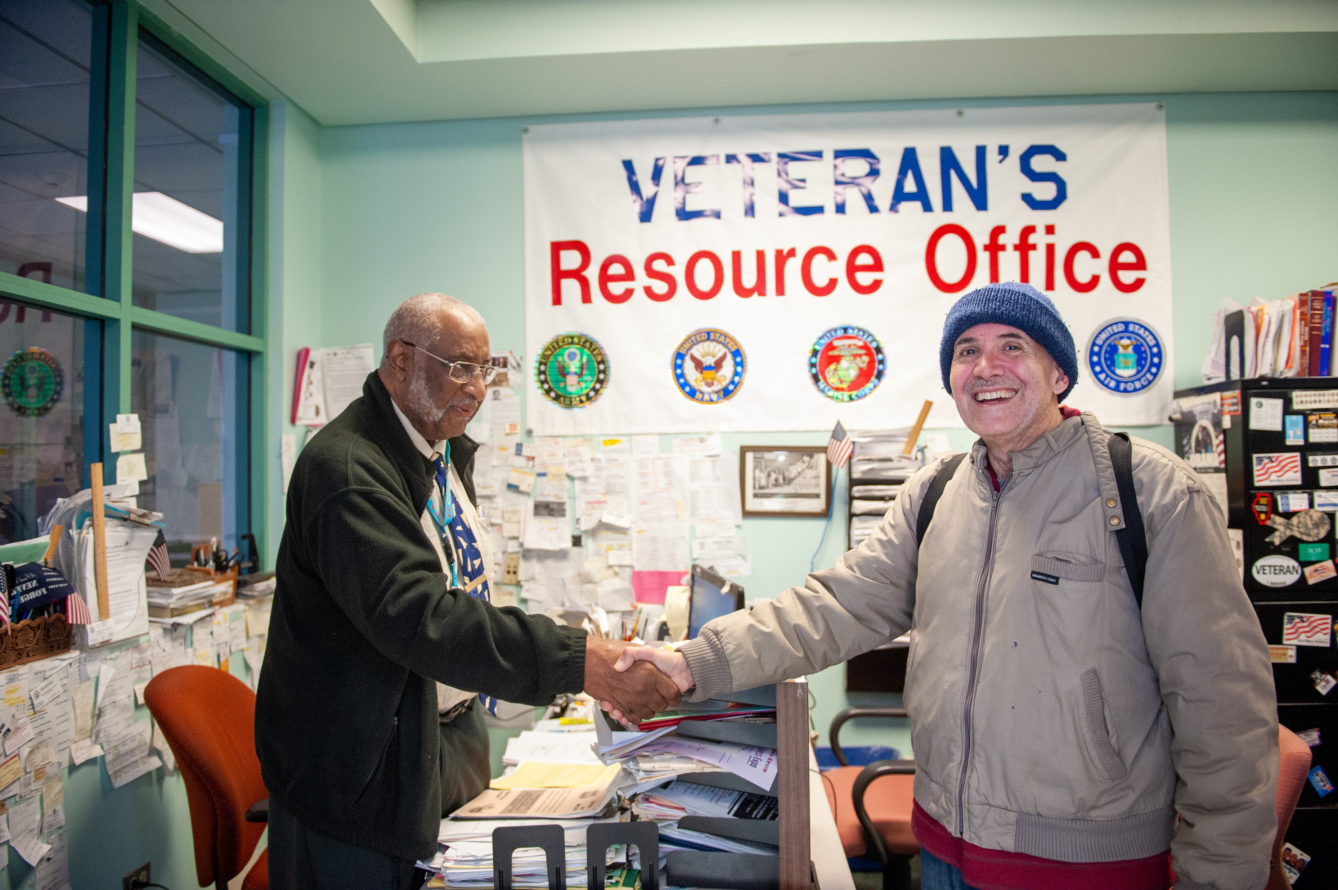
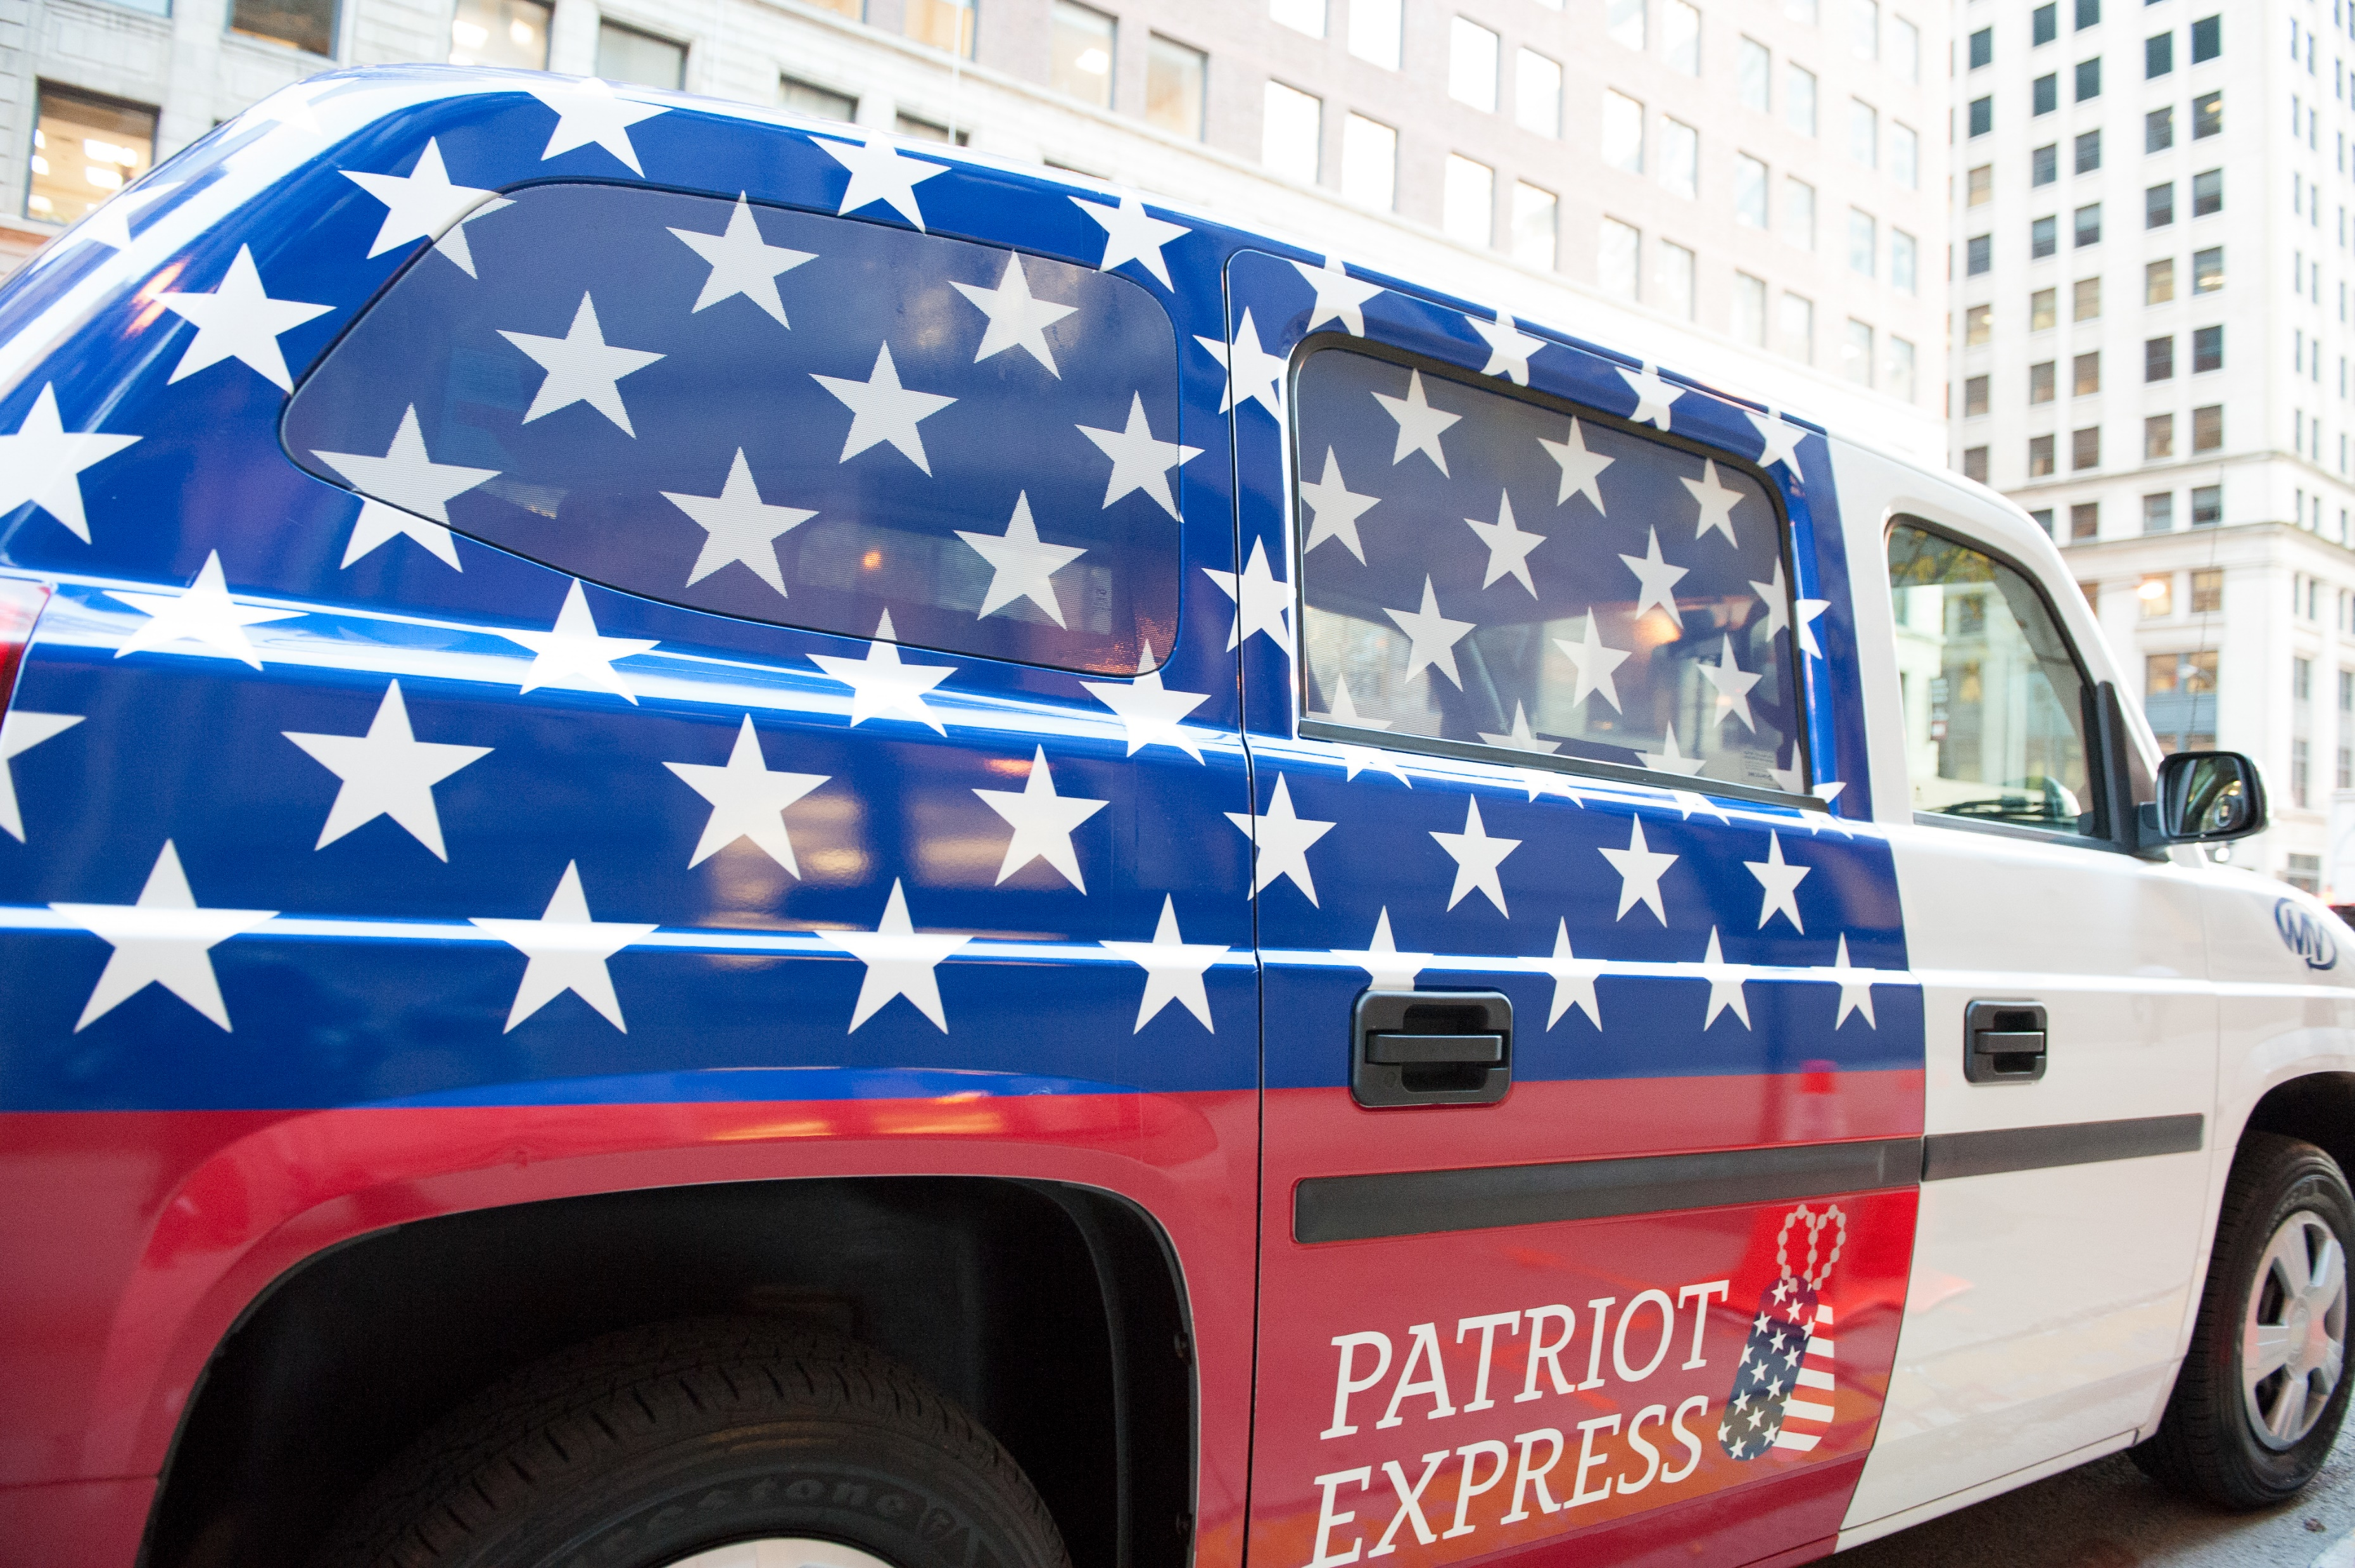
Veteran-owned Subcontractor Utilization Bid Incentive
Program Goal: Applies to contracts for construction projects and is designed to encourage the utilization of veteran- owned subcontractors in the performance of the contract
Key Points:
  Bidder must utilize veteran-owned small local businesses (VBE) as subcontractors
  Tiered incentive based on the Bidder’s commitment to the use of veteran-owned subcontractors in the performance of the contract:
    If the commitment is 1-16%, the Incentive is 0.5% of the contract base bid;
    If the commitment is 17-32% the Incentive is 1% of the contract base bid;
    If the commitment is 33-49% the Incentive is 1.5% of the contract base bid;
    If the commitment is 50% or greater, the Incentive is 2% of the contract base bid.
Municipal Code:
2-92-940

Slide 27
City-Based Manufacturers Bid Incentive
Municipal Code: 2-92-410
Program Goal: Designed to increase contracting/supply opportunities and participation by city-based manufacturers
Key Points:
  Manufacturer licensed, taxed and operating in the City
  Contracts for goods with an estimated value of $100,000 or more.
  Tiered Incentive:
    Goods provided equals 25-49% results in 1% bid incentive
    Goods provided equals 50-74% results in 1.5% bid incentive
    Goods provided equals 75% or more results in 2% bid incentive

Slide 28
Alternatively Powered Vehicles Bid Incentive
Municipal Code: 2-92-413
Program Goal: Designed as an incentive for City vendors to use alternatively powered vehicles in their business fleet
Key Points:
  An eligible business must
    1) be located in the Six County Region; and
    2) a majority of the fleet (at least 10 vehicles) must be located and used in the Six County Region; and
    3) the majority of those vehicles must be alternatively powered
  Alternatively powered vehicles are fueled by alternative fuel including, but not limited to, natural gas, liquified petroleum, gas, hydrogen, ethanol E85, and electricity
  Contracts of $100,000 or more
  0.5% bid incentive

Slide 29
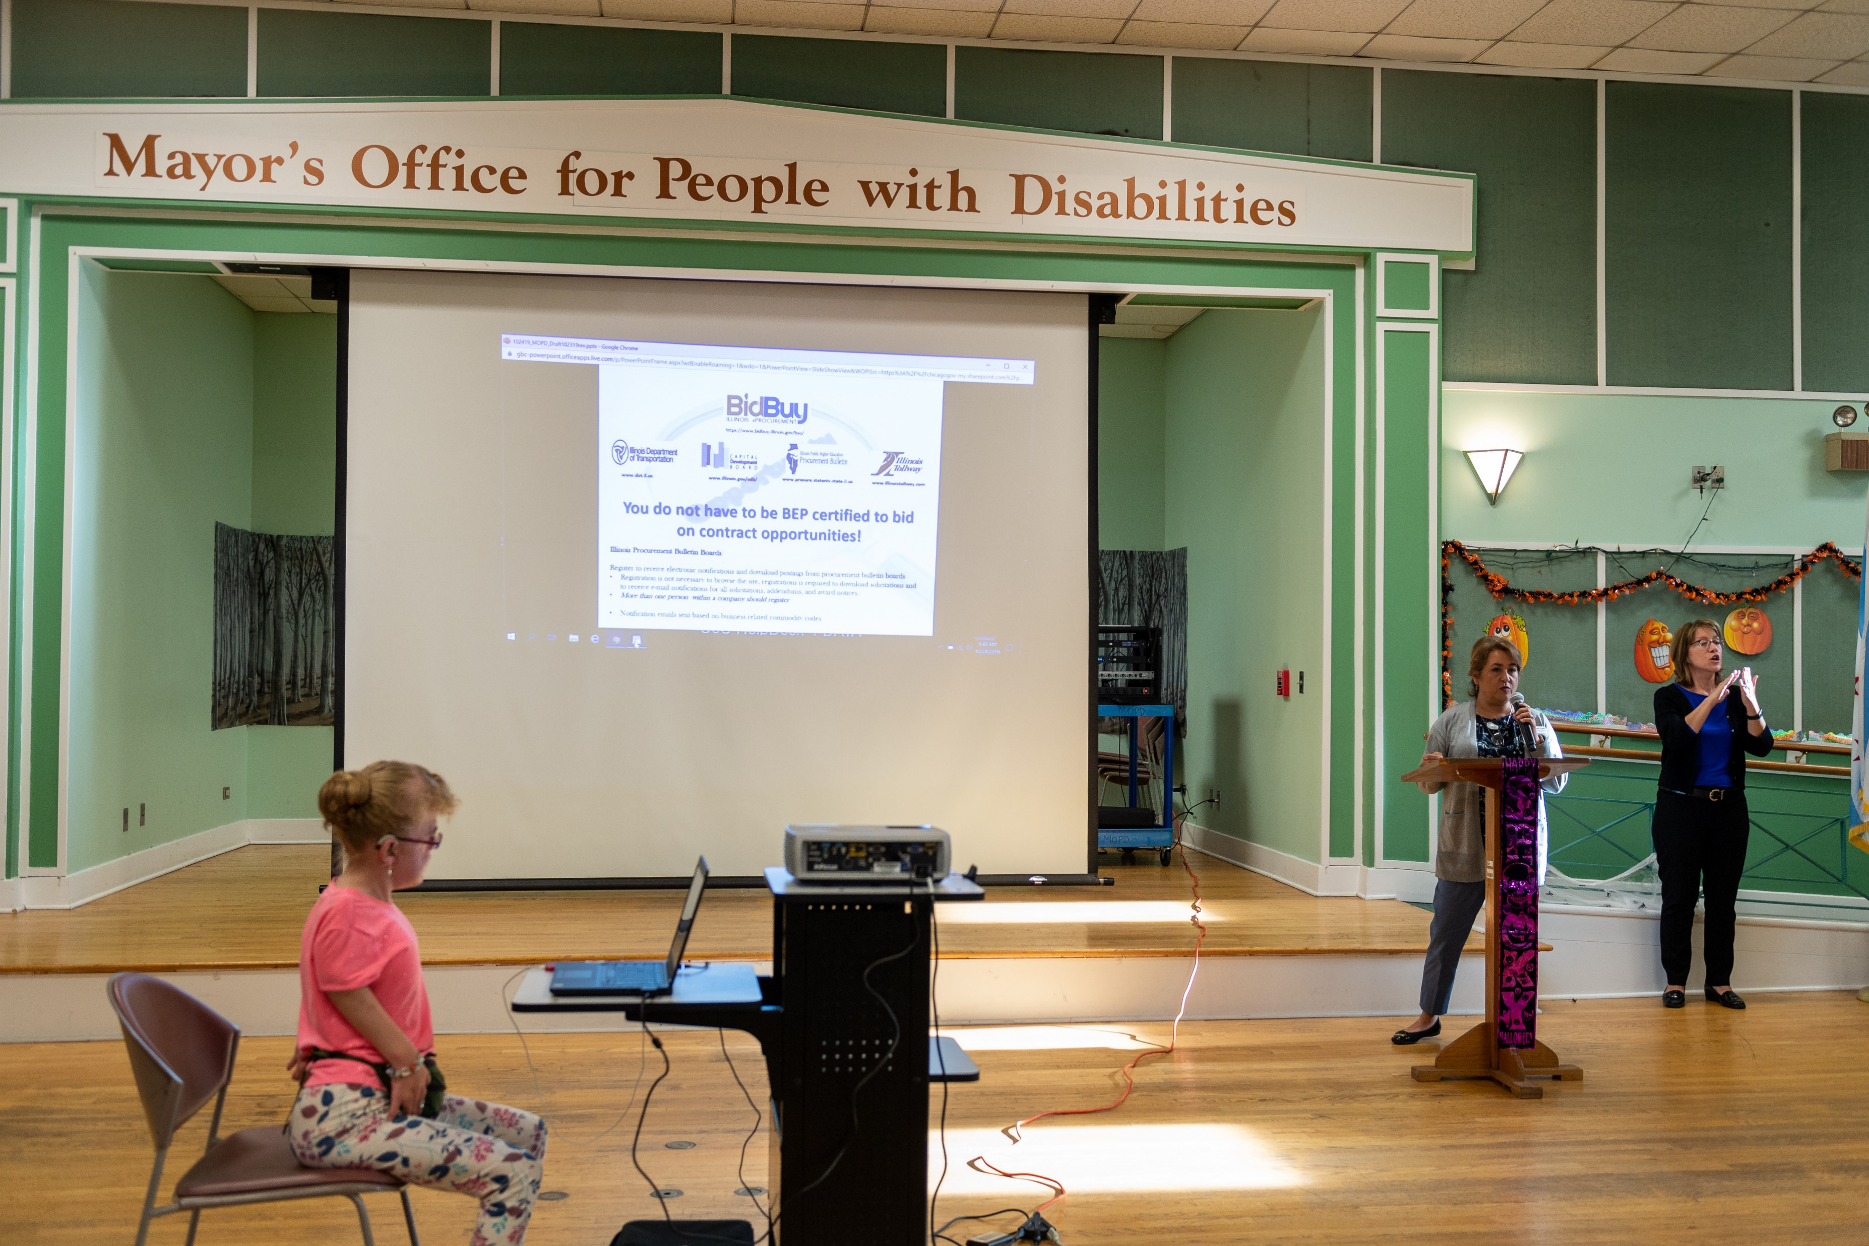
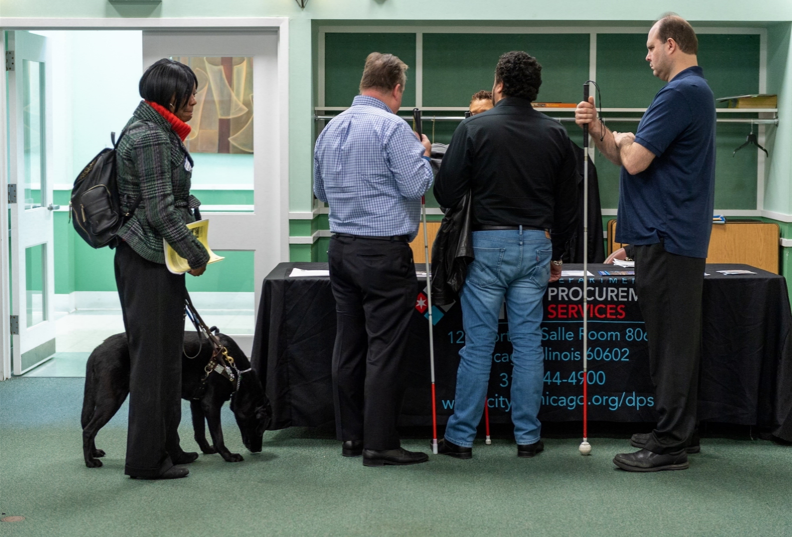
Business Enterprises Owned or Operated By People with Disabilities
Program Goal: Designed to increase contracting opportunities and participation by business enterprises owned or operated by people with disabilities
Key Points:
  Business enterprise must be 51% or more owned by person with disability
  Prime or Subcontractor
  Must be a certified Business Enterprise Owned by People with Disabilities (BEPD)
  Tiered incentive:
    Participation of 2-5% results in 1% bid incentive
    Participation of 6-9% results in 2% bid incentive
    Participation of 10-13% results in 3% bid incentive
    Participation of 14% or more results in 4% bid incentive
Municipal Code:
2-92-337

Slide 30
City-Based Business Bid Incentive
Municipal Code: 2-92-412
Program Goal: Designed to increase contracting opportunities and participation by city-based businesses
Key Points:
  Contracts for $100,000 or more
  4% bid incentive if City-based
    Conduct meaningful day-to-day business from a facility in the City
    Majority of regular, full-time employees work out of City facility
    Holds all City licenses, and
    Subject to applicable City taxes
  6% bid incentive if firm qualifies for the 4% bid incentive and majority of regular, full-time workforce are City residents
  8% bid incentive if firm qualifies for the 6% bid incentive and the majority of its City resident workforce lives in socio-economically disadvantaged areas

Slide 31
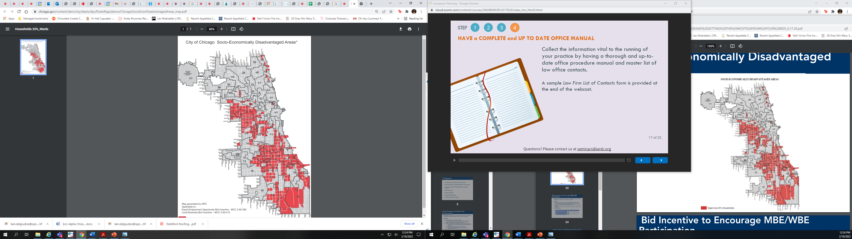
Socio-Economically Disadvantaged Areas
Current copy of map located at https://www.chicago.gov/content/dam/city/depts/dps/RulesRegulations/ChicagoSocioEconDisadvantagedAreas_map.pdf

Slide 32
Bid Incentive to Encourage MBE/WBE Participation
Program Goal: Designed as an incentive to encourage participation of MBEs and WBEs on contracts where no goals can be assigned
Key Points:
  On certain contracts, the City cannot set MBE/WBE participation goals because an insufficient number of certified firms are available; this bid incentive is available on these 0%/0% goals contracts
  To be eligible for the incentive, a compliance plan must be submitted with the bid
  MBE/WBE participation can be at the prime or subcontractor level, and can be direct or indirect

Slide 33
Bid Incentive to Encourage MBE/WBE Participation
Key Points:
  Tiered Incentive:
MBE or WBE Participation as a Percentage of the Estimated Contract Dollar Amount | Bid Incentive, as a Percentage of the Contract Base Bid
5% | 0.75%
10% | 1.00%
15% | 1.25%
20% | 1.50%
25% | 1.75%
30% | 2.00%

Slide 34
Veteran-owned + Small Business Joint Venture Bid Incentive
Municipal Code: 2-92-950
Program Goal: Designed to increase contracting opportunities and participation by small-local veteran-owned business enterprises (VBEs) and eligible joint ventures consisting of one or more veteran-owned business enterprises
Key Points:
  Contracts over $100,000
  5% bid incentive
  A VBE can qualify by itself-no need to JV with another business
    VBEs must have 51% or more veteran ownership and must be certified by the City

Slide 35
Veteran-owned + Small Business Joint Venture Bid Incentive
Municipal Code: 2-92-950
Key Points:
  For JVs:
    All members must be an SBE, veteran-owned business, or both;
    At least one member must be a veteran-owned business;
    All SBEs must collectively have at least 30% interest in the JV;
    All veteran-owned businesses must collectively have at least 30% interest in the JV;
    The JV partners must self-perform at least 20% of the work; and
    None of the JV members may act as brokers

Slide 36
Diverse Workforce and Management Bid Incentive
Municipal Code: 2-92-407
Program Goal: Designed to encourage contractors to employ a diverse workforce and management. Applies to contracts with an estimated value of $100,000 or more
Key Points:
  Bidders must have a diverse workforce and/or diverse management
  Two tiered incentives can be combined
    Diverse Workforce:
    Diverse Management
Percentage of Workforce that is Diverse | Bid Incentive
10-20% | 2%
>20-40% | 4%
Over 40% | 6%
Percentage of Management that is Diverse | Bid Incentive
10-20% | 0.5%
>20-40% | 2%
Over 40% | 4%

Slide 37


Slide 38


FOLLOW US ON SOCIAL MEDIA
@CHICAGODPS
Did you find this workshop helpful? Share it on social media using #DPSWorkshops and spread the word to help the City business community learn about the programs and initiatives available at the City of Chicago.

