Slide 1


eProcurement 101

Slide 2
Welcome
The Department of Procurement Services is committed to Communications and Outreach, which is key to keeping citizens informed of bid opportunities, new programs, and innovations.
Also, ensure that you download a copy of our most recent Consolidated Buying Plan. This is a 15-month forecast including hundreds of upcoming opportunities for 12 city agencies. To download, go to: www.chicago.gov/dps.
We encourage you to follow us on our website www.chicago.gov/dps for the latest news, updates, and our calendar of events. Go online, www.chicago.gov/DPS and click on the letter icon and sign-up for our Email Newsletter: DPS Alerts full of news that you can use.
Follow us on social media to stay informed:
Facebook: www.facebook.com/ChicagoDPS
LinkedIn: www.linkedin.com/company/chicagodps
Youtube: www.YouTube.com/ChicagoDPS
NOTE: Legal advertisements for the City of Chicago Department of Procurement Services (DPS) appear in the Chicago Tribune. Information about DPS contracting opportunities will be available at www.chicago.gov/bids.

Slide 3









RESOURCE GUIDES
DPS has published a four-volume set of Resource Guides, expanding on the guiding principle of transparency.
The Resource Guides were divided into key areas of the procurement process:
  Contract Administration
  Incentives and Programs
  Certification
  Compliance
Download now at www.chicago.gov/dpsguides
@CHICAGODPS

Slide 4
OUR GOALS AT A GLANCE
What is eProcurement – overview
Accessing iSupplier Portal / Online Bidding
How to register
View Bids / Solicitations
How to respond to Bid/Solicitation
Questions

Slide 5
DPS is the contracting authority for the procurement of goods and services for the City of Chicago. We work together as a team and with our customers to guarantee an open, fair, and timely process by establishing, communicating and enforcing superior business practices.
DPS Mission Statement

Slide 6

Overview of eProcurement
eProcurement established in 2017, is the City’s Financial Management Procurement System aka (FMPS) in Oracle that applies web technology to the acquisition of goods and services.
The iSupplier Portal is the full-service resource for vendors doing business with the City of Chicago.
All DPS bids, RFPs, and RFQs are electronic and are advertised through eProcurement.

Slide 7
Overview of eProcurement
(cont’d)
You must be a registered Vendor to access the “iSupplier” Portal Online eProcurement System for all purchasing activities.
As a registered Vendor in the iSupplier Portal you will be able to:
  View and Respond to Bids / Solicitations online
  View Orders, Payments, Invoices past and present
  Update Your Company Information – contacts, address, phone, email
To assist vendors with the transition to the iSupplier Portal and Online Bidding process, the City developed the eProcurement microsite, a website “How To” manual for eProcurement. The web address www.chicago.gov/eprocurement

Slide 8
SECURITY iSupplier Portal/Abstract
www.chicago.gov/eprocurement
Your information is secure, the City takes security seriously and ensures all information is encrypted.
The City uses the https: protocol for secure communication.
Bids solicitations are not visible to employees or other vendors prior to Bid Opening. Your Active Bid is secure.

Slide 9
First Time Vendor Registration
  Log in and registration
  Existing Vendors with a City vendor number: Click on the request an iSupplier invitation button to direct your request to CustomerSupport.
  New Vendors without an existing City vendor number: Click on the New Vendor Registration button.
  What is needed at New Vendor Registration?
  W9/FEIN/Tax ID attached as PDF. If not attached your registration request will be returned.
  The legal business name of the company must match the company name on the W9/FEIN/Tax ID form, or your registration request will be returned.

Slide 10
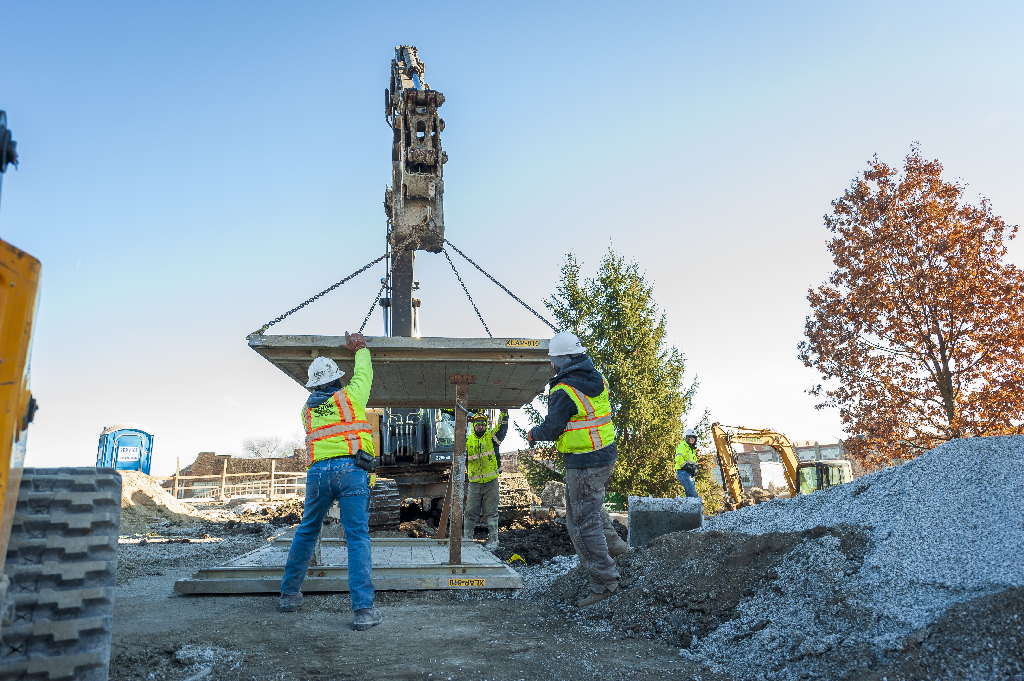
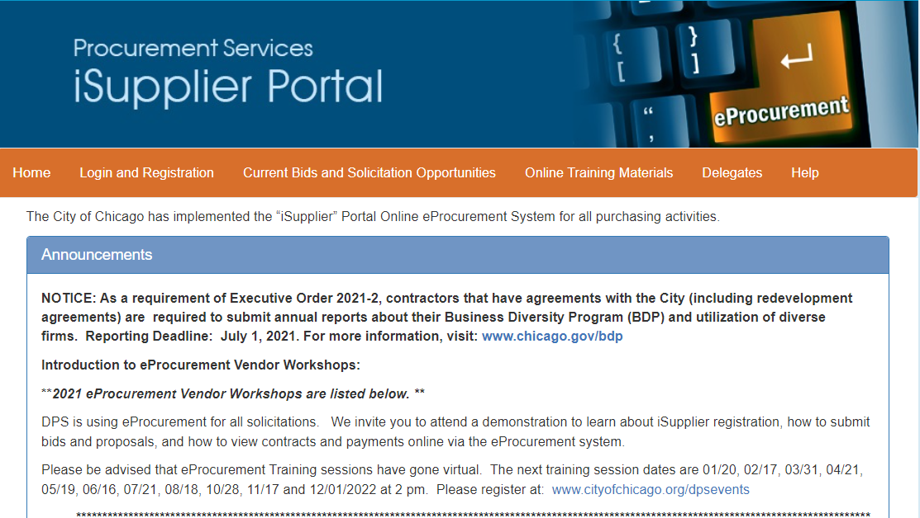
Microsite

Slide 11
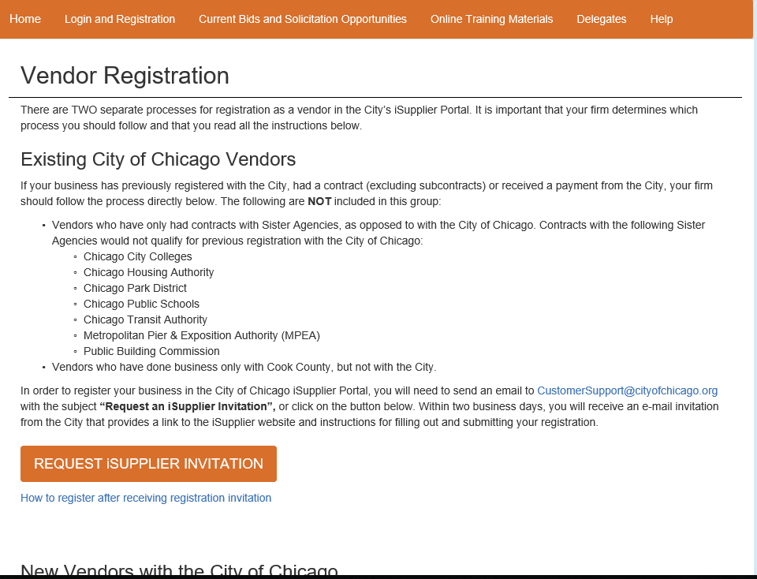
Existing Vendor Registration
Required: Full Name, Email Address, Phone Number and FEIN/Tax ID/EIN 9 digit number

Slide 12
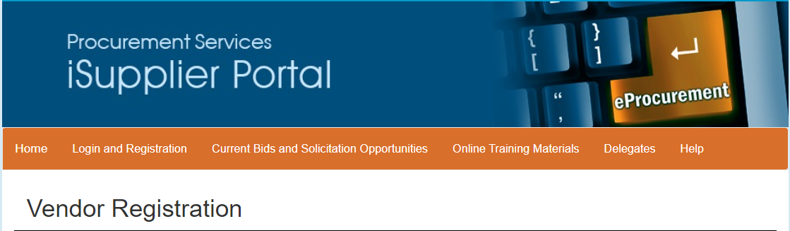
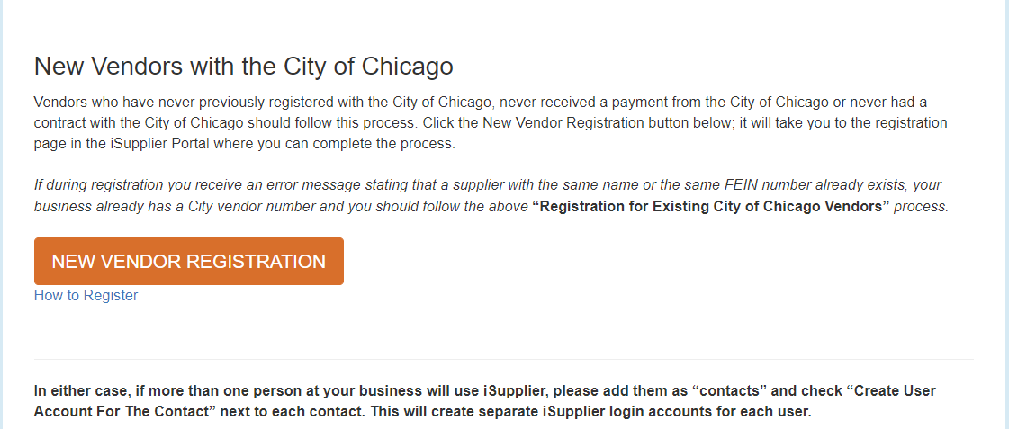
New Vendor Registration

Slide 13
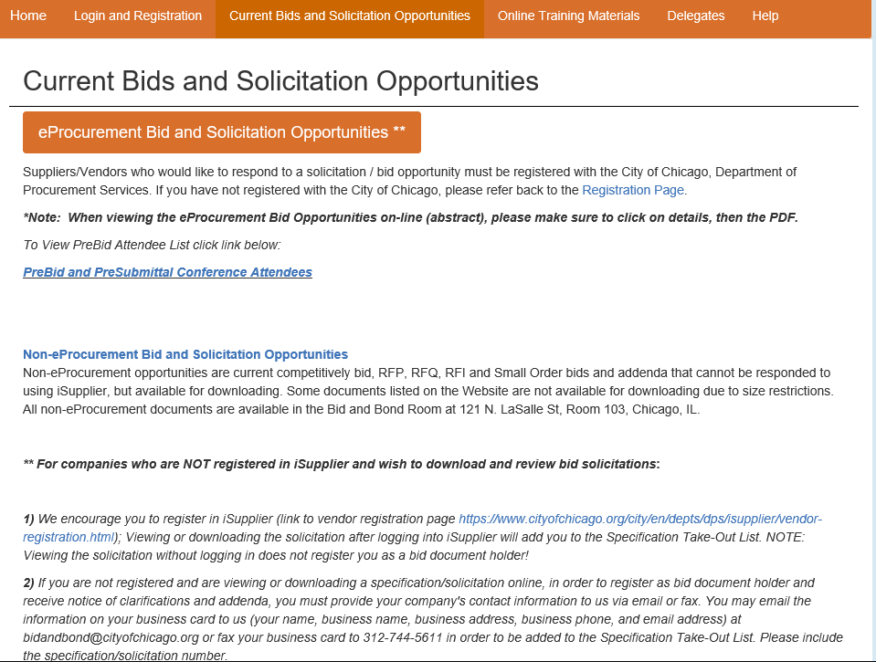
Current Bid & Solicitations Opportunities & Other Accessibles

Slide 14
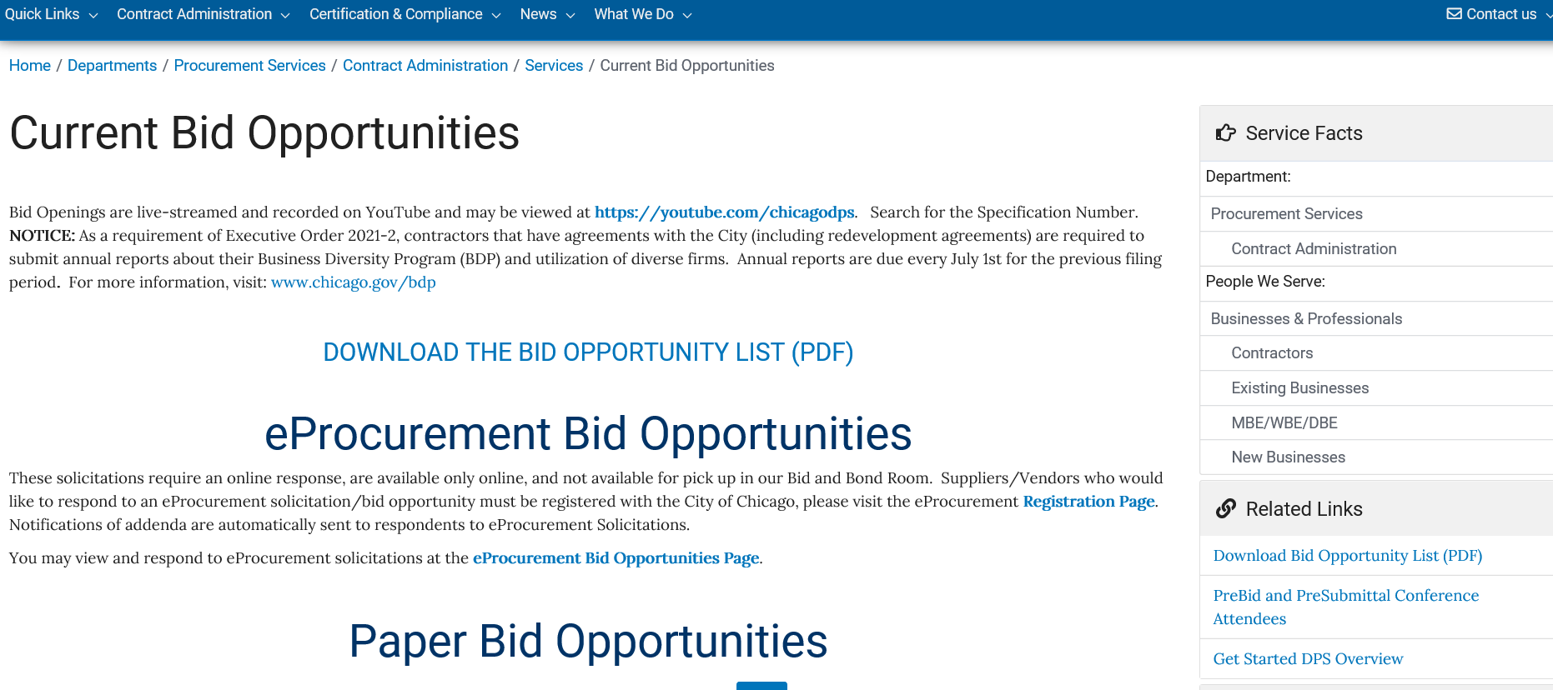
Current Bid Opportunties & Bid Opening
Listing

Slide 15
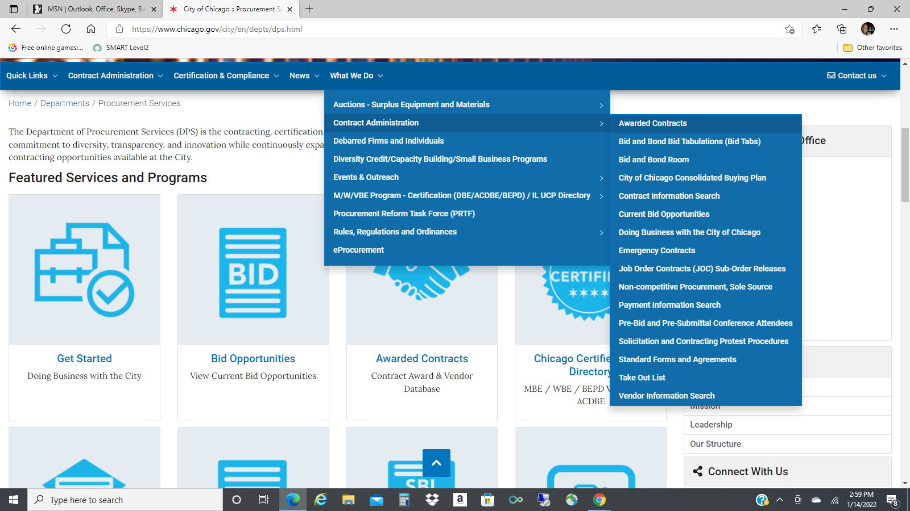
What We Do

Slide 16
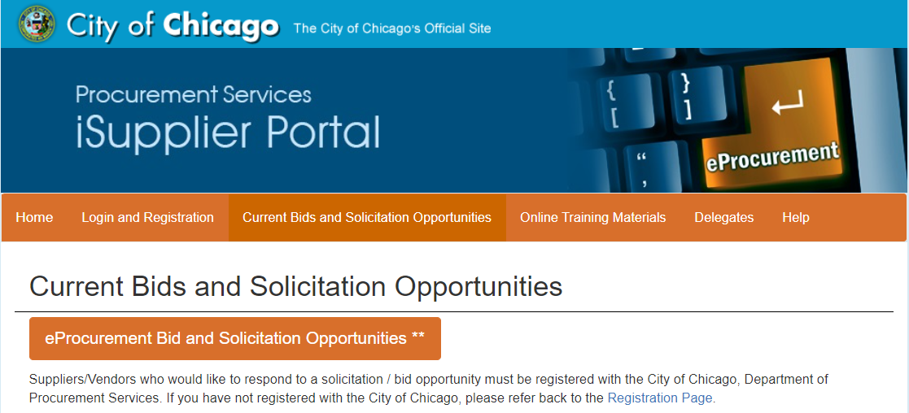
Current Bids &
Solicitation
Opportunities
Click the orange button

Slide 17
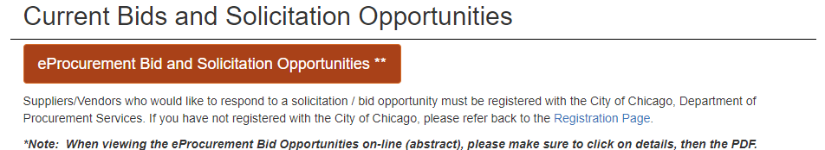
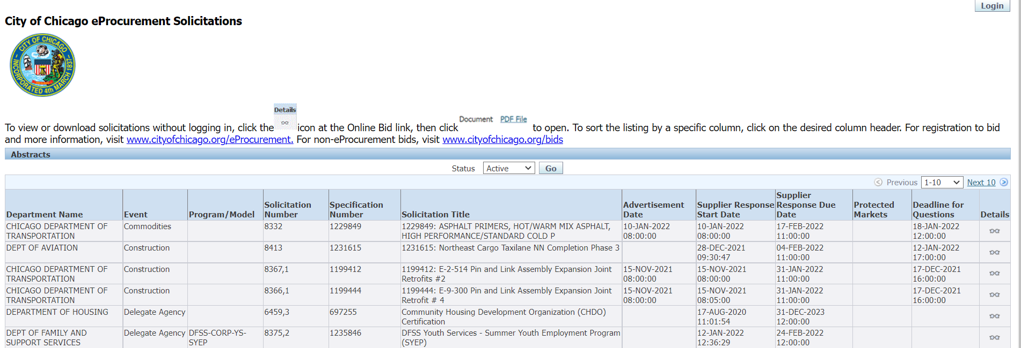
The Abstract
Page of Active Bids/
Solicitations

Slide 18
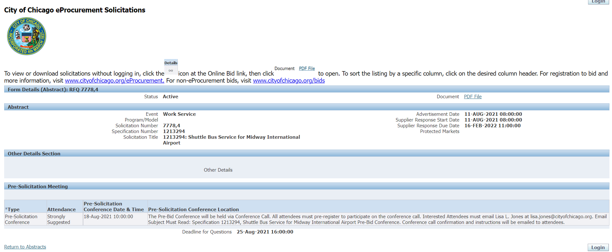
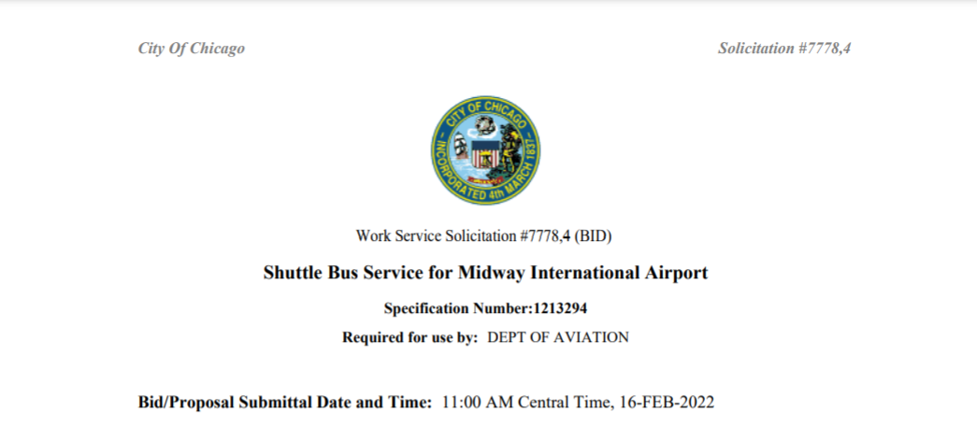
Abstract cont’d

Slide 19
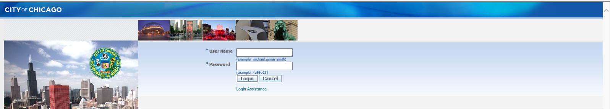
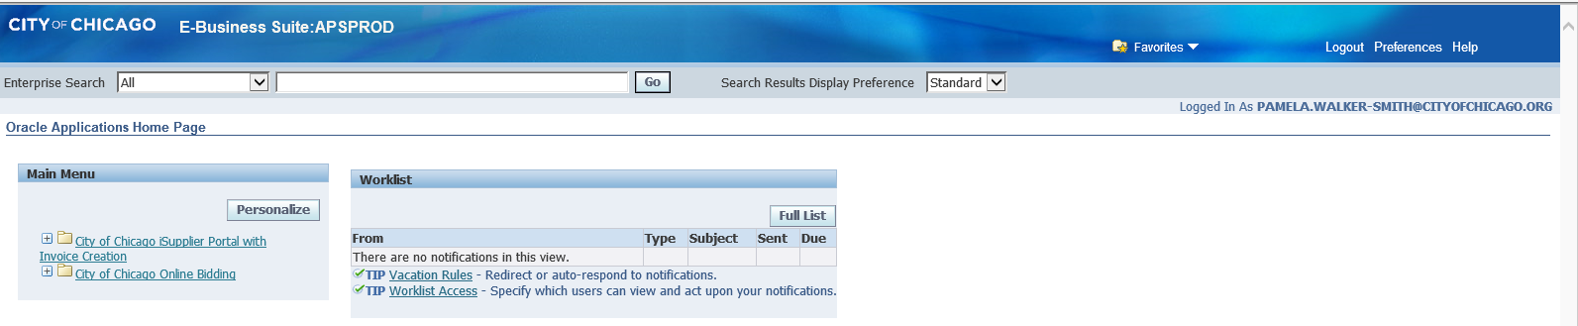
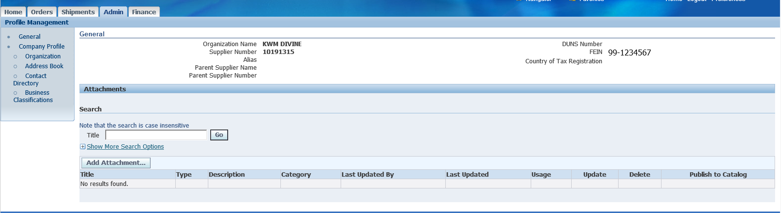
Log In/1st Folder – iSupplier Portal https://chicago.gov/eprocurement
After entering your temporary password you will be directed to change to permanent password. Login.

Slide 20
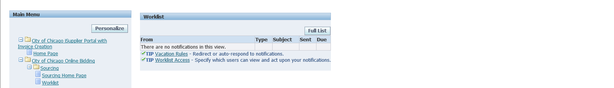
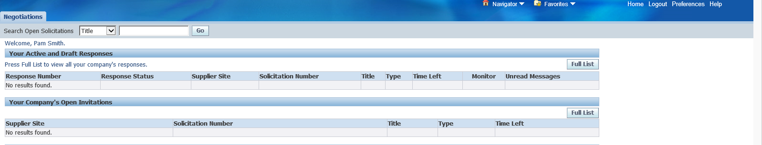
Log In/2nd Folder – Online Bidding https://chicago.gov/eprocurement
After entering your temporary, password you will be directed to change to permanent password. Login.
The Worklist is currently empty, as you bid or have question your conversation will appear here. Click on Sourcing Home Page.

Slide 21
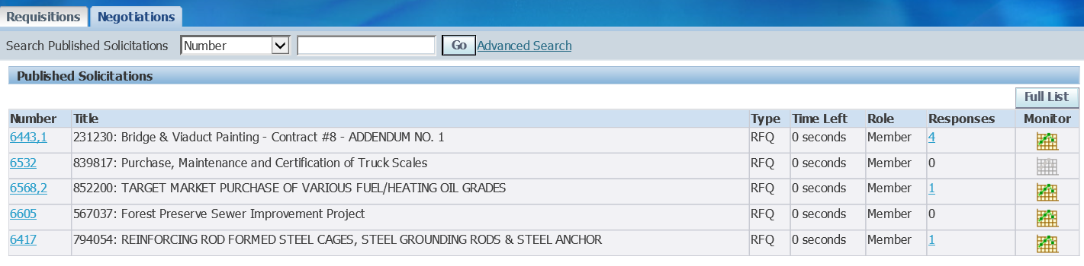
Log In/2nd Folder – Online Bidding https://chicago.gov/eprocurement
Table Legend
Response Number: is the number received when a solicitation has been saved. It’s your # for the specific solicitation write it down.
Response Status: Occurs with an action: Active bid submitted; Draft began and saved not submitted; and Resubmission Required: an addendum has been issued that you must acknowledge receipt of.
Supplier Site: Not used by DPS.
Solicitation Number: The number for the RFQ.
Title: Precedes with the Specification Number, colon and Title/Subject of RFQ.
Type: Terminology for eProcurement Solicitations is RFQ.
Time Left: Number of days remaining before the due date (bid/proposal opening).
Monitor: Can be used to see the activity for the RFQ.
Unread Messages: Messages are sent via the Online Discussions by the DPS Procurement Specialist conducting the RFQ.

Slide 22
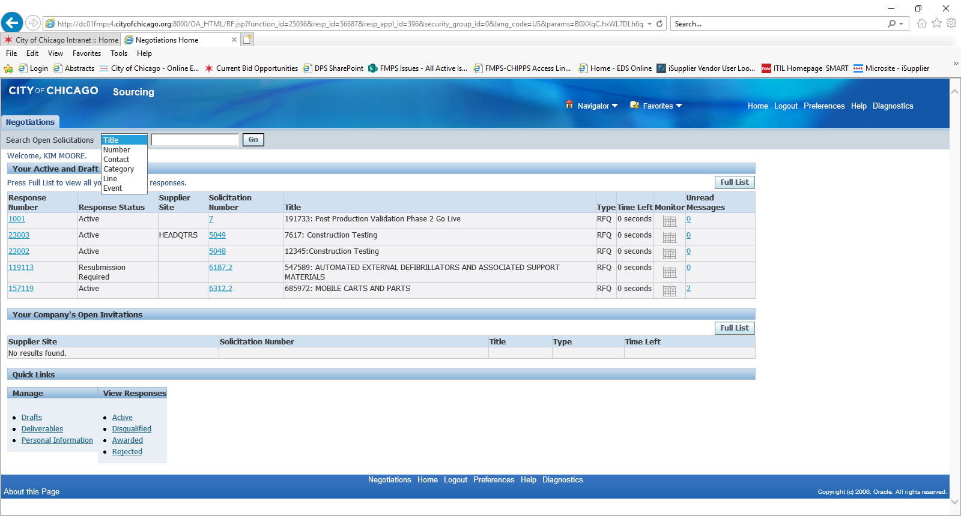
Responding to a Solicitation
Methods of Search for a RFQ or
Specification #
Title: is the Specification #
Number: is the RFQ #
These are the primary methods to search for the RFQ of your interest.

Slide 23
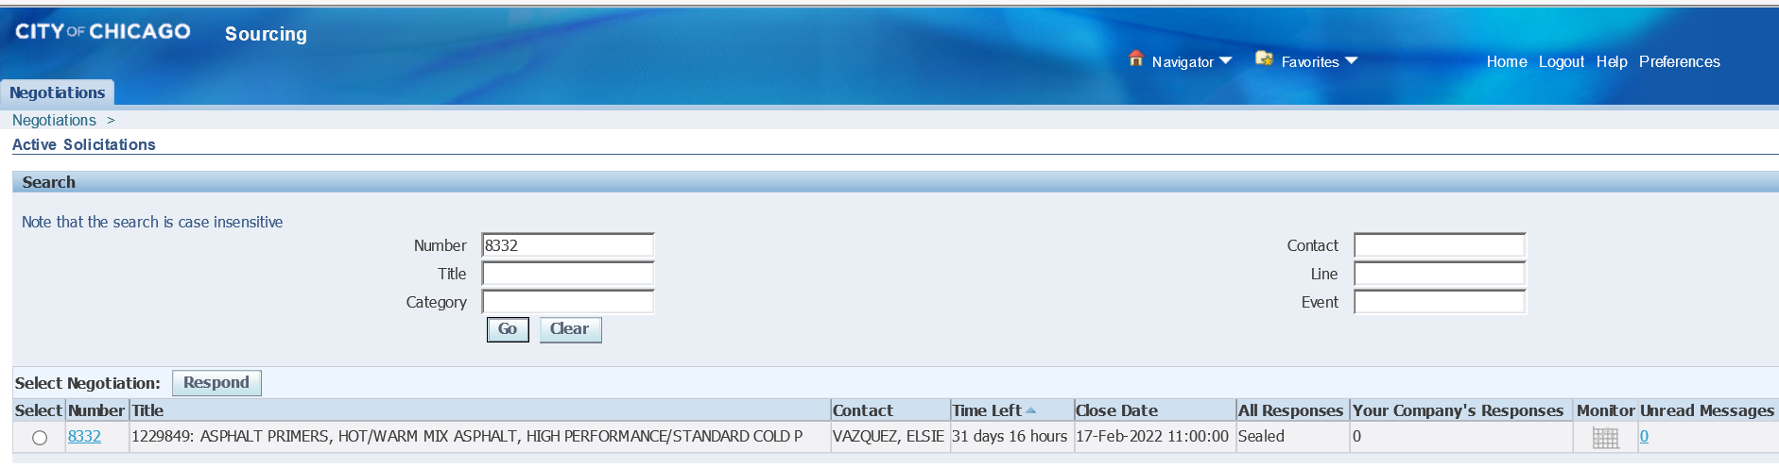
RFQ (number) # Selected
Click Respond
Select & Respond

Slide 24
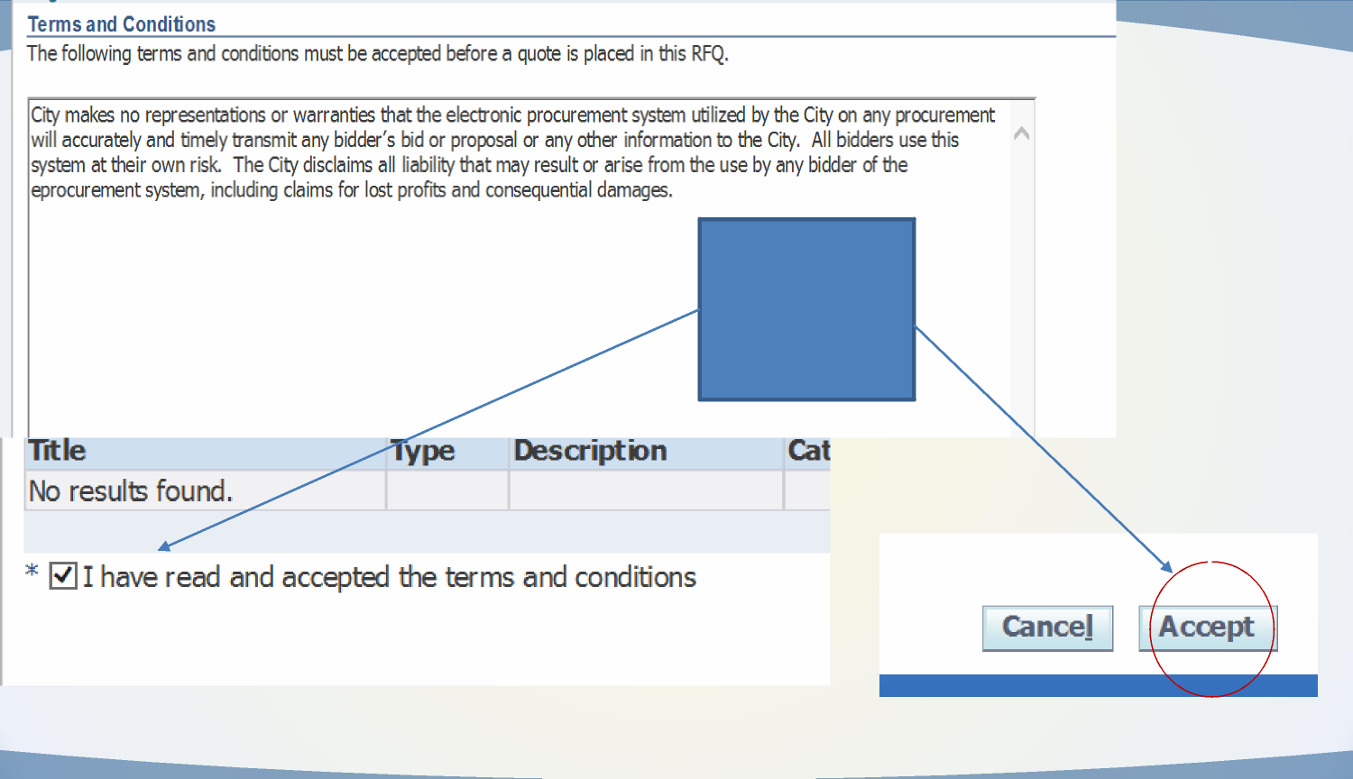
Terms & Conditions Acknowledgement
When you accept
the terms and
conditions your firm
is added to the Take
Out List

Slide 25
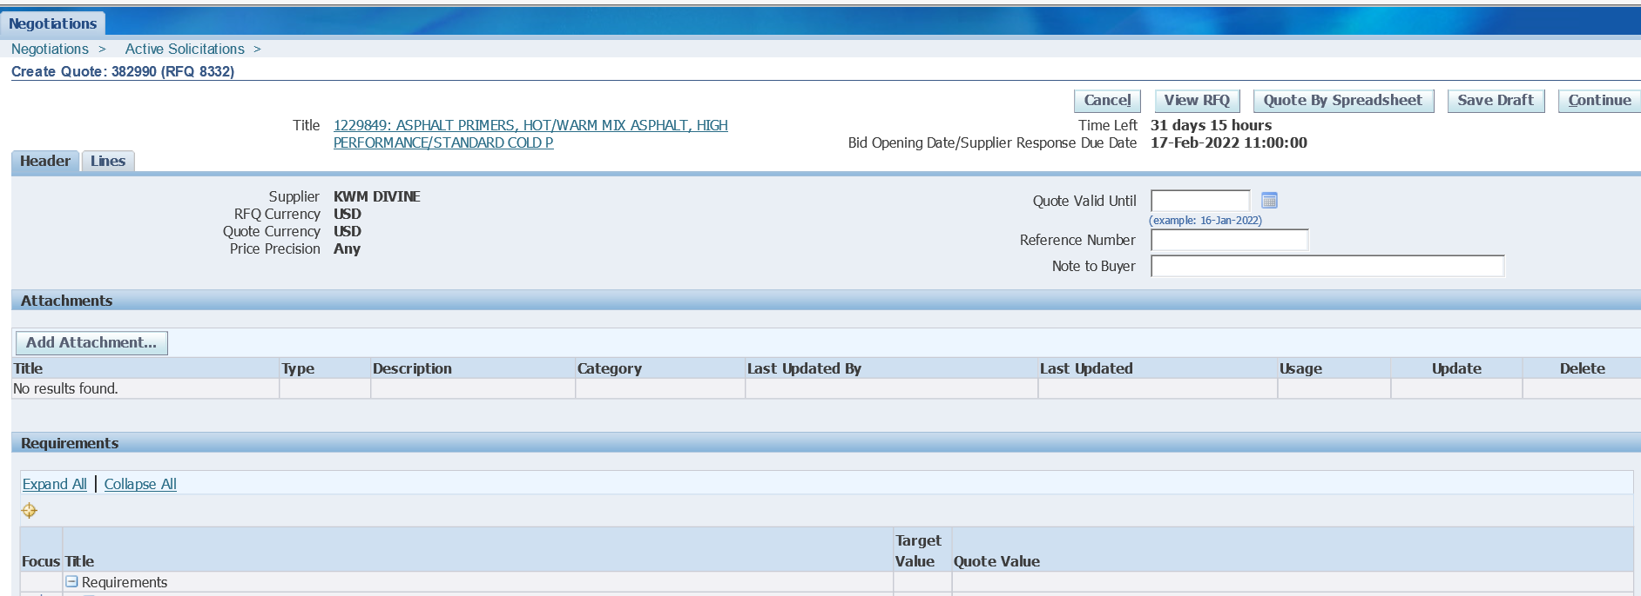
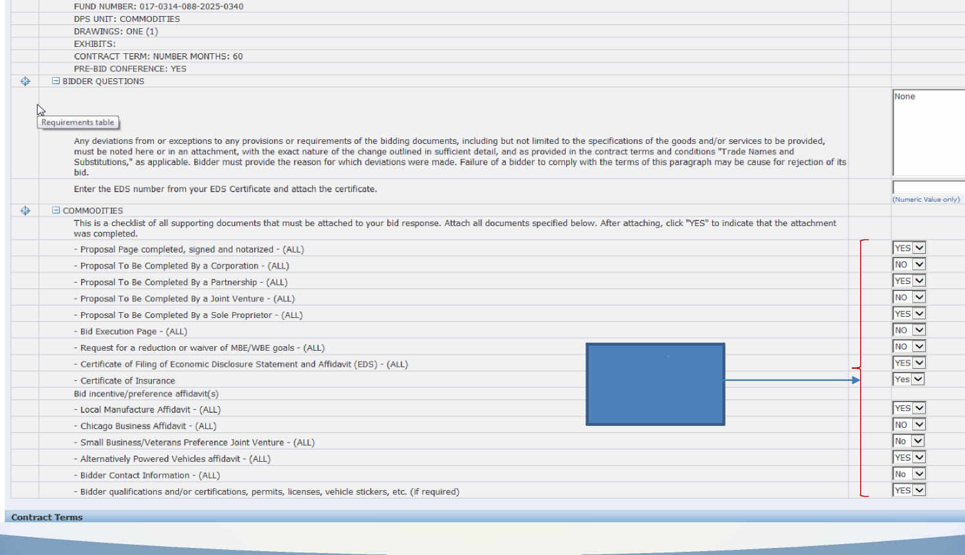
Header Tab Page
Provide a ‘Yes’ or
‘No’ for each
requirement
Provide a ‘Yes’ or
‘No’ for each
requirement

Slide 26
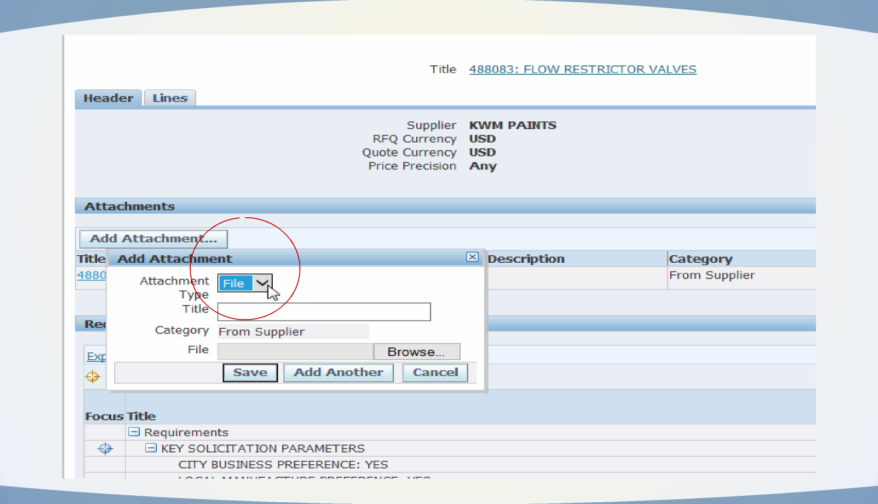
Header Tab Page/Upload
Attachments

Slide 27
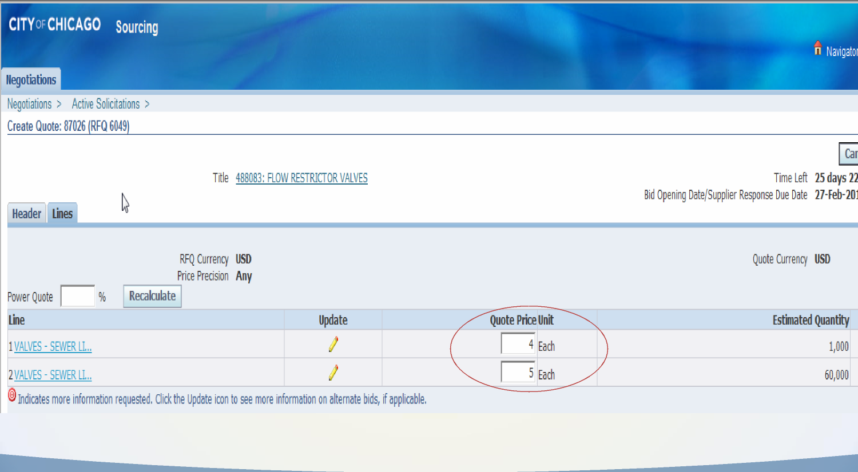
Lines Tab
Enter Pricing

Slide 28
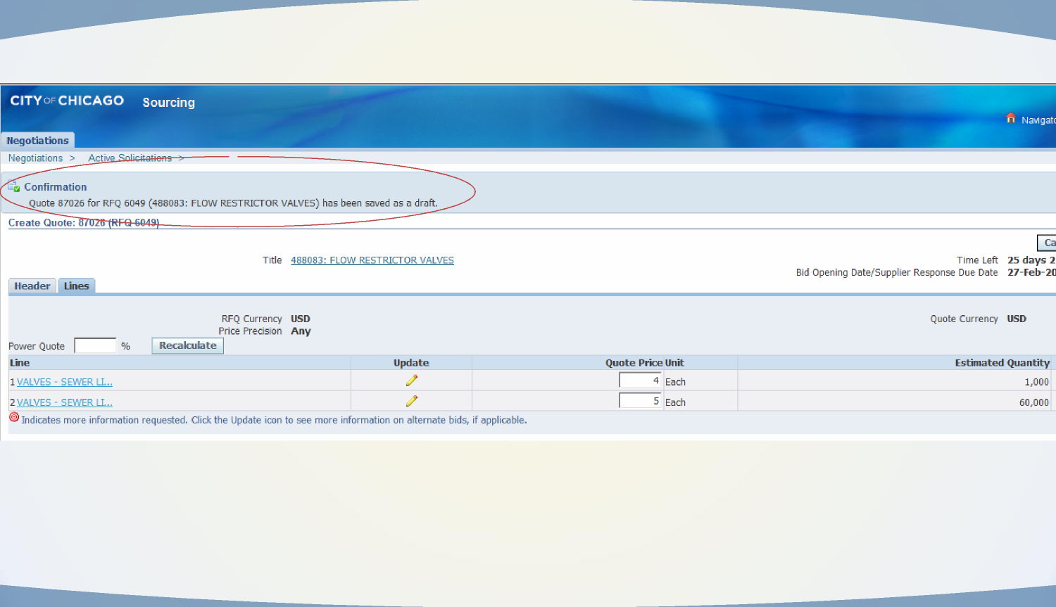
Save & Save
Often / Draft

Slide 29
No Paper Bids
Addenda
Responses
Groups Bid
Help
Items to Note:
Responses must be submitted through eProcurement. Surrogate (paper) responses are not allowed.
Addenda: Acknowledge in the system and on provided acknowledgement forms, if any.
Responses: Fill out the PDF forms, scan and upload as an attachment. Also fill in the total price in the line provided. Submit detailed pricing on the sheets provided. For RFPs, enter 0.01 and enter pricing on the sheets provided.
Groups: Some solicitations provide for bidding by groups, where a bidder can bid on one or more groups. To enter a “NO BID” for a group, enter 0.0000000001 for all lines in the group.
Assistance: Contact the eProcurement Help Desk, 312-744-HELP, or customersupport@cityofchicago.org for assistance.

Slide 30
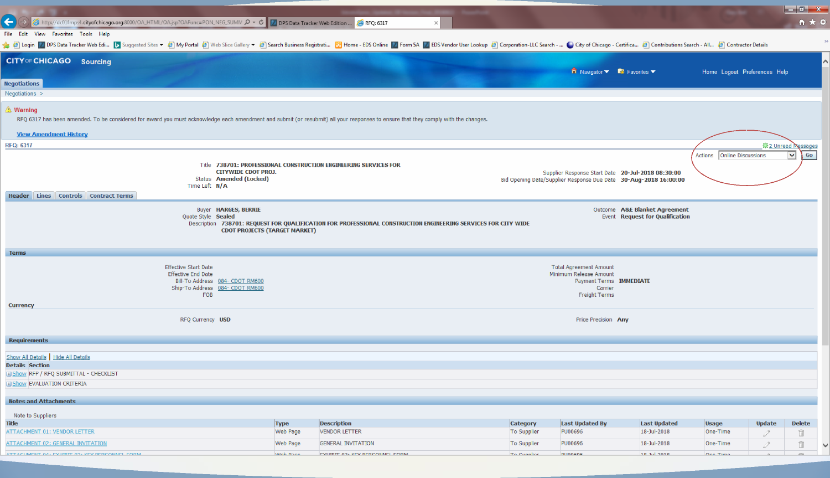
Online Discussions w/
DPS Specialist

Slide 31
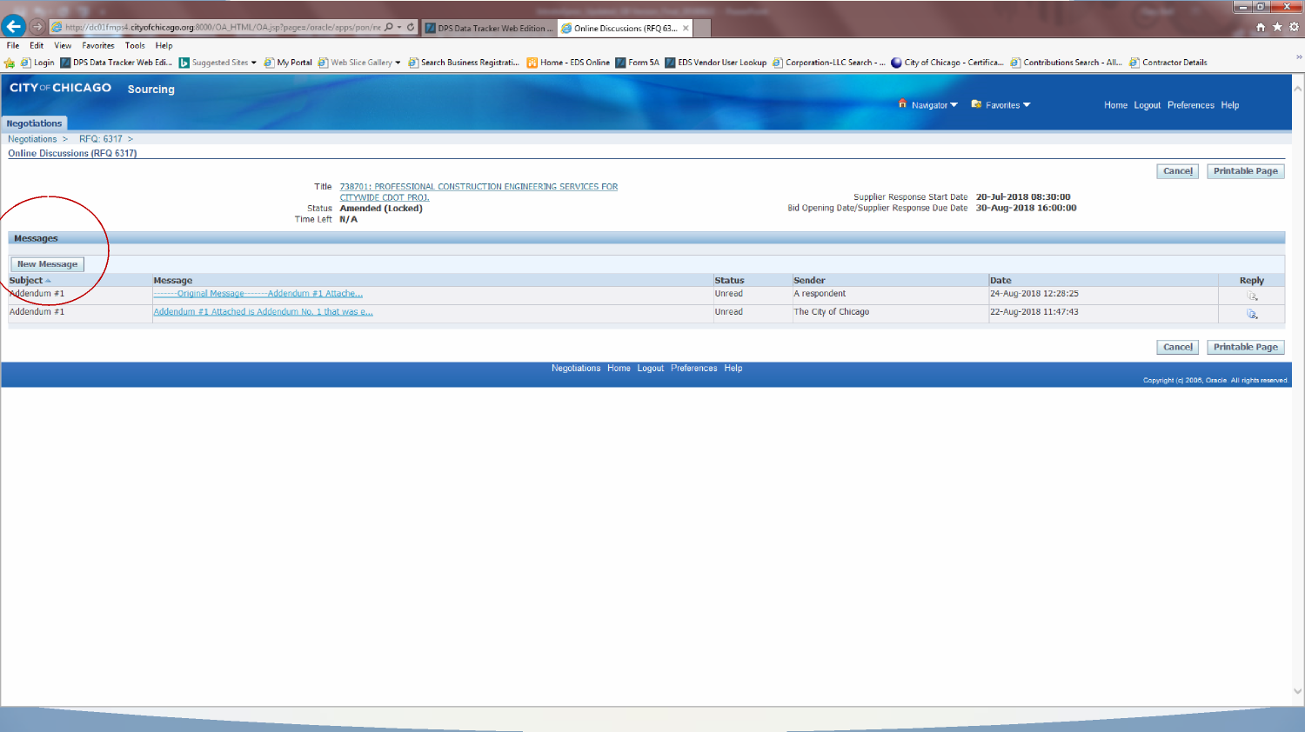
Online Discussions
(cont’d)

Slide 32
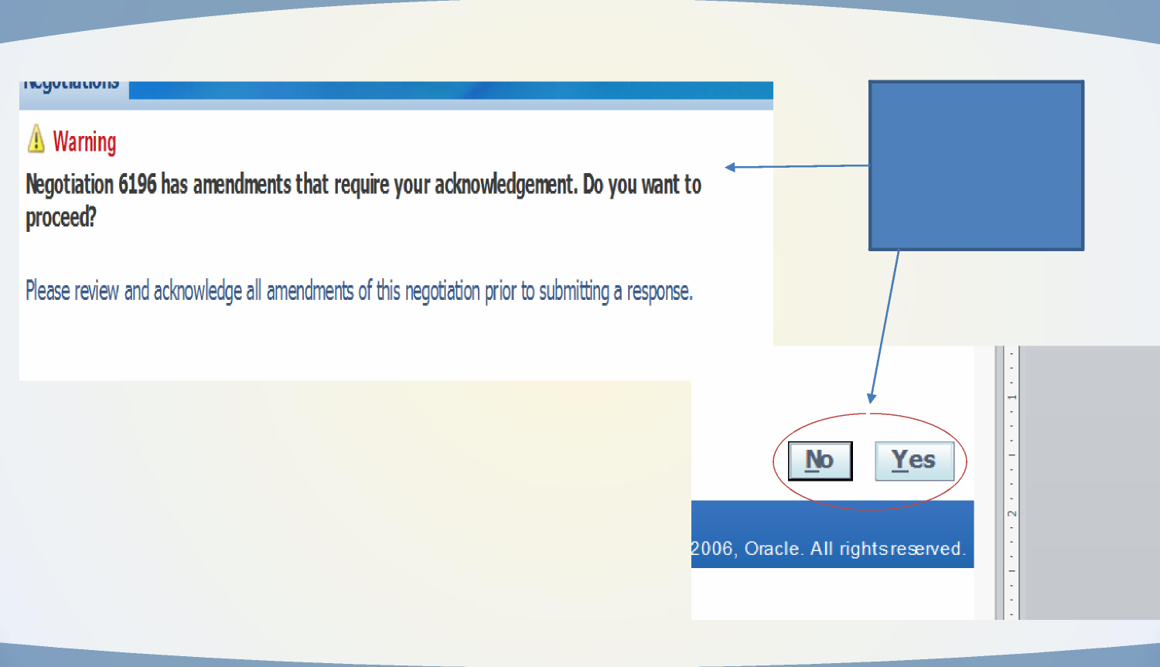
Amendment
Acknowledgement
WHEN YOU
ACKNOWLEDGE YOU
ARE ADDED TO THE
TAKE OUT LIST FOR
THIS SOLICITATION

Slide 33
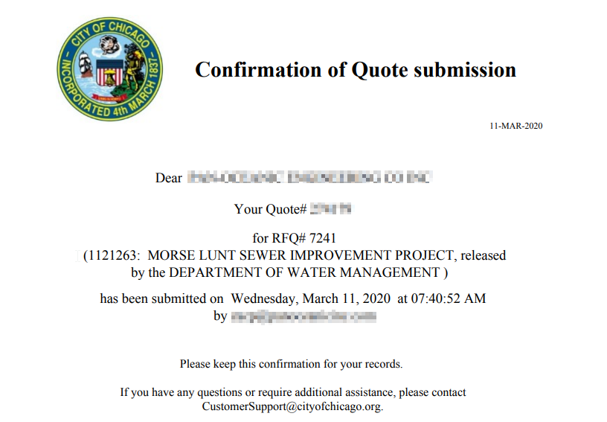
Confirmation of Submission
Make sure you completed electronic signature – if you didn’t do this, your submission is still “Draft” and is not valid.
Look for Quote status of “Active”
You will receive a confirmation email the next day at 7:30 AM.
You still must check for addenda that may be issued after you receive your confirmation – Quote status will change to “Resubmission Required.”

Slide 34
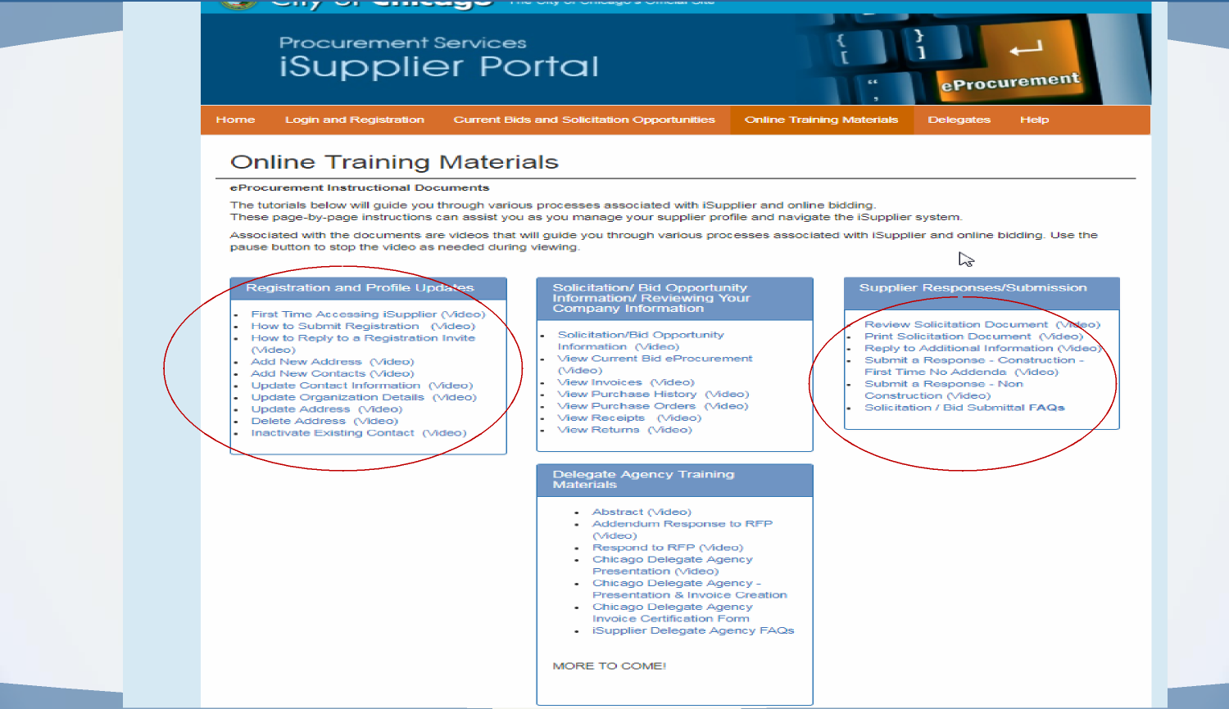
Training Materials

Slide 35
Who to Contact for Assistance
Access Help Page on the iSupplier Portal – information on this page
Questions on Registration: Contact 312-744-HELP or email to customersupport@chicago.gov (Mon. – Fri., 8:30 a.m. to 4:30 p.m.)
Training Materials (Documents and Videos):
https://www.chicago.gov/city/en/depts/dps/isupplier/online-training-materials.html

Slide 36

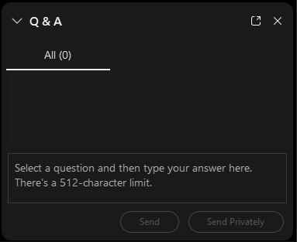
QUESTIONS?
Do you have a question? Please use the WebEx Q&A feature as shown.

Slide 37


FOLLOW US ON SOCIAL MEDIA
@CHICAGODPS
Did you find this workshop helpful? Share it on social media using #DPSWorkshops and spread the word to help the City business community learn about the programs and initiatives available at the City of Chicago.

