Slide 1


WORKING WITH ASSIST AGENCIES
Presented By:
HIRE360
LGBT Chamber of Commerce
Illinois Hispanic Chamber of Commerce

Slide 2
Welcome
The Department of Procurement Services is committed to Communications and Outreach, which is key to keeping citizens informed of bid opportunities, new programs, and innovations.
Also ensure that you download a copy of our most recent Consolidated Buying Plan. This is a 15-month forecast including hundreds of upcoming opportunities for 12 city agencies. To download go to: www.chicago.gov/dps
We encourage you to follow on our website www.chicago.gov/dps for the latest news, updates, and our calender of events. Go online www.chicago.gov/DPS and click on the letter icon and sign-up for our Email Newsletter: DPS Alerts full of news that you can use.
Follow us on social media to stay informed:
Facebook: www.facebook.com/ChicagoDPS
Twitter: www.twitter.com/ChicagoDPS
LinkedIn: www.linkedin.com/company/chicagodps
Youtube: www.YouTube.com/ChicagoDPS
NOTE: As of October 12, 2020, legal advertisements for the City of Chicago Department of Procurement Services (DPS) appear in the Chicago Tribune. Information about DPS contracting opportunities will be available at www.chicago.gov/bids.

Slide 3

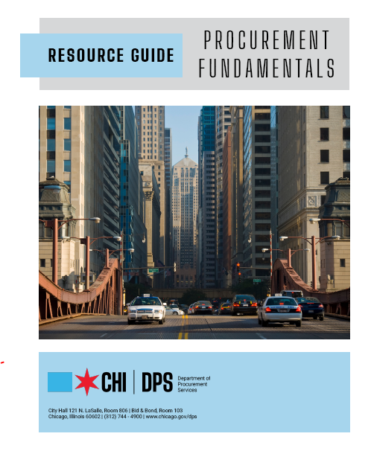







RESOURCE GUIDES
DPS has published a four-volume set of Resource Guides, expanding on the guiding principle of transparency.
The Resource Guides were divided into key areas of the procurement process:
  Contract Administration
  Incentives and Programs
  Certification
  Compliance
Download now at www.chicago.gov/dpsguides
@CHICAGODPS

Slide 4
Today’s Workshop
Everyone is muted upon entry for the presentation portion of the workshop
We ask that you hold your questions to the end of the presentation. You can use the chat feature to type out your question and the speaker will answer the questions at the end of the presentation.
To Send a Question: Use only the Q & A panel to ask your question. Do not use the chat panel
  Use the Q & A panel on the right side of your screen.
  In the Send to or To drop-down list, select the recipient of the message.
  Enter your message in the chat text box, then press Enter on your keyboard.
  Note: If you join a meeting, session, or event in progress, you can see only the Q & A that participants send after you join.

Slide 5
HIRE360
HIRE360 is a non-profit that connects community members with careers in the trades, focusing employment opportunities through recruiting, training, and placement assistance; invest capital in helping minority- and women-owned businesses grow and thrive; connect area youth, underrepresented populations, and local residents with job inspiration and opportunities; and model socially responsible hiring and supply chain accountability in Chicago and beyond.

Slide 6
WORKING WITH ASSIST AGENCIES
Presented By:
Chynna Hampton
HIRE360
Notes:
Ve

Slide 7
Industry Lead – Community Focused

Slide 8
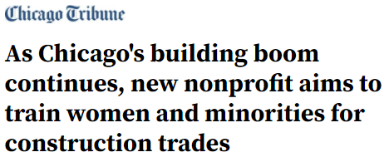
Our Journey - Bringing Industry Stakeholders Together
3 Groups that formed HIRE360
CAGC Table – Largest Developers, Trade Unions, and General Contractor Leaders on that Mayor’s Executive Order
Public Sector Table – Agencies who build pushing the construction industry to do more
CFL and United Way – launched a workforce pilot based on national model WRTP
HIRE360 Launch – January 2020

Slide 9
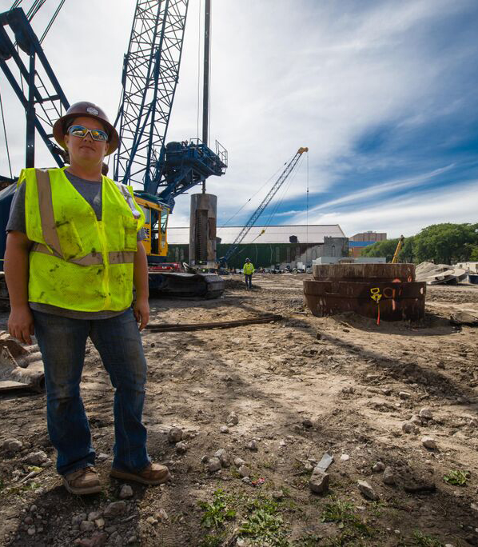
Why
Too many Chicagoans work multiple low-wage jobs and still struggle to make ends meet
Opportunities in Construction
More than $100 billion in new construction projects will break ground in Chicago over the next 15 years.
“Grey Tsunami” of Journey Workers
Increased Participation Goals giving diverse candidates a better opportunity
By 2020-Apprenticeable occupations in the US are projected to grow by 22.5%
Time is now for under-represented populations

Slide 10

Who
HIRE360 is a unique partnership among Organized Labor, Philanthropy, Developers, and Contractors

Slide 11
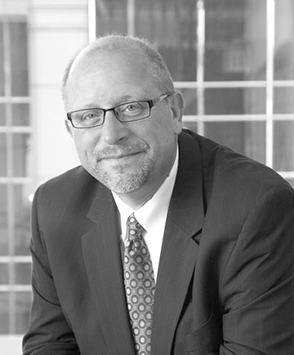
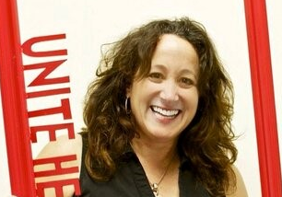
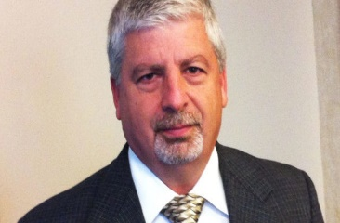
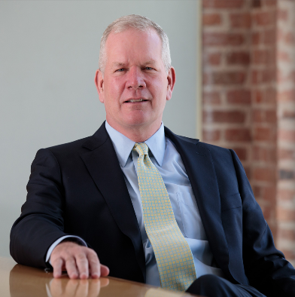
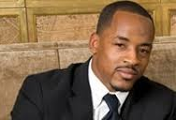
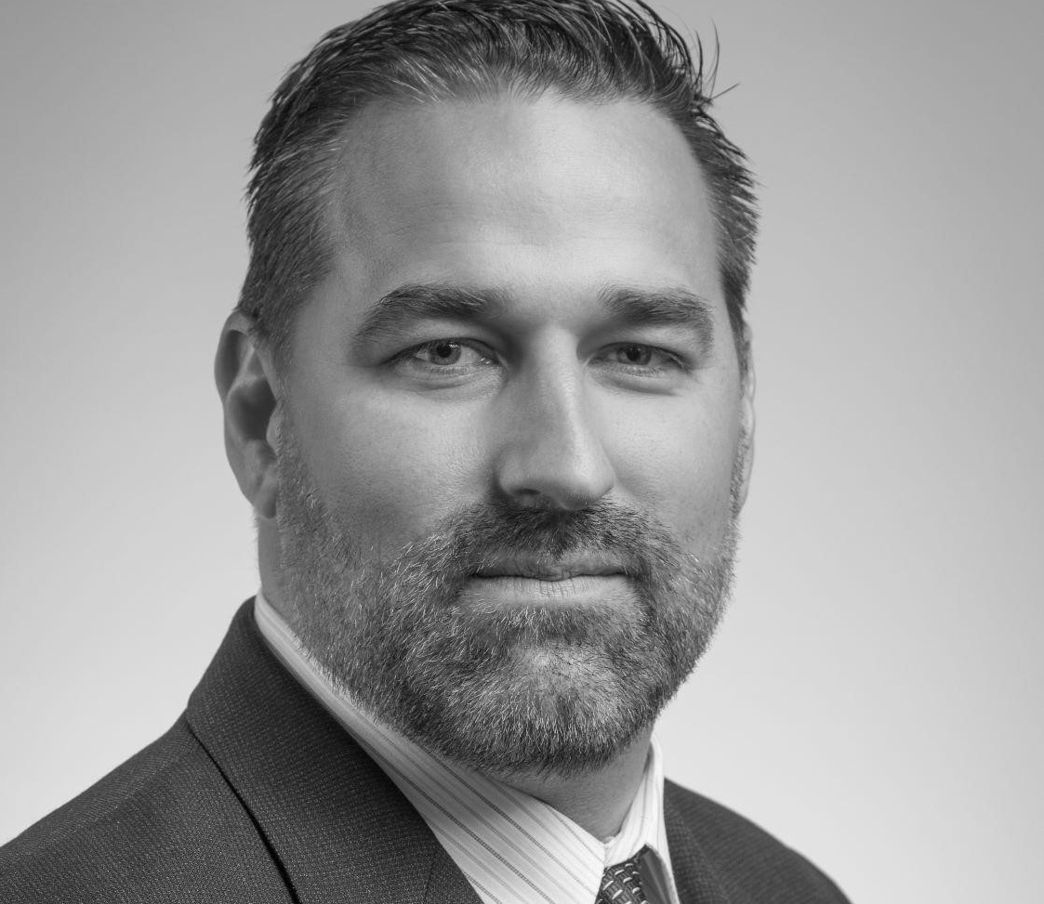
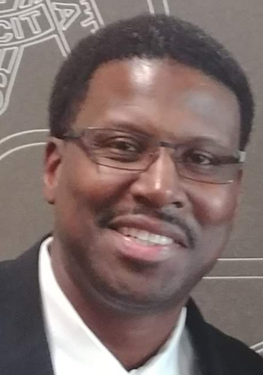
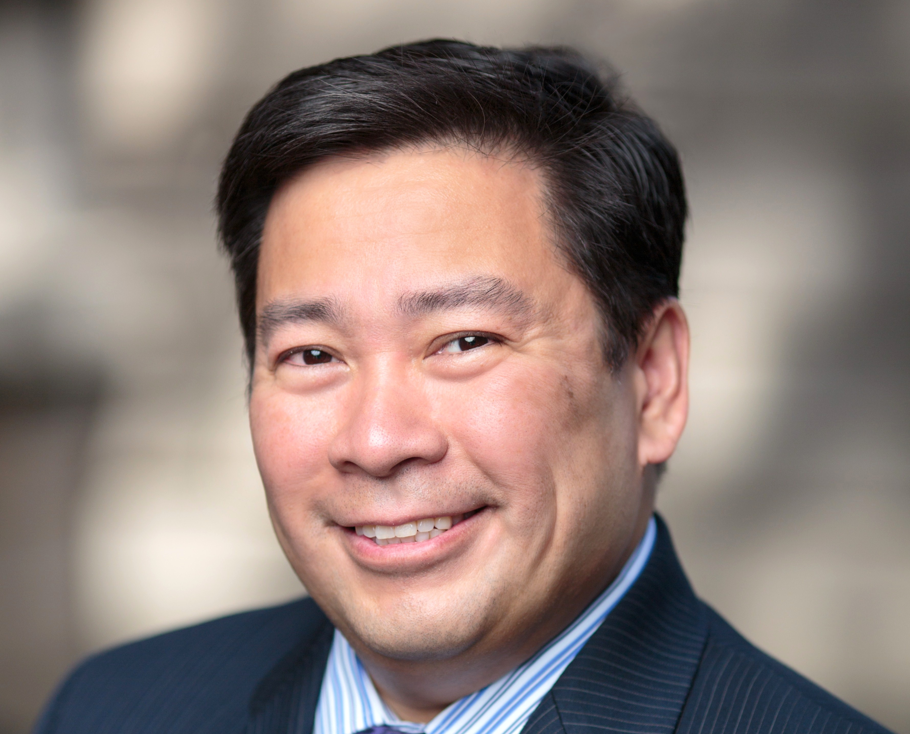
Board of Directors
Don Biernacki: Board Chair
Senior Vice President, Related Midwest
Karen Kent
President, UNITE HERE Local 1
Ralph Affrunti
President, Chicago & Cook County Building Trades Council
Michael Meagher
President, McHugh Construction;
Vice President, Chicagoland Associated General Contractors
Rashied Davis
Co-Founder, Saturday Place
Brian Ortiz
CEO, Trinidad Construction
Jonathan Jones
Business Representative / Organizer, Chicago Regional Council of Carpenters;
President, Labor Brothers United
Don Villar
Secretary-Treasurer, Chicago Federation of Labor

Slide 12
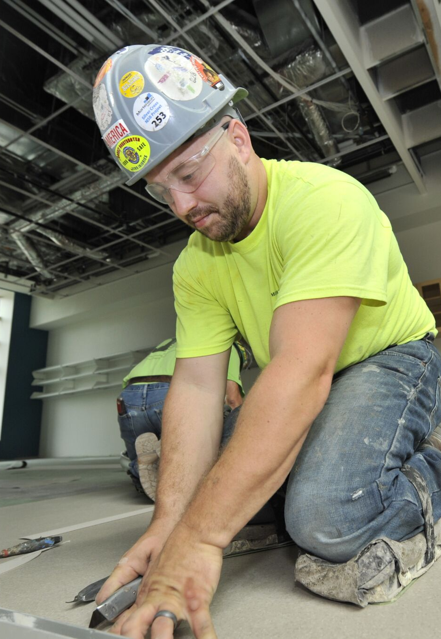

What
4 Pillars
Workforce Development
Scaling Up Diverse Contractors
Supply Chain
Next Chicago Builders

Slide 13
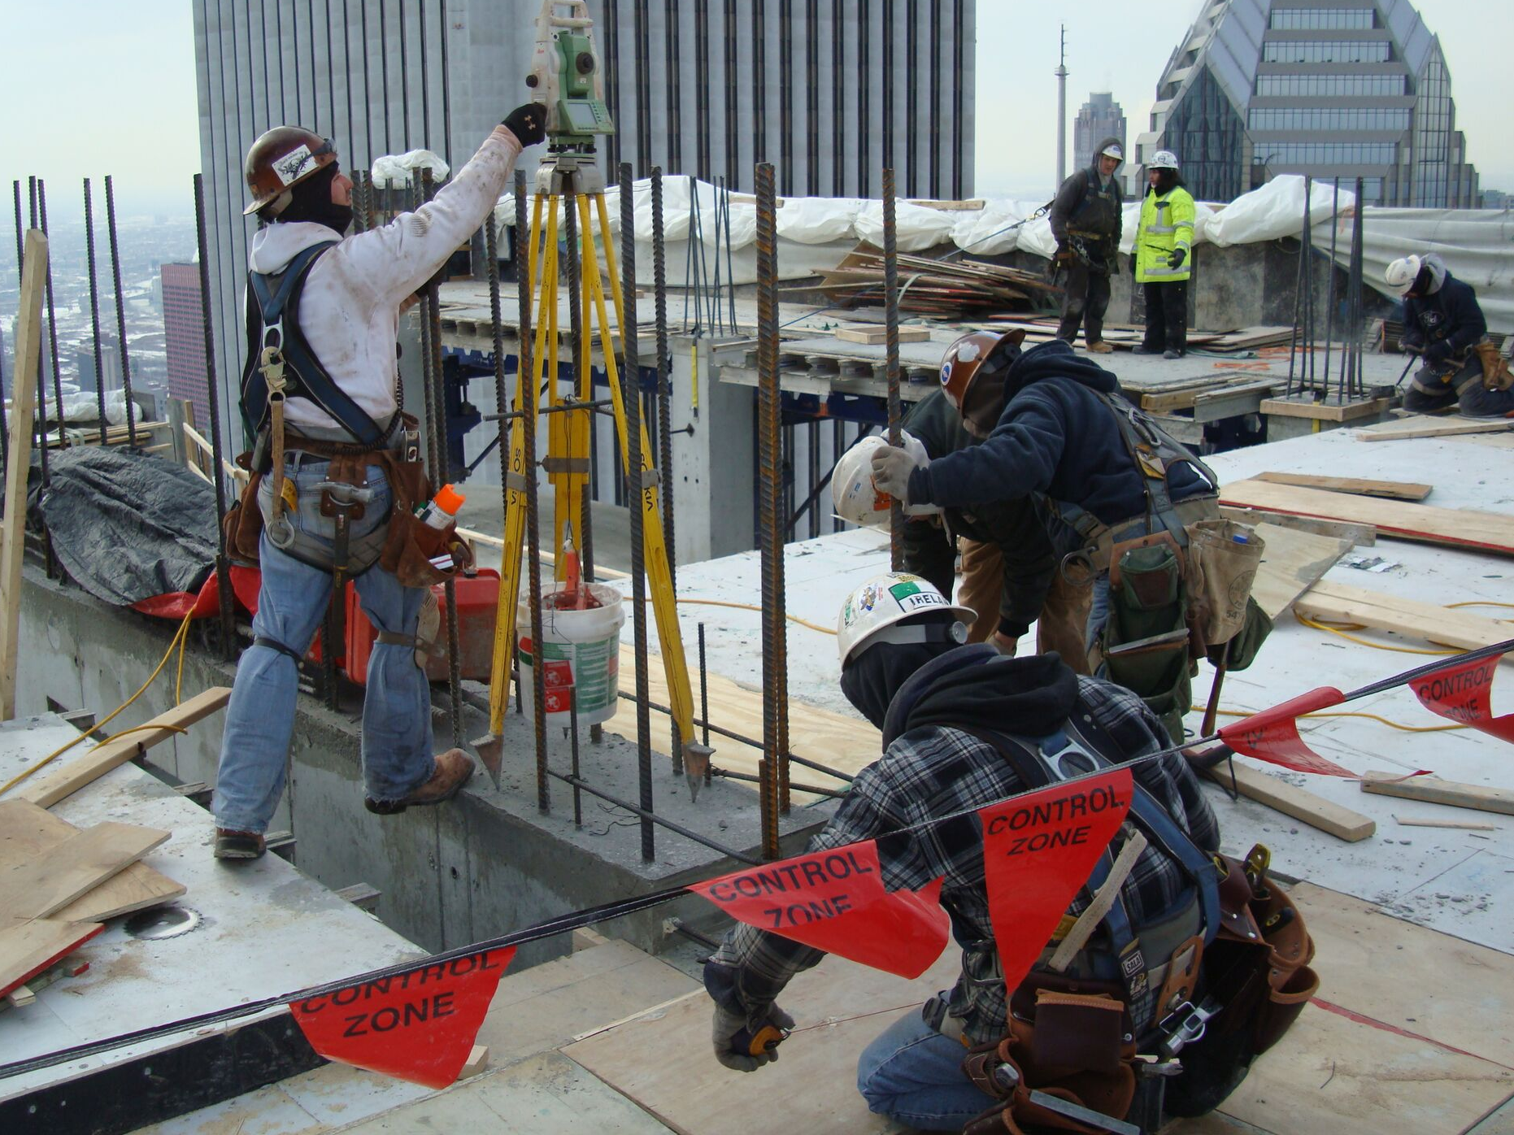
Workforce Development

Slide 14
Workforce Development In A Pandemic
100% Virtual Services
Targeted Outreach
  Outreach to Candidates from Economically Disadvantaged Areas
Virtual Intake & Programming
Barrier Assistance
Virtual Robust Reporting

Slide 15
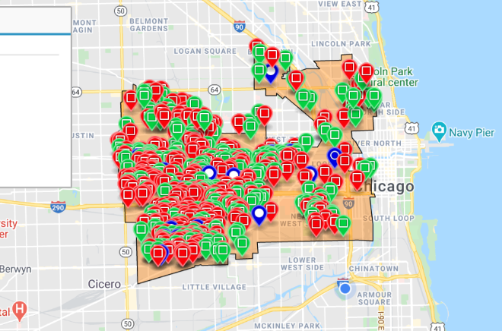
Targeted Outreach

Slide 16
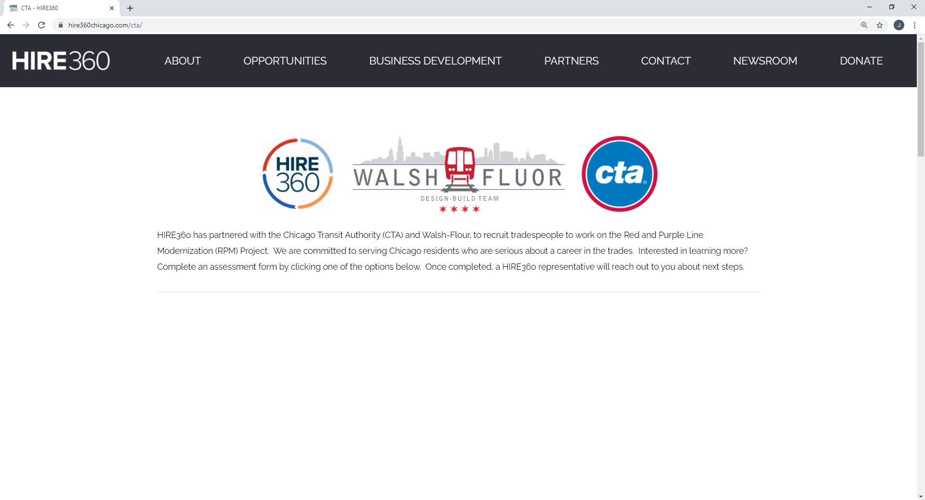
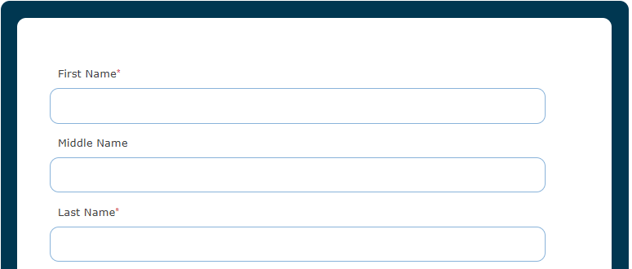
Journey Begins

Slide 17

Walking the Path
Learning about the Trades
Orientation on the trades
Applying for the Trade
1:1 Assessment of skills, barriers, interests
Apprenticeship Ready
Soft skills preparation – resume workshops, mock interviews
Job Clubs to help learn about opportunities
12 hours of Test Prep focused on Math and Spatial and 1:1 tutoring through CTUF
Tours of training centers and talks by industry leaders
Supported as an Apprentice
First set of tools, boots and other costs paid for via Barrier Reduction Fund
Reconnections to work
Assigned a Mentor to show you the ropes
Connections with Contractors for sponsorship
Taking the Sample Test
Navigating the apprenticeship application process
Study Halls

Slide 18
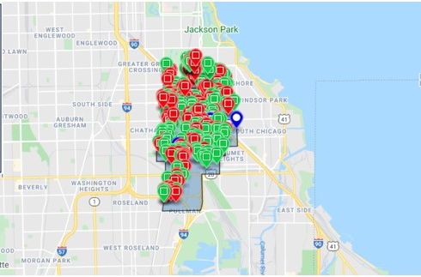
Virtual Robust Reporting

Slide 19
For more Information HIRE360Chicago.com
Chynna Hampton
CHampton@HIRE360Chicago.com

Slide 20
LGBT Chamber of Commerce of Illinois
LGBT Chamber of Commerce of Illinois is the business voice of the LGBTQ+ community, the largest advocacy organization dedicated to expanding economic opportunities and advancements for LGBTQ+ people, and the exclusive certifying body for LGBT-owned businesses. The LGBT Chamber of Commerce has built awareness about LGBTQ+ businesses, as well as sharing information with their members about opportunities and resources at the City of Chicago.

Slide 21
WORKING WITH ASSIST AGENCIES
Presented By:
Jerome Holston
LGBT Chamber of Commerce of Illinois

Slide 22
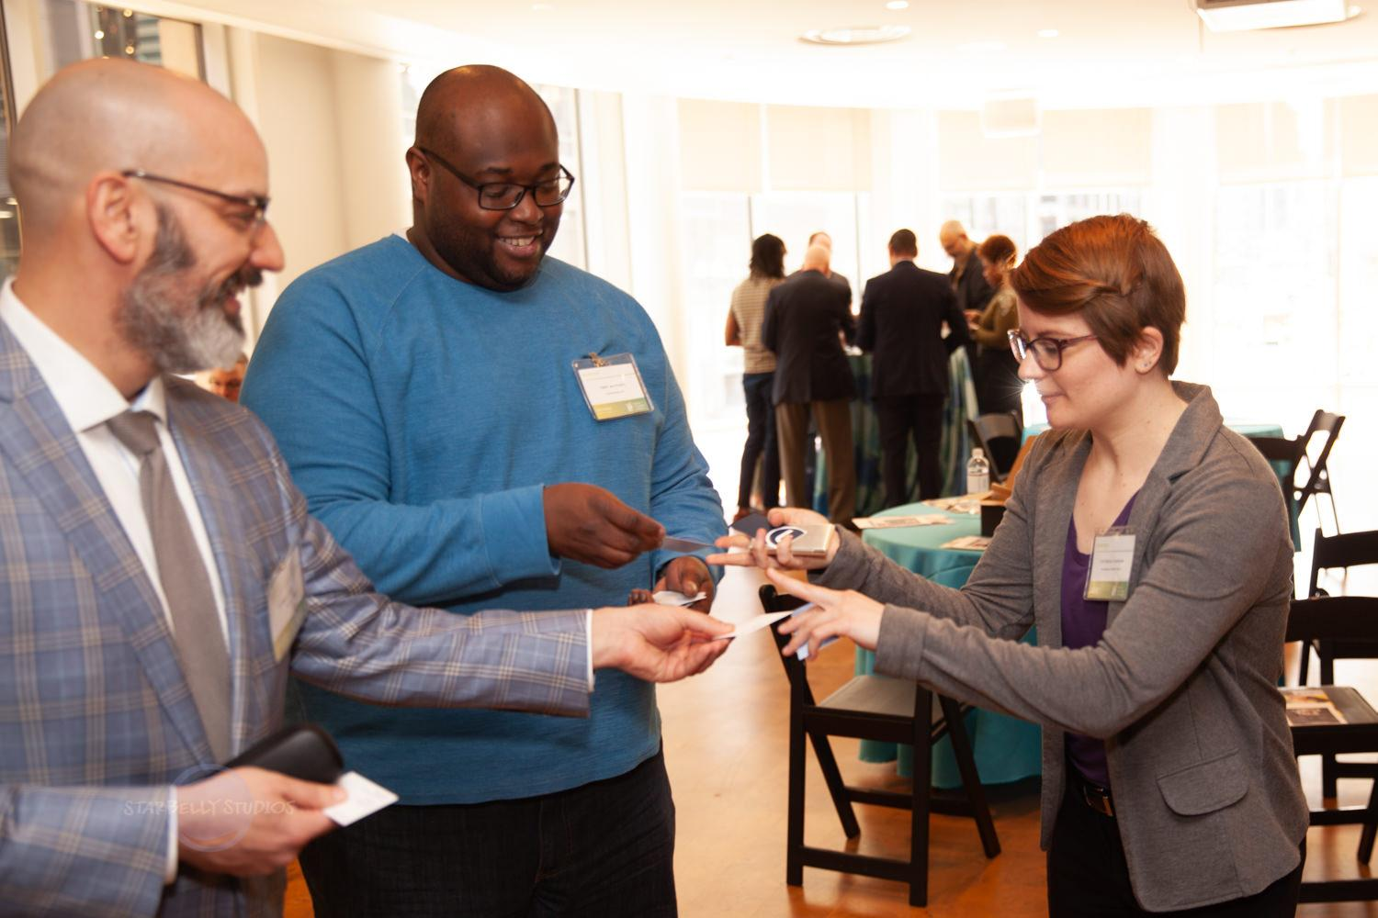
LGBT Business Enterprise Certification
May 26, 2021

Slide 23
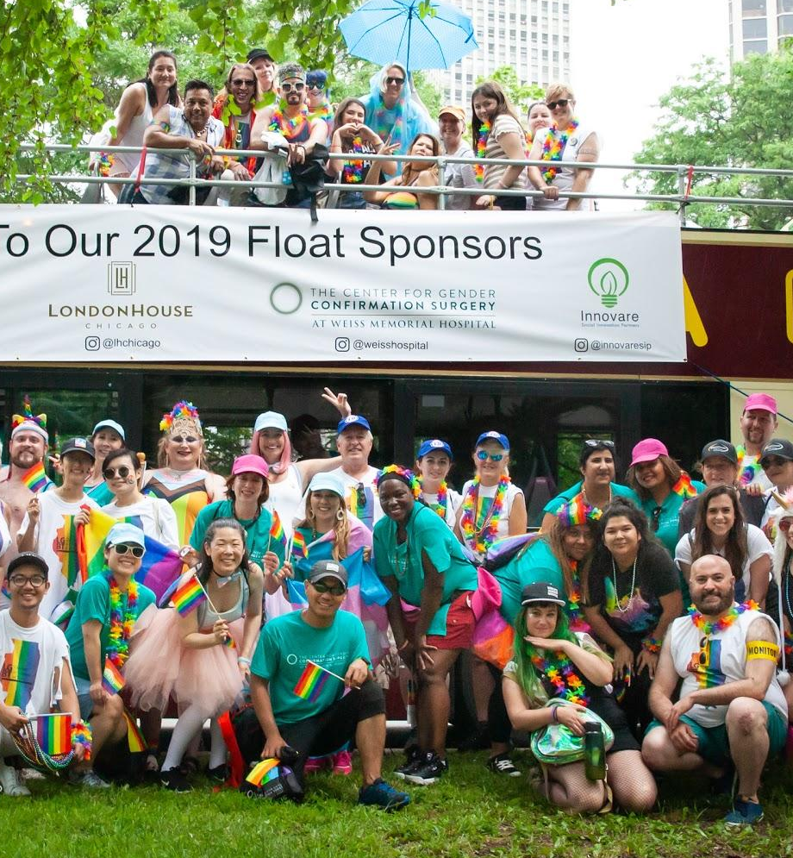
Our Mission
To promote economic opportunities for the LGBT Community by being an advocate and resource for all member businesses that encourage equality.
Our Members
Our Resources
Fortune 500
Small Businesses
Nonprofits
Government
Networking
Marketing
Professional
Development
Advocacy

Slide 24

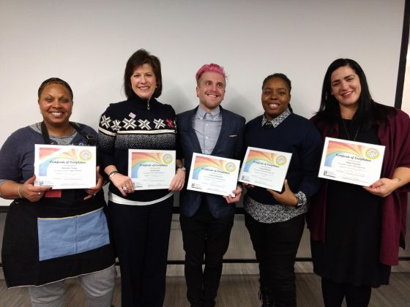
Resources
Networking
  70+ Events
  Affinity Network Groups: Young Professionals, LatinX, Women, and Black
Marketing
  Public Directory Listing
  Chicago PRIDE Business Expo
Professional Development
  LGBTQ+ Biz Bootcamp
Advocacy
  LGBT Business Enterprise Certification

Slide 25

LGBT Business Enterprise Certification
51% LGBT Owned
Headquarters in the United States
Formed as legal entity in the United States
Independent from non-LGBT business enterprise
www.nglcc.com/org-certified

Slide 26


Slide 27

Corporate Partners

Slide 28
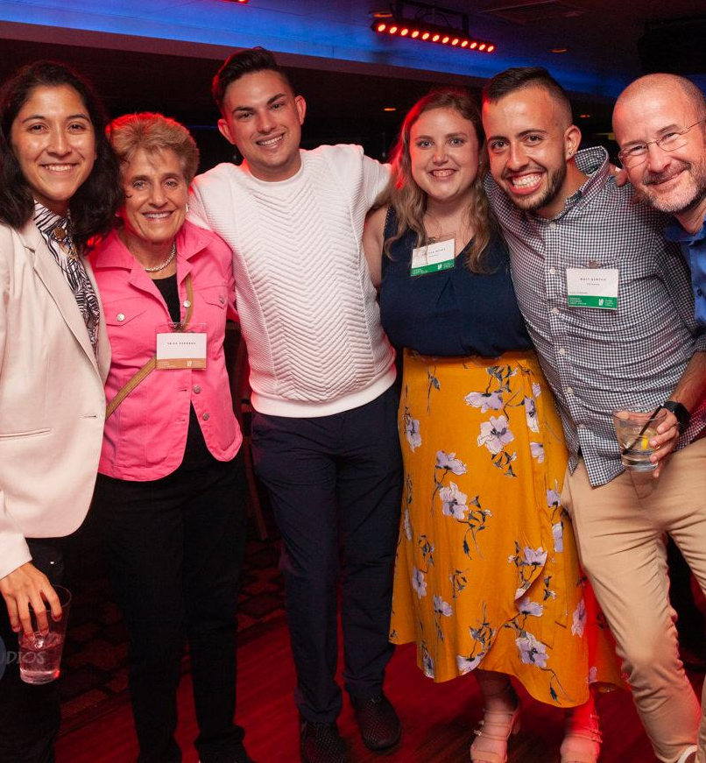
Join Us!
5/27 Illinois LGBTQ+ Business Roundtable
6/10 PRIDE Connect: Multichamber Networking
6/17 & 6/24 PRIDE Support Workshops
On The Horizon
25th Anniversary
Affinity Networking Series
LGBTQ+ Biz Bootcamp
Statewide Engagement
LGBTBE Recognition
Collaboration

Slide 29

THANK YOU
JEROME’ HOLSTON (Jeremy)
Director, LGBTCC
jholston@lgbtcc.com
773.303.0167
lgbtcc.com
lgbtcc.com/foundation

Slide 30
Illinois Hispanic Chamber of Commerce
Illinois Hispanic Chamber of Commerce is the leading Hispanic business, networking, advocacy, and development organization in Illinois. Founded in 1990 as the Mexican American Chamber of Commerce of Illinois, IHCC is now the largest community of Hispanic business owners in Illinois and the Midwest. IHCC works to cultivate knowledge, connections, and collaboration to effect transformational social change and achieve sustainable economic impact through entrepreneurship.

Slide 31
WORKING WITH ASSIST AGENCIES
Presented By:
Angie Alonso
PTAC (Illinois Procurement Technical Assistance Center) Director
Illinois Hispanic Chamber of Commerce
Notes:
Ve

Slide 32


Slide 33


Slide 34
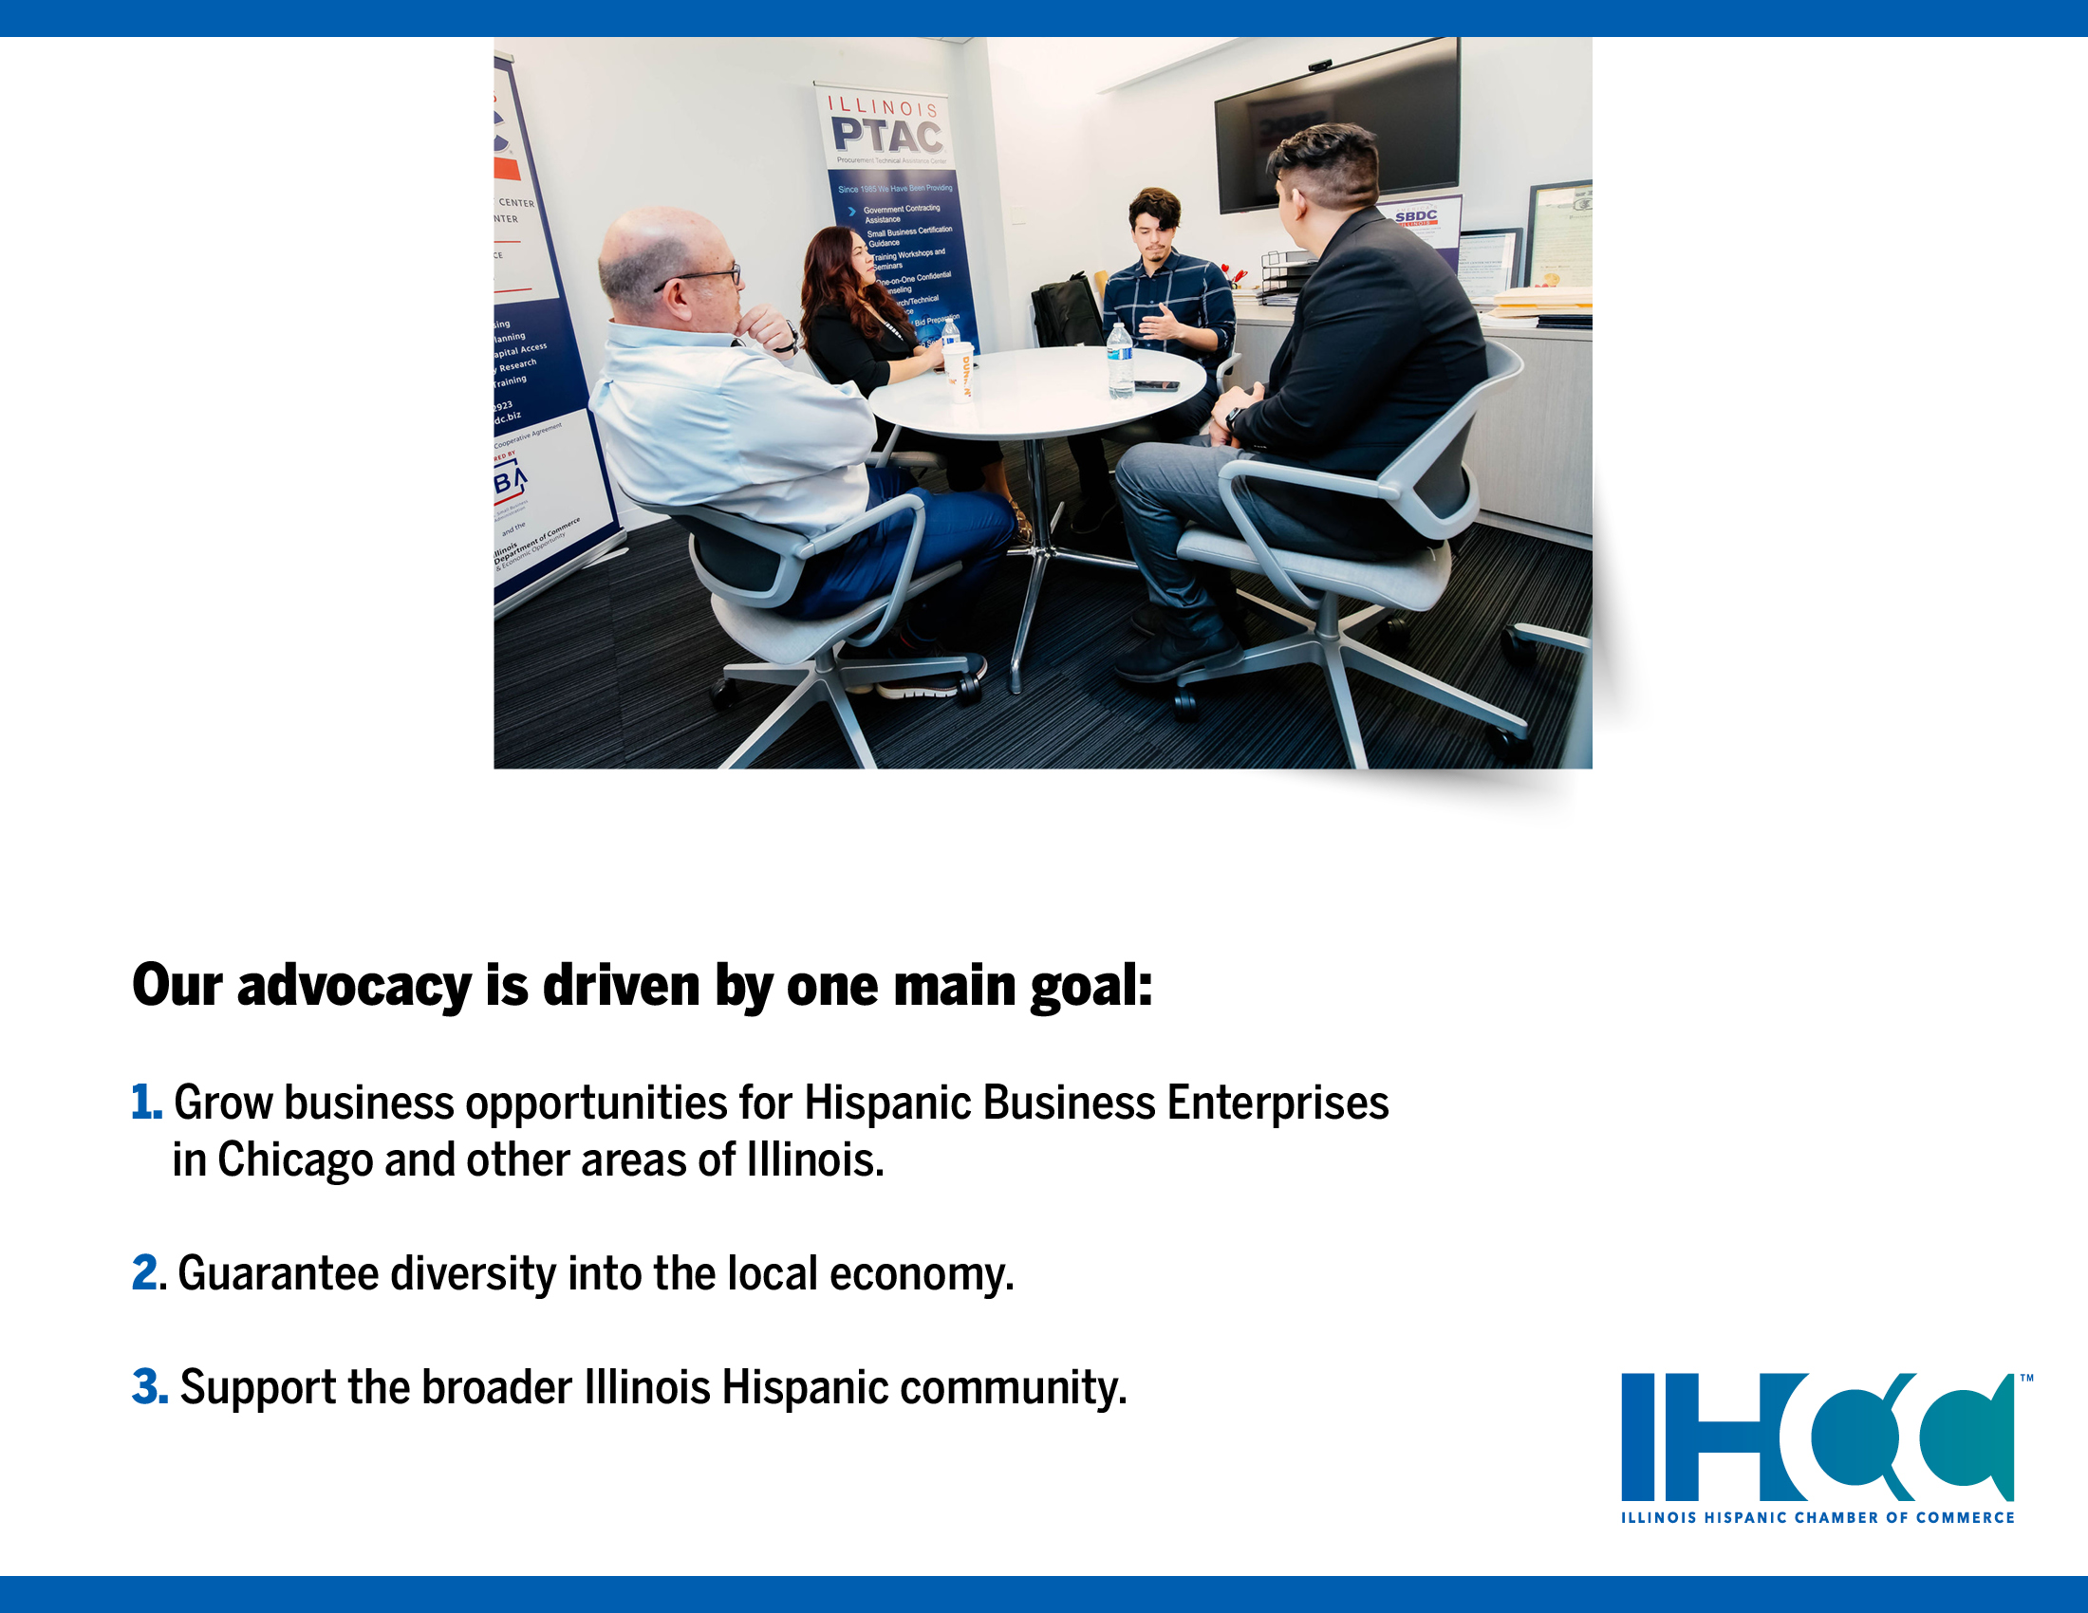

Slide 35
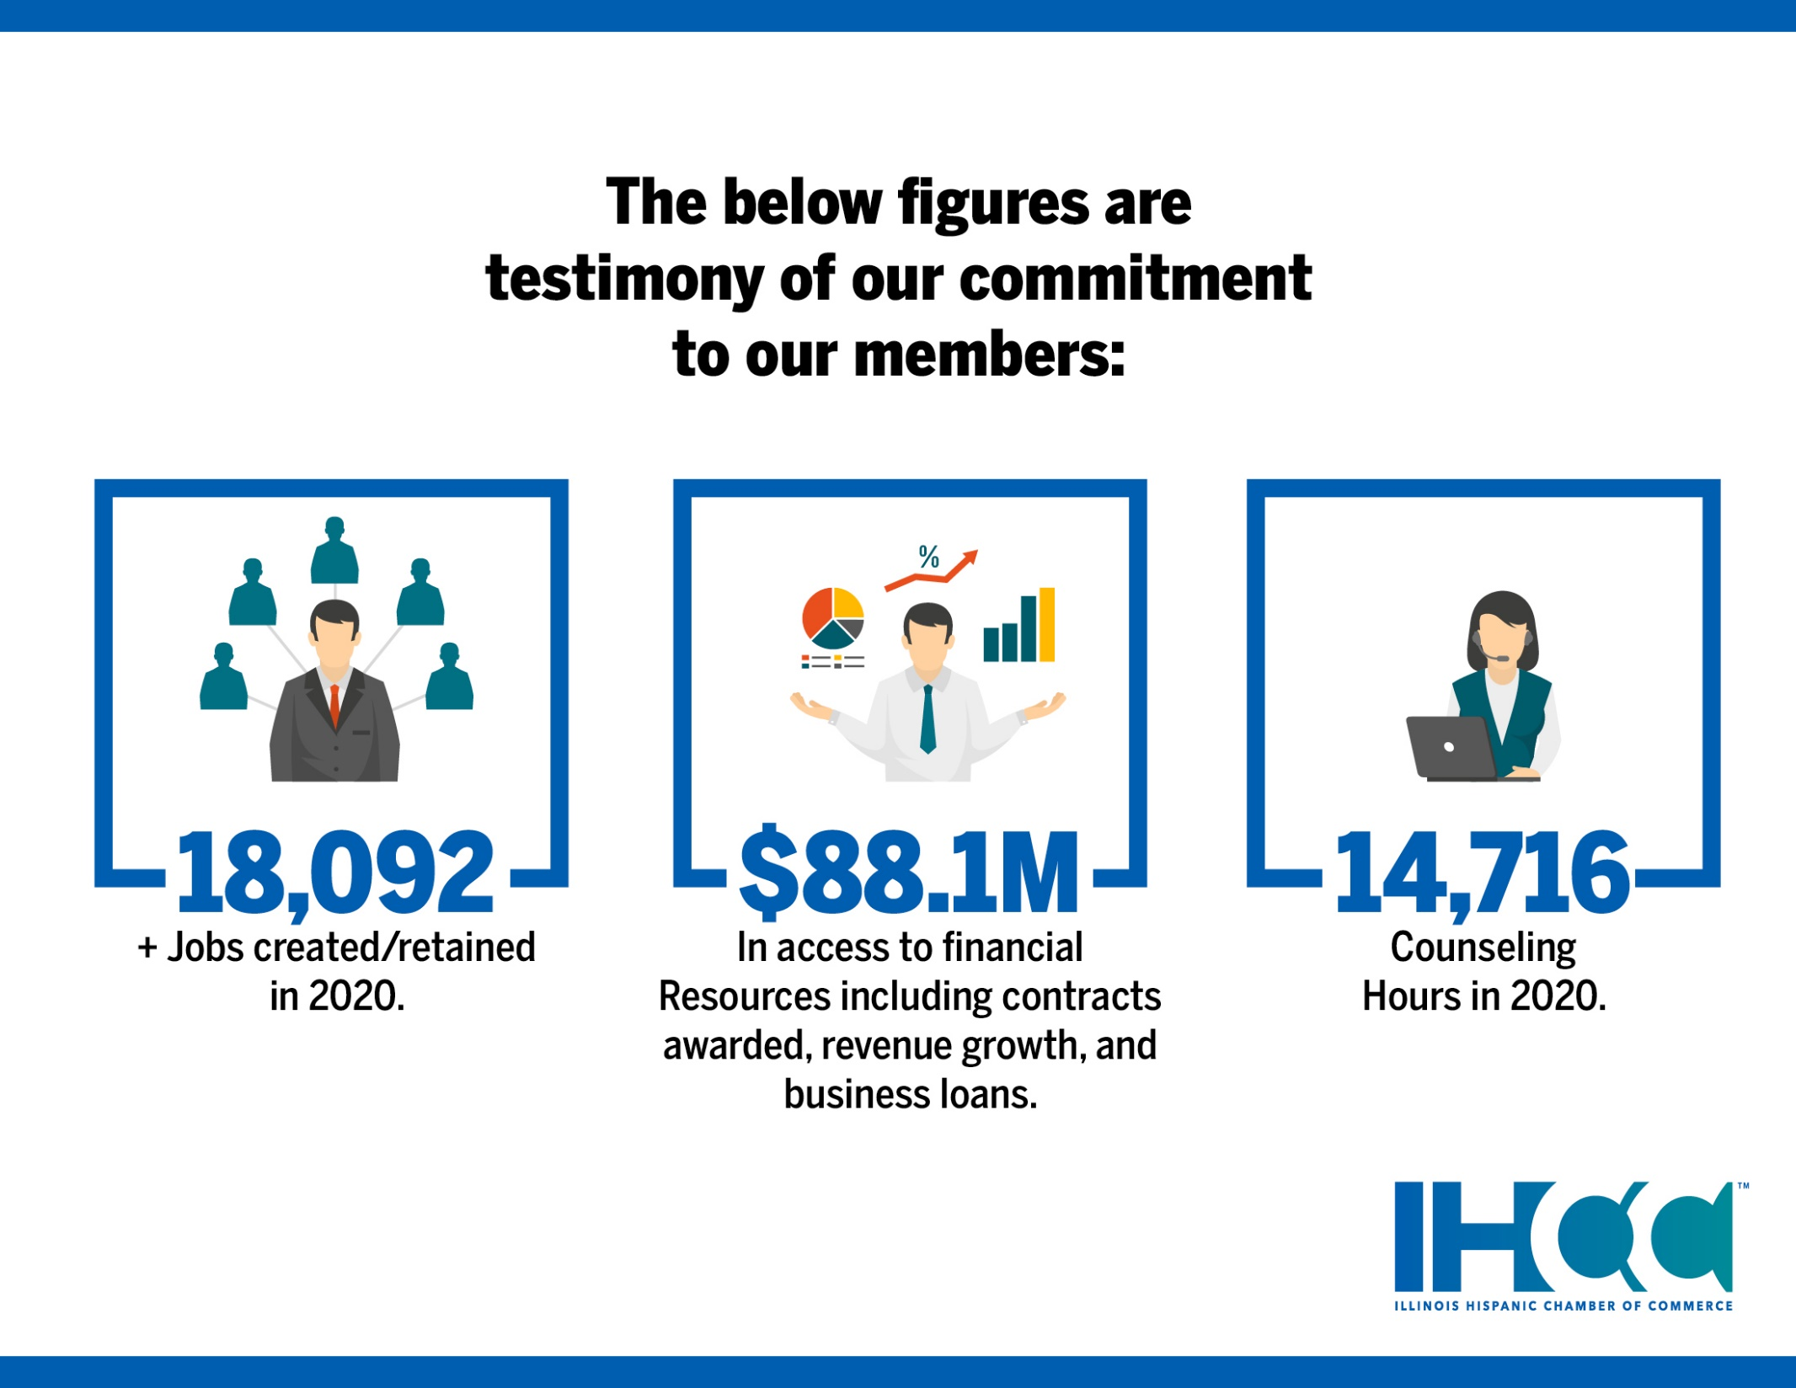

Slide 36
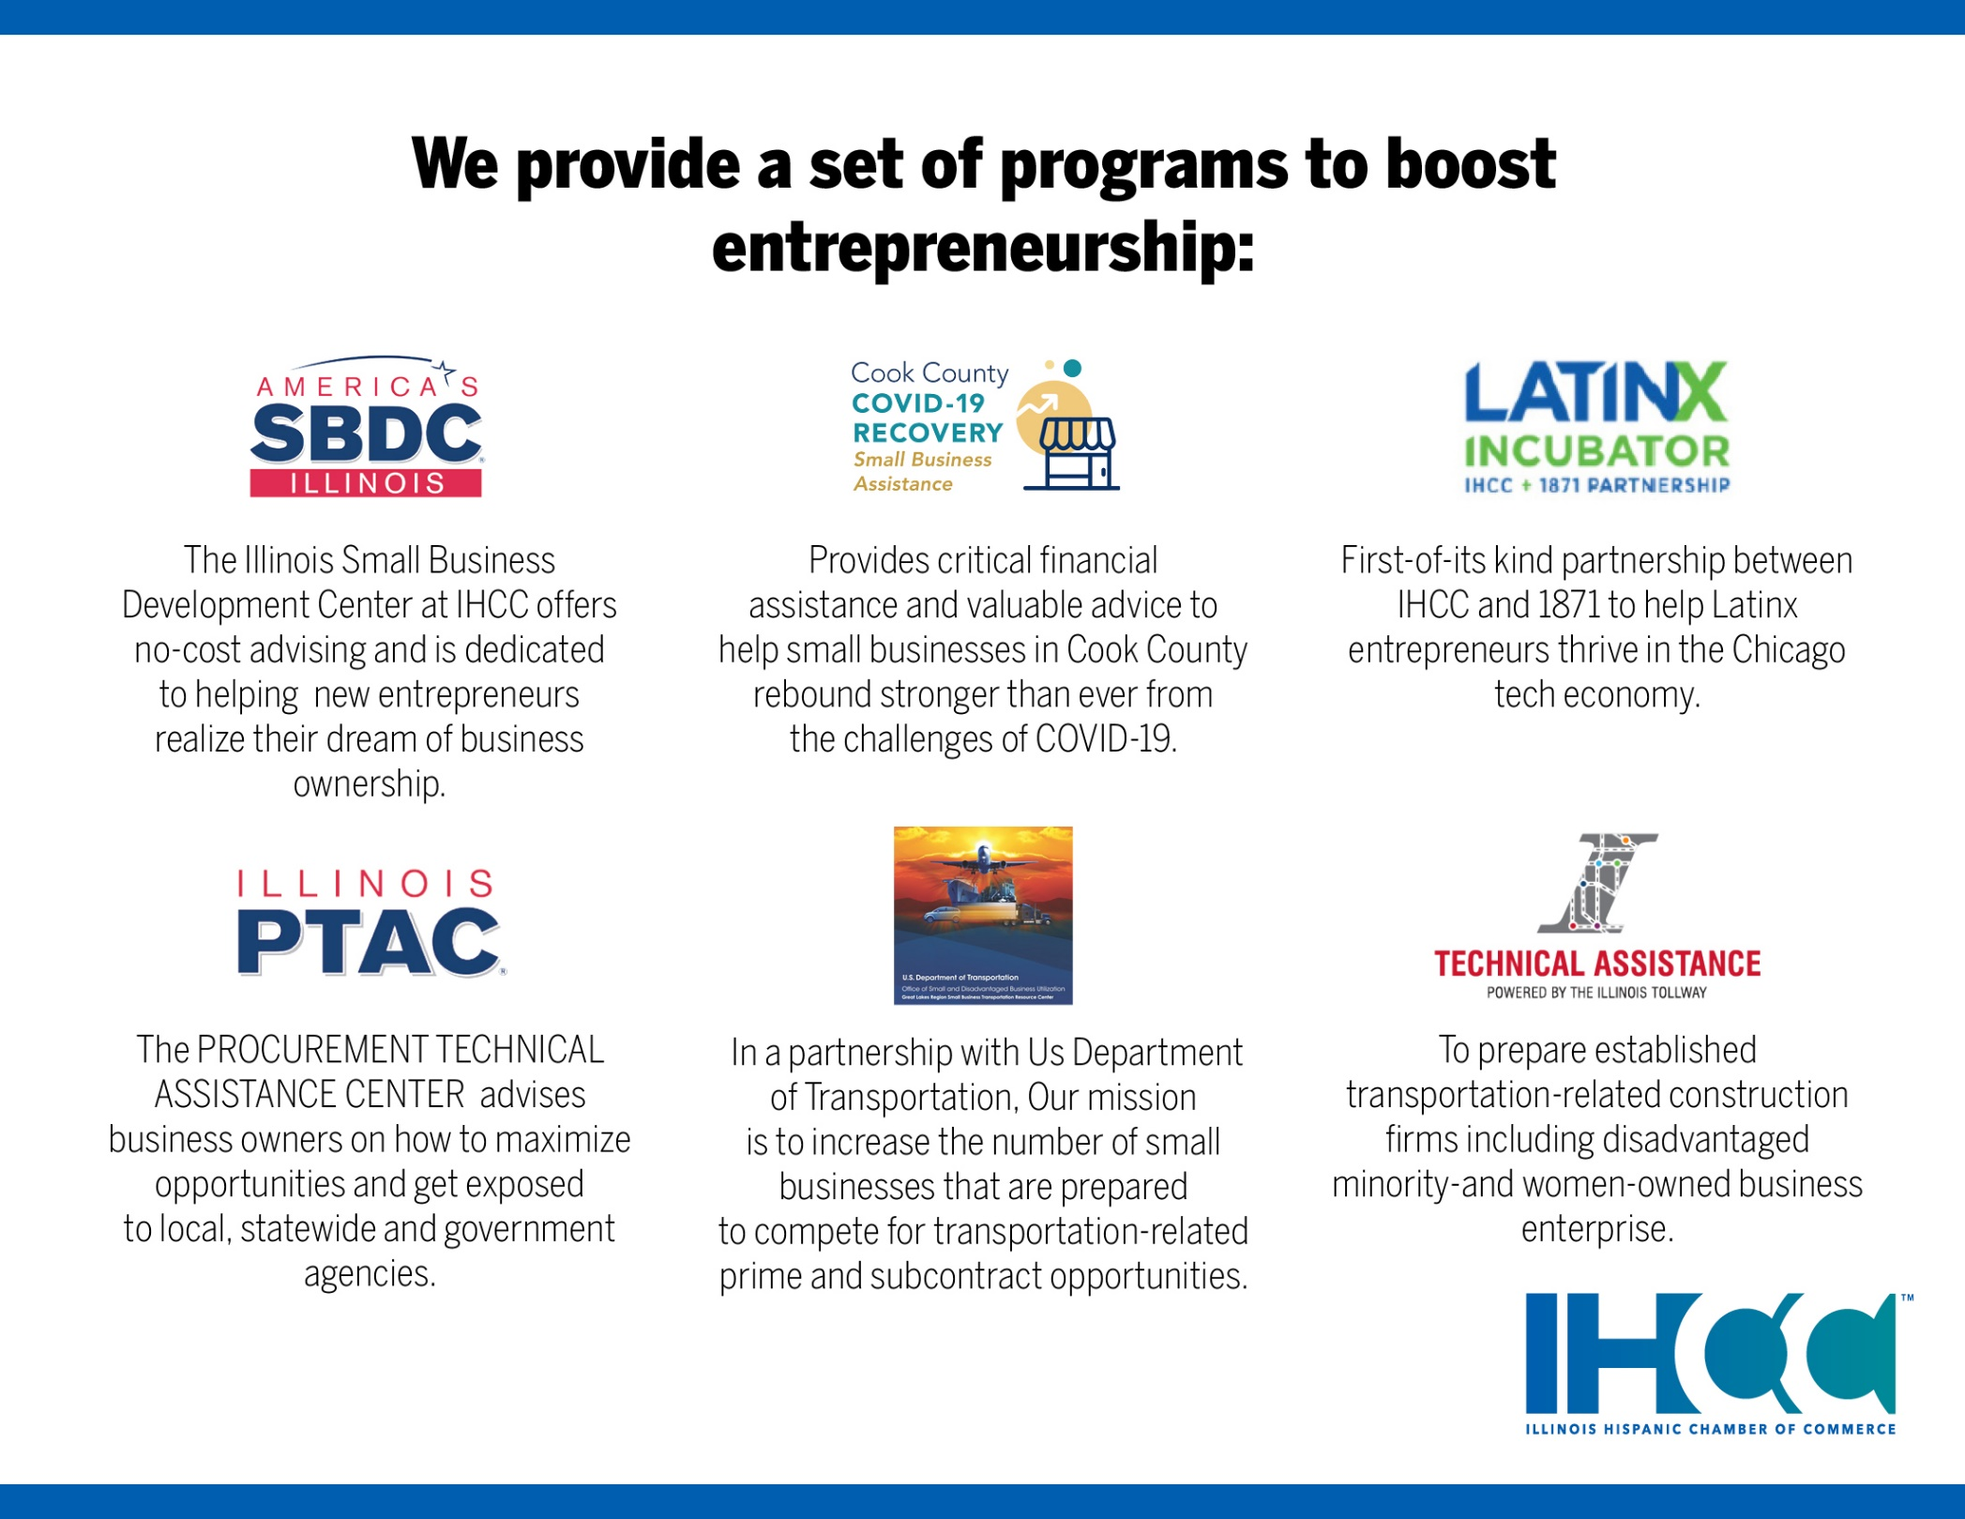

Slide 37
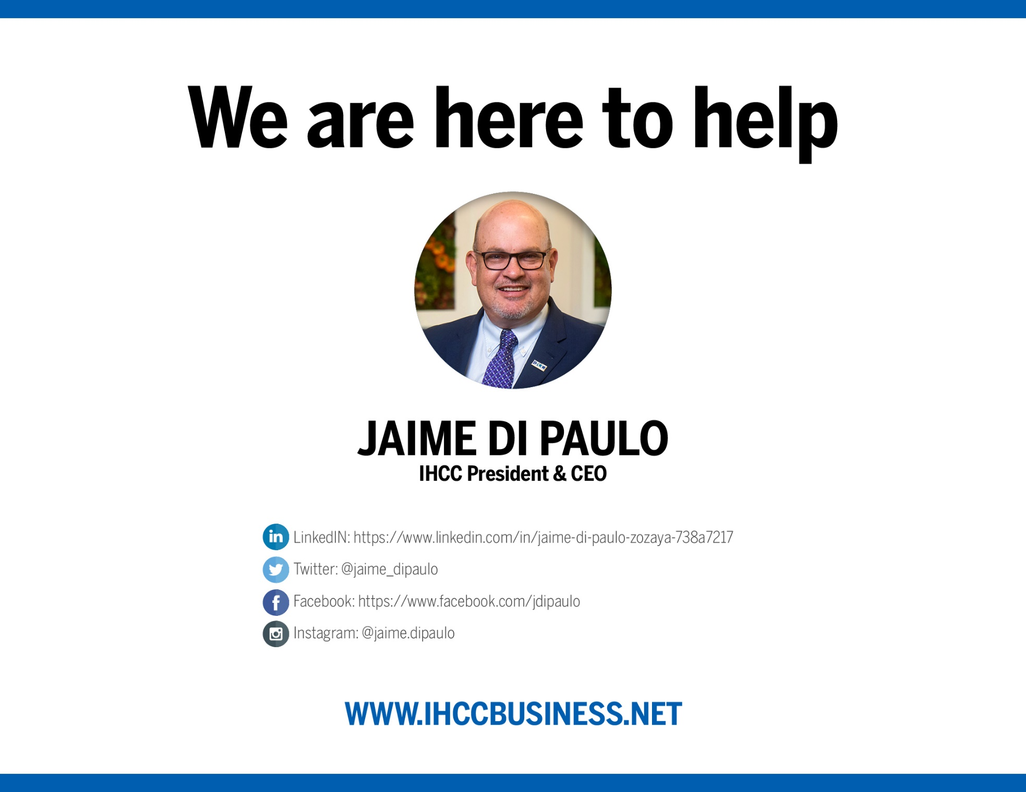

Slide 38
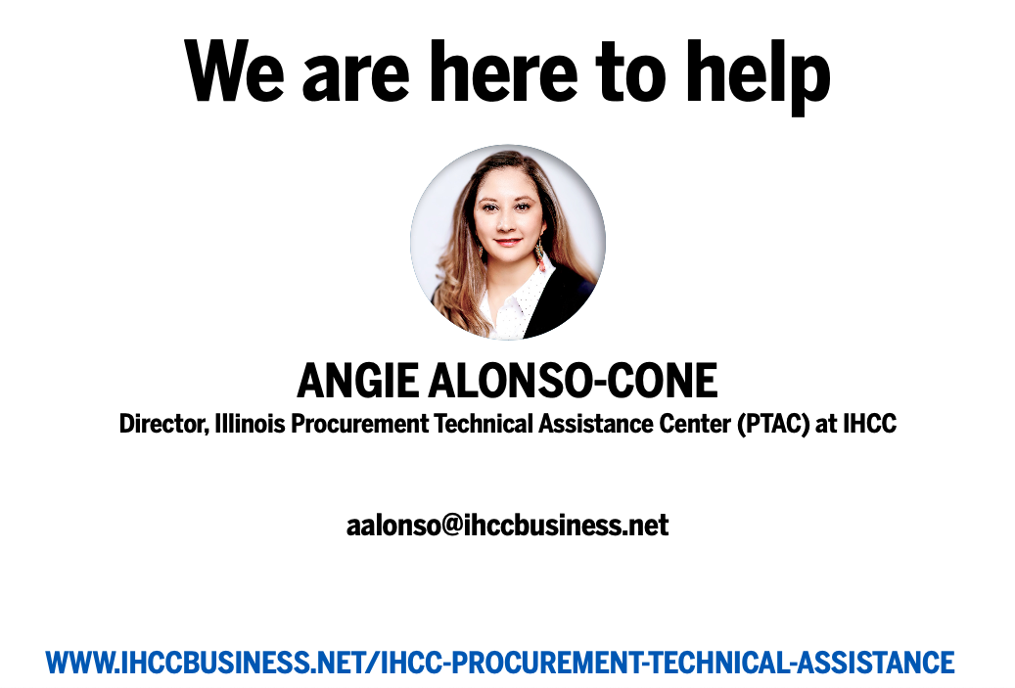

Slide 39

Questions?

Slide 40
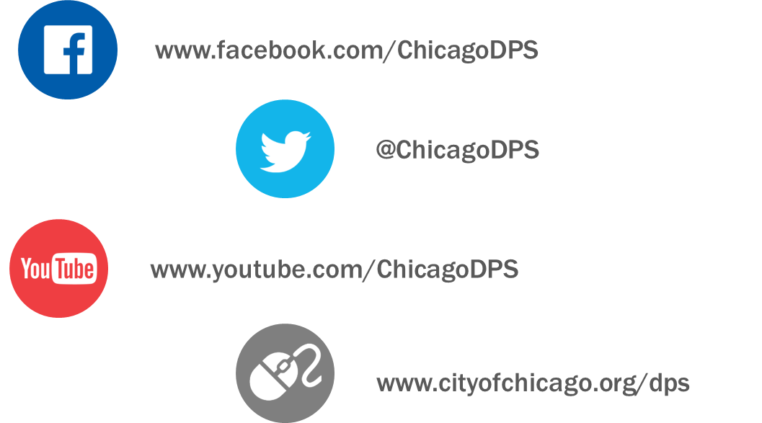
TRAINING • OUTREACH • COMMUNICATIONS

Slide 41

Thank You for Attending…
FAIRNESS • TRANSPARENCY • DIVERSITY • INCLUSION
Department of Procurement Services
121 North LaSalle, City Hall Room 806, Chicago, IL 60602
City Hall Bid & Bond Room 103 ● 11th Floor Room 1103
www.chicago.gov/dps ● dpsevents@chicago.gov
facebook.com/ChicagoDPS ● @ChicagoDPS ● youtube.com/ChicagoDPS

