Slide 1
Reply to Registration Invitation (Email)
Notes:
[Instructor Notes, if any, will appear here.]

Slide 2
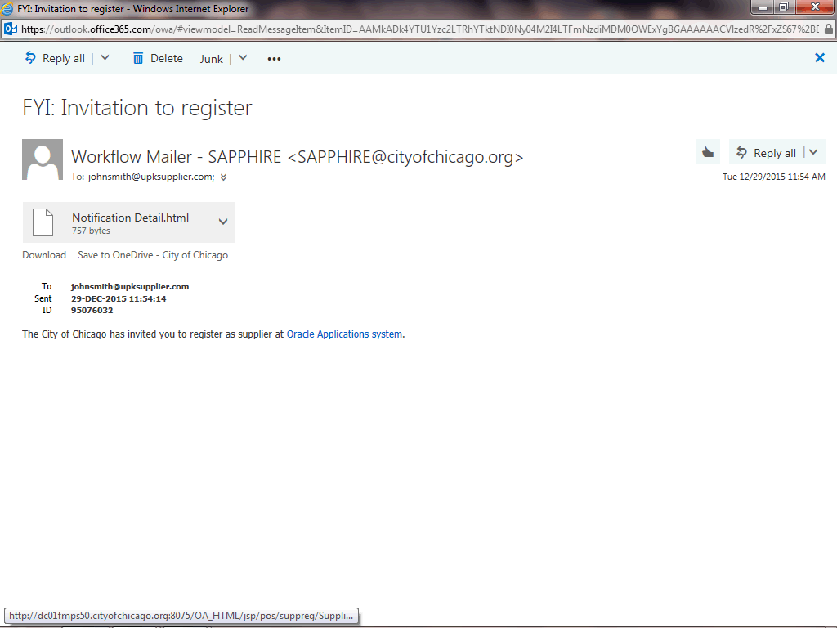
Reply to Registration Invitation (Email)
In this Course you will learn how to reply to a registration invitation from the City of Chicago for access to their iSupplier Portal.
This registration process will only happen if the City has information from your company prior to sending this invitation.

Slide 3
Reply to Registration Invitation (Email)
Step 1
You will receive an email notification from the City of Chicago. The Subject will read along the lines of the following:
"FYI: Invitation to register"
In order to access the registration, click the Oracle Applications system link in the email.

Slide 4
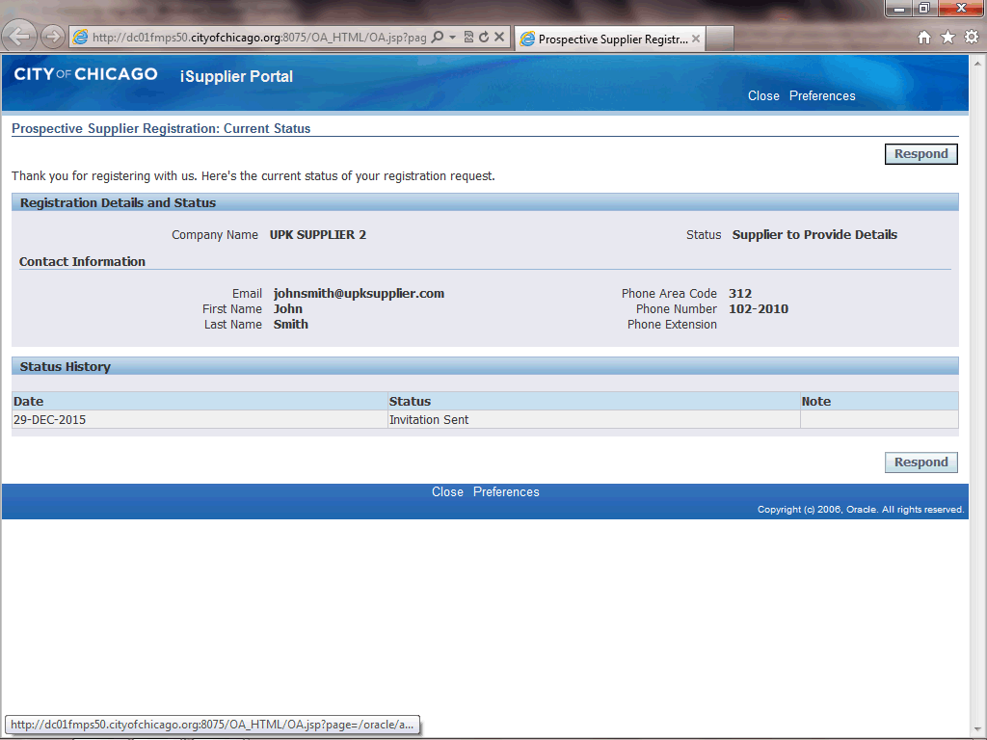
Reply to Registration Invitation (Email)
Step 2
The Prospective Supplier Registration: Current Status window will pop up. In order to finish your registration, click the Respond button.

Slide 5
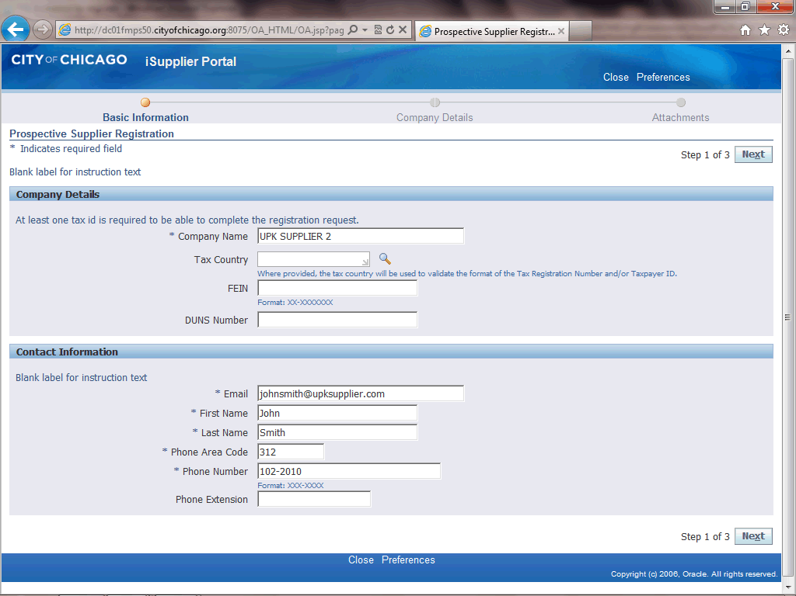
Reply to Registration Invitation (Email)
Step 3
The Prospective Supplier Registration window now appears.
You will see some of the information has defaulted based on inputs from the City of Chicago. Anywhere you see information which is incorrect, please make the appropriate changes.
Click in the FEIN field. You will need to enter your company's Federal Tax ID EIN Number in this field.

Slide 6

Reply to Registration Invitation (Email)
Step 4
Enter the desired information into the FEIN field. In this example, enter "XX-XXXXXXX".

Slide 7

Reply to Registration Invitation (Email)
Step 5
Click in the First Name field. You can make any changes to the contact information as necessary.
Remember at least one contact is required for this registration.

Slide 8
Reply to Registration Invitation (Email)
Step 6
Click the Next button.
Note: It is important only to click the Next button once. Please wait patiently for the next page to load.

Slide 9
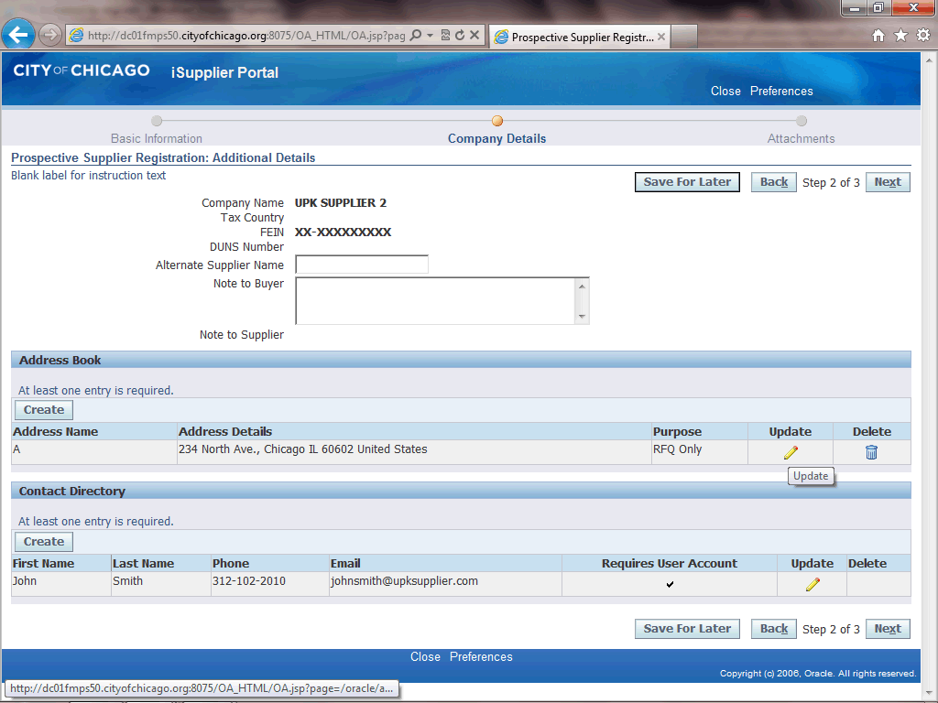
Reply to Registration Invitation (Email)
Step 7
Registration: Additional Details window now appears.
At least one address must be provided for your company.
Click the Update button (Pencil Icon) for the Address Book. This will allow you to make any necessary corrections to the address.

Slide 10
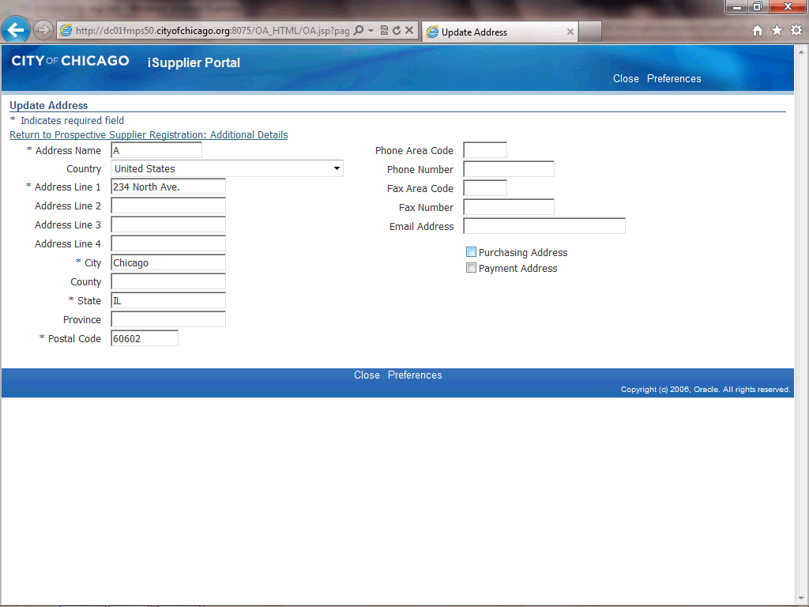
Reply to Registration Invitation (Email)
Step 8
The Update Address window now appears.
Determine what this address can be used for.
If this is a purchasing address, click the Purchasing Address option. (Checkbox)

Slide 11

Reply to Registration Invitation (Email)
Step 9
If this is a payment address as well or only, click the Payment Address option. (Checkbox)

Slide 12
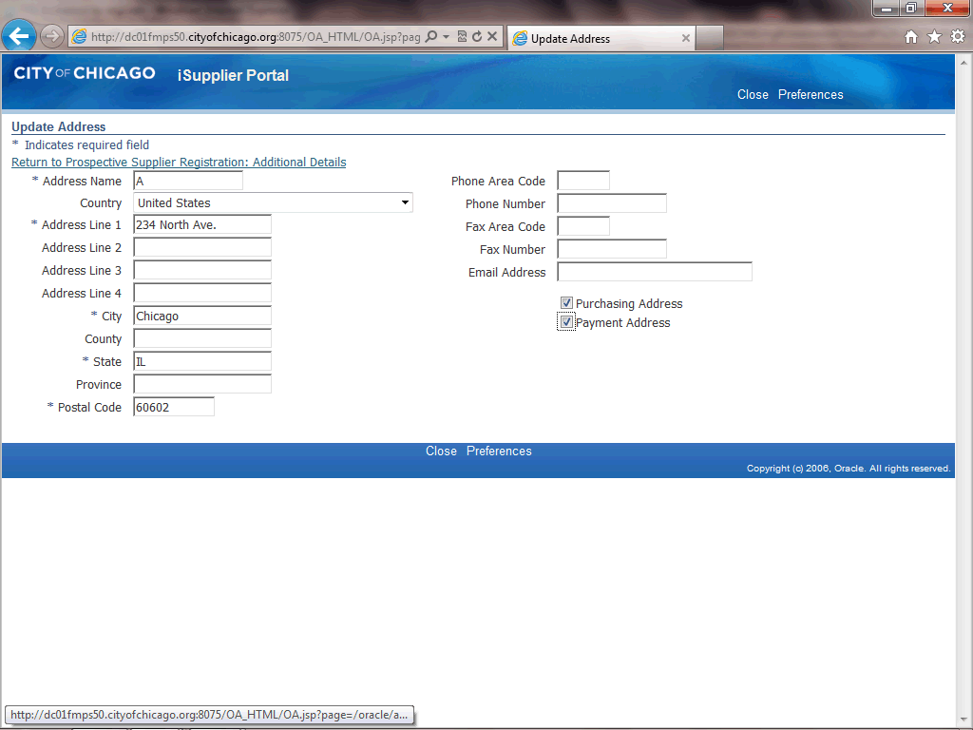
Reply to Registration Invitation (Email)
Step 10
Once you have updated all of your address information, click the Return to Prospective Supplier Registration: Additional Details link.

Slide 13
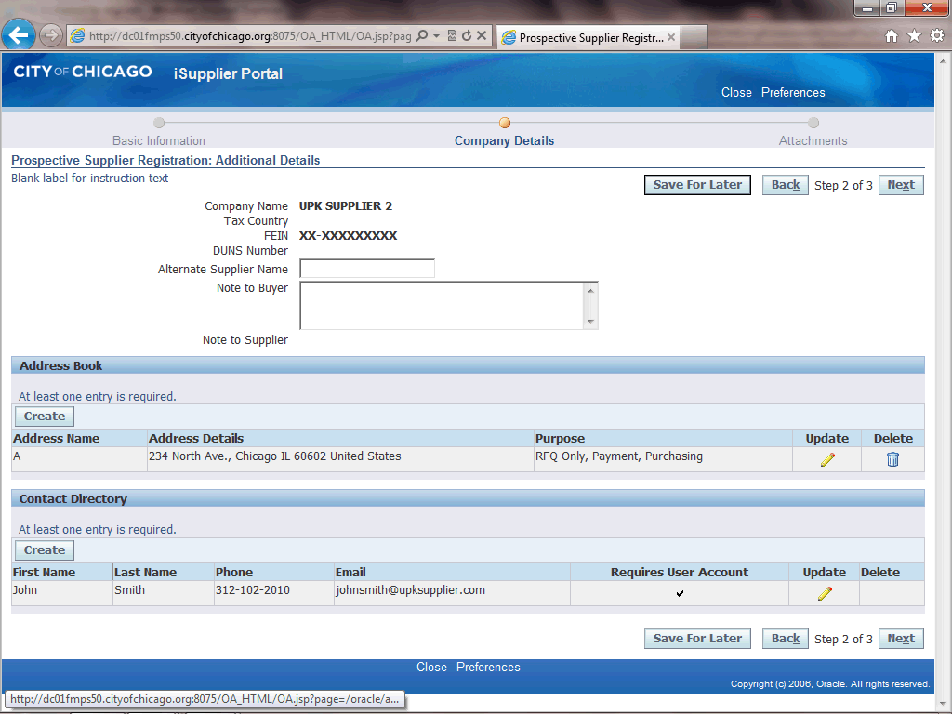
Reply to Registration Invitation (Email)
Step 11
You can now also create an additional address if needed. If no additional address is need, you can skip the next steps.
Click the Create button under the Address Book section of the page.

Slide 14
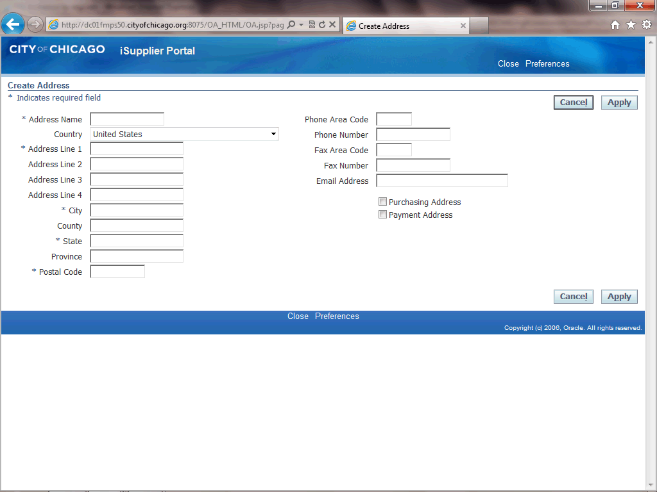
Reply to Registration Invitation (Email)
Step 12
The Create Address window now appears.
Click in the Address Name field.

Slide 15
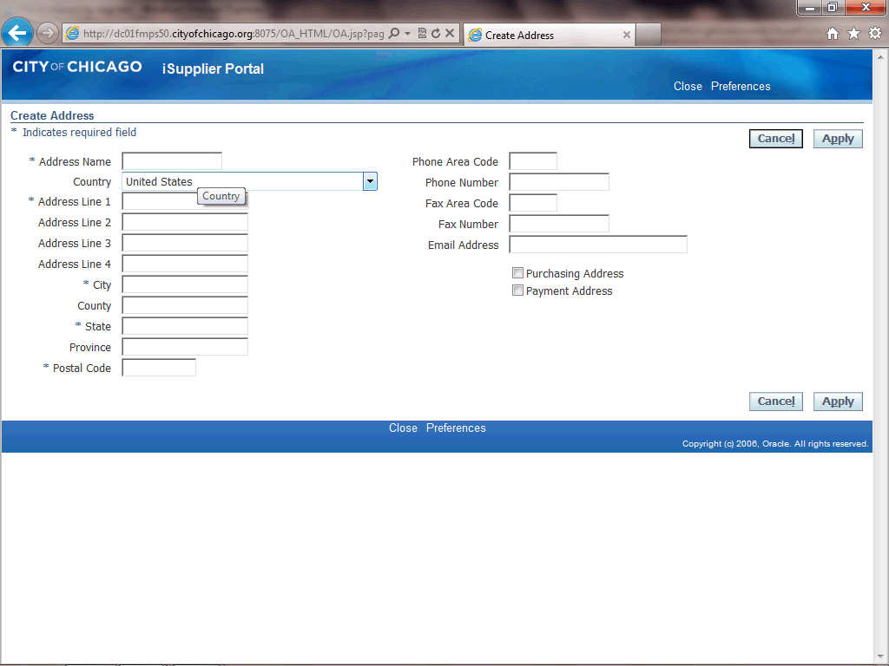
Reply to Registration Invitation (Email)
Step 13
Give your address a name.
Enter the desired information into the Address Name field. In this example, enter "Headquarters".

Slide 16
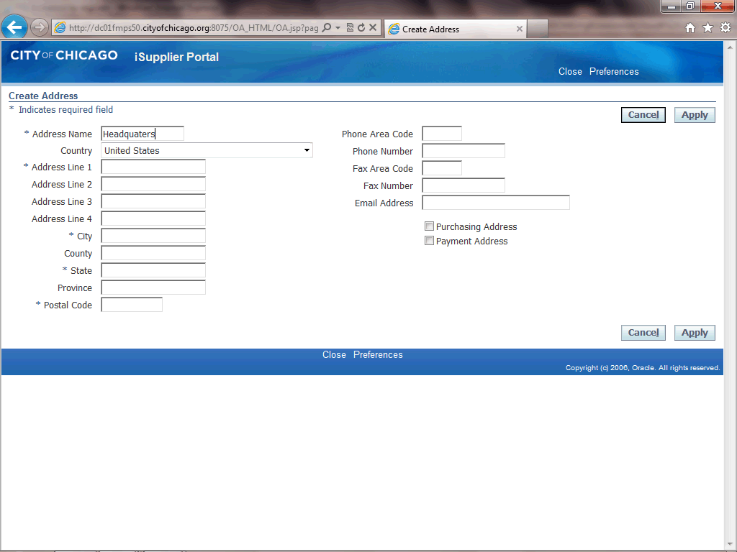
Reply to Registration Invitation (Email)
Step 14
Click in the Address Line 1 field.

Slide 17

Reply to Registration Invitation (Email)
Step 15
Enter the desired information into the Address Line 1 field. In this example, enter "123 Main St.".

Slide 18
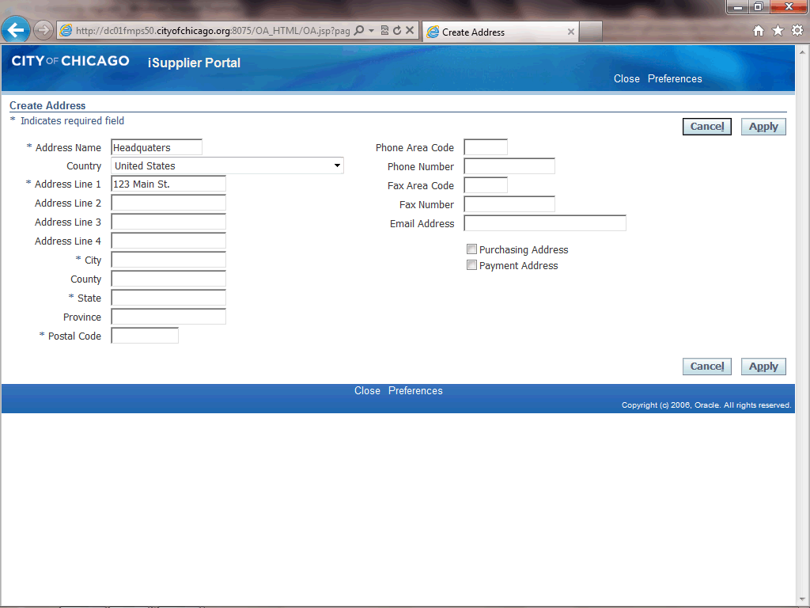
Reply to Registration Invitation (Email)
Step 16
Click in the City field.

Slide 19
Reply to Registration Invitation (Email)
Step 17
Enter the desired information into the City field. In this example, enter "Chicago".

Slide 20
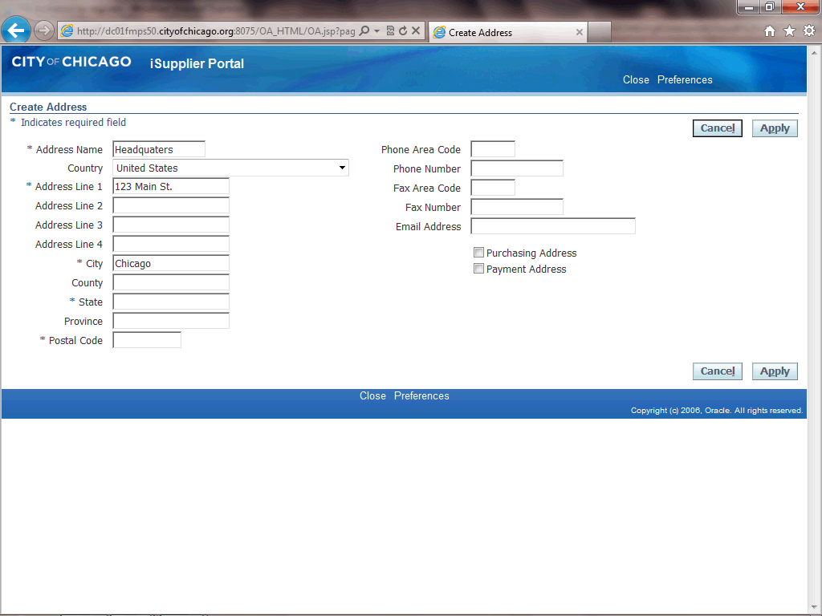
Reply to Registration Invitation (Email)
Step 18
Click in the State field.

Slide 21
Reply to Registration Invitation (Email)
Step 19
Enter the desired information into the State field. In this example, enter "IL".

Slide 22

Reply to Registration Invitation (Email)
Step 20
Click in the Postal Code field.

Slide 23
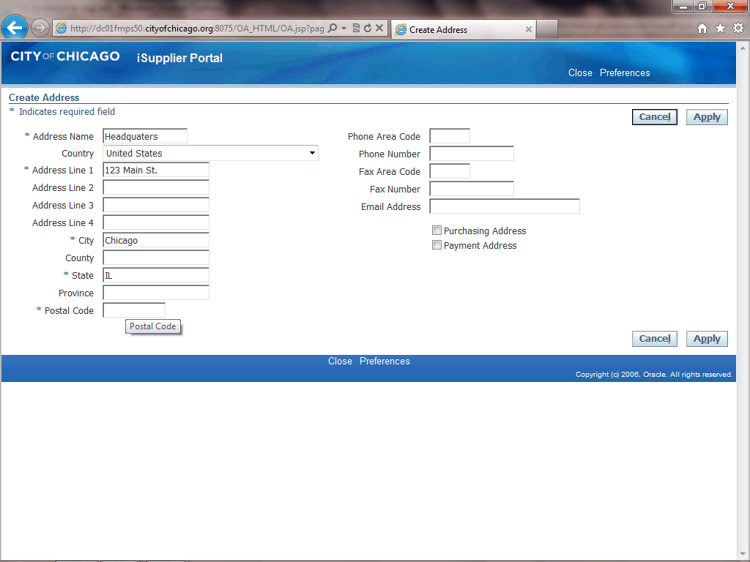
Reply to Registration Invitation (Email)
Step 21
Enter the desired information into the Postal Code field. In this example, enter "60602".

Slide 24
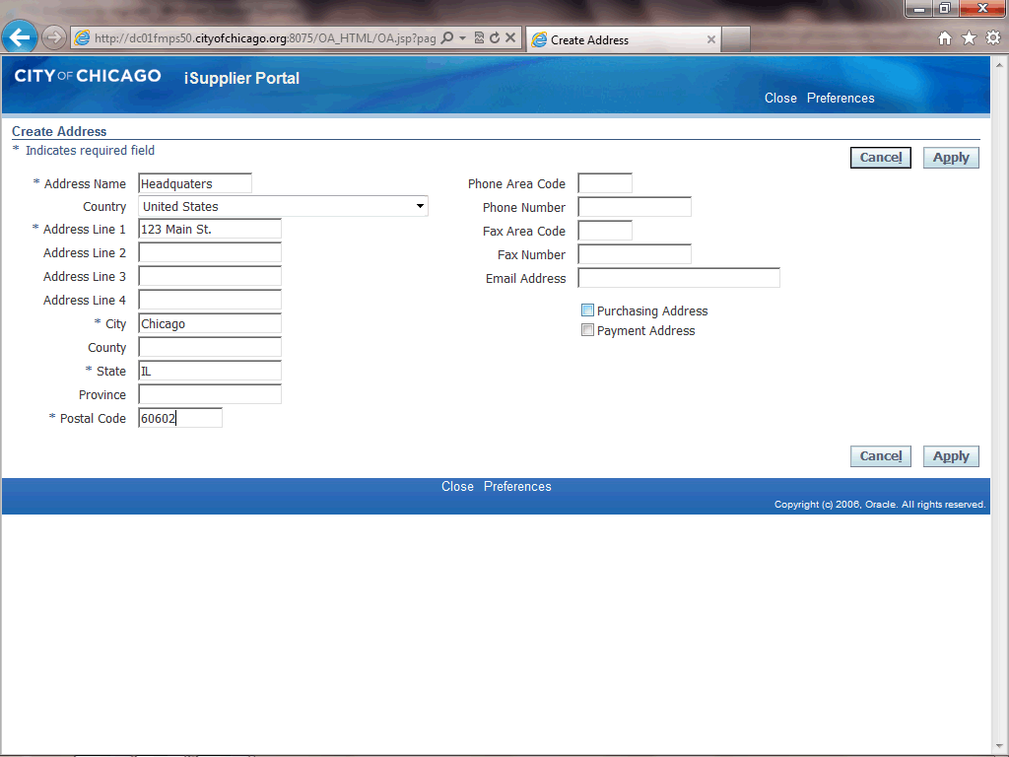
Reply to Registration Invitation (Email)
Step 22
Determine what this address can be used for.
If this is a purchasing address, click the Purchasing Address option. (Checkbox)

Slide 25
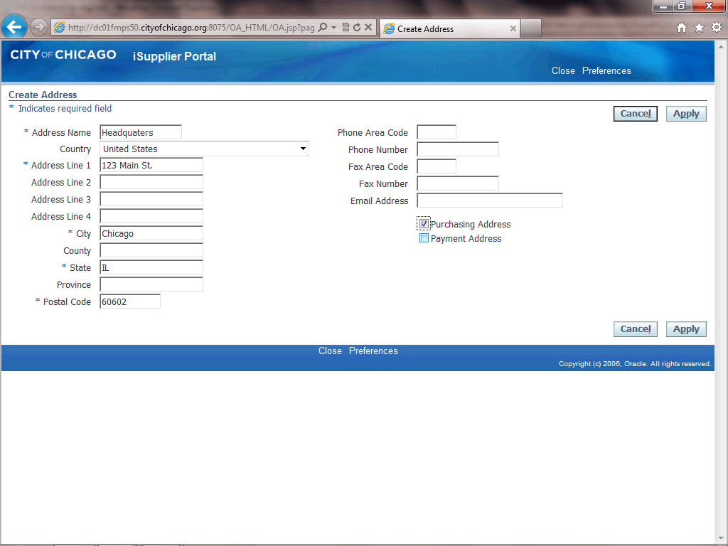
Reply to Registration Invitation (Email)
Step 23
If this is a payment address as well or only, click the Payment Address option. (Checkbox)

Slide 26
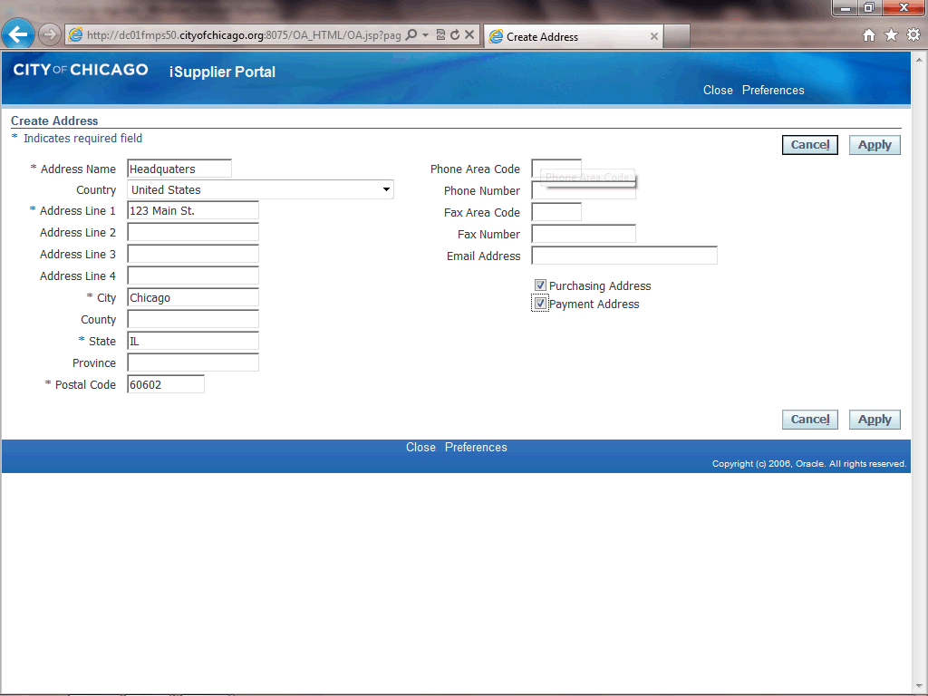
Reply to Registration Invitation (Email)
Step 24
Click in the Phone Area Code field.
This is a phone number for this address. This is NOT a phone number for a specific contact.

Slide 27

Reply to Registration Invitation (Email)
Step 25
Enter the desired information into the Phone Area Code field. In this example, enter "312".

Slide 28
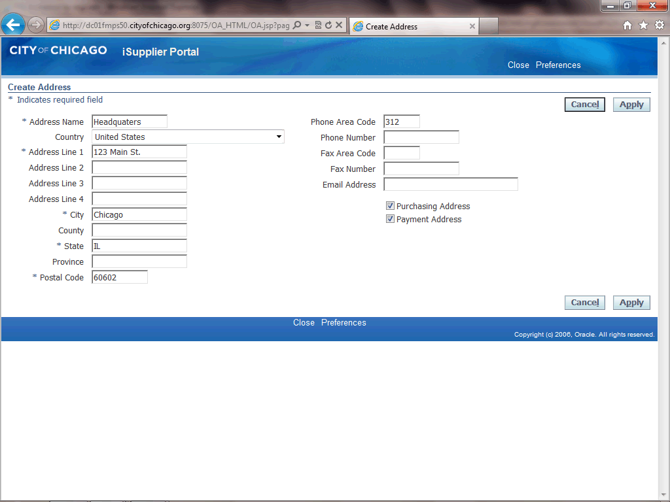
Reply to Registration Invitation (Email)
Step 26
Click in the Phone Number field.

Slide 29
Reply to Registration Invitation (Email)
Step 27
Enter the desired information into the Phone Number field. In this example, enter "098-0976".

Slide 30
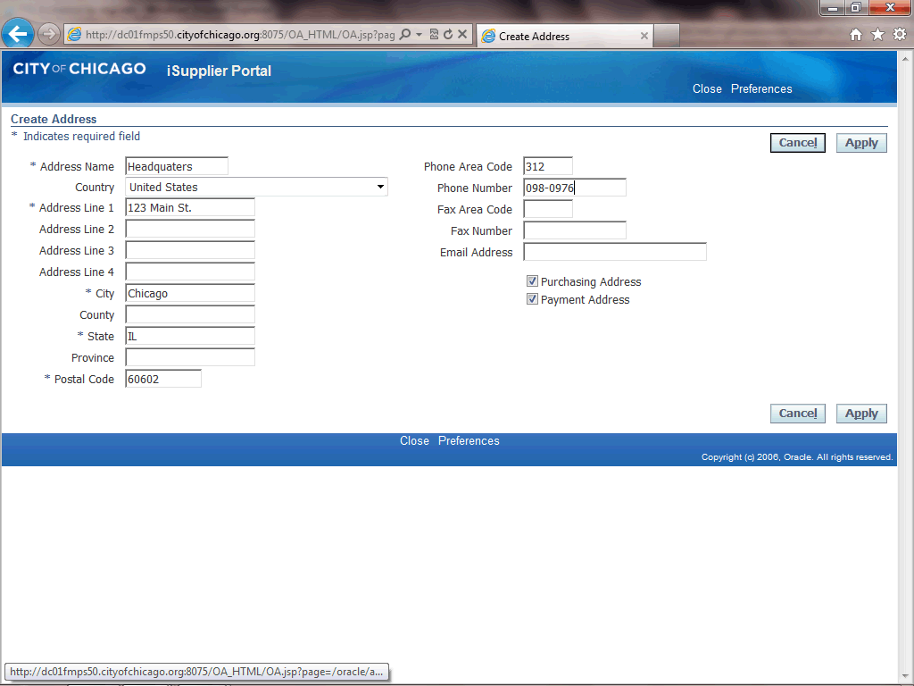
Reply to Registration Invitation (Email)
Step 28
You can also enter any of the other fields as appropriate for your company's address.
Once finished with this address, click the Apply button.

Slide 31
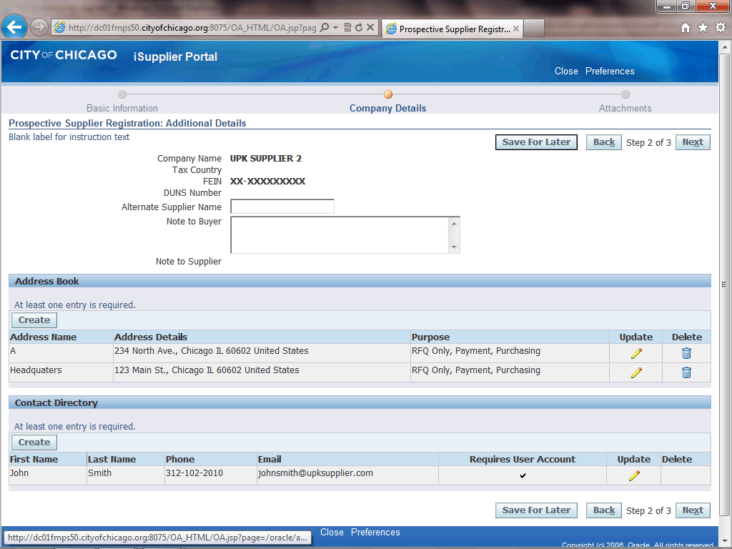
Reply to Registration Invitation (Email)
Step 29
You can also update the Contact if needed.
Click the Update button (Pencil Icon) for the contact that needs to be updated..

Slide 32
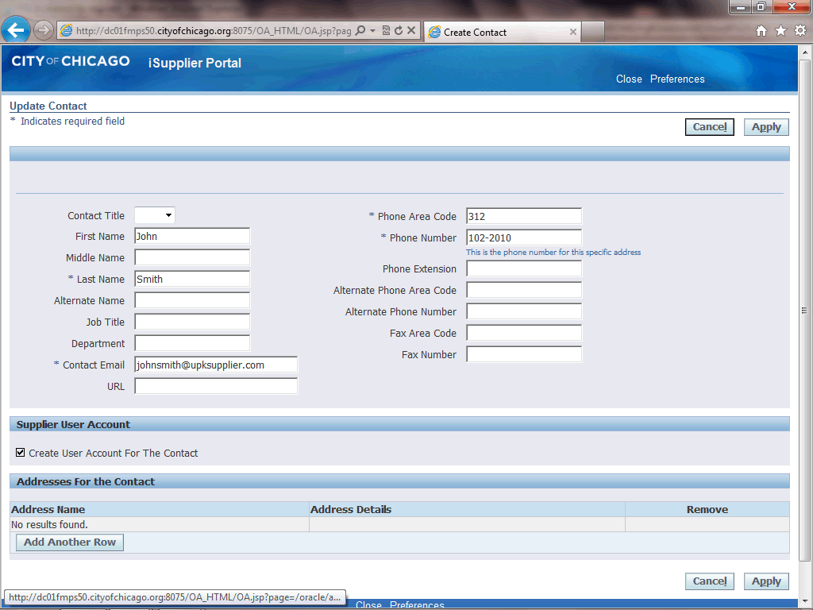
Reply to Registration Invitation (Email)
Step 30
Make any necessary changes to the contact information and then click the Apply button.

Slide 33
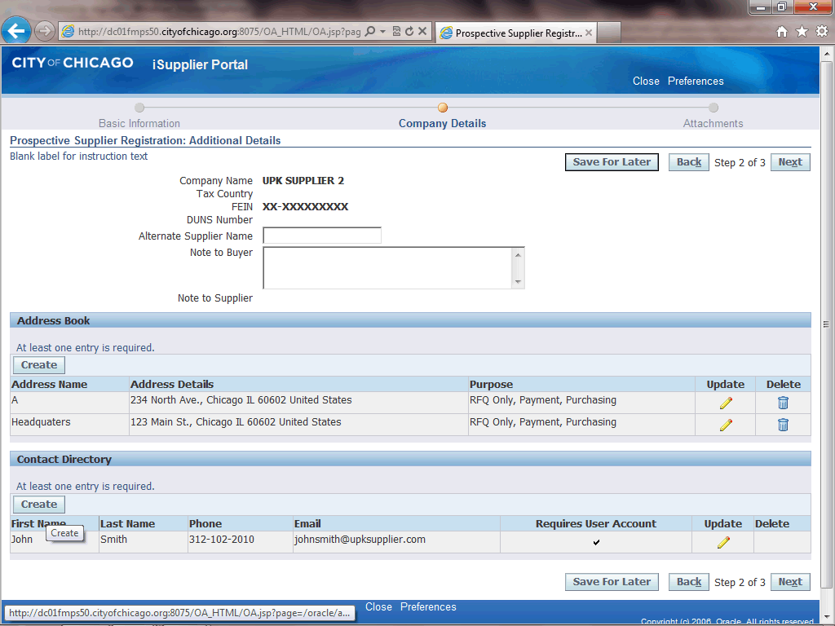
Reply to Registration Invitation (Email)
Step 31
You can also add additional contacts to your company's profile.
Click the Create button under the "Contact Directory" section of the page.
Note: At least one contact is required for your registration.

Slide 34
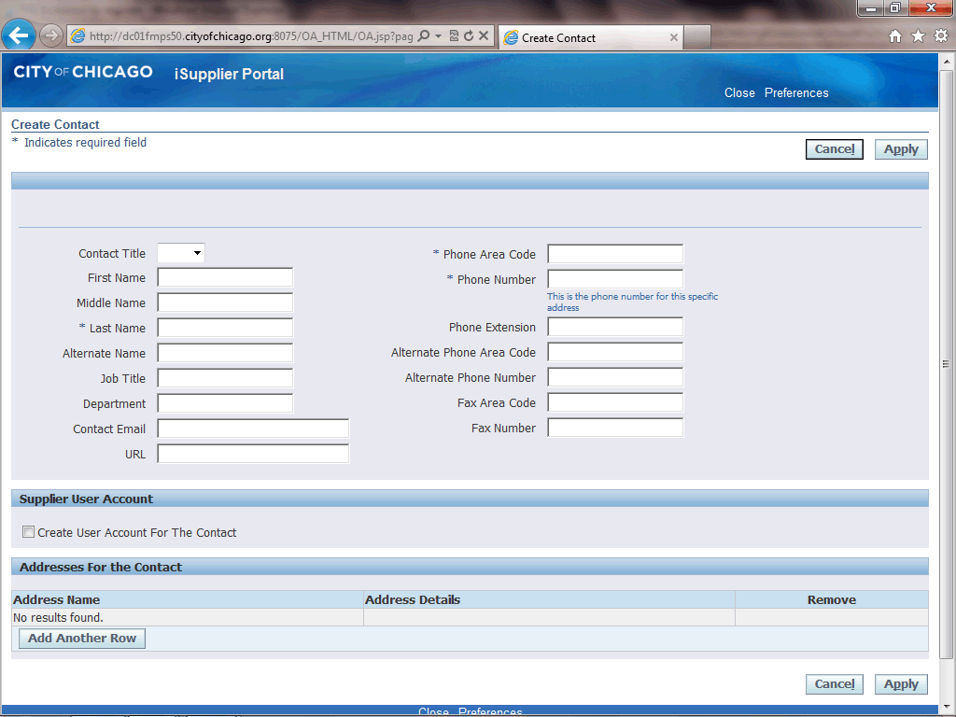
Reply to Registration Invitation (Email)
Step 32
The Create Contact window now appears.
Click in the First Name field.

Slide 35

Reply to Registration Invitation (Email)
Step 33
Enter the desired information into the First Name field. In this example, enter "Bill".

Slide 36

Reply to Registration Invitation (Email)
Step 34
Click in the Last Name field.

Slide 37

Reply to Registration Invitation (Email)
Step 35
Enter the desired information into the Last Name field. In this example, enter "Dunham".

Slide 38

Reply to Registration Invitation (Email)
Step 36
Click in the Contact Email field.

Slide 39
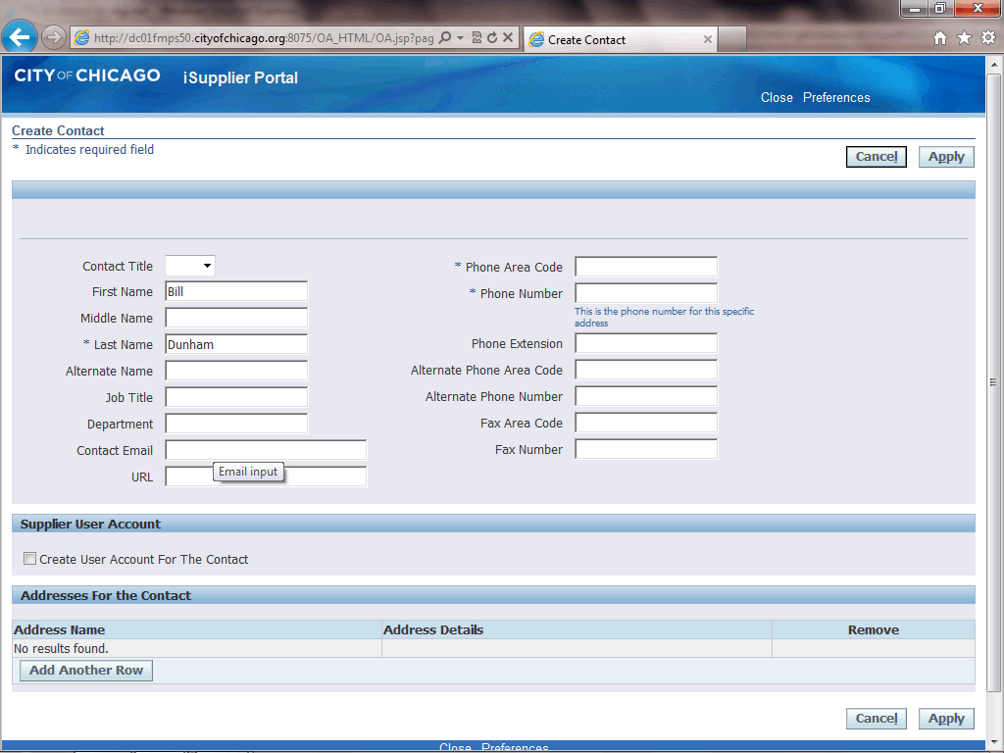
Reply to Registration Invitation (Email)
Step 37
Enter the desired information into the Contact Email field. In this example, enter "bdunham@upksupplier.com".

Slide 40

Reply to Registration Invitation (Email)
Step 38
Click in the Phone Area Code field.

Slide 41
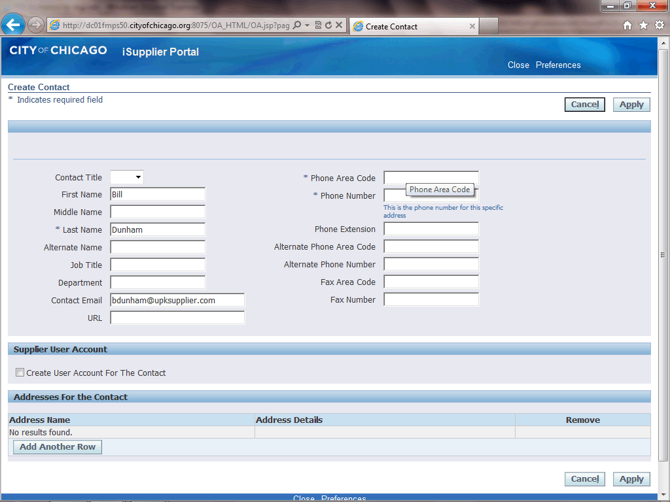
Reply to Registration Invitation (Email)
Step 39
Enter the desired information into the Phone Area Code field. In this example, enter "312".

Slide 42

Reply to Registration Invitation (Email)
Step 40
Click in the Phone Number field.

Slide 43
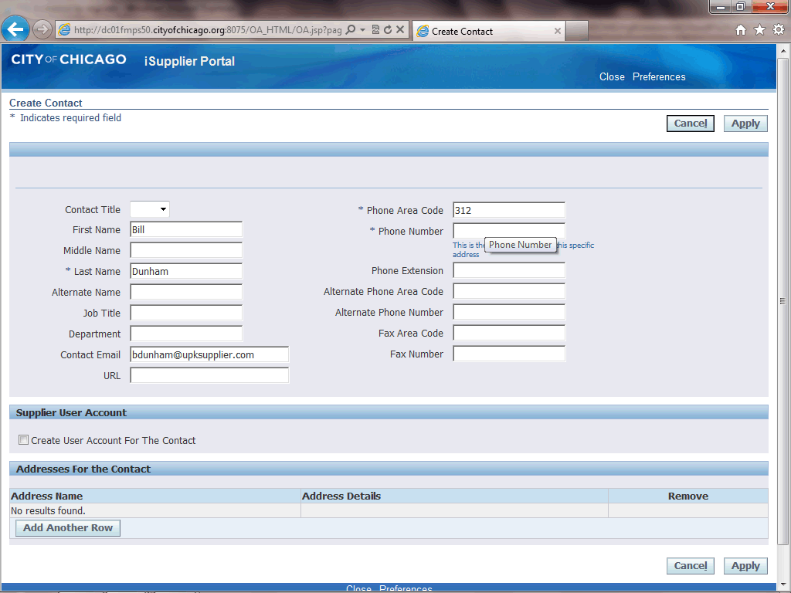
Reply to Registration Invitation (Email)
Step 41
Enter the desired information into the Phone Number field. In this example, enter "123-3243".
You can also add any additional information for this contact by filling out any of the other fields.

Slide 44

Reply to Registration Invitation (Email)
Step 42
If you would like this user to be setup with an iSupplier account for the City of Chicago, click the Create User Account For The Contact option.
If no iSupplier account is necessary, skip the next step.

Slide 45
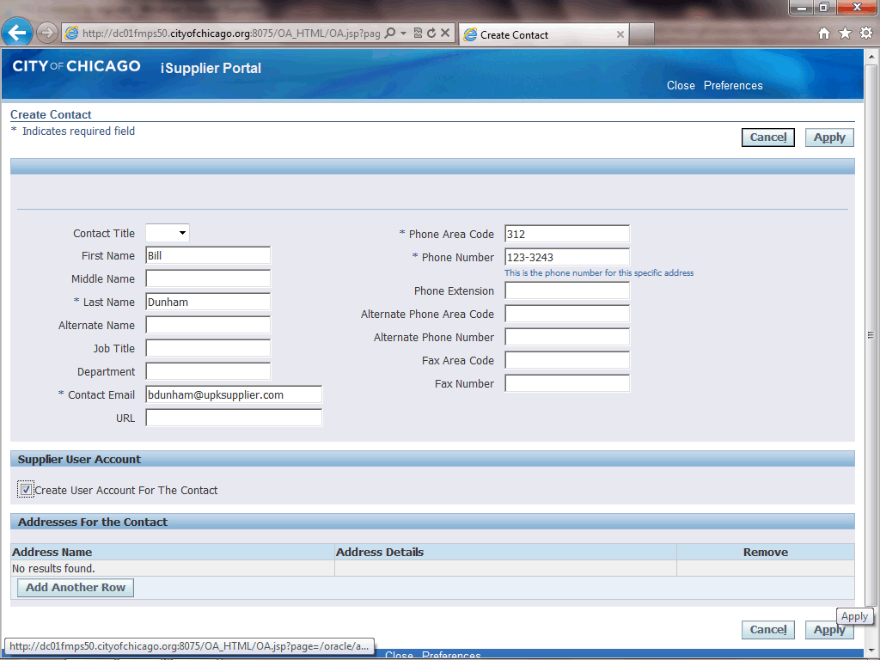
Reply to Registration Invitation (Email)
Step 43
Click the Apply button.

Slide 46
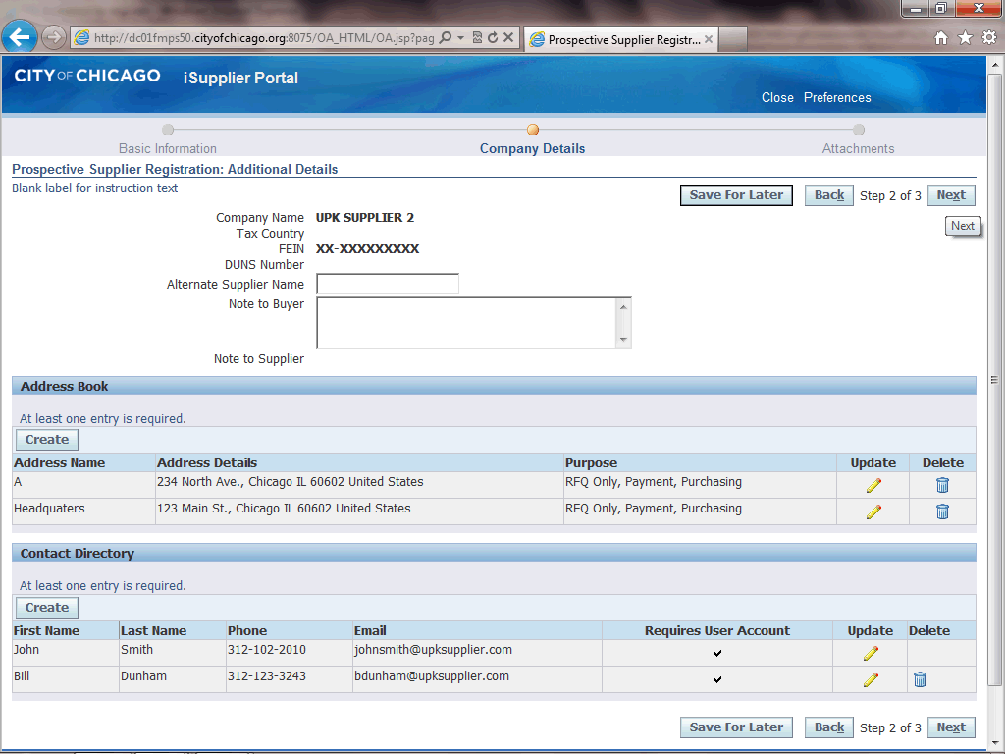
Reply to Registration Invitation (Email)
Step 44
Once all information is entered, click the Next button.

Slide 47
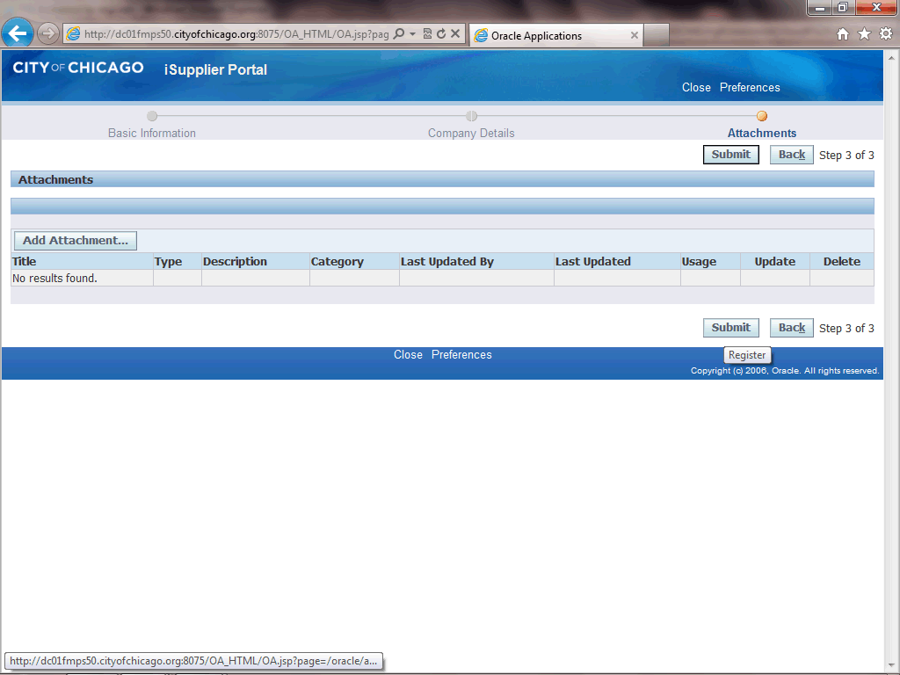
Reply to Registration Invitation (Email)
Step 45
Click the Submit button to submit your registration for approval to the City of Chicago.

Slide 48
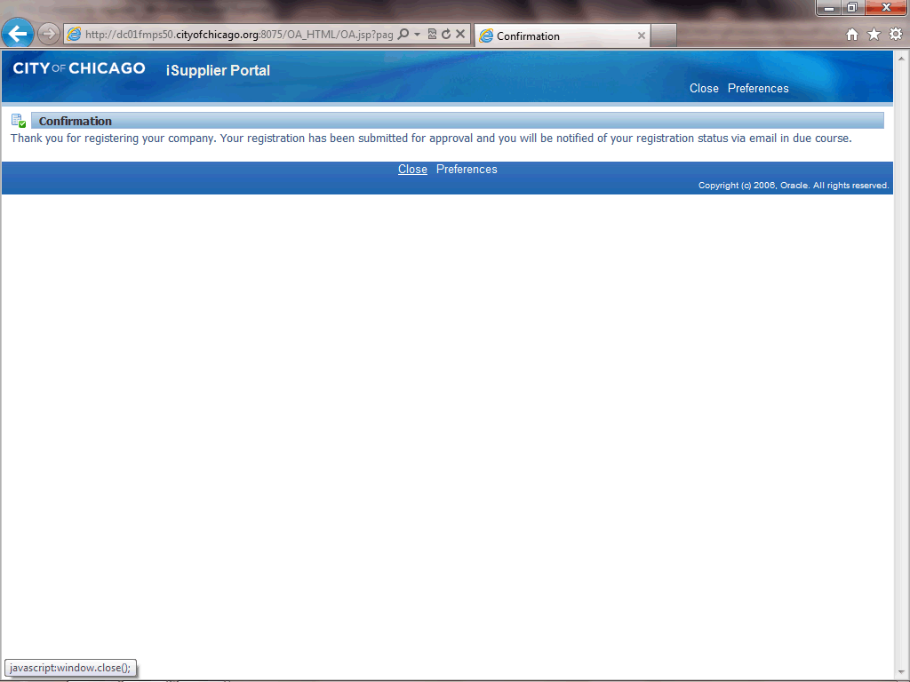
Reply to Registration Invitation (Email)
Step 46
You will receive confirmation that your registration has been submitted. Upon approval of your registration, you will receive another email with details on your username and password.
Click the Close link to close the registration page.

Slide 49
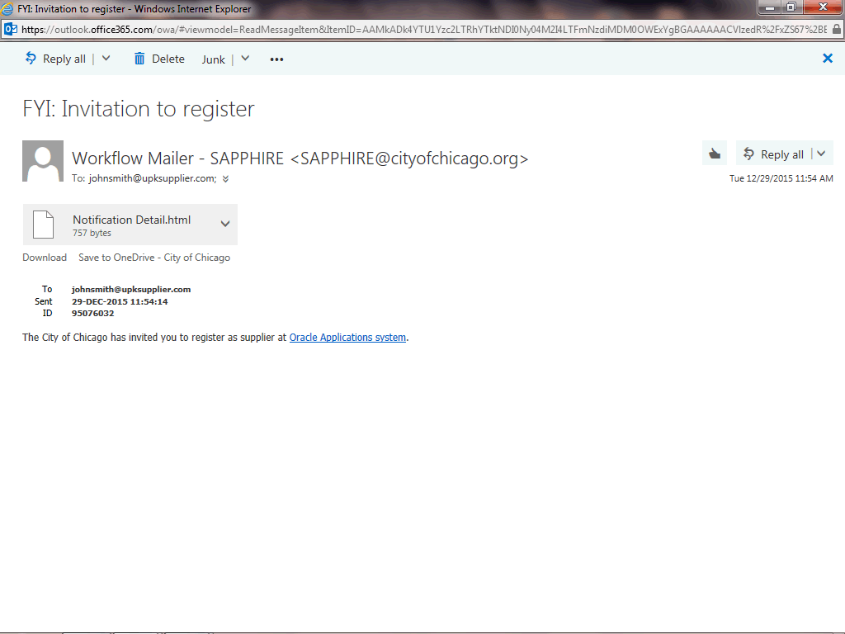
Reply to Registration Invitation (Email)
Step 47
You have just finished submitting a registration to gain access to the City of Chicago's iSupplier Portal.
Once your submission is approved, you will receive an email with instructions to log in. You can also use the provided training material to help gain access to the iSupplier Portal.
End of Procedure.

