Slide 1
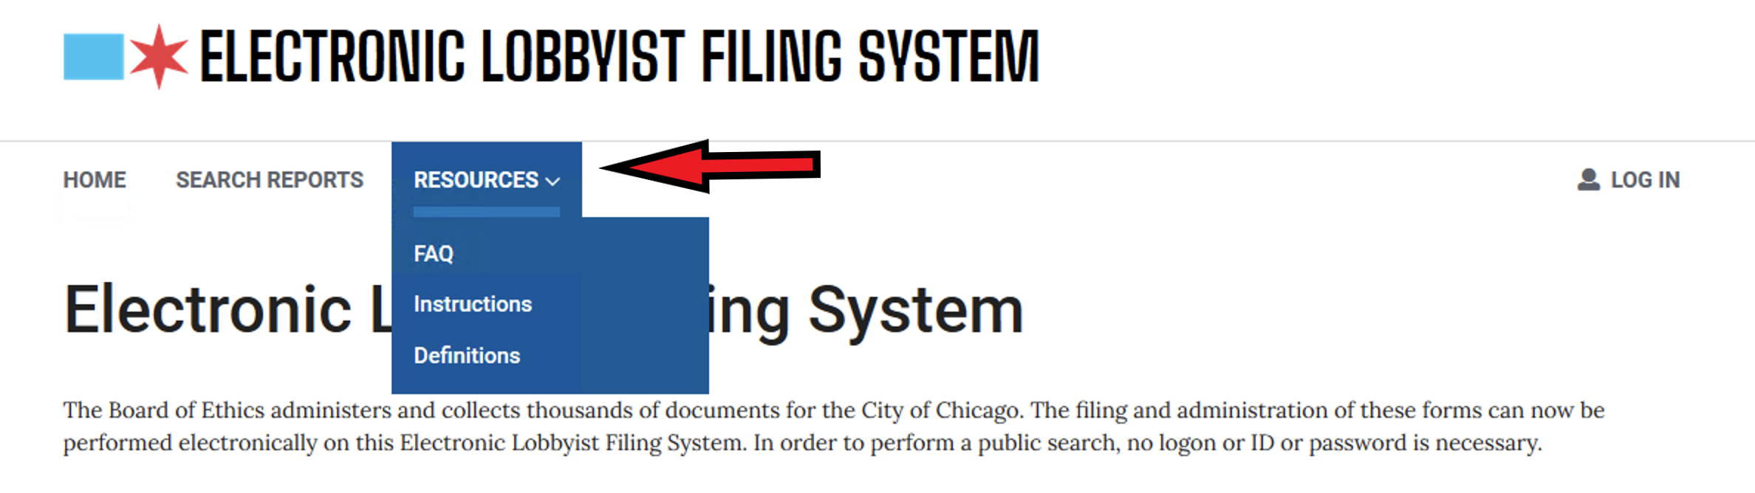
Before beginning. Just a reminder that clicking the Resources link at the top of all the pages in ELF you can find links to Instructions, FAQ’s and Definitions.

Slide 2
Deleting Clients
Step by step “how to”

Slide 3
There are several steps you must take in order to delete a client.
1 File an activity report for each client you wish to delete (almost all these step will be the same as filing a quarterly report with some small differences)
2 Have that activity report reviewed and approved by Board staff
3 Actually deleting the clients appearing in your registration, for whom you submitted activity reports in your registration.
4 Having your amended registration reviewed and approved by Board staff.

Slide 4
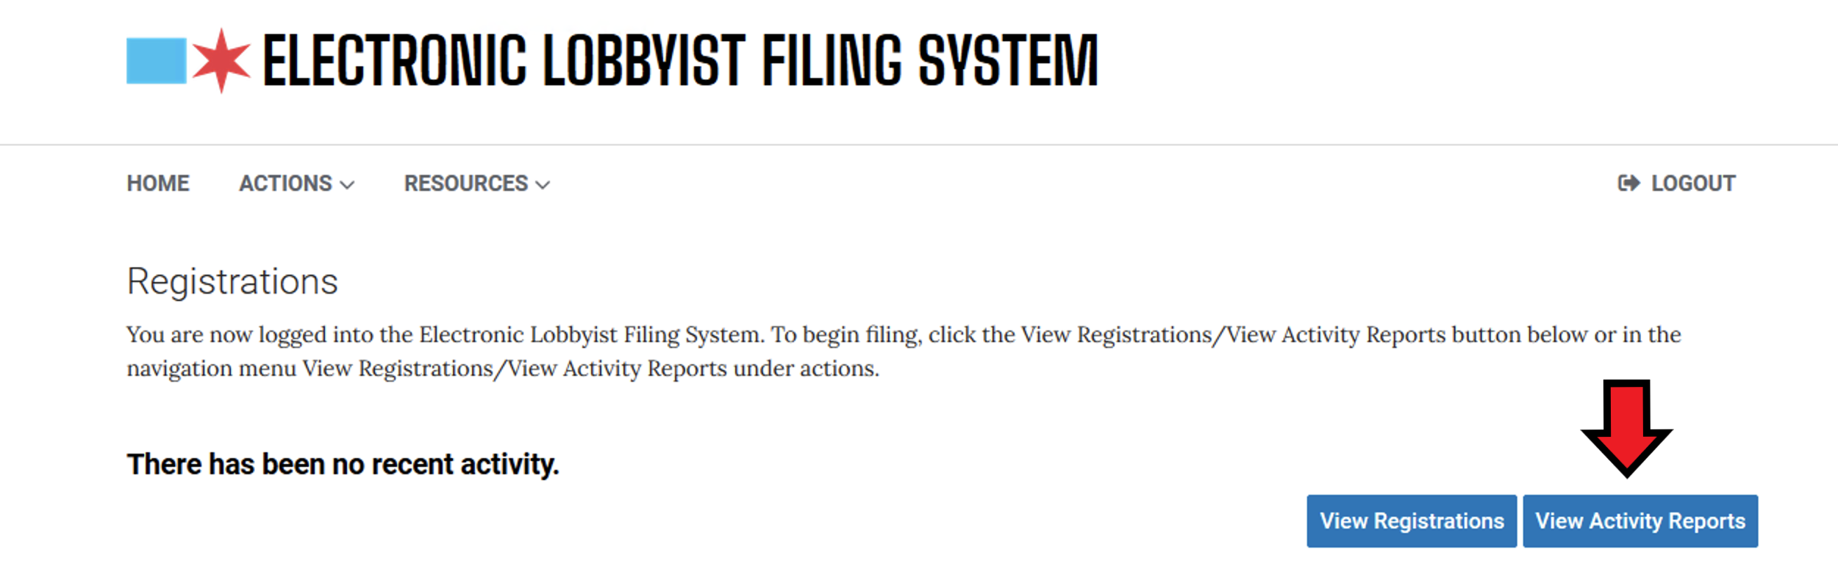
After logging into ELF, choose View Activity Reports.

Slide 5
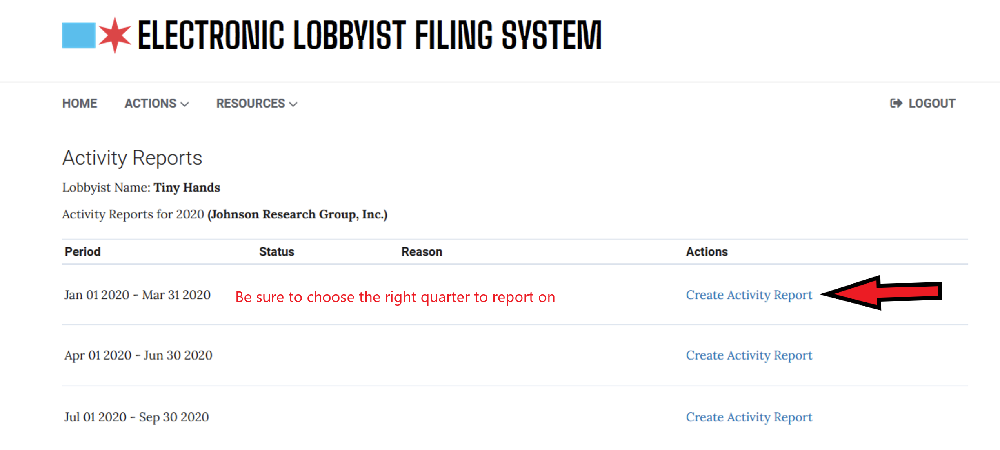
Choose the correct filing period and then click Create Activity Report

Slide 6
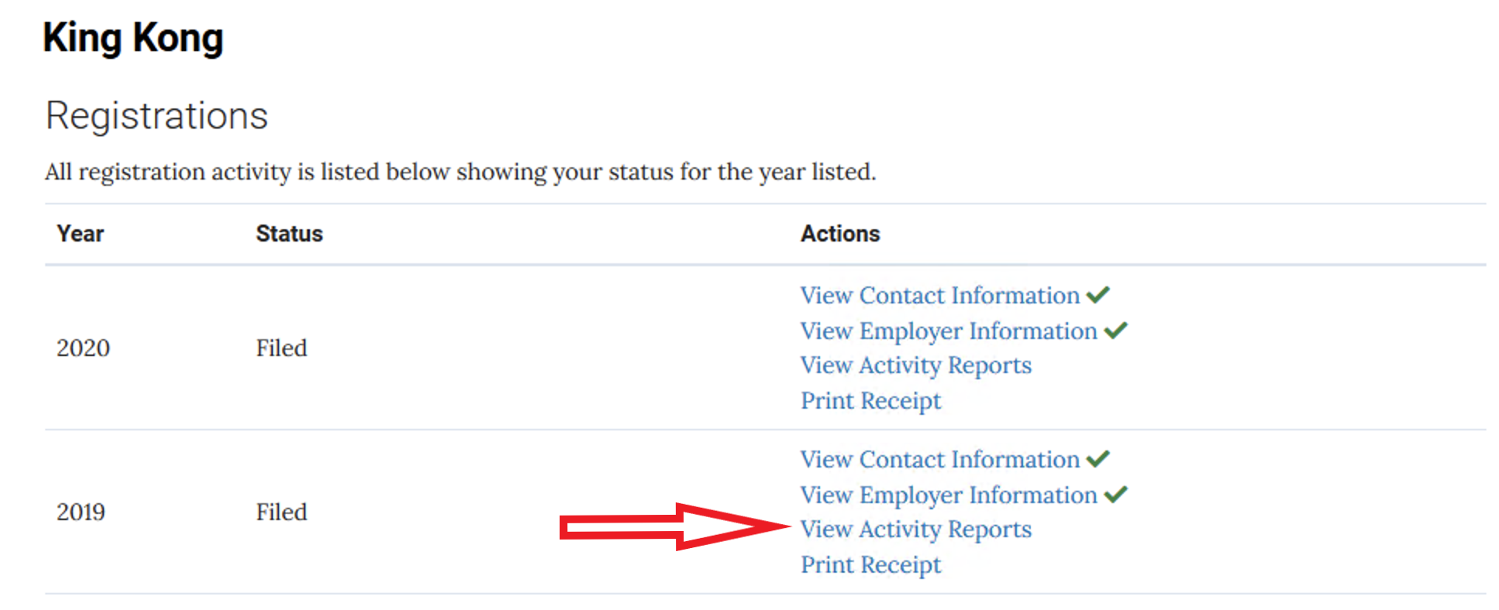
If you are amending or filing for another year choose View Registrations and then View Activity Reports for the year you need.

Slide 7
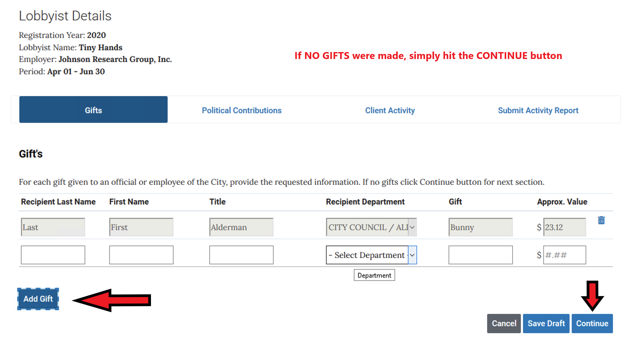
Provide the requested information for all gifts given. Click Add Gift to add more. When done, or there were no gifts to report, click Continue

Slide 8
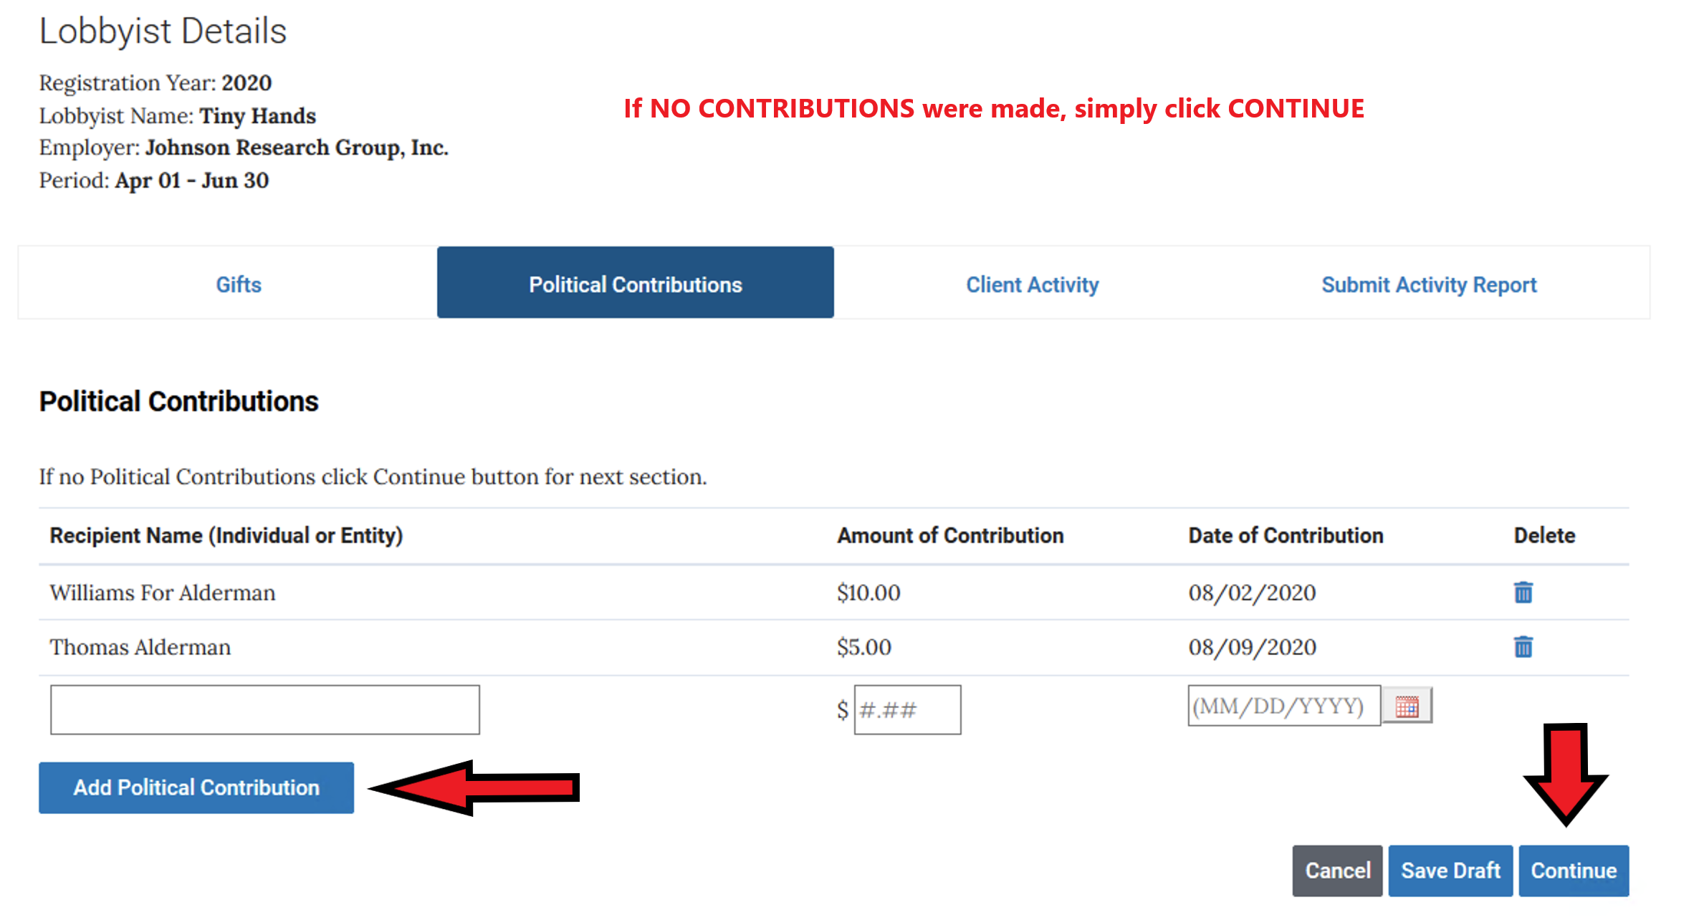
Report Political Contributions made by the lobbyist. After listing them all or if there were none to report choose Continue.

Slide 9
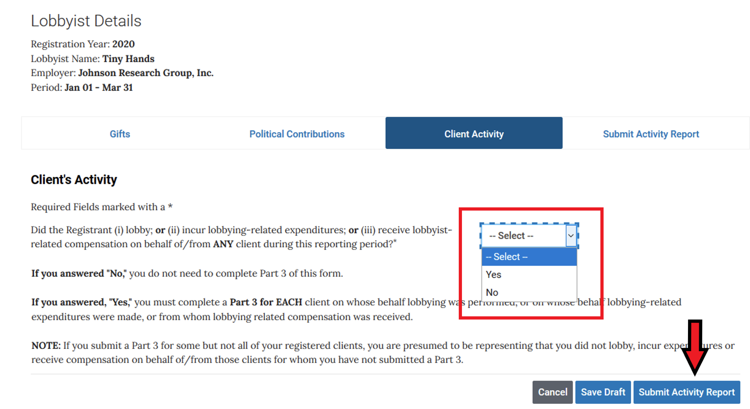
You must answer the question on top of this page. If you answer No, you are done and may then hit Submit Activity Report at the bottom of the page (see toward the bottom of this tutorial for the next steps). If you answer YES, you will be asked for further reporting information.

Slide 10
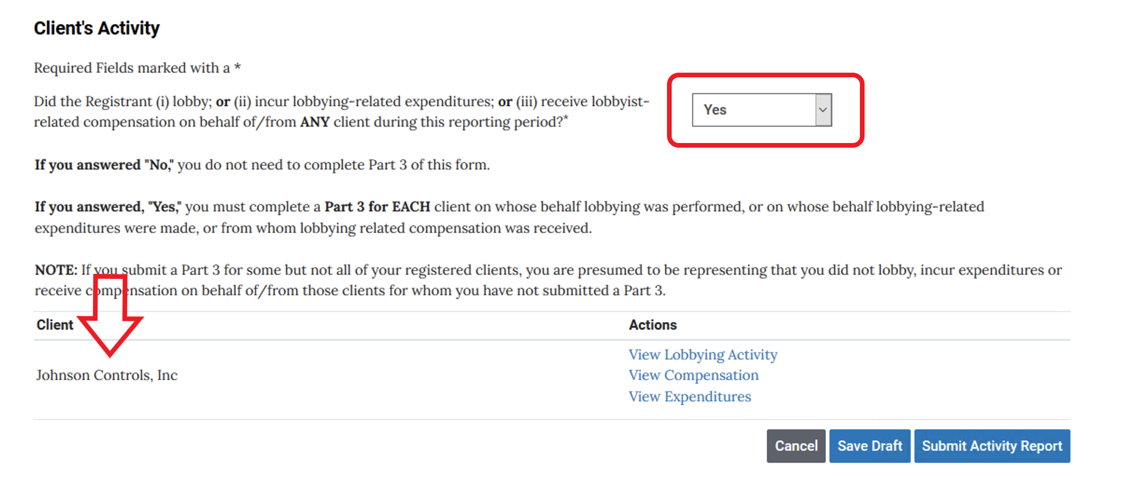
If you answer yes to the question regarding lobbying, a list of all your clients will pop up. You will then report on the client(s) you wish to delete.

Slide 11
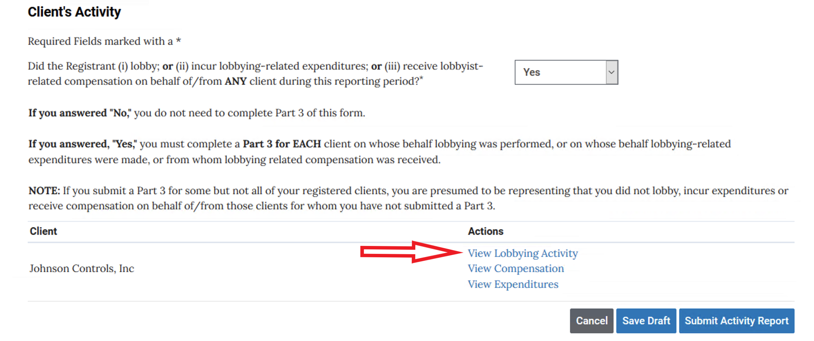
To begin reporting on the selected client, choose View Lobbying Activity from the menu.

Slide 12
If you answer the top question YES (you must answer this question), you will be asked to provide the name and information of that client.
NOTE – if you say Yes, and the particular person or entity is not already registered to you, you will have to add this client to your registration. Because the ELF system only allows you one process at a time, you will have to delete the work you have done thus far and begin by adding the client, having that addition approved, and then pay for that client. You will then begin all over in submitting your activity report.

Slide 13
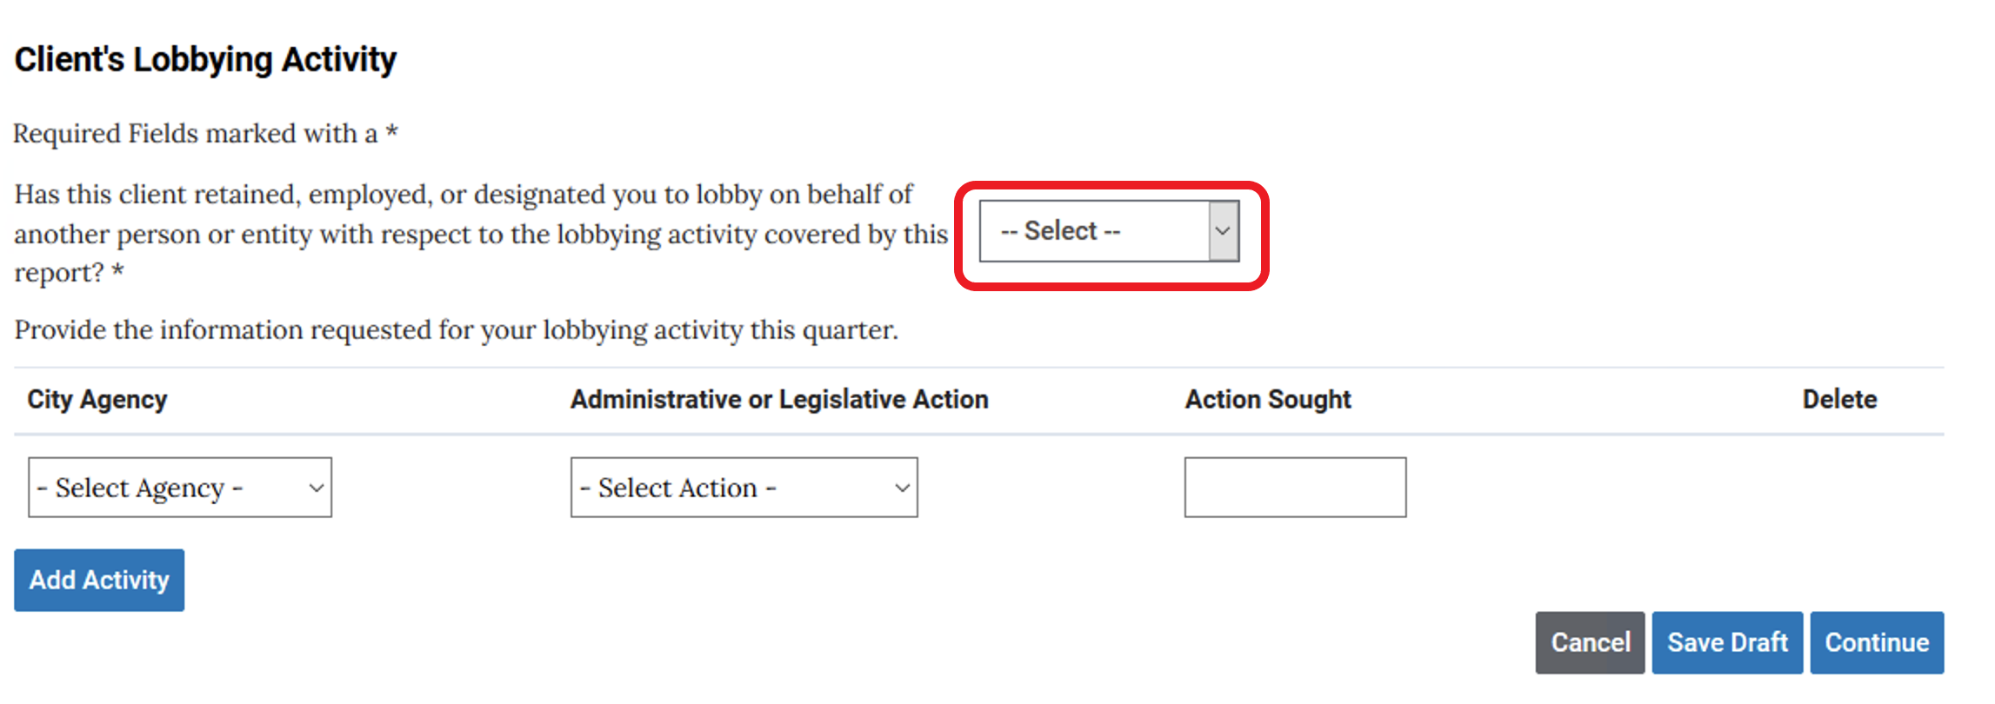
Answer this question as per instructions on the previous slide.

Slide 14
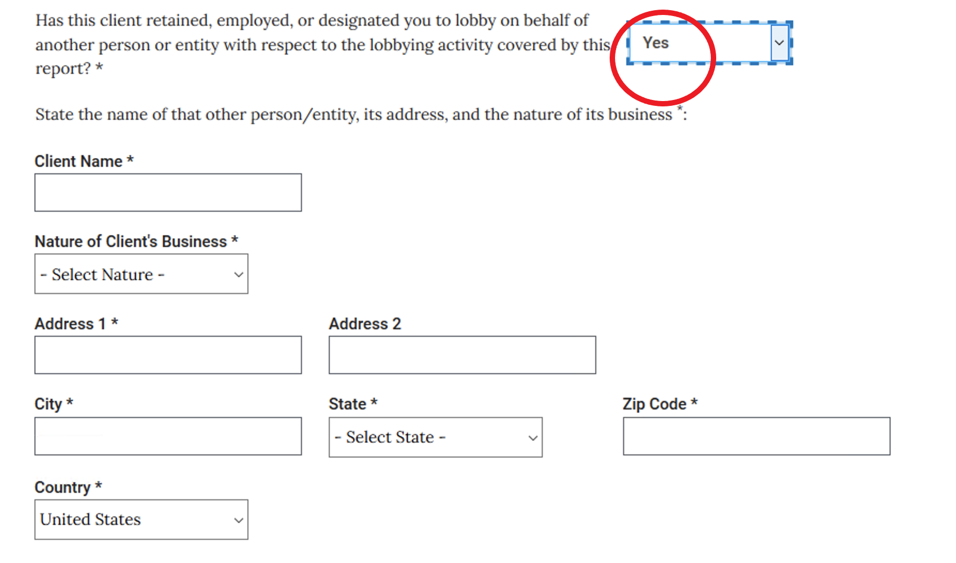
If you answered YES, provide the requested information.

Slide 15
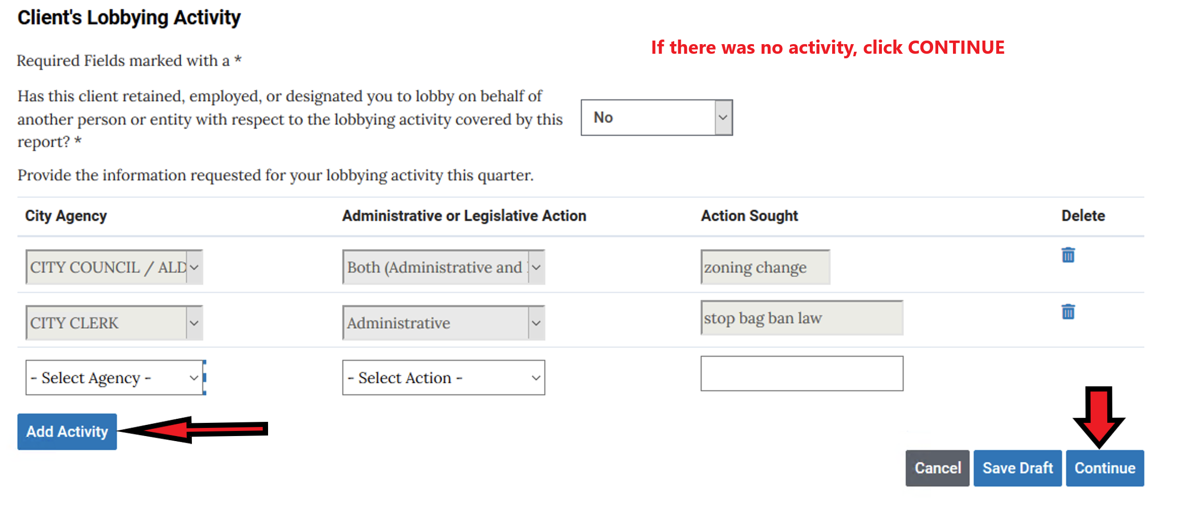
Provide the information for your lobbying activity for this client. Use the Add Activity button to report all activity. When complete or if there was no activity – click Continue

Slide 16
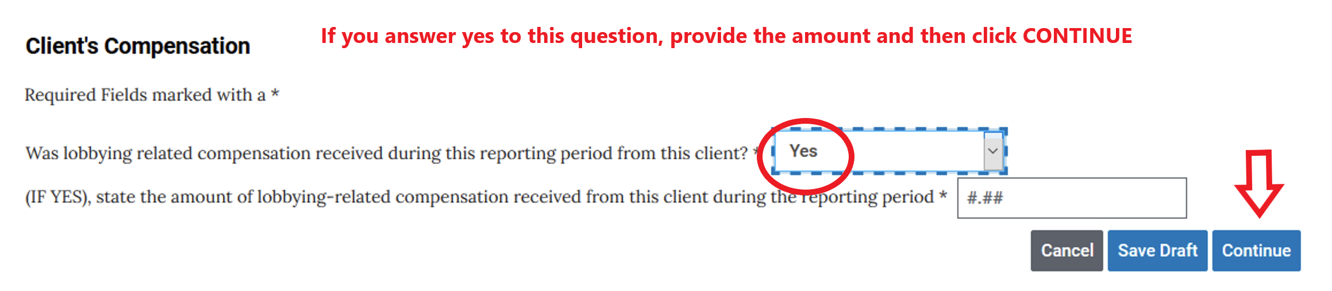
If you answer NO, click Continue. If you answer Yes, provide the amount and hit Continue

Slide 17
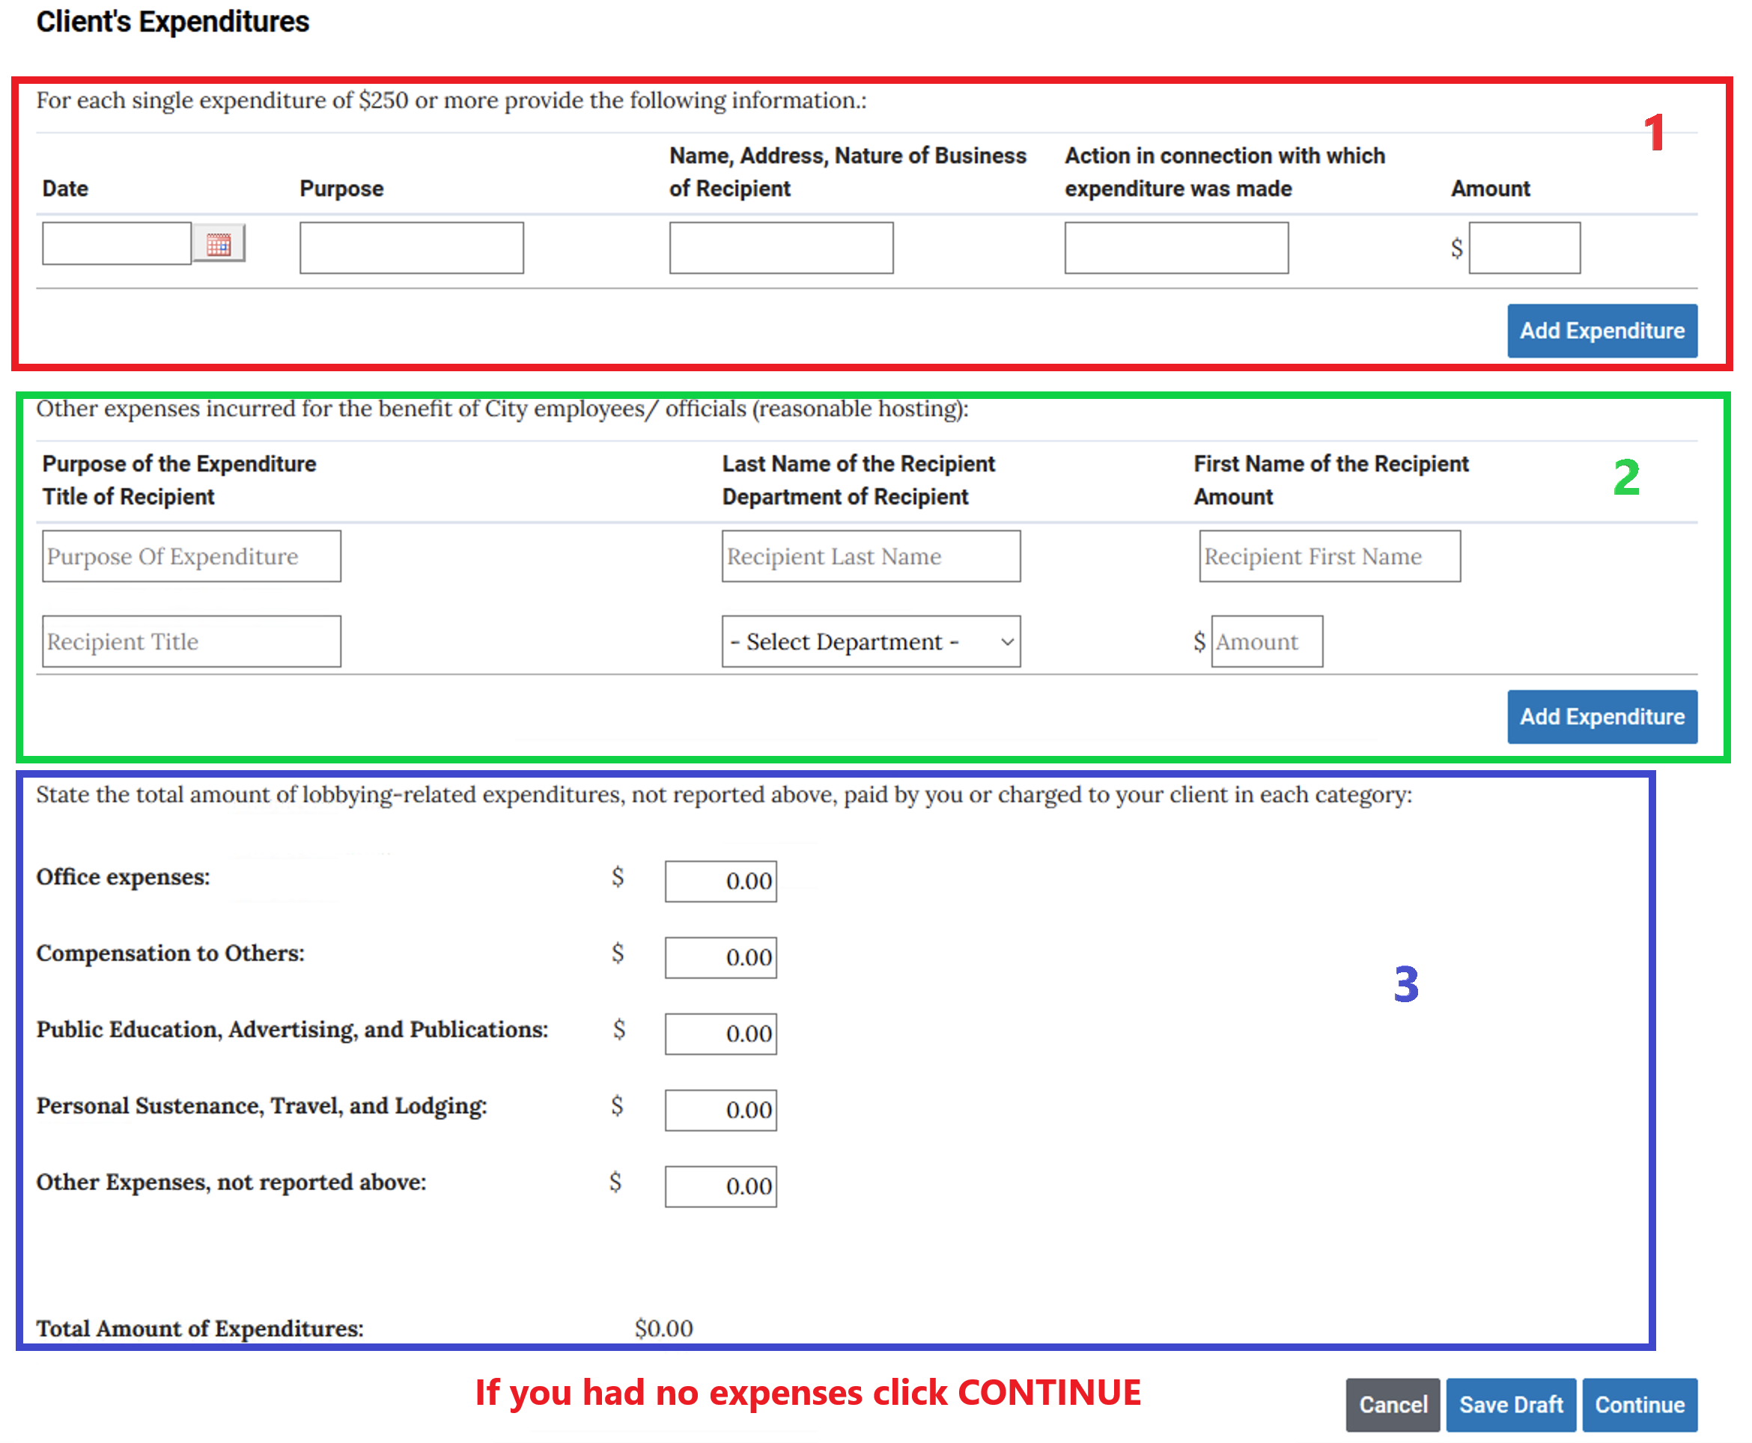
The next screen asks you to list your expenditures. Though, not marked as such in the ELF system, this page can be divided into 3 parts.

Slide 18
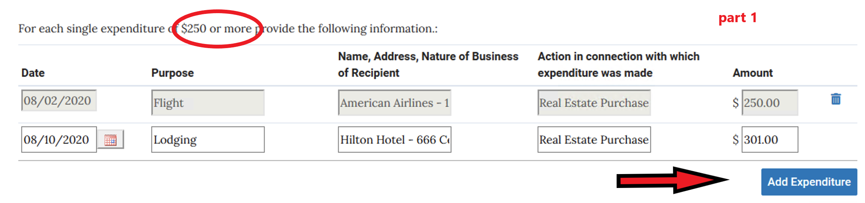
Part 1 asks you to list each single expenditure of 250.00 or more. Provide all the information. Use Add Expenditures to add more. If there are none, leave them blank.

Slide 19
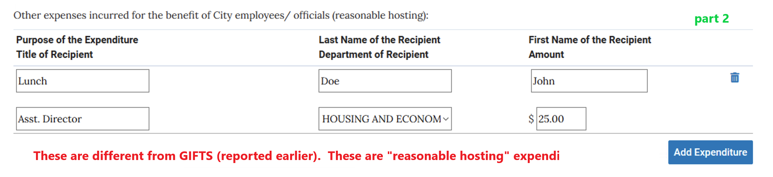
Part 2 asks you to enter other expenditures incurred for the benefit of City employees / officials (commonly referred to as “reasonable hosting” expenditures).

Slide 20
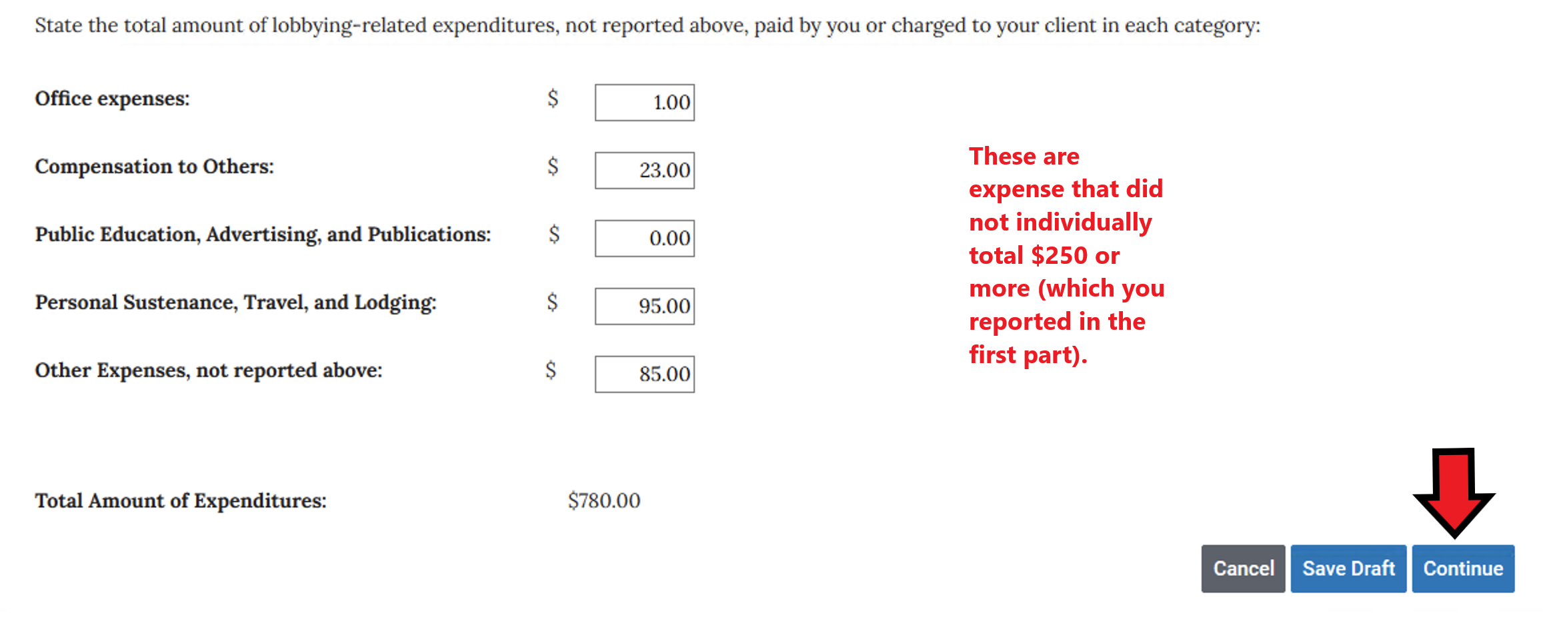
Part 3 asks you to report any expenditures (not already reported in parts 1 and 2) incurred by you or charged to your client in different categories. If there were no expenses or when all expenses are reported, click the Continue button at the bottom of the screen.

Slide 21
You may continue reporting on each client you wish to delete.
After completing your reporting, click the Submit Activity Report button on the bottom of the screen.

Slide 22
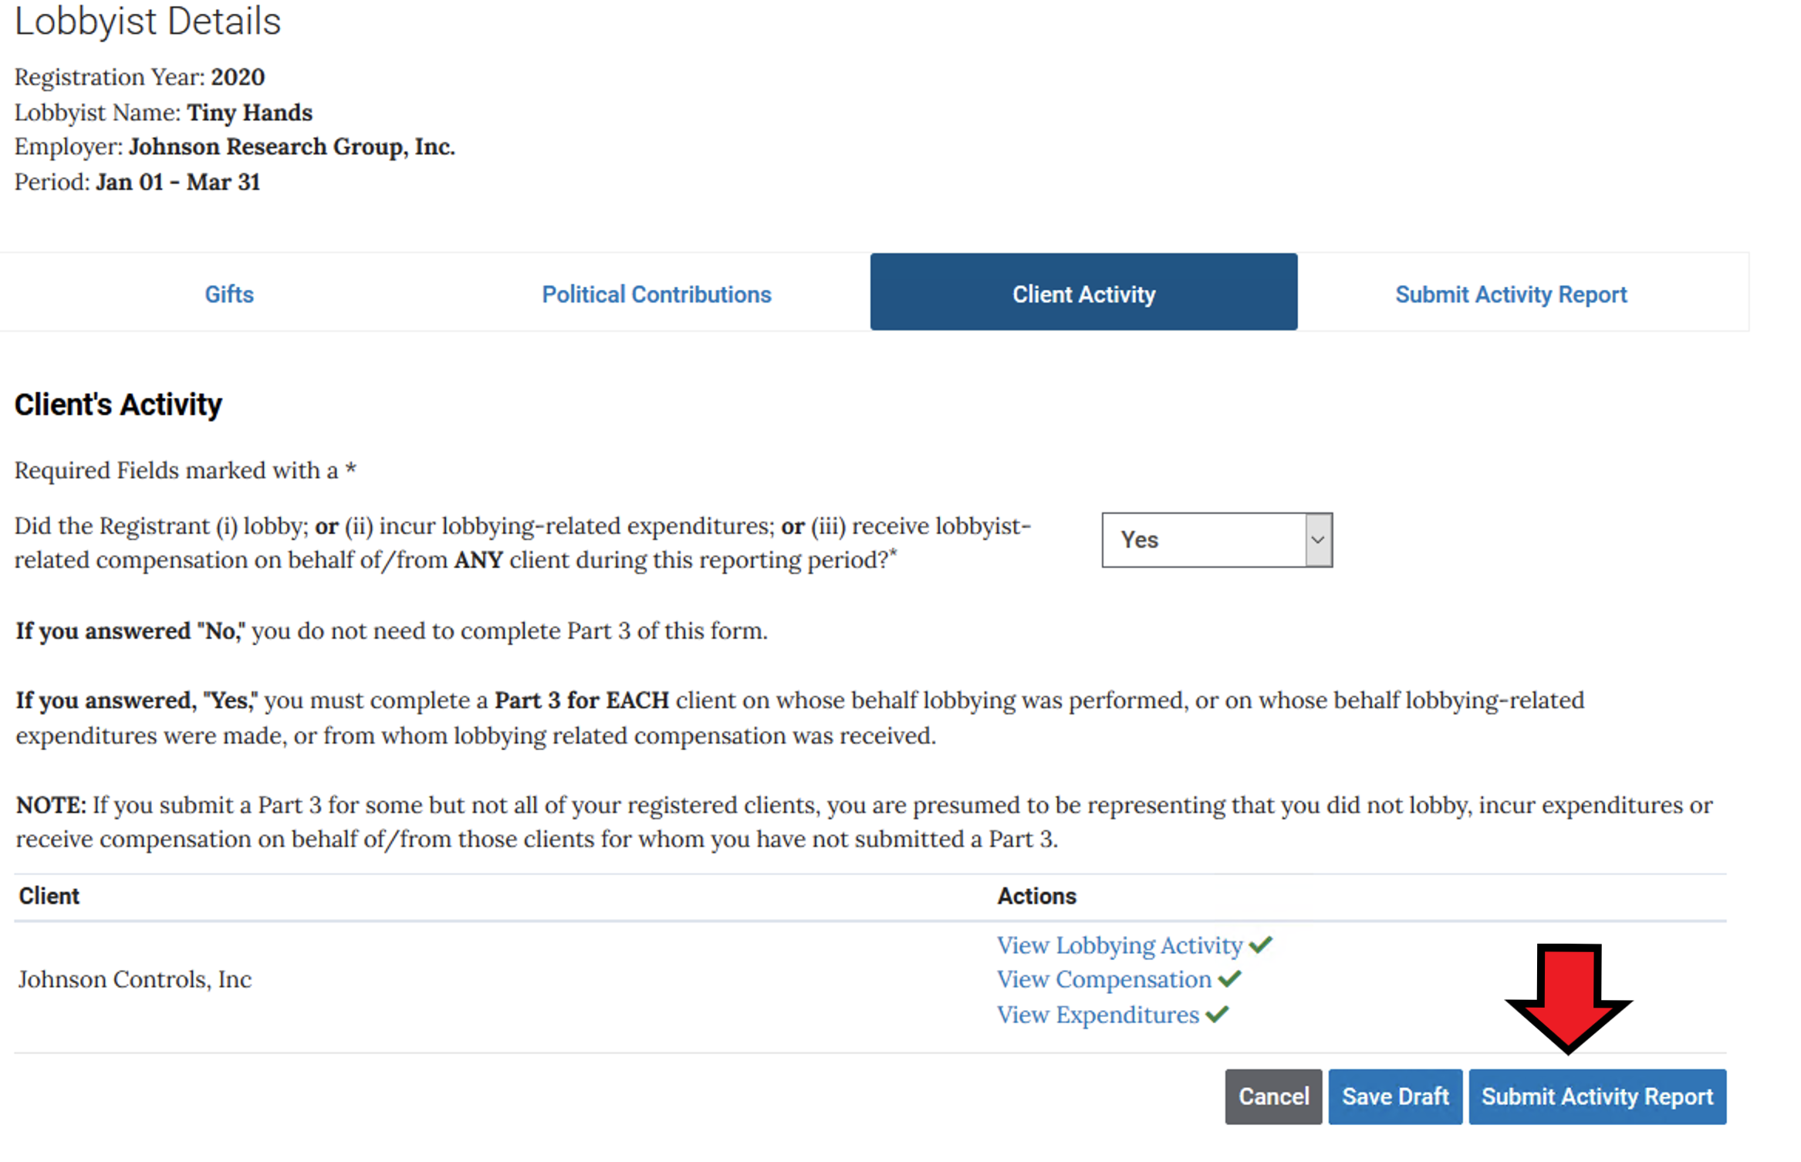
When finished reporting on all the clients you need to click Submit Activity Report

Slide 23
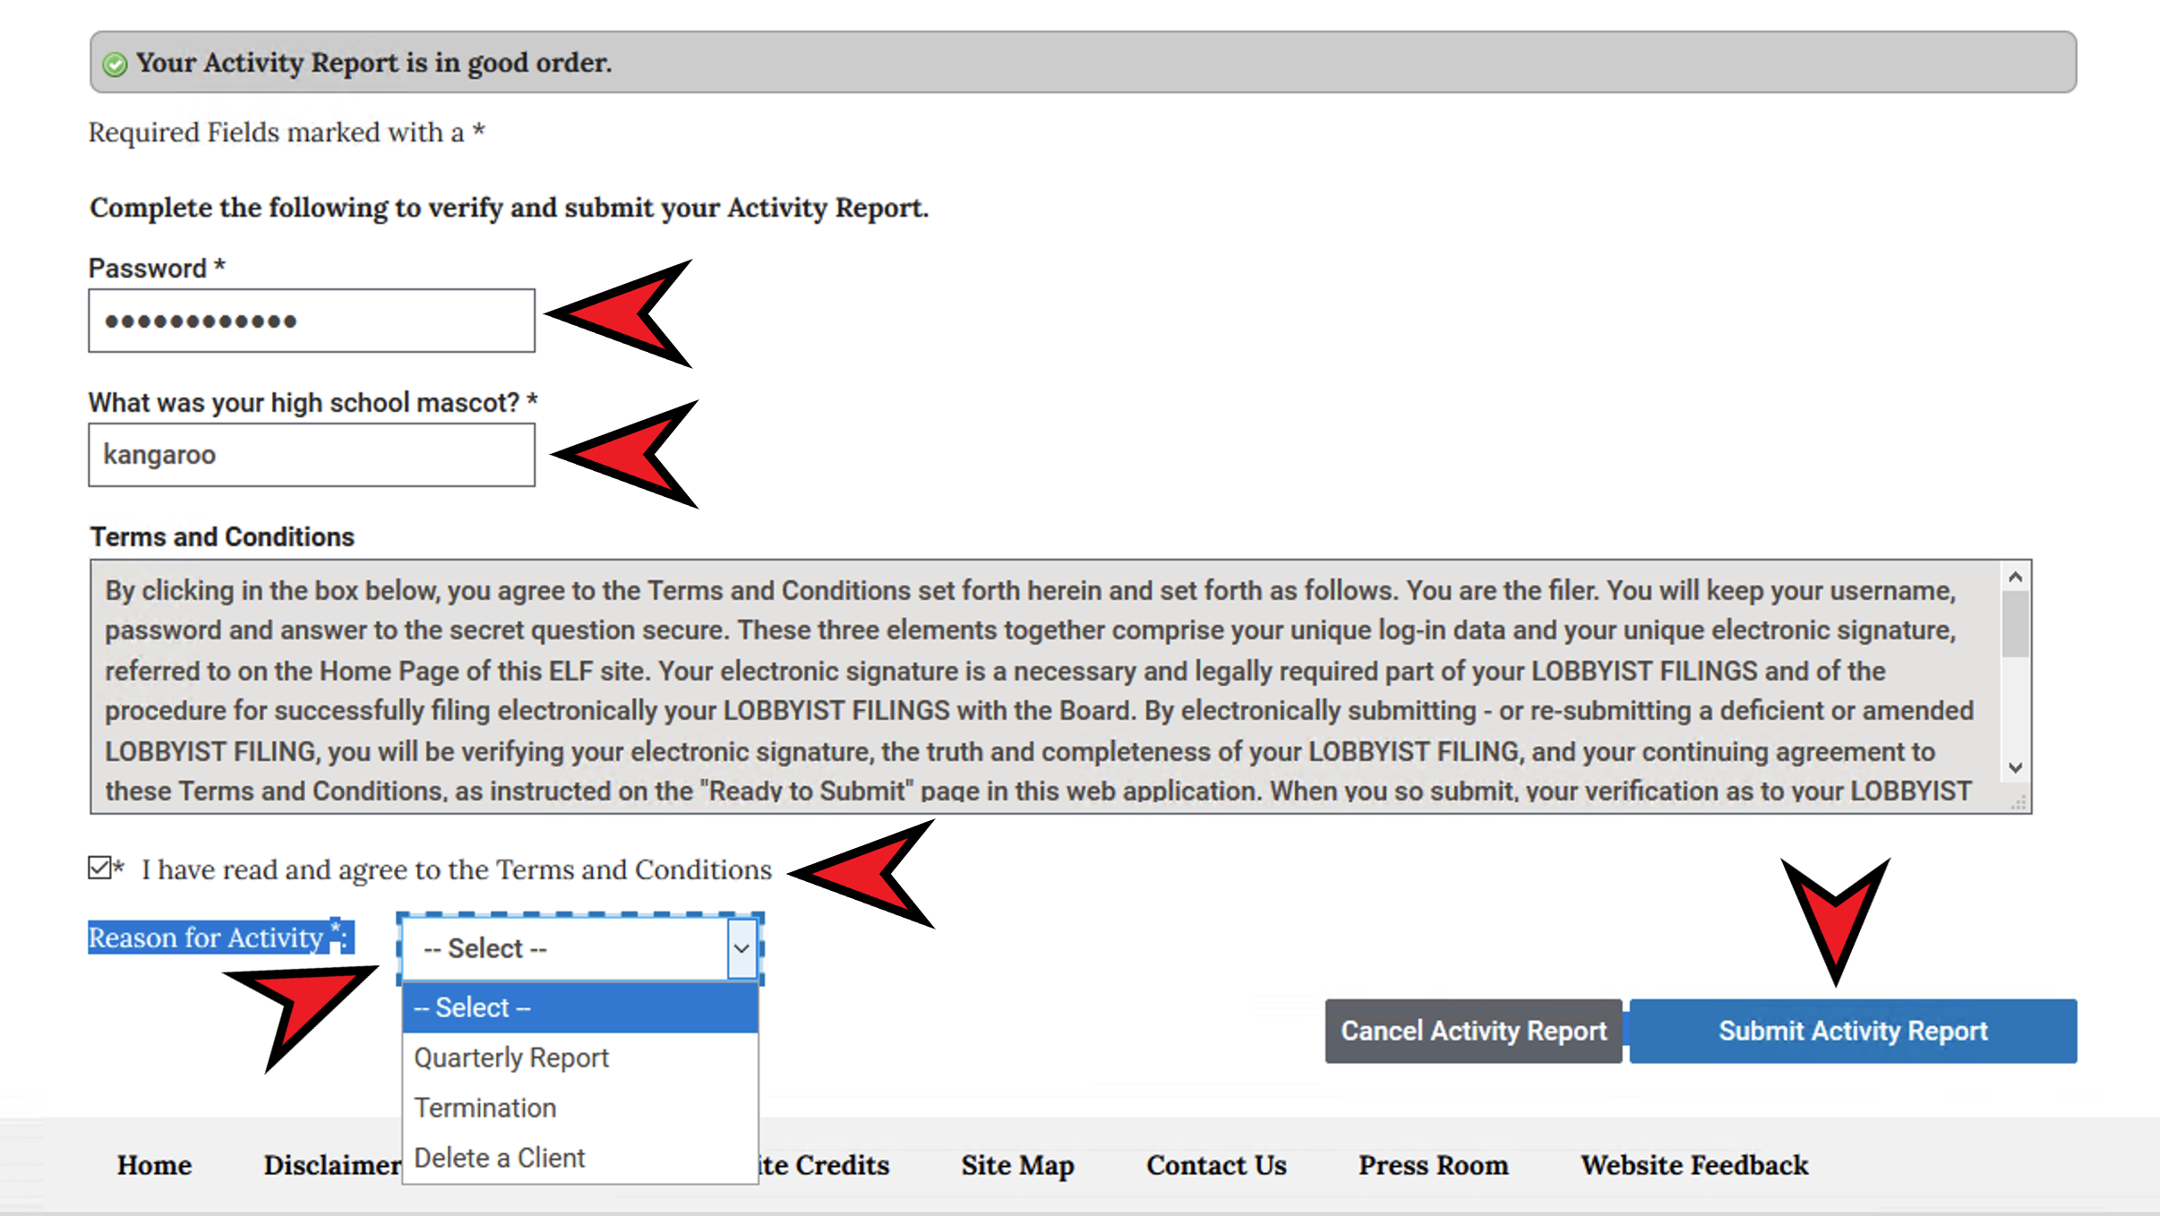
Fill in all the requested information and click Submit Activity Report. Choose Delete a Client for the Reason for the Activity Report
<<<Choose delete a Client

Slide 24
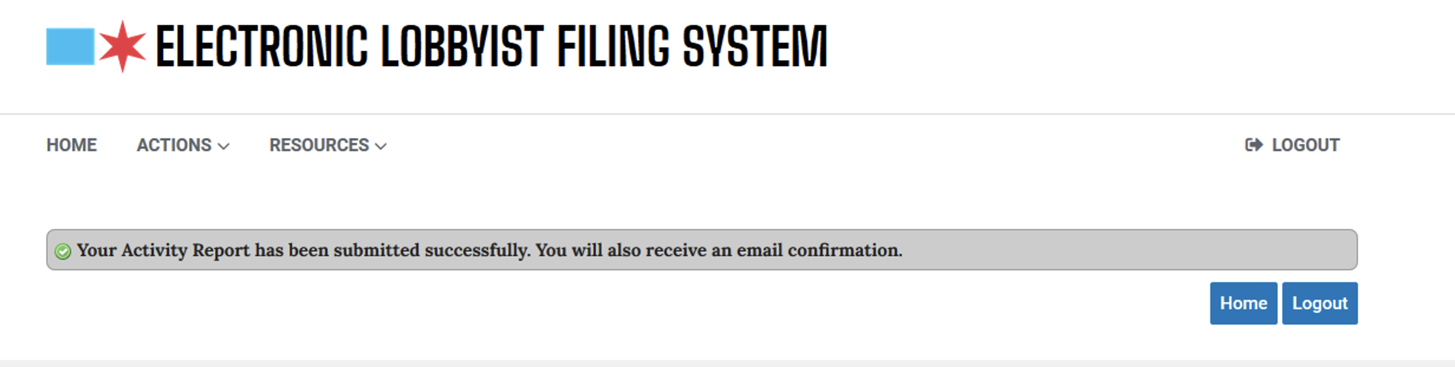
When you have properly submitted your report, an email will be sent to you and you will be taken to the screen below. Click Logout or Home

Slide 25
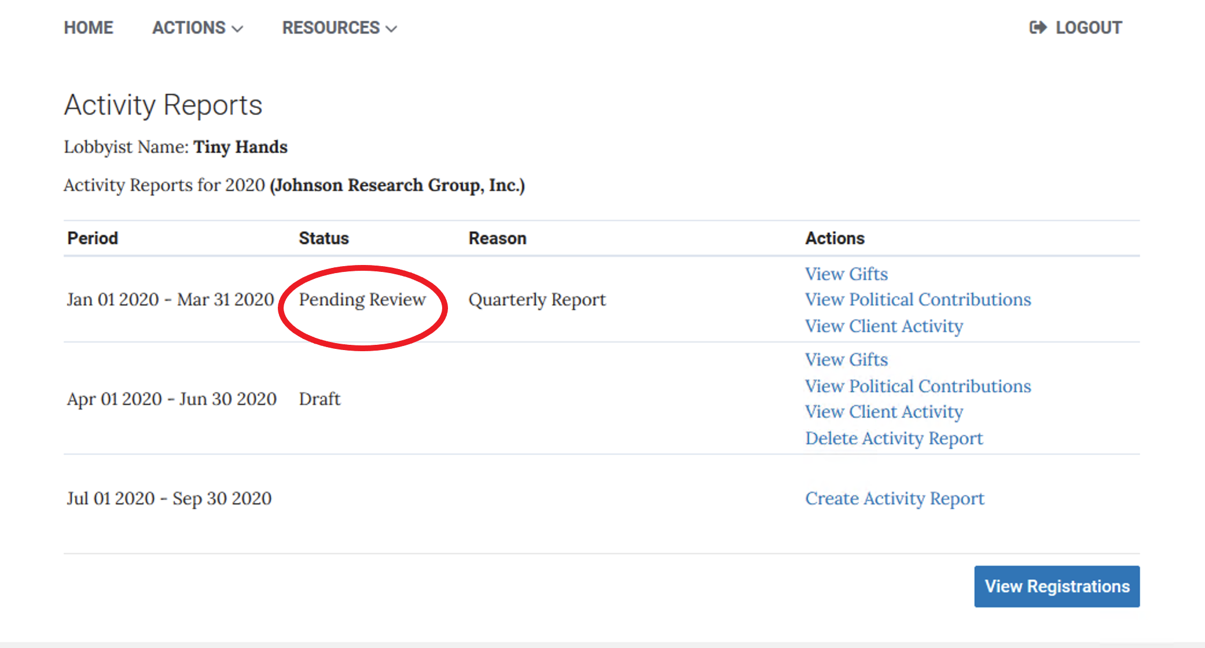
Until our staff has reviewed your report and accepted it as complete, your status will be Pending Review.

Slide 26
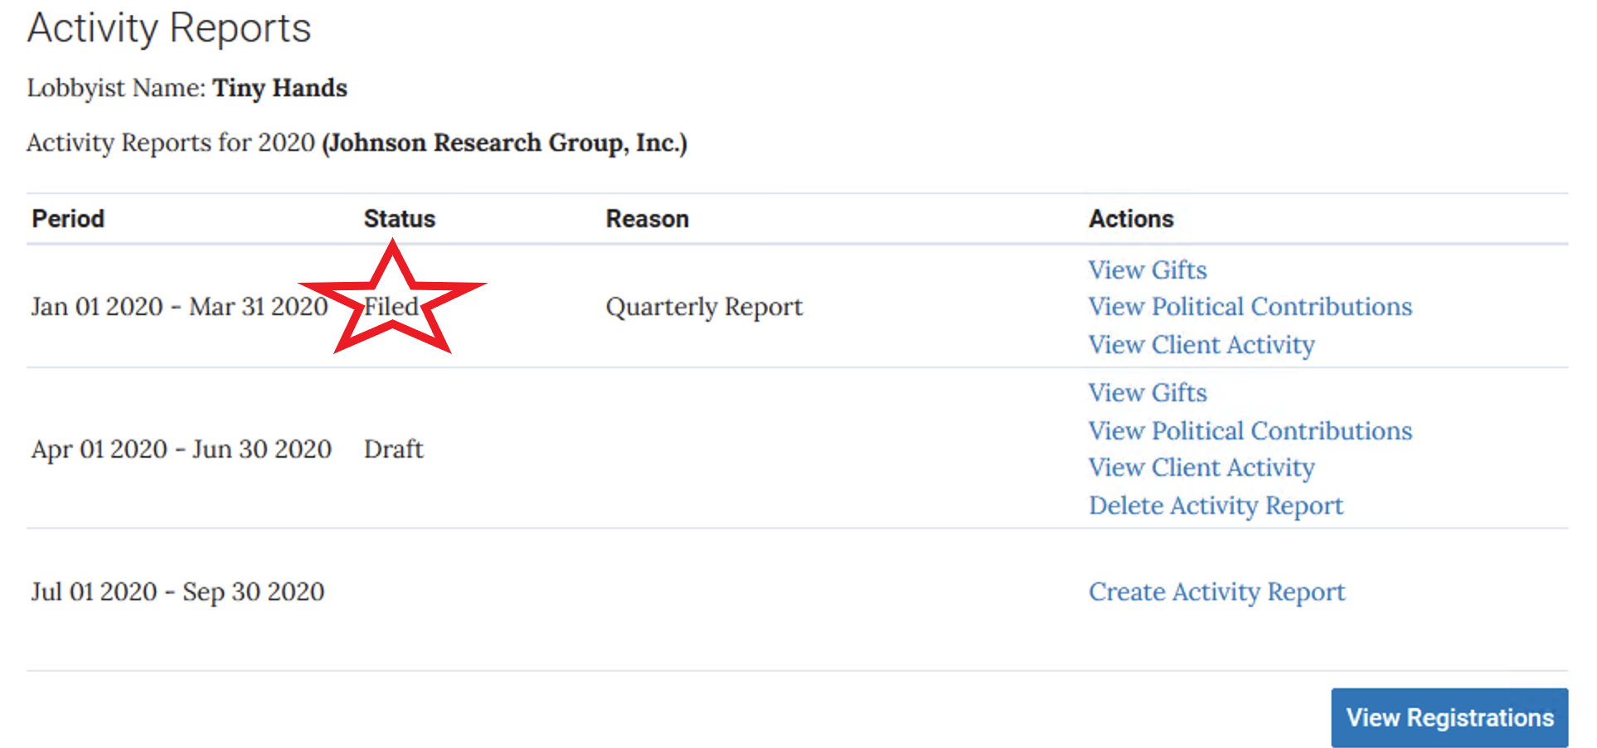
Once reviewed and accepted your status becomes FILED. You will receive an email to that effect.

Slide 27
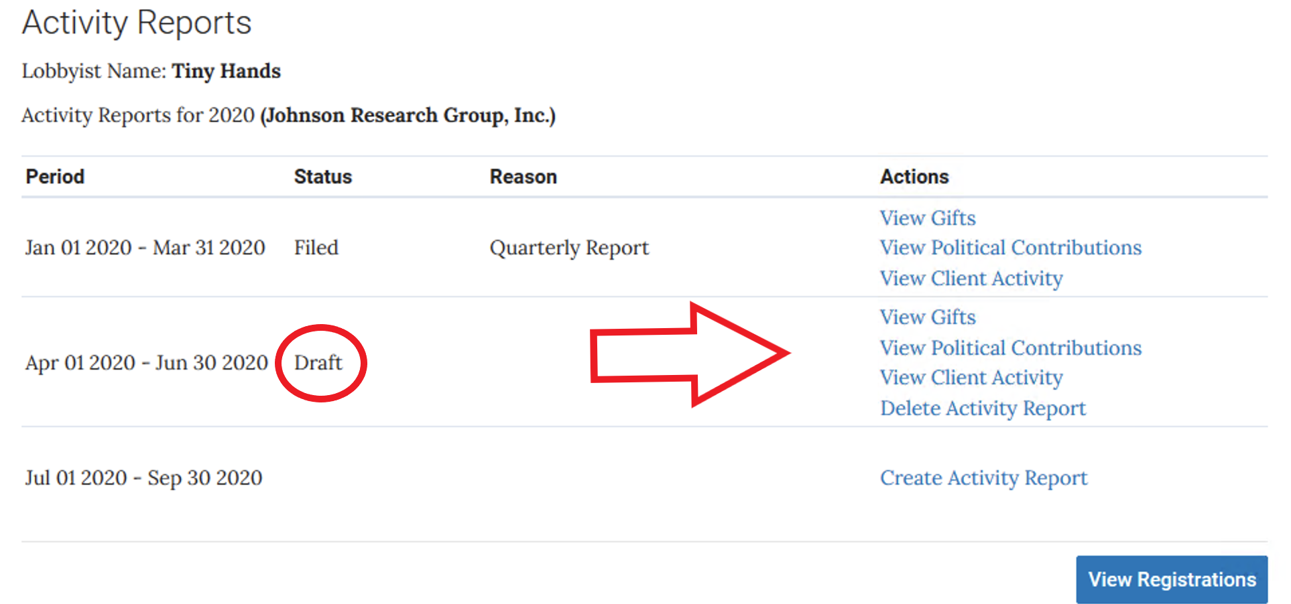
If your submission is rejected and needs correction, you will receive an email telling you why and your status will be changed to DRAFT. This will allow you to go back into the form to make any corrections necessary and re-submit. By clicking on Gifts, Political Contributions or Client Activity, you can then go back into the form and make your corrections.

Slide 28
Once your Activity Report has been approved you will then return to ELF and remove the client(s) from your registration.

Slide 29
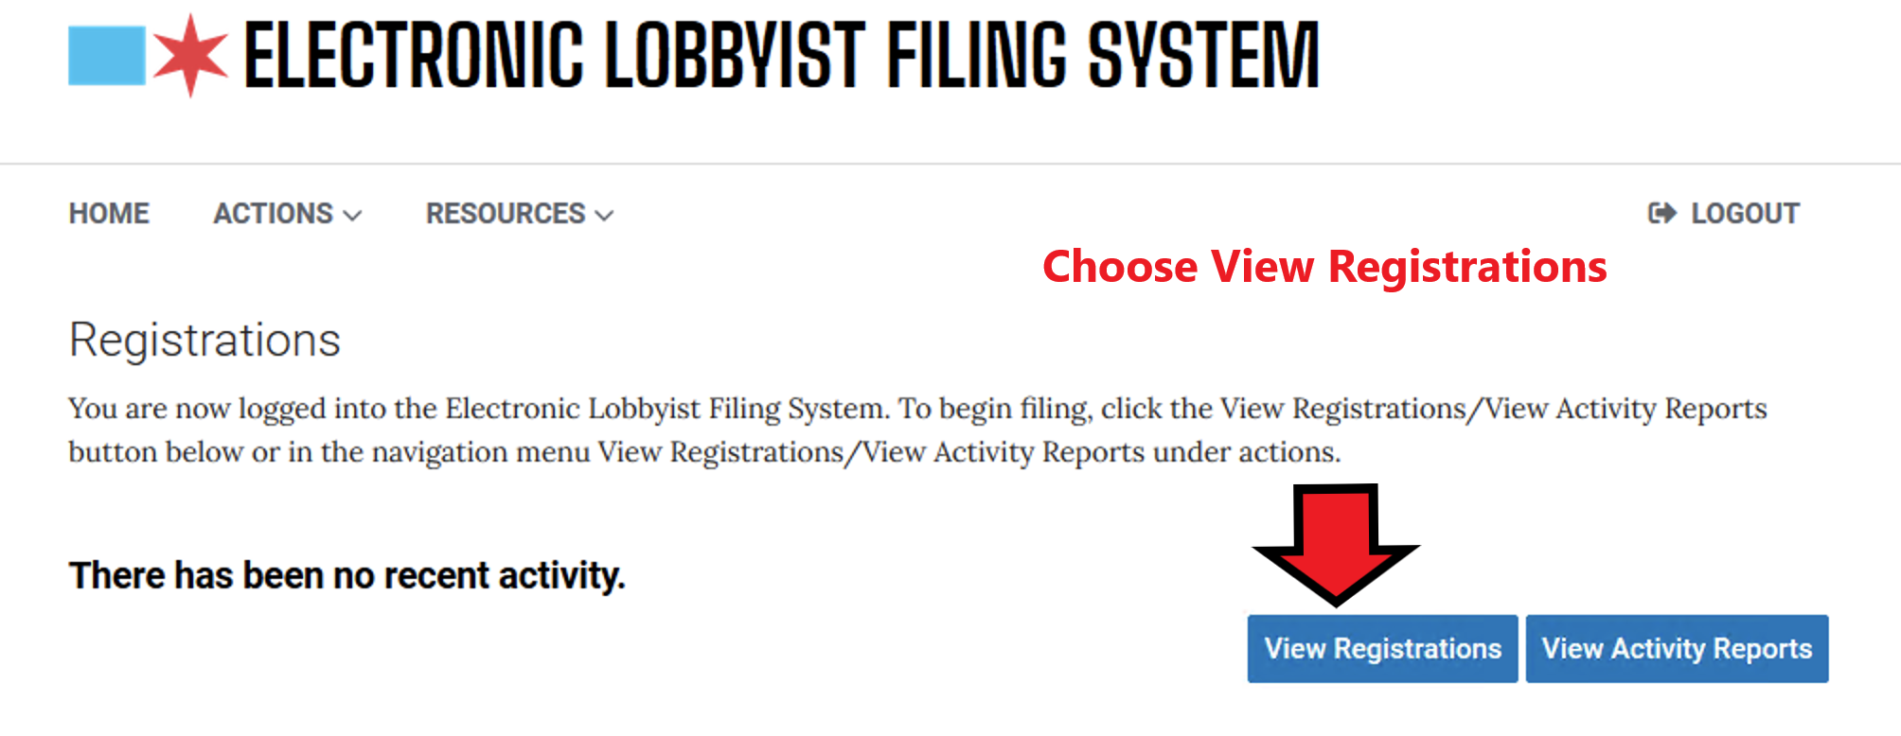
Log in and Choose View Registrations

Slide 30
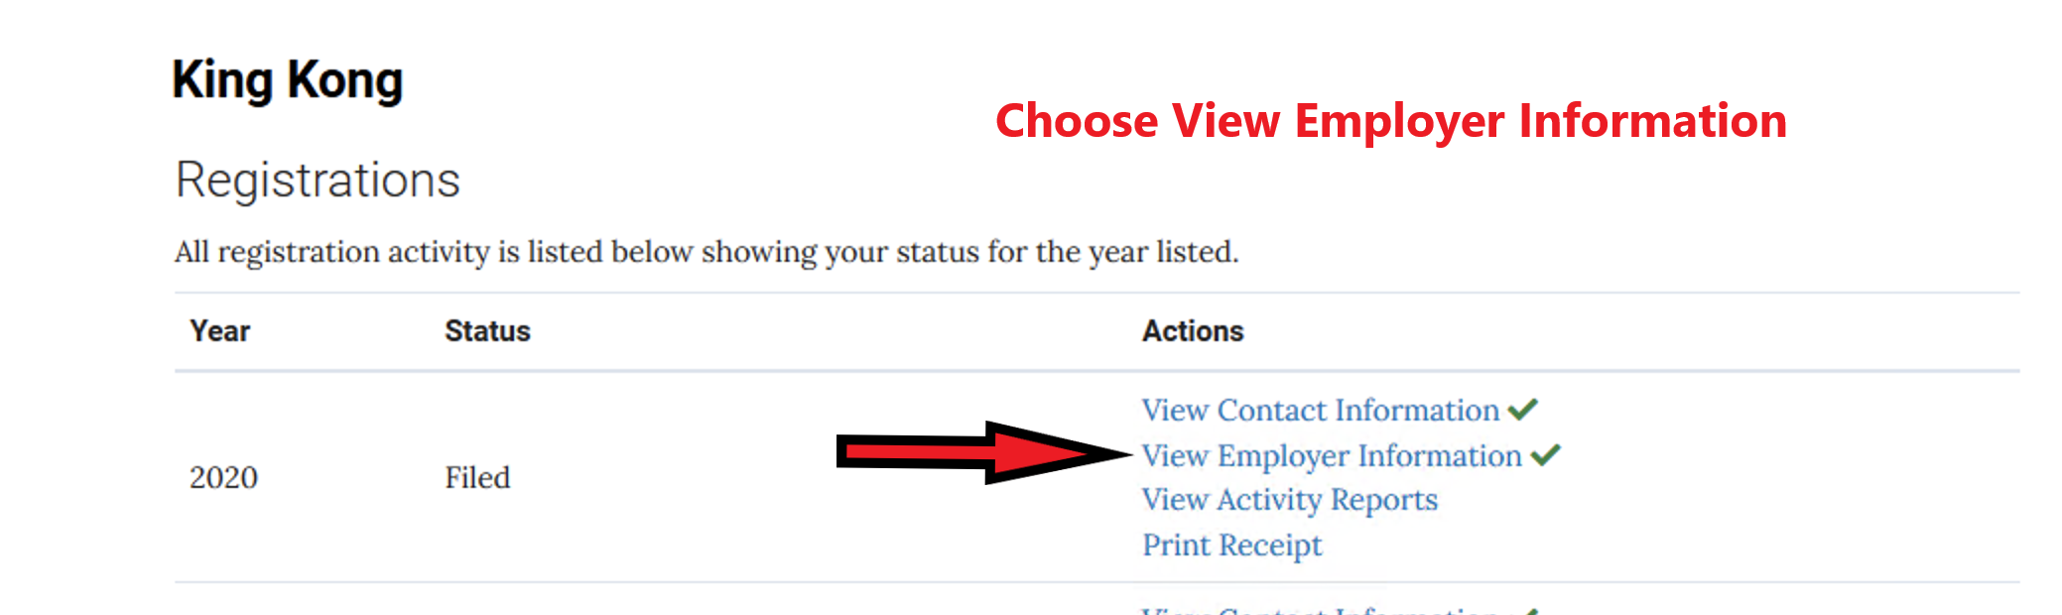
Choose View Employer Information

Slide 31
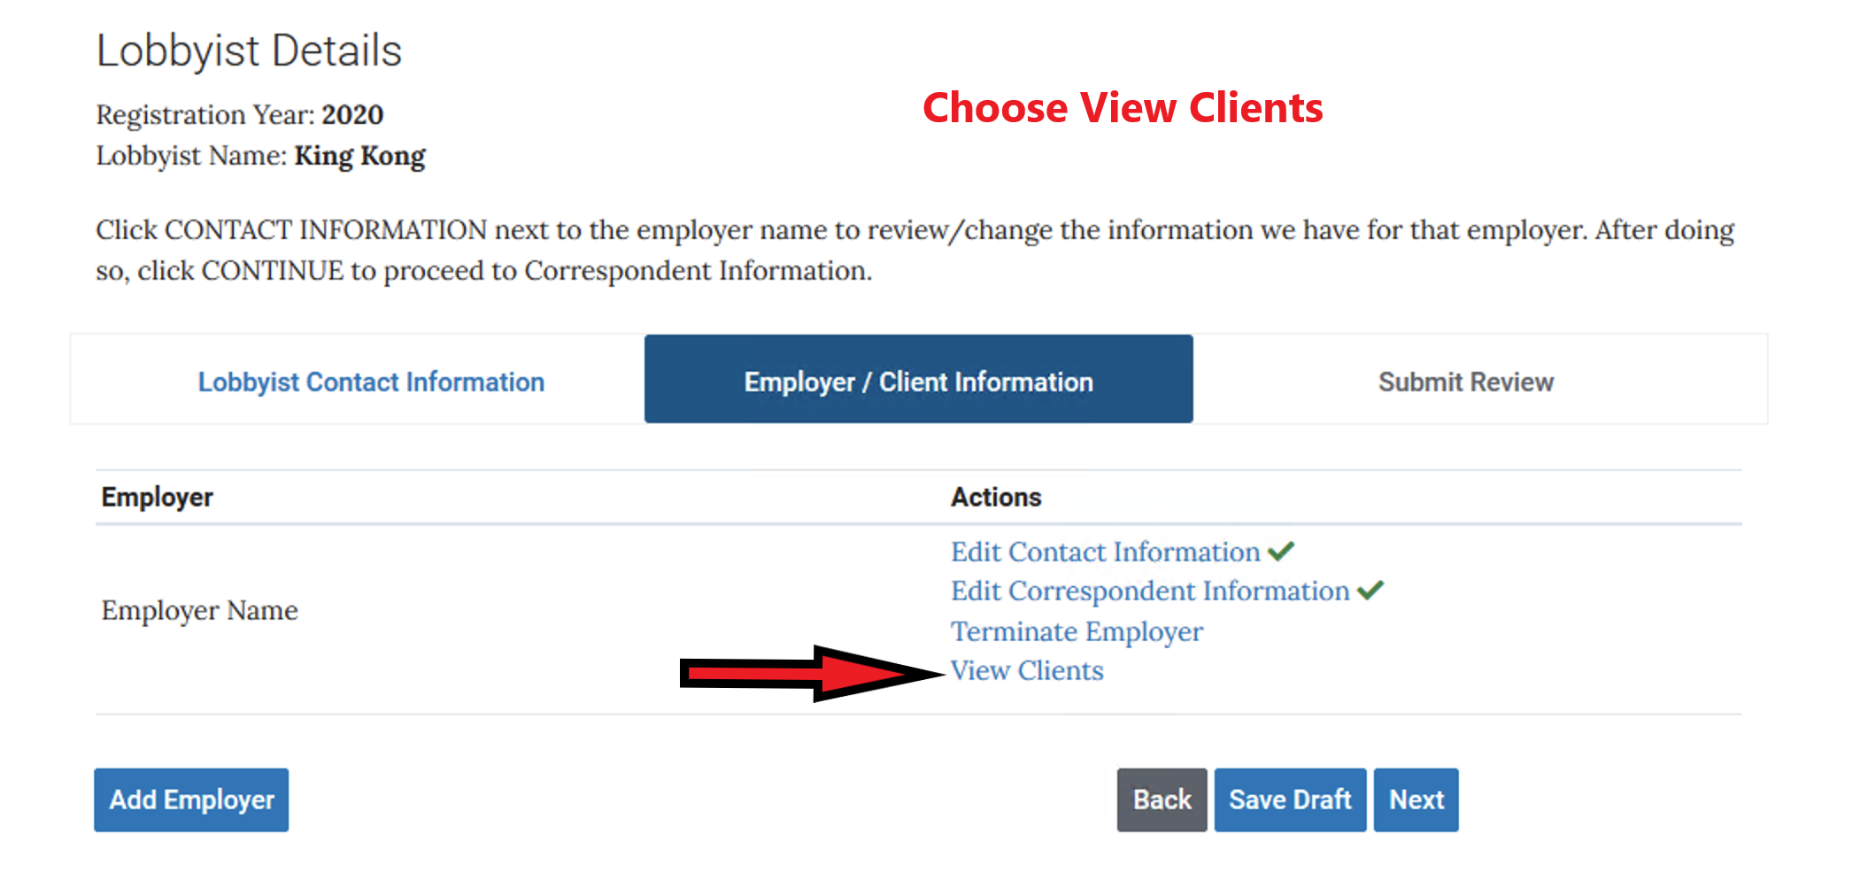
Choose View Clients

Slide 32
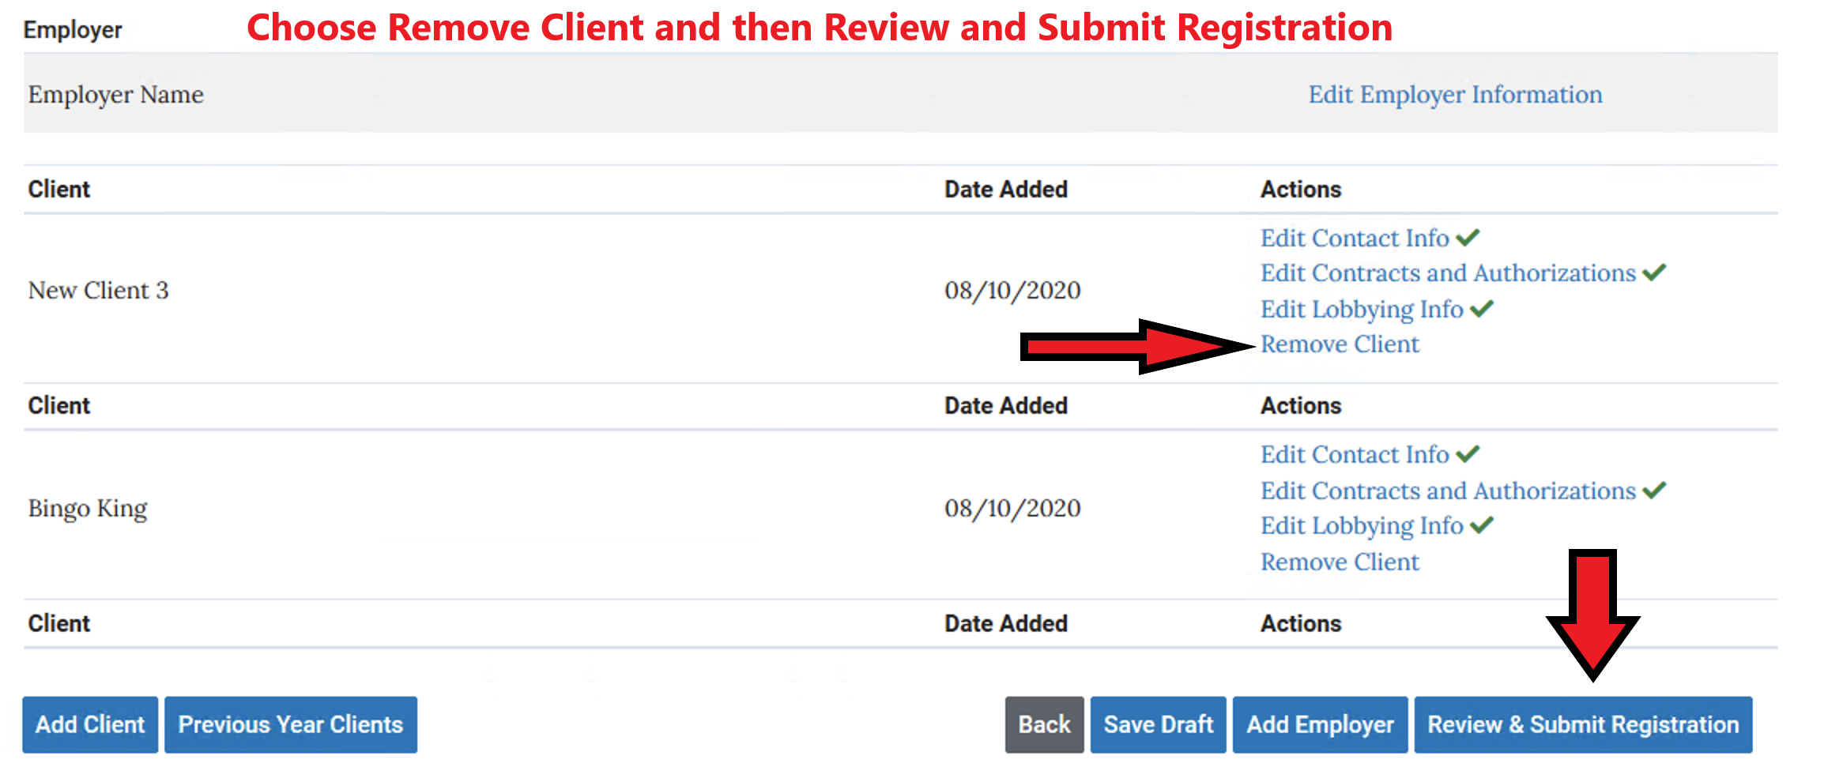
For each client you want to delete, choose Remove Client and then Review and Submit

Slide 33
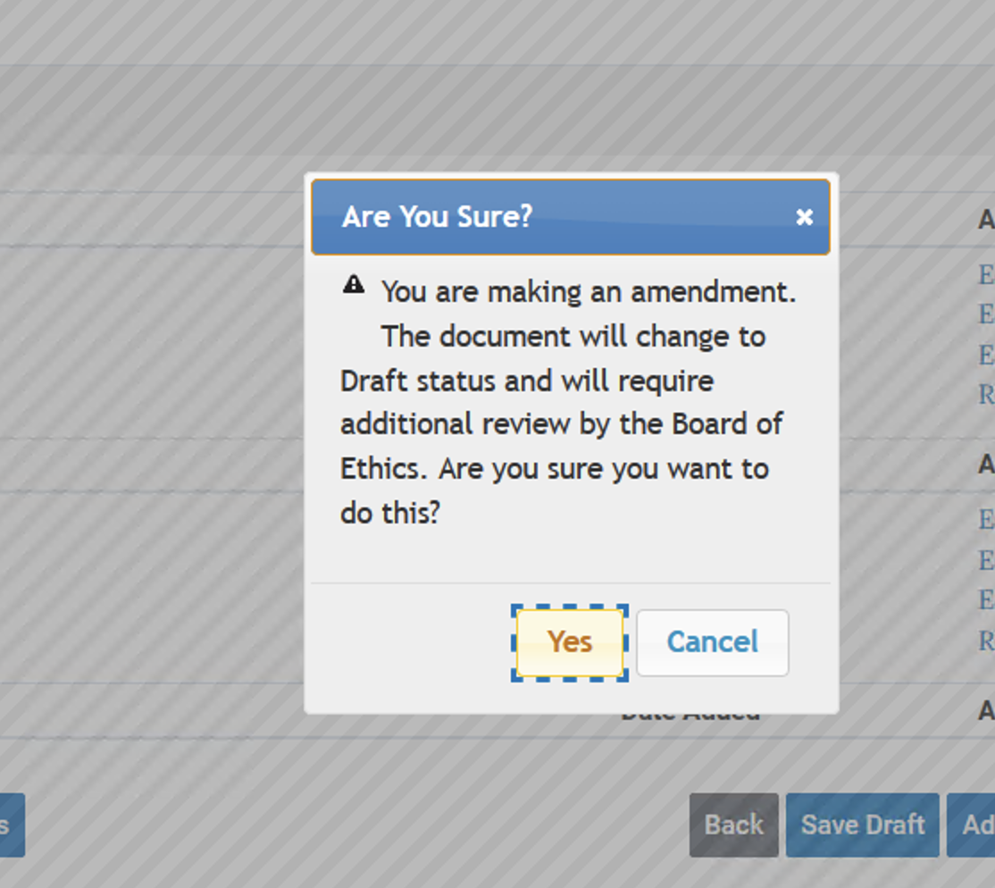
A pop up will appear asking you to confirm the changes – click Yes

Slide 34
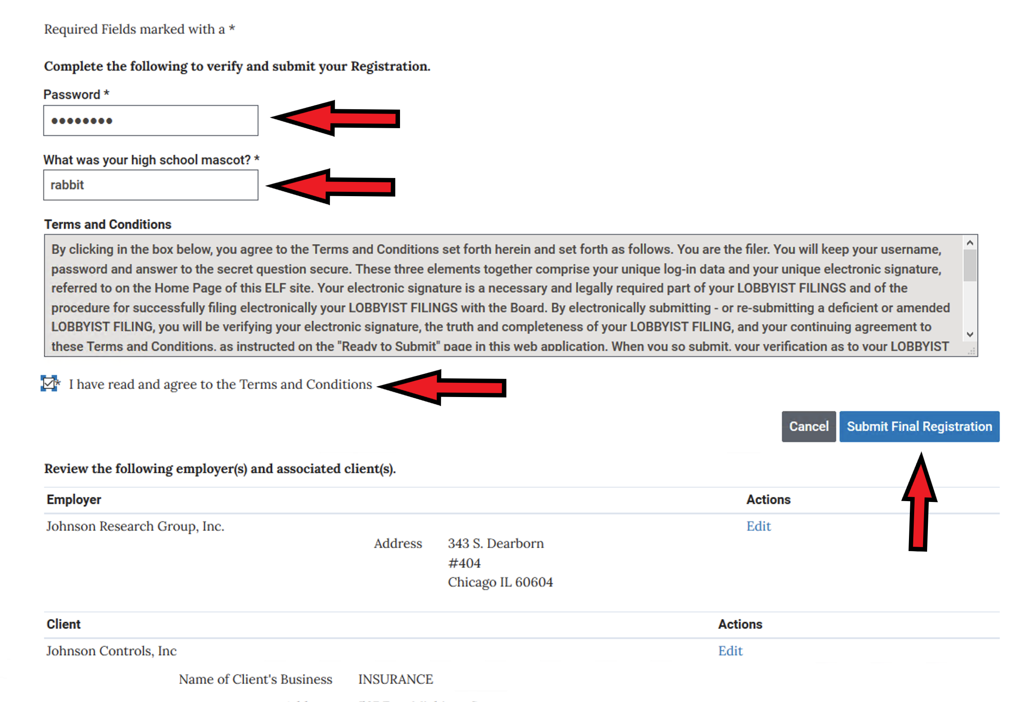
Provide your Password, Security Answer and click that you have read the terms and conditions. You can review what you are submitting by scrolling down the page. Click Submit Final Registration

Slide 35
Your Submission will go into Pending Review status.
Once your submission is reviewed and Approved, your Filing will go into Filed Status.

