Slide 1
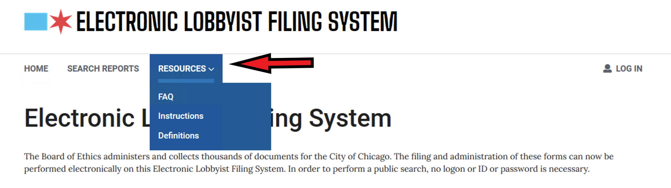
Before beginning. Just a reminder that clicking the Resources link at the top of all the pages in ELF you can find links to Instructions, FAQ’s and Definitions.

Slide 2

A Step-by-Step Guide to Registering as a lobbyist with the Chicago Board of Ethics using the “ELF” System.
For Lobbyists representing Non-Profits who may be entitled to a fee waiver.
Chicago Board of Ethics
740 North Sedgwick, Suite 500
Chicago, IL 60654
312-744-9660
https://www.chicago.gov/city/en/depts/ethics.html
Lori Lightfoot, Mayor
William F. Conlon, Chair

Slide 3
Registering as a Lobbyist
These instructions will walk you through, screen by screen, how to use the Electronic Lobbyist Filing System (ELF) to register as a lobbyist. There are other presentations for Activity Reports and Termination.
The ELF is found at this website: https://webapps1.chicago.gov/elf/index.html

Slide 4
If you are a new lobbyist and have never registered before, please follow the directions below.
If you are already registered and want to add more clients to your registration - begin at slide 16.
For other instructions and helps, please click the RESOURCES button at the top of the ELF screens

Slide 5
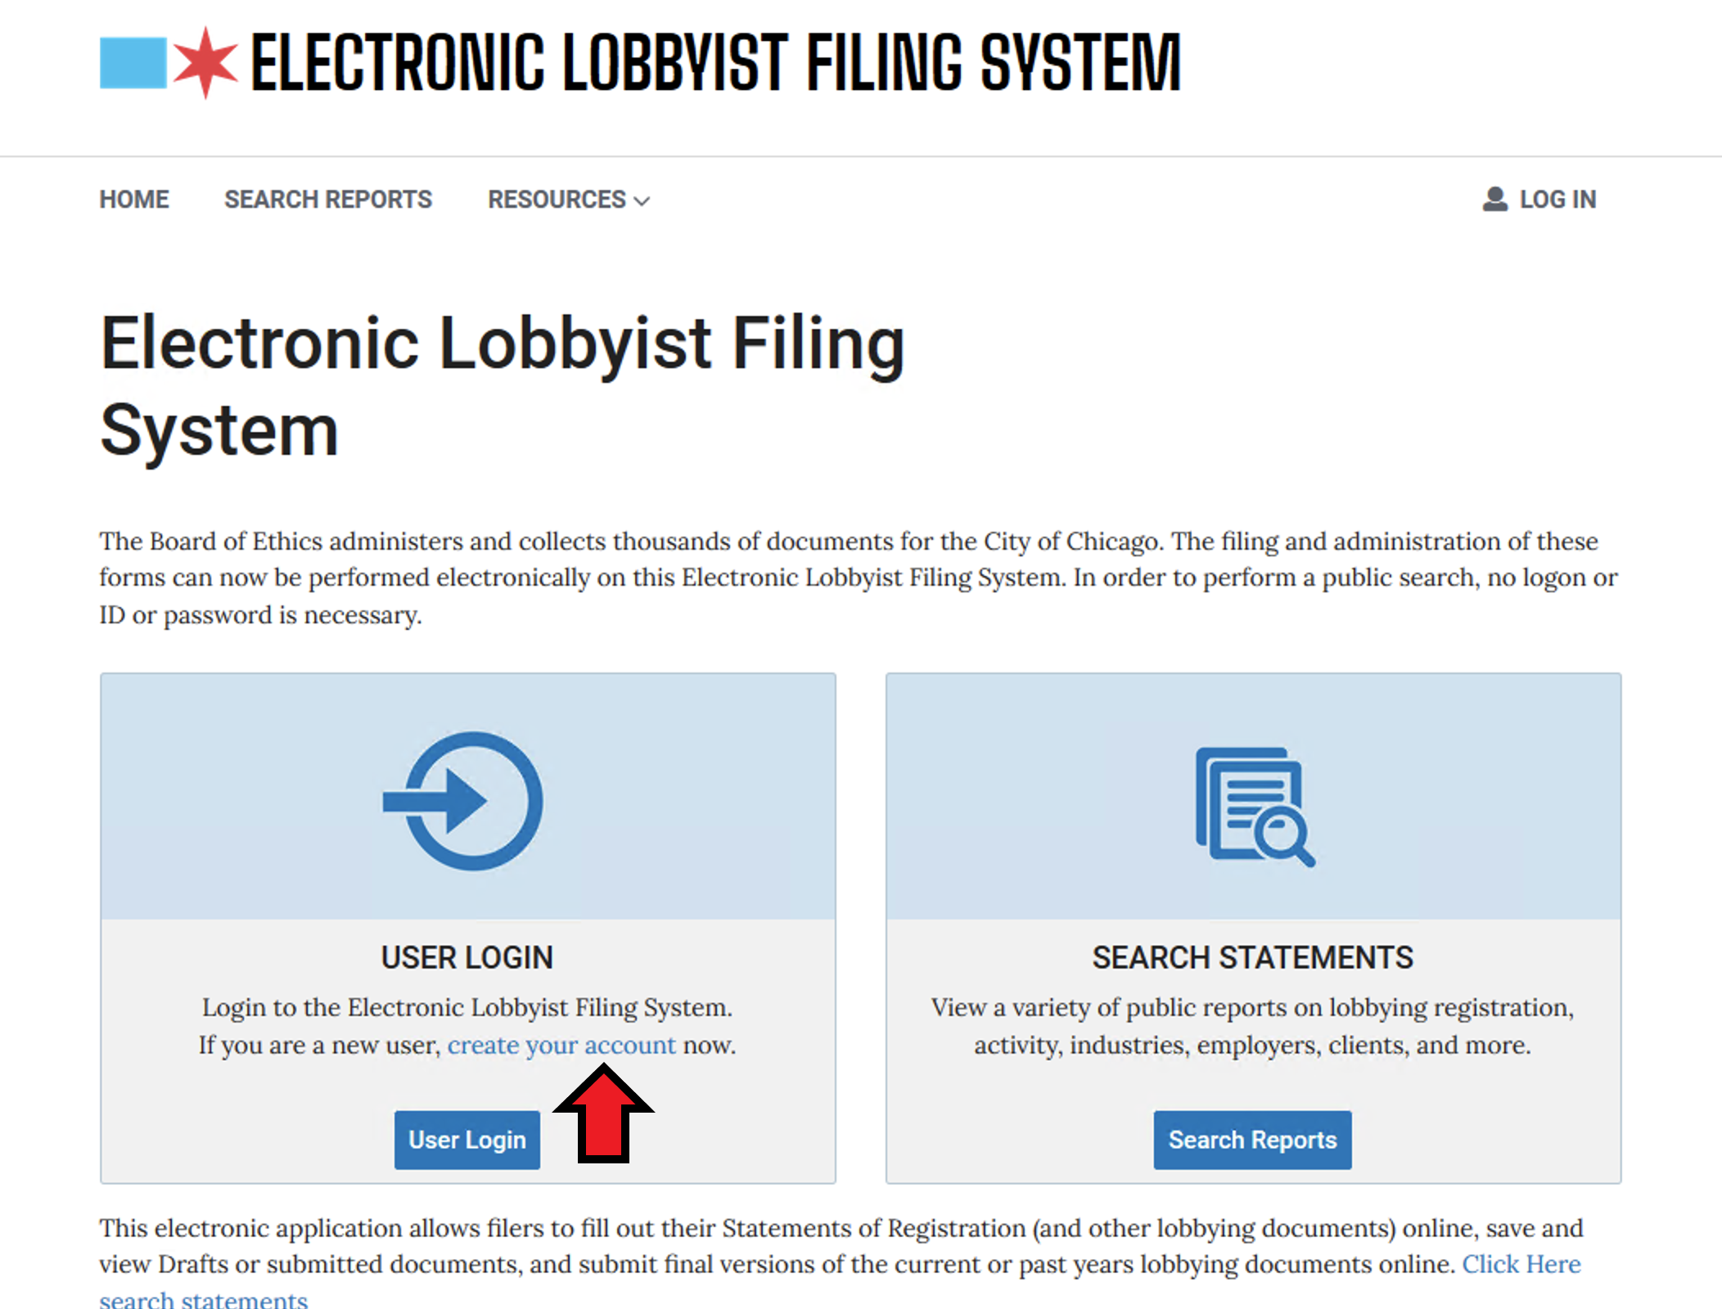
For new lobbyists, you will have to create your login name and password. Click on Create Your Account

Slide 6
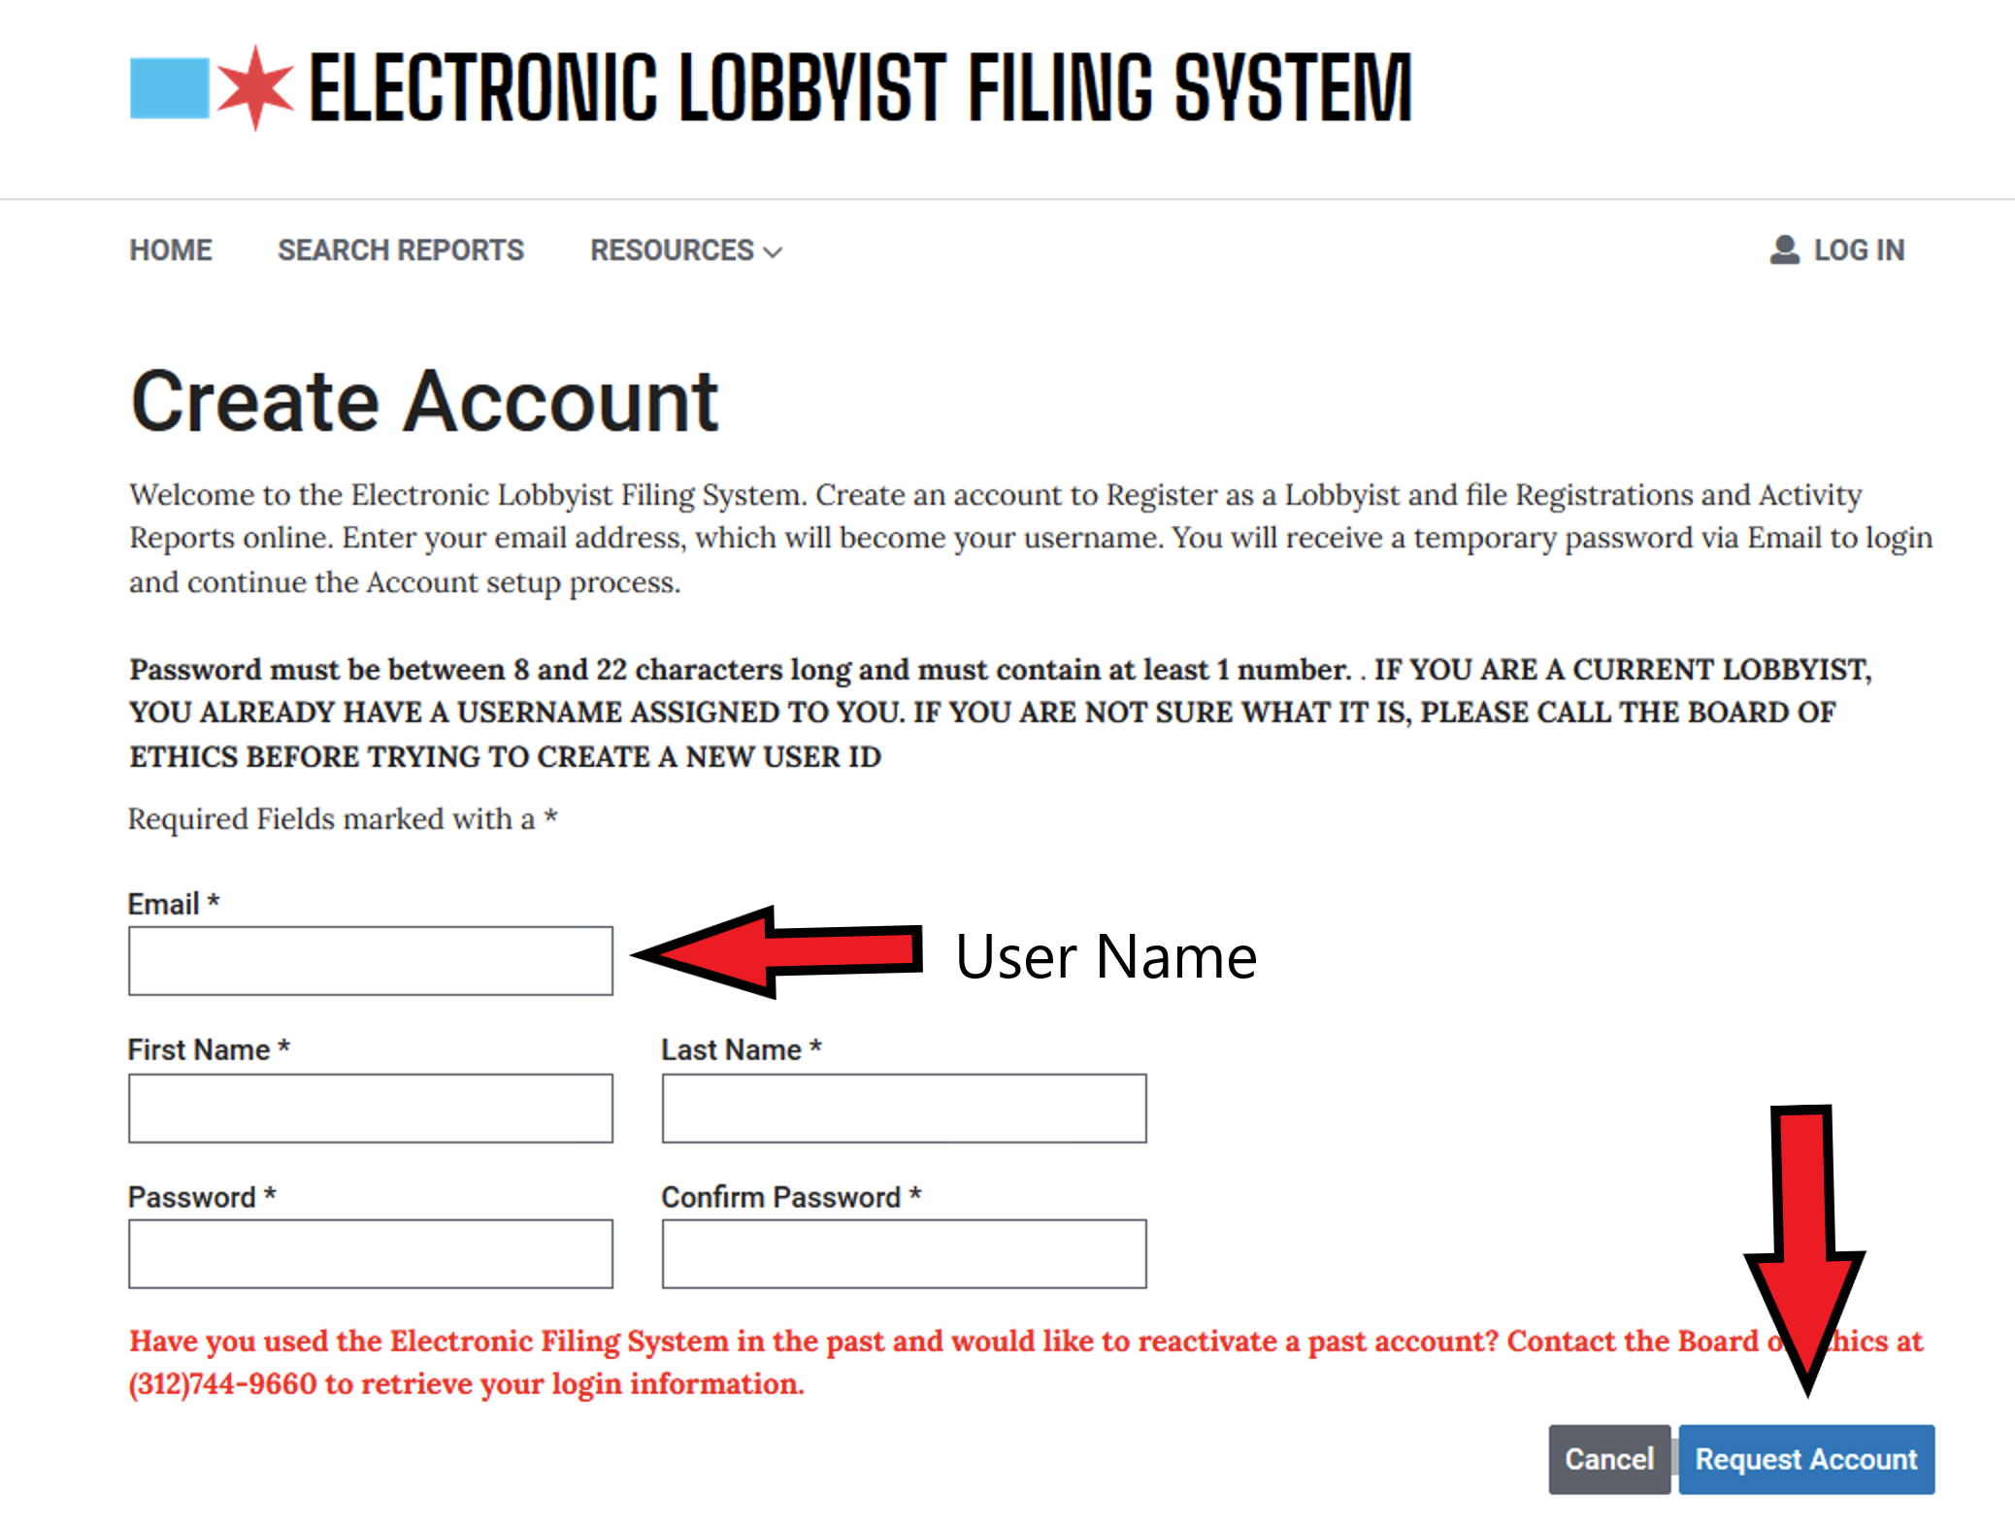
Provide all the requested information and click the Request Account button. The email address you provide at this step is also your login user-name This should be unique for each lobbyist.

Slide 7
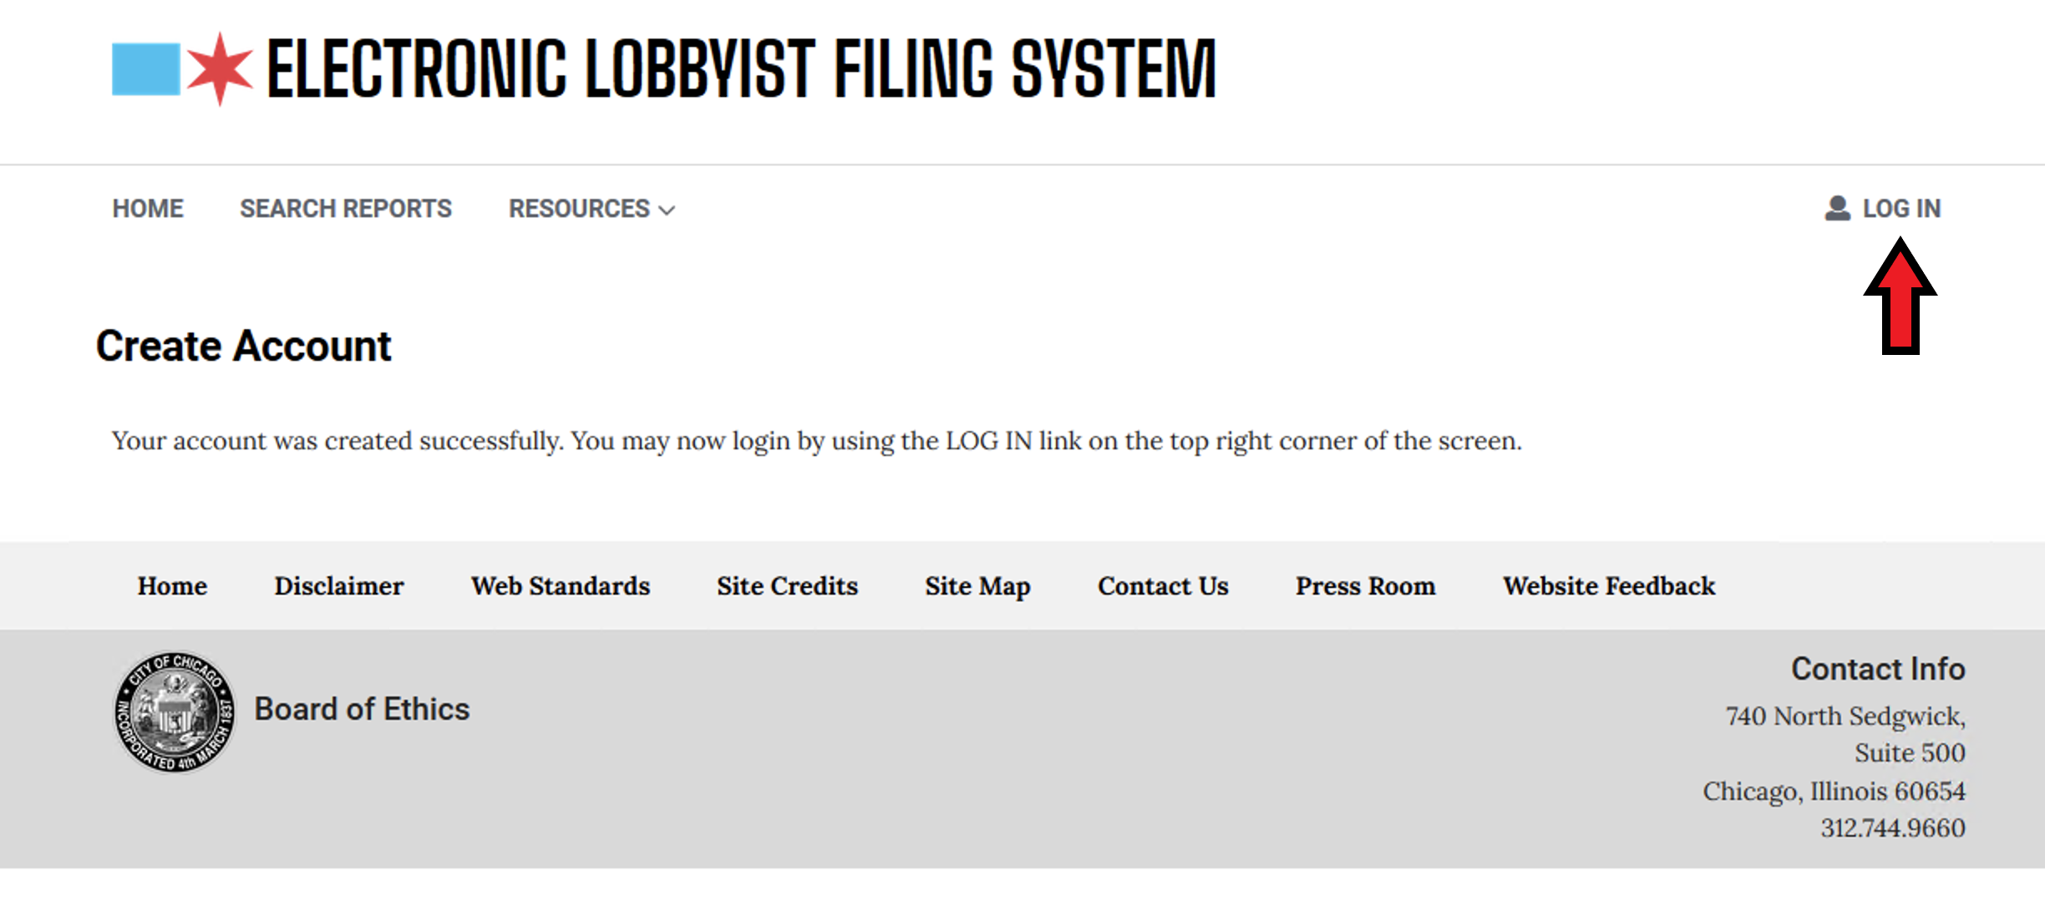
After creating your account you may then log in to ELF. Use the Log In button

Slide 8
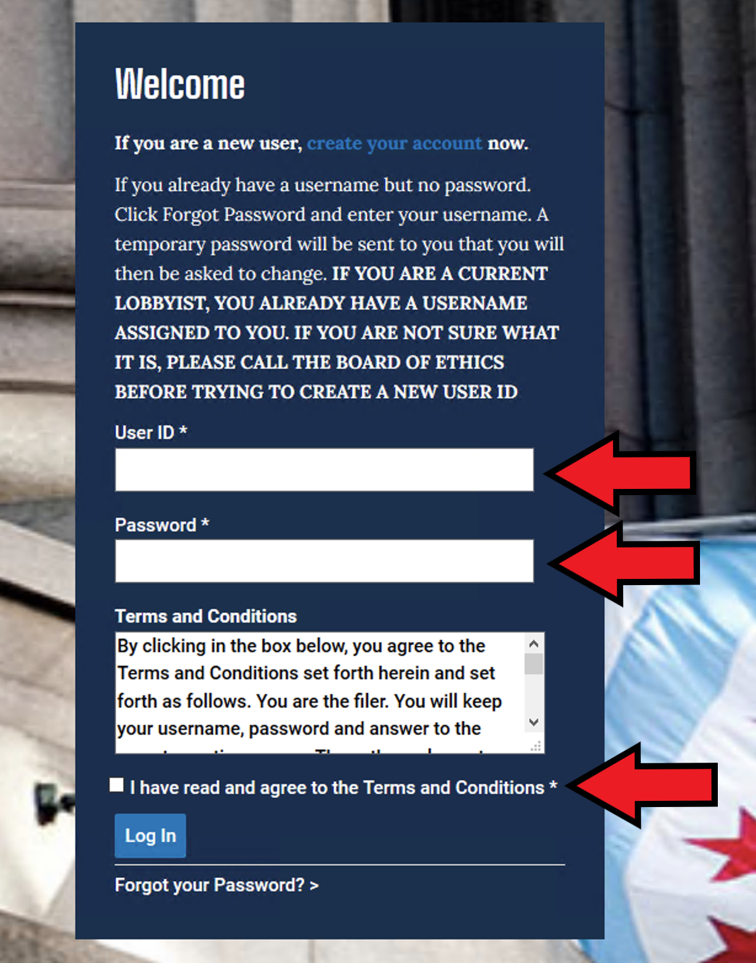
Put in your username, password and be sure to click the box that said you read the terms and conditions and then hit Log In.

Slide 9
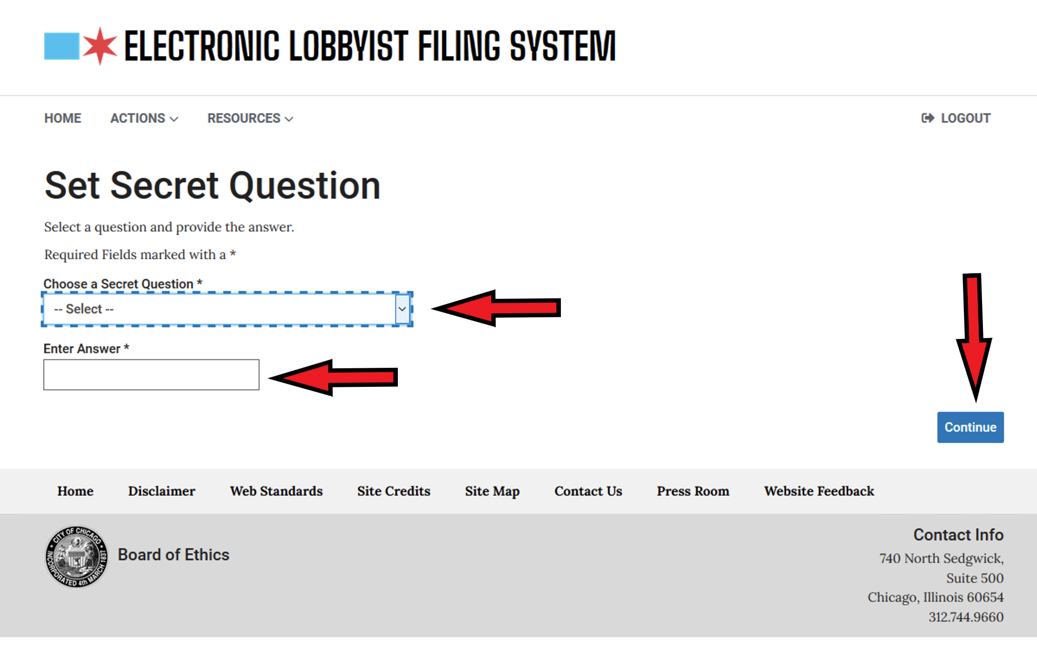
After logging in, Choose a security question and provide the answer. Choose Continue.

Slide 10
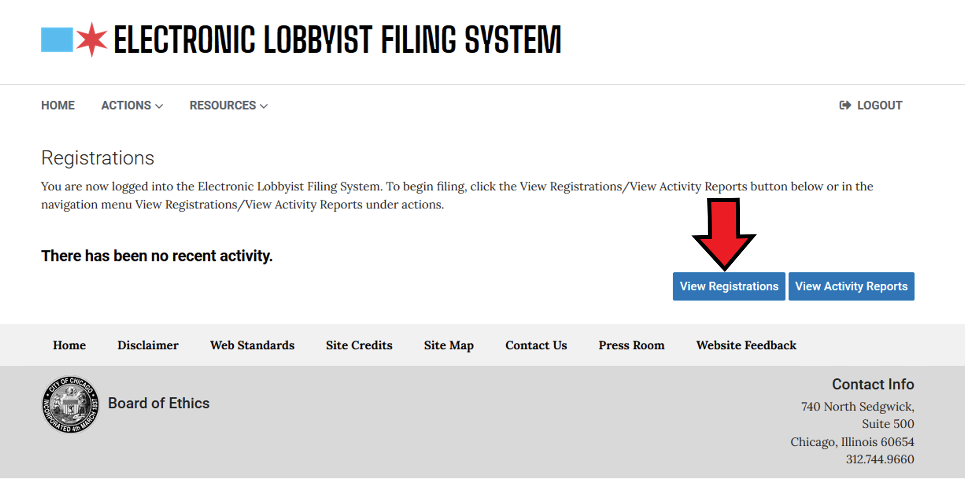
At this window, choose View Registrations

Slide 11
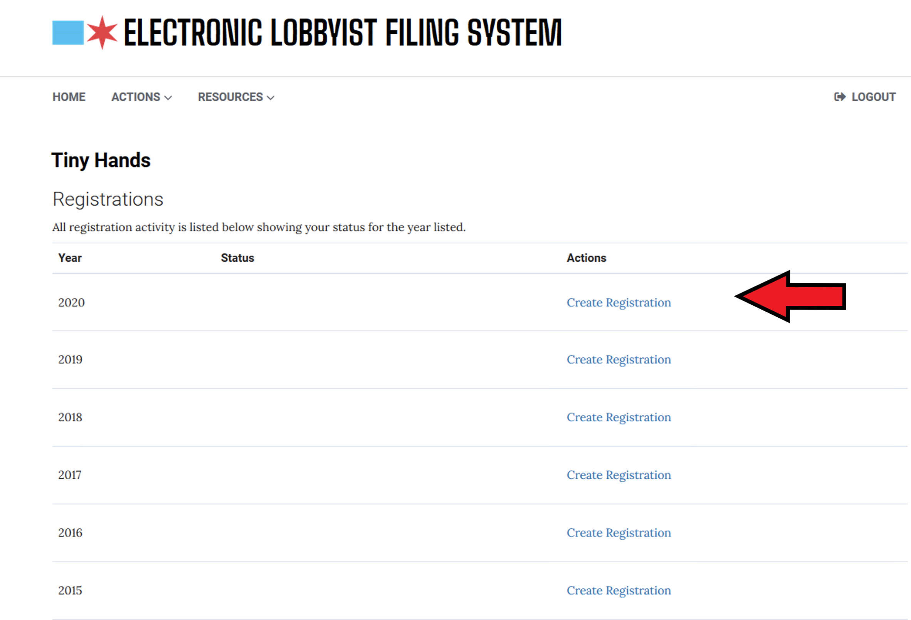
In the proper year choose Create Registration

Slide 12
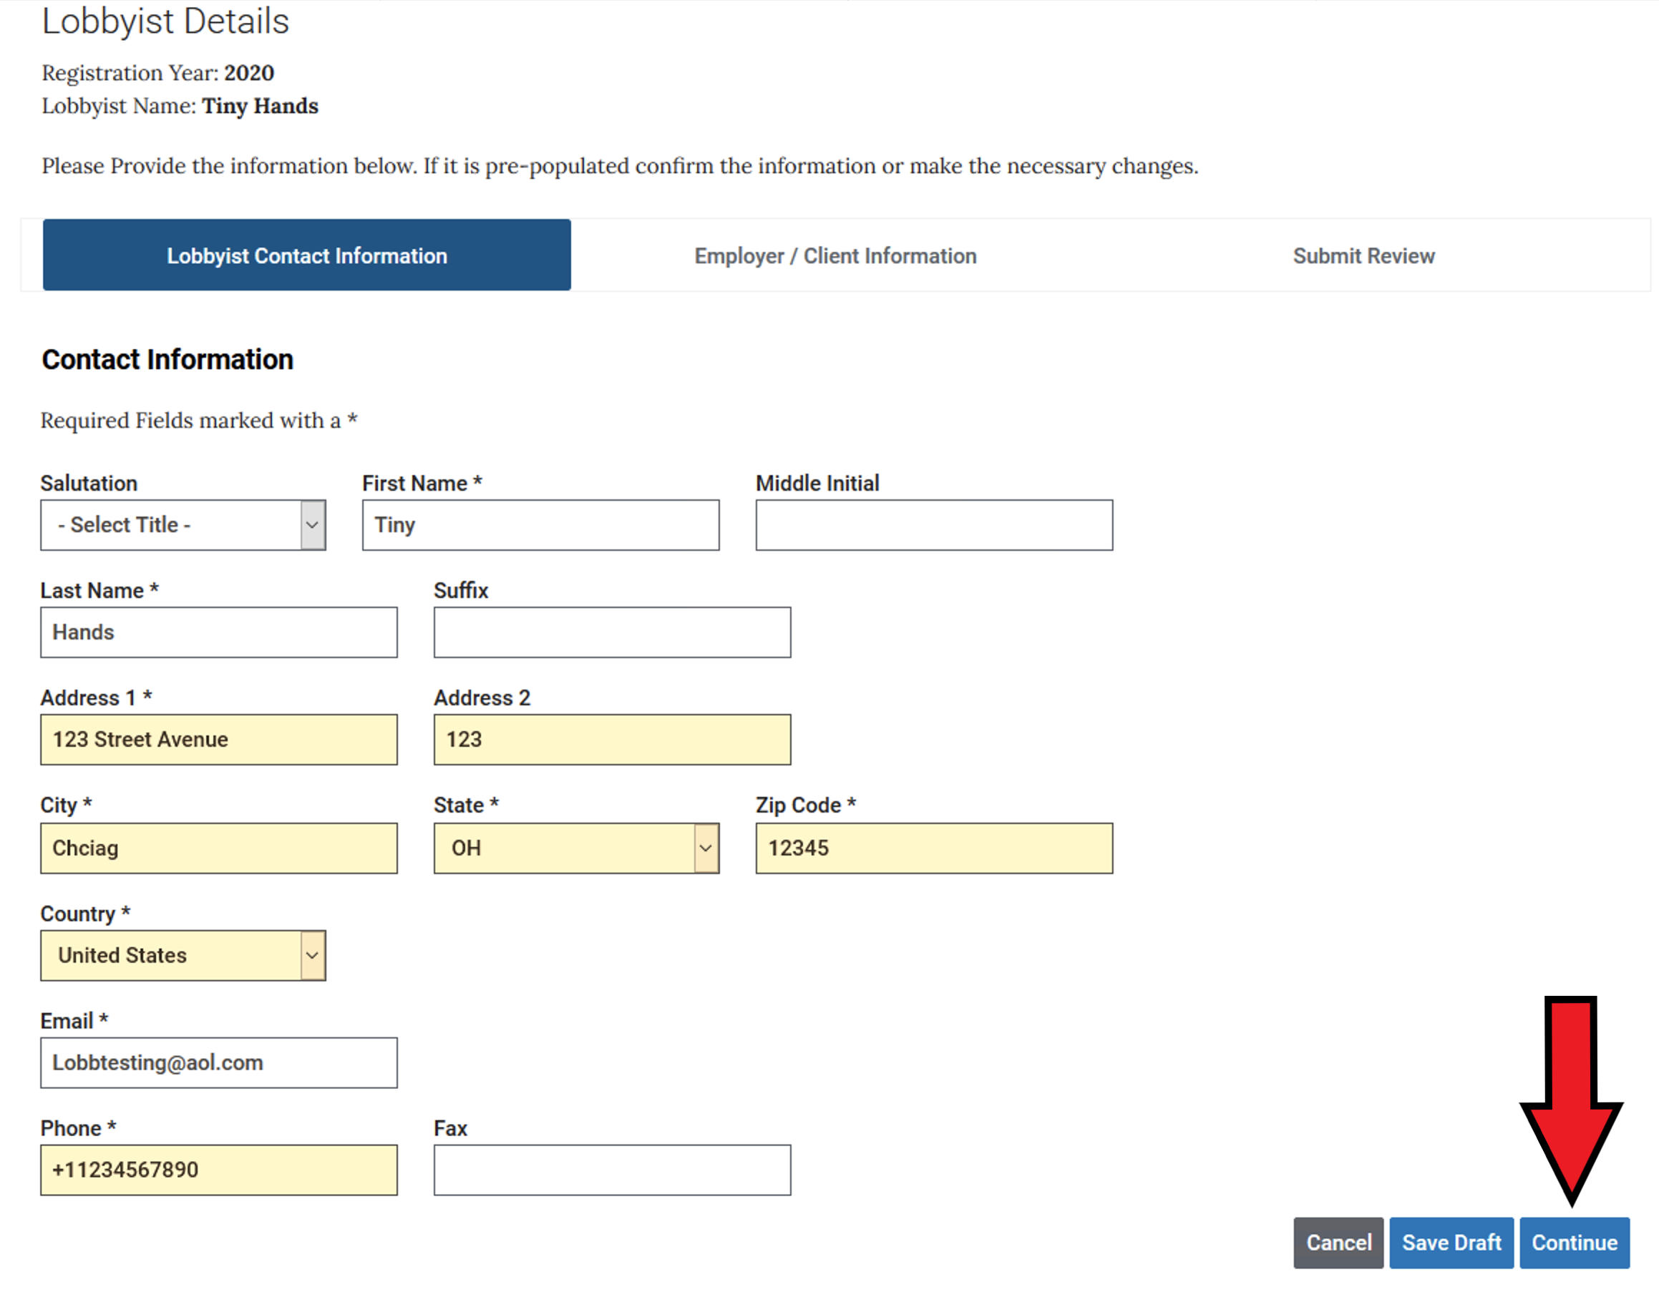
Provide the Lobbyist Details (if pre-populated make sure it is correct) and hit Continue

Slide 13
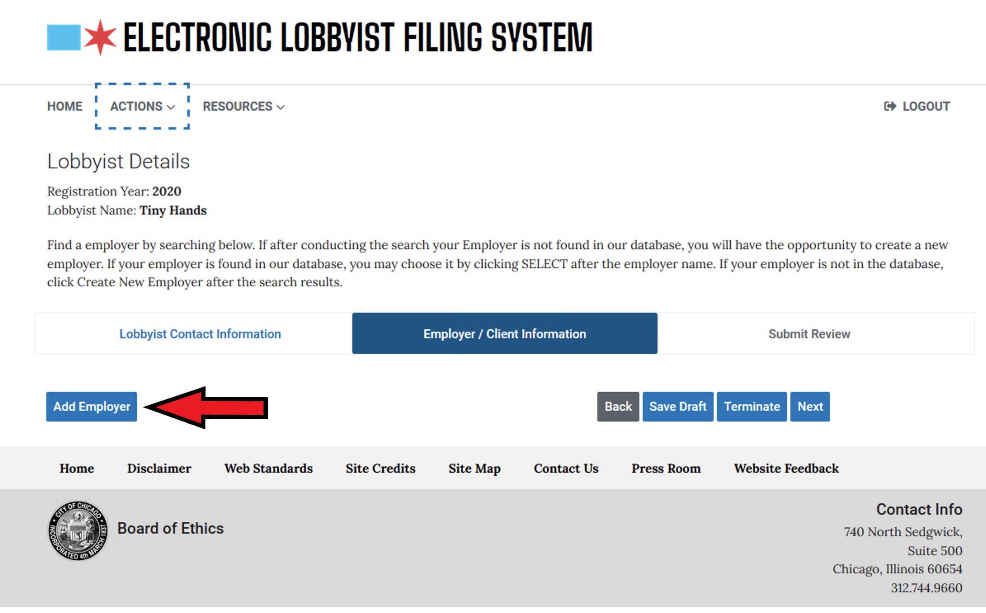
Choose Add Employer

Slide 14
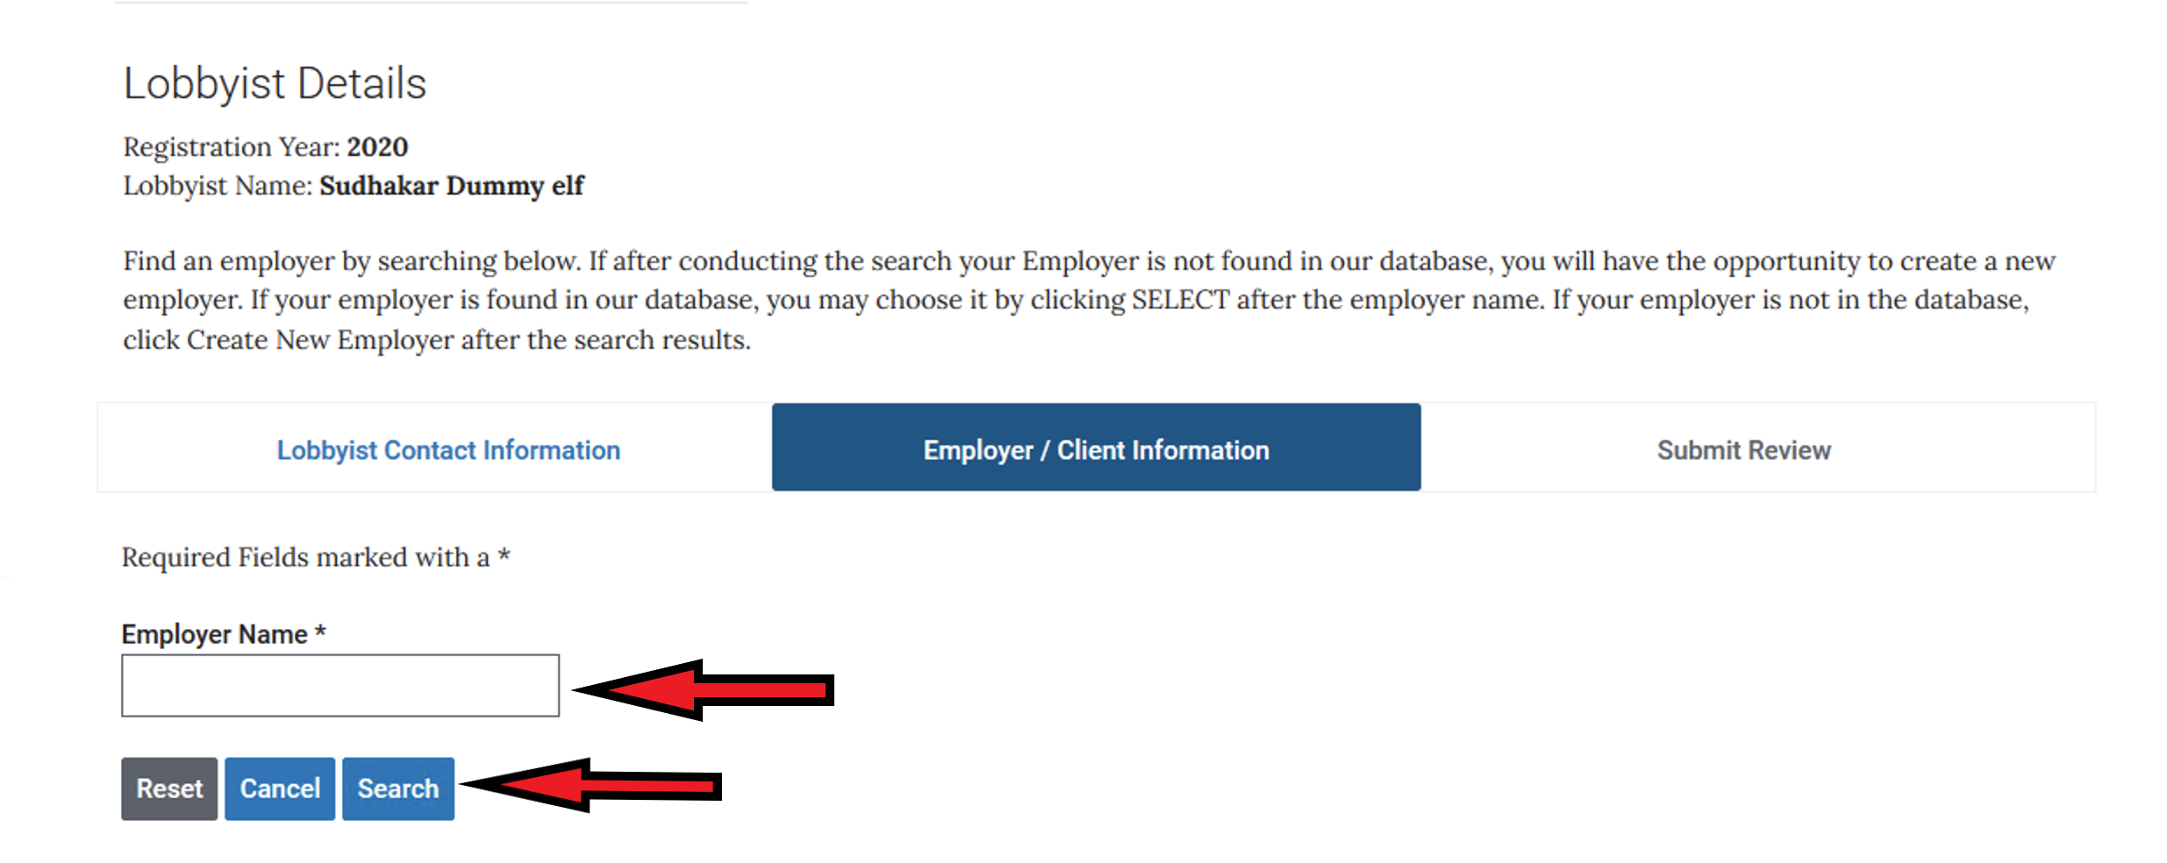
You will then conduct a search for your employer in our database. Type your employer name in the box and then hit the SEARCH button. If after conducting the search your Employer is not found in our database, you will have the opportunity to create a new employer

Slide 15
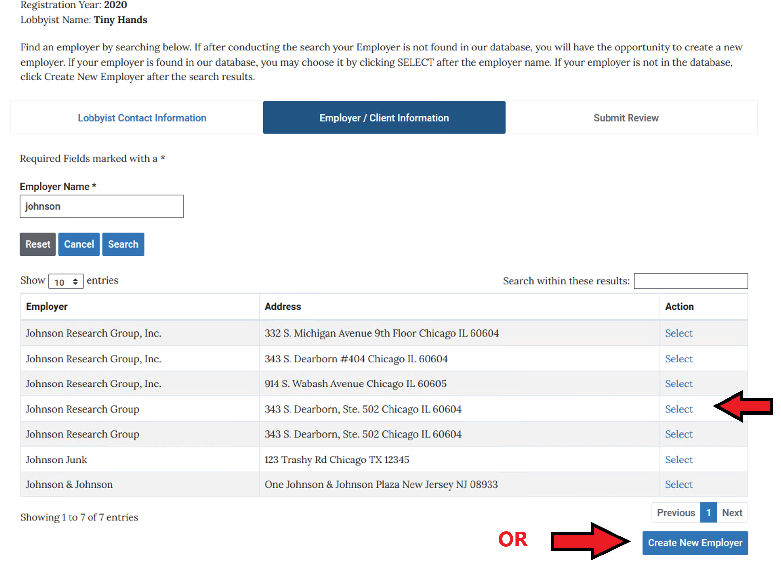
If your employer exists, you may choose it by clicking on the SELECT (if the address is different, you will have an opportunity to change it as you progress through the screens). If your employer is not in our database, click Create New Employer below.

Slide 16
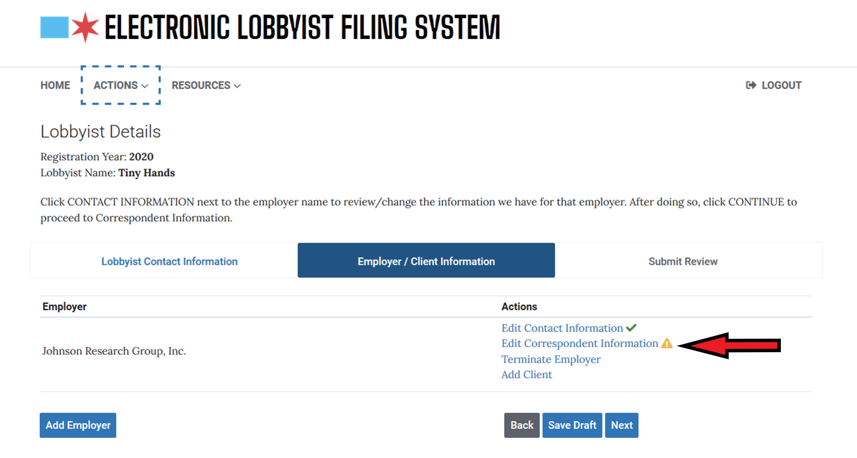
If you do not need to edit the Contact Info. For the Employer, choose Edit Correspondent Information

Slide 17
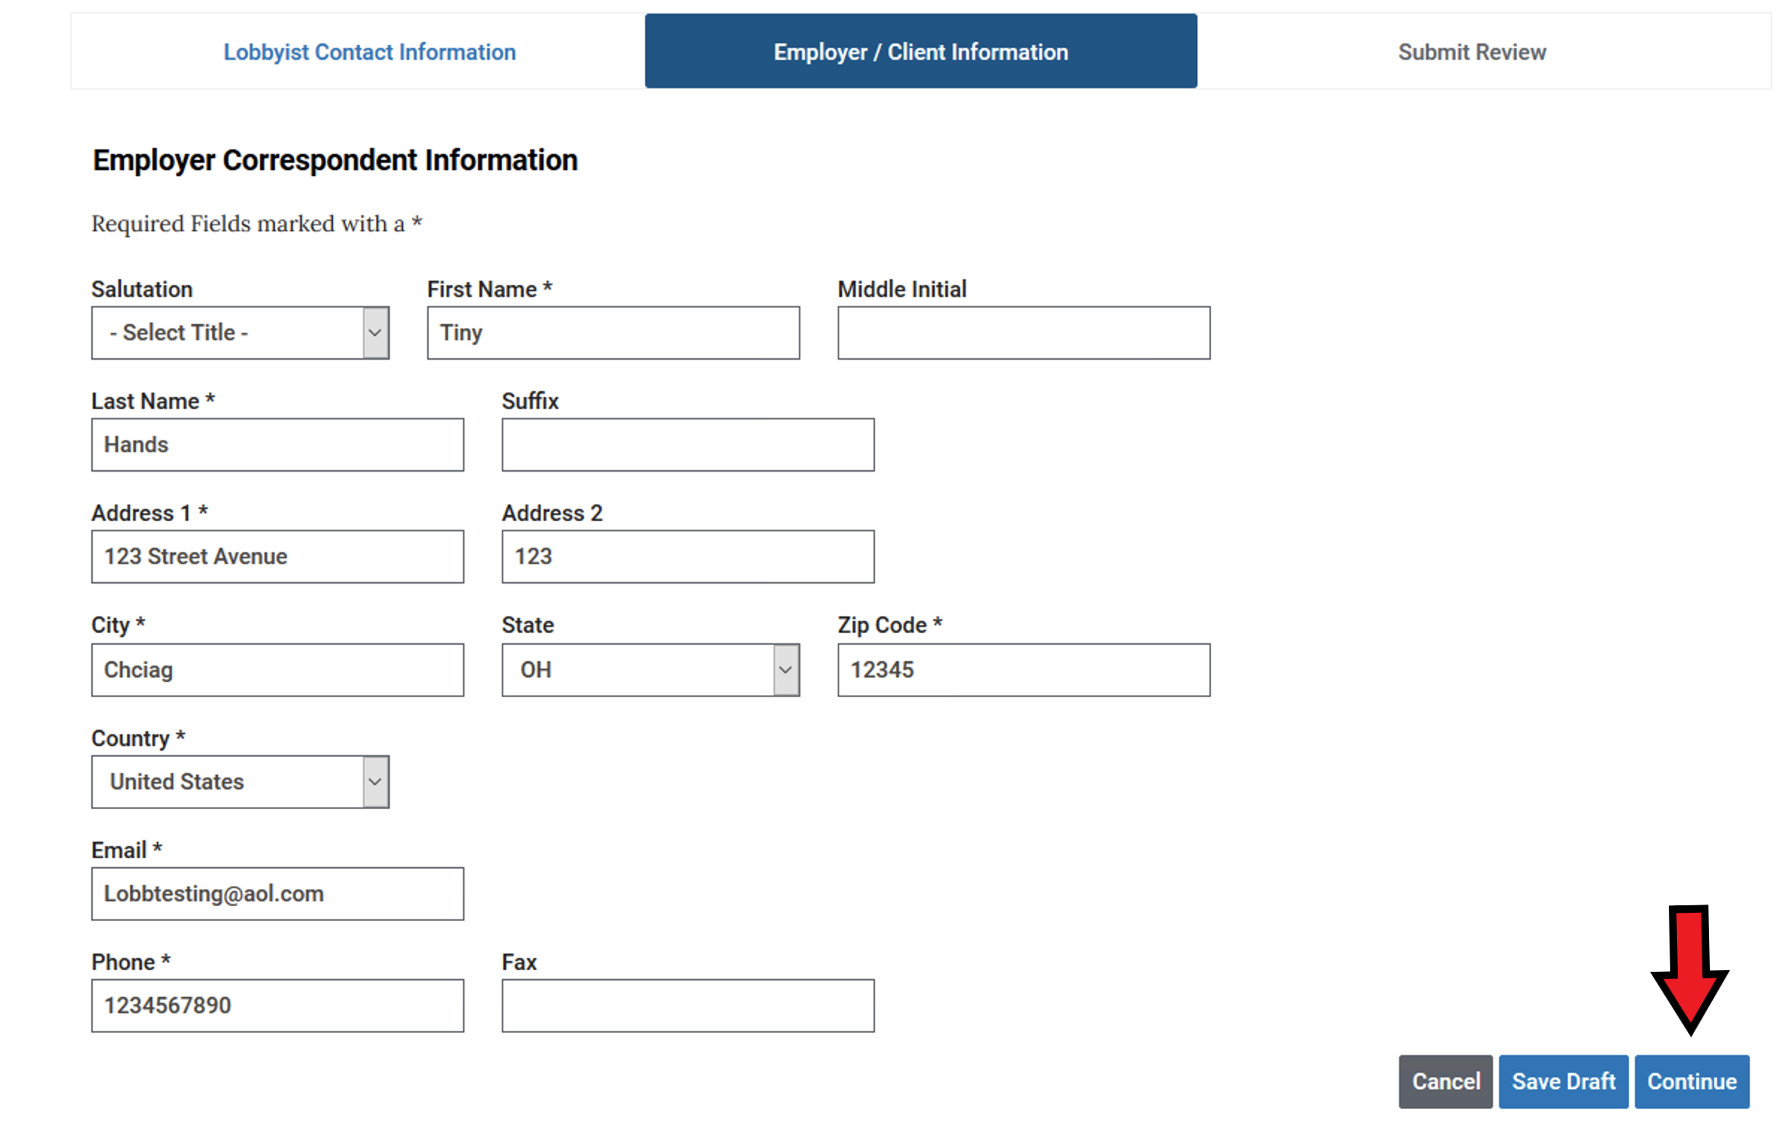
Often this will be the same as the information for the registrant. However, if there is someone else who should receive notifications regarding lobbying or who takes care of filing for you, this would be the place to add that information. Once the correspondent information is verified or changed, press the CONTINUE button at the bottom of the screen

Slide 18
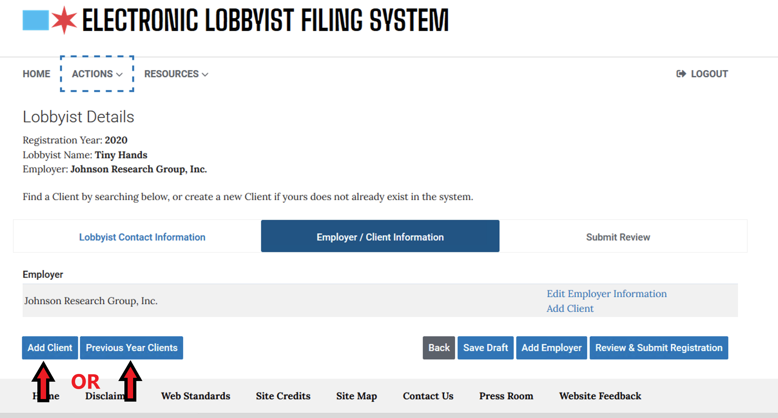
You must have at least one client in order to register as a lobbyist (even if the client and the employer are the same). Click the ADD CLIENT button to continue. This will begin a search If your client does not exist in the database, you will have the opportunity to CREATE NEW CLIENT

Slide 19
If you are returning lobbyist and want to add clients from the previous year, choose PREVIOUS YEAR CLIENTS and a drop- down list of prior clients will appear.

Slide 20
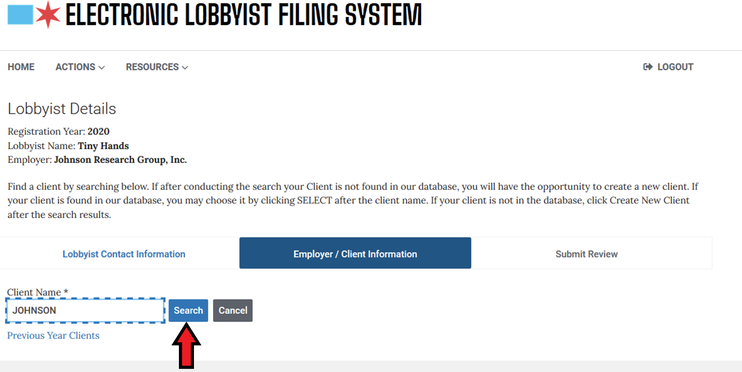
Put in the name of your client and choose Search.

Slide 21
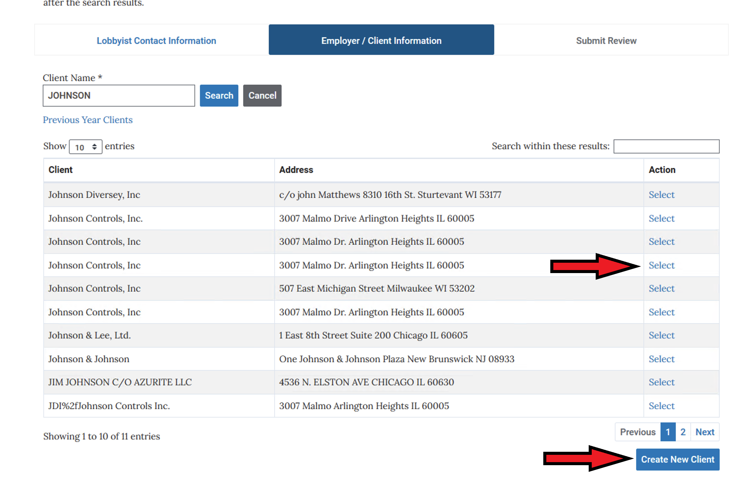
If your client was not found in our database, no options will show up for you to choose from, you will then click the CREATE NEW CLIENT button and follow the steps for adding client information.

Slide 22
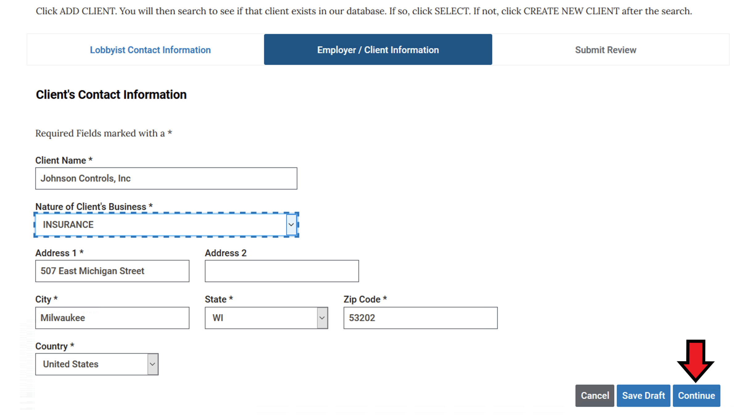
Provide all the requested information for the client and then click Continue

Slide 23
Let’s pause here to discuss the lobbyist registration fee waiver for certain persons who lobby on behalf of non-profit organizations.
Lobbyists required to register with the City of Chicago Board of Ethics typically must pay a registration fee of $350 for part or all of each calendar year in which they are registered, and $75 for each client they represent after their first client (there is no fee for the first client).

Slide 24
HOWEVER, individuals who lobby on behalf of non-profit organizations are eligible to have that fee waived. Under §2-156-230(d) of the City’s Governmental Ethics Ordinance, the Board may grant a waiver of lobbyist registration fees if: (i) the lobbyist is paid or otherwise compensated to lobby solely on behalf of one non-profit entity; and (ii) that entity is exempt from income taxation under section 501(c)(3) of the Internal Revenue Code of 1986.
In order to take advantage of this exception, the Board requires you to upload certain documents into ELF, including those evidencing your oral or written contractual relationship with the non-profit. Here’s what you need to “upload”.

Slide 25
1. A letter on organization letterhead signed by a person (which may be you) authorized to act officially on behalf of the organization.
2. The letter shall state or provide:
(i) the name and organization position of the signatory;
(ii) the name of the person to be registered as a lobbyist;
(iii) that the signatory requests that the City of Chicago lobbyist registration fee be waived;
(iv) that the organization is currently a 501 (c) (3) not-for-profit organization in good standing;
(v) a statement that the person to be registered as a lobbyist will lobby on behalf of the organization only, and on behalf of no other person or entity;
(vi) any written contract for lobbying between the person to be registered and the organization, or
(vii) a written summary of any oral contract for lobbying between the person to be registered and the organization.
Note: And, as to (vi) and (vii), above, if there is no agreement specifically to lobby, please state that the registrant’s job includes “duties as directed, including lobbying where necessary”; in addition, if there is no uploaded written agreement, a statement of the method of payment to the lobbyist by the organization, whether the lobbyist is authorized to incur expenditures and whether the lobbyist will be reimbursed.

Slide 26
The document described on the previous page will be uploaded into the registration form under contracts and authorizations.
If your registration and your documents are approved by the Board of Ethics, you will receive an email stating that. It will ask that you log back into ELF to pay a fee; however, you may skip that step. The emailed approval will evidence that your request for waiver also has been approved.
If you receive an email stating that there are any deficiencies in your registration or your fee waiver request, you can cure those deficiencies as stated in the email. Once you have cured them, you will receive an email approving your registration.

Slide 27
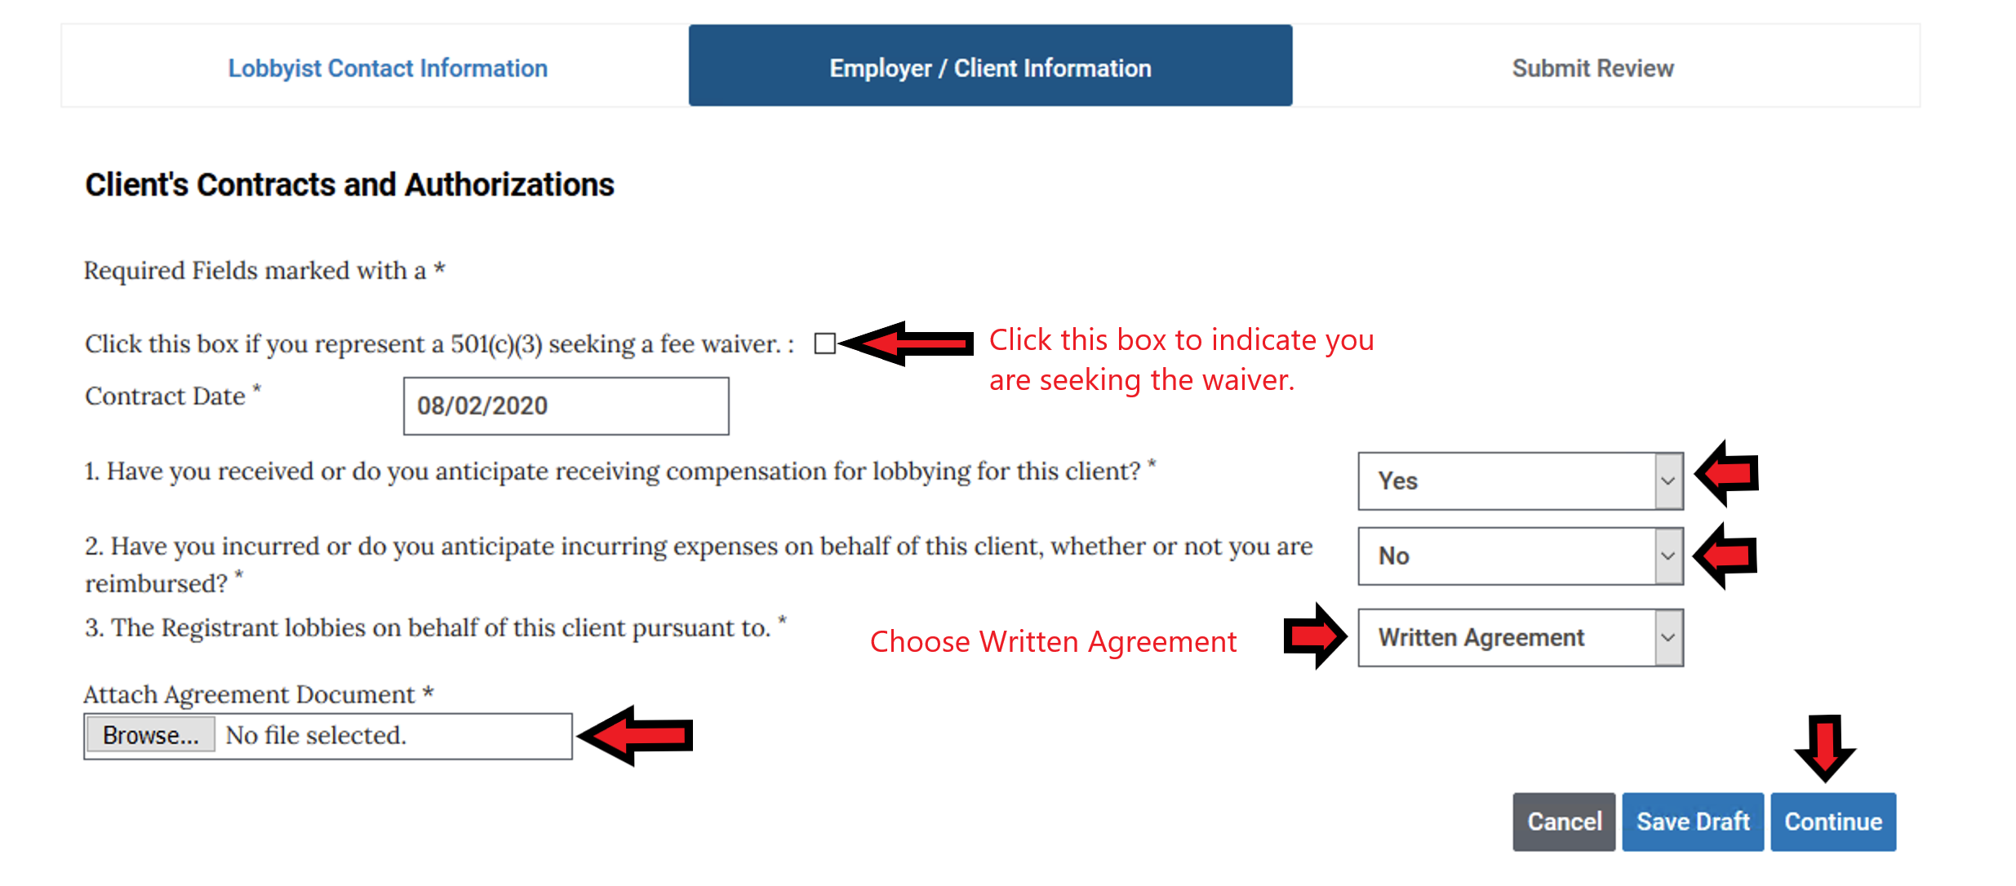
You must now provide the requested information for the client you are registering. The CONTRACT DATE, if there is no actual contract, might be the lobbyist’s date of hire or date he/she began to lobby for this client.
You will Choose WRITTEN AGREEMENT. You will then upload the previously discussed document by choosing the browse button, finding the document on your computer and choosing it. When you hit CONTINUE, it will be uploaded.

Slide 28
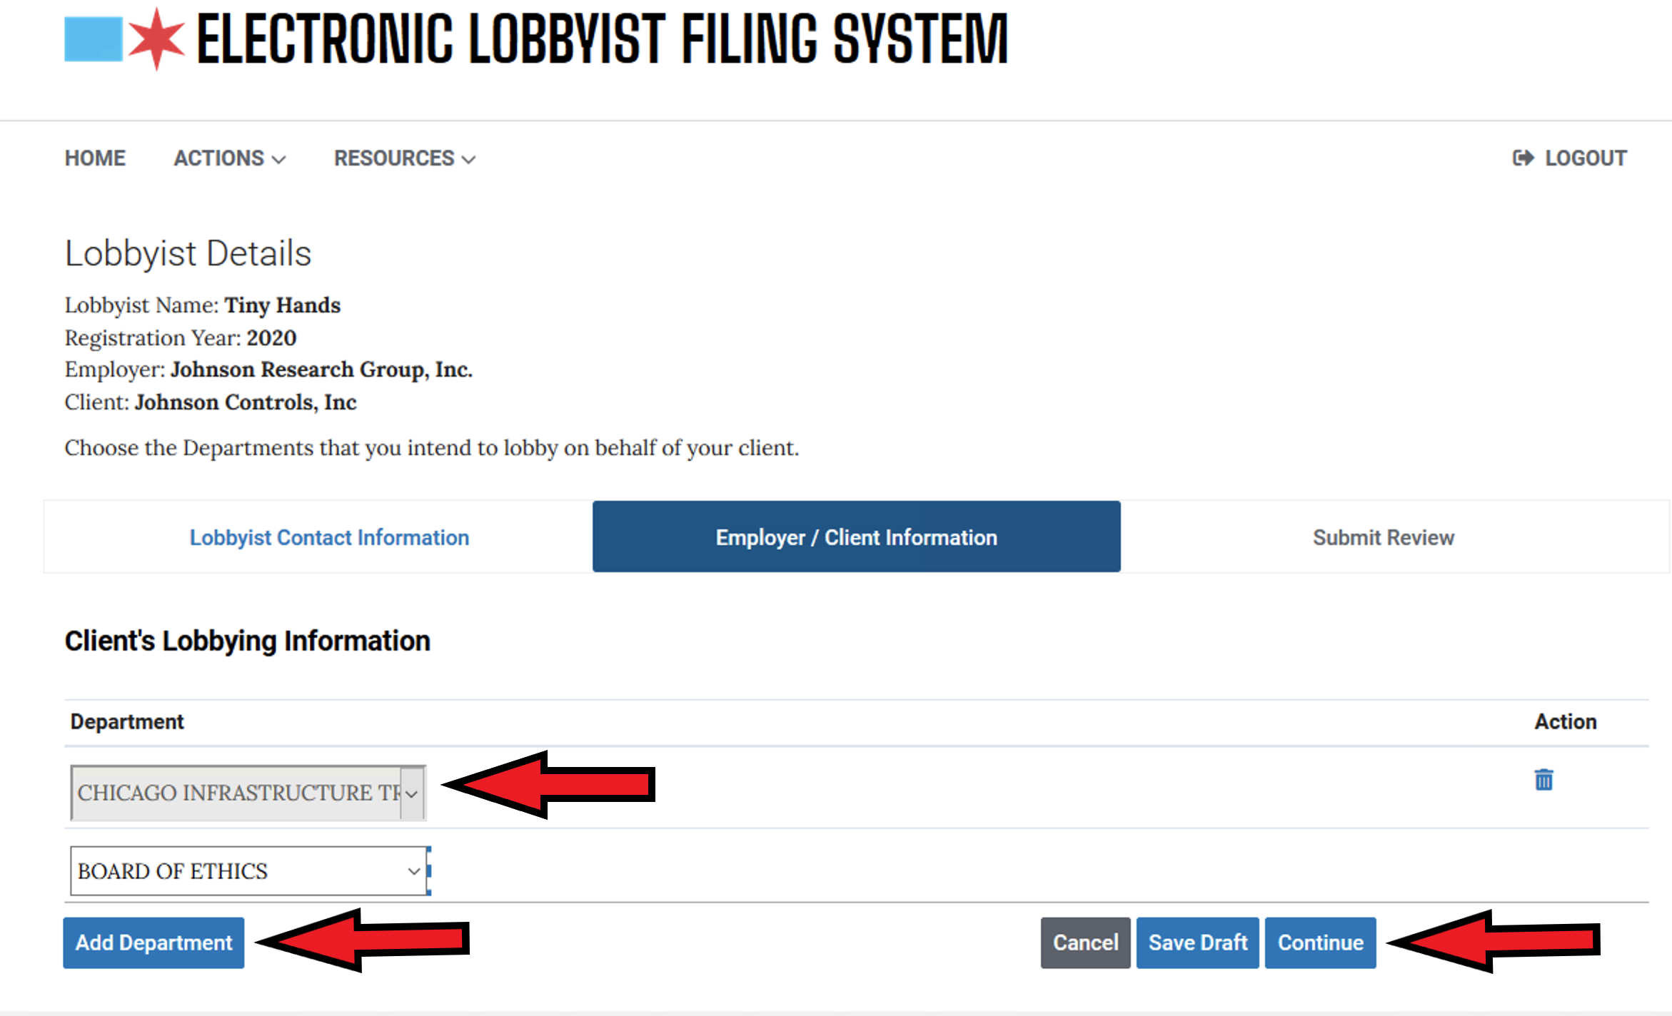
Finally, for each client, you will be asked what City Department(s) you intend to lobby on behalf of this client. Choose agencies from the drop- down list. Use the Add Department button to add more. Hit Continue when you have added all the agencies that you intend to lobby

Slide 29
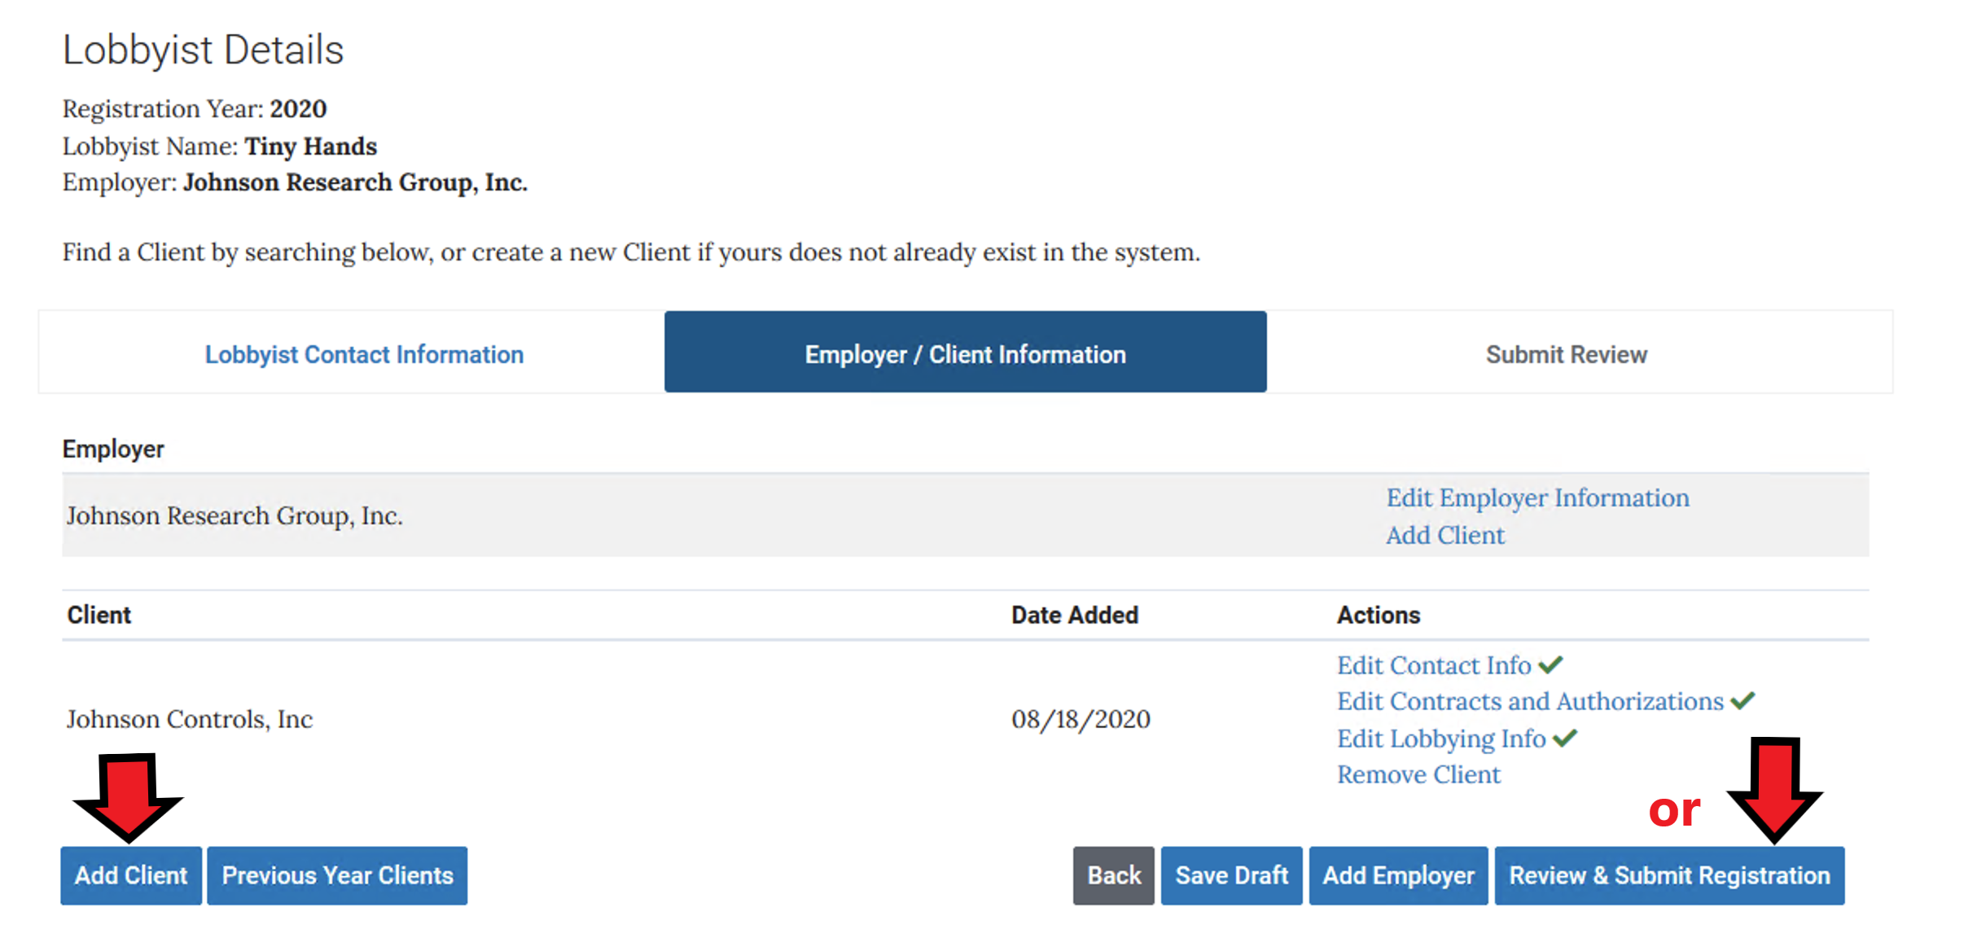
After adding all your clients, Click the REVIEW & SUBMIT REGISTRATION button to continue.

Slide 30
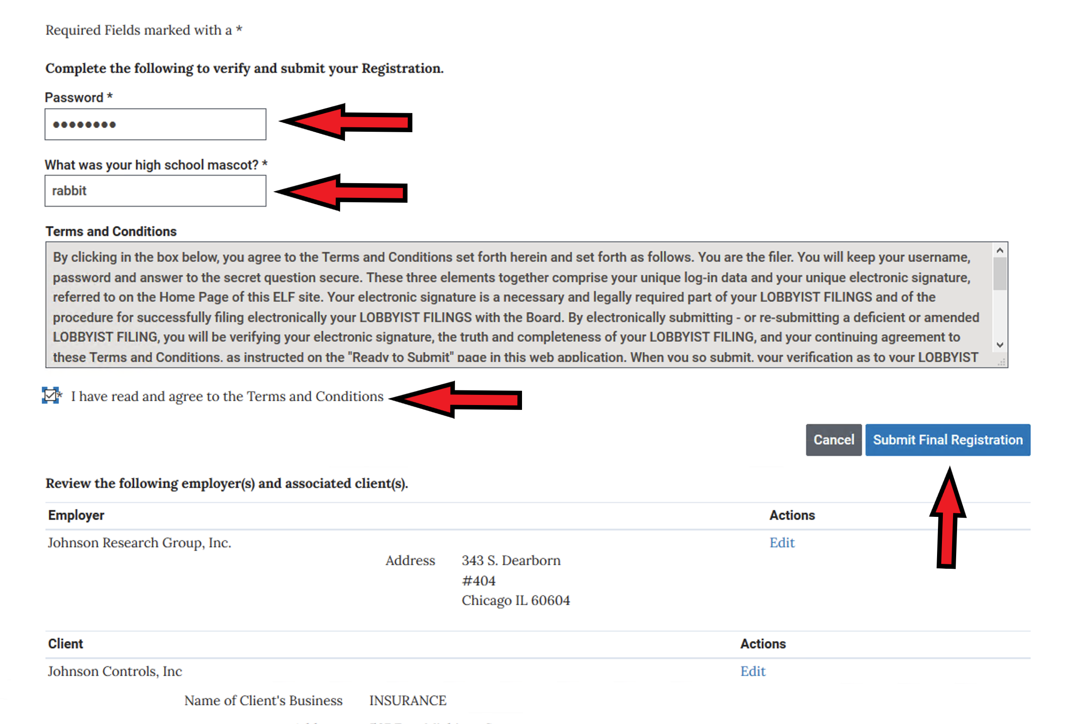
Provide your Password, Security Answer and click that you have read the terms and conditions. You can review what you are submitting by scrolling down the page. Click Submit Final Registration

Slide 31
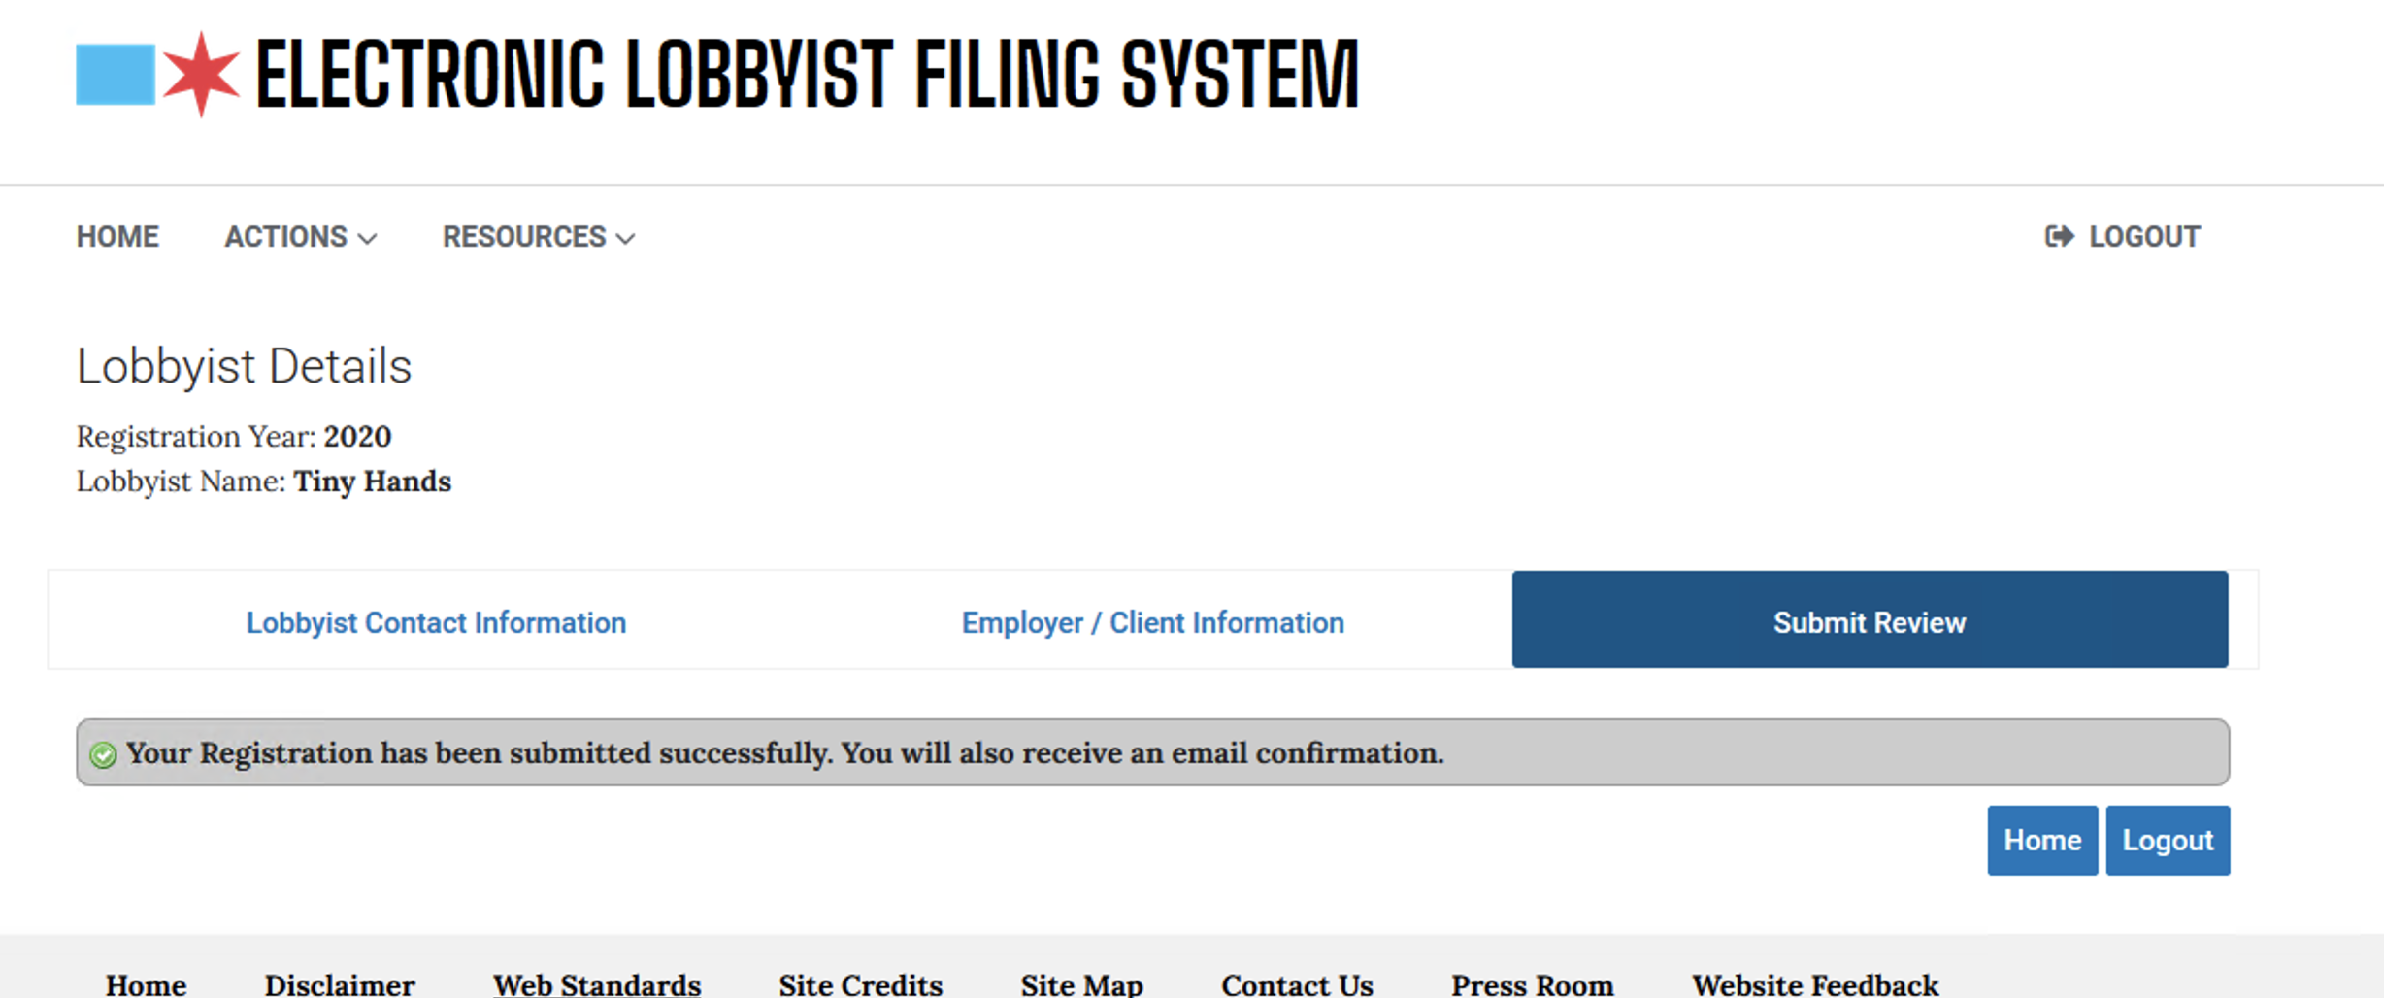
This screen tells you that you have submitted your registration successfully. You will receive an email to that effect. After Board of Ethics personnel have reviewed your registration (and all submissions must be reviewed), you will receive another email informing you of any problems that they found or, if there are no problems, that you may now pay your registration fee and finalize the registration process

Slide 32
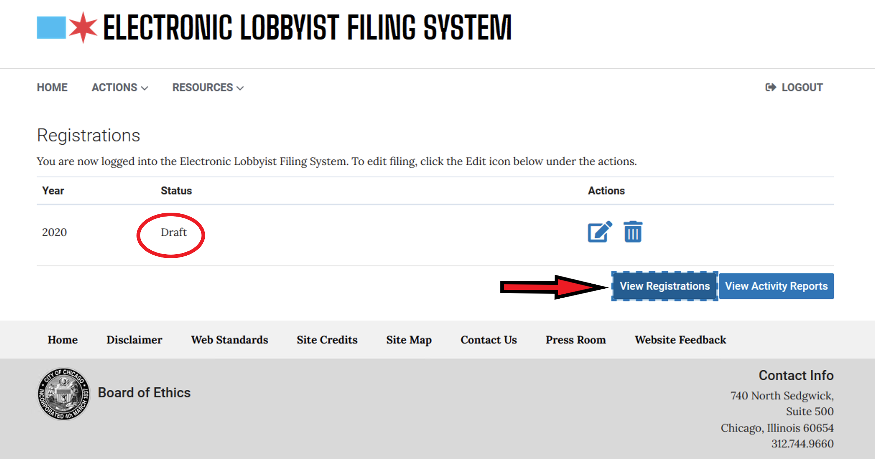
If you had a problem and your registration was rejected when you login you will see your form is in DRAFT status. It is usually a client problem, so begin by Viewing Employer Information

Slide 33
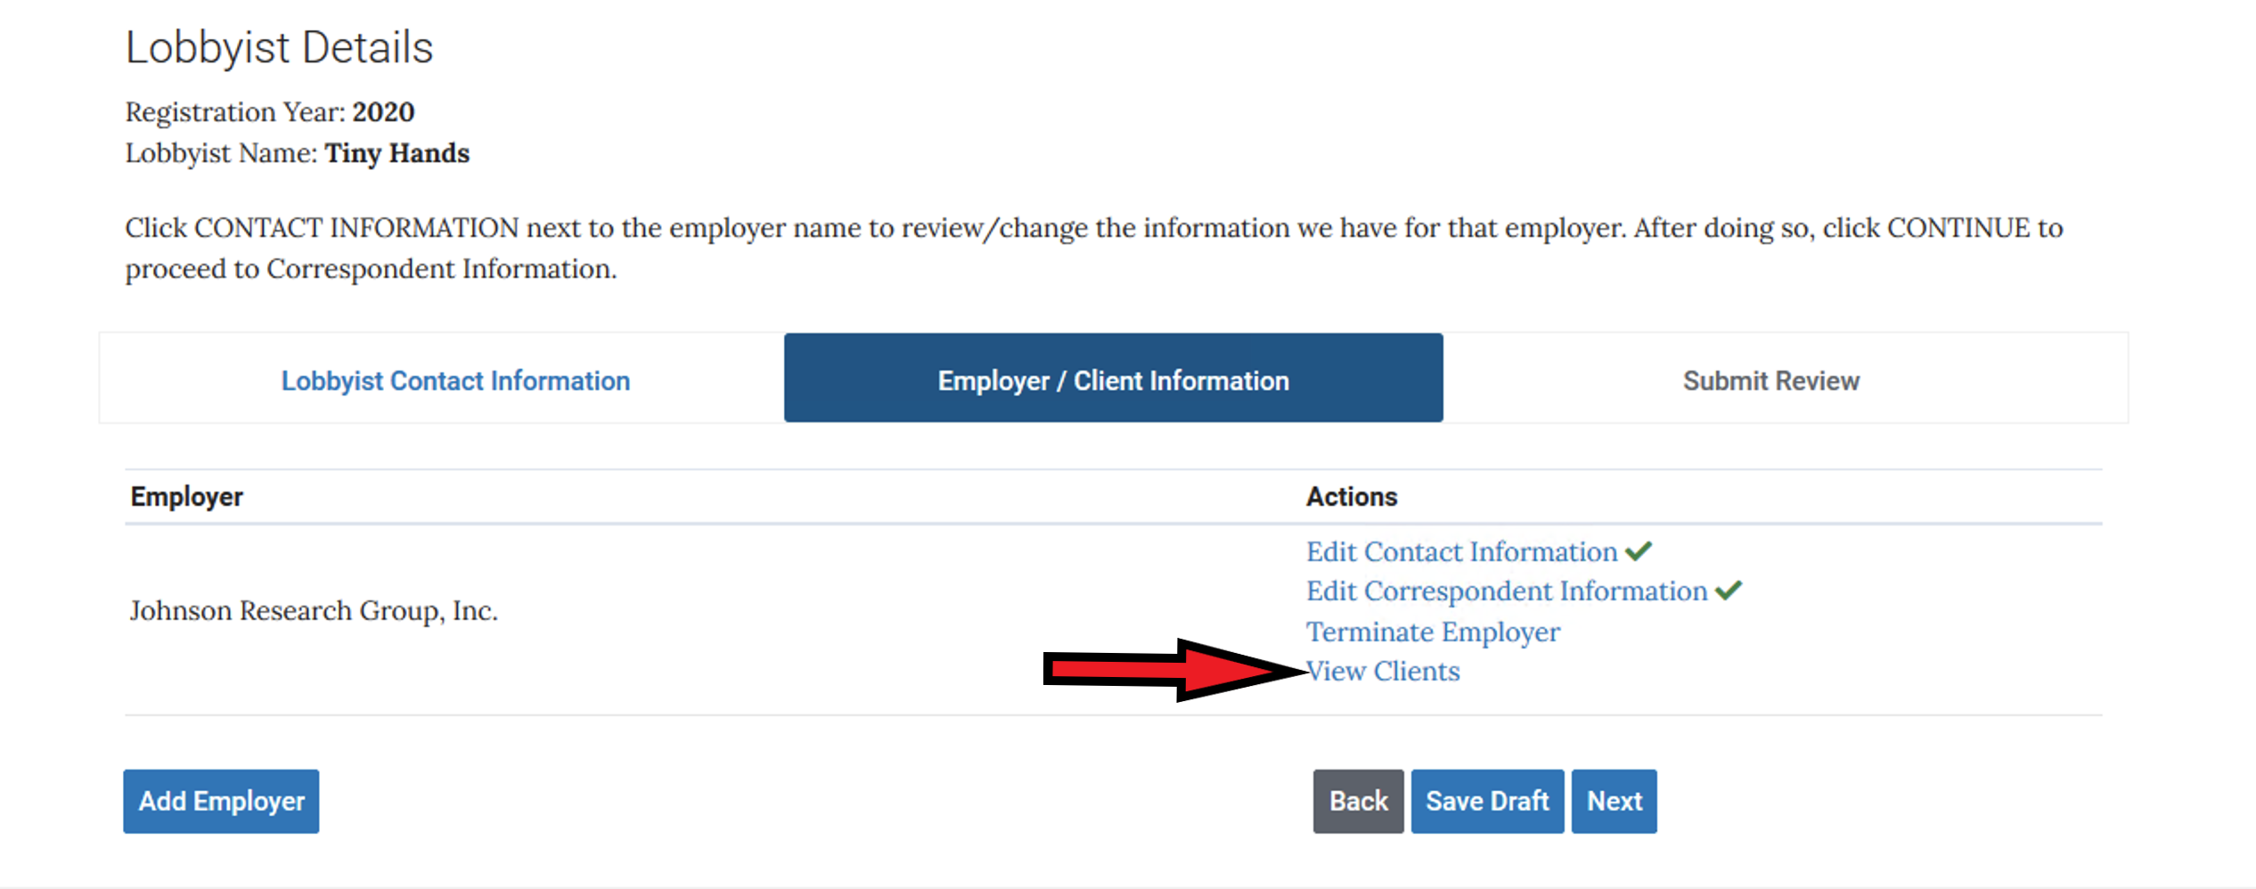
Then Click View Clients

Slide 34
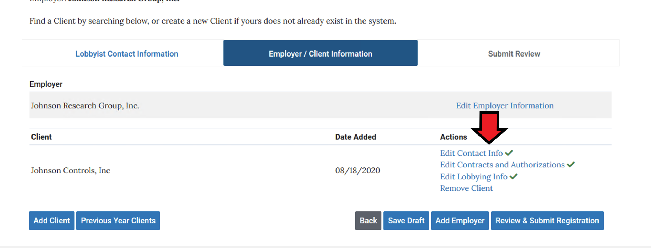
Then choose what you want to edit… usually it is a Contract issue that gets you rejected. Make the corrections and re-submit your registration.

Slide 35
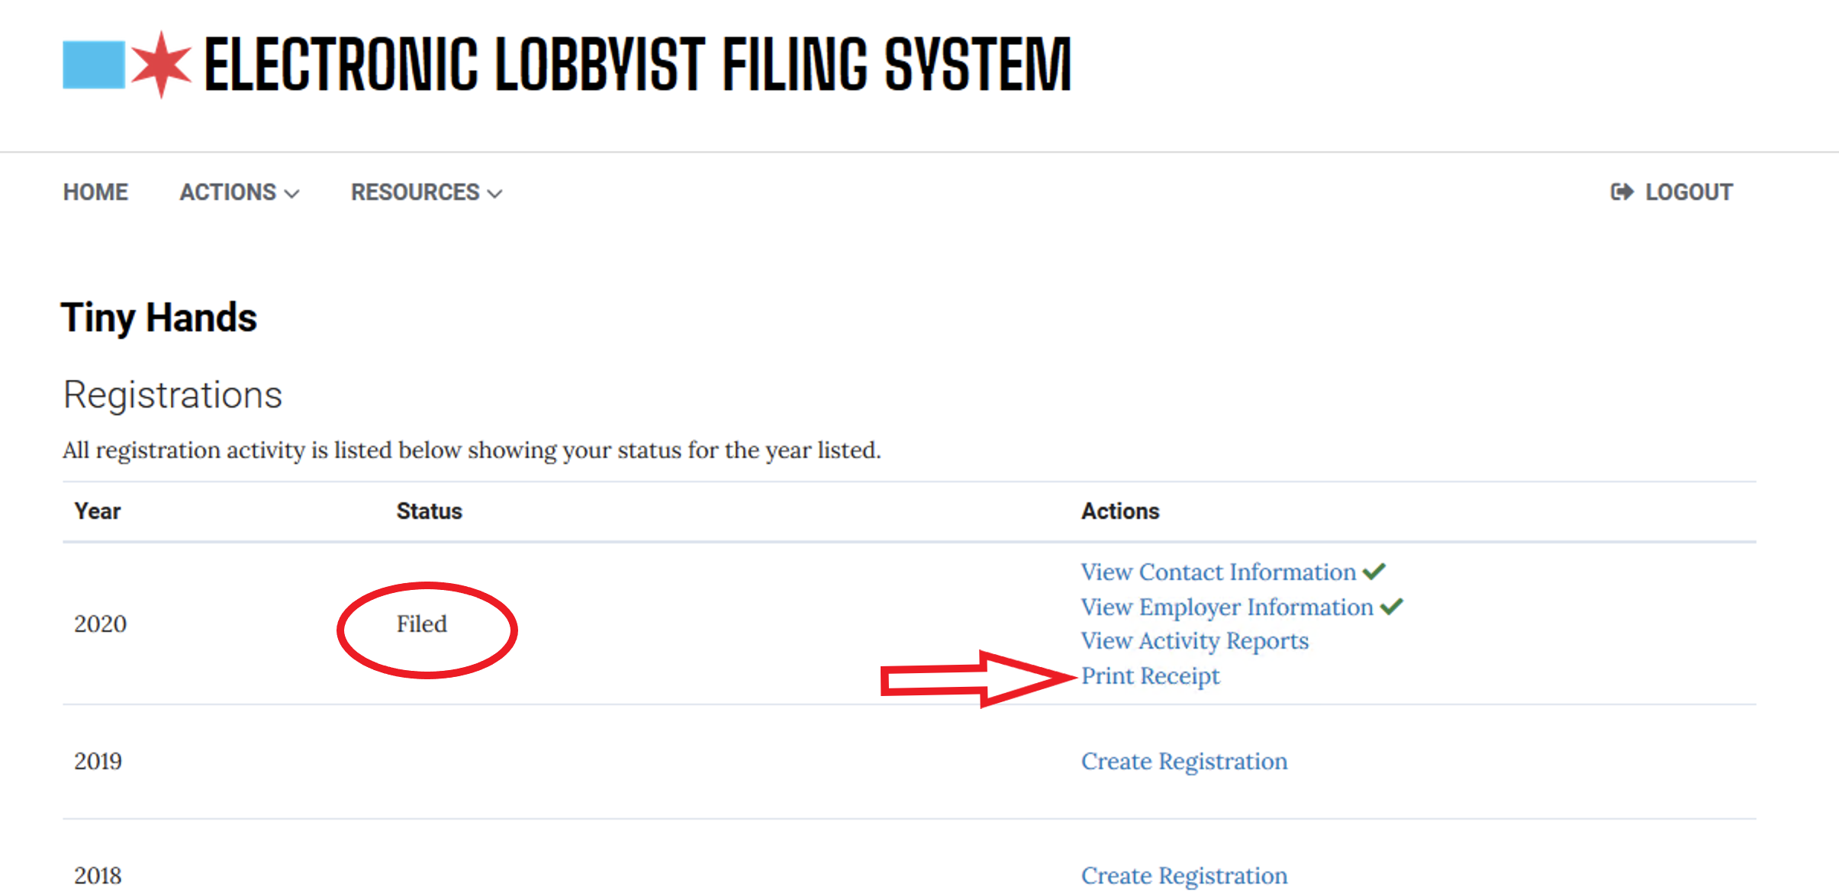
Once your filing has been approved, your filing status will be changed to Filed. You can also print out a proof of filing by choosing Print Receipt in ELF.

Slide 36
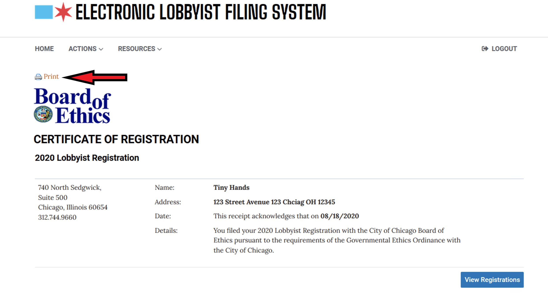
Click Print and a PDF will be produced. This receipt is not necessary for the City, but you might want one for your records.

