Slide 1
Department of Family and Support Services Youth Services: Youth Enrichment Chicago Housing Authority (CHA) Year-Round Program RFP
Please stand by, the webinar will begin shortly.
Release Date: July 12, 2022
Due Date: August 25, at 12 pm (noon)
Notes:
Julia

Slide 2
House Keeping
Due to the volume of participants, everyone has been placed on mute.
Please submit questions via the question box and we will respond to questions after going through the slides.
Please use the question box to notify us of any technical issues.
Youth Enrichment CHA Year-Round Program RFP
Notes:
Julia

Slide 3
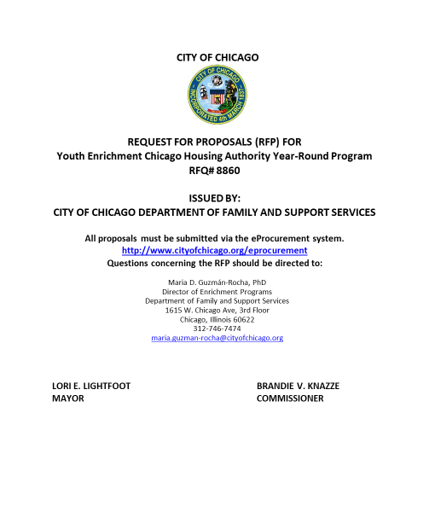
Agenda
Welcome and Introductions
Purpose
Background
Program Requirements
Performance Goals/Outcomes
Guidance for Respondents
Selection Criteria
Basis of Award
Timeline
Technical Assistance for Applicants and eProcurement
Questions
Youth Enrichment CHA Year-Round Program RFP
Notes:
MGR

Slide 4
Enrichment Portfolio 2023 RFP Schedule
RFP | Release | Webinar | RFP Due | Contract Begins
Enrichment School Year | Tuesday, June 14, 2022 | Friday, June 24, 2022 | Tuesday, July 26, 2022 | Sunday, January 1, 2023
Enrichment Year-Round | Tuesday, June 14, 2022 | Friday, June 24, 2022 | Tuesday, July 26, 2022 | Sunday, January 1, 2023
CHA Year-Round | Tuesday, July 12, 20222 | Tuesday, July 26, 2022 | Thursday, August 25, 2022 | Sunday, January 1, 2023
Enrichment Summer | Fall 2022 | Fall 2022 | Fall 2022 | Saturday, April 1, 2023
CHA Summer | Fall 2022 | Fall 2022 | Fall 2022 | Saturday, April 1, 2023
Youth Enrichment CHA Year-Round Program RFP
Notes:
MGR

Slide 5
Purpose of the RFP
The Department of Family and Support Services (DFSS) seeks to fund agencies who have experience in implementing out-of-school time programs for young people ages 6 to 21 in Chicago. The DFSS Enrichment Year-Round Chicago Housing Authority CHA Program Request for Proposals (RFP) seeks to provide funding for delegates to implement safe, supportive, interactive, and engaging youth development activities, primarily for youth who are residents of CHA in Douglas, Grand Boulevard, Near West Side, Riverdale, Roseland, and Washington Park.
Youth Enrichment CHA Year-Round Program RFP
Page 5
Notes:
MGR

Slide 6
Goals
All Enrichment CHA Year-Round delegates will provide youth with meaningful and enriching programming that leads to young people feeling safe and supported by trained practitioners; builds and reinforces social, emotional, and cognitive skills; develops positive relationships and belonging with peers and adults; and provides leadership opportunities.
Ultimately, the Enrichment CHA portfolio is seeking to enact policies and practices to engage and support Chicago communities and change the odds for children & youth by implementing best practices at the point-of-service.
Youth Enrichment CHA Year-Round Program RFP
Notes:
MGR

Slide 7
Background
Research has found that out-of-school time programs foster protective factors in several ways, including providing children and youth with access to caring adults and by promoting their health and well-being
Participation in out-of-school time programs fosters the development of young people, resulting in a more positive self-concept, better problem solving and decision-making, more interpersonal skills, higher sense of belonging and connectedness, competence, self-efficacy, and agency
The protective factors that participation in out-of-school time programs can provide have also been linked to fewer problems in childhood and adolescence, including lowered rates of substance abuse, fewer problem behaviors, and improved performance in school
These programs and activities provide critical foundations that support goals for healthy development and violence prevention
Out-of-school time programs have a unique ability to adapt and expand services to meet the needs of the young people they serve
This was especially true during the pandemic, when DFSS-funded programs pivoted to ensure that the basic needs of families were being met and that families could navigate the changing learning environments
Youth Enrichment CHA Year-Round Program RFP
Notes:
MGR

Slide 8
Current State and Priorities for Improvement
Current State
In 2021, DFSS funded 400 to 19 CHA Enrichment Year-Round and Summer programs that served over 487 youth ages 6 to 21
Out of 925 youth that were surveyed in summer of 2021, 87% reported having a positive relationship with an adult in the program, 78% reporting feeling more hopeful about the future, and 74% reported the program helping to strengthen or build new friendships
Over 50% of youth in CHA Enrichment programs lived in the six priority areas-Riverdale (25%), Near West Side (10%), Douglas (6%), Washington Park (3%), Roseland (3%), and Grand Boulevard (5%). About 15% of youth resided in Near North Side (7%), Oakland (4%), and North Lawndale (4%)
Priorities for Improvement
Prioritize enrollment of underserved youth and ensure appropriate support and services
Programming that fosters positive youth development through accessible and equitable approaches
Program design that continues to be more aligned with research in youth development and out-of-school time programming
Focused programming and developmentally appropriate activities based on youth needs
Prioritize continuous improvement, focusing on using data to make programmatic decisions
Youth Enrichment CHA Year-Round Program RFP
Notes:
MGR

Slide 9
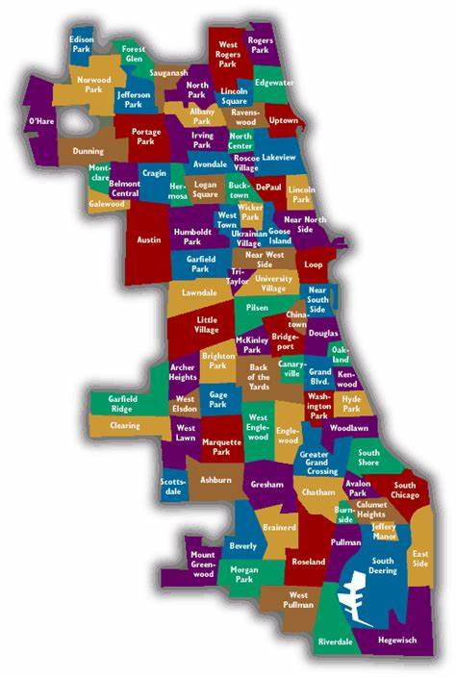
CHA Community Areas
Youth Enrichment CHA Year-Round Program RFP
Notes:
Ebony

Slide 10
Target Population
RFP page 9
The Enrichment CHA Year-Round program intends to serve 120 CHA youth
Priority community areas are Douglas, Grand Boulevard, Near West Side, Riverdale, Roseland, and Washington Park
Eligibility for this program is restricted to youth who are current residents of CHA (as demonstrated by a CHA Client ID number), who are between the ages of 6 and 21
Youth Enrichment CHA Year-Round Program RFP
Notes:
Ebony- add more information about CHA programming? Funding? Any additional information?

Slide 11
Target Population
RFP page 9-10
DFSS is seeking respondents with a proven track record in implementing out-of-school time programs tailored to serve CHA youth residents in Chicago
DFSS asks respondents to design and deliver a high-quality out-of-school time program that meets the needs of children and youth through safe, supportive, interactive, and engaging youth activities, especially those who are in community areas where youth have had adverse experiences and have fewer opportunities to participate in activities
Programs must use a positive youth development framework that promotes learning, leadership, and positive peer-to-peer social connections
Youth Enrichment CHA Year-Round Program RFP
Notes:
MGR

Slide 12
Program Requirements
RFP page 5
All Enrichment CHA programs will provide children and youth with access to asset-based, positive youth development programs that recognize, utilize, and enhance youth’s strengths and promote positive outcomes for young people. The program must offer youth opportunities for new experiences to foster positive relationships including connections to caring adults, and to support enriching activities and safe spaces in community settings
Name of Program Model | Enrichment CHA Year-Round Program
Rate per Youth Slot | $1,800
Number of Youth Slots | 2:20
Staff: Youth Ratio | 2:20 ratio for base cohort with additional cohorts added at a ratio of 1:10 increments
Program Dosage & Frequency | Programs must offer a minimum of 360 hours of programming a calendar year (approximately 8 hours a week for 45 weeks) Year-round programs must offer programming during school breaks, such as spring break and winter break, and during summer Hours may include evenings and weekends
Program Completion Goal (80% of Program Dosage) | Youth need to participate at least 288 hours a calendar year
Youth Enrichment CHA Year-Round Program RFP
Notes:
MGR

Slide 13
RFP pages 10
Program Requirements
Enrichment CHA Program Requirements (Year-Round & Summer)
Age Groups | 6-10 years 11-13 years 14-17 years 18-21 years Respondents may select multiple age groups
Staff: Youth Ratio | 2:20 ratio for base cohort with additional cohorts added at a ratio of 1:10 increments
Program Recruitment | CHA youth residents from the following priority community areas: Douglas, Grand Boulevard, Near West Side, Riverdale, Roseland, and Washington Park. Eligibility for this program is restricted to youth who are between the ages of 6 and 21
Program Specialty Areas | Arts, Culture & Music (e.g., band, choir, music theory, dance, theatre, performance poetry, spoken word, drama, creative writing, filmmaking, etc.) Science, Technology, Engineering, & Math (e.g., STEM, coding programs, robotics, digital literacy/digital learning, etc.) Health & Wellness (e.g., sports, fitness, nutrition, wellness, etc.) Academic tutoring & support (e.g., grade promotion support, academic recovery, large and small group tutoring, reading intervention programs, etc.) College & career/job readiness (e.g., career advising/coaching, college preparation, career and technical education, etc.)
Program Components | Create safe and supportive spaces for youth Foster positive connections with caring adults Foster youth voice and agency in program decision-making Activities designed and implemented using Sequenced, Active, Focused, Explicit (S.A.F.E.) elements Consistent and intentional staff onboarding and training opportunities Consistent and intentional opportunities for parent/family and community engagement
Youth Enrichment CHA Year-Round Program RFP
Notes:
MGR

Slide 14
Program Requirements
RFP pages 10-13
Respondents will recruit, hire, and manage program staff, using a 2:20 staff to youth ratio
Program staff should be positive, enthusiastic, civic minded individuals with connections to both their community and the world outside their community
Program staff will ensure program objectives are met for the overall program while also providing individual and group support, instruction, and coaching to youth participants in a culturally competent environment
Duties may also include administrative functions, such as data entry and data collection
Preference will be given to agencies who hire program staff with experience in youth development, youth education, and/or out-of-school time, and those who come from the communities in which the program is located
See RFP page 12 for examples of roles and responsibilities for program staff
Youth Enrichment CHA Year-Round Program RFP
Notes:
CG

Slide 15
Program Requirements
RFP pages 13
Prior to the program start date, staff must have:
Federal Fingerprint Background check (required every five years from date of initial check)
Illinois Mandated Reporter Training, Certificate, & Acknowledgment of Mandated Reporter Status Form (annual)
Cardiopulmonary resuscitation (CPR) and First Aid Certification (every two years)
All documentation must be current and entered in the database system for verification prior to the program start date. Staff/volunteers cannot work with youth until background checks are completed. Staff and volunteers can only work with youth in the presence of a staff person who has a cleared Federal Fingerprint Background check.
Program staff will be required to participate in DFSS-sponsored professional learning meetings and deliver all necessary training to staff who interface directly with youth. Learning meetings will provide delegate agencies with a shared learning experience that features discussions of:
Pertinent youth development issues/challenges
Best practices in the youth development and out of school time fields
Staff professional development
Support around data use and analysis
Cultivation of professional and personal networks
Training on City of Chicago processes and procedures
Youth Enrichment CHA Year-Round Program RFP
Notes:
CG

Slide 16
Program Requirements
RFP page 14
Enrichment Program Procedure Requirements
Programmatic Changes: Agencies are required to notify the DFSS Enrichment Youth Services Coordinator and the Director of the Youth Services Enrichment Portfolio of any changes to staff, facility, facility location, or work plan in writing within seven (7) business days of the change. These changes must be updated in your work plan in the system database within thirty (30) days of the change
Program Written Procedures: Agencies are required to have a written procedure for identifying and reporting suspected child abuse or neglect. Agencies are also required to have written emergency procedures for a lost child and major/minor injuries and written safety/facility evaluation procedures. Staff should be trained on these procedures
Program Close-Out Procedures: DFSS Close-Out Procedures must be followed if a DFSS-funded agency program is closing for any reason
Youth Enrichment CHA Year-Round Program RFP
Notes:
CG

Slide 17
Performance Goals and Outcomes
RFP page 14-15
To track progress toward achieving the outcome goals of this program and assess success, DFSS will monitor a set of performance indicators. We will monitor the outcomes below through data collection from youth, parent/guardian, and staff at the beginning, middle and end of the year:
85% of youth will report feeling safe and supported after their program experiences
85% of youth will report learning a new skill or an increase in their skills after their program experience
85% of youth will report positive relationships with adult(s) and peers after their program experience
85% of youth will report feeling a sense of connectedness and belonging after their program experience
To monitor and recognize intermediate progress toward the above performance indicators, DFSS also intends to track monthly output metrics from delegate agencies that may include, but are not limited to:
90% of youth slots will be filled at any given time
50% of youth will meet the target population criteria
80% average daily program attendance
85% of youth will complete the year-round program (i.e., attend at least 288 hours a year)
Youth Enrichment CHA Year-Round Program RFP
Notes:
CG
Respondents are welcome to add their own performance measures to their application

Slide 18
Guidance for Respondents
RFP pages 16-17
This RFP seeks respondents that can serve targeted community areas: Douglas, Grand Boulevard, Near West Side, Riverdale, Roseland, and Washington Park; collaborative applications are strongly encouraged.
Awards will be made by community area.
Respondents seeking funding for multiple sites in different community areas are required to apply for each community area separately.
DFSS will make recommendations for contract awards by community area balancing program location, target population, age group, and program specialty area.
Respondents can only apply for a community area in which they can demonstrate a physical address.
DFSS intends to award up to 6 agencies, each receiving 20 slots per contract.
Youth Enrichment CHA Year-Round Program RFP
Notes:
CG
See Section 2, A. Eligible Respondents for more information.
Give example if applying for more than one community area (Roseland & West Side) you will submit 2 separate applications.
If you apply for more than one community area you will need multiple iSupplier accounts which means you must use a separate email address for each submittal proposal. We will go over this later in the presentation. (check w/Julia)

Slide 19
Guidance for Respondents
RFP pages 16
Enrichment Year-Round CHA RFP Anticipated Awards by community area
Respondents are encouraged to collaborate in order to allow agencies to sub-contract and expand an organization’s network to deliver programming
Youth Enrichment CHA Year-Round Program RFP
Notes:
CG

Slide 20
RFP page 12
Budget Proposal
Respondents applying for the Year-Round Enrichment CHA program RFP will budget for a rate of $1,800 per youth, with a minimum of 20 youth per program and additional increments of 10 youth
The anticipated cost of a year-round program for the minimum number of 20 youth is $36,000
Should Respondents apply for more than the minimum 20 youth, they can plan to increase their budget by $18,000 for each additional increment of 10 youth
See RFP page 12 for additional information about budget categories
Number of Youth | Rate per Slot | TOTAL
20 | $1,800 | $36,000
Year-Round Program Sample Budget Breakdown
Category | Description | Sample Allocation
Personnel | Salaries, overtime, salary adjustments, etc. | $24,000
Professional and Technical Services | Consultants, speakers, trainings, etc. | $3,400
Materials and Supplies | Office supplies, snacks, books, training materials, etc. | $2,500
Travel/ Transportation | Bus cards, mileage, parking, etc. | $2,500
Indirect Cost | Administration cost (15% cap) | $3,600
Total Budget for 20 Youth |  | $36,000
Youth Enrichment CHA Year-Round Program RFP
Notes:
CG
The budget provided below is an example for Respondents on expected budget expenditures for a program serving a minimum of 20 youth.

Slide 21
Budgets or Cost Proposals
The term of contract(s) executed under this RFP will be from January 1, 2023, through December 31, 2024
Administrative costs will be capped at 15% percent per application
All respondents must be able to demonstrate a minimum 15% percent in-kind match
Please submit a budget for ONE year (12 months) of services
Cost category definitions are attached as Budget instructions in every RFP
Be thoughtful and inclusive when developing your budget. Apply for your program’s actual costs
Use the reasonable costs question on the application to discuss how you determined the costs reflected in the budget
Youth Enrichment CHA Year-Round Program RFP
Notes:
CG

Slide 22
Budgets or Cost Proposals – Common Errors
Common mistakes we see on budgets are:
Fringes – check your calculations
Supplies – these are frequently under or over budgeted
Make sure your job description titles and your job description uploads have the same title. Also put a brief description of the job in the budget document itself, if you have not discussed it specifically in your application
Put your budget in the appropriate column
Show your match
Read budget instructions carefully!
Youth Enrichment CHA Year-Round Program RFP
Notes:
CG

Slide 23
Selection Criteria – Community Involvement
RFP pages 18-19
The Respondent:
Demonstrates a clear understanding of the youth in the community area in which they are proposing their program location, including their needs and challenges as well as their strengths and opportunities
Has the relevant competencies, capabilities, and/or infrastructure needed to provide appropriate services to young people in the proposed community area
Describes how the agency is seeking to be more inclusive in their internal operations
As organization and with its Board reflects and engages the diverse people of the communities it serves
Youth Enrichment CHA Year-Round Program RFP
Notes:
MGR

Slide 24
Selection Criteria - Organizational Capacity
RFP page 19
The Respondent:
Demonstrates that program staffing is sufficient for the level of services proposed, staff are qualified, culturally competent and/or reflective of the communities to be served
Has adequate systems and processes to support monitoring program expenditures and fiscal controls
Has adequate Human Resources capacity to hire and manage staff
Youth Enrichment CHA Year-Round Program RFP
Notes:
CG

Slide 25
Selection Criteria – Strength of Proposed Program
RFP pages 19
The Respondent:
Provides a clear connection between their proposed program activities and the outcome goals of the RFP
Provides a clear and specific description of how the program will incorporate each of the Program Components as outlined in the RFP
Clearly describes how they will ensure that program activities are developmentally appropriate for the age groups the program proposes to serve
Clearly outlines how the proposed program will identify, recruit, and retain the youth they are proposing to serve, including ensuring the program will reach underserved youth
Provides a detailed description of how the proposed program will collaborate with other entities to provide comprehensive services to the youth they serve
Provides a detailed description of how they will gather youth feedback and how they will incorporate it into improving the program
Youth Enrichment CHA Year-Round Program RFP
Notes:
MGR

Slide 26
Selection Criteria – Performance Management, and Outcomes
RFP pages 19
The Respondent:
Demonstrates evidence of strong past performance in the same or similar out-of-school time programs against desired outcome goals and performance metrics and/or other notable accomplishments in providing services to youth ages 6 to 21
Has the relevant systems and processes needed to track and report performance on program outcomes
Has experience using data to inform/improve its services or practices and describes a strong desire to engage in continuous improvement processes
Has the relevant systems and practices needed to collect and store key participant and performance data
Youth Enrichment CHA Year-Round Program RFP
Notes:
CG

Slide 27
Selection Criteria – Reasonable Costs, Budget Justification, and Leverage of Funds
RFP pages 19-20
The Respondent
Demonstrates reasonable implementation costs and funding requests relative to its financial and human resources. The proposed budget supports the proposed scope of work or work plan
Has the fiscal capacity, as demonstrated by its auditing process, to implement the proposed program
Leverages other funds and in-kind contributions to support total program and administrative cost (e.g., state, federal, foundation, corporate, individual donations)
Youth Enrichment CHA Year-Round Program RFP
Notes:
MGR

Slide 28
Selection Criteria - Attachments
Please upload the following documents:
Liability Insurance
Board Member Identification
SAM Certification
Certificate of Good Standing
By Laws and Articles of Incorporation
Financial Statement or 990 Form
IRS Determination Letter
Program Budget Forms
City of Chicago Compliance Acknowledgement
Conflict of Interest
Memorandum of Understanding or Linkage Agreements
Youth Coordinator or Program Leader Job Description
CPS Vendor Confirmation or Letter of Intent from School Principal if program located in a school
Be sure to attach reports, studies or other documentation that show performance toward reaching the program goals, demonstrate results and accomplishments
Be sure to attach the resumes for key staff that are overseeing the program
Youth Enrichment CHA Year-Round Program RFP
Notes:
CG

Slide 29
Basis of Award
RFP page 20
DFSS may consider additional factors in selection to ensure systems-level needs are met; geography, program specialty area, and ability to serve specific sub-populations
DFSS will make recommendations for contract awards within Community Areas balancing program location, target population, age group, and program specialty area
Youth Enrichment CHA Year-Round Program RFP
Notes:
MGR

Slide 30
Selection and Transition Timeline
Pre-proposal webinar – July 26, 2022
Due date to submit pre-proposal questions – July 28, 2022
Applications due – August 25, 2022, at 12:00, Noon
Program period begins – January 1, 2023
Youth Enrichment CHA Year-Round Program RFP
Notes:
MGR

Slide 31
Deadline
Applications are due
on August 25, 2022
at 12:00, Noon
Youth Enrichment CHA Year-Round Program RFP
Notes:
MGR

Slide 32
Application Tips
Start Early!!
If you have never done business with the City of Chicago, register into iSupplier/eProcurement ASAP.
Review RFP narratives and application questions closely. Remember they align with the scope and selection criteria. Use the information in the RFP for guidance in formulating your answers.
Carefully review the selection criteria.
There is a 4,000-character limit which includes punctuation and spaces. Each response is allotted 4,000 characters.
Do not use the back button on your browser.
Save Often!!
Youth Enrichment CHA Year-Round Program RFP
Notes:
Julia slides 30-50

Slide 33
Tips for Working in eProcurement
Organizations submitting more than one proposal may do so by submitting each proposal under a separate, unique registered account user with online bidding responsibilities within the organization’s iSupplier account, using their individual login information.
You can “submit” your application and later amend it up until the due date August 25, 2022, at 12:00, Noon
Avoid the rush and possible mishaps by submitting early. Plan on submission taking 30-60 minutes
Late applications will not be accepted
Make use of the eProcurement hotline for help at 312-744-4357 (HELP)
Please note that the hotline operates during business hours only, Monday-Friday 9-5
Save often, submit early!
Youth Enrichment CHA Year-Round Program RFP

Slide 34
Technical Assistance!
On the DFSS web page is a link to the RFP of interest and training documents. See “Alerts” Section on our website.
For Questions on Registration and eProcurement Technical Assistance for Delegate Agencies –
CustomerSupport@cityofchicago.org or call 312-744-HELP (4357)
Training Materials (Documents and Videos) – https://www.cityofchicago.org/city/en/depts/dps/isupplier/online-training-materials.html
Youth Enrichment CHA Year-Round Program RFP

Slide 35
How to Accept an Amendment
Youth Enrichment CHA Year-Round Program RFP

Slide 36
How to accept an amendment – Step 1
The RFP you are interested in has been amended. In order to start an application, you will need to acknowledge and accept the amendment first in order to start your application. (Please not that the RFP shown in this and subsequent slides is an example). To accept the amendment, click on “View Amendment History”.
If the RFP has not been amended (yet), select “Create Quote” from the drop-down menu in the “Actions” box and click on “Go”. This will take you to the application page, where you can get started.
Youth Enrichment CHA Year-Round Program RFP

Slide 37
How to accept an amendment – Step 2
To begin the acceptance and acknowledgment process, to open the RFP in view only, click on the Document number (1) To review the amended changes to the RFP, click on the infinity or eyeglass icon (2) To acknowledge receipt and understanding of these changes and proceed, (3) click on the “Acknowledge Amendments” button.
By acknowledging the amendment, you are indicating that you are aware of the changes made to the RFP in the amendment.
Youth Enrichment CHA Year-Round Program RFP

Slide 38
How to accept an amendment – Step 3
When you get to this screen, click on the “I accept…” check box and then click on “Acknowledge”
Youth Enrichment CHA Year-Round Program RFP

Slide 39
How to accept an amendment – Step 4
Click on “Yes” to indicate that you confirm your acknowledgement of the amendment.
Youth Enrichment CHA Year-Round Program RFP

Slide 40
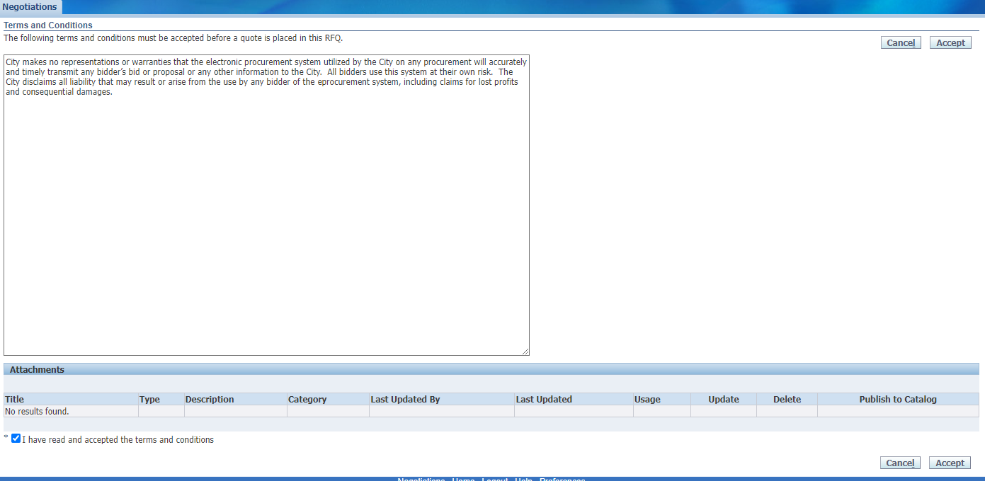
How to accept an amendment – Step 5
Finally, (1) click on the checkbox that you accept the terms and conditions and then (2) click on “Accept” to accept them.
This is the final step in acknowledging and accepting the amendment.
Youth Enrichment CHA Year-Round Program RFP

Slide 41
How to Submit an Application
Youth Enrichment CHA Year-Round Program RFP

Slide 42
How to submit an application - Step 1
When you are ready to submit, start by saving your draft one last time. Then click Continue.
Youth Enrichment CHA Year-Round Program RFP

Slide 43
How to submit an application - Step 2
If you are missing information, you will be given an error message on the top of the page.
Youth Enrichment CHA Year-Round Program RFP

Slide 44
How to submit an application - Step 3
Usually the error messages direct to something left undone in the application.
In the last example, the error message indicated that the lines (found under the lines tab) had not been filled out.
Youth Enrichment CHA Year-Round Program RFP

Slide 45
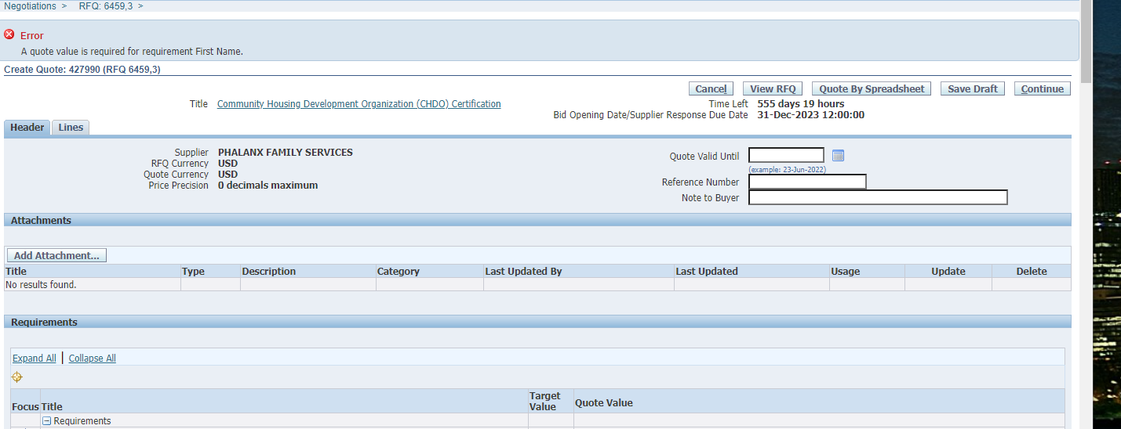
How to submit an application - Step 4
In this example, the error is about an unanswered question in the application (or Requirements section). The Quote Value refers to your (in this case, missing) answer.
Youth Enrichment CHA Year-Round Program RFP

Slide 46
How to submit an application - Step 5
Once your application is free from errors, you are ready to proceed and submit! At this point, clicking “Continue” should put your application into the “Review and Submit” phase.
Youth Enrichment CHA Year-Round Program RFP

Slide 47
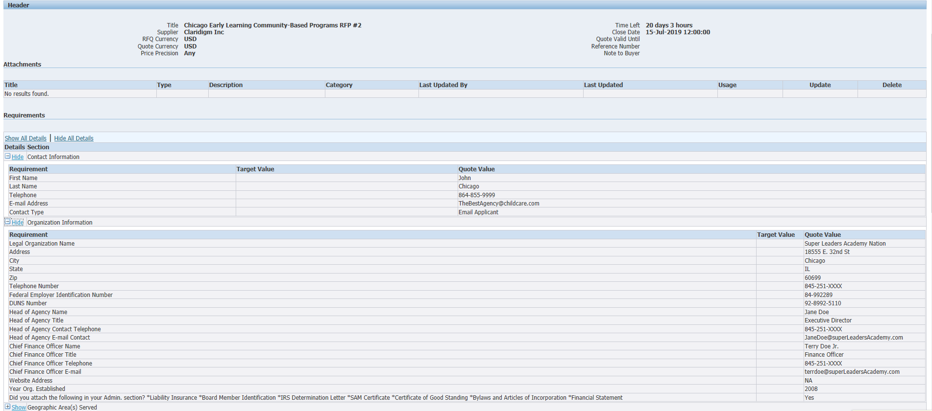
How to submit an application - Step 6
This is your last chance to review all your data and confirm that it is accurate. Check your attachments and scroll to the bottom of the screen to see all your responses.
Youth Enrichment CHA Year-Round Program RFP

Slide 48
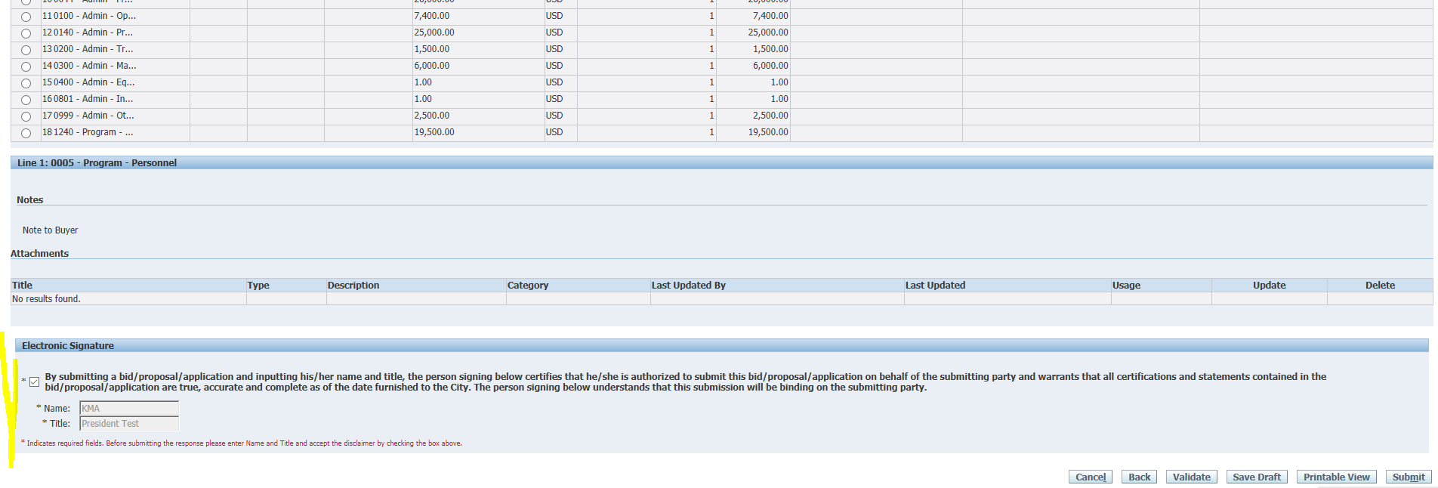
How to submit an application - Step 7
At the bottom of the screen you will be asked to provide an electronic signature. Be sure to fill in the signature before checking the box!
Youth Enrichment CHA Year-Round Program RFP

Slide 49
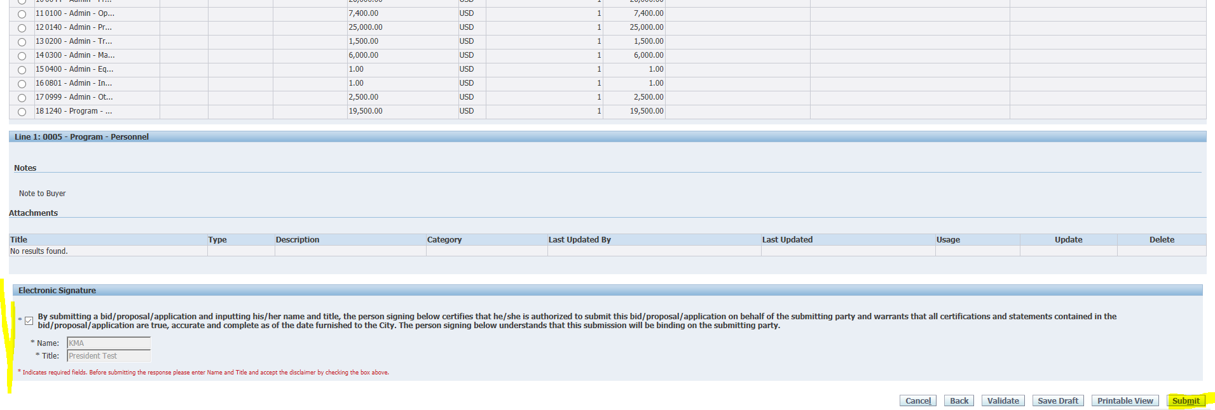
How to submit an application - Step 8
Then click “Submit”.
Youth Enrichment CHA Year-Round Program RFP

Slide 50
How to submit an application - Step 9
Make sure that you see this submittal confirmation screen. The eProcurement system will send a confirmation email within 24 hours of your submission. Please call or email me if you desire confirmation prior to then.
Youth Enrichment CHA Year-Round Program RFP

Slide 51
Program Questions?
Maria D. Guzmán-Rocha, Ph.D.
Director of Enrichment Programs
312-746-7474
maria.guzman-rocha@cityofchicago.org
For non-programmatic questions contact:
Julia Talbot
(312)-743-1679
Julia.Talbot@cityofchicago.org
Youth Enrichment CHA Year-Round Program RFP

