Slide 1
Department of Family and Support Services MCMF Community Anchor Organizations RFP
Please stand by, the webinar will begin shortly.
Release Date: December 28, 2022
Due Date: February 3, 2023
Notes:
JT

Slide 2
House Keeping
Due to the volume of participants, everyone has been placed on mute.
Please submit questions via the question box and we will respond to questions at the midpoint and end of the presentation.
Please use the question box to notify us of any technical issues.
This webinar is being recorded.
A copy of the recording will be posted on the DFSS YouTube channel with a link to the recording and a .pdf of these Power Point slides will be posted to the DFSS webpage at: https://www.chicago.gov/city/en/depts/fss.html under the ‘Alerts” and/or “Funding Opportunities” tabs. This will take up to five business days.
Notes:
JT

Slide 3
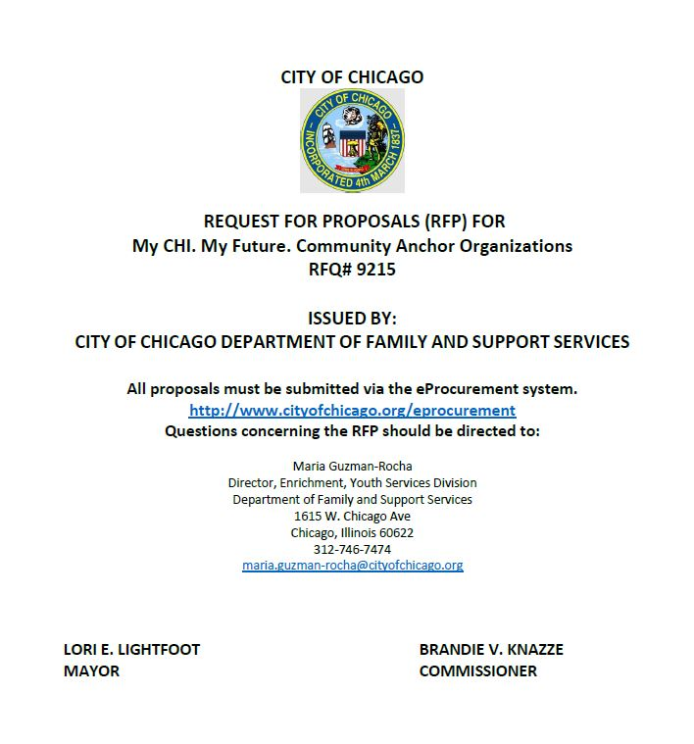
Agenda
Welcome and Introductions
Purpose
Background
Program Scope and Requirements
Selection Criteria
Timeline
Technical Assistance for Applicants and eProcurement
Questions
Notes:
JT

Slide 4
Purpose of the RFP
The Department of Family and Support Services (DFSS) seeks to fund community-based organizations to deliver the My CHI. My Future. (MCMF) Community Anchor Organization initiative in 15 regions across the city to address the COVID-19 pandemic-related effects on young people and communities.
DFSS seeks to fund community-based organizations with experience in community-level convening, strategic planning, and youth development.
Page 4
Notes:
MGR

Slide 5
Program Description and Goals
The goal of the MCMF Community Anchor Organization initiative is to address the COVID-19 pandemic-related effects on young people and communities through convening community-level stakeholders and caring adults committed to youth development (i.e., youth-serving organizations, faith leaders, school staff, etc.) to mobilize and connect young people of all ages to engaging and meaningful out-of-school time programming in their community.
This work will include hosting monthly convenings of partners to strategize, collaborate, and share resources; creating and implementing a community plan outlining how agencies in the region, including the Anchor Organization, will support a healthy community ecosystem for youth; and hosting community engagement events (i.e., opportunity fairs, trainings).
Notes:
MGR

Slide 6
Background
MCMF was conceptualized in 2019 and has since launched several initiatives, including both city-wide and community-based strategies, to achieve the MCMF vision statement:
Every young person in Chicago connects to a variety of rich, engaging, safe, and youth-centered out-of-school time experiences that empower them to discover and cultivate their talents, passions, skills, and identities; develop as physically, mentally, and emotionally healthy members of society; build relationships and networks with peers and mentors; and explore multiple pathways to college, careers, trades, entrepreneurship, and life-long learning. Access and participation in Chicago’s diverse out-of-school opportunity ecosystem must be equitable (not equal) across race, gender identities, disability, age, immigration status, income, neighborhood, and other identities, resulting in all young people (as well as their families, mentors, and caring adults) leveraging community assets and the city’s resources to build positive futures for themselves and their communities.
Notes:
MGR

Slide 7
Background
City-wide Strategy
MCMF was initiated in the fall of 2019 through a citywide convening. In 2020, MCMF launched MyCHIMyFuture.org, an online database of youth programs across the city. In May 2022, MCMF launched a mobile app that works in conjunction with the online platform to ensure youth and families have opportunities to learn about and connect to programs and resources.
MCMF Community Strategy
In early 2020, the City selected four initial communities of focus (Austin, Back of the Yards, Garfield Park, and Roseland) for deeper connections and on-the-ground-work. In partnership with LISC Chicago, the City provided small seed grants in each of the focus communities to support existing and new youth programming. South Shore was added as a fifth focus community in 2021. Also in 2020, the City began implementing out-of-school time campaigns, such as Halloweek, Make 2021 Yours, and the Kickback series. During the summer and winter months, the City piloted the Kickback Series, which provided 278 youth with part-time jobs organizing 140 community events attended by more than 12,000 children and family members. In 2022, the summer Kickback Series employed youth in 15 regions across Chicago most impacted by COVID-19.
Notes:
MGR

Slide 8
Background
The MCMF Community Anchor Organizations Request for Proposals is the second in a series of RFPs to be released by DFSS in 2022-23 to implement the MCMF Community Strategy. The goal of these three RFPs together is to strengthen youth ecosystems and deepen networks for agencies in 15 Community Strategy Regions across Chicago through a variety of approaches.
DFSS My CHI. My Future. RFPs
The Year-Round Safe Spaces for Youth Initiative (RFP released Fall 2022) will provide year-round programming for youth and families and youth employment opportunities for youth ages 16-24 in 15 regions.
The Micro-Grant Program (RFP release early 2023) will provide funding for safe and engaging youth programs within the 15 regions.
The Community Anchor Organization Initiative (focus of this RFP) will provide support for anchor organizations to convene community-based organizations in 15 regions with the goal of strengthening local, youth-serving opportunity ecosystems.
Notes:
MGR

Slide 9
Community Anchor Organizations RFP
RFP PAGE 8-9
With this RFP, DFSS seeks to expand the MCMF community strategy through selecting an agency in each of 15 Community Strategy Regions to convene local youth-serving agencies and individuals towards the goal of developing a community plan focused on youth engagement opportunities. DFSS is committed to building upon best practices in youth development in the execution of all its programs. The priorities for improvement that DFSS is focusing on for this RFP include:
Strengthen community-based approaches to address COVID-19 pandemic impact on youth
Strengthen collaborative community partnerships
Foster positive youth development through accessible and equitable approaches
Strengths-based approach to working with youth and centering youth voice
Prioritize continuous improvement, focusing on using data to make decisions
Notes:
TL

Slide 10
MCMF Community Strategy Regions
RFP PAGE 9-10
MCMF Community Strategy Regions
The MCMF Community Anchor Organizations program is designed to serve 15 MCMF Community Strategy Regions covering 19 Community Areas. Several of the Community Strategy Regions are made up of more than one community area.
These 19 community areas, as seen in Table 1 on the following slide, ranked high on the Chicago Community Vulnerability Index (CCVI) and/or the UIC Chicago Community Area Economic Hardship Index. Additionally, 13 of the 15 MCMF Community Strategy Regions are foci for Mayoral initiatives, such as the Community Safety Coordination Center (CSCC) and/or Invest SOUTH/WEST.
Delegates must be based in one of the 19 Community Areas; programming must engage young people and communities in the Community Area(s) within the agency’s home Community Strategy Region.
Notes:
TL

Slide 11
MCMF Community Strategy Regions
RFP PAGE 9
Table 1: MCMF Community Strategy Regions and Community Areas included within regions.
MCMF Community Strategy Regions | City of Chicago Community Areas Served
Auburn Gresham | Auburn Gresham
Austin | Austin
Back of the Yards | New City
Belmont Cragin | Belmont Cragin
Brighton Park | Brighton Park
Chicago Lawn | Chicago Lawn
Gage Park | Gage Park
Garfield Park | East Garfield Park West Garfield Park
Greater Englewood Area | Englewood West Englewood
Greater Grand Crossing | Greater Grand Crossing
Greater Roseland Area | Pullman Roseland Area West Pullman
Humboldt Park | Humboldt Park
Little Village | South Lawndale
North Lawndale | North Lawndale
South Shore | South Shore
Notes:
TL

Slide 12
Eligibility & Target Population
RFP PAGES 9-10
The focus of this RFP is on agencies that serve 15 MCMF Community Strategy Regions covering 19 Community Areas.
The Respondent is encouraged to recruit youth for opportunities and events related to the program from the following underrepresented populations outlined below:
Individuals with disabilities (i.e., physically impaired, visually impaired)
Individuals attending high schools that are categorized as Level 2, Level 3 or Options High School based on the current Chicago Public School Quality Rating Policy (SQRP)
Individuals who are English as a Second Language learners
Individuals that are experiencing homelessness/unstably housed
Individuals placed in the foster care system
Individuals who are justice involved (i.e., parole, probation)
Opportunity youth defined as out of school and out of work
Notes:
TL

Slide 13
Program Requirements
PROGRAM REQUIREMENTS
RFP PAGES 10-17
Through the programs outlined in this RFP, anchor organizations will support the three pillars of the MCMF community strategy outlined below:
Activate and convene a network of caring adults
Strengthen the opportunity ecosystem for Chicago’s youth
Connect youth to opportunities centering their voice & choice
Notes:
TL

Slide 14
Program Requirements
PROGRAM REQUIREMENTS
RFP PAGES 10-17
The Program Requirements for this RFP are listed below:
Host monthly convenings
Create a Community Plan
Develop and host community engagement events
Hire (or assign) and manage quality Program Manager
Ensure that agency, collaborating organizations, and youth are connected to the MCMF platform and app
Notes:
TL

Slide 15
Program Requirements
HOST MONTHLY CONVENINGS
RFP PAGES 11-12
Host monthly convenings
Delegates will be required to host monthly convenings of stakeholders dedicated to youth development within their home Community Strategy Region. Anchor organizations will be required to build relationships and collaborate to achieve shared goals. DFSS will support this through providing connections to and collaborations with City departments and sister agencies, such as local libraries, parks, and schools.
A key function of these convenings is to ensure that adults working in community youth spaces are connected to one another to ensure youth receive "warm handoffs" from one opportunity to the next. The connections established through monthly convenings will foster the creation of a strong youth ecosystem of support and learning opportunities.
Notes:
TL

Slide 16
Program Requirements
HOST MONTHLY CONVENINGS
RFP PAGES 11-12
Key functions of hosting monthly convenings:
Host convenings
Secure meeting location and manage logistics including tech, etc.
Create and provide necessary materials, including food
Create opportunities for meeting attendees to collaboratively develop detailed agendas with clear goals for each monthly convening
Keep time during meetings and ensure that agenda items are addressed
Manage any action items between monthly meetings, including items towards creation of Community Plan
Keep detailed notes of each meeting including action items
Oversee outreach and attendance
Conduct outreach and build relationships with a diverse group of local stakeholders
Ensure that convenings include representation from a range of groups, including but not limited to youth, faith-based organizations, social influencers, youth serving organizations, block club leaders, CPS administration, MCMF Safe Spaces for Youth agencies, and City agencies
Send meeting invitations and follow up about attendance
Ensure stakeholders are consistently present at convenings
Submit monthly attendance reports to DFSS
Notes:
TL

Slide 17
Program Requirements
HOST MONTHLY CONVENINGS
RFP PAGES 11-12
Key functions of hosting monthly convenings (continued):
Gather and report feedback and data
Work with convening attendees to identify key findings (e.g., numbers and demographics for youth who are not connected to programming, existing programs in Community Strategy Region, etc.) to guide development of a Community Plan
Track topics identified in meetings and meeting notes
Trainings and support
Use convenings to share resources and best practices with attendees based on stated needs of partners
Bring in speakers and citywide agencies to conduct trainings and informational sessions with convening attendees
Include time in meetings for attendees to share challenges and strategies with one another
Notes:
TL

Slide 18
Program Requirements
CREATE A COMMUNITY PLAN
RFP PAGES 12-14
Create a Community Plan
Anchor organizations, in collaboration with community stakeholders, will develop a Community Plan that outlines a strategy to connect youth to programming in the Community Strategy Region. The community plan will enhance actions at the community level to close long-standing gaps in participation in educational opportunities with youth becoming more well-rounded and more well-prepared. This plan should address the impact of COVID-19 pandemic on youth in the community and detail the specific needs, barriers, and assets of the community. The Community Plan will be developed in stages (Table 2) and will be implemented and updated throughout the duration of the program’s contract. The final Community Plan is the outcome of the monthly convenings and should include data and resources, as well as specific goals and an actionable plan for achieving those goals, identified during these convenings.
Anchor organizations and community stakeholders will be expected to diagnose and address barriers that prevent youth from accessing out-of-school time programming through the development and implementation of the Community Plan, including conducting a community needs assessment. The community needs assessment process will provide the Anchor Organization and its collaborators with an overview of the strengths and resources available in the community to meet the needs of children, youth, and families, as well as any gaps. Through this process, the Anchor Organization and its partners will seek to understand what barriers the region faces and what opportunities may be available.
Through the Community Plan, anchor organizations will help guide this critical analysis and cross-community collaboration to strengthen the youth ecosystem in their regions.
Notes:
TL

Slide 19
Program Requirements
CREATE A COMMUNITY PLAN
RFP PAGES 12-14
Create a Community Plan (continued):
Table 2: Community Plan Timeline
Goal | Duration | Schedule
Convene stakeholders, identify shared goals and working groups | 6 weeks | April 1 – May 15, 2023
Conduct community needs assessment | 6 weeks | May 15 – June 30, 2023
Draft Community Plan, distribute for feedback and update | 3 months | July 1 – September 30, 2023
Implement Community Plan v1 | 6 months | October 1, 2023 – March 31, 2024
Draft a sustainability plan after conclusion of the program’s contract | 2 months | March 31 – May 31, 2024
Evaluate process towards goals and update Community Plan as needed | 2 months | April 1 – May 31, 2024
Implement Community Plan v2 | 6 months | June 1 – November 30, 2024
Evaluate Community Plan | 2 months | November 1 – December 31, 2024
Update sustainability plan | 1 month | December 1 – December 31, 2024
Notes:
TL

Slide 20
Program Requirements
CREATE A COMMUNITY PLAN
RFP PAGES 12-14
Key functions of creating a community plan:
Organize and oversee working groups
Through monthly convenings, identify organizations to be part of working groups for development of a Community Plan
Identify youth to be part of a youth working group
Host two working group meetings per month (host additional working groups as needed to meet scheduling needs of organizations and youth participants)
Establish check-ins to ensure that outcomes of working groups are tracked and reflected in the Community Plan
Coordinate compensation for organizations and youth that are part of Community Plan working groups
Conduct community needs assessment
Identify and utilize existing resources for gathering data, or create new ones
Leverage the existing MCMF app and website to identify programming in the region
Work with the City and DFSS to pull data about region from existing databases
Complete and implement the Community Plan within the program’s duration according to the provided timeline (Table 2)
Notes:
TL

Slide 21
Program Requirements
CREATE A COMMUNITY PLAN
RFP PAGES 12-14
Key functions of creating a community plan (continued):
Draft Community Plan including the following components
Community background and goals
Youth opportunities data & community needs assessment
Plan to build, expand, and/or maintain a regional network
Stakeholder roles and responsibilities
Commitment to My CHI. My Future.
Plan to coordinate outreach, education, and engagement strategies to link youth to opportunities in the community.
Implement the Community Plan
Publish the Community Plan to the MCMF community page and share with community stakeholders.
Ensure that community stakeholders are equipped to carry out the goals of the community plan.
Monitor progress to ensure goals are met.
Track goals met.
Notes:
TL

Slide 22
Program Requirements
CREATE A COMMUNITY PLAN
RFP PAGES 12-14
Key functions of creating a community plan (continued):
Evaluate the Community Plan
Gather feedback from community stakeholders on the implementation of the Community Plan
Conduct surveys within the community to assess the effectiveness of the plan in addressing needs gap
Update as needed
Draft a sustainability scope for the Community Plan to be implemented after the conclusion of initial contract
Identify elements of the Community Plan that can be sustained without access to program funding
Identify continued sources of funding or support for implementation and updating of the Community Plan
Sustainability scope should be added as an addendum to the Community Plan upon completion
Notes:
TL

Slide 23
Program Requirements
COMMUNITY ENGAGEMENT EVENTS
RFP PAGE 15
Develop and host community engagement events
Delegate agencies will be expected to develop and host community programming aligned with the development and implementation of the Community Plan. Three programs will be hosted in the region each year (Table 3) and may take the following forms, including but not limited to:
Out-of-school program opportunity fairs for youth featuring local stakeholders
Job recruitment events for youth ages 16-24
Job readiness trainings for youth and families
Youth outreach training for youth-serving local stakeholders
Trainings for community-based, youth-serving organizations
Events designed to share out the findings and implementation of the Community Plan
Table 3: Overview of Community Engagement Events
Season | Alignment | Number of Required Events
Spring (March/April) | CPS Spring Break | 1 event
Summer (May/June) | CPS Summer Break | 1 event
Fall (August/September) | Start of the CPS School Year | 1 event
Notes:
TL

Slide 24
Program Requirements
COMMUNITY ENGAGEMENT EVENTS
RFP PAGE 15
Key functions of developing and hosting community engagement events:
Develop programming that is responsive to gaps identified in the Community Plan
Oversee event logistics including securing space, renting or providing supplies and materials, paying vendors, etc.
Manage outreach to youth and families including flyers, social media, and email blasts
Manage outreach and communications to participating stakeholders
Host planning meetings with participating stakeholders as needed
Provide follow up communication and/or materials for programming as needed
Notes:
TL

Slide 25
Program Requirements
HIRE AND MANAGE PROGRAM MANAGER
RFP PAGES 15-16
Hire/assign and manage quality Program Manager
Organizations must recruit, hire, and manage a Program Manager (new position or repurposed current position) to supervise the activities outlined in this RFP: host monthly convenings, create a community plan, and develop and host community engagement events. Duties also include administrative functions such as collecting and entering data and representing the community region at citywide events.
Program Managers should be positive, enthusiastic, civic minded individuals with connections to both their community and the world outside their community. Program Managers should have experience and skills in community organizing, project management, leadership, recruiting and mobilizing, or related areas.
Notes:
TL

Slide 26
Program Requirements
HIRE AND MANAGE PROGRAM MANAGER
RFP PAGES 15-16
Key functions of hiring/assigning and managing quality Program Manager:
Hire (or repurpose current position) and supervise Program Manager to oversee the program from kick-off to completion
Administer payroll for Program Manager. Personnel salaries and/or payment will not exceed the budget allocation unless supplemented with administrative funds or in-kind match
All program staff working with youth must be properly trained and have cleared a background check on file with their agency and DFSS prior to the start of programming. All documentation must be current and entered in the database system for verification prior to the program start date. Staff/volunteers cannot work with youth until background checks are completed. Staff and volunteers can only work with youth in the presence of a staff person who has a cleared Federal Fingerprint Background check. Prior to the program start date, staff must have:
Federal Fingerprint Background check (required every five years from date of initial check)
Illinois Mandated Reporter Training, Certificate, & Acknowledgment of Mandated Reporter Status Form (annual)
Cardiopulmonary resuscitation (CPR) and First Aid Certification (every two years)
Notes:
TL

Slide 27
Program Requirements
HIRE AND MANAGE PROGRAM MANAGER
RFP PAGES 15-16
Program Manager roles and responsibilities:
Work with agency Leadership and administrative team to oversee the successful roll-out and implementation of the Anchor Organizations initiative.
Duties related to hosting monthly convenings and working group meetings including creating agendas, facilitating/co-facilitating meetings, overseeing outreach, securing location, sending invites, managing logistics, and creating and providing necessary materials.
Duties related to hosting Community Engagement Events including overseeing outreach to stakeholders, youth, and community members; working with leadership to plan and execute engaging events; securing location; working with vendors; and acting as day-of contact for events.
Ensure elements of the Community Plan are developed according to the provided timeline (Table 2).
Play a role in the development of the Community Plan, including writing and/or working with consultants to oversee creation of the Community Plan.
Oversee implementation of Community Plan and support stakeholders as needed.
Manage MCMF community page for region and MCMF page for anchor organization; ensure that youth opportunities, events, resources, and more are updated as needed.
Share program data as requested by DFSS.
Represent the region in MCMF and sister-agency city-wide events and initiatives.
Act at liaison between DFSS, Mayor’s Office and the anchor organization and region.
Notes:
TL

Slide 28
Program Requirements
CONNECT TO MCMF PLATFORM AND APP
RFP PAGES 16-17
Ensure that agency, collaborating organizations, and youth are connected to the MCMF platform and app
Agencies funded to carry out the programs outlined in this RFP will be connected to the MCMF collaborative youth opportunity ecosystem in Chicago. As part of this agreement, agencies must incorporate MCMF into their work in the following ways. Trainings and resources required to carry out these requirements will be provided as needed.
Notes:
TL

Slide 29
Program Requirements
CONNECT TO MCMF PLATFORM AND APP
RFP PAGES 16-17
Key functions of ensuring that agency, collaborating organizations, and youth are connected to the MCMF platform and app:
Manage Community Page for MCMF Community Strategy Region on MCMF website. Community Page will include program information, contact information, resources, as well as information about monthly convenings and the Community Plan.
Create a MCMF account for the organization to post opportunities on the website and app. Resources and guides can be found at partners.mychimyfuture.org.
Post all youth-related opportunities (events, jobs, programs, resources) for youth ages 0-24 offered by the agency to the MCMF platform on the first day of each month.
Encourage all collaborating organizations to post all youth-related opportunities (events, jobs, programs, resources) for youth ages 0-24 offered by the agency to the MCMF platform on the first day of each month.
Encourage all youth participants in related programs ages 13 and older who have smartphones (Android and iPhone) to download the MCMF app to get access to opportunities throughout the year.
Delegates must participate in citywide and local MCMF convenings and networks. Information on these meetings will be posted in MCMF’s weekly newsletters. Delegates can sign up for this newsletter at partners.mychimyfuture.org.
Notes:
TL

Slide 30
Budget Breakdown
RFP PAGES 17-18
Table 4: MCMF Anchor Organization Initiative Sample Budget Breakdown Per Delegate: Year 1
Personnel (includes salary + fringe benefits) | -- | -- | Total Funding
Project Manager (FT salary) | -- | -- | $55,500
Agency Director (25% of FT salary) | -- | -- | $38,850
Agency coordinator/admin (55% of FT salary) | -- | -- | $27,750
Community Convenings | Cost (per event) | Number of events | Total funding
Space Rental | $250 | 10 | $2,500
Materials and supplies | $100 | 10 | $1,000
Speaker honoraria | $150 | 10 | $1,500
Community Plan (Year 1)* | -- | -- | Total funding
Consulting fees (design, writing, copywriting) | -- | -- | $7,500
Consulting fees (research, needs assessment) | -- | -- | $15,000
Research / data miscellaneous (incentives, materials and supplies) | -- | -- | $2,500
Outreach materials | -- | -- | $2,000
Community Plan Working Groups | Cost (per event) | Number of events | Total funding
Materials and supplies | $100 | 20 | $2,000
Community organization honoraria (15 agencies * $100 per meeting) | $1,500 | 20 | $30,000
Youth honoraria (10 individuals * $100 per meeting) | $1,000 | 20 | $20,000
Notes:
MGR

Slide 31
Budget Breakdown (continued)
RFP PAGES 17-18
Table 4: MCMF Anchor Organization Initiative Sample Budget Breakdown Per Delegate: Year 1 (continued)
Community Engagement Events | Cost (per event) | Number of events | Total funding
Materials and supplies | $200 | 3 | $600
Speaker honoraria / performer fees | $500 | 3 | $1,500
Space / equipment rental | $750 | 3 | $2,250
Transportation | $200 | 3 | $600
Food Related Costs for Participants | -- | -- | Total funding
Food related costs for participants at events and meetings | -- | -- | $6,600
Subtotal |  |  | $217,650
Agency Administrative Costs (15% of total budget) |  |  | $32,648
TOTAL RFP funding per delegate per contract period |  |  | $250,298
*During the first year of funding, Community Plan expenses should be used for research and development; during the second year of funding, Community Plan expenses should be used for evaluation and sustainability planning.
Notes:
MGR

Slide 32
Advanced Payment Policy
RFP PAGE 22
The Respondent is required to incur and pay expenses before seeking reimbursement from the City. However, advances for costs will be considered according to the City’s advance payment policy.
Respondents will need to indicate in their application whether they wish to exercise the City’s advance payment policy option.
For additional information about the City's advance payment policy, see the Delegate Agency Request for Advance Mobilization Payment Form which has been uploaded as an attachment in the RFP’s application.
This form is attached to the RFP for information only, and applicants should not complete the form at the time of submitting the application.
Notes:
MGR

Slide 33
Performance Goals and Outcomes
RFP PAGES 18-20
The goal of this program is to mobilize strategies to connect young people of all ages to engaging and meaningful out-of-school time programming in each of the 15 MCMF Community Strategy Regions, 19 addressing the impact of COVID-19 on under-resourced communities through coordinated community-based approaches. To track progress toward achieving the outcome goals of this program and assess success, DFSS will monitor a set of performance indicators. We will monitor the outcomes below through data collection from community stakeholders and youth and families. Monitored performance indicators may include, but are not limited to: Community Convenings
Outputs
Agencies host 10 Community Convenings each year
20 non-city stakeholders attend at each monthly meeting
At least 3 sectors (i.e., youth programming, faith, education, public health) are in attendance at each meeting
Participating stakeholders attend at least 75% of meetings per year
75% of participating stakeholders contributing to shared calendar
Outcomes
100% of stakeholders, including anchor organization, collaborating organizations, youth, and community members, will feel that the Community Convenings contributed to a stronger community youth ecosystem
Notes:
MGR

Slide 34
Performance Goals and Outcomes
RFP PAGES 18-20
Community Plan
Outputs
At least 15 non-city stakeholders attend 95% of working group meetings
At least 10 youth attend 95% of Community Plan working group meetings
100% of Community Plan completion deadlines are met
75% of activities outlined in the Community Plan are completed
25% of youth disconnected from out-of-school programs are connected to opportunities after implementation of the Community Plan
Outcomes
100% of stakeholders, including anchor organization, collaborating organizations, youth, and community members, will feel that the Community Plan contributed to a stronger community youth ecosystem
Community Engagement Events
Outputs
Agencies will host 3 events each year
100 households/individuals are reached at each event
Outcomes
85% of attendees will report feeling a sense of community or belonging at events
85% of attendees will report feeling like the content of events reflects their interests or needs
Notes:
MGR

Slide 35
Performance Goals and Outcomes
RFP PAGES 18-20
MCMF Platform
Outputs
25% increase in number of programs and activities posted on the MCMF app and website after one year.
Outcomes
75% of caring adults at anchor organizations and other community stakeholders will believe that the MCMF network has helped them to identify opportunities for the youth with which they interact.
Notes:
MGR

Slide 36
Guidance for Respondents
RFP PAGE 21
Respondents must indicate which MCMF Community Strategy Region they will be applying for:
Auburn Gresham, Austin, Back of the Yards, Belmont Cragin, Brighton Park, Chicago Lawn, Gage Park, Garfield Park, Greater Englewood Area, Greater Grand Crossing, Greater Roseland Area, Humboldt Park, Little Village, North Lawndale, South Shore
Respondents must submit one application for each MCMF Community Strategy Region for which they wish to apply.
Respondents can only apply for a MCMF Community Strategy Region in which they can demonstrate a physical address.
Multiple applications by the same agency for the same MCMF Community Strategy Region will NOT be considered
Notes:
MGR
Give example for if applying for more than one region (Greater Roseland & North Lawndale) you will submit 2 separate applications.
If you apply for more than one zone you will need multiple iSupplier accounts which means you must use a separate email address for each submittal proposal. We will go over this later in the presentation.

Slide 37
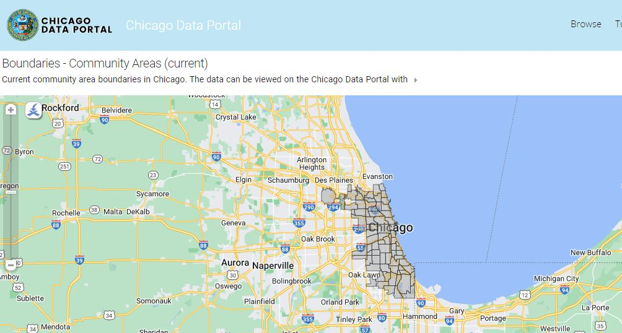
Guidance for Respondents
RFP PAGE 21
To determine the Chicago community area where your program is located, go here: https://data.cityofchicago.org/Facilities-Geographic-Boundaries/Boundaries-Community-Areas-current-/cauq-8yn6
Click the symbol circled below to enter an address and determine the Chicago community area where it is located.
Notes:
MGR

Slide 38
Selection Criteria – Community Involvement
RFP PAGES 23-24
The Respondent understands the distinct assets and challenges faced by the region it serves
The Respondent has expertise working with the target population and has relevant capabilities and/or infrastructure needed to serve this group
The Respondent’s organization reflects and engages the diverse people of the communities it serves
Notes:
TL

Slide 39
Selection Criteria - Organizational Capacity
RFP PAGES 23-24
The Respondent has a plan to ensure a qualified staff person responsible for program oversight and management is hired or reassigned
The Respondent has adequate systems and processes to support monitoring program expenditures and fiscal controls
The Respondent has articulated a strategy to ensure adequate staffing to achieve the outcomes of the program
Notes:
TL

Slide 40
Selection Criteria – Strength of Proposed Program
RFP PAGES 23-24
The Respondent provides a clear connection between their mission and/or vision and the MCMF mission and vision
The Respondent provides a clear connection between their proposed program activities and the outcome goals of the RFP
The Respondent has a plan to recruit and retain collaborating agencies in the region
The Respondent has experience partnering with other local organizations to better support the community it serves
The Respondent demonstrates prior experience with planning, promoting, and executing events
The respondent demonstrates an understanding of resources or processes available to use in determining assets and gaps in the region
Notes:
TL

Slide 41
Selection Criteria – Performance Management and Outcomes
RFP PAGES 23-24
The Respondent demonstrates evidence of strong past performance in similar programs against desired outcome goals and performance metrics
The Respondent has experience using data to inform/improve its services or practices
The Respondent has the relevant systems and processes needed to collect and store key participant and performance data
The Respondent has the relevant systems and processes needed to track and report performance on program outcomes
The Respondent has demonstrated experience with collecting and analyzing data to inform programming
Notes:
TL

Slide 42
Selection Criteria – Reasonable costs, budget justification, and leverage of funds
RFP PAGES 23-24
The Respondent describes the cash-flow and capacity to expend funds prior to implement the proposed program
The Respondent demonstrates an understanding of how the allotted budget can be implemented to meet the proposed scope of work or work plan
The Respondent describes an auditing process
Notes:
TL

Slide 43
Selection Criteria - Attachments
Be sure to attach the job description for the Program Manager overseeing the program.
Be sure to attach your organization's budget for this program
Please ensure that all program requirements are addressed
Please ensure that the request from DFSS does not exceed the total outlined in the sample budget provided in the RFP (Table 4, pages 17-18)
Notes:
TL

Slide 44
Selection and Transition Timeline
Pre-proposal webinar – January 11, 2023
Applications due – February 3, 2023, at 12:00 noon
Program period begins – March 1, 2023
Notes:
TL

Slide 45
Deadline
Applications are due
on February 3, 2023
at 12:00, Noon
Notes:
TL

Slide 46
Application Tips
Start Early!!
If you have never done business with the City of Chicago, register into iSupplier/eProcurement ASAP.
Review RFP narratives and application questions closely. Remember they align with the scope and selection criteria. Use the information in the RFP for guidance in formulating your answers.
There is a 4,000-character limit which includes punctuation and spaces. Each response is allotted 4,000 characters.
Do not use the back button on your browser.
Save Often!!
Notes:
JT

Slide 47
Tips for Working in eProcurement
You can “submit” your application and later amend it up until the due date February 3, 2023, at 12:00 noon.
Avoid the rush and possible mishaps by submitting early. Plan on submission taking 30-60 minutes.
Late applications will not be accepted.
Make use of the eProcurement hotline for help at 312-744-4357 (HELP).
Please note that the hotline operates during business hours only, Monday-Friday 9-5.
Save often, submit early!
Notes:
JT

Slide 48
Technical Assistance!
On the DFSS web page is a link to the RFP of interest and training documents. See “Alerts” Section on our website.
For Questions on Registration and eProcurement Technical Assistance for Delegate Agencies –
CustomerSupport@cityofchicago.org or call 312-744-HELP (4357)
Training Materials (Documents and Videos) – https://www.cityofchicago.org/city/en/depts/dps/isupplier/online-training-materials.html

Slide 49
How to Accept an Amendment
MCMF Community Anchor Organizations

Slide 50
How to accept an amendment – Step 1
If the RFP you are interested in has been amended. In order to start an application, you will need to acknowledge and accept the amendment first. (Please not that the RFP shown in this and subsequent slides is an example). To accept the amendment, click on “View Amendment History”.
If the RFP has not been amended (yet), select “Create Quote” from the drop-down menu in the “Actions” box and click on “Go”. This will take you to the application page, where you can get started.
MCMF Community Anchor Organizations

Slide 51
How to accept an amendment – Step 2
To begin the acceptance and acknowledgment process, to open the RFP in view only: (1) click on the Document number. (2) To review the amended changes to the RFP, click on the infinity or eyeglass icon. (3) To acknowledge receipt and understanding of these changes and proceed, click on the “Acknowledge Amendments” button.
By acknowledging the amendment, you are indicating that you are aware of the changes made to the RFP in the amendment.
MCMF Community Anchor Organizations

Slide 52
How to accept an amendment – Step 3
When you get to this screen, click on the “I accept…” check box and then click on “Acknowledge”
MCMF Community Anchor Organizations

Slide 53
How to accept an amendment – Step 4
Click on “Yes” to indicate that you confirm your acknowledgement of the amendment.
MCMF Community Anchor Organizations

Slide 54
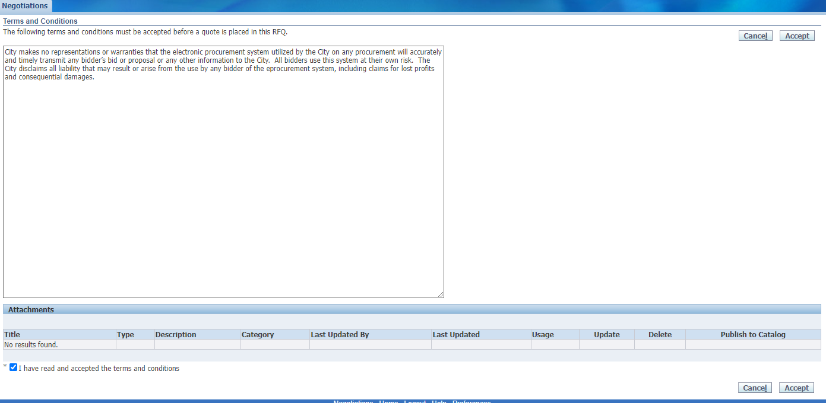
How to accept an amendment – Step 5
Finally, (1) click on the checkbox that you accept the terms and conditions and then (2) click on “Accept” to accept them.
This is the final step in acknowledging and accepting the amendment.
Youth Mentoring Program RFP
MCMF Community Anchor Organizations

Slide 55
How to Submit an Application
Youth Mentoring Program RFP
MCMF Community Anchor Organizations

Slide 56
How to submit an application – Step 1
When you are ready to submit, start by saving your draft one last time. Then click Continue.
Youth Mentoring Program RFP
MCMF Community Anchor Organizations

Slide 57
How to submit an application – Step 2
If you are missing information, you will be given an error message on the top of the page.
Youth Mentoring Program RFP
MCMF Community Anchor Organizations

Slide 58
How to submit an application – Step 3
Usually the error messages direct to something left undone in the application.
In the last example, the error message indicated that the lines (found under the lines tab) had not been filled out.
Youth Mentoring Program RFP
MCMF Community Anchor Organizations

Slide 59
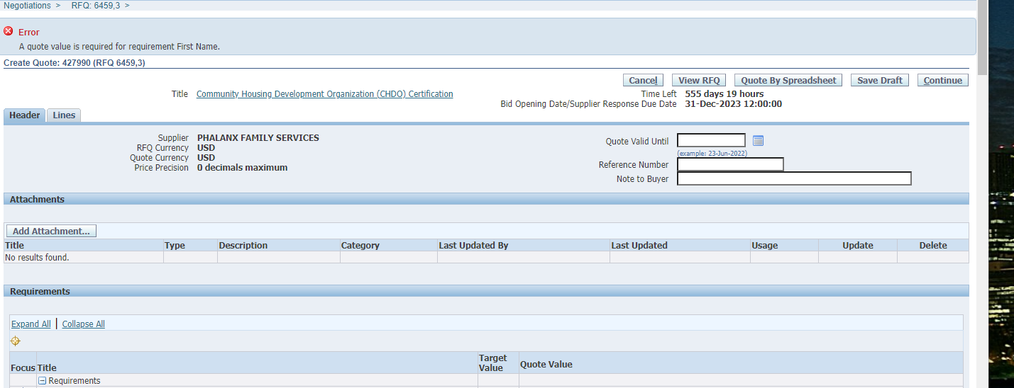
How to submit an application – Step 4
In this example, the error is about an unanswered question in the application (or Requirements section). The Quote Value refers to your (in this case, missing) answer.
Youth Mentoring Program RFP
MCMF Community Anchor Organizations

Slide 60
How to submit an application – Step 5
Once your application is free from errors, you are ready to proceed and submit! At this point, clicking “Continue” should put your application into the “Review and Submit” phase.
Y
MCMF Community Anchor Organizations

Slide 61
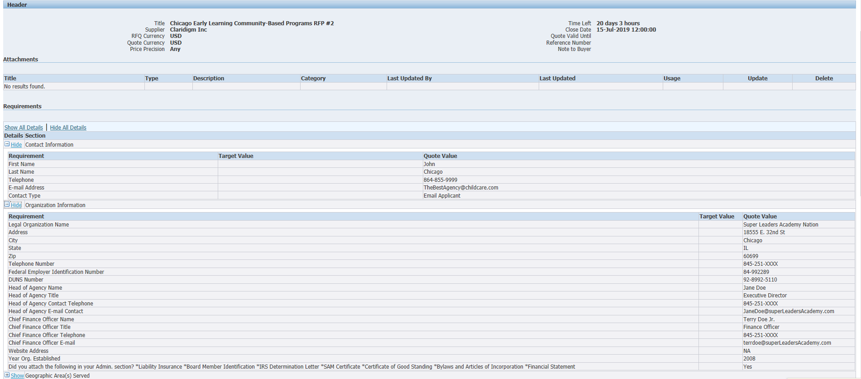
How to submit an application – Step 6
This is your last chance to review all your data and confirm that it is accurate. Check your attachments and scroll to the bottom of the screen to see all your responses.
MCMF Community Anchor Organizations

Slide 62
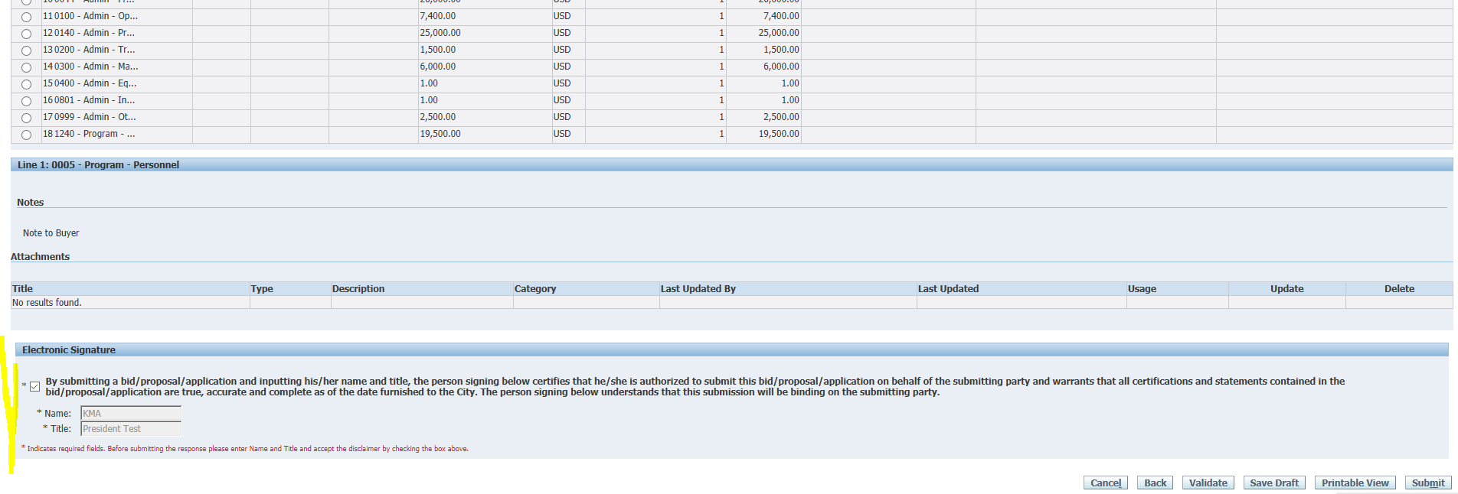
How to submit an application – Step 7
At the bottom of the screen you will be asked to provide an electronic signature. Be sure to fill in the signature before checking the box!
MCMF Community Anchor Organizations

Slide 63
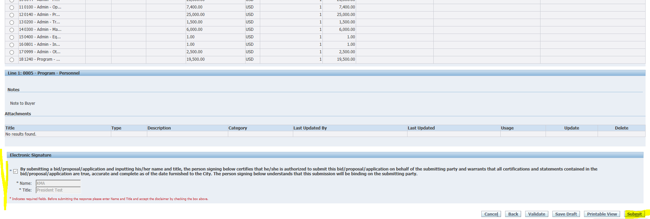
How to submit an application – Step 8
Then click “Submit”.
MCMF Community Anchor Organizations

Slide 64
How to submit an application – Step 9
Make sure that you see this submittal confirmation screen. The eProcurement system will send a confirmation email within 24 hours of your submission. Please call or email me if you desire confirmation prior to then.
Youth Mentoring Program RFP
MCMF Community Anchor Organizations

Slide 65
Questions?
MCMF Community Anchor Organizations

Slide 66
For program questions contact:
Maria Guzman-Rocha
312-746-7474
Maria.Guzman-Rocha@cityofchicago.org
For non-programmatic questions contact:
Julia Talbot
(312)-743-1679
Julia.Talbot@cityofchicago.org
MCMF Community Anchor Organizations

