Slide 1
Department of Family and Support Services MCMF Year-Round Safe Spaces for Youth RFP
Please stand by, the webinar will begin shortly.
Release Date: September 29, 2022
Due Date: November 4, 2022
Notes:
JT

Slide 2
House Keeping
Due to the volume of participants, everyone has been placed on mute.
Please submit questions via the question box and we will respond to questions after going through the slides.
Please use the question box to notify us of any technical issues.
Notes:
JT

Slide 3
Agenda
Welcome and Introductions
Purpose
Background
Information about the scope/program description
Selection Criteria
Timeline
Technical Assistance for Applicants and eProcurement
Questions
Notes:
JT

Slide 4
Purpose of the RFP
The Department of Family and Support Services (DFSS) seeks to fund community-based organizations to deliver the My CHI. My Future. (MCMF) Year-Round Safe Spaces for Youth initiative in 15 regions across the city.
DFSS seeks to fund community-based organizations with experience in 1) managing youth development programming and leveraging community participation and 2) implementing subsidized youth employment programs for young people ages 16-24 in Chicago.
Page 4
Notes:
MGR

Slide 5
Program Description and Goals
The goal of the MCMF Year-Round Safe Spaces for Youth initiative is to ensure local youth have meaningful and safe out-of-school time opportunities in their home regions.
MCMF Safe Spaces for youth events—called “Kickbacks”—will strengthen healthy community ecosystems for young people and their families through enriching, community-based out-of-school time activities. “Kickbacks” are community-based events for young people where they can gather with other youth in their communities.
A youth employment component for older youth (ages 16-24) will help young people increase their self-efficacy and gain work experiences and skills needed to succeed in today’s and future economies.
Notes:
MGR

Slide 6
Background
MCMF was conceptualized in 2019 and has since launched several initiatives, including both city-wide and community-based strategies, to achieve the MCMF vision statement:
Every young person in Chicago connects to a variety of rich, engaging, safe, and youth-centered out-of-school time experiences that empower them to discover and cultivate their talents, passions, skills, and identities; develop as physically, mentally, and emotionally healthy members of society; build relationships and networks with peers and mentors; and explore multiple pathways to college, careers, trades, entrepreneurship, and life-long learning. Access and participation in Chicago’s diverse out-of-school opportunity ecosystem must be equitable (not equal) across race, gender identities, disability, age, immigration status, income, neighborhood, and other identities, resulting in all young people (as well as their families, mentors, and caring adults) leveraging community assets and the city’s resources to build positive futures for themselves and their communities.
Notes:
MGR

Slide 7
Background
City-wide Strategy
MCMF was initiated in the fall of 2019 through a citywide convening. In 2020, MCMF launched MyCHIMyFuture.org, an online database of youth programs across the city. In May 2022, MCMF launched a mobile app that works in conjunction with the online platform to ensure youth and families have opportunities to learn about and connect to programs and resources.
MCMF Community Strategy
In early 2020, the City selected four initial communities of focus (Austin, Back of the Yards, Garfield Park, and Roseland) for deeper connections and on-the-ground-work. In partnership with LISC Chicago, the City provided small seed grants in each of the focus communities to support existing and new youth programming. South Shore was added as a fifth focus community in 2021. Also in 2020, the City began implementing out-of-school time campaigns, such as Halloweek, Make 2021 Yours, and the Kickback series. During the summer and winter months, the City piloted the Kickback Series, which provided 278 youth with part-time jobs organizing 140 community events attended by more than 12,000 children and family members. In 2022, the summer Kickback Series employed youth in 15 regions across Chicago most impacted by COVID-19.
Notes:
MGR

Slide 8
Background
The MCMF Year-Round Safe Spaces for Youth Request for Proposals is the first in a series of RFPs to be released by DFSS in 2022 to implement the MCMF Community Strategy. The goal of these three RFPs together is to strengthen youth ecosystems and deepen networks for agencies in 15 Community Strategy Regions across Chicago through a variety of approaches.
DFSS My CHI. My Future. RFPs
The Year-Round Safe Spaces for Youth Initiative (focus of this RFP) will provide year-round programming for youth and families and youth employment opportunities for youth ages 16-24 in 15 regions.
The Community Anchor Organization Initiative (RFP release Fall/Winter 2022) will provide support for anchor organizations to convene community-based organizations in 15 regions with the goal of strengthening local, youth-serving opportunity ecosystems.
The Micro-Grant Program (RFP release Fall/Winter 2022) will provide funding for safe and engaging youth programs within the 15 regions.
Notes:
MGR

Slide 9
Safe Spaces for Youth RFP
With this RFP, DFSS seeks to expand MCMF programming to a year-round model through selecting an agency in each of 15 Community Strategy Regions to employ 15 youth and host Kickback events while prioritizing the objectives listed below. DFSS is committed to continuing to build upon best practices in youth development in the execution of all its programs. The priorities for improvement that DFSS is focusing on for this RFP include:
Leverage partnerships and collaboration between agencies based in the same Community Strategy Regions
Prioritize hiring and serving youth in the target Community Strategy Region
Strengths-based approach to working with youth
Connect youth to employment opportunities that reflect their interests
Focus on continuous improvement using data to make programmatic decisions
Build young people's financial capabilities
Notes:
TL

Slide 10
MCMF Community Strategy Regions
MCMF Community Strategy Regions
The year-round MCMF Kickback events will be targeted to youth ages 13-19 and their families within 15 Community Strategy Regions covering 19 community areas. Several of the MCMF Community Strategy Regions are made up of more than one Community Area.
These 19 community areas, as seen in Table 1 on the following slide, ranked high on the Chicago Community Vulnerability Index (CCVI) and/or the UIC Chicago Community Area Economic Hardship Index. Additionally, 13 of the 15 MCMF Community Strategy Regions are foci for Mayoral initiatives, such as the Community Safety Coordination Center (CSCC) and/or Invest SOUTH/WEST.
Delegates must be based in one of the 19 Community Areas; programming must engage youth and families in the Community Area(s) within the agency’s home Community Strategy Region.
Notes:
TL

Slide 11
MCMF Community Strategy Regions
Table 1: MCMF Community Strategy Regions and Community Areas included within regions.
MCMF Community Strategy Regions | City of Chicago Community Areas Served
Auburn Gresham | Auburn Gresham
Austin | Austin
Back of the Yards | Back of the Yards
Belmont-Cragin | Belmont-Cragin
Brighton Park | Brighton Park
Chicago Lawn | Chicago Lawn
Gage Park | Gage Park
Garfield Park | East Garfield Park West Garfield Park
Greater Englewood Area | Englewood West Englewood
Greater Grand Crossing | Greater Grand Crossing
Greater Roseland Area | Pullman Roseland Area West Pullman
Humboldt Park | Humboldt Park
Little Village | Little Village
North Lawndale | North Lawndale
South Shore | South Shore
Notes:
TL

Slide 12
Eligibility & Target Population
Eligibility for youth employees
Chicago youth ages 16-24 years old
Youth must be 16 by the day the program starts
Must show proof of Chicago residency, have a valid Chicago Public School or State of Illinois ID card, and have a signed consent form from the parent or guardian on file for youth under the age of 18.
The respondent is encouraged to recruit youth employees from the following underrepresented populations outlined below:
Individuals with disabilities (i.e., physically impaired, visually impaired)
Individuals attending high schools that are categorized as Level 2, Level 3 or Options High School based on the current Chicago Public School Quality Rating Policy (SQRP)
Individuals who are English as a Second Language learners
Individuals that are experiencing homelessness/unstably housed
Individuals placed in the foster care system
Individuals who are justice involved (i.e., parole, probation)
Opportunity youth defined as out of school and out of work
Notes:
TL

Slide 13
Program Requirements
Through the programs outlined in this RFP, DFSS asks agencies to support the MCMF community strategy vision and goals below:
Center youth voice and choice
Provide a safe space for youth to spend time during school breaks
Offer developmentally appropriate activities and entertainment
Encourage young people to develop connections amongst one another and with caring adults within their community
Notes:
TL

Slide 14
Program Requirements
PROGRAM REQUIREMENTS
RFP PAGES 10-17
The Program Requirements for this RFP are listed below:
Employ local youth
Administer Kickback events
Hire quality Program Coordinator with youth and event production experience
Ensure that agency and youth are connected to the MCMF platform and app
Notes:
TL

Slide 15
Program Requirements
EMPLOY LOCAL YOUTH
RFP PAGES 10-13
1. Employ local youth
DFSS asks delegates to design and deliver a year-round youth employment program with a focus on providing work experiences in event planning and developing 21st century skills in preparation of future career pathways for 15 youth.
Key facts of employing local youth:
Youth Ages: 16-24
Minimum Number of Youth Served Per Agency: 15 youth participants per agency (1:15 staff ratio)
Recruitment: The Respondent is encouraged to recruit youth employees from following underrepresented populations outlined in the Target Population section; all youth must reside within the selected agencies’ Community Strategy Region (which may include more than one Community Area)
Program Schedule: 360 hours per youth over a span of 26 weeks
Notes:
TL

Slide 16
Program Requirements
EMPLOY LOCAL YOUTH
RFP PAGES 10-13
Key facts of employing local youth (continued):
Table 2: Youth Employee Schedule and Hours Overview
Season | Number of weeks | Hours per week | Total Hours
Spring | 4 | 10 | 40
Summer | 10 | 20 | 200
Fall | 4 | 10 | 40
Winter | 8 | 10 | 80
Total | 26 | -- | 360
Notes:
TL

Slide 17
Program Requirements
EMPLOY LOCAL YOUTH
RFP PAGES 10-13
Key functions of employing local youth:
Recruit and retain youth
Coordinate outreach and recruitment
Provide orientation and training for youth, and families
Maintain communication with youth and families throughout program
Track and enter data as needed
Implement weekly program curriculum, including administering MCMF trainings and speaker series
Develop weekly goals and activities informed by provided curriculum
Facilitate access for youth to complete financial literacy training
Encourage youth to attend Safe Spaces for Youth Speaker Series
Enter youth data into Cityspan
Administer payroll for youth wages
Collect participant timesheets and record in payroll system
Pay participants on a bi-weekly basis
Maintain time and payroll documents in a secure space
Support youth participation in All Teen Gatherings
Share information about events with youth and families in a timely manner
Support transportation logistics to and from events
Notes:
TL

Slide 18
Program Requirements
ADMINISTER KICKBACK EVENTS
RFP PAGES 13-15
2. Administer Kickback events
Delegates will be expected to manage the youth Kickback events intended to reach youth residing within the agency’s home region. Youth Kickback events should be held during key out-of-school time periods, such as spring break, summer, Halloweek, and winter break.
Table 3: Kickback Event Overview
Season | Alignment | Number of Required Events
Spring (April) | CPS Spring Break | 1 event
Summer (June – August) | CPS Summer Break | 7 events
Fall (October) | Halloweek | 1 event
Winter (December) | CPS Winter Break | 2 events
Notes:
TL

Slide 19
Program Requirements
ADMINISTER KICKBACK EVENTS
RFP PAGES 13-15
2. Administer Kickback events
Three Kickback event models will allow for different scales of events:
Summer Kickbacks (6 events per year; Target attendance: 100)
Youth-focused, hyperlocal events that include entertainment / activities and food.
School Year Kickbacks (4 events per year; Target attendance: 200)
Youth-focused, hyperlocal events that include entertainment / activities and food for a larger number of attendees.
Summer Mothership (1 event per year; Target attendance: 300)
Youth-focused, community-based events that foster connections for young people with peers and caring adults both within and outside of their home communities with additional resources put towards entertainment / activities and food and for a larger number of attendees.
Mothership events are planned collaboratively by a cohort of 3 delegate agencies identified by DFSS and event costs and outreach efforts are shared by all agencies.
The Summer Mothership will require additional hours for planning and outreach to meet higher attendance goals than summer and school year events.
Notes:
TL

Slide 20
Program Requirements
ADMINISTER KICKBACK EVENTS
RFP PAGES 13-15
Key functions of administering Kickback events:
Prepare a safe and accessible space for a large, public event
Identify a site for each Kickback event that is owned or leased by delegate or that they have written permission to use for the event
Complete necessary paperwork or agreements for access to site
Provide reasonable accommodations for attendees with disabilities
Plan activities, food, and entertainment for events
Identify activities and entertainment appropriate for a teen audience
Work with vendors to provide activities, food, and entertainment
Pay vendors for services in a timely manner
Collaborate with other community organizations, parks, libraries, etc. to plan events and ensure events reach youth in communities
Collaborate with designated partner agencies to plan and host one Summer Mothership Create and distribute digital and physical advertisements for Kickback events
Work towards goal of reaching attendance of 100-300 participants per event
Prepare sample social media posts and a sample email for partner organizations Collaborate with partner organizations to identify additional information or activities that those organizations can provide at Kickbacks
Notes:
TL

Slide 21
Program Requirements
ADMINISTER KICKBACK EVENTS
RFP PAGES 13-15
Key functions of administering Kickback events (continued):
Collect data on events
Identify total number of participants in attendance from targeted MCMF Community Strategy Region.
Collect information about event attendees including audience demographics and perceived outcomes
Submit all data to DFSS
Collect photos, videos, and testimonials from events
Track event expenses and payouts
Track all event-related payments
Identify plan for inclement weather and other unforeseen circumstances
Identify plan for weather and other emergency situations
Identify staff person to liaison with emergency service providers as needed
Establish protocol for communicating changes in location, etc. with attendees
Notes:
TL

Slide 22
Program Requirements
HIRE QUALITY STAFF
RFP PAGES 15-16
3. Hire quality program coordinator with youth and event production experience
Organizations must recruit, hire, and manage one Program Coordinator to supervise 15 youth employees and oversee Kickbacks. Only one individual may fill the coordinator role and its associated responsibilities.
Key functions of hiring quality program coordinator:
Hire and supervise Program Coordinator to manage the program from kick-off to completion
All Program Coordinators working with youth must be properly trained and have a cleared background check on file with their agency and DFSS prior to hire for the program
Administer payroll for Program Coordinator. Personnel salaries and/or payment will not exceed the budget allocation unless supplemented with administration funds or in-kind match
Notes:
TL

Slide 23
Program Requirements
HIRE QUALITY STAFF
RFP PAGES 15-16
Key functions of hiring quality program coordinator (continued):
Table 4: Program Coordinator Schedule and Hours Overview
Season | Number of weeks | Hours per week | Total Hours
Spring | 5 | 15 | 75
Summer | 12 | 25 | 300
Fall | 5 | 15 | 75
Winter | 9 | 15 | 135
Total | 31 | -- | 585
Notes:
TL

Slide 24
Program Requirements
HIRE QUALITY STAFF
RFP PAGES 15-16
Program Coordinator Roles and Responsibilities
Oversee Youth Employees
Facilitate, direct, and supervise all programmatic activities with youth employees
Build strong, positive relationships with youth and facilitate team building between participants
As needed, engage youth in wrap around services within their agency and work with external partners to provide additional support services to youth who are identified as at-risk
Develop and implement creative strategies to retain youth participants throughout the program
Assist with data collection and entry into DFSS-designated platforms
Manage student work hours and student timesheets; work with the delegate to ensure that youth employees are paid in a timely manner
Implement performance measurement tools with youth participants and ensure completion
Notes:
TL

Slide 25
Program Requirements
HIRE QUALITY STAFF
RFP PAGES 15-16
Program Coordinator Roles and Responsibilities (Continued)
Oversee Kickback Events
Working with the agency, oversee production of all Kickback events for the year
Working with the agency and youth, ensure event outreach throughout community including distributing flyers, social media posts, etc.
Work with vendors and performers including deliveries and set-up, payment, and scheduling
Gather data around event participation, and photo and video documentation
Act as day-of contact during Kickbacks
Ensure youth are supported in completing the required Kickback-related tasks
Receive and respond to calls and questions from DFSS and youth
Attend mandatory trainings and meetings per request of DFSS
Respondents must submit a job description of the program coordinator position
Notes:
TL

Slide 26
Program Requirements
CONNECT TO MCMF PLATFORM & APP
RFP PAGES 16-17
4. Ensure that agency and youth are connected to the MCMF platform and app
The delegate will incorporate MCMF into their work in the following ways (trainings and resources required to carry out these requirements will be provided as needed):
Create a MCMF account for the agency to post opportunities on the website and app. Resources and guides can be found at partners.mychimyfuture.org
Post all youth-related opportunities (events, jobs, programs, resources) for youth ages 0-24 offered by their agency to the MCMF platform on the first day of each month.
Inform all their youth participants ages 13 and older who have smartphones (Android and iPhone) about the MCMF app and encourage them to download the app to get access to opportunities throughout the year.
Lead a warm-handoff exercise with youth participants to help them find their next opportunity through the MCMF app two weeks before a scheduled program concludes.
Participate in citywide and local MCMF convenings and networks. Information on these meetings will be posted in MCMF’s weekly newsletters. Delegates can sign up for this newsletter at partners.mychimyfuture.org
Notes:
TL

Slide 27
Budget Breakdown
RFP PAGES 17-18
Table 5: MCMF Safe Space for Youth Budget Breakdown Per Delegate
Personnel | Quantity | Wages (hourly) | Hours (per year) | FICA | Total funding (total staff*hourly rate*hours*1.11)
Youth Participants | 15 | $15.40 | 360 | 1.11 | $92,308
Program Coordinator | 1 | $20 | 585 | 1.11 | $12,987
Kickback events | Number of events | Cost (per event) | -- | -- | Total funding
Summer Kickbacks (100 attendees) | 6 | $2,000 |  |  | $12,000
Summer Mothership (300 attendees) | 1 | $2,000* |  |  | $2,000
School Year Kickbacks (200 attendees) | 4 | $4,000 |  |  | $16,000
Miscellaneous | Number of youth | Rate (per youth) | Total weeks | -- | Total funding (number of youth * rate * weeks)
Supportive services | 15 | $200 | -- |  | $3,000
Snacks | 15 | $12 | 26 |  | $4,680
Transportation | 15 | $20 | 26 |  | $7,800
Subtotal |  |  |  |  | $150,775
Indirect costs (15% of total budget) |  |  |  |  | $22,616
TOTAL RFP funding per delegate = |  |  |  |  | $173,391
*Each collaborating agency will contribute equal funding to the Mothership Event for a total of $6,000 per event.
Notes:
MGR

Slide 28
Advanced Payment Policy
RFP PAGE 20
The Respondent is required to incur and pay expenses before seeking reimbursement from the City. However, advances for costs will be considered according to the City’s advance payment policy.
Respondents will need to indicate in their application whether they wish to exercise the City’s advance payment policy option.
For additional information about the City's advance payment policy, see the Delegate Agency Request for Advance Mobilization Payment Form which has been uploaded as an attachment in the RFP’s application.
This form is attached to the RFP for information only, and applicants should not complete the form at the time of submitting the application.
Notes:
MGR

Slide 29
Performance Goals and Outcomes
RFP PAGES 18-19
To track progress toward achieving the outcome goals of this program and assess success, DFSS will monitor a set of performance indicators. We will monitor the outcomes below through data collection from youth participants, youth attendees of Kickback events, and program staff. Monitored performance indicators may include, but are not limited to: Youth Employment Program Participants
100% of youth will be recruited and enrolled in the program from target regions
95% of youth will complete the entire 26-week program
85% of youth will attend all weekly Speaker Series programs
100% of youth will complete the financial literacy training via online platform
80% of youth will sign up for Direct Deposit
100% youth will be paid on time
100% of youth will download the MCMF app
100% of youth will demonstrate work readiness skills for continued employment
85% of youth will report learning a new skill or an increase in their skills after their program experience
85% of youth will report a positive relationship with adult(s) and peers after their program experience
85% of youth will report feeling safe and supported after their program experiences
85% of youth will report feeling a sense of connectedness and belonging within their community after their program experience
Notes:
MGR

Slide 30
Performance Goals and Outcomes
RFP PAGES 18-19
To track progress toward achieving the outcome goals of this program and assess success, DFSS will monitor a set of performance indicators. We will monitor the outcomes below through data collection from youth participants, youth attendees of Kickback events, and program staff. Monitored performance indicators may include, but are not limited to: Kickback Event Attendees
85% of attendees will report feeling safe at the Kickback event
85% of attendees will report feeling interested/engaged in the activities or entertainment at the Kickback event
85% of attendees will report feeling a sense of connectedness and belonging within their community following the Kickback event
100% of attendees will be from the host agency’s target region
100% of attendees learn about the MCMF app and website
100-300 youth (and family members) will be reached at each Kickback event, depending on event model
Notes:
MGR

Slide 31
Guidance for Respondents
RFP PAGE 20
Respondents must indicate which MCMF Community Strategy Region they will be applying for:
Auburn Gresham, Austin, Back of the Yards, Belmont-Cragin, Brighton Park, Chicago Lawn, Gage Park, Garfield Park, Greater Englewood Area, Greater Grand Crossing, Greater Roseland Area, Humboldt Park, Little Village, North Lawndale, South Shore
Respondents must submit one application for each MCMF Community Strategy Region for which they wish to apply.
Respondents can only apply for a MCMF Community Strategy Region in which they can demonstrate a physical address.
Multiple applications by the same agency for the same MCMF Community Strategy Region will NOT be considered
Notes:
MGR
Give example for if applying for more than one region (Greater Roseland & North Lawndale) you will submit 2 separate applications.
If you apply for more than one zone you will need multiple iSupplier accounts which means you must use a separate email address for each submittal proposal. We will go over this later in the presentation.

Slide 32
Selection Criteria – Community Involvement
RFP PAGES 22-23
The Respondent understand the distinct assets and challenges faced by the region it serves
The Respondent has expertise working with the target population and has relevant capabilities and/or infrastructure needed to serve this group
The Respondent has experience partnering with other local organizations to better support the community it serves
The Respondent’s organization reflects and engages the diverse people of the communities it serves via its Diversity, Equity, Inclusion, and Access plan
Notes:
TL

Slide 33
Selection Criteria - Organizational Capacity
RFP PAGES 22-23
The Respondent has qualified staff responsible for program oversight and management, or a plan to ensure qualified staff are hired
The Respondent has articulated a plan to fill the Program Coordinator position in a timely manner, and a management strategy that will ensure success
The Respondent has adequate systems and processes to support monitoring program expenditures and fiscal controls
Notes:
TL

Slide 34
Selection Criteria – Strength of Proposed Program
RFP PAGES 22-23
The Respondent provides a clear connection between their proposed program activities and the outcome goals of the RFP
The Respondent provides a detailed description of how it will employ youth in alignment with the Employ Local Youth Program components
The Respondent provides a detailed description of how it will administer the series in alignment with the stated program component outlined in the Program Requirements section
The Respondent clearly outlines how the proposed program will identify, recruit, and retain the youth they are proposing to serve
The Respondent demonstrates prior experience with a strategic planning or goal setting process to achieve measurable outcomes
The Respondent indicates they will enroll no fewer than the minimum number of participants outlined in the program description
Notes:
TL

Slide 35
Selection Criteria – Performance Management and Outcomes
RFP PAGES 22-23
The Respondent demonstrates evidence of strong past performance in similar youth programs and event production against desired outcome goals and performance metrics and/or other notable accomplishments in providing services to youth
The Respondent has experience using data to inform/improve its services or practices
The Respondent has the relevant systems and processes needed to track and report performance on program outcomes
The Respondent has the relevant systems and processes needed to collect and securely store key participant and performance data
Notes:
TL

Slide 36
Selection Criteria – Reasonable costs, budget justification, and leverage of funds
RFP PAGES 22-23
The Respondent demonstrates an understanding of how the allotted budget can be implemented to meet the proposed scope of work or work plan
The Respondent describes its fiscal capacity to implement the proposed program
The Respondent describes a sufficient auditing process
Notes:
TL

Slide 37
Selection Criteria - Attachments
Be sure to attach the job description for the Youth Coordinator overseeing the program.
Be sure to attach your organizations budget for this program
Please ensure that all program requirements are addressed
Please ensure that the request from DFSS does not exceed the total outlined in the MCMF Safe Space for Youth Budget Breakdown Per Delegate (Table 5)
Notes:
TL

Slide 38
Selection and Transition Timeline
Pre-proposal webinar – October 14, 2022
Applications due – November 4, 2022 at 12:00 noon
Program period begins – January 15, 2023
Notes:
TL

Slide 39
Deadline
Applications are due
on November 4, 2022
at 12:00, Noon
Notes:
TL

Slide 40
Application Tips
Start Early!!
If you have never done business with the City of Chicago, register into iSupplier/eProcurement ASAP.
Review RFP narratives and application questions closely. Remember they align with the scope and selection criteria. Use the information in the RFP for guidance in formulating your answers.
Carefully review the selection criteria.
There is a 4,000 character limit which includes punctuation and spaces. Each response is allotted 4,000 characters.
Do not use the back button on your browser.
Save Often!!
Notes:
JT

Slide 41
Tips for Working in eProcurement
You can “submit” your application and later amend it up until the due date November 4, 2022 at 12:00 noon.
Avoid the rush and possible mishaps by submitting early. Plan on submission taking 30-60 minutes.
Late applications will not be accepted.
Make use of the eProcurement hotline for help at 312-744-4357 (HELP).
Please note that the hotline operates during business hours only, Monday-Friday 9-5.
Save often, submit early!
Notes:
JT

Slide 42
New Agency Requirements
1) Provide Articles of Incorporation and any Amended Articles of Incorporation.
2) IRS Affirmation Letter – for not-for-profit agencies only. This letter must be dated within sixty (60) days of submittal. You can obtain this by calling the IRS directly at 1-877-829-5500. If you are a for-profit agency, submit your original letter from the IRS showing your FEIN number.
3) DUNS Number.
4) Central Contractor Registration (CCR) – Provide a copy of the Entity Overview Page on the www.sam.gov website.
5) Certificate of Good Standing Letter with the State of Illinois.

Slide 43
Technical Assistance!
On the DFSS web page is a link to the RFP of interest and training documents. See “Alerts” Section on our website.
For Questions on Registration and eProcurement Technical Assistance for Delegate Agencies –
CustomerSupport@cityofchicago.org or call 312-744-HELP (4357)
Training Materials (Documents and Videos) – https://www.cityofchicago.org/city/en/depts/dps/isupplier/online-training-materials.html

Slide 44
How to Accept an Amendment
Youth Mentoring Program RFP

Slide 45
How to accept an amendment – Step 1
If the RFP you are interested in has been amended. In order to start an application, you will need to acknowledge and accept the amendment first. (Please not that the RFP shown in this and subsequent slides is an example). To accept the amendment, click on “View Amendment History”.
If the RFP has not been amended (yet), select “Create Quote” from the drop-down menu in the “Actions” box and click on “Go”. This will take you to the application page, where you can get started.
Youth Mentoring Program RFP

Slide 46
How to accept an amendment – Step 2
To begin the acceptance and acknowledgment process, to open the RFP in view only: (1) click on the Document number. (2) To review the amended changes to the RFP, click on the infinity or eyeglass icon. (3) To acknowledge receipt and understanding of these changes and proceed, click on the “Acknowledge Amendments” button.
By acknowledging the amendment, you are indicating that you are aware of the changes made to the RFP in the amendment.
Youth Mentoring Program RFP

Slide 47
How to accept an amendment – Step 3
When you get to this screen, click on the “I accept…” check box and then click on “Acknowledge”
Youth Mentoring Program RFP

Slide 48
How to accept an amendment – Step 4
Click on “Yes” to indicate that you confirm your acknowledgement of the amendment.
Youth Mentoring Program RFP

Slide 49
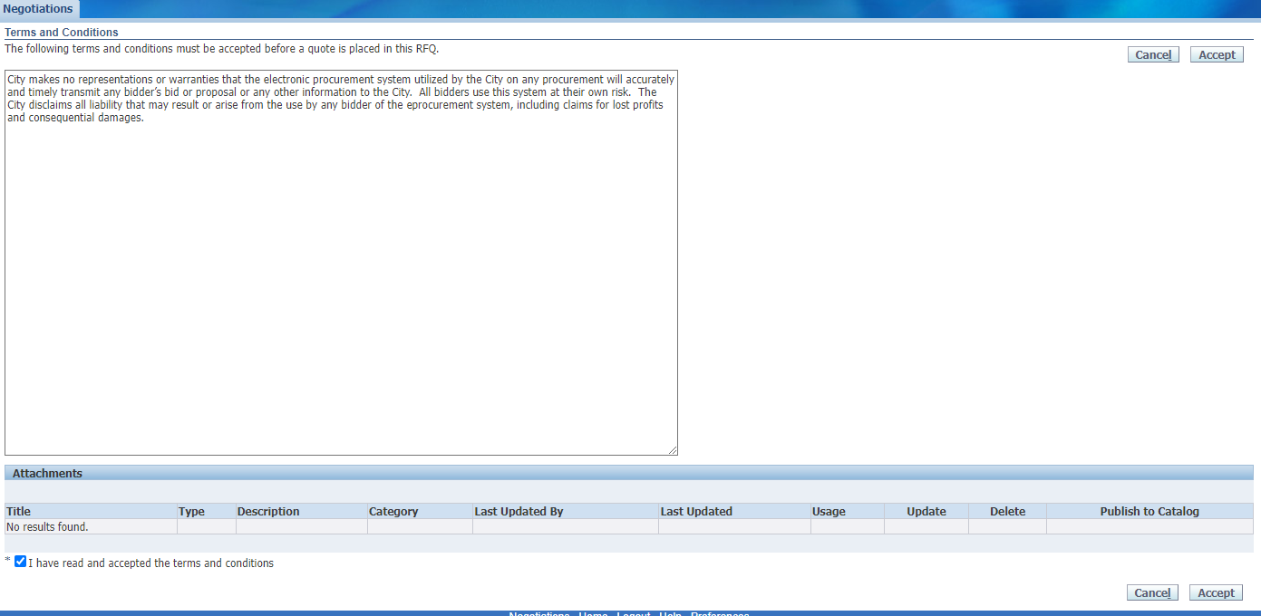
How to accept an amendment – Step 5
Finally, (1) click on the checkbox that you accept the terms and conditions and then (2) click on “Accept” to accept them.
This is the final step in acknowledging and accepting the amendment.
Youth Mentoring Program RFP

Slide 50
How to Submit an Application
Youth Mentoring Program RFP

Slide 51
How to submit an application – Step 1
When you are ready to submit, start by saving your draft one last time. Then click Continue.
Youth Mentoring Program RFP

Slide 52
How to submit an application – Step 2
If you are missing information, you will be given an error message on the top of the page.
Youth Mentoring Program RFP

Slide 53
How to submit an application – Step 3
Usually the error messages direct to something left undone in the application.
In the last example, the error message indicated that the lines (found under the lines tab) had not been filled out.
Youth Mentoring Program RFP

Slide 54
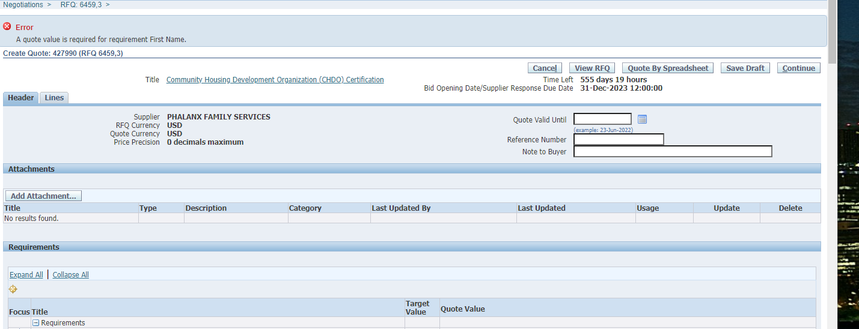
How to submit an application – Step 4
In this example, the error is about an unanswered question in the application (or Requirements section). The Quote Value refers to your (in this case, missing) answer.
Youth Mentoring Program RFP

Slide 55
How to submit an application – Step 5
Once your application is free from errors, you are ready to proceed and submit! At this point, clicking “Continue” should put your application into the “Review and Submit” phase.
Youth Mentoring Program RFP

Slide 56
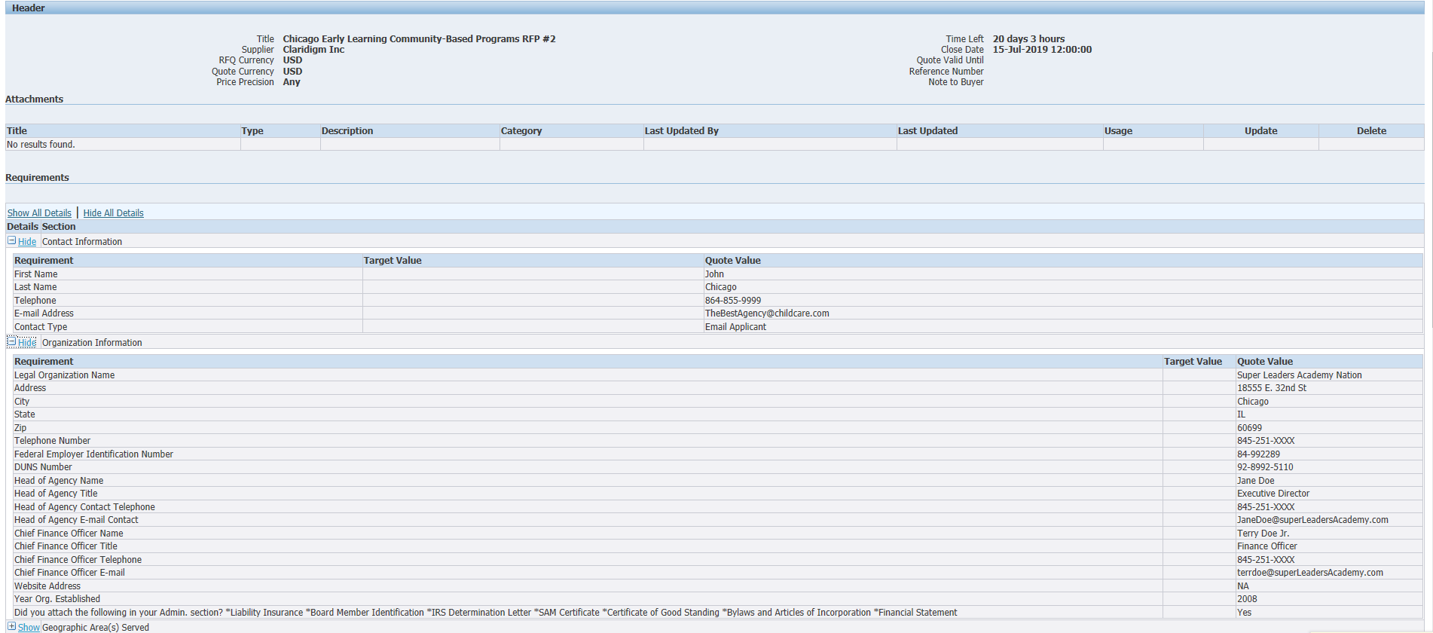
How to submit an application – Step 6
This is your last chance to review all your data and confirm that it is accurate. Check your attachments and scroll to the bottom of the screen to see all your responses.
Youth Mentoring Program RFP

Slide 57
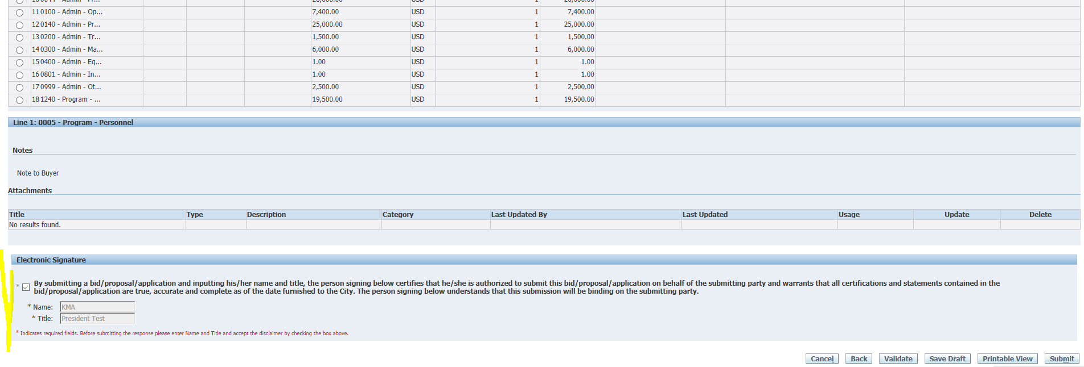
How to submit an application – Step 7
At the bottom of the screen you will be asked to provide an electronic signature. Be sure to fill in the signature before checking the box!
Youth Mentoring Program RFP

Slide 58
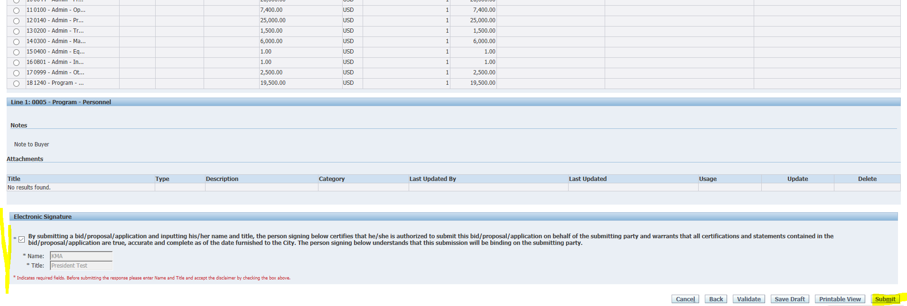
How to submit an application – Step 8
Then click “Submit”.
Youth Mentoring Program RFP

Slide 59
How to submit an application – Step 9
Make sure that you see this submittal confirmation screen. The eProcurement system will send a confirmation email within 24 hours of your submission. Please call or email me if you desire confirmation prior to then.
Youth Mentoring Program RFP

Slide 60
Questions?

Slide 61
Program Questions?
Maria Guzman-Rocha
312-746-7474
Maria-Guzman-Rocha@cityofchicago.org
For non-programmatic questions contact:
Julia Talbot
(312)-743-1679
Julia.Talbot@cityofchicago.org

