Slide 1
Department of Family and Support Services SPRING FORWARD: Housing Navigation Program RFP
Please stand by, the webinar will begin shortly.
Release Date: February 17, 2023
Due Date: March 23, 2023

Slide 2
House Keeping
Due to the volume of participants, everyone has been placed on mute.
Please use the questions box to notify us of any technical issues.
We will address the questions at the midpoint and end of the presentation.
This webinar is being recorded. A copy of the recording will be posted on the DFSS YouTube channel with a link to the recording and a .pdf of these Power Point slides will be posted to the DFSS webpage at: https://www.chicago.gov/city/en/depts/fss.html under the ‘Alerts” and/or “Funding Opportunities” tabs. This will take up to five business days.

Slide 3
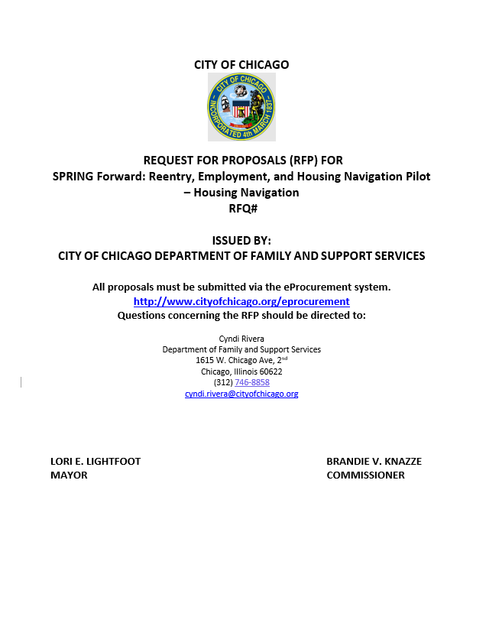
Agenda
Welcome and Introductions
DFSS Overview and Commitment to Outcomes
Review of SPRING Forward RFP: Housing Navigation Program
Timeline
Submission of RFP to eProcurement
Questions
9128
Housing Navigation Program RFP

Slide 4
DFSS Mission and Priorities
OUR MISSION
Working with community partners, we connect Chicago residents and families to resources that build stability, support their well-being, and empower them to thrive.
OUR PRIORITIES
Deliver and support high-quality, innovative, and comprehensive services that empower clients to thrive
Collaborate with community partners, sister agencies, and public officials on programs and policies that improve Chicagoans’ lives and advance systemic change
Inform the public of resources available to them through DFSS and its community partners
Steward DFSS’ resources responsibly and effectively
Housing Navigation Program RFP
Page 4
Notes:
SPRING FORWARD: Selected Pre-Release for Intensive Navigation support Going Forward

Slide 5
Chicago’s Equity Statement of Principles
Racial equity focuses on the social construction of race and how it has been used to unjustly distribute opportunity and resources based on a person’s skin color, heritage, ethnicity, and/or national origin.
The City of Chicago defines equity as both an outcome and a process.
As an outcome: equity results in fair and just access to opportunity and resources that provide everyone the ability to thrive.
As a process: equity requires a new way of doing business –
Prioritizes access and opportunities for groups who have the greatest need.
Methodically evaluates benefits and burdens produced by seemingly neutral systems and practices.
Engages those most impacted by the problems we seek to address as experts in their own experiences, strategists in co-creating solutions, and evaluators of success.
Housing Navigation Program RFP
Page 5
Notes:
SPRING FORWARD: Selected Pre-Release for Intensive Navigation support Going Forward

Slide 6
Purpose of the RFP’s
The Reentry, Employment, and Housing Navigation Pilot Programs are to support returning residents from Cook County Jail (CCJ) or the Illinois Department of Corrections (ISOC) to Chicago who are at the highest risk of housing security, homelessness, and recidivism.
Housing Navigation Program RFP
Page 6
Notes:
SPRING FORWARD: Selected Pre-Release for Intensive Navigation support Going Forward

Slide 7
Presentation Content
SPRING FORWARD Pilot:
Selected Pre-Release for Intensive Navigation support Going Forward
DFSS has released two separate RFPs to solicit proposals from respondents who can administer the following two program components:
Reentry and Employment Navigation Program
Housing Navigation Program
Respondents are eligible to submit proposals for both RFPs. Each RFP will have separate webinars to review its components.
This webinar will be focused on:
HOUSING NAVIGATION PROGRAM RFP
Housing Navigation Program RFP

Slide 8
Overview
Goal of Program | To annually support up to 70 individuals returning to Chicago from CCJ and IDOC (140 for two years) with housing navigation services that facilitate access to permanent housing and 12-month rental assistance subsidies to build their stability, support their well-being and empower them to thrive.
Service Overview | Identify and facilitate access to a supply of housing that meets applicable housing, health, and safety codes and can service individuals exiting CCJ and IDOC while providing a unit-based subsidy.
Target Population | Chicago residents 18 years or older, returning from CCJ or IDOC within the past 18 months to Chicago who are at the highest risk of housing insecurity, homelessness, and recidivism. All program participants will be referred by the selected Reentry & Employment Navigation Agency.
Key Performance Metrics (subset) | 100% of individuals referred from the Reentry and Employment partner will be assessed for risk of homelessness. 85% of selected participant will be housed within 60 days of the completion of housing eligibility assessment. 85% participants with at least 30 days in housing will not be re-incarcerated for offenses committed after entry into the housing program. 80% of participants will remain stably housed after 90 days 85% of participants will remain stably housed after 6 months
Priorities | Demonstrate partnership with the following: DFSS, CCJ, IDOC, Chicago-Based Transitional Housing sites, and the DFSS Reentry and Employment Navigation partner. 70 individuals will receive rental assistance and additional housing subsidies and intake assessment annually (300 for two years).
Funding | Two-year program with an initial contract period of April 2023 through 2024. Total funding of $2,979,967 for the duration of two fiscal years. Made available from the U.S Department of Treasury – American Rescue Plan (ARP).
Housing Navigation Program RFP

Slide 9
Background: Why housing and employment navigation?
Having a record hinders the individual’s ability to access affordable housing and obtain meaningful employment.
In addition, since the pandemic, returning residents have had to face a diminished job market with fewer supports and an increased likelihood of mental health problems
Data obtained from the Homeless Management Information System, The Illinois Department of Public Health, and the Cook County Sheriff’s Office shows:
2,648 individuals cycles through all three systems
Only 15% accessed permanent housing in the Continuum of Care (CoC).
1 in 3 of those cycling in and out of jail and spent an average of 320 days in jail over a four-year period.
Chicagoans in CCJ and IDOC with a stay of longer than 90 days are not considered homeless upon release and there are ineligible to access interim housing under Housing and Urban Development (HUD).
Institutional stays (incarceration, inpatient mental health institutions) longer than 90 days constitutes a “break” in homelessness, which resets the clock for the length of homelessness.
Housing Navigation Program RFP

Slide 10
Goal of Program
To annually support up to 70 participants released from CCJ and IDOC to the City of Chicago with housing navigation services to facilitate access to permanent housing and a 12-month rental subsidy which will stabilize returning residents and mitigate their risk of recidivism.
How? By building infrastructure for re-entry housing that is designed to connect returning residents to permanent housing and supportive services, including rental assistance and additional financial subsidies related to housing services.
Housing Navigation Program RFP
Notes:
300 participants for two years

Slide 11
Service Overview
Facilitate access to affordable permanent housing and manage distribution of a unit-based 12-month rental subsidy.
Primary Activities
Landlord outreach, recruitment, and screening
Manage a streamlined housing application process
Implementation of Minimum Habitability Standards inspection process
Rental housing assistance for participant referrals, eligibility, and prioritization
Rental fees and subsidy processing
Housing case management and tenancy support services
Housing Navigation Program RFP

Slide 12
Service Overview
Breakdown of Primary Activities:
Landlord Outreach, Recruitment, and Screening
Recruit and retain landlords, non-for-profit or for-profit owners, and housing providers
Look for property owners willing to work with individuals with recent criminal histories and low to no credit histories
Screen landlords based on their experience with other subsidy-based programs and types/sizes of units available
Determine acceptable rents based on HUD’s Fair Market Rate (FMR)/negotiate rents above FMR
Manage a Streamlined Housing Application Process
Complete the intake and application process for potential tenants & obtain the required documentation
Manage oversight of scattered sites and/or master leasing agreements
Implementation of Minimum Habitability Standards
Housing inspection process per HUD’s standards including lead screening, when applicable
Conduct inspection of all units within 30 days of the approved subsidy application
Housing Navigation Program RFP
Notes:
FMR: review and negotiate rents above the FMR limits on a case-by-case basis
Manage streamlined: Required documentation such as proof of identity, address, credit history, or income verification

Slide 13
Service Overview
Breakdown of Primary Activities (continued):
Rental Housing Assistance for Participant Referrals, Eligibility, and Prioritization
Receive referrals from selected Reentry and Employment Navigation partner
Conduct a screening and housing assessment for participants to assess the type of housing that is appropriate
Development of an Individualized Housing Support Plan
Development of an Individualized Crisis Plan
Screen referral as determined by guidelines set forth by DFSS
Manage the prioritization and randomization of eligible participants as outlined by DFSS
Rental Fees and Subsidy Processing
Manage unit-based, 12-month subsidy payments which include security deposits and furniture allowance.
Ensure monthly rental subsidy is paid to property owners/managers in a timely fashion.
Housing Navigation Program RFP
Notes:
Rental Housing: Include location and other factors; Identification of possible housing transition and retention barriers such as accessibility needs, criminal background, and needed supports.
IHSP: identifies types of housing-related services and support individuals will need based on the assessment; include long-short term measurable goal; interventions to address identified barriers/needs, defined roles for and responsibilities for tenant and support staff
ICP: identifies emergent situations that could jeopardize housing; appropriate and timely intervention services to respond; clearly defined staff roles and responsibility
Priority and Randomization: Respondents will screen referrals to identify eligible tenants per the final program guidelines determined by DFSS. Prioritization will be determined through a randomized lottery and the selected respondent must use the DFSS lottery management platform

Slide 14
Service Overview
Breakdown of Primary Activities (continued):
Housing Case Management and Tenancy Support Services
Report on housing retention, stability, and services rendered on a monthly basis.
Provide provision of a 24/7 crisis line for property owners/managers to address tenant emergencies.
Manage and distribute funds for additional housing costs
Assist the participant to schedule activities (turning on utilities, change of address, etc.)
Train participants to manage and reduce behavior that may jeopardize housing
Assist participants in connecting to the Cook County Early Resolution Program (ERP)
Review and update the housing and crisis plan
Provide ongoing support, coaching, motivational interviewing, and behavioral interventions
Housing Navigation Program RFP
Notes:
Rental Housing: Include location and other factors; Identification of possible housing transition and retention barriers such as accessibility needs, criminal background, and needed supports.
IHSP: identifies types of housing-related services and support individuals will need based on the assessment; include long-short term measurable goal; interventions to address identified barriers/needs, defined roles for and responsibilities for tenant and support staff
ICP: identifies emergent situations that could jeopardize housing; appropriate and timely intervention services to respond; clearly defined staff roles and responsibility
Priority and Randomization: Respondents will screen referrals to identify eligible tenants per the final program guidelines determined by DFSS. Prioritization will be determined through a randomized lottery and the selected respondent must use the DFSS lottery management platform

Slide 15
Target Population
Participants must meet all four of the criteria:
Is a Chicago resident, 18 years or older
Released within the past 18 months from Cook County Jail or the Illinois Department of Corrections
Is part of a household in which one or more individuals can demonstrate a risk of experiencing homelessness, housing insecurity, or recidivism
Be referred by the Reentry and Employment Navigation Agency
Housing Navigation Program RFP

Slide 16
Key Performance Metrics
The following is a set of metrics that will be used by DFSS to track progress toward achieving the outcome goals and assess success:
85% of selected participants will be housed within 60 days of the completion of the housing eligibility assessment.
85% of participants with at least 30 days in housing will not be re-incarcerated for offenses committed after the entry into the housing program.
85% of participants will remain in good standing with the lease agreement
80%% of the participants will remain stably housed after 90 days
85% of participants will remain at stably house after 6 months
90% of participants report having a positive experience
90% of landlords report having a positive experience
100% of individuals referred from the Reentry and Employment Navigation partner will be assessed for risk of homelessness
70% of participants remain stably housed 6 months after the rental assistance subsidy ends
In addition, DFSS intends to track additional output metrics.
Housing Navigation Program RFP

Slide 17
Additional Performance Metrics
The following output metrics may be used to monitor and recognize intermediate progress toward the original nine performance measures:
150 individuals will receive a housing assessment which will be used to determine who will be selected for the rental assistance subsidy
(This will be a total of 300 for the duration of the contract)
70 participants will receive a unit-based, 12-month rental assistance subsidy and housing support services (total of 140 for the duration of the contract)
DFSS encourages agencies to propose additional indicators and metrics!
Housing Navigation Program RFP
Notes:
Clarification: the housing assessment is not the deciding factor; it will be used in addition to other factors outlined in the vulnerability, which will be developed with the selected agency.

Slide 18
Case Management Data Reporting Requirements
Key Requirements
Periodic check-ins with delegates
Collect and report client-level demographic data, performance data, and service data
Submission of reports by the 4th of every month
Input of participant data into the Enterprise Case Management Version 6 (ECM) System
Additional reports as needed
Housing Navigation Program RFP

Slide 19
Programmatic Funding
$2,988,967
Award amount for this RFP is from the U.S. Department of Treasury via the American Rescue Plan (ARP).
DFSS anticipates one award of up to $2,988,967 for two fiscal years.
Contract period begins April 2023 and ends December 2024.
One-year extension may be available*
Funding is intended to support participants enrolled in the program for a minimum of one year after enrollment:
*at the discretion of the City based on the availability of funds, the need to extend services, and the respondent’s performance
Eligible Costs | Award Amount
Intake assessments for 150 participants for one year (300 for two years). | $2,540,622
Program and administrative costs | Up to $448,345 (15% or less)
Housing Navigation Program RFP

Slide 20
Budgets/Costs
A total of $2,988,967 will be made for the duration of two fiscal years
140 total participants (70 annually)
15% max for program and administrative costs
Please submit a budget for ONE year (12 mos.) of service.
The maximum amount allocated for this RFP for one year is: $1,494,835
Contract Term: May 2023 – December 2024
Match recommendation for the program: 10% or higher
Housing Navigation Program RFP

Slide 21
Budgets Tips
Cost category definitions are attached as Budget instructions in every RFP (except RFPs that have cost proposals).
Be thoughtful and inclusive when developing your budget. Apply for your program’s actual costs.
Use the reasonable costs question on the application to discuss how you determined the costs reflected in the budget.
Fringes – check your calculations.
Supplies – these are frequently under or over budget.
Make sure your job description titles and your job description uploads have the same title. Also put a brief description of the job in the budget document itself, if you have not discussed it specifically in your application.
Put your budget in the appropriate column.
Show your match!
Housing Navigation Program RFP

Slide 22
Eligibility, Evaluation & Selection Process
Eligible Respondents
May apply as a single agency or lead agency with multiple agencies serving as subcontractors
Open to non-for-profits and faith-based organizations
Evaluation Process
Each eligible proposal will be evaluated on the strengths of the proposal and the responsiveness to the selection criteria.
Selection Criteria
Selection Criteria | 100 points (maximum)
Community Selection | 25
Organizational Capacity | 15
Strength of Proposed Program | 30
Performance Management and Outcomes | 15
Reasonable Costs, Budget Justification, and Leverage of Funds | 15
Housing Navigation Program RFP

Slide 23
Selection and Transition Timeline
Pre-proposal webinar – February 24, 2023
Applications due – March 23, 2023
Program period begins – May 1, 2023
Housing Navigation Program RFP

Slide 24
Deadline
Applications are due
on March 23, 2023
at 12:00, Noon
Housing Navigation Program RFP

Slide 25
Application Tips
Start Early!!
If you have never done business with the City of Chicago, register into iSupplier/eProcurement ASAP
Read RFP narratives, selective criteria, and application questions closely. Use the information in the RFP for guidance in formulating your answers.
Organizations submitting more than one proposal may do so by submitting each proposal under a separate, unique registered account user with online bidding responsibilities within the organization’s iSupplier account, using their individual login information.
Review application questions and make sure you fully answer all questions
Remember there is a 4,000-character limit for all questions
Do not use the back button on your browser while completing the application
Use spell check and don’t forget to attach required attachments
Do not wait until the last moment, submit 24-48 hours in advance of the deadline
Late applications will not be accepted (NO EXCEPTIONS)
You can “submit” your application and amend it later up until the due date/time.
Avoid the rush and possible mishaps by submitting early. Plan on submission taking 30-60 minutes.
Save Often!!
Reentry & Employment Navigation Program RFP

Slide 26
Technical Assistance
Make use of the eProcurement hotline for help at 312-744-4357 (HELP).
The hotline operates during business hours only, Monday-Friday 9-5
You can also email questions on Registration and eProcurement Technical Assistance for Delegate Agencies to:
CustomerSupport@cityofchicago.org
There are many Training Materials (Documents and Videos) available at: https://www.cityofchicago.org/city/en/depts/dps/isupplier/online-training-materials.html
Save often, submit early!
Youth Enrichment Summer Program RFP

Slide 27
How to accept an amendment
Housing Navigation Program RFP

Slide 28
How to accept an amendment – Step 1
If the RFP you are interested in has been amended. In order to start an application, you will need to acknowledge and accept the amendment first. (Please not that the RFP shown in this and subsequent slides is an example). To accept the amendment, click on “View Amendment History”.
If the RFP has not been amended (yet), select “Create Quote” from the drop-down menu in the “Actions” box and click on “Go”. This will take you to the application page, where you can get started.
Youth Mentoring Program RFP
Housing Navigation Program RFP

Slide 29
How to accept an amendment – Step 2
To begin the acceptance and acknowledgment process, to open the RFP in view only: (1) click on the Document number. (2) To review the amended changes to the RFP, click on the infinity or eyeglass icon. (3) To acknowledge receipt and understanding of these changes and proceed, click on the “Acknowledge Amendments” button.
By acknowledging the amendment, you are indicating that you are aware of the changes made to the RFP in the amendment.
Youth Mentoring Program RFP
Housing Navigation Program RFP

Slide 30
How to accept an amendment – Step 3
When you get to this screen, click on the “I accept…” check box and then click on “Acknowledge”
Youth Mentoring Program RFP
Housing Navigation Program RFP

Slide 31
How to accept an amendment – Step 4
Click on “Yes” to indicate that you confirm your acknowledgement of the amendment.
Youth Mentoring Program RFP
Housing Navigation Program RFP

Slide 32
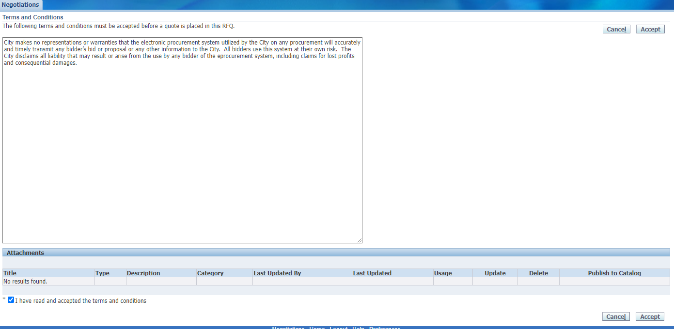
How to accept an amendment – Step 5
Finally, (1) click on the checkbox that you accept the terms and conditions and then (2) click on “Accept” to accept them.
This is the final step in acknowledging and accepting the amendment.
Youth Mentoring Program RFP
Housing Navigation Program RFP

Slide 33
How to submit an application
Housing Navigation Program RFP

Slide 34
How to submit an application – Step 1
When you are ready to submit, start by saving your draft one last time. Then click Continue.
Youth Mentoring Program RFP
Housing Navigation Program RFP

Slide 35
How to submit an application – Step 2
If you are missing information, you will be given an error message on the top of the page.
Youth Mentoring Program RFP
Housing Navigation Program RFP

Slide 36
How to submit an application – Step 3
Usually the error messages direct to something left undone in the application.
In the last example, the error message indicated that the lines (found under the lines tab) had not been filled out.
Youth Mentoring Program RFP
Housing Navigation Program RFP

Slide 37
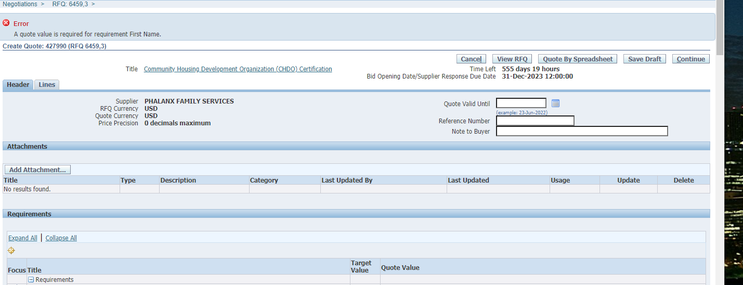
How to submit an application – Step 4
In this example, the error is about an unanswered question in the application (or Requirements section). The Quote Value refers to your (in this case, missing) answer.
Youth Mentoring Program RFP
Housing Navigation Program RFP

Slide 38
How to submit an application – Step 5
Once your application is free from errors, you are ready to proceed and submit! At this point, clicking “Continue” should put your application into the “Review and Submit” phase.
Youth Mentoring Program RFP
Housing Navigation Program RFP

Slide 39
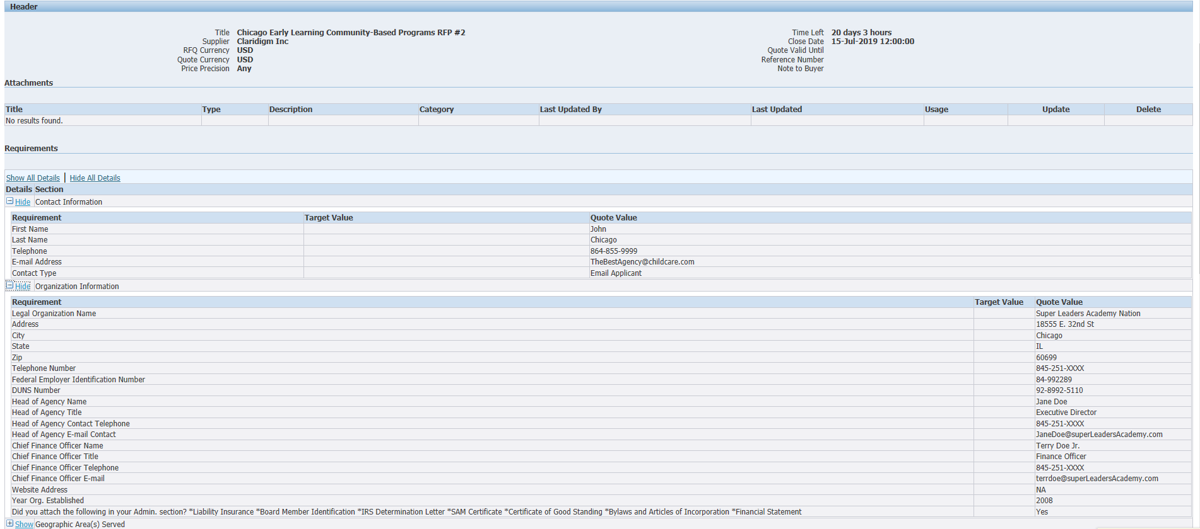
How to submit an application – Step 6
This is your last chance to review all your data and confirm that it is accurate. Check your attachments and scroll to the bottom of the screen to see all your responses.
Housing Navigation Program RFP

Slide 40
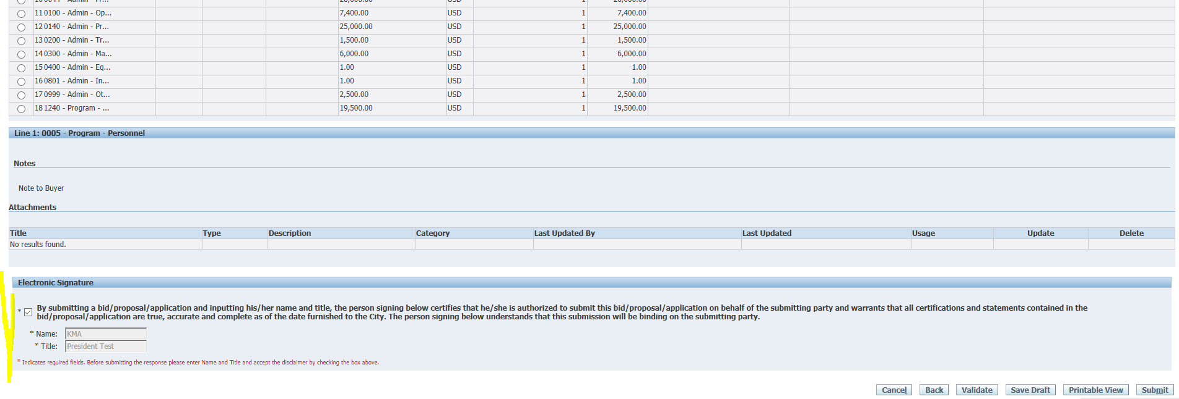
How to submit an application – Step 7
At the bottom of the screen you will be asked to provide an electronic signature. Be sure to fill in the signature before checking the box!
Housing Navigation Program RFP

Slide 41
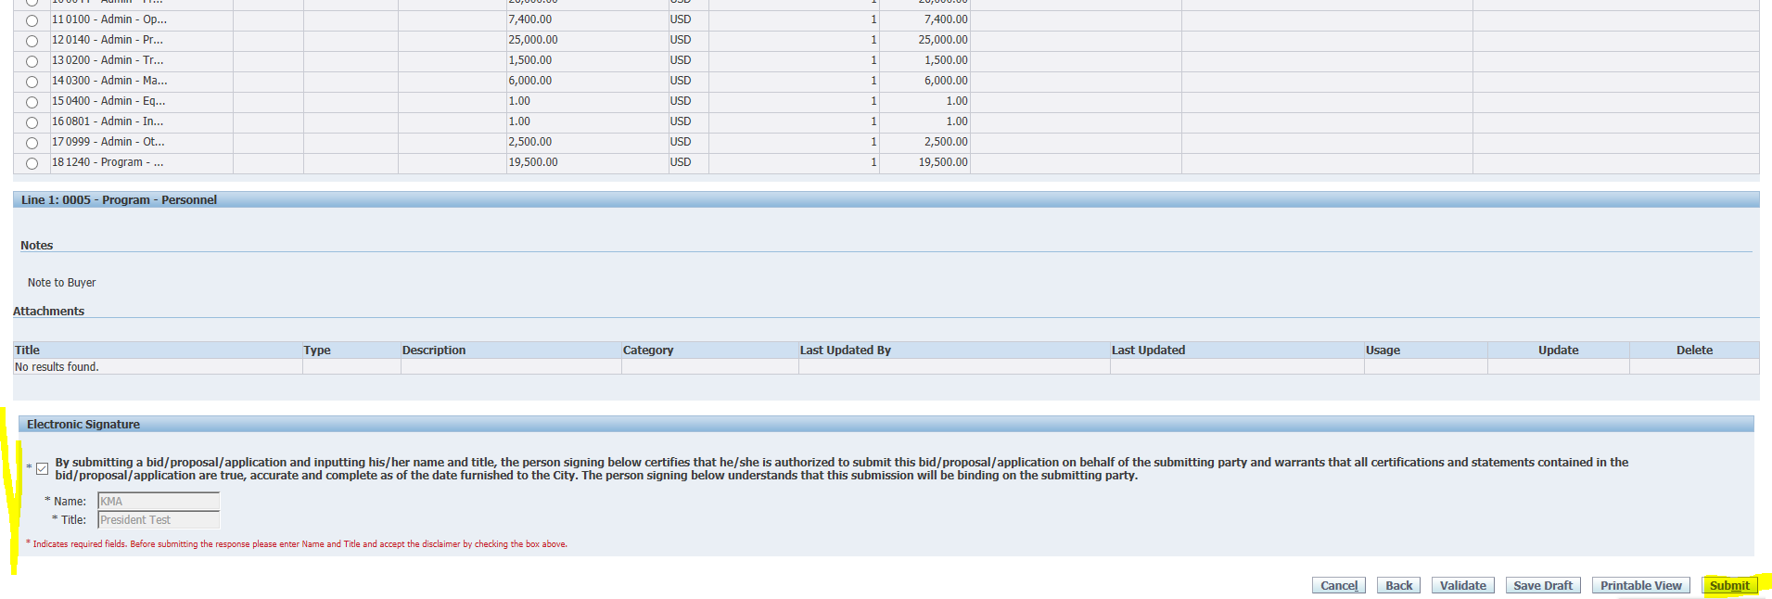
How to submit an application – Step 8
Then click “Submit”.
Youth Mentoring Program RFP
Housing Navigation Program RFP

Slide 42
How to submit an application – Step 9
Make sure that you see this submittal confirmation screen. The eProcurement system will send a confirmation email within 24 hours of your submission. Please call or email me if you desire confirmation prior to then.
Housing Navigation Program RFP

Slide 43
Program Questions?
Cyndi Rivera
312-746-8858
cyndi.rivera@cityofchicago.org
For non-programmatic questions contact:
Julia Talbot
(312)-743-1679
Julia.Talbot@cityofchicago.org
eProcurement Hotline:
(312)-744-4357 (HELP)
CustomerSupport@cityofchicago.org
Please note that the hotline operates during business hours only
Monday – Friday (9 am to 5 pm)

