Slide 1


Slide 2

Stay Informed
The Department of Procurement Services is committed to Communications and Outreach, which is key to keeping citizens informed of bid opportunities, new programs, and innovations.
We encourage you to follow us social media to stay informed. You can find us on LinkedIn, Facebook, Twitter, and YouTube.

Slide 3
We encourage you to visit the DPS table for additional resources and to ask any questions about doing business with the City.
You can also contact us anytime via email at DPS.Feedback@CityOfChicago.Org

Slide 4
Construction Summit 2024
February 22, 2024

Slide 5



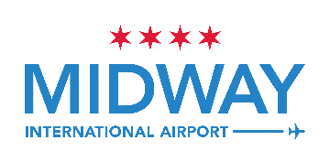
CDA Overview –
Two Airports, One Department
All 77 communities are represented in CDA’s workforce
O’Hare and Midway are
owned and operated by
the City of Chicago
CDA employs more than 1,600 City residents
The Chicago Department of Aviation (CDA) administers
all aspects of the Airports.
More than 44,000 people
are employed at O’Hare
and 9,300 at Midway
O’Hare and Midway Airports operate financially as two
separate enterprise funds
per federal regulations
Chicago’s Airport System is critical to the local economy
Both Airports are financially
self-sustaining per federal regulations
Provides 730,000 full-time equivalent jobs across
nine counties
No State or Local taxpayer dollars
are used to pay for airport operations
  CONSTRUCTION SUMMIT 2024

Slide 6
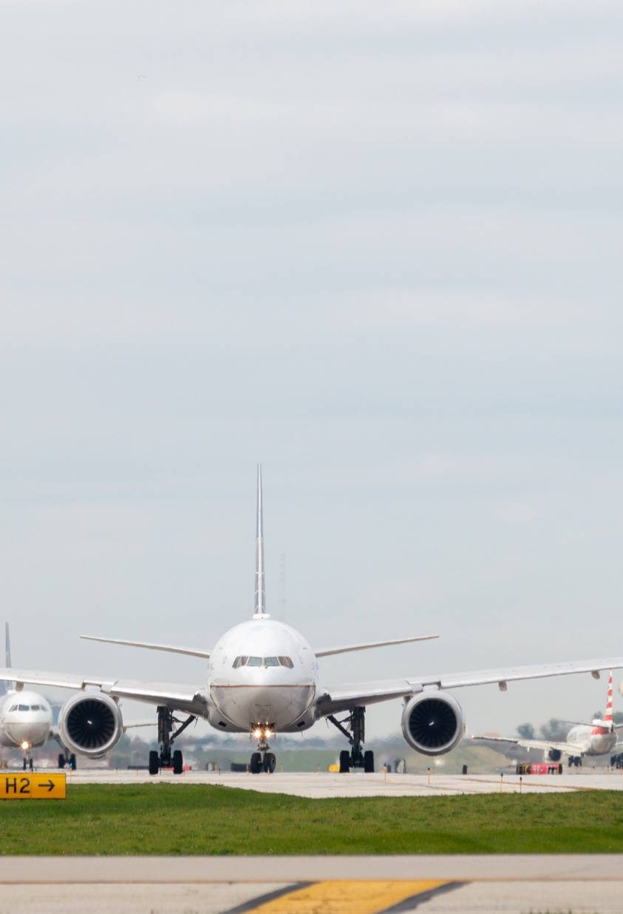
A year in review:
Unparalleled Service and Connectivity
ORD
MDW

Slide 7
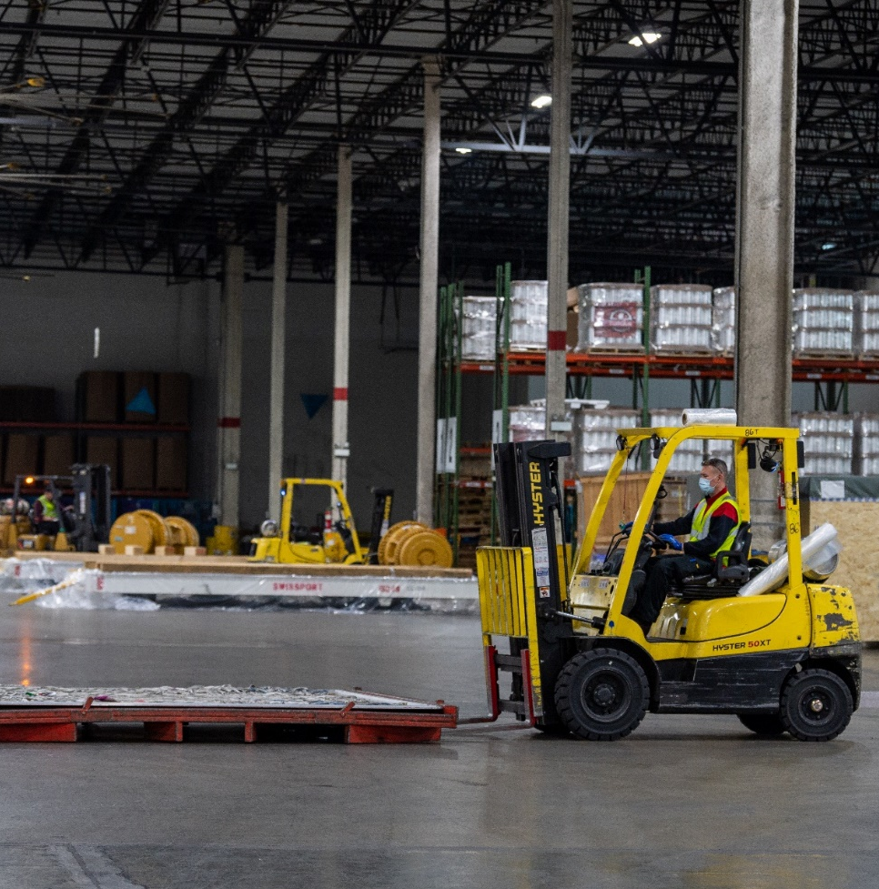
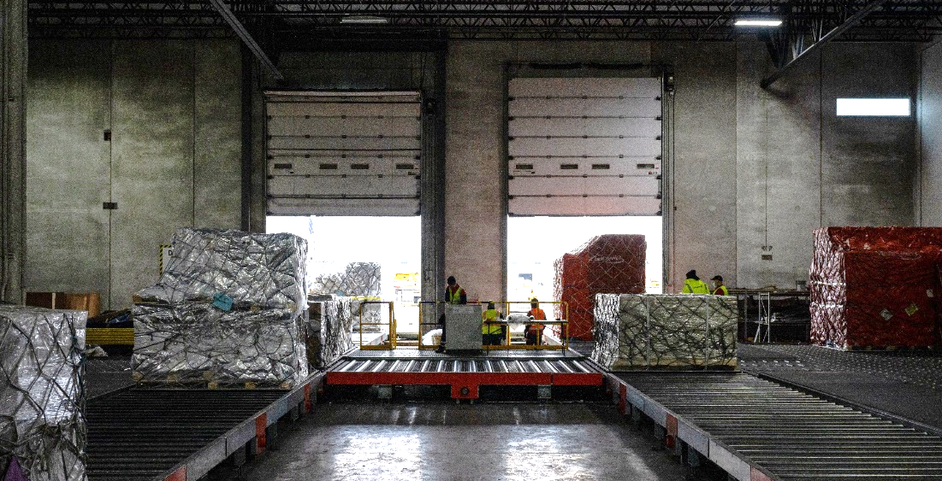
Air Cargo
Chicago is a top air cargo gateway thanks to its central geography, massive infrastructure, and business climate.
  CONSTRUCTION SUMMIT 2024

Slide 8
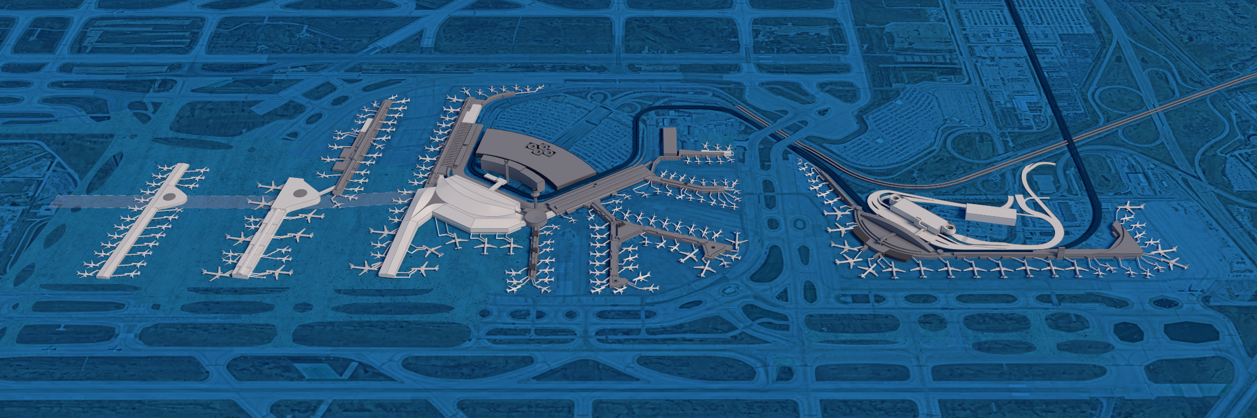
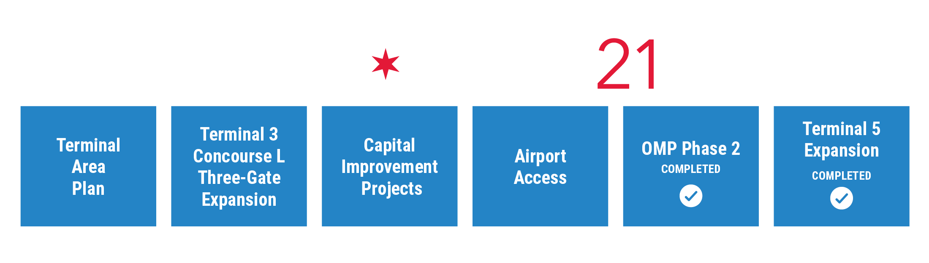
TRANSFORMS O’HARE INTO A 21ST CENTURY GLOBAL GATEWAY
  CONSTRUCTION SUMMIT 2024

Slide 9
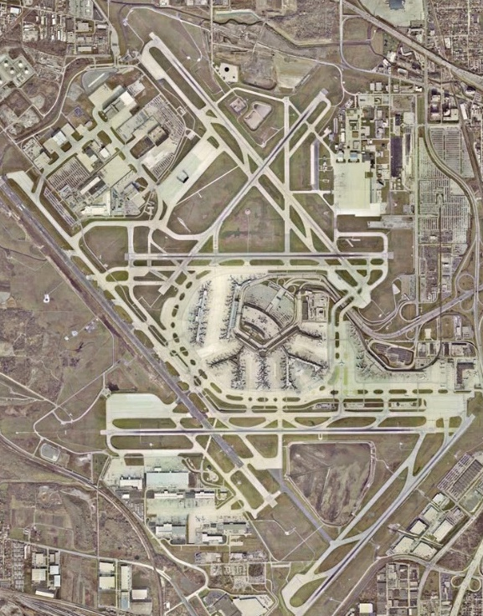
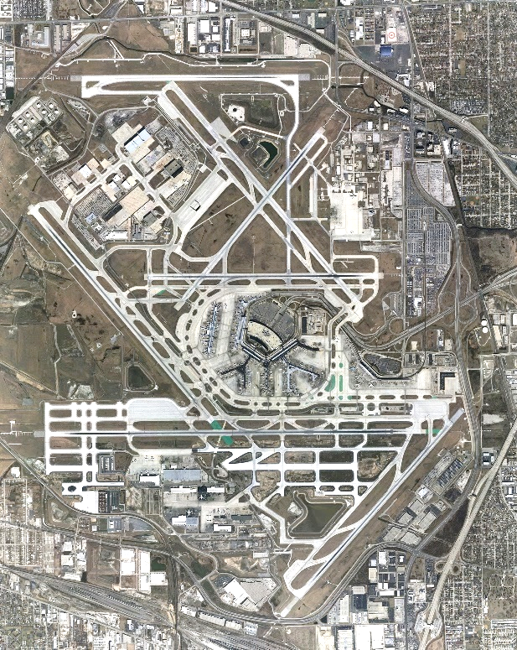
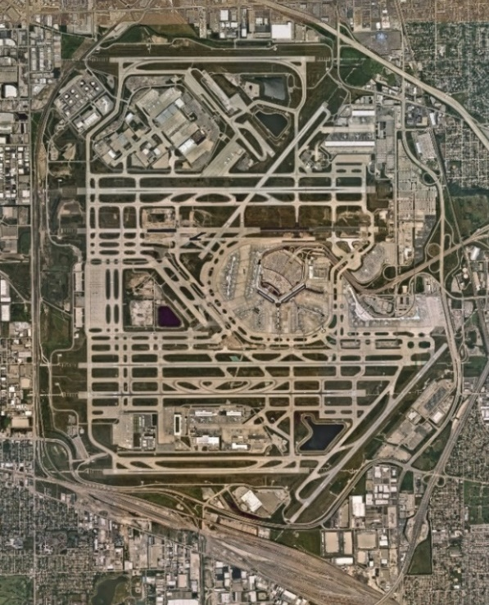
Historic Airfield Reconfiguration Reduces System Impact Delays by 67%
O’Hare - 2001
O’Hare - 2011
O’Hare - 2021
O’HARE MODERNIZATION PROGRAM
  CONSTRUCTION SUMMIT 2024

Slide 10
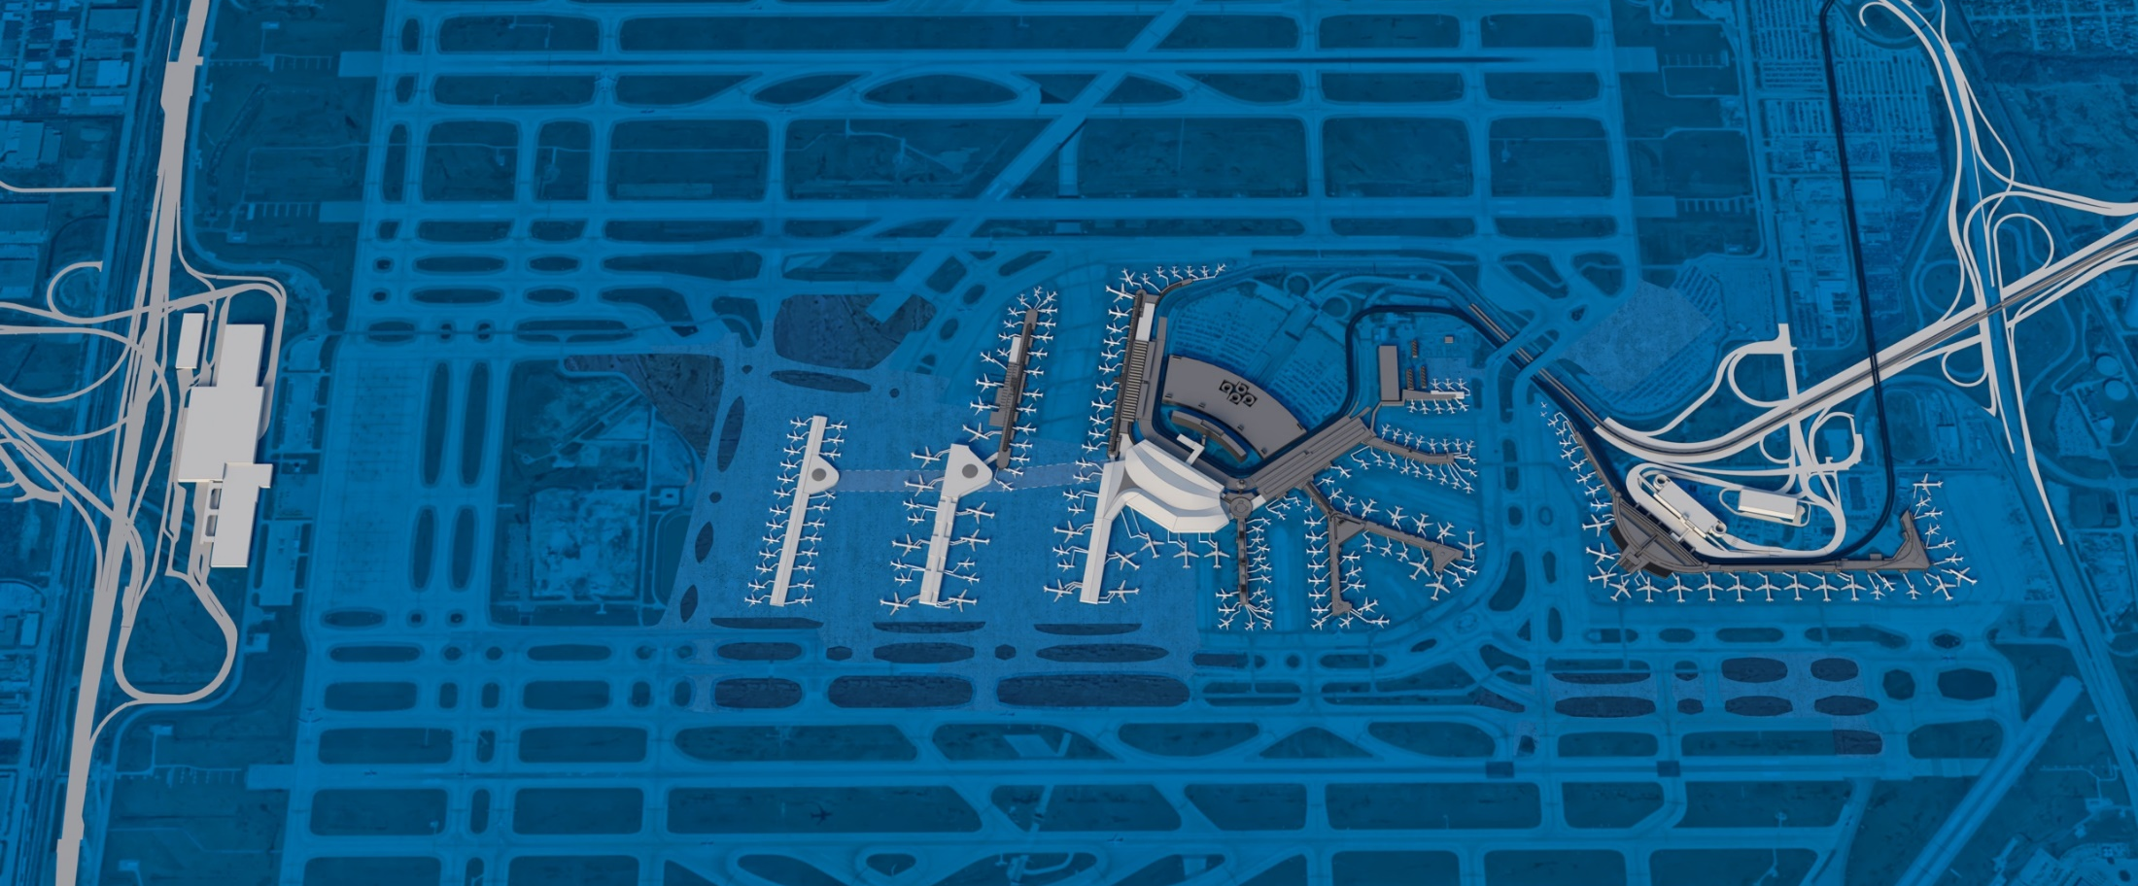
TAP SUPPORTS the Long-Term Development of
O’Hare’s Passenger Terminal Facilities
Terminal 5
Increased airport capacity
Flexible MARS gates
Co-location of Delta
and Skyteam Alliance
Important for local passenger traffic
Satellite 2
Multi-purpose function for near- and long-term
Enables replacement of Terminal 2
Capacity for future growth
Satellite 1
Flexible MARS gates
International arrival gates
Adjacent to United Airlines hub
Consolidated Tunnel
Backbone of O’Hare
for near-term use and
long-term growth
Multi-purpose passenger, baggage
and utility functions
OGT
Future central hub
Co-location of international and domestic operations
Modern amenities
Improved passenger flow
10
  CONSTRUCTION SUMMIT 2024

Slide 11
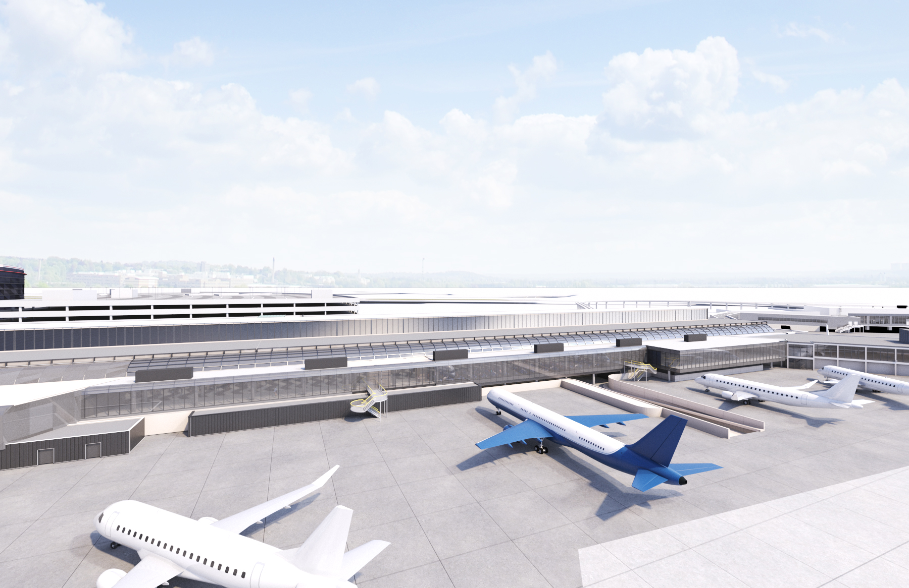
The Terminal 3 Improvements Project Received $90 Million in BIL ATP

Slide 12
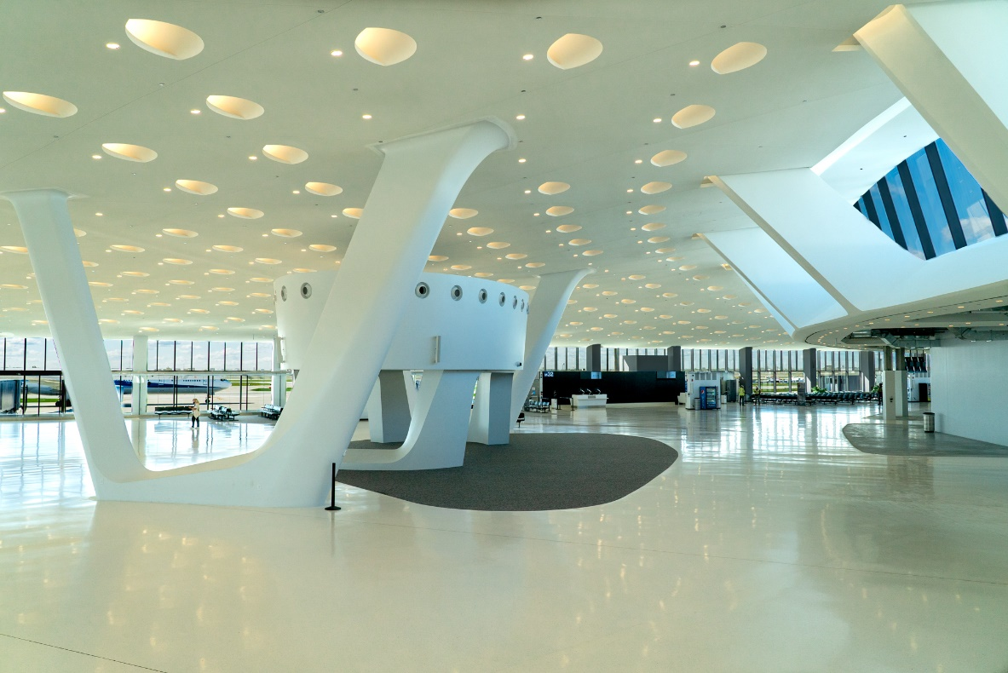
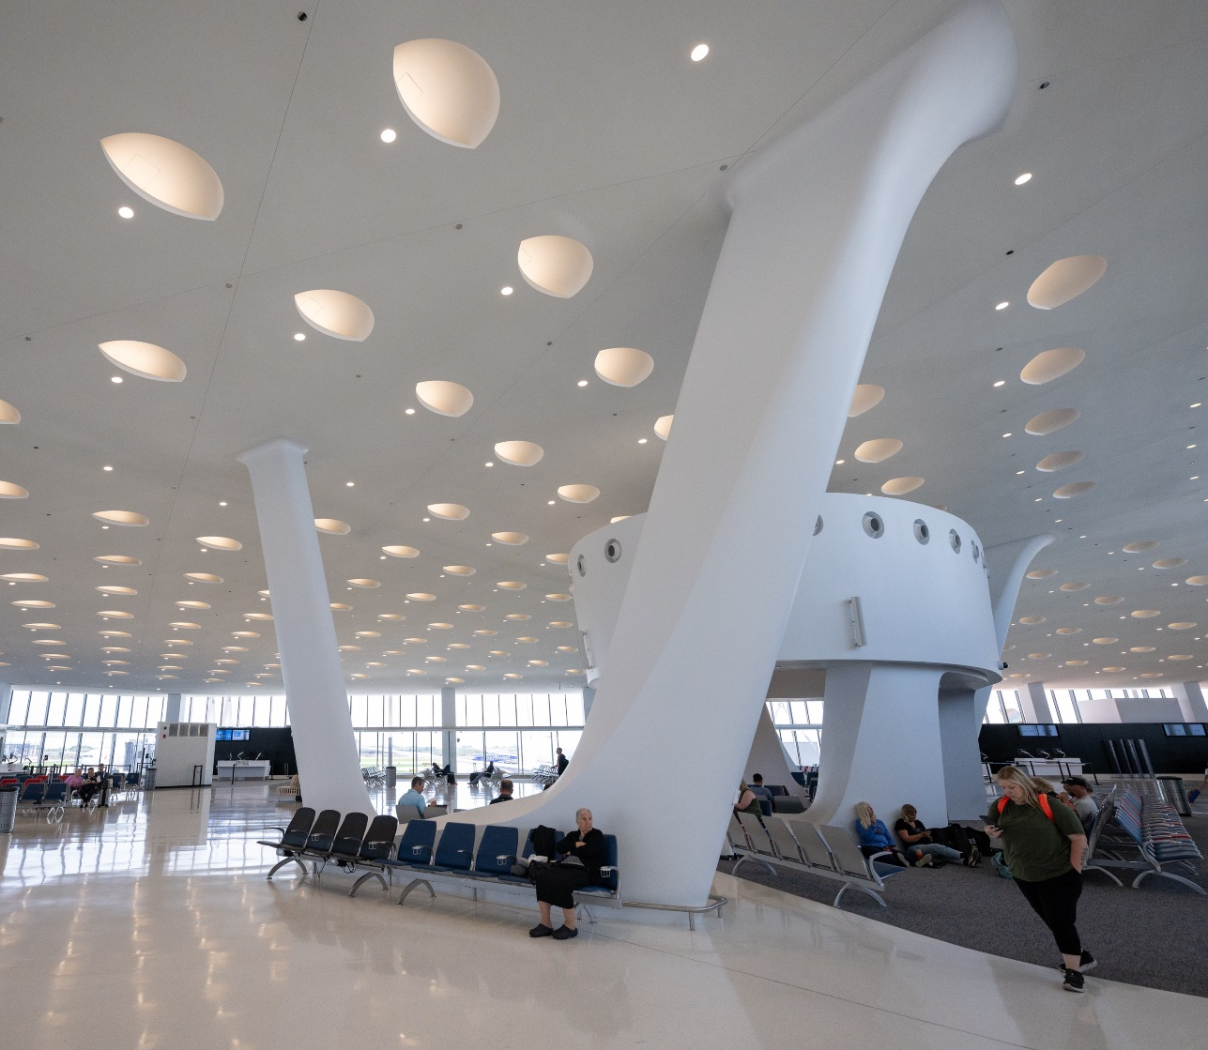
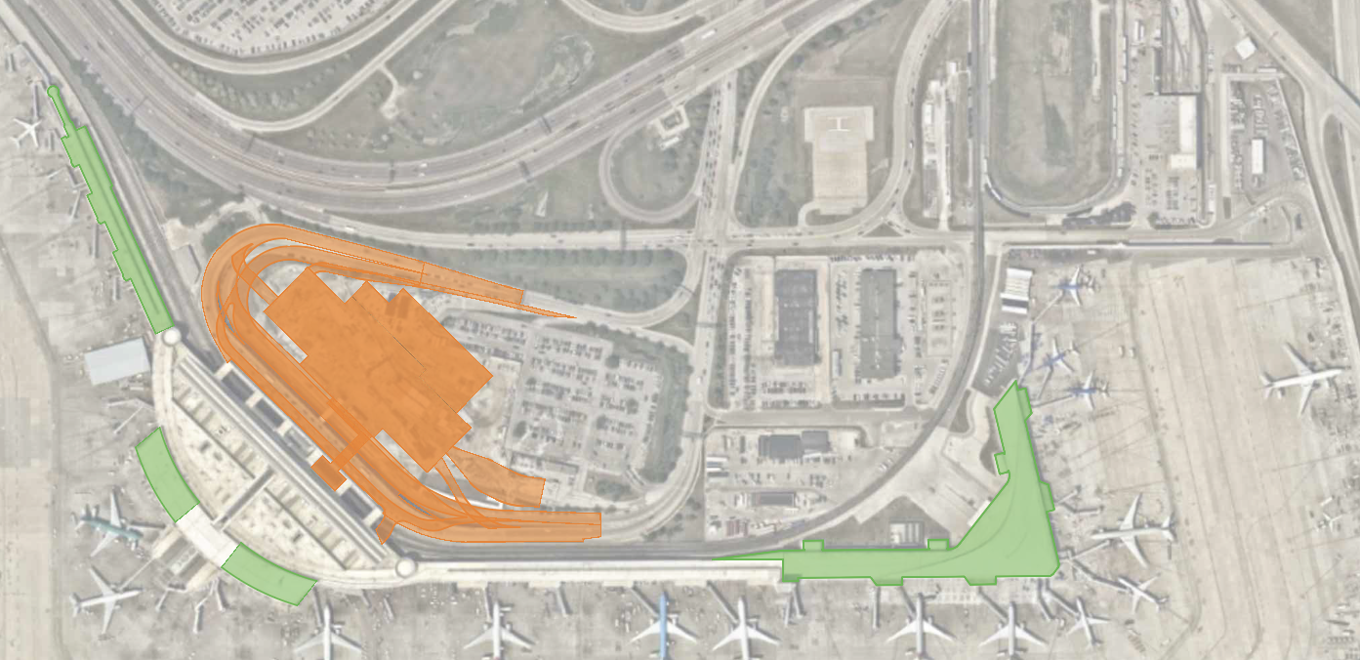
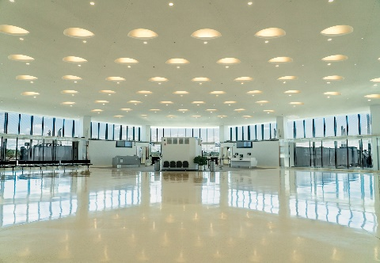
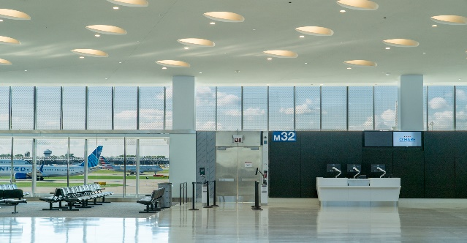
Terminal 5 Expansion
10 additional gates
350,000 additional square feet
Expanded core area for additional amenities
New 22,000 square-foot Delta Sky Lounge
Reconfigured international arrivals facility and
security checkpoint
Baggage handling system to increase
throughput capacity to be completed this year

Slide 13
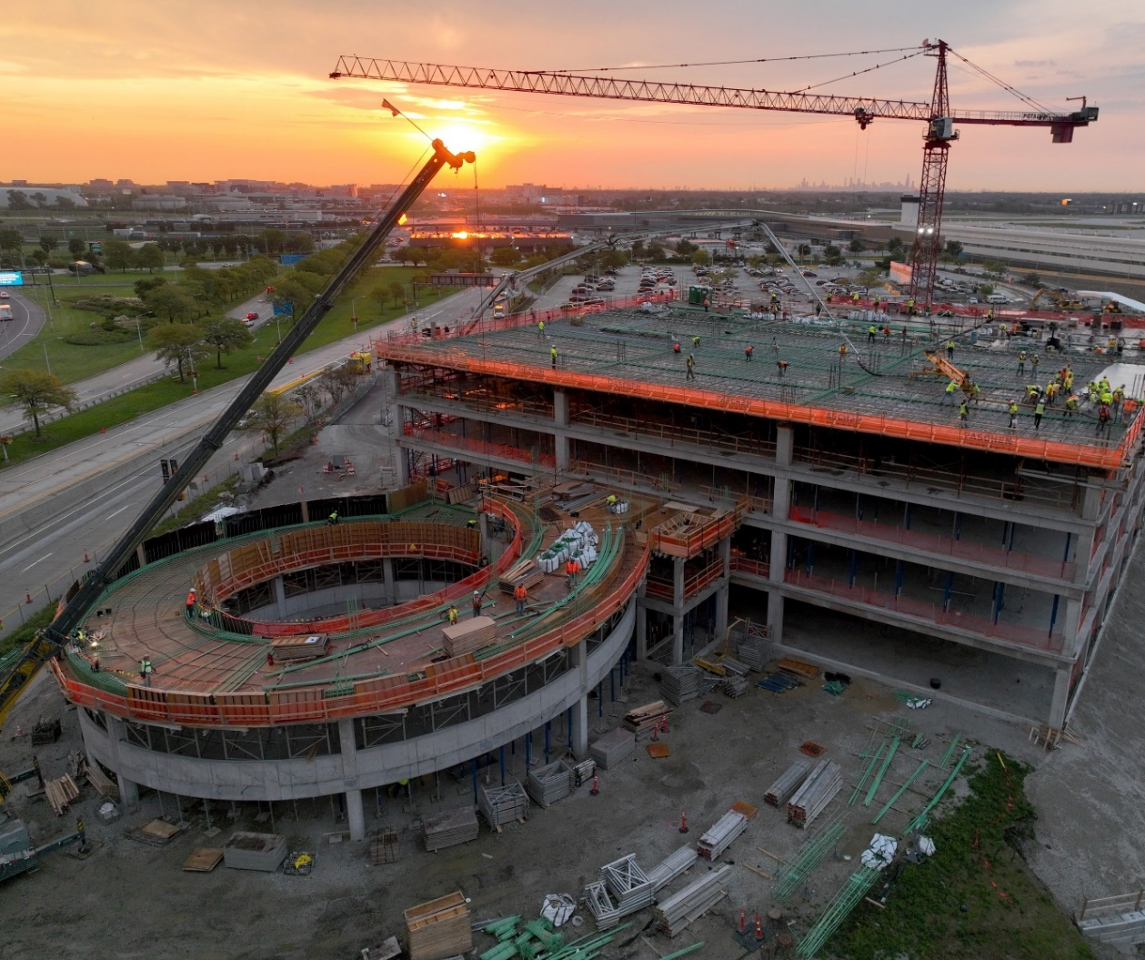
Terminal 5 parking garage
Coming in 2024
Approximately 1,700 parking spaces
More than doubling the available parking
Expanded capacity for multi-day parking
  CONSTRUCTION SUMMIT 2024

Slide 14
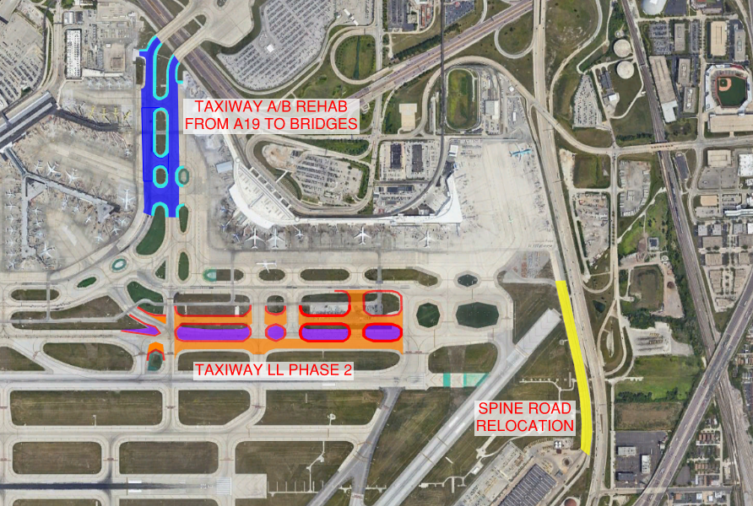
EAST AIRFIELD Taxiway IMPROVEMENT
SCOPE OF WORK:
Rehabilitation of existing hot-mix asphalt roadway (Spine Road); taxiway and taxiway shoulder pavement (A/B from TW A19 to the I-190 bridges), and the construction of new PCC taxiway pavement (Taxiway LL) and new HMA taxiway shoulders (Taxiways LL
and N).
Demolition of existing pavement and earthwork, new chain link fence, pavement marking, airfield electrical work including new circuits, and lighting (in-pavement, elevated and lighted signage).
Utility work includes new ductile iron watermain, new storm sewer, repair to storm sewer structures, and new PCC encased ductbanks.
Revised Photo in progress
Taxiway LL
Taxiway N
ANTICIPATED CONSTRUCTION ADVERTISEMENT | 4Q 2023
ESTIMATED CONTRACT VALUE | $75M
DBE/MBE/SBE/WBE GOALS | 30% DBE
Subject to change
  CONSTRUCTION SUMMIT 2024

Slide 15
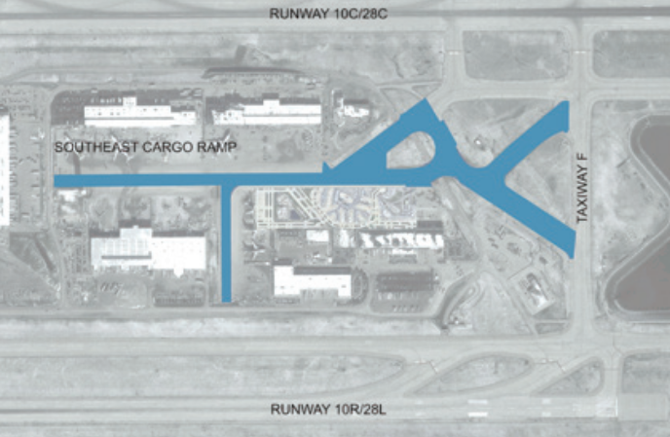
Taxiway S, s1, s2 and s3 rehabilitation
SCOPE OF WORK:
Will be soliciting proposals for design and subsequent rehabilitation of the Taxiway S and associated connector Taxiways S1, S2 and S3.
Work also includes the SE Cargo Ramp Taxilane.
Rehabilitation will include over 90,000-square-yards (SY) of taxiway pavement and 22,000 SY of taxiway shoulders. Included in the scope is Portland Cement Concrete and bituminous pavement rehabilitation, as well as airfield electrical circuiting, signing, lighting, marking, and drainage improvements.
ANTICIPATED CONSTRUCTION ADVERTISEMENT | 1Q 2025
ESTIMATED CONTRACT VALUE | $20M – $25M
DBE/MBE/SBE/WBE GOALS | MBE 26% - WBE 6%
Subject to change
  CONSTRUCTION SUMMIT 2024

Slide 16
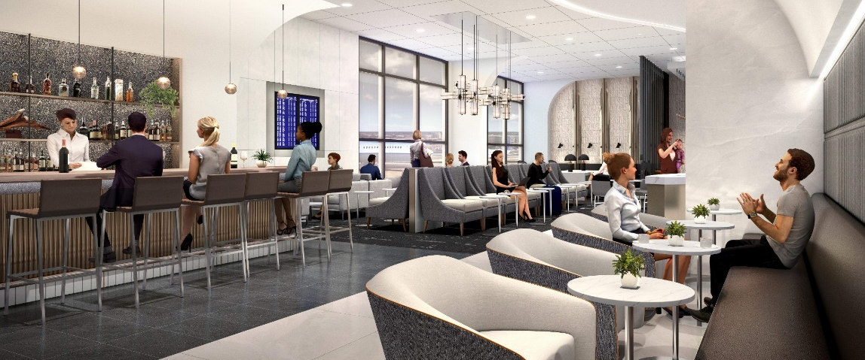
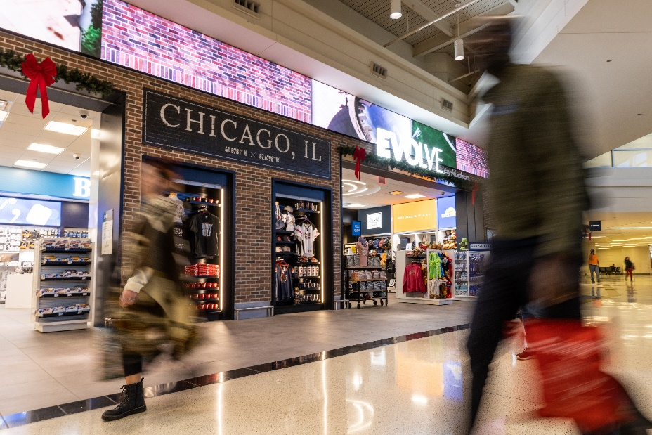
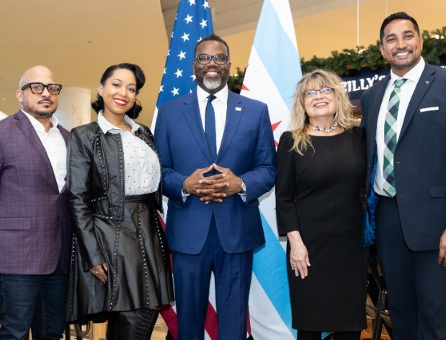
The midway modernization program is complete
The program enhanced the overall passenger experience:
  A new security pavilion
  A streamlined, single checkpoint area
  A new inline baggage handling system for carry-on items
  Improvements to our Customs arrival corridor
  Parking structure improvements
The CDA completed the buildout of the Midway Central Market, marking the final phase of the $400 million Midway Modernization Program.
55% ACDBE participation rate
  CONSTRUCTION SUMMIT 2024

Slide 17
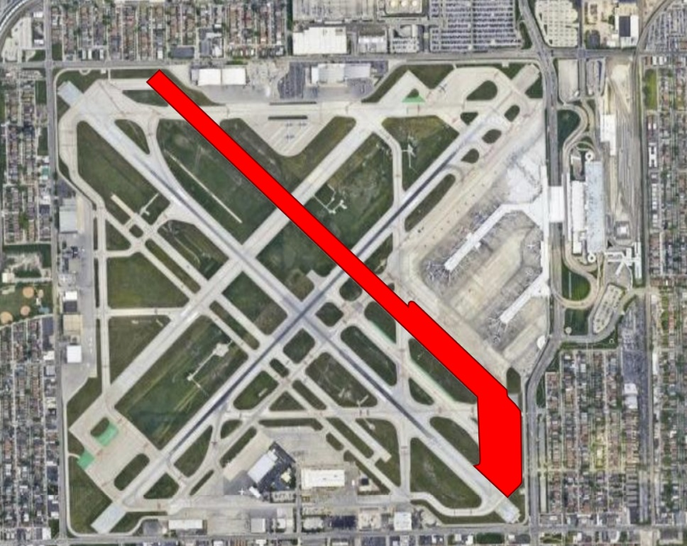
CENTRAL TERMINAL PAD AND ASSOCIATED MODIFICATIONS
SCOPE OF WORK:
Modification of taxiway and runway geometry to create a new central holding pad.
Runway 13L-31R will be converted to a taxiway.
Accounts for less than 1% of airport operations
Allow greater flexibility to aircraft ground movements Enhance terminal core efficiency and flexibility to accommodate future demand
Taxiways E1, E2, and E3 will be modified to two taxiways with updated geometry connecting the new pad to Runway 13C-31C.
Taxiways P, T, and Y will be updated to create space for the pad.
PROJECT START / END DATE | 2023 – 2025
TOTAL PROJECT BUDGET | 6.5M
  CONSTRUCTION SUMMIT 2024

Slide 18
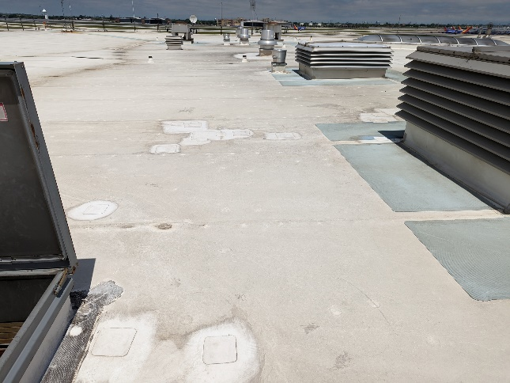
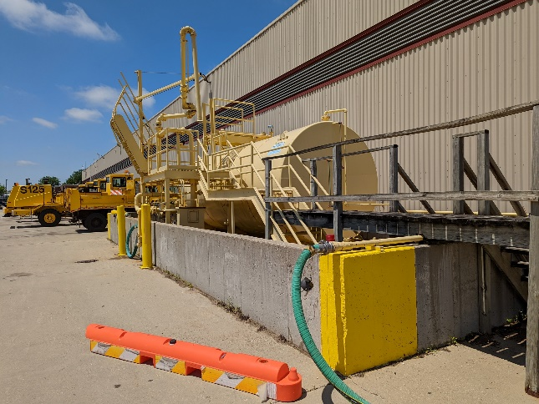
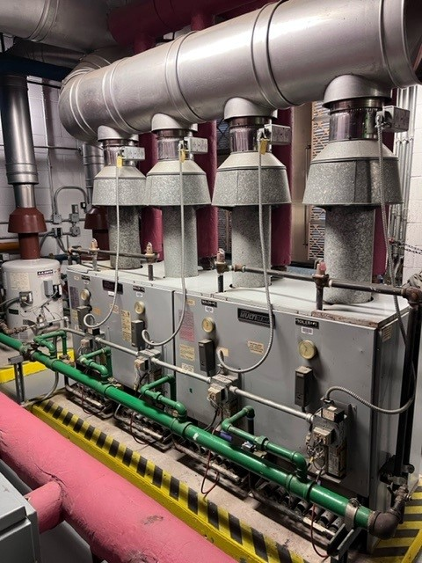
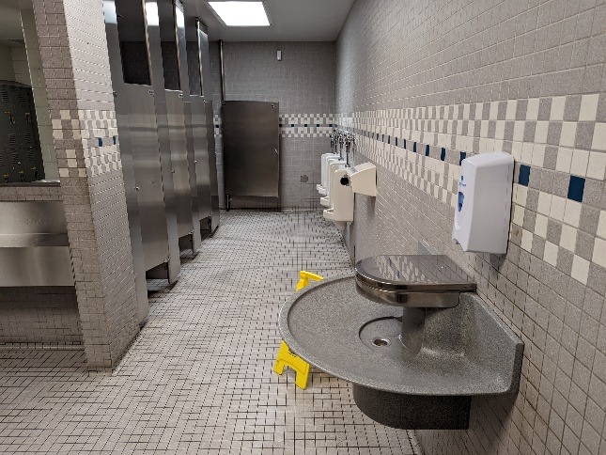
AIRPORT MAINTENANCE COMPLEX (AMC) IMPROVEMENTS
SCOPE OF WORK:
Comprehensive modernization of the existing AMC building, including, but not limited to:
  replacement of mechanical equipment, replacement of garage overhead doors, upgrade emergency generator and switchgear, install new deicing system tanks and pumps, replace garage roof membrane, replace windows, replace entry doors and update ADA accessibility.
  may also include construction of a new vehicle storage facility.
The work has been split into four scope groups:
  office area roofing, deicing system improvements, mechanical upgrades and garage roofing, and the remaining items described above.
PROJECT START / END DATE | 2023 – 2026
TOTAL PROJECT BUDGET | 62.75M
  CONSTRUCTION SUMMIT 2024

Slide 19
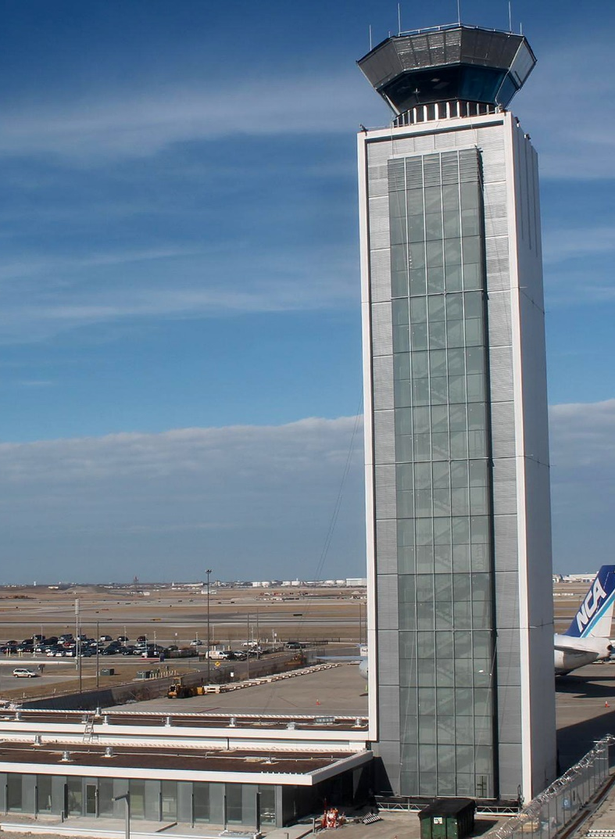
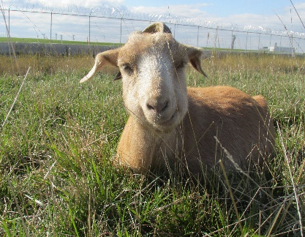
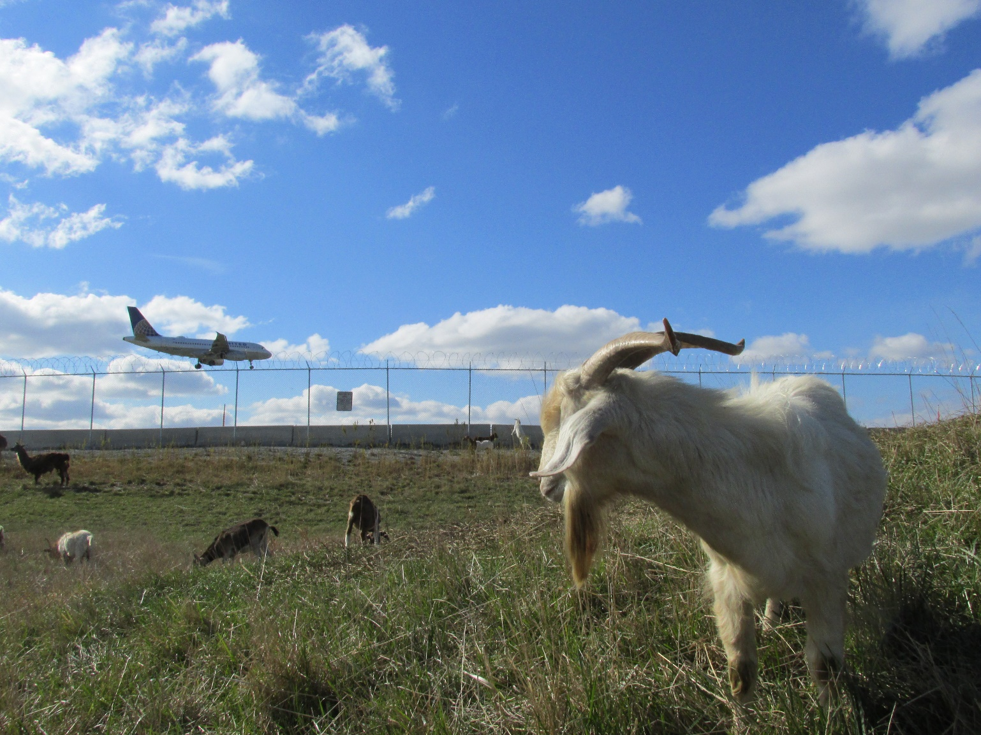

Sustainable Airport Manual® (SAM®)
O’Hare Urban Garden
Vegetated Green Roofs
U.S. Green Building Council® (USGBC®) Certification:
Sustainable Construction Practices
O’Hare Apiary (Beehives)
Electric Vehicle Charging
Green Concessions Policy
Airports Going Green® Conference
O’Hare Grazing Herd
Energy Efficiency
Water Refill Stations
Wetlands Restoration
Sustainability
Sustainable Airport Manual® (SAM®)
O’Hare Urban Garden
Vegetated Green Roofs
U.S. Green Building Council® (USGBC®) Certification:
Sustainable Construction Practices
O’Hare Apiary (Beehives)
Electric Vehicle Charging
Green Concessions Policy
Airports Going Green® Conference
O’Hare Grazing Herd
Energy Efficiency
Water Refill Stations
Wetlands Restoration

Slide 20
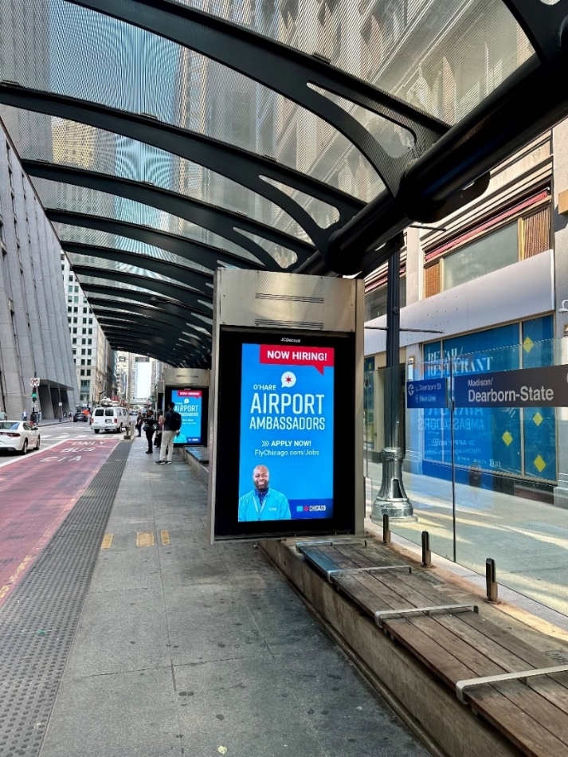

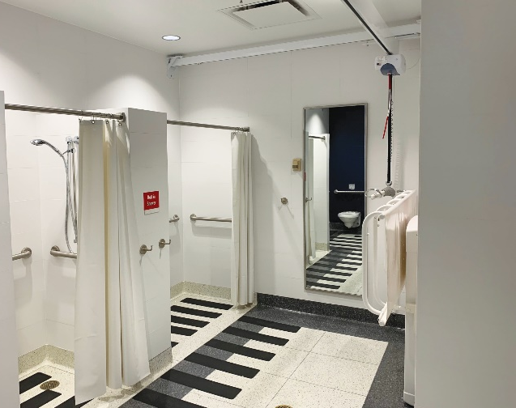
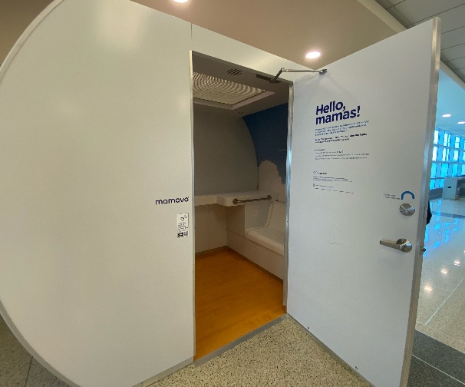
Airport Accessibility
Terminal facilities comply with
Americans with Disabilities Act (ADA)
Service Animal Relief Areas
Accessible drop-off areas
Accessible parking spaces
“Changing Places Facility”
Mental health services
Lactation Pods
  CONSTRUCTION SUMMIT 2024
For more information, please visit Accessibility Guide on flychicago.com

Slide 21

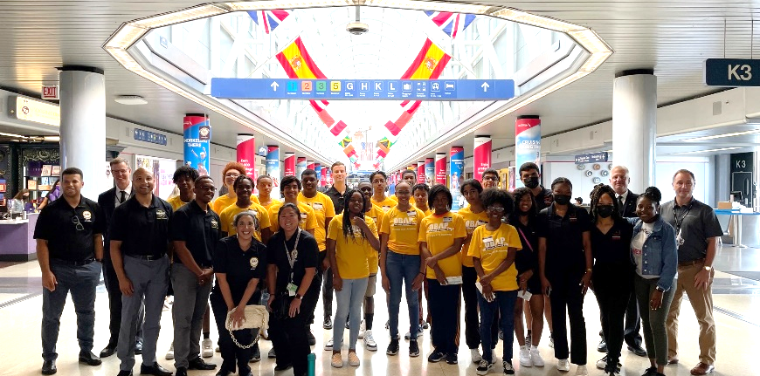

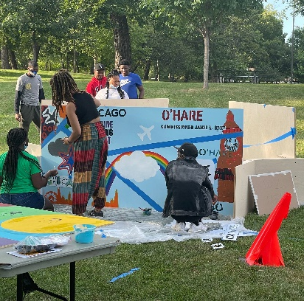
Engaging Chicago’s youth
Strategic outreach events
Pilot program with CPS and City Colleges Counselors
Back to school events
Aviation-related events and celebrations
After School Matters events
Partnerships with federal agencies and airlines to engage youth
North Lawndale Employment Network partnership
Community Event Attendance
Biannual Vendor Fairs
Development of Curriculum with City Colleges

Slide 22
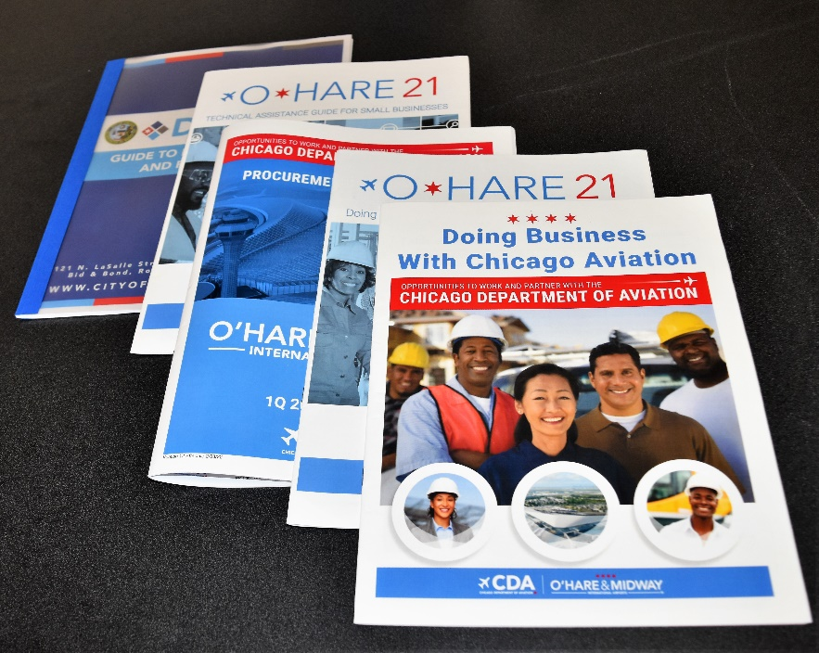
The CDA utilizes both federal and local inclusion Initiatives To achieve inclusion, diversity, and equity in government contracting
50/50 Program & Prompt
Payment Initiative
Mentor Protégé Program
–
More than 20 Protégé Firms
Bid and Resource Center
SBI, MBI, and
Target Market Programs
3-Year CDA Buying Plan
Assist Agency Partnerships
Assist Agency Symposiums
CDA GUIDES:
Procurement Opportunities Guide
Doing Business With CMR
Doing Business With Chicago Aviation
Technical Assistance For Small Businesses
CDA/DPS COVID-19
Reimbursable Agreements
Aviation Learning Series
Small Business Symposiums
Career Fairs
Career Days

Slide 23
CDA Procurement opportunities
PROFESSIONAL
SERVICES
Includes Architecture and Engineering services, property management services and parking management services, etc.
WORK SERVICES CONTRACTS
Includes facility maintenance and landscaping services, etc.
COMMODITY CONTRACTS
Includes various construction materials, facility supplies, tools
and safety equipment,
etc.
CONSTRUCTION CONTRACTS
Includes the full scope of bids of both small and large dollars.
UNBUNDLING
Strategic unbundling of trade packages that might otherwise be bid out as larger packages allows for important growth for small to medium-sized Chicago businesses in the
O’Hare 21 Program
CONSTRUCTION MANAGERS AT RISK
Opportunities for prime contractors and subcontractors to submit bids through the CMRS (over $1 billion paid to date to CMR primes and subs)

Slide 24
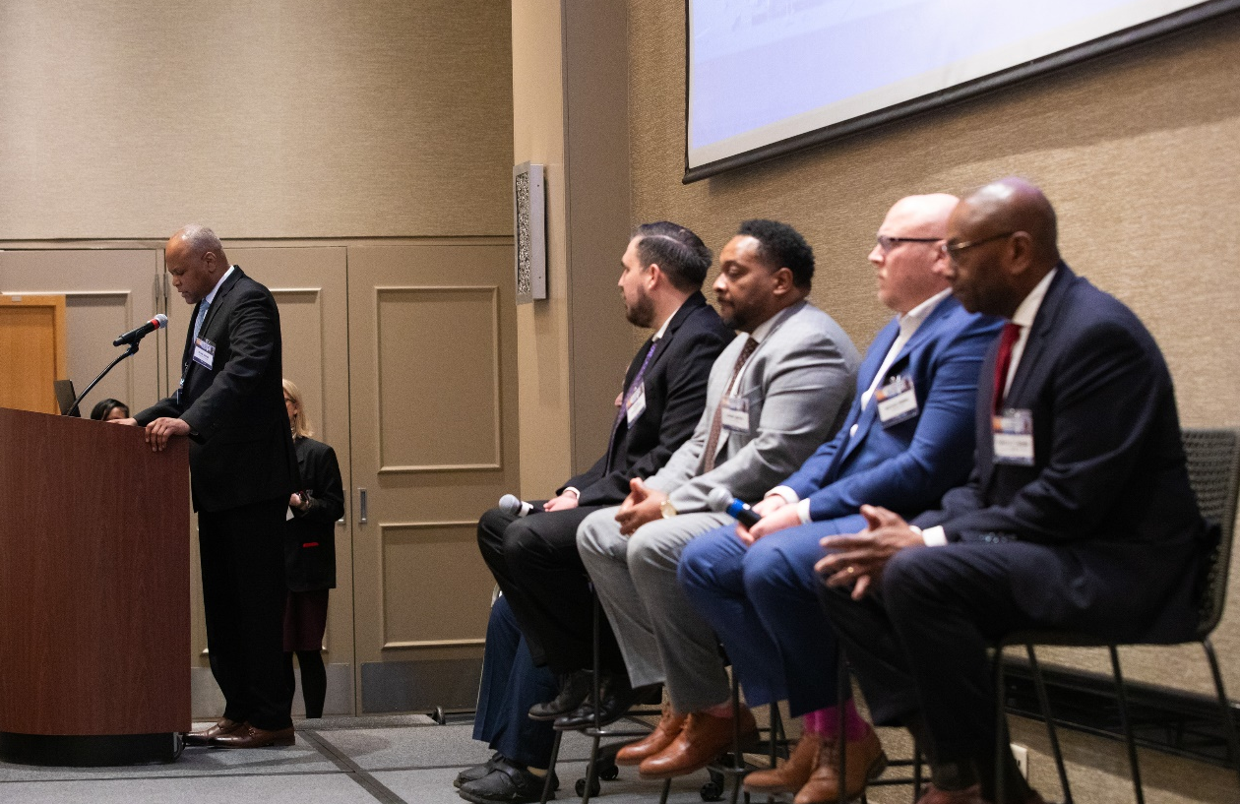
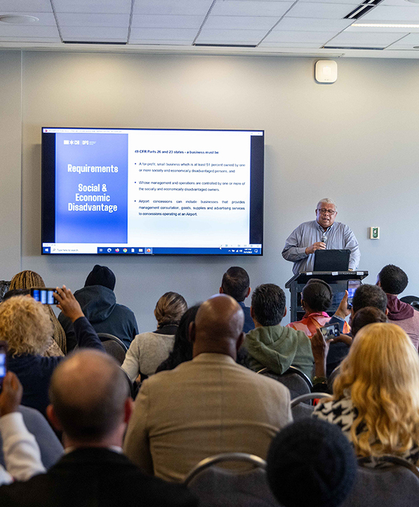
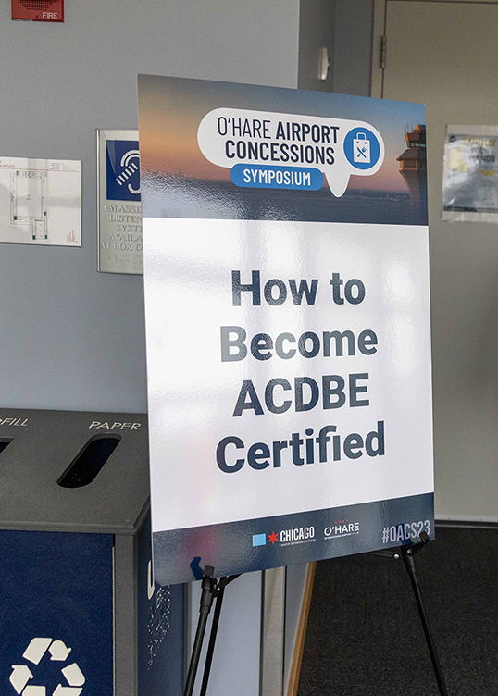
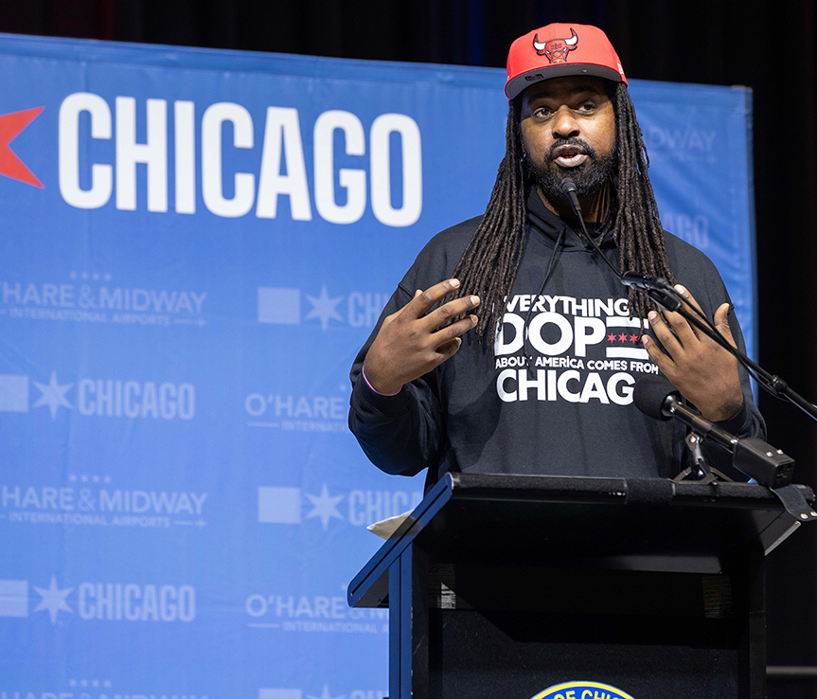
Concessions Symposium
Recently, CDA held two outreach events with a combined attendance of nearly 700 entrepreneurs, small business owners, and local restauranteurs. These unique forums, held in November of last year and on February 15th, fostered opportunities for partnerships on concessions opportunities at O’Hare, as well as valuable tips on financing and proposal writing.

Slide 25

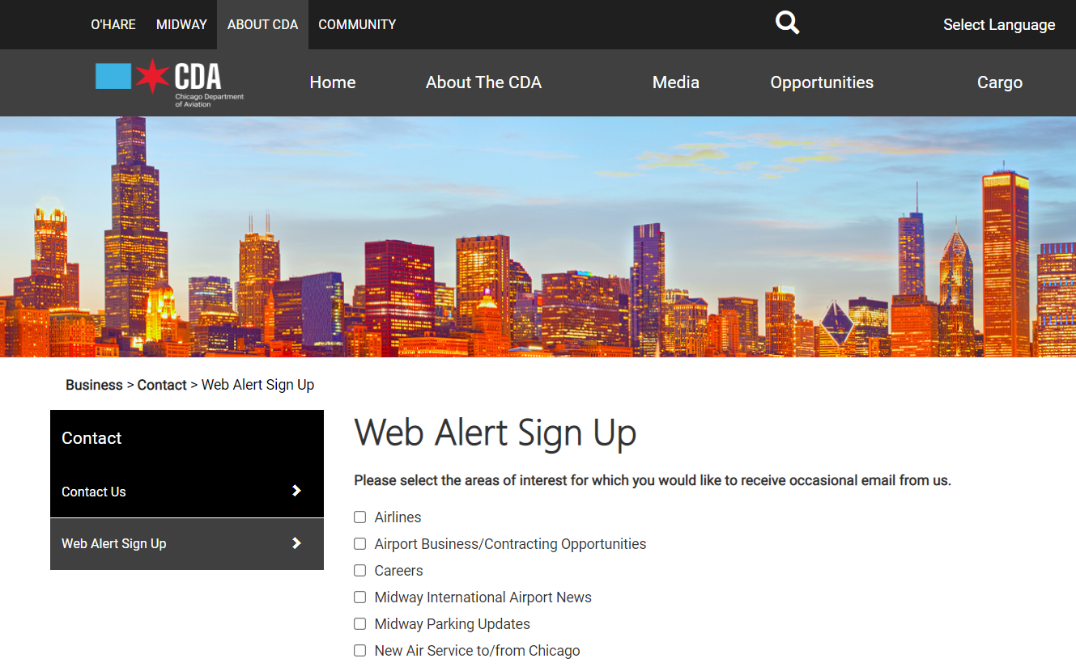
Visit Our Website
Maybe move this in front of resources since its about the process. Then go to resources and questions.
Sign up for CDA Web Alerts at
flychicago.com/signup
And be notified of:
Bid packages advertisements
Pre-Bid Conference
Upcoming Concessionaire Workshops, Symposiums, and other events

