Slide 1


Slide 2

Stay Informed
The Department of Procurement Services is committed to Communications and Outreach, which is key to keeping citizens informed of bid opportunities, new programs, and innovations.
We encourage you to follow us social media to stay informed. You can find us on LinkedIn, Facebook, Twitter, and YouTube.

Slide 3
We encourage you to visit the DPS table for additional resources and to ask any questions about doing business with the City.
You can also contact us anytime via email at DPS.Feedback@CityOfChicago.Org

Slide 4

Procurement Fundamentals: Doing Business with the City of Chicago
Host: Patrick Hall, General Counsel
Department of Procurement Services

Slide 5
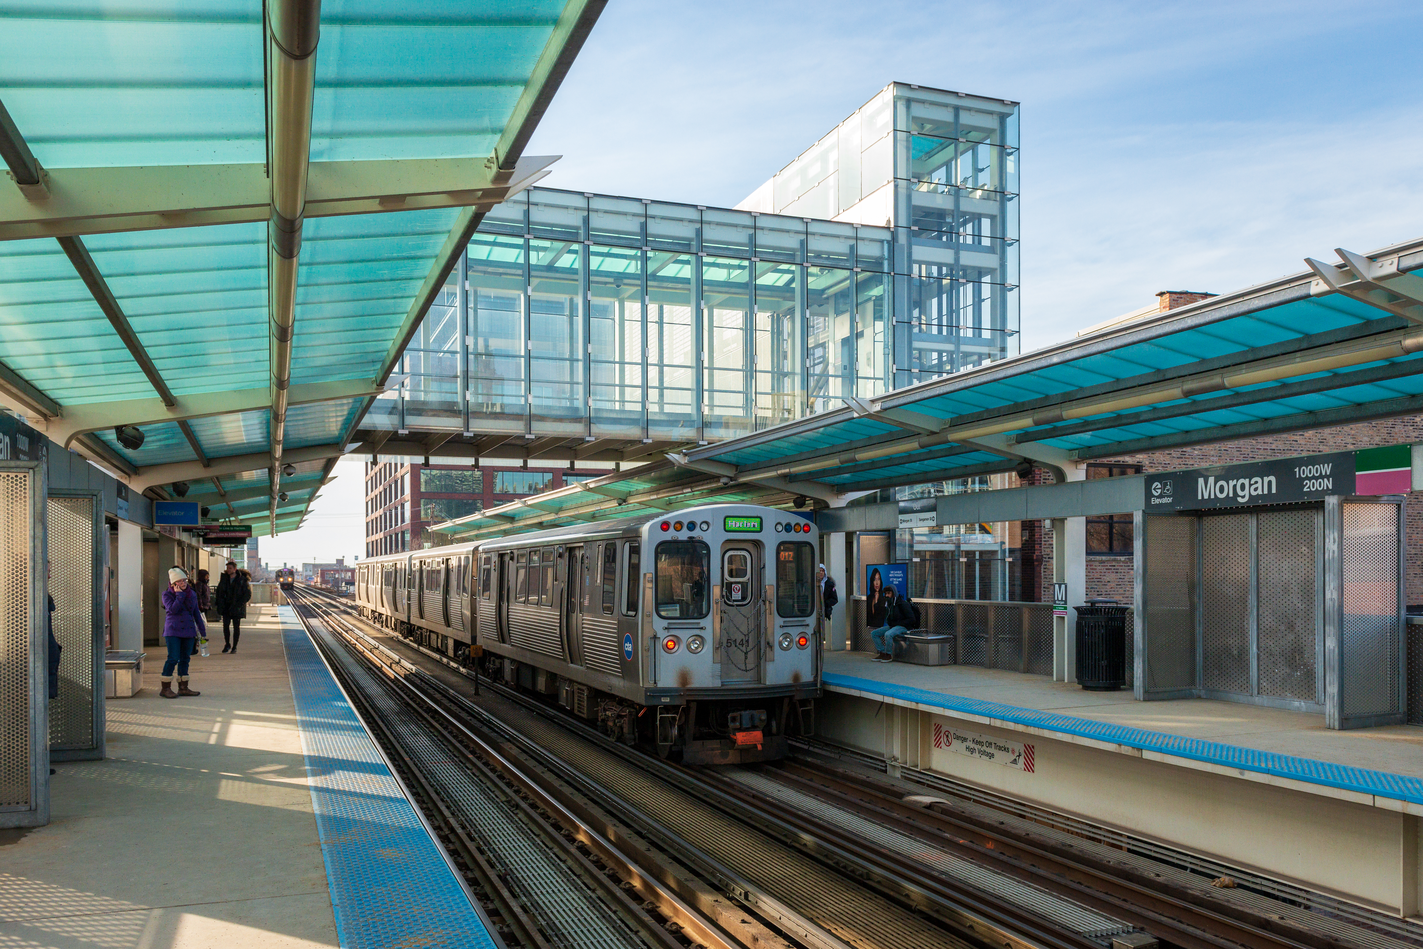
Welcome
The Department of Procurement Services is committed to Communications and Outreach, which is key to keeping citizens informed of bid opportunities, new programs, and innovations.
Also, ensure that you download a copy of our most recent Consolidated Buying Plan. This is a 15-month forecast including hundreds of upcoming opportunities for 12 city agencies.
We encourage you to visit our website, www.chicago.gov/DPS and click on the letter icon, and sign-up for our Email Newsletter: DPS Alerts full of news that you can use.
Follow us on social media to stay informed:
Facebook: www.facebook.com/ChicagoDPS
Twitter: www.twitter.com/ChicagoDPS
LinkedIn: www.linkedin.com/company/chicagodps
Youtube: www.YouTube.com/ChicagoDPS

Slide 6


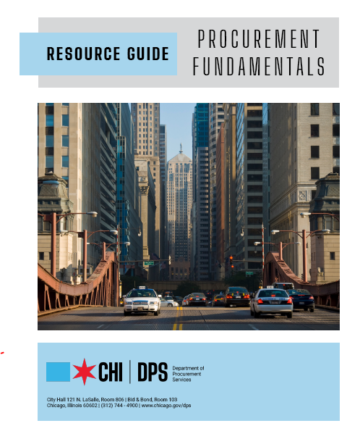

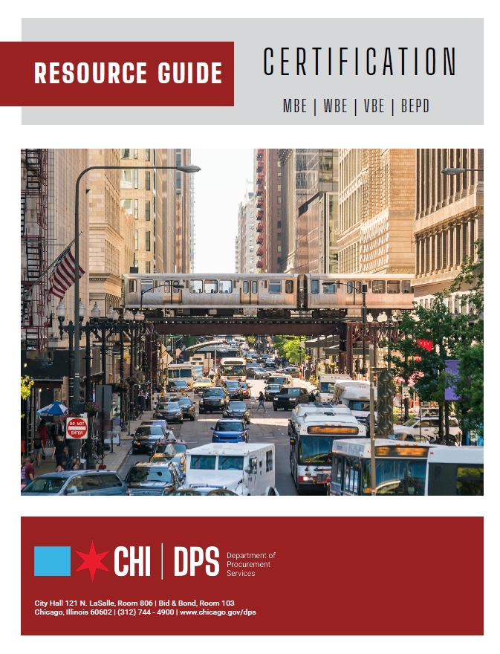
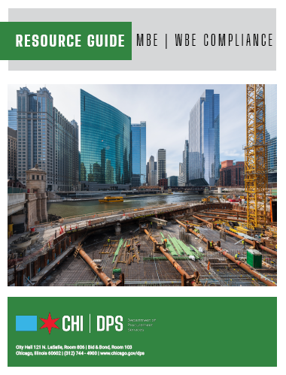




RESOURCE GUIDES
DPS has published a four-volume set of Resource Guides, expanding on the guiding principle of transparency.
The Resource Guides were divided into key areas of the procurement process:
    Contract Administration
    Incentives and Programs
    Certification
    Compliance
Download now at www.chicago.gov/dpsguides
@CHICAGODPS

Slide 7
OUR GOALS AT A GLANCE
Department overview
Laws governing the procurement process
Procurement terms
Types of procurement
Certification
Contract monitoring and compliance
Programs & bid incentives
DPS website
Q & A

Slide 8

DPS is the contracting authority for the procurement of goods and services for the City of Chicago. We work together as a team and with our customers to guarantee an open, fair, and timely process by establishing, communicating, and enforcing superior business practices.
DEPARTMENT OVERVIEW

Slide 9
Laws Governing the Process

Slide 10
Laws Governing the Process
Municipal Purchasing Act (65 ILCS 5/8-10-1 et seq.)
    The state statute that governs the City’s procurement practices
Chapter 2-92 of the Municipal Code of Chicago
    The City ordinances that governs purchasing

Slide 11
Procurement Terms

Slide 12
Procurement Terms
Bid Package- A set of documents issued by the City to solicit bids for goods and services. Bid packages are now all provided electronically through the City’s e-Procurement system.
Addendum- A change to the City’s requirements in an invitation to bid, request for qualifications, or request for proposals. Addenda are all uploaded to e-Procurement. When addenda are uploaded to e-Procurement, notice is sent to all vendors registered for the solicitation.

Slide 13
Procurement Terms
Contract- The written agreement between the City and a vendor for the provision of goods and/or services to the City by that vendor. There are a number of different forms of contracts.
Amendment or Modification- A document which formally changes the terms and conditions of a contract. There are several forms of amendments and/or modifications to contracts. The form that is most commonly known is a change order to a construction contract.

Slide 14
Types of Procurement

Slide 15
Procurement Types
Small Orders
Competitive Bids
Job Order Contracts (JOC)
Request for Proposals (RFP)
Request for Qualifications (RFQ)

Slide 16
Small Orders
Procurement of goods or services (<$250,000)
MBE/WBE compliance required for bids over $10,000

Slide 17
Competitive Bids
Formal bid solicitation (> $250,000)
Advertisement
  Chicago Tribune newspaper
  Daily (classified section)
Website
  www.chicago.gov/eProcurement
Bid & Bond Room
  City Hall Room 103
Bid solicitation period
  10 – 30 calendar days
Plan deposit may be required for some bids

Slide 18
Competitive Bids
Pre-Bid Meeting (could include site inspection of work location after pre-bid meeting)
  Check solicitation to determine if optional or mandatory
  Requirements for bidding process which include:
    Review of specifications
    Address concerns regarding specification
    Q & A
  When optional bidders' attendance encouraged
  May result in addendum or clarification questions regarding bid documents

Slide 19
Competitive Bids
Pre-Bid Meeting
If there is not a pre-bid meeting, bidders are encouraged to review the specification and contract documents during the bid solicitation period and contact the Department of Procurement Services contract administrator identified in the bid advertisement regarding any questions about the bid documents.

Slide 20
Competitive Bids
Bid Documents
    Fill in all required Information
    Note: Certain bid documents must be submitted and executed with the bid, if not, the bid could be REJECTED.
    Sign / execute the document
    Notarize document

Slide 21
Competitive Bids
Bid Submittal
Bid bond or deposit may be required for some bids
  Will not exceed 10% of the contract amount
  Must be submitted in the proper form (cash is not accepted)
All bids must be TIMELY on the bid opening date

Slide 22
Competitive Bids
Bid Openings
Day: Monday – Friday (except major holidays)
Time: 11:00 am
Location: City Hall – Bid & Bond Room 103 & Streamed via Youtube
    Bids are opened and read aloud
    Bids are tabulated
    Bid tabulation and bid documents are reviewed for accuracy and completeness
    Bid tabulation can be viewed on-line at DPS website 24 hours after bid opening

Slide 23
Competitive Bids
Award Process
      Determination is made regarding the bidder’s responsiveness and responsibility for award
      Recommendation of award
      Acceptable bid (s) are packaged
      Contractor performance & payment bond, insurance and funding agency concurrence for award (if applicable) are obtained
      Bid and contract documents are routed through the signature/approval process
      Contract awarded to the lowest responsive and responsible bidder meeting City specifications

Slide 24
Job Order Contracts (JOC)
JOC is a firm, fixed price, competitively bid, indefinite quantity contract specifically designed for each department’s construction program.
Method is used to accomplish small to medium size projects.
Instead of bidding every small or medium construction job and developing plans and technical specifications, departments can use JOC.
General contractors are solicited to respond to an advertised JOC specification which contains a unit price book (various construction tasks) with description, unit of measure and unit price for each task.

Slide 25
Requests for Proposals (RFP)
Method used to solicit proposals to implement a new project requiring professional services.
Used when the City doesn’t have in-house technical experts or resources to implement project or services.
RFP defines project objectives and scope of services but doesn’t detail every aspect of implementing project.
Requires detailed evaluation of proposals by an evaluation committee based on criteria stated in the RFP. Low price is not the only factor.
Award is made to the highest rated and ranked respondents.

Slide 26
Requests for Qualifications (RFQ)
Method used to solicit qualifications from companies who possess a high degree of technical expertise and knowledge in specific disciplines.
City “pre-qualifies” companies to build a vendor pool to respond to future task orders (individual projects).
Evaluation/selection is based on qualifications and technical competence.
For A & E RFQ’s, there is no cost proposal. Fee schedule is negotiated later as part of the master agreement.
Most commonly used for A & E design contracts and certain categories of consulting.

Slide 27
Economic Disclosure Statements (EDS)
The EDS addresses the disclosure of ownership.
Online completion of the EDS is mandatory for most solicitations.
In addition to the applicant, any legal entity which owns more than 7.5% interest, direct or indirectly, in the applicant firm, must also file an EDS.

Slide 28
Certification

Slide 29
Certification
SIX (6) TYPES OF CERTIFICATION
MBE: Minority-Owned Business Enterprise
WBE: Women-Owned Business Enterprise
BEPD: Business Enterprise owned by People with Disabilities
DBE: Disadvantaged Business Enterprise
ACDBE: Airport Concession Disadvantaged Business Enterprise
VBE: Veteran-Owned Business Enterprise

Slide 30
Certification
BASIC ELIGIBILITY REQUIREMENTS
Businesses must be at least 51% owned and controlled by qualifying minorities, women, veterans, individuals with disabilities, or other disadvantaged individuals
Businesses must also be small businesses
Businesses must be independent and viable

Slide 31
MBE/WBE/DBE Participation
Section 2-92-420 sets forth the City’s Minority-Owned and Women-Owned Business Enterprise procurement program for all contracts other than construction.
Section 2-92-650 sets forth the City’s Minority- and Women-Owned Business Enterprise procurement program for construction contracts.
49 CFR Part 26 sets forth the rules regarding participation by Disadvantaged Business Enterprises on federally funded projects.

Slide 32
Commercially Useful Function
The City of Chicago Department of Procurement Services counts MBE/WBE/DBE expenditures toward MBE/WBE/DBE goals only if the MBE/WBE/DBE is performing a “commercially useful function.”
What constitutes a “commercially useful function?”
A certified firm performs a commercially useful function when it is responsible for the execution of a distinct element of the work of the contract, which is carried out by actually performing, managing, and supervising the work involved, or fulfilling responsibilities as a joint venture.

Slide 33
Reduction, Waiver & Good Faith Efforts
Reduction, Waiver & Good Faith Efforts
A contractor shall not be entitled to a reduction or waiver of MBE or WBE goals during the performance of the contract, after substantial completion of the contract, or at the time of contract close out, unless the contractor, in writing, makes a request to the CPO for reduction or waiver.
A contractor seeking a waiver or reduction of MBE and/or WBE goals must demonstrate to the satisfaction of the CPO that it has made good faith efforts to meet its MBE and WBE utilization goals.

Slide 34
Contract Monitoring and Compliance

Slide 35
Contract Monitoring and Compliance
Monitor the actual utilization of MBEs, WBEs and DBEs that have been listed as subcontractors on a compliance plan.
Ensure compliance with Chicago Residency Ordinance (CRO) requirements and Equal Employment Opportunity (EEO) commitments.

Slide 36
Chicago Residency Ordinance (CRO)
Construction contract must be estimated at $100,000 or more and funded by the City of Chicago.
50% of the total work hours must be performed by actual residents of the City of Chicago and 7.5% of the total work hours must be performed by project area residents

Slide 37
Equal Employment Opportunity
In order to promote equality of opportunity for minority and female personnel on city funded construction projects an award criteria determination (canvassing formula) must be inserted into each contract specification that is estimated at $100,000 or more.
Bidders are invited to propose the minority and female employee utilization goals.

Slide 38
Ways to Achieve Compliance
The prime contractor is an MBE/WBE or DBE
Joint venturing with MBEs/WBEs or DBEs
Subcontracting a portion of the work to one or more MBE/WBE or DBE
Purchasing materials that are used in the performance of the contract from one or more MBE/WBE or DBE

Slide 39
Reporting Requirements
Prime contractors are responsible for submitting:
Monthly subcontractor payment certification forms
Weekly certified payrolls
Waivers of lien

Slide 40
Programs & Bid Incentives

Slide 41
Summary Workshop Recap Report
Programs
Small Business Initiative (SBI) Construction
Mid-Sized Business Initiative (MBI) Construction
Non-Construction MBI Program
Diversity Credit Program
Target Market Program – Non-Construction Only
Mentor/Protégé Program
MBE/WBE Phased Graduation Program

Slide 42
Summary Workshop Recap Report
Bid Incentives
Veteran-Owned Business Enterprises/Small Local Business JV + VBEs
Veteran-Owned Subcontractor Utilization
Business Enterprises Owned by People with Disabilities
City-Based Manufacturers
City-Based Businesses
Apprentice Utilization – Returning Resident and CPS/CCC Graduates
Alternatively Powered Vehicles
Mentor/Protégé Program
Project Area Subcontractor Utilization
Equal Employment Opportunity (EEO)
Incentive to Encourage Utilization of MBE/WBEs
Diverse Workforce and Management Incentives

Slide 43
Executive Order: Diversity Reporting
Executive Order 2021-2 (EO) requires all contractors that have agreements with the City to submit annual reports about their company’s Business Diversity Program, or lack thereof. The Business Diversity Program and Utilization Report (BDPR) is due on July 1st of each calendar year from all contractors, with limited exceptions. A dedicated microsite with information, the reporting form, and FAQs can be found at http://www.chicago.gov/bdp.

Slide 44
DPS Website

Slide 45
DPS Website
Awarded contracts and modifications
Payments
Bid tabulations
Weekly bid opportunities
Searchable MBE/WBE Directory
Bid incentives
Regulations
www.chicago.gov/DPS

Slide 46

QUESTIONS?
Do you have a question? Please use the WebEx Q&A feature as shown.

