Slide 1


Slide 2

Stay Informed
The Department of Procurement Services is committed to Communications and Outreach, which is key to keeping citizens informed of bid opportunities, new programs, and innovations.
We encourage you to follow us social media to stay informed. You can find us on LinkedIn, Facebook, Twitter, and YouTube.

Slide 3
We encourage you to visit the DPS table for additional resources and to ask any questions about doing business with the City.
You can also contact us anytime via email at DPS.Feedback@CityOfChicago.Org

Slide 5

City of Chicago - Department of Procurement Services
Introduction to Job Order Contracting (JOC)

Slide 6
Objectives
Job Order Contracting (JOC) Overview
City of Chicago JOC Process
Benefits of JOC
How to bid JOC - Prime Contractors
Getting Involved - Subcontractors
Diversity and Inclusion
Review and Key Points
Q&A

Slide 7
Who is Gordian?
Gordian is the leading provider of facility and construction data, software and expertise.
Data
Owner specific Construction Task Catalog® (CTC).
CTC has over 275,000 construction tasks with preset prices.
Price research facilitated by RSMeans data Engineering Team.
Software
Built from decades of industry experience, used by thousands of contractors daily.
Easily manage the functions of the construction procurement process.
Allows collaboration between the contractor and Gordian Account Manager.
Expertise
Gordian’s founder created the original Job Order Contracting process in the USACE in 1981.
Implemented and administered hundreds of programs.
Dedicated onsite field personnel, review proposals to ensure project success.

Slide 8
Gordian JOC Overview
Total JOC Programs
305
Total Contracts
8,715
Contract Types
28
Total Contractors
1,359
More than $3B in construction volume is completed through
Gordian’s Job Order Contracting programs annually.
As of 12/2022

Slide 9


Construction Procurement Challenges
Staff limitations
Meeting inclusion requirements
Cost control and change orders
Lack of transparency/auditability
Time
Procurement burden relative to job size and scope

Slide 10
Construction Delivery Methods
In-House Staff
Construction Management (CM) at Risk
Unit Price Contracts
Design-Bid-Build
Time and Materials
Design-Build
Job Order Contracting

Slide 11

Overview of Job Order Contracting
JOC is another delivery method for the City to procure construction services
JOC is not meant to replace any procurement method - it is another tool for the City to accomplish work.

Slide 12
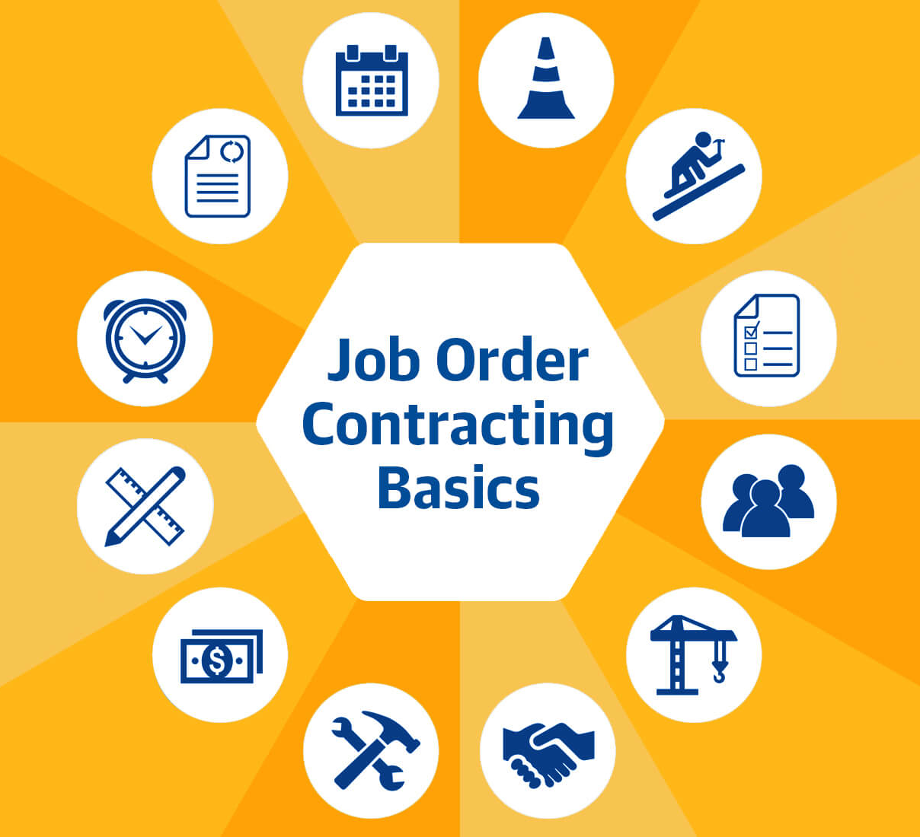
Overview of Job Order Contracting
Job Order Contracts are: Firm, fixed price, competitively bid, indefinite quantity, delivery method designed to produce a large number of multi-traded, repair and rehabilitation projects, as well as minor new construction projects quickly.
Firm, Fixed Price: Construction Task Catalog® of pre-priced work tasks.
Competitively Bid: all bidders submit a set of adjustment factors to the fixed prices in the Construction Task Catalog®.
Offers a fundamentally different construction procurement relationship.
  Fosters collaborative relationship between the contractor and the owner
  Allows contractors to work with clients without the risk of being outbid
  Contractors and owners build lasting partnerships

Slide 13
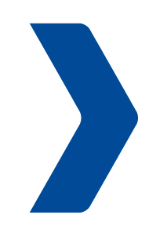
Typical Construction Procurement Process
Prepare design
Develop scope
Create contract documents
Upload contract documents for distribution
Conduct pre-bid
meeting and walk through
Answer RFIs via addendum
Conduct formal bid opening
Verify lowest, responsive, responsible bidder
Collect bonds and insurance certificates from low bidder
Finalize contract
Office renovation
Office renovation contract
Prepare design
Develop scope
Create contract documents
Upload contract documents for distribution
Conduct pre-bid
meeting and walk through
Answer RFIs via addendum
Conduct formal bid opening
Verify lowest, responsive, responsible bidder
Collect bonds and insurance certificates from low bidder
Finalize contract
LED lighting updates
LED lighting update contract
Prepare design
Develop scope
Create contract documents
Upload contract documents for distribution
Conduct pre-bid
meeting and walk through
Answer RFIs via addendum
Conduct formal bid opening
Verify lowest, responsive, responsible bidder
Collect bonds and insurance certificates from low bidder
Finalize contract
Parking lot paving
Parking lot paving contract
= Time & Money

Slide 14
JOC Construction Procurement Process
Create contract documents
Upload contract documents for distribution via solicitation
Conduct pre-bid meeting
Answer RFIs via addendum
Conduct formal bid opening
Verify lowest, responsive, responsible bidder
Collect bonds and insurance certificates from low bidder(s)
Finalize contract
Classroom renovation
LED lighting update
Parking lot paving
HVAC replacement
Security system installation
Window replacement
Roof and gutter replacement
ADA compliance upgrade
One contract for
many projects

Slide 15









Types of Projects
With one competitively-awarded contract, you are able to complete an indefinite number of projects
Straightforward
new construction
Repairs
Renovations
Replacement
in-kind
Maintenance
Emergency
work
Time sensitive
projects
Alterations

Slide 16

Performance-Based
Job Order Contracts are a performance-based contracting system.
Responsiveness of the contractor
  Performance is rated from the project development phase through construction—start-up to close-out
Project development phase
  Scope definition
  Timely and accurate price proposals
Construction phase
  Timely start-up
  Effective management of work crew
  Ensuring project is constructed according to the specifications
Success in developing a partnership relationship with the contractor

Slide 17
Performance-Based
JOC contracts include measurable performance standards
Quality Price Proposals: accurate price proposals that can be approved on the first or second submission.
Timely Price Proposals: timely price proposals that are submitted on or before the due date indicated on the Request for Proposal.
Timely Construction: rapid mobilization to start work, adherence to the agreed upon construction schedule and timely completion of any punch list items.
Quality Construction: good quality construction where projects are constructed according to the specifications and require minimal punch list items.
Achievement of M/WBE Goals: meet or exceed the M/WBE goals set forth in the contract documents.
Achievement of Self Performance Goals: meet or exceed the self performance goals set forth in the contract documents.

Slide 18

Benefits to JOC - Prime
Prime Contractor’s benefits with Job Order Contracting
JOC can be profitable
  Profit is a function of volume
  Volume is driven by performance
  JOC provides a steady flow of work
  Do not have to chase the next project
Long-term relationship with the City
  Non-adversarial relationship
  Develop partnership with the City
Professionally rewarding
  Different types of projects (varying scope)
  Ability to provide input during scope development

Slide 19


Benefits to JOC - Subcontractor
Subcontractor’s benefits with Job Order Contracting
No projects are identified at the time of bidding, so Prime Contractor cannot staff up to self perform.
Increased subcontracting opportunities because Prime Contractors must utilize the subcontracting community.
Simplified procurement process for the City allowing them to procure more work in a shorter period of time.
Multiple projects on multiple sites simultaneously.

Slide 20
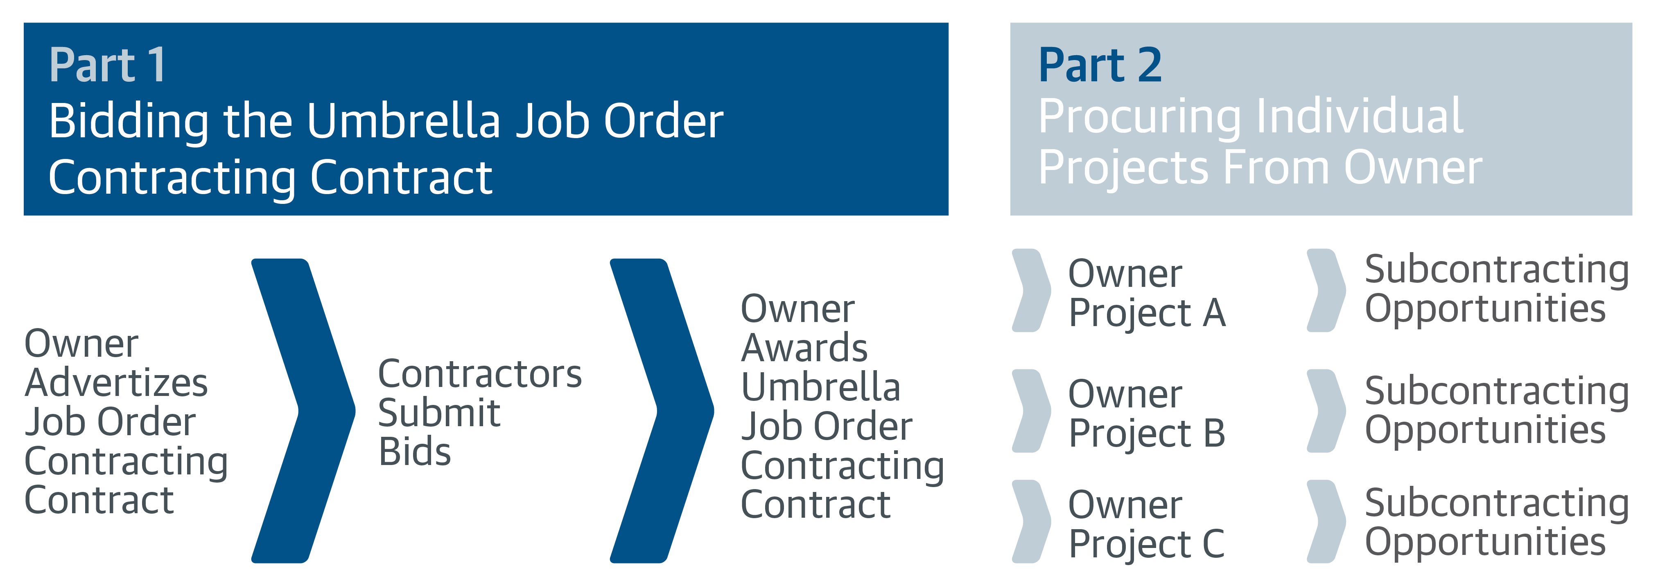
Bidding as a Prime Contractor
Prime Contractors Prime & Subcontractors

Slide 21
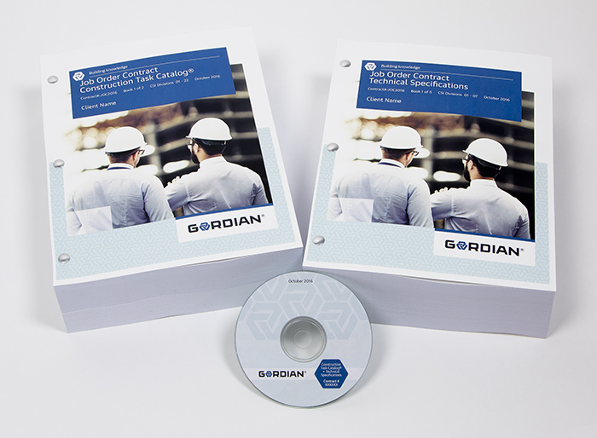
Part 1 - Bidding as a Prime Contractor
Gordian Documents
Book 1: Instructions to Bidders and Execution Documents
Book 2: City’s General Conditions and JOC Special Conditions
Book 3: Construction Task Catalog®
Book 4: Technical Specifications
Book 5: Clients’ Specifications

Slide 22
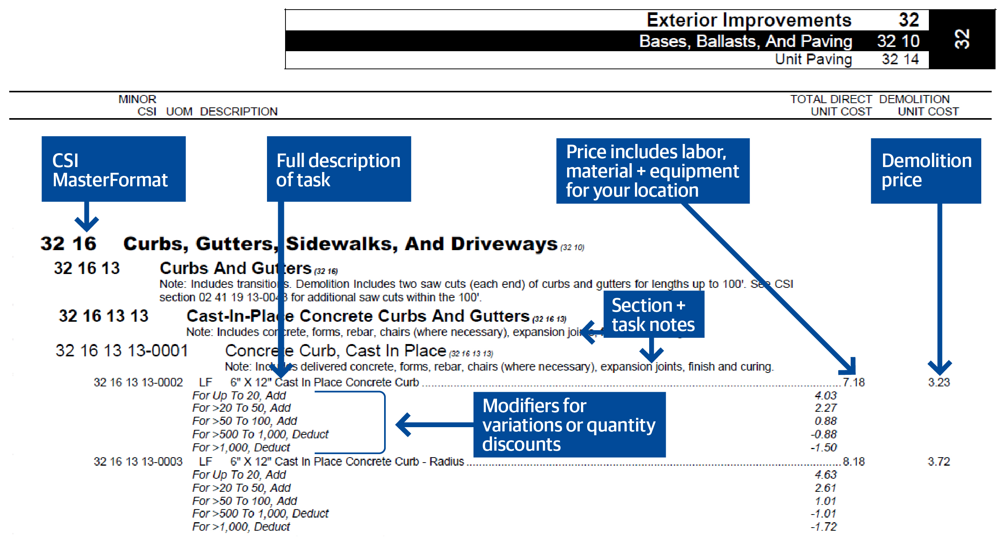
Construction Task Catalog (CTC)
Book 3: Construction Task Catalog® (CTC) (Link in eProcurement)
Catalog of pre-priced construction tasks
Organized by CSI MasterFormat
Prices include local labor, equipment and material (LEM) costs
Customized for City’s tasks and standards
Prices in the CTC are fixed for the duration of the contract.

Slide 23

Bidding as a Prime Contractor
Step 1: Determine direct costs
  Analyze the CTC and specifications
  Completeness and clarity
  Review the CTC price against the direct cost for accomplishing the work
  Prices in the CTC do not include subcontractor OH & P
  Do you have to increase prices to cover your direct costs?
  Depends on the amount of self-performance versus subcontracting
Step 2: Determine overhead costs & profit expectations
  Bonding, insurance, etc.
  Main overhead is staffing
  How much will it cost to employ the required staff?
Step 3: Bid normal hours and other than normal hours factors to the prices quoted in the CTC
  Applied to all work tasks in the CTC
  Must cover direct costs, overhead, and profit
  Cannot exclude any tasks
Step 4: Specify EEO commitments and determine the award criteria figure
  The bid forms will walk bidders through the calculations
  * Low bidder is based on the lowest award criteria figure

Slide 24
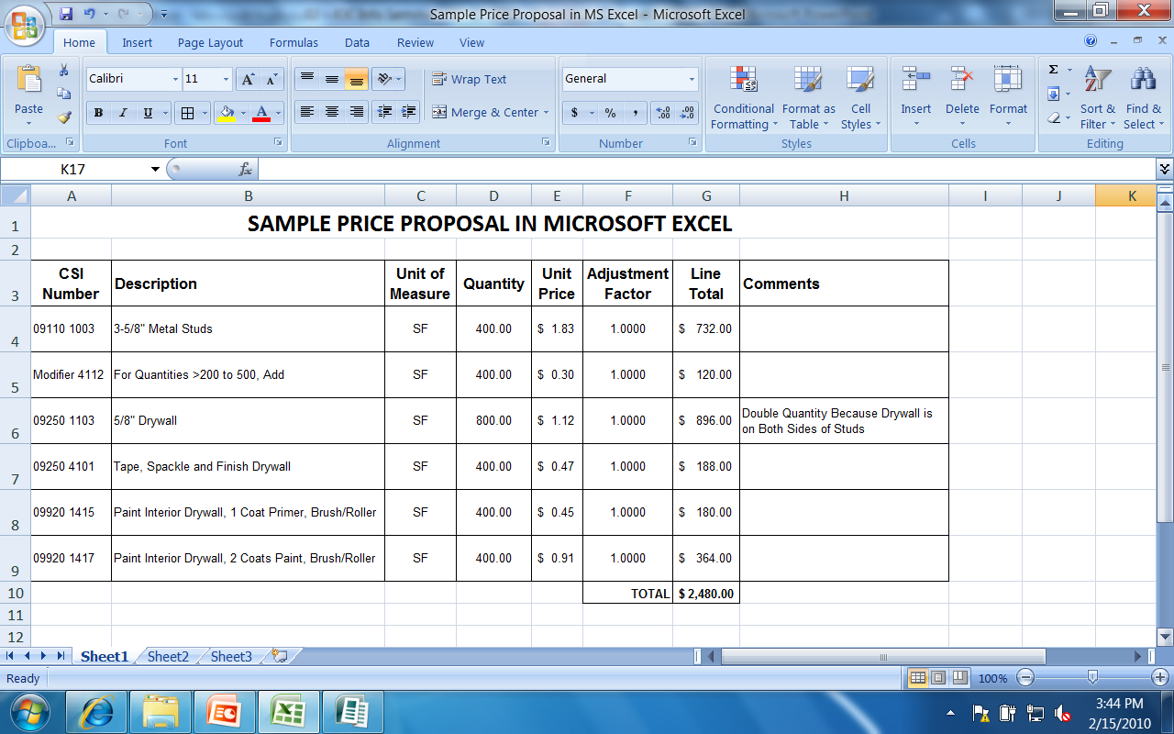
Bidding as a Prime Contractor
Preferred method for analyzing the price in the CTC versus your costs
Select a comparable project from your files (more than one)
  Example: The project you selected paid you $82,323.00
Build a price proposal from the CTC at a factor of 1.0000 (i.e., no adjustment)
  Price from the CTC = $75,746.00
Calculate the adjustment factor
  If you were satisfied with the $82,323.00 (i.e., covers your direct costs, OH & profit)
  You would need an adjustment factor of: ($82,323.00 / $75,746.00) = 1.0868
Don’t Stop There – Select More Than One Project!
Dollar amounts and adjustment factor used above are for example
purposes only.

Slide 25
Bidding as a Prime Contractor
Tips for being a successful JOC Contractor
Bid correctly
  Anticipate the type of work the City expects to complete using JOC
  Depends on the contract.
  At the pre-bid meeting, there are slides detailing the type of work used under the previous JOC contract.
  Analyze the prices in the CTC versus your costs
  Run sample projects.
  Determine factors required to adjust prices in CTC to cover your direct costs, overhead, and profit.
Staff correctly
The bid factors and quality of staff affect whether or not a contractor can meet the performance standards

Slide 26
Getting Involved!
Getting involved in the JOC program
Analyze the JOC programs in the Chicago area and any other areas you are willing to work.
Identify those programs whose Scope of Work relates to your work.
For Prime Contractors, analyze the prices in the CTC and develop accurate adjustment factors at the time of bidding.
For Subcontractors, establish a relationship with Prime Contractors.

Slide 27

Subcontractors – Getting Involved!!
Contact the Awarded JOC Contractors!
  Illustrate your portfolio and previous projects completed
  Provide contacts and/or references who would champion your performance
  Show off your work!
Attend Outreach Events & Network
  Some Contractors host their own outreach events
Contractors will contact you in several ways:
  Emails, BuildingConnected, The Blue Book Network, Cold Calls
  Contractors may ask for Project references
Word of Mouth - JOC Contractors will ask other JOC Contractors

Slide 28

Subcontractors – Getting Involved!!
Tips for things to keep in mind when you are talking with a JOC Prime:
FAST and RESPONSIBLE pricing
  JOC Contractor may request pricing in a matter of days
  Understanding the Scope of Work thoroughly to price accurately
Obtain and Hold M/WBE Certifications
  JOC Contractors look online for potential M/WBE Subcontractors
Agreement and Understanding JOC Contractor Contract Terms
  Completing Compliance Paperwork accurately and timely
  Bonding & Insurance Capacity Requirements

Slide 29
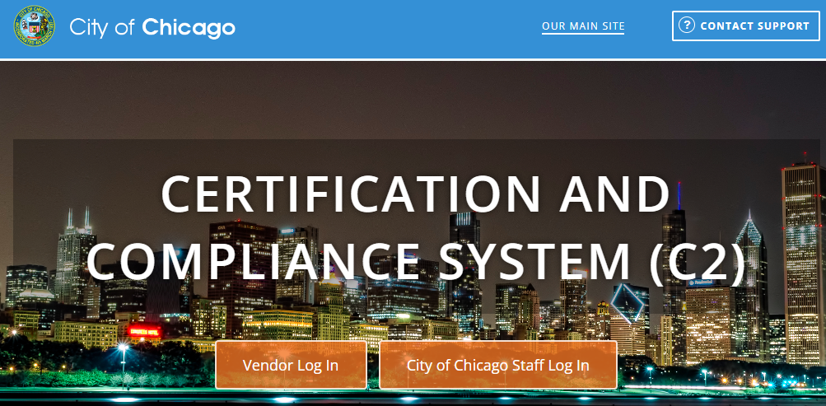
Subcontractors – Getting Involved!!
Payment Timelines & Capacity –
    Payments are NOT made to the JOC Contractor immediately and takes time
    Retainage is held on a project by project basis
    Subcontractor upkeep of Certified Payroll.
    Providing all waivers (Partial & Final) accurately and timely

Slide 30





Getting Involved!
JOC Programs within the City of Chicago
Department of Fleet and Facilities Management (2FM)
  Bureau of Architecture, Engineering & Construction (AEC)
  Bureau of Environmental, Health & Safety Management (EHS)
Department of Aviation (CDA)
Department of Water Management (DWM)
Department of Transportation (CDOT)
Office of Emergency Management and Communications (OEMC)

Slide 31
Getting Involved!
Chicagoland Area JOC Programs
Chicago Public Schools
Chicago Transit Authority
Public Building Commission
City Colleges of Chicago
University of Illinois at Chicago
Cook County
Lake County
Naperville
United States Postal Service
Equalis Group – ezIQC
Sourcewell IL ezIQC
Identification of other agency's JOC programs is for informational purposes only.
All discussions in this workshop pertain to the City of Chicago only.
Procedures at other agencies identified on this slide may be different.
To find advertisements for agencies listed on this slide, look on the agency’s website.
The City’s website does not advertise contracts for agencies listed on this slide.

Slide 32
Diversity, Equity & Inclusion
Gordian provides best practices around establishing M/WBE contract goals by:
Developing and maintaining relationships with affiliated organizations and construction industry partners to provide Informational Meetings on Job Order Contracting (JOC) and upcoming JOC opportunities
Leveraging relationships our clients have already established with local Minority Contractor Associations and provide Informational Meetings highlighting client-specific JOC opportunities
Creating targeted contractor lists for outreach, which are developed through local associations, client reference, web research, Gordian’s contractor database and companies expressing interest in Gordian’s JOC programs
Tracking M/WBE contractor participation through our JOC platforms/programs
Providing networking opportunities with Primes/Sub-Contractors
Providing on-going support to contractors after contract award to ensure they succeed in the program
Notes:
Diversity, Equity, and Inclusion is important to Gordian and the clients we service. Gordian has created a channel to promote Job Order Contracting awareness among the Diverse Contractor Community to ensure Diverse contractors have the knowledge to participate in a JOC solicitation. Kellie Erickson heads up this initiative by collaborating with D&I, Sales and Operations, and the client in the early stages of a contract kick off. Our goal is to ensure that clients meet and exceed their diverse goals through Job Order Contracting. Here are some of the ways we achieve success….

Slide 33
Organizations and Associations
National Association of Minority Contractors
U.S. Minority Contractors Association
Black Contractors United
Hispanic American Construction Industry Association
Chicago Minority Supplier Development Council
African American Contractors Association
National Association of Women in Construction
Chicago Urban League
Notes:
This is an example of some of the diverse organizations and associations that we partner with at the local level to create awareness. This is not an all inclusive list. This changes based on the location in which we’re conducting the solicitation.

Slide 34
Review/Key Points
JOC is an established procurement system used by several types of public agencies nationwide.
JOC has benefits for all parties: Owner, Prime Contractor, & Subcontractors.
Performance based contracting system that determines the amount of work to be issued.
Be aware of the tips and methods to connect with the JOC Prime Contractors
Be ready to perform at a high level.

Slide 35
To Find More Information…
To find out about current advertisements (applies to all City contracts)
Sign up for DPS alerts!
Check the DPS website
  Go to www.cityofchicago.org/dps
  Under Bid Proposal Information, click on the link for “Current Bids and Requests for Proposal”
Check the newspaper (Chicago Tribune)

Slide 36
Key Contacts
Job Order Contracting Process
Michael Judd
Regional Director
Gordian
e: m.judd@gordian.com
p: 312-489-7277
Job Order Contracting Process
Cristiane Jobes
Account Manager
Gordian
e: c.jobes@gordian.com
p: 312-579-8627
Job Order Contracting Process
Kellie Erickson
Contractor Diversity, Equity, and Inclusion Manager
Gordian
e: k.erickson@gordian.com
p: 218-296-1772

Slide 37
Questions?

Slide 38
Thank you!

