Slide 1


Slide 2

What is Compliance?
February 22, 2023

Slide 3
The Compliance Team
Compliance Officers Sr. Compliance Officers
Gwen Dancy Terrence Bray
Ruelyn Howard Gisela Cervantes
Zelma Martin Jorge Mota
Theresa Whittington
Compliance Manager
Charles Coleman
Contracting Equity Officer
Tammi Morgan

Slide 4
Agenda
Compliance is a pivotal component at DPS
What We Do
Setting Project M/W/V/DBE Goals
Review Bidders/Proposer Compliance Plan
Monitor M/W/V/DBE Commitments
Monitor Equal Employment Opportunity (Minority and Female Commitments)
Monitor CRO / Local Residency Requirement
Contract Closeout
How We Do It
Certification and Compliance System (C2)
Certified Payroll Processing System (LCP Tracker)
Conduct Audits
Site Visits

Slide 5
Pre Award Requirements
How Contract Goals Are Set
M/W/V/DBE Direct Opportunities identified
Contract Goals Inserted into each Specification
Percentages from 0% to 100%

Slide 6
Pre Award Requirements, cont.
M/W/DBE Compliance Plan (Schedule D)
Documentation of Good Faith Efforts
Full or Partial Waiver of the Contract Goals
Proper Compliance Plan Submittal

Slide 7
Schedules
Schedule B
M/W/DBE Affidavit of Joint Venture
Schedule C
M/W/DBE Letter of Intent
Schedule D
Compliance Plan for M/W/DBE Participation
Schedule H
Documentation of Good Faith Efforts

Slide 8
Commercially Useful Function
Commercially Useful Function: the responsibility for the execution of a distinct element of the work of the Contract, which is carried out by actually performing, managing and supervising the work involved, evidencing the responsibilities and risks of a business owner such as negotiating the terms of subcontracts, taking on financial risk with the contract or subcontract, acquiring the appropriate lines of credit and/or loans or fulfilling responsibilities as a Joint Venture Partner.

Slide 9
Commercially Useful Function, cont.
Commercially Useful Function
Performing
Managing
Supervising

Slide 10
Counting Participation
Area of Specialty
NAICS Codes
M/W/DBE
Self Performs = 100%
M/W/DBE
Manufacturer = 100%
M/W/DBE
Supplier = 60%

Slide 11
Compliance Reviews (Pre-Award)
Schedule C’s
Project name/Specification Number Identified
Dates of when the Schedule C was signed (Post/Pre Bid-Opening)
Certification Letter(s)
Is the firm identified on the Schedule D Certified?
What area(s) of specialty / NAICS code(s) is the firm Certified in?
Quotes/Proposals
Request copies of the proposals/quote submitted to Prime
Request to see the communications/negotiations between Prime and M/W/V/DBE Firm (fax/email/phone)
Work and/or Services clearly described
Dollar amount matches the Schedule D
Is their Certification in line with the work/services outlined on Schedule C?
CONFIRM AGREEMENT

Slide 12
Post Award Requirements/Contract Monitoring
Contract Monitoring Begins
M/W/DBE Participation
Equal Employment Opportunity (EEO)
Chicago Residency Ordinance (CRO)
Local Residency

Slide 13
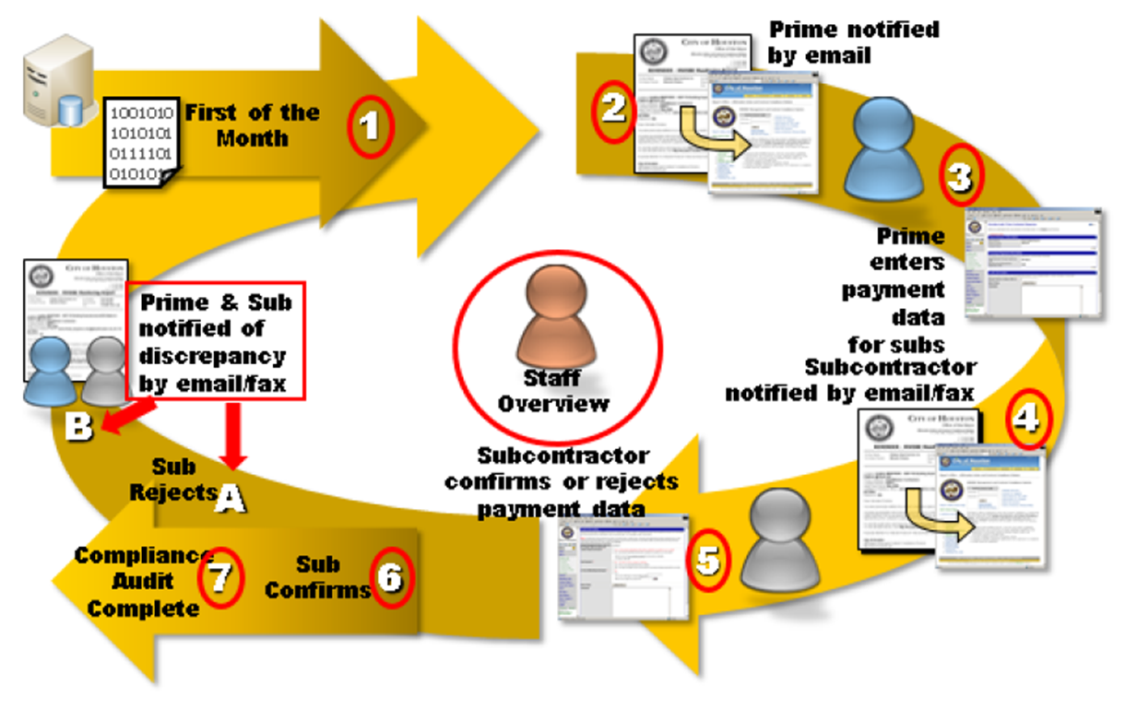
Compliance Audit Cycle

Slide 14
C2 – MBE/WBE/DBE Payment Reporting
TRACK Payments
To Prime
To M/W/DBE Firms
Online VERIFY
Requires confirmation of payments made to M/W/DBE Firms
TRENDING Report
Identify how the Prime is trending on goal attainment

Slide 15
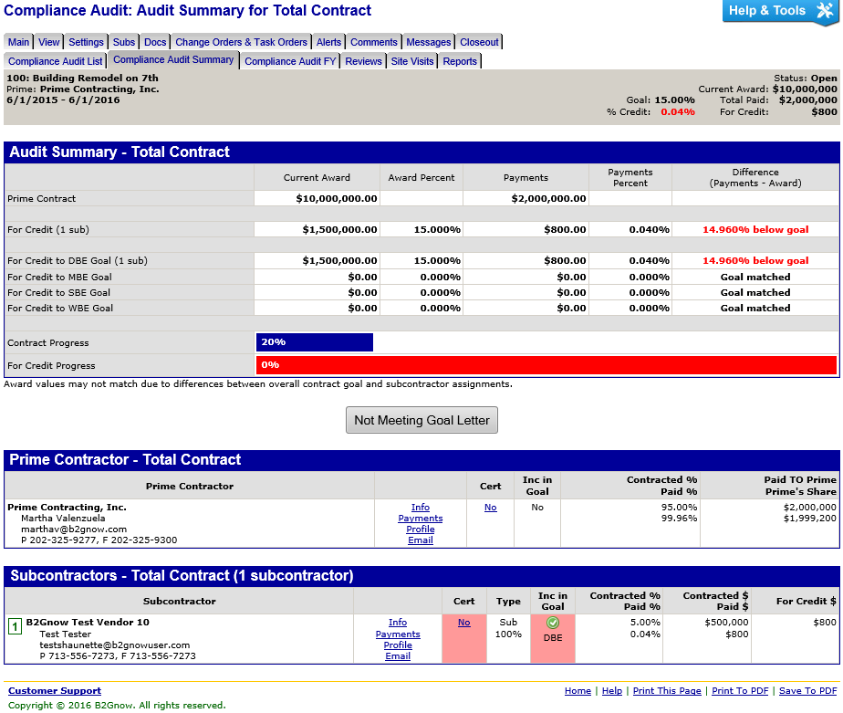
Compliance Audit Summary – C2

Slide 16
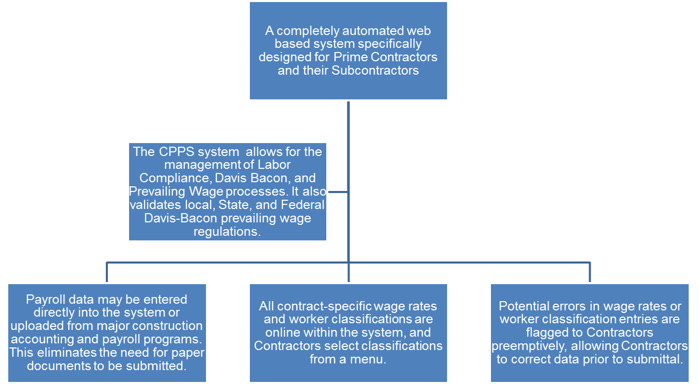
CPPS – Certified Payroll Reporting / LCP

Slide 17
Reports
Certified Payroll Processing Reports

Slide 18
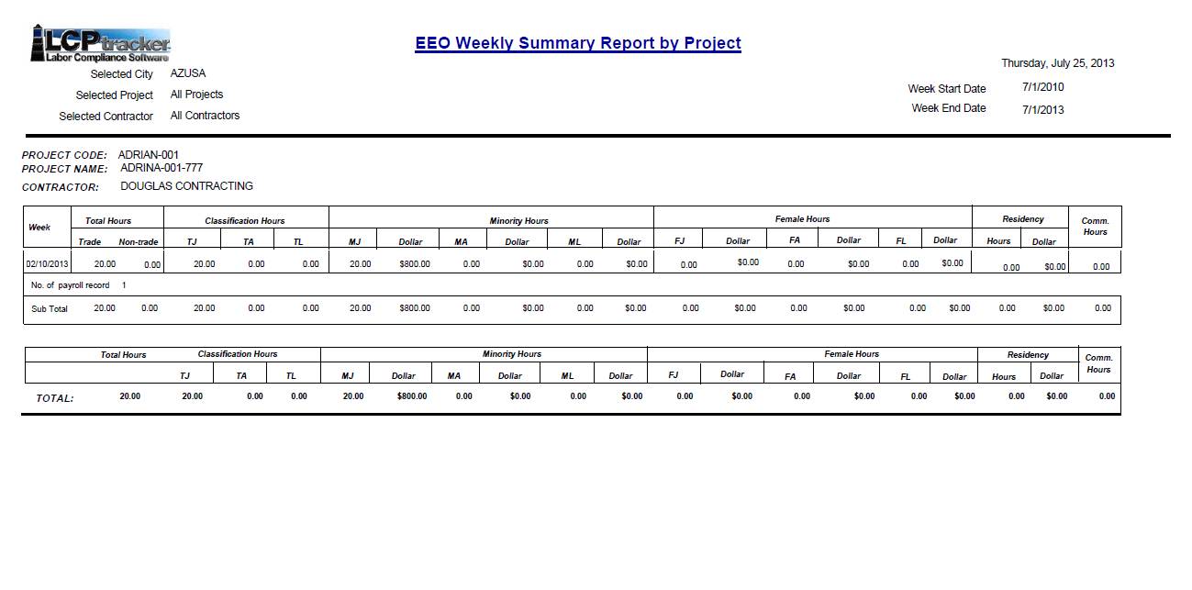
EEO Weekly Summary Report

Slide 19
Access to Systems
The request must come from a City employee
The request must identify if the person who needs access is a City employee or consultant
  First and Last name of User, Title, phone number, and email
If a consultant, what is the name of the company they work for, and provide the contract number
Who does the individual report to at the City (even if a City employee)
Purpose for utilizing the LCP Tracker System and/or C2
Contract/ PO Number that will be needed to be accessed in LCP Tracker and/or C2

Slide 20
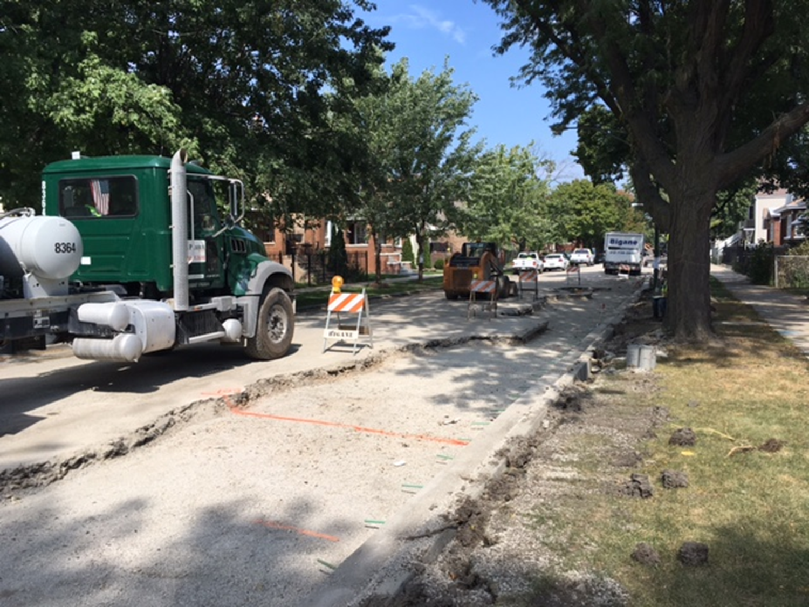
Field Analyst
Field Analyst: Jeffery Harris
Compliance
An extension of the Compliance Officers role with the focus on conducting site visits to physically observe and collect data on M/W/DBE Firms to ensure a Commercially Useful Function is being performed

Slide 21
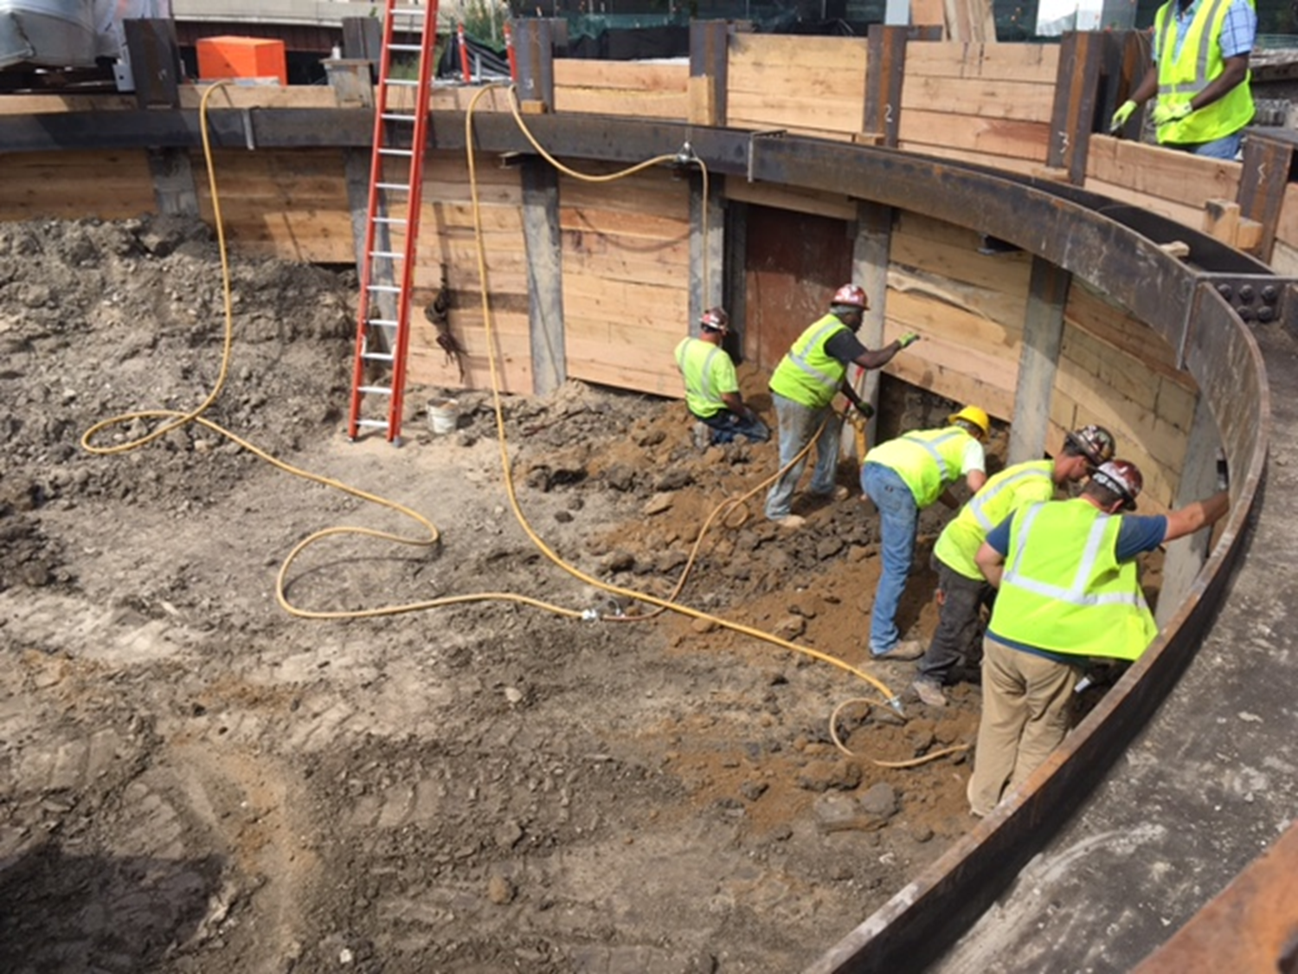
Site Visit Process Overview
Attend Pre-Construction Meetings
Prepare
Weekly Work Schedule
Review Award Criteria Determination
Attend Progress Meetings

Slide 22
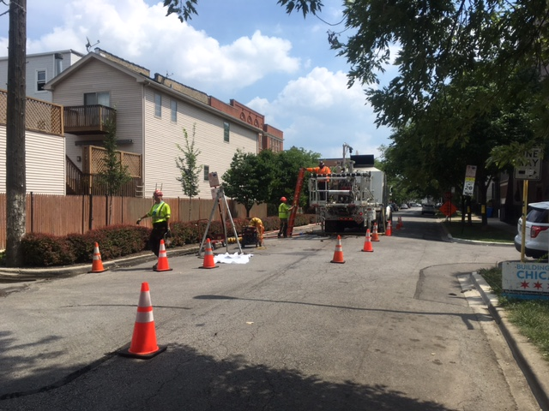
Site Visit Process
Pre-Construction Meetings
- Meet RE’s, PM’s and Construction Managers
- Review Contract Goals
- Review Scope of Work
Prepare Weekly Work Schedules
- Perform Announced and Unannounced Site Visits
- Based on Contractors performing onsite, how site progresses and Compliance request
Review Award Criteria
- Familiarize self with Contract Goals
- Review the Schedule D and Schedule C’s
- Identify data to collect (CRO/EEO Goals)
- CUF Reviews based on Contractors Observed
Progress Meeting
Obtain look ahead schedules
Collect job progress data
Discuss with Resident Engineers and Contractors

Slide 23
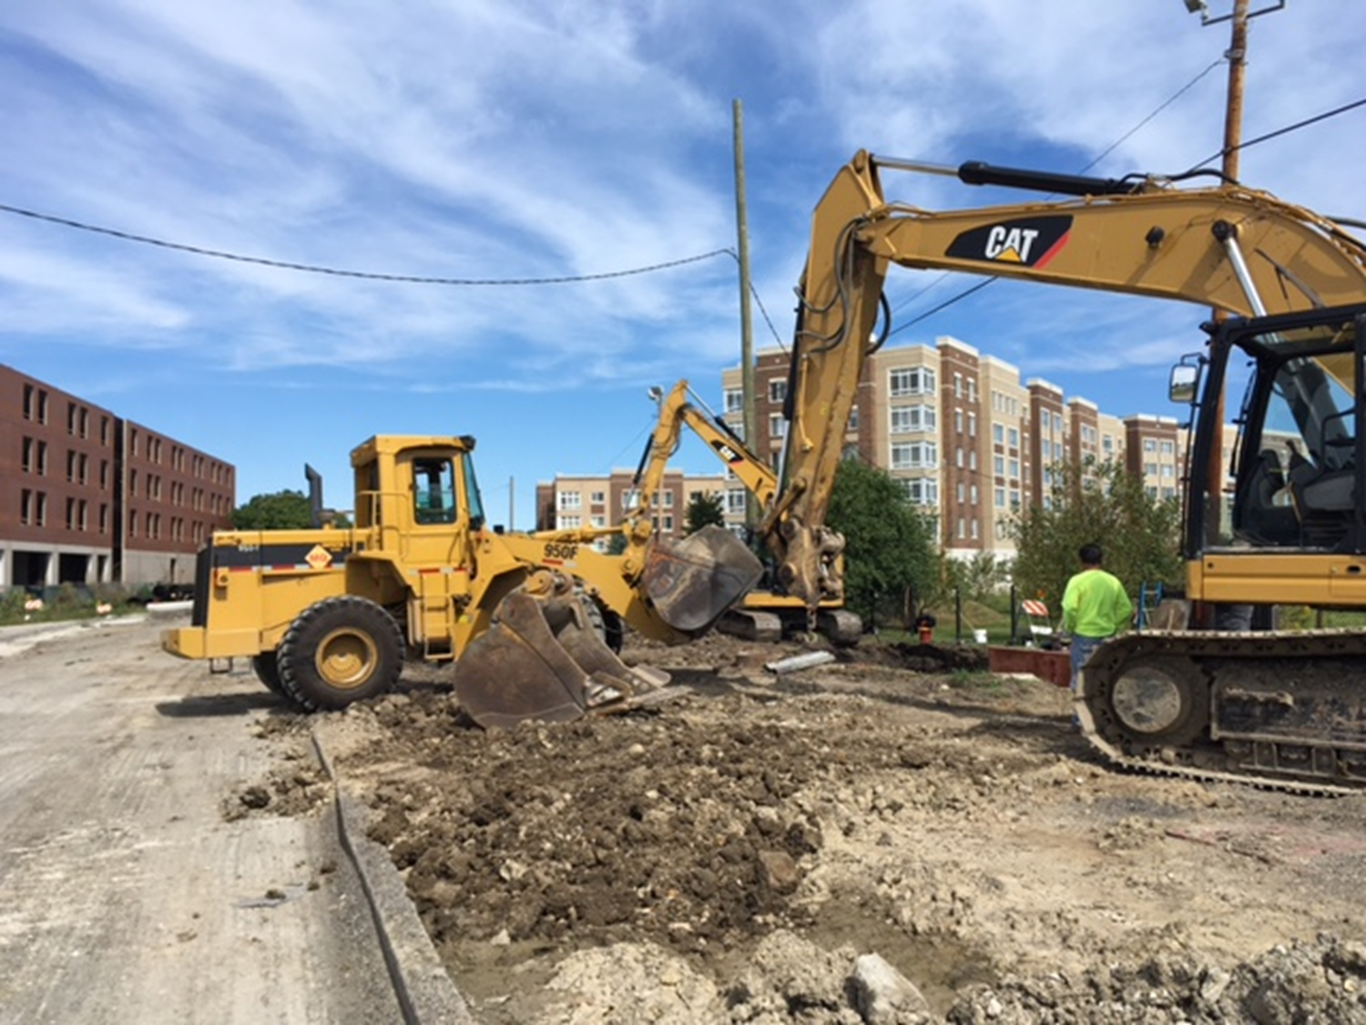
Site Visits
Contractor Inspection Reports
- Tally of workers onsite by gender, race, and trade
- Identify geographical area where work is being performed
- Identify Contractor(s)
Employee Interviews
- Verify information provided on inspection report
- Confirm name / address / trade / wages / employer
Commercially Useful Function Review
- Review Certified Firms Work
- Equipment used
- Managing / Supervising Employees
- Working within designated scope of work
Job Board Review
- State and Federal Equal Opportunity Laws
- Employee Rights / Davis Bacon
- OSHA Posters
- Are the posters visible????

Slide 24
Contract Closeout Overview
Final Quantities Received
Issue Final Letter and IOC
Compile Waivers (Partial / Full Waivers)
Review Good Faith Efforts
Request justification if Subcontractors not utilized
Issue Preliminary Letters if shortfalls identified
Review Payroll Summaries
(Total Hours / EEO / CRO / Local Residency

Slide 25


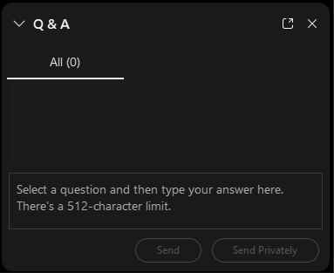
QUESTIONS?

Slide 26

Stay Informed
The Department of Procurement Services is committed to Communications and Outreach, which is key to keeping citizens informed of bid opportunities, new programs, and innovations.
We encourage you to follow us social media to stay informed. You can find us on LinkedIn, Facebook, Twitter, and YouTube.

Slide 27
We encourage you to visit the DPS table for additional resources and to ask any questions about doing business with the City.
You can also contact us anytime via email at DPS.Feedback@CityOfChicago.Org

