Slide 1
City of Chicago Toolkit

Slide 2
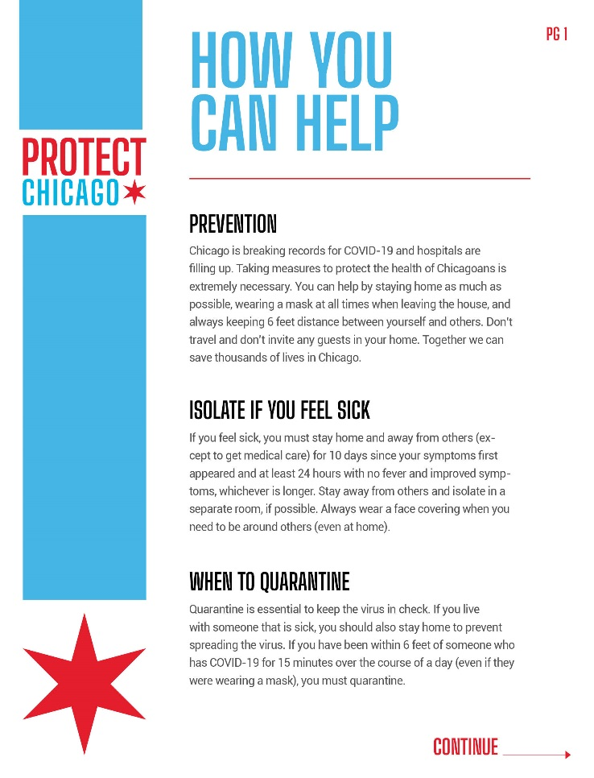
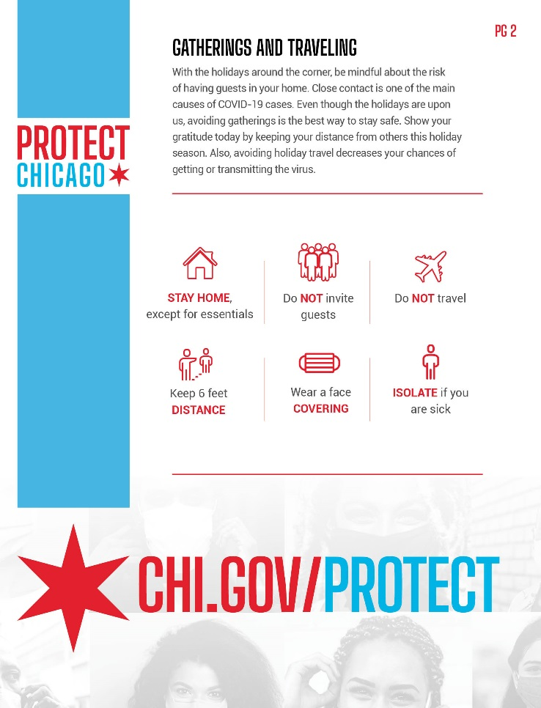
Flyer

Slide 3


Slide 4

Delete and add your logo here
Contact Number (000) 000-000

Slide 5
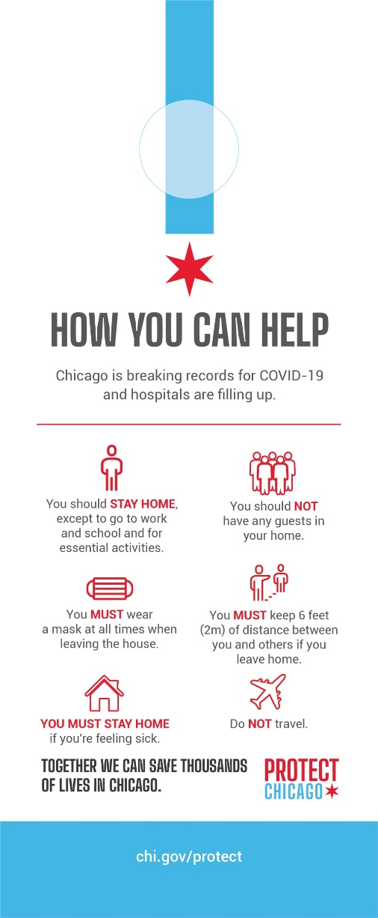

Slide 6
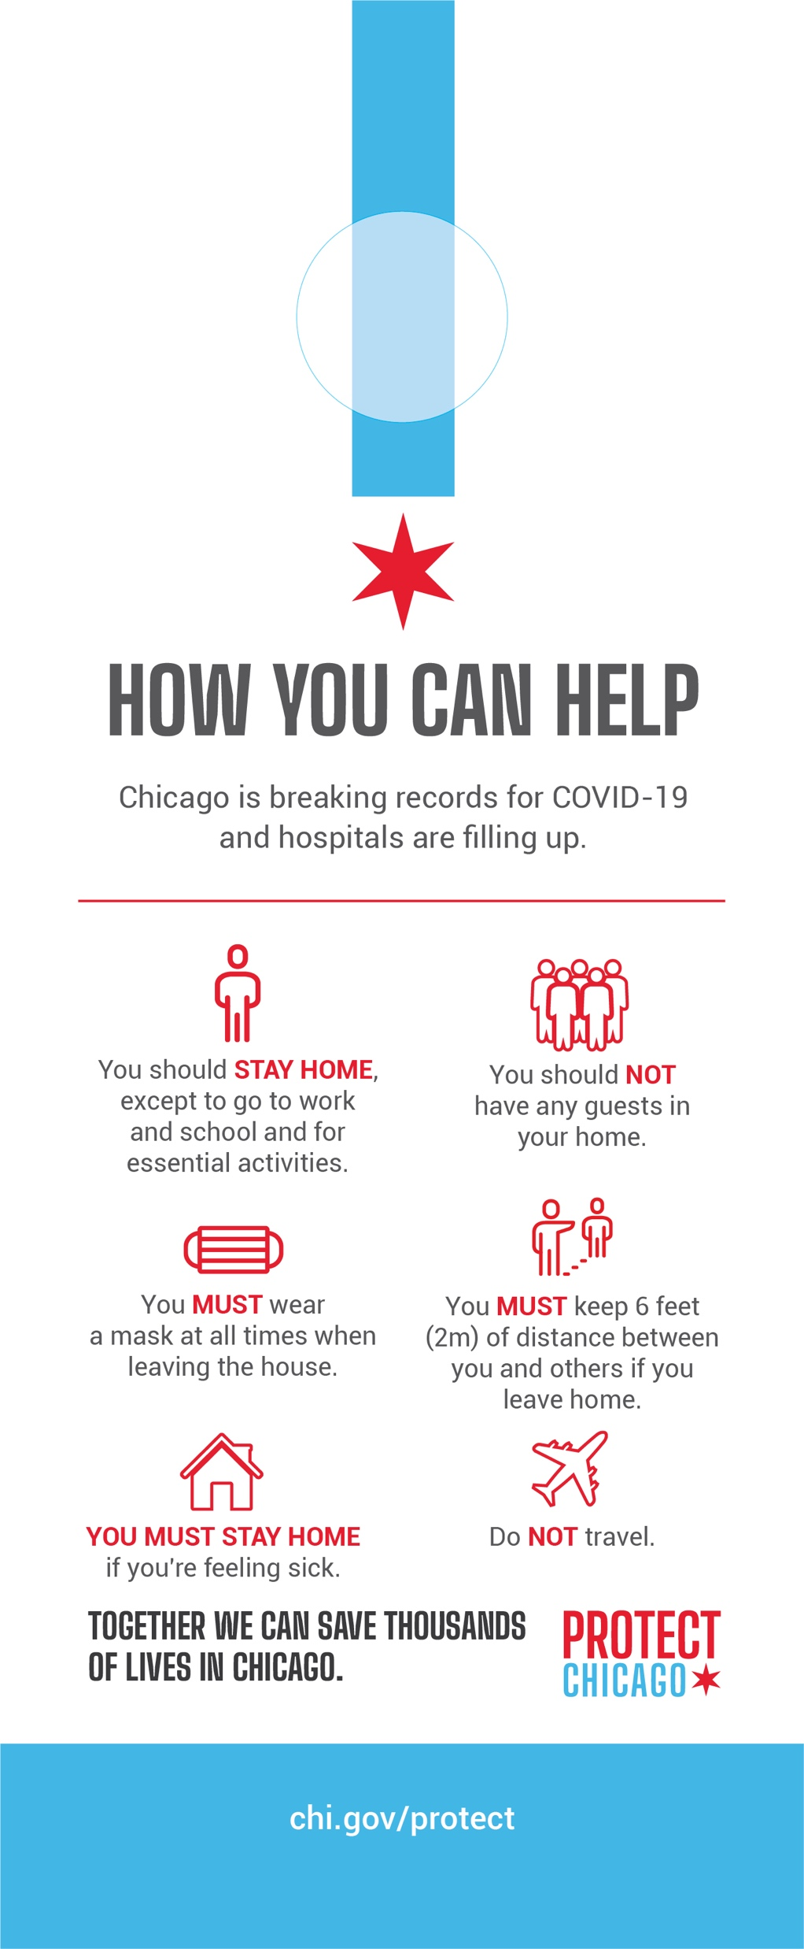
Delete and add your logo here
Number (000) 000-000

Slide 7
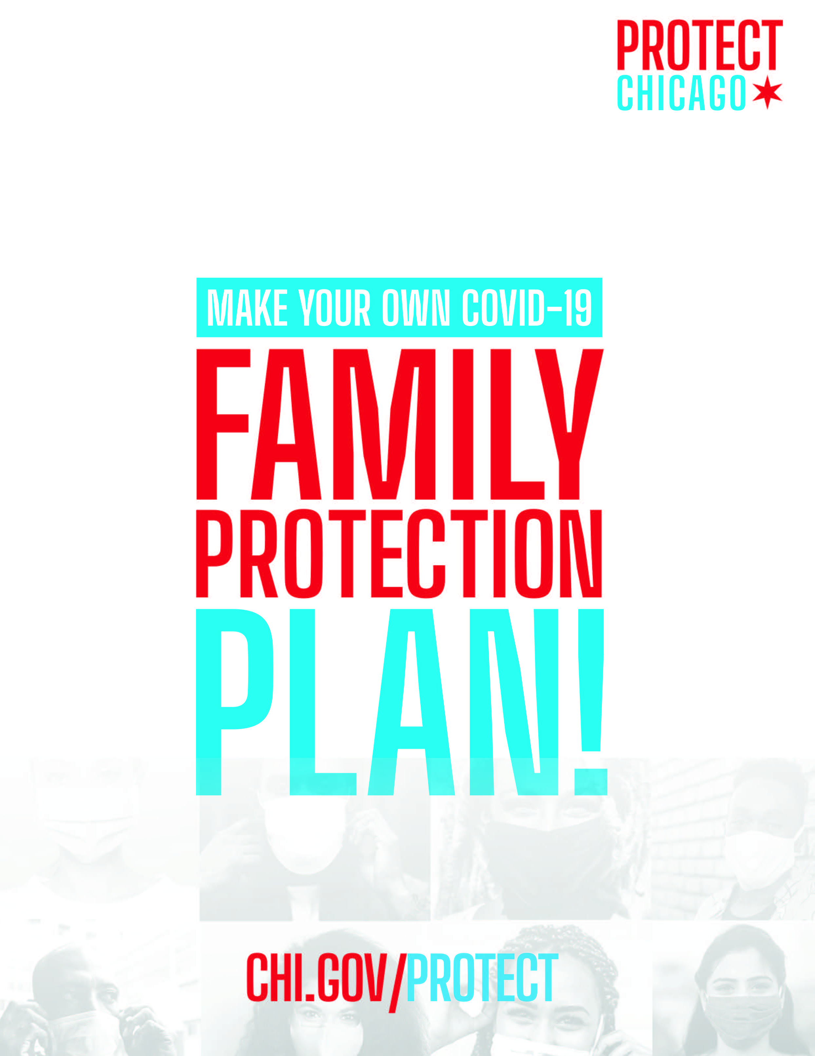
Delete and add your logo here
Number (000) 000-000

Slide 8
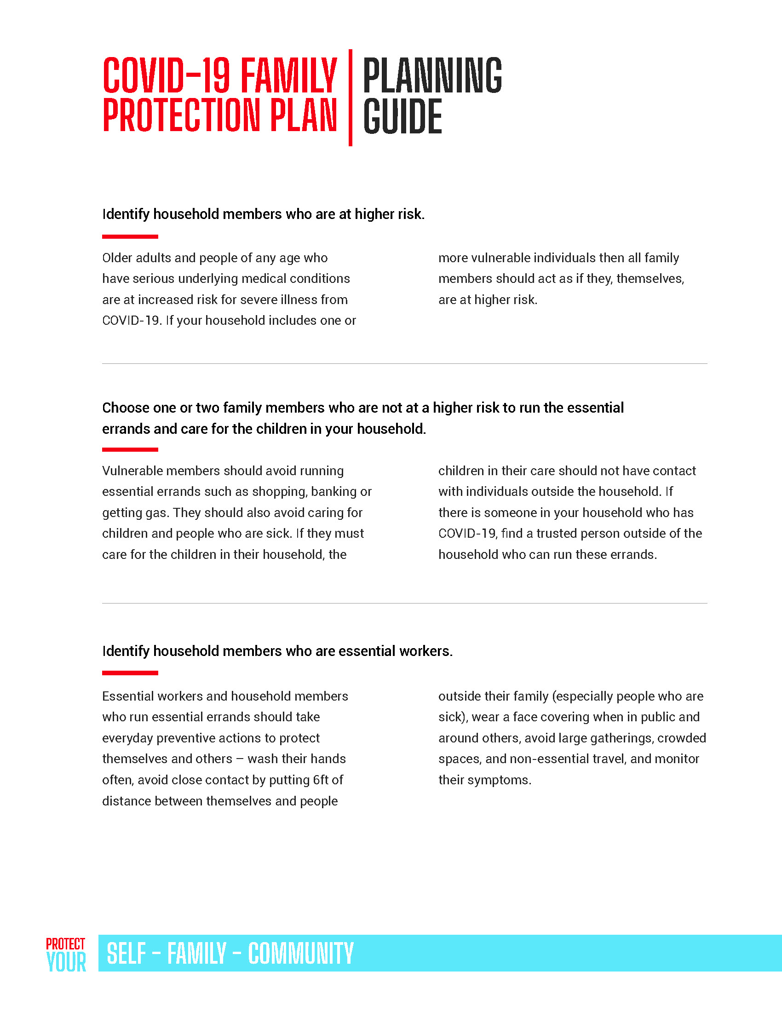
Number (000) 000-000

Slide 9
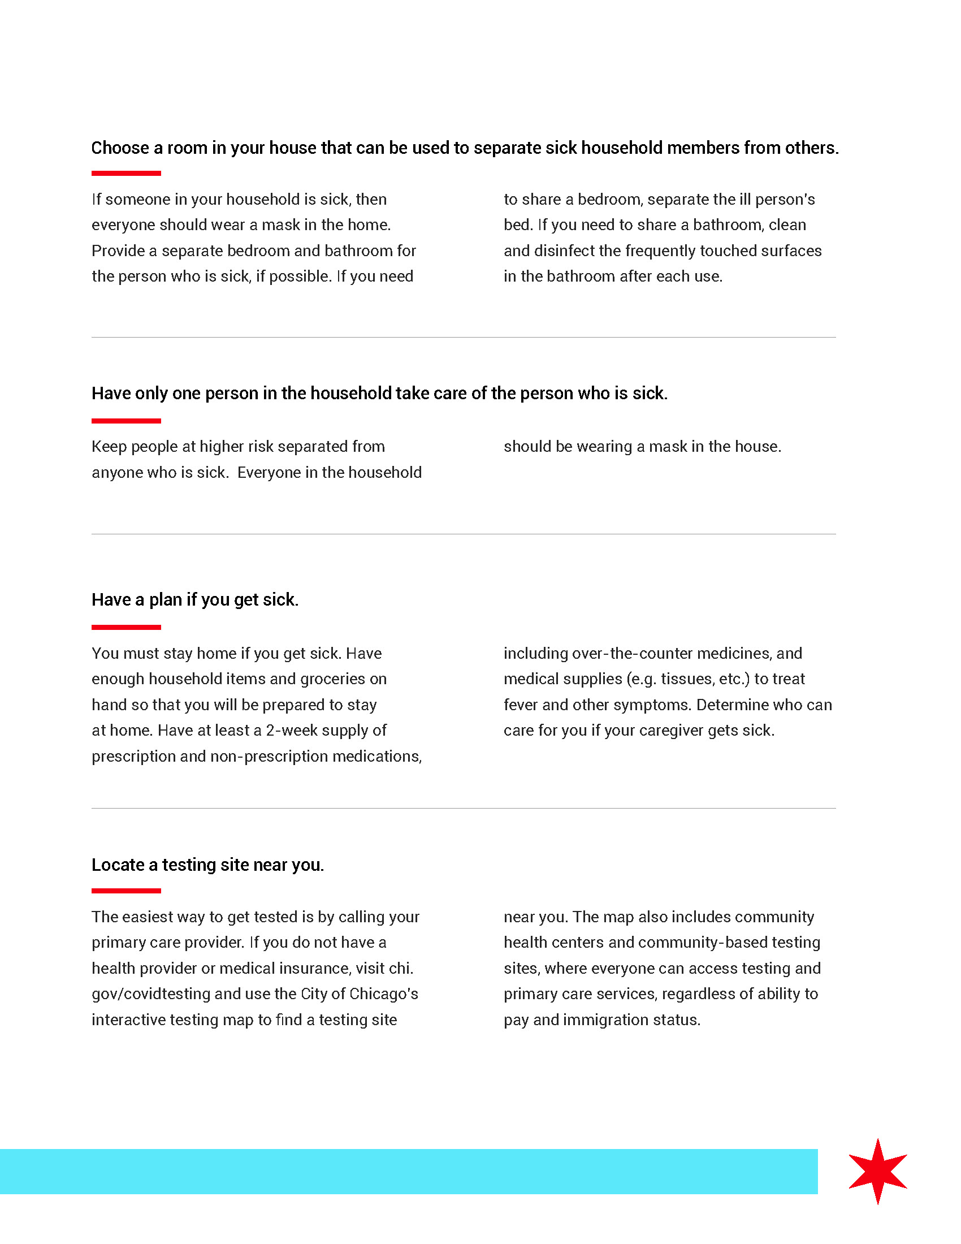
Number (000) 000-000

Slide 10
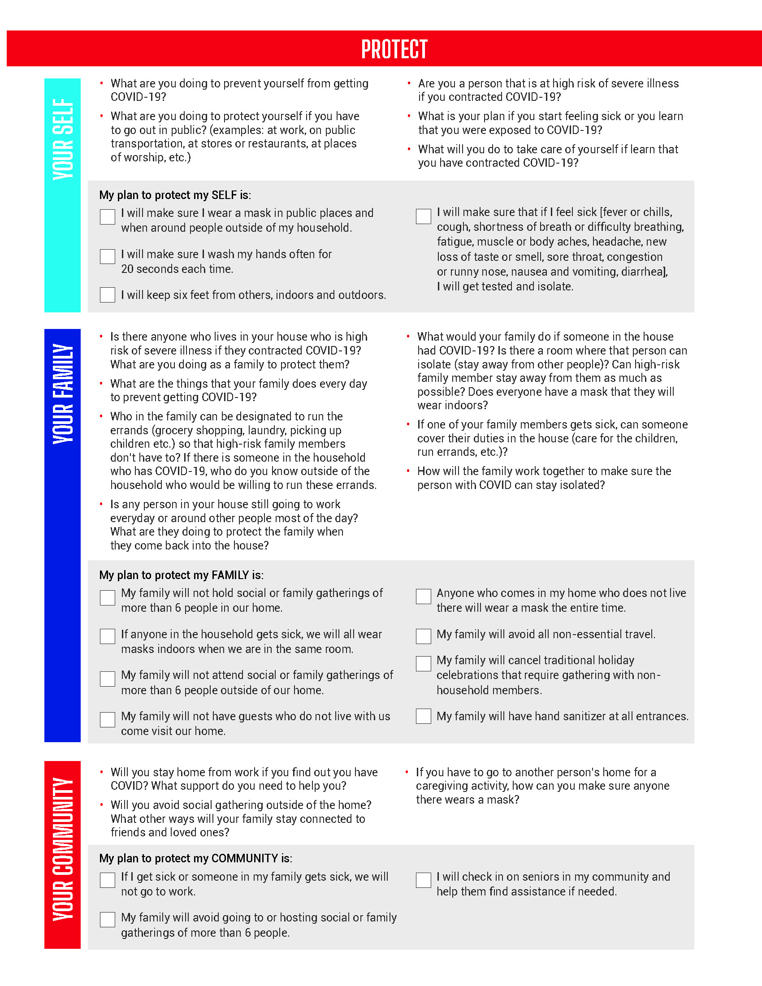
Number (000) 000-000

