Slide 1
Gear Up Get Ready:
Being Prepared To Help Yourself
Insert Organization
Presentation Date

Slide 2
Welcome and Agenda
[insert agenda]

Slide 3
Housekeeping
Restrooms
Smoking policy
Cell phone policy (silent mode)
Emergency exits

Slide 4
Do you really need to be ready?
In the midst of day-to-day activities, most do not remember that we live in a weather prone country and region.
Annually, Americans cope with an average of 10,000 thunderstorms, 2,500 floods, 1,000 tornadoes, and an average of six deadly hurricanes, on average.
In addition, there are other emergencies that happen on a more frequent basis, like house fires and incidences in our schools.
Most do not take any action until AFTER these events impact their households.

Slide 5
Being ready makes a difference
http://www.fema.gov/medialibrary/media_records/6809

Slide 6
Being ready makes a difference
Preparedness gives individuals and households the tools to help themselves.
Preparedness reduces stress and anxiety during and following disasters.
Preparedness minimizes the impact to families.
Preparedness reduces the burden to the community / first responders.

Slide 7
Take the first step: complete your emergency card
The emergency card should be completed for all members of the household.
Emergency cards should be kept in wallets / backpacks / purses.
It includes a local emergency contact name, out of town contact name, neighborhood meeting place.
Additional information may include the name of doctors, telephone number of employers, or other relevant information.

Slide 8
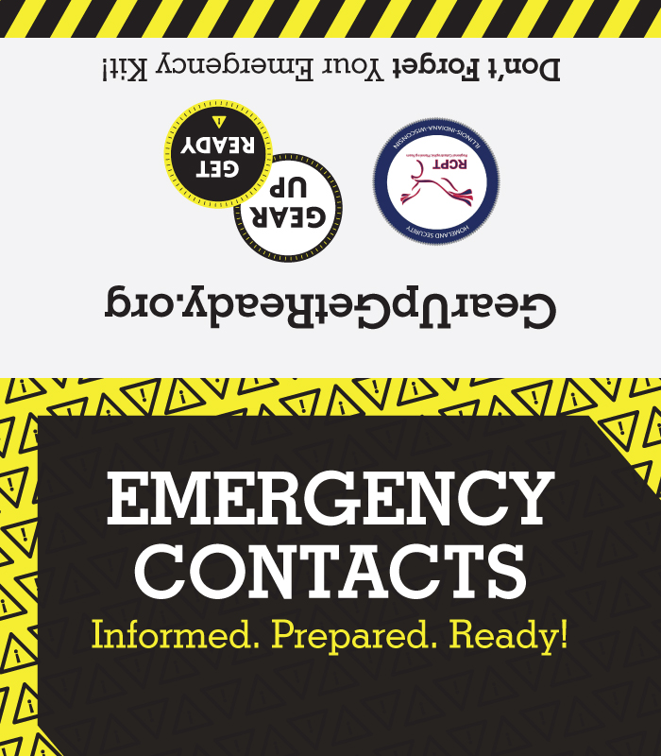
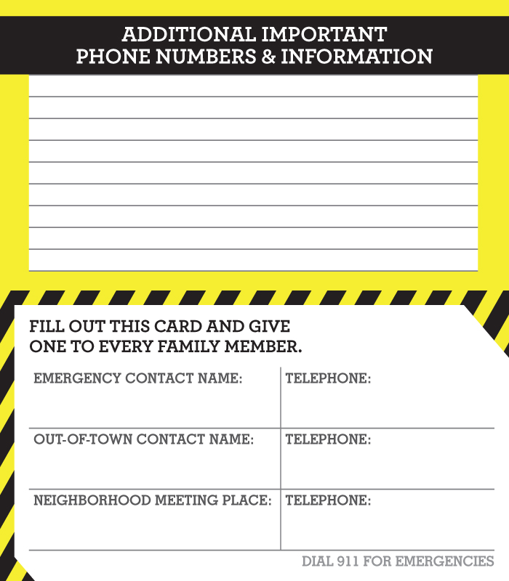

Slide 9
Take the next step: complete your family plan
The family emergency plan contains more detailed information than the emergency card.
This includes telephone numbers, social security information and medical information for EACH member of the family.
It contains detailed information about insurance, physicians, workplaces, and other important locations (neighbors homes or after-school activities).

Slide 10
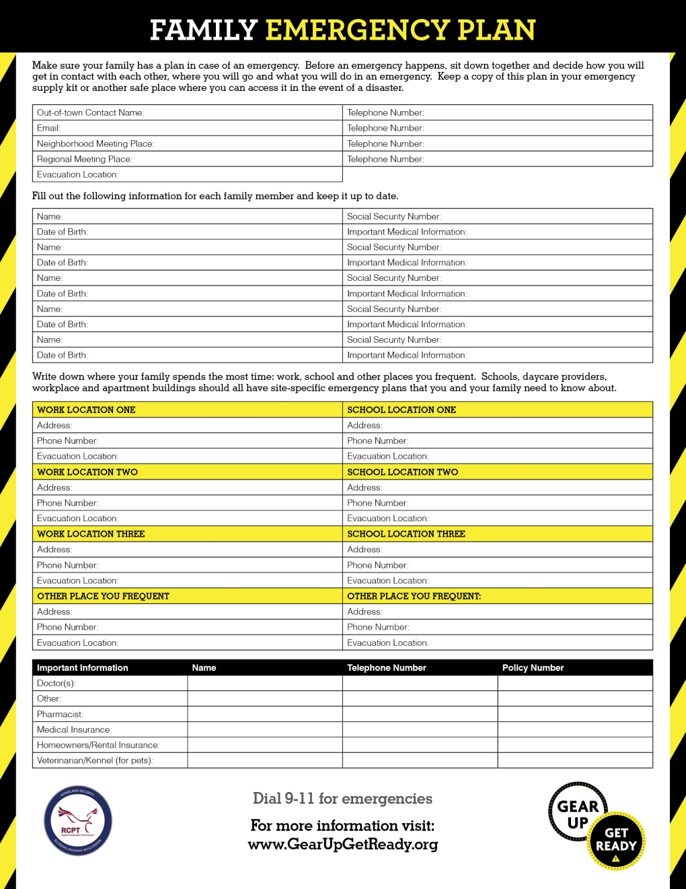

Slide 11
Develop a kit for your family – basics
Bottled water and non-perishable food – per person, per day for at least 3 days
NOAA Radio
Can Opener
Flashlight and batteries
Personal hygiene items
First aid kit
Whistle
Copies of important documents
Blankets / towels
Change of clothing
Durable container
You have most of these items around your house – collect them in one place!

Slide 12
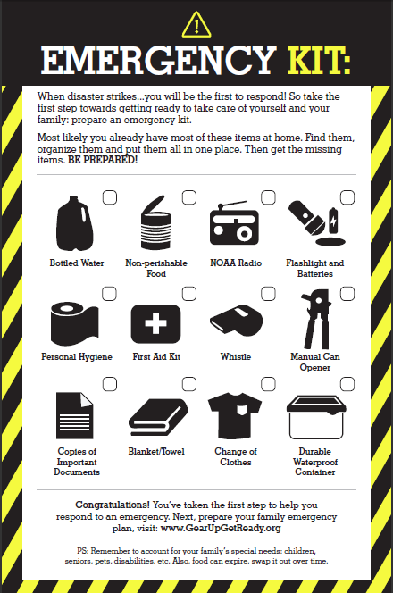

Slide 13
Develop a kit for your family
Remember to account for the unique needs of your family.
Special considerations may include:
  Medical supplies, including extra prescriptions for medications taken daily.
  Cash or traveler’s checks.
  Food (formula, baby-food) and toys for children.

Slide 14
Additional Kit Types
In addition to having these items at home, you may want to consider:
  Creating a light-weight version of the kit (i.e. Go Kit) in a sturdy backpack to allow you to evacuate easily.
  Storing food, water, and supplies at your office (i.e. Work Kit). This may include a comfortable change of clothing and a sturdy pair of shoes.
  Keeping emergency supplies in your car (i.e. Car Kit) including food items, jumper cables, warm clothing / sleeping bags, and kitty litter for tire traction.

Slide 15
Questions
Do you have any questions about anything covered in this module?

Slide 16
Gear Up Get Ready:
Preparedness for Seniors
Insert Organization
Presentation Date

Slide 17
Agenda
[Insert agenda]
Notes:
Course Instructors
If the general emergency preparedness slides have not been employed in the training, insert an agenda slide appropriate to the training.
Welcome the participants to the training.
Provide a summary overview of the agenda.
Introduce yourself and provide some background information about your past experiences.
Ask other instructors to introduce themselves in the same way. Consider asking:
The participant’s name;
The participant’s organization;
The participant’s role or title; and
Why the participant is taking the course.

Slide 18
Housekeeping
Restrooms
Smoking policy
Cell phone policy (silent mode)
Emergency exits

Slide 19
The Importance of Senior Preparedness
Disasters can have a more severe impact on seniors who may have health needs or mobility constraints.
  Power failures may cut off oxygen supplies.
  Homebound seniors may not be able to evacuate when flood waters rise.
  Walking aids may be necessary to walk down stairs.
These challenges mean seniors may need to take additional steps to be ready and remain safe.

Slide 20
Additional Preparedness Items for Seniors
Consider storing your emergency kit in an easy to transport container, such as a cart with wheels.
Label any equipment, such as wheelchairs, canes or walkers, that you would need with your name, address and phone numbers.
Talk to your doctor to and ensure that your kit contains an additional supply of necessary medications.
Make sure your kit contains important documents, such as information about your doctors and copies of prescriptions, deeds or leases, birth certificates and insurance policies.

Slide 21
Additional Preparedness Actions for Seniors
Post emergency numbers near your phones, including those for transportation providers, doctors, and local / out-of-area contacts.
Keep necessary items, such as wheelchairs and walkers, in a designated place so they can be found and accessed quickly.
Keep necessary tools like hearing aids in a safe and accessible place close to your bed.

Slide 22
Evacuation Tips for Seniors
Try to make arrangements to evacuate before an incident. This includes how you will evacuate, specifically if you need additional resources (i.e. paratransit) to evacuate.
Contact your local emergency management agency for tips on how to evacuate, or to register for additional assistance.
If you are instructed to evacuate, try to carpool and use routes specified by local officials.

Slide 23
Questions
Do you have any questions about anything covered in this module?

Slide 24
Gear Up Get Ready:
Preparedness for Persons with Disabilities
Insert Organization
Presentation Date

Slide 25
Agenda
[insert agenda]
Notes:
Course Instructors
If the general emergency preparedness slides have not been employed in the training, insert an agenda slide appropriate to the training.
Welcome the participants to the training.
Provide a summary overview of the agenda.
Introduce yourself and provide some background information about your past experiences.
Ask other instructors to introduce themselves in the same way. Consider asking:
The participant’s name;
The participant’s organization;
The participant’s role or title; and
Why the participant is taking the course.

Slide 26
Housekeeping
Restrooms
Smoking policy
Cell phone policy (silent mode)
Emergency exits

Slide 27
The Importance of Preparedness for Persons with Disabilities
Disasters can have a more severe impact on persons with disabilities.
  Individuals with limited hearing may not receive warning signals.
  Individuals in wheelchairs may need transit assistance when evacuating.
  Assistive products may not be left behind in an emergency.
These challenges mean persons with disabilities may need to take additional steps to be ready and remain safe.

Slide 28
Complete a Personal Assessment
In order to better prepare for disasters, individuals with disabilities or caretakers should engage in a personal assessment.
Considerations should include:
  Personal care: What type of assistance is necessary to bathe, groom, and dress?
  Utilities: What utilities are necessary to the individual and what will the individual do if those utilities are not available?

Slide 29
Complete a Personal Assessment
Considerations should include (continued):
  Equipment: What equipment is used on a day to day basis? This includes personal care equipment, mobility equipment, and feeding equipment.
  Transportation: What equipment or resources are necessary to facilitate transportation?
  Service Animals / Pets: What resources are necessary to care for service animals or pets?

Slide 30
Additional Considerations for Individuals with Disabilities
Ensure that your emergency plan includes contact information for your network. This goes beyond local and out-of-area contacts and should include caregivers or others who provide regular support.
Understand and document escape routes from your home, in case your home becomes unsafe. Account for your specific needs in these routes.
Plan for work-arounds in case utilities or day-to-day equipment are not functional. For example, have a manual wheelchair for backup if an electric wheelchair is used on a day-to-day basis.

Slide 31
Additional Considerations for Individuals with Disabilities
Talk to your local emergency management about ways that you can receive emergency notifications that are meet your unique needs.
Talk to your apartment building about marking accessible emergency exits and notifications in the building to help meet your needs.
Ensure that your emergency supply kit contains the resources you need, including medicines or backup equipment.
Always follow the recommendations of local officials regarding evacuation routes and ways to stay safe.

Slide 32
Additional Considerations for Individuals with Disabilities
Communicate your emergency plan with your personal network.
Ensure members of your personal network know where equipment you may need is located, and how it can be moved or operated.
Contact local officials regarding registrations or notification lists where you can register to receive assistance.
Notes:
Course Instructors
Emphasize that those around you, including neighbors, caregivers, and family can provide additional help during an emergency.
Emphasize the importance of communicating the plan and any additional needs to these individuals to help ensure that needs are being met.

Slide 33
Questions
Do you have any questions about anything covered in this module?

Slide 34
Gear Up Get Ready:
Preparedness for Pet Owners
Insert Organization
Presentation Date

Slide 35
Agenda
[insert agenda]

Slide 36
Housekeeping
Restrooms
Smoking policy
Cell phone policy (silent mode)
Emergency exits

Slide 37
The Importance of Preparedness for Pets
Household pets can also be impacted by a disaster.
  It may not be safe for pets to go outside for sanitation.
  An emergency may happen when you are away from your home, or when it is difficult to get back to your home.
These challenges mean families with pets may need to take additional steps to be ready and remain safe.

Slide 38
Basic Preparedness for Pets
Make sure that your pets have an ID and that it is up-to-date.
Have a copy of your pet’s rabies certificate, and ensure up-to-date tags are on your pet’s collar.
Include pet food, medication, and hygiene items (such as a litter box) for your pet in your disaster supply kit. Include contact information for your pet’s vet.
Include pet transportation supplies (harness, carrier) in your kit.

Slide 39
Plan for your Pet to Have a Safe Place
Identify hotels / kennels / friends and relatives who may help keep your pet safe during an emergency.
Plan for how you will evacuate with your pet.
Plan for how your pet will be kept safe during a storm or disaster. This includes planning for how you will keep your pet safe if hazards remain outside for a significant duration of time.

Slide 40
Additional Considerations for Pet Preparedness
If you can’t get to your pet, identify how a family member, neighbor, or other trusted individual can access or help take care of your pet.
Place a sticker in your window identifying the number and type of pets in your home and key contact information for emergency responders.
Keep a recent photo of your pet in your kit in case you and your pet are separated.

Slide 41
Questions
Do you have any questions about anything covered in this module?

Slide 42
Gear Up Get Ready:
Additional Resources
Insert Organization
Presentation Date

Slide 43
Warning Systems
Emergency Alert Systems
Sirens
Phone calls
NOAA Weather Radio
Social Media
In an emergency, always listen to what local emergency management tells you to do

Slide 44
Local Hazards
Earthquake
Extreme Heat
Floods
Fire
Food Borne Illness
Pandemic Influenza
Winter Storms
Thunderstorms
Tornadoes
Active Shooter
Chemical and Hazardous Materials
Cyber
Nuclear Power Plant
Terrorism

Slide 45
Get Ready for a Terrorist Attack
Terrorism is the unlawful use of force or violence by a person or group. The goal is to intimidate or coerce societies or governments.
By planning how to respond to a terrorist attack, you can greatly improve your chances of survival.
Biological | The deliberate release of germs or other harmful substances that can cause illness
Chemical | The deliberate release of toxic gases, liquids, or solids that can poison people and the environment
Radiation | The spread of harmful radiation through an explosion such as a “dirty bomb”
Nuclear | The deliberate detonation of a nuclear device resulting in intense light, heat, radiation, and collateral damage
Explosive | The use of explosions to cause mortal injury or destruction of property

Slide 46

Get Ready for a Terrorist Attack
Stay or go?
  If you are advised by local officials to shelter in place, remain inside your home or office and protect yourself there.
  If you are advised to evacuate, do so immediately. Don’t forget to lock your home and take your pets with you.
Important activities
  If you see something, say something!
  If you receive a bomb threat, try to get as much information from the caller as possible. Call 911 and report it to the police immediately.
  Be wary of suspicious packages and letters. Be particularly cautious of parcels that:
    Have no return address or a return address that can’t be verified as legitimate.
    Show a city or state in the postmark that doesn’t match the return address.
    Are not addressed to a specific person.
    Have hand-written or poorly typed addresses

Slide 47
Additional Information – General Population
FEMA (www.ready.gov)
State Emergency Management Agency
Local Emergency Management Agency
American Red Cross (www.redcross.org)
Gear Up, Get Ready! (www.gearupgetready.org)
If You See Something, Say Something (http://www.dhs.gov/if-you-see-something-say-something)

Slide 48
Additional Information – Disabilities / Access and Functional Needs populations
The National Organization on Disability’s Disaster Readiness Tips for People with Disabilities (http://nod.org/assets/downloads/Readiness-Tips-Disabilities.pdf)
American Red Cross: Preparing for Disasters for People with Disabilities and Other Special Needs. (http://www.redcross.org/images/MEDIA_CustomProductCatalog/m4240199_A4497.pdf)

Slide 49
Additional Information – Seniors
American Red Cross: Disaster Preparedness, For Seniors, By Seniors (http://www.redcross.org/images/MEDIA_CustomProductCatalog/m4640086_Disaster_Preparedness_for_Srs-English.revised_7-09.pdf)
Centers for Disease Control: Emergency Preparedness for Older Adults (http://www.cdc.gov/aging/emergency/preparedness.htm)

Slide 50
Additional information – Pet Owners
American Society for the Prevention of Cruelty to Animals Disaster Preparedness (http://www.aspca.org/pet-care/disaster-preparedness/)
Humane Society: Make a Disaster Plan for Pets (http://www.humanesociety.org/issues/animal_rescue/tips/pets-disaster.html)

Slide 51
Get involved
Take action in your neighborhood – if you have an elderly neighbor or a neighbor with a disability, talk to them about their preparedness and how you can help.
Take Community Emergency Response Team training or other training offered by your jurisdiction.
Take CPR Training or first-aid training.
Identify how to get involved in your community, faith-based organization, or service organization.

Slide 52
Questions
Do you have any questions about anything covered in this module?
Notes:
Course Instructors
Remember on the last slide to provide your contact information and relevant contact information for individuals in our community, such as the local emergency management agency.

