Slide 1
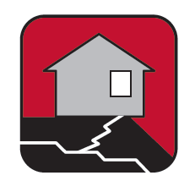
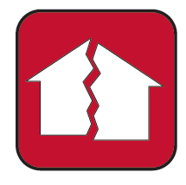
Get Ready for an Earthquake
Earthquakes are the sudden, rapid shaking of the earth caused by the breaking and shifting of rock deep underground
Including Illinois, Indiana, and Wisconsin, there are 45 states and territories in the US at moderate to high risk for earthquakes
Most deaths and injuries occur by falling objects and debris or when buildings collapse
Aftershock | An earthquake of similar or lesser intensity that follows the main earthquake.
Fault | The break in the earth’s crust which moves during an earthquake. The movement may range from less than an inch to more than 10 yards
Epicenter | The place on the earth’s surface where the earthquake rupture began.
Seismic Waves | Vibrations that travel outward from the earthquake fault at speeds of several miles per second.
Magnitude | The amount of energy released during an earthquake, which is computed from the amplitude of the seismic waves.
Notes:
An earthquake is the sudden, rapid shaking of the earth caused by the breaking and shifting of rock deep underground.
Earthquakes can happen.
Know more about earthquakes by understanding the basic terms used to describe them…
Important activities: Proper insurance - Homeowners and renters insurance are great solutions to and your family from the cost of repairs and replacing your belongings.

Slide 2
Get Ready for an Earthquake
Stay or go?
  The best action for you and your family will typically be to shelter in place.
  Remain calm, stop and take cover from falling debris.
  After the earthquake, remain aware of aftershocks and look for hazards like broken glass, fallen trees or downed power lines before you move from your location.
Important Activities
  Properly insure your home and belongings.
  Properly secure breakable objects and hang picture frames or heavy items away from beds, couches, and anywhere people sit.
  Locate safe spots in each room and take cover under a sturdy table or against an inside wall.
  Hold earthquake drills with your family members so everyone knows what to do.
Notes:
An earthquake is the sudden, rapid shaking of the earth caused by the breaking and shifting of rock deep underground.
Earthquakes can happen.
Know more about earthquakes by understanding the basic terms used to describe them…
Important activities: Proper insurance - Homeowners and renters insurance are great solutions to and your family from the cost of repairs and replacing your belongings.

Slide 3
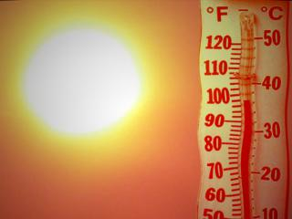
Get Ready for Extreme Heat
Heat is the number one weather-related killer in the United States.
Heat kills by pushing the human body beyond its limits and makes the body work extra hard to maintain a normal temperature.
Your best defense against heat-related illnesses is prevention.
Recognize the Symptoms of Heat-Related Illnesses
  Heat Exhaustion:
    Heavy sweating
    Fainting
    Dizziness
    Pale skin
    Headaches
    Muscle cramps
  Heat Stroke:
    High temperature of 103°F+
    Hot, red, dry skin
    Rapid pulse, weak or strong
    No sweating
    Dizziness, nausea and confusion
    Possibly unconscious
Notes:
Extreme heat is the number-one weather killer in Wisconsin with 116 directly-related deaths from 1982-2010. WI had an an additional 95 indirectly-related fatalities from 1982-2010 from heat
You can be prepared by knowing the symptoms of heat disorders and overexposure to the sun, staying hydrated and being ready to give first aid treatment. Heat stroke and heat exhaustion are two common problems
Higher risk from poor air quality: People living in urban areas may be at greater risk from the effects of a prolonged heat wave than those living in rural areas.

Slide 4
Get Ready for Extreme Heat
Ways to be prepared for extreme heat:
Drink plenty of water.
Install window air conditioners snugly and check air conditioning ducts for proper insulation.
Install temporary window reflectors for use between windows and drapes to reflect heat back outside.
Weather-strip doors and sills to keep cool air in.
Cover windows that receive morning or afternoon sun.
Keep storm windows up all year.
Check on family, friends, and neighbors who are alone and do not have air conditioning, especially those 65 years of age or older.
Is your family at higher risk?
Conditions that can increase risk include old age, obesity, fever, dehydration, heart disease, poor circulation and sunburn.
Heat-related illnesses can be induced by poor air quality and little to no air circulation.
Notes:
Extreme heat is the number-one weather killer in Wisconsin with 116 directly-related deaths from 1982-2010. WI had an an additional 95 indirectly-related fatalities from 1982-2010 from heat
You can be prepared by knowing the symptoms of heat disorders and overexposure to the sun, staying hydrated and being ready to give first aid treatment. Heat stroke and heat exhaustion are two common problems
Higher risk from poor air quality: People living in urban areas may be at greater risk from the effects of a prolonged heat wave than those living in rural areas.

Slide 5
Get Ready for a Flood
Floods are one of the most common hazards in the U.S.
Not all floods are the same.
Stay or go?
  If you are not evacuating, plan for moving essential items to an upper floor and sticking to higher ground.
  If you are advised to evacuate, do so immediately. Evacuation is
  simple and safer before the flood waters rise.
  Have your evacuation plan, and follow recommended routes.
Flood Watch | Flooding is possible
Flash Flood Watch | Flash flooding is possible. Be prepared to move to higher ground
Flood Warning | Flooding is occurring or will occur soon; if advised to evacuate, do so immediately
Flash Flood Warning | A flash flood is occurring; seek higher ground on foot immediately
Notes:
Floods can happen - For example, since 1981, 99 of the 102 counties in Illinois have been declared major disaster areas by the President due to flooding
Know more about floods – not all floods are the same: Not all floods are alike. Some floods develop slowly - often times over a period of days. Flash floods can develop quickly, sometimes in a matter of minutes and without any visible signs of rain. Flash floods often have a dangerous wall of roaring water that carries rocks, mud and other debris, sweeping away most things in its path.
Helpful equipment: Building materials can help you and your household prepare for a flood if you live in an area that is flood prone.
Important activities: Most homeowner and renter policies do not cover flood damage, but info can be accessed through the National Flood Insurance Program (NFIP).

Slide 6
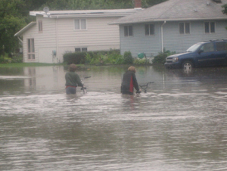
Get Ready for a Flood
Helpful Equipment
The following materials can help you construct
barriers to stop floodwater from entering your home:
  Plastic sheeting
  Lumber
  Nails
  Hammer
  Saw
  Shovels
  Sandbags
Important activities
Find out if you live in a flood-prone area by visiting www.floodsmart.gov
Know if your property is above or below the flood stage water level
As your insurance agent about flood insurance.
Raise items in basements and ground level to upper floors or higher off the ground to prevent damage from floodwaters
Notes:
Floods can happen - For example, since 1981, 99 of the 102 counties in Illinois have been declared major disaster areas by the President due to flooding
Know more about floods – not all floods are the same: Not all floods are alike. Some floods develop slowly - often times over a period of days. Flash floods can develop quickly, sometimes in a matter of minutes and without any visible signs of rain. Flash floods often have a dangerous wall of roaring water that carries rocks, mud and other debris, sweeping away most things in its path.
Helpful equipment: Building materials can help you and your household prepare for a flood if you live in an area that is flood prone.
Important activities: Most homeowner and renter policies do not cover flood damage, but info can be accessed through the National Flood Insurance Program (NFIP).

Slide 7

Get Ready for a Fire
Fire Basics:
Fires affect thousands of Americans and cause billions of dollars in damage every year.
Fires can be particularly deadly because they spread so quickly
Suffocation is the leading cause of fire-related deaths
Make a Fire Escape Plan
Make sure all family members know what to do in case of a fire.
Practice feeling the door before opening it. If the door is hot, get out another way.
Draw a floor plan with at least two escape routes from every room of your home.
Select a location outside your home where everyone will meet after escaping.
Practice your escape plan at least once a month.
Notes:
Fires are deadly: Fire can be life threatening in two minutes and can engulf a residence in as little as five minutes
Fire deaths from suffocation from lack of oxygen outnumbers burn deaths, 3 to 1. As fires burn, poisonous gases are emitted that can cause you to become disoriented or drowsy.

Slide 8
Get Ready for a Fire
To help keep your home safe:
Install a smoke alarm inside each sleeping area and on each level of your home.
  Test each smoke alarm once a month and replace bad batteries immediately.
  Regularly replace batteries – consider using daylight savings as a reminder to do so.
  Replace smoke alarms every 10 years.
Sleep with the doors closed to slow the spread of the fire.
Keep one or more working fire extinguishers in your home and know how to use them.
Never leave something cooking on the stove unattended.
Keep matches and lighters safely out of reach of children.
Place heaters at least three feet away from flammable material.
Do not overload outlets or extension cords.
Make sure your home’s address can be clearly seen from the street.
Notes:
Fires are deadly: Fire can be life threatening in two minutes and can engulf a residence in as little as five minutes
Fire deaths from suffocation from lack of oxygen outnumbers burn deaths, 3 to 1. As fires burn, poisonous gases are emitted that can cause you to become disoriented or drowsy.

Slide 9
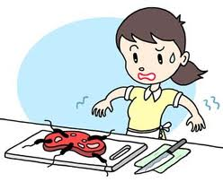
Get Ready for
Foodborne Illness
Food poisoning is any illness resulting from the consumption of contaminated food, pathogenic bacteria, viruses, or parasites that contaminate food.
48 million people (1 in 6 Americans) in the U.S. get sick from contaminated food annually.
Common symptoms range from mild to serious and they include:
  Upset stomach
  Abdominal cramps
  Nausea and vomiting
  Diarrhea
  Fever
  Dehydration
Some things that can contribute to foodborne illness are:
  Inadequate hand-washing
  Cross-contamination
  Storage and cooking temperatures
  Contamination of food by waste
Notes:
Each year, 48 million people (1 in 6 Americans) in the U.S. get sick from contaminated food.
Not all illnesses are caused by the same pathogens but the symptoms are usually very similar. Common symptoms are….
Food becomes contaminated through a variety of mechanisms and may occur at any stage in the process from food production to consumption.
Important activities:
Foods that can spoil should be refrigerated - If perishable foods stand at room temperature for more than 2 hours, they may not be safe to eat.
In addition to washing your hands, remember that utensils and surfaces should be washed with hot, soapy water before and after they are used to prepare food.

Slide 10
Get Ready for
Foodborne Illness
Important activities to properly store and handle food
Foods that can spoil should be refrigerated or frozen promptly.
Cook meat to the proper temperature:
  145 degrees for roasts, steaks, and chops of beef, veal, pork, and lamb
  160 degrees for ground beef, veal, pork, and lamb
  165 degrees for poultry
Wash fruits and vegetables under running water.
Keep raw meat, poultry, seafood, and their juices away from other foods.
Wash your hands for at least 20 seconds with warm, soapy water before and after handling raw food.
Notes:
Each year, 48 million people (1 in 6 Americans) in the U.S. get sick from contaminated food.
Not all illnesses are caused by the same pathogens but the symptoms are usually very similar. Common symptoms are….
Food becomes contaminated through a variety of mechanisms and may occur at any stage in the process from food production to consumption.
Important activities:
Foods that can spoil should be refrigerated - If perishable foods stand at room temperature for more than 2 hours, they may not be safe to eat.
In addition to washing your hands, remember that utensils and surfaces should be washed with hot, soapy water before and after they are used to prepare food.

Slide 11
Get Ready for Pandemic Influenza
An influenza pandemic is a global outbreak of a new version of the flu virus that can spread easily from person to person.
Take these steps to protect your health:
  Cover your nose and mouth with a tissue when you cough or sneeze.
  Wash your hands often with soap and water, especially after you cough or sneeze.
  Avoid touching your eyes, nose or mouth. Germs spread this way.
  Try to avoid close contact with sick people.
  If you get sick with influenza, stay home from work or school and limit contact with others
Have extra supplies on hand
  Two week supply of water and food
  Continuous supply of your regular prescription drugs
  Non-prescription drugs and other health supplies (pain relievers, cough and cold medicines)
Notes:
It’s important to know that there are steps you and your family can take to help prepare for this threat. Follow these actions suggested by the Centers for Disease Control and Prevention (CDC) that can help prevent the spread of germs that cause influenza. Take these steps….
Having extra supplies will be important in case you can’t get to a store or if stores are out of supplies…
A pandemic flu outbreak: Decrease your personal risk by being informed and prepared for what will happen if a flu pandemic occurs. It will likely be a prolonged and widespread outbreak that could require changes in many parts of our everyday lives.
Hospitals and doctors might be overwhelmed with sick patients.
Essential supplies and services may become limited or unavailable.
Travel and public gatherings might be limited to keep the virus from spreading.

Slide 12
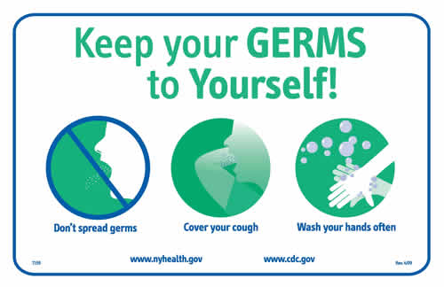
Get Ready for Pandemic Influenza
An outbreak is likely to be widespread and may affect your everyday life. Changes may involve everyday supplies and services, overwhelmed doctors and hospitals, and restrictions on travel and public gatherings.
An outbreak is likely to be widespread and may affect your everyday life. Changes may involve everyday supplies and services, overwhelmed doctors and hospitals, and restrictions on travel and public gatherings.
Important activities
  Get a yearly flu vaccination, especially if you are at high risk for flu complications.
  Practice good hygiene and wash your hands frequently.
  Cover your nose and mouth when coughing or sneezing.
  Regularly clean surfaces that are touched by multiple people.
  Stay healthy by eating a balanced diet, getting regular exercise and getting enough rest.
Notes:
It’s important to know that there are steps you and your family can take to help prepare for this threat. Follow these actions suggested by the Centers for Disease Control and Prevention (CDC) that can help prevent the spread of germs that cause influenza. Take these steps….
Having extra supplies will be important in case you can’t get to a store or if stores are out of supplies…
A pandemic flu outbreak: Decrease your personal risk by being informed and prepared for what will happen if a flu pandemic occurs. It will likely be a prolonged and widespread outbreak that could require changes in many parts of our everyday lives.
Hospitals and doctors might be overwhelmed with sick patients.
Essential supplies and services may become limited or unavailable.
Travel and public gatherings might be limited to keep the virus from spreading.

Slide 13
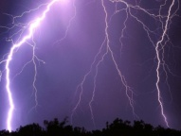
Get Ready for a Thunderstorm
Thunderstorms can bring high winds, heavy rains and dangerous lightning, one of the leading causes of weather-related deaths in the United States each year.
In Illinois, Indiana, and Wisconsin, severe thunderstorms frequently occur in the late afternoon or evening.
Wisconsin had 290 lighting strikes between 2000 and 2010, resulting in five deaths, 56 injuries, and about $47 million in property damage.
If you can see lightning, go indoors and wait 30 minutes after you hear the last clap of thunder to go outside.
Notes:
Thunderstorms can be destructive and extremely dangerous weather emergencies.

Slide 14
Get Ready for a Thunderstorm
Important activities
  Remove dead trees and rotten branches that could fall and cause injury or damage.
  Secure outdoor objects that could blow away or cause damage.
  Shutter windows and secure outside doors.
  Postpone outdoor activities if a thunderstorm is likely in your area.
  Avoid showering or bathing. Plumbing can conduct electricity.
  Use a corded telephone only for emergencies.
  Unplug appliances and other electrical items such as computers and turn off air conditioners. Power surges from lightning can cause serious damage.
  Listen for weather updates from local officials
Notes:
Thunderstorms can be destructive and extremely dangerous weather emergencies.

Slide 15
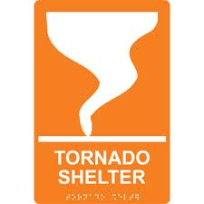
Get Ready for a Tornado
Tornadoes can appear suddenly and without warning.
These violent storms can pack winds of up to 300 mph and leave damage trails up to 1 mile wide and 50 miles long.
Illinois, Indiana, and Wisconsin average between 23 and 26 tornadoes a year.
Know the signs that a tornado could be imminent:
  Dark, often greenish sky.
  A large, dark rotating cloud (funnel-shaped)
  Large hail, which is often produced by the same storms that produce tornadoes.
  Loud roar, similar to the sound of a freight train.
  Tornadoes may occur and be visible near the trailing edge of a thunderstorm.
  Tornadoes may also be embedded in rain and not visible.
Tornado Watch | Tornado Warning
Conditions are favorable for tornadoes in and lose to the watch area. | A tornado has been detected by Doppler Radar and/or has been sighted.
Notes:
Every part of the continental United States is at risk for tornados.

Slide 16
Get Ready for a Tornado
Shelter in place during a tornado watch:
  Be prepared to take shelter immediately if conditions worsen. Stay tuned to local radio or TV for weather information.
Shelter in place during a tornado warning:
  Take shelter immediately. A tornado has been sighted or indicated by weather radar.
Important activities
  Determine a place where you will take shelter in case of a tornado warning. Storm cellars or basements provide the best protection.
  If underground shelter is not available, go into an interior room or hallway on the lowest floor possible.
  Stay away from windows, doors and outside walls. Go to the center of the room.
  If you're not in your home, seek shelter in the basement or an interior room of a nearby, sturdy building.
  Do not try to outrun a tornado in your car.
  Do not stay in a mobile home. They offer little protection, even if they are tied down.
Notes:
Every part of the continental United States is at risk for tornados.

Slide 17
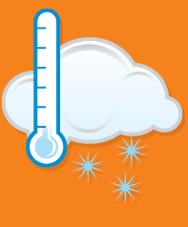
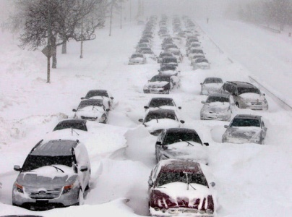
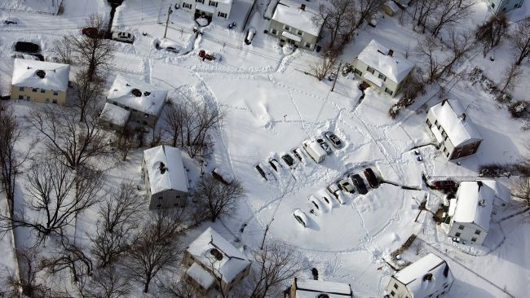
Get Ready for a Winter Storm
Winter storms include a variety of weather, including snow or subfreezing temperatures, strong winds and even ice or heavy rain storms.
At some point every winter, temperatures in this area drop below zero.
Add supplies to your emergency kit in preparation for the winter weather.
  Rock salt to melt ice on walkways
  Sand or kitty litter to improve traction
  Snow shovels and other snow removal equipment.
  Adequate clothing and blankets to keep you and your family warm
Notes:
Most deaths are indirectly related to the storm.
A total of 109 people have died from exposure to cold temperatures in the state of Illinois since 1997.
=> This is more deaths than severe thunderstorms, tornadoes, floods, and lightning during the same period.
If symptoms are detected, get medical help immediately.
If symptoms of hypothermia are detected, get medical help as soon as possible.

Slide 18
Get Ready for a Winter Storm
Know the signs of frostbite and hypothermia
  Frostbite: loss of feeling and white or pale appearance in extremities such as fingers, toes, ear lobes, and the tip of the nose.
  Hypothermia: uncontrollable shivering, memory loss, disorientation, incoherence, slurred speech, drowsiness, and apparent exhaustion.
Important activities
  Listen to your radio, television, or NOAA Weather Radio for weather reports and emergency information.
  Wear layers of loose-fitting, lightweight, warm clothing. Wear gloves (or mittens) and a hat to help prevent loss of body heat.
  Make sure your home is well insulated.
  Use extreme caution when using alternative heating sources.
  Learn how to shut off water valves in case a pipe bursts.
  If you plan to be driving, prepare your vehicle by checking your antifreeze level, battery, brakes, tire treat and air levels, fuel, oil, and lights.
Notes:
Most deaths are indirectly related to the storm.
A total of 109 people have died from exposure to cold temperatures in the state of Illinois since 1997.
=> This is more deaths than severe thunderstorms, tornadoes, floods, and lightning during the same period.
If symptoms are detected, get medical help immediately.
If symptoms of hypothermia are detected, get medical help as soon as possible.

Slide 19
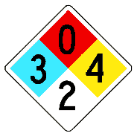
Get Ready for a Chemical or Hazardous Material Incident
Many hazardous materials do not have any odor, and may only be detected once physical symptoms like watering eyes or nausea occur.
These substances are most often released as a result of transportation accidents or because of chemical accidents in manufacturing plants.
Stay or go?
  If an incident occurs and emergency officials inform you to evacuate, do so immediately.
  If an incident occurs and you are informed to shelter in place, close and lock all exterior doors and windows. Turn off air conditioners and ventilation systems. Go into a pre-selected shelter room above ground.
Notes:
Chemical and hazardous substances, often called hazardous materials, if released or misused, can pose a threat to you or the environment. Because hazardous materials are transported on our roadways, railways, waterways and pipelines every day, a hazardous materials incident can happen anywhere and you need to be prepared in case an incident occurs near you
Some hazardous materials can cause death, serious injury, long-lasting health effects, and damage to buildings and property.
Important activities:
Understand that hazardous materials can be transported quickly by water and wind. You will be best prepared if you know to stay uphill and upstream…

Slide 20
Get Ready for a Chemical or Hazardous Material Incident
Substances can have an immediate effect (a few seconds to a few minutes) or a delayed effect (2 to 48 hours).
Three methods of exposure
  Inhaling the chemical or hazardous material.
  Swallowing contaminated food, water, or medication.
  Touching it or coming into contact with clothing or things that have touched the substance.
Important activities
  Listen to local radio or television stations for detailed information and instructions.
  If you witness a hazardous materials incident, spill or leak, call 911, your local emergency number or the fire department as soon as possible.
  Avoid contact with any spilled liquid materials, airborne mist or condensed solid deposit.
  Stay upstream, uphill and upwind in case of an incident.
Notes:
Chemical and hazardous substances, often called hazardous materials, if released or misused, can pose a threat to you or the environment. Because hazardous materials are transported on our roadways, railways, waterways and pipelines every day, a hazardous materials incident can happen anywhere and you need to be prepared in case an incident occurs near you
Some hazardous materials can cause death, serious injury, long-lasting health effects, and damage to buildings and property.
Important activities:
Understand that hazardous materials can be transported quickly by water and wind. You will be best prepared if you know to stay uphill and upstream…

Slide 21
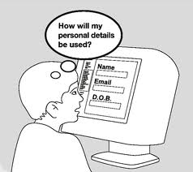
Get Ready for Cyber Crime
Cyber security involves protecting infrastructure by preventing, detecting, and responding to cyber incidents
Cyber intrusions and attacks have increased dramatically over the last decade.
Threats are often difficult to identify and understand. Cyber risks include:
  viruses erasing entire systems
  intruders breaking into systems and altering files
  intruders using your computer or device to attack others
  intruders stealing confidential information.
Notes:
We rely on a vast array of networks to communicate and travel, power our homes, run our economy, and provide government services.
Increase in cyber attacks has been exposing sensitive personal and business information, disrupting critical operations, and imposing high costs on the economy.
The spectrum of cyber risks is limitless; threats can have wide-ranging effects on the individual, community, organizational, and national level. These risks include:
Organized cybercrime, state-sponsored hackers, and cyber espionage can pose national security risks to our country.
Transportation, power, and other services may be disrupted by large scale cyber incidents. The extent of the disruption is highly uncertain as it will be determined by many unknown factors such as the target and size of the incident.
Vulnerability to data breach and loss increases if an organization’s network is compromised. Information about a company, its employees, and its customers can be at risk.
Individually-owned devices such as computers, tablets, mobile phones, and gaming systems that connect to the Internet are vulnerable to intrusion. Personal information may be at risk without proper security
Cyber crimes that primarily target computer networks or devices include:
Computer viruses
Denial-of-service attacks
Malware (malicious code)
Cyber crimes that use computer networks or devices to advance other ends include:
Cyber stalking
Fraud and identity theft
Information warfare
Phishing scams
Learn more from the Department of Homeland Security’s website on cyber security, the Norton/Symantec homepage, and the McAfee homepage.
Important activities: Don’t give personal info out over the internet. Most organizations – banks, universities, companies, etc. – do not ask for your personal information over
the Internet.

Slide 22
Get Ready for Cyber Crime
Important activities
  Only connect to the Internet over secure, password- protected networks.
  Do not click on links or pop-ups, open attachments, or respond to emails from strangers.
  Always enter a URL by hand instead of following links if you are unsure of the sender.
  Do not respond to online requests for Personally Identifiable Information.
  If you think an offer is too good to be true, then it probably is.
  Do not use the same password twice; change your passwords on a regular basis.
Learn more about cyber security and current virus threats from the Department of Homeland Security’s website on cyber security, or visit your computer security provider’s homepage.
Notes:
We rely on a vast array of networks to communicate and travel, power our homes, run our economy, and provide government services.
Increase in cyber attacks has been exposing sensitive personal and business information, disrupting critical operations, and imposing high costs on the economy.
The spectrum of cyber risks is limitless; threats can have wide-ranging effects on the individual, community, organizational, and national level. These risks include:
Organized cybercrime, state-sponsored hackers, and cyber espionage can pose national security risks to our country.
Transportation, power, and other services may be disrupted by large scale cyber incidents. The extent of the disruption is highly uncertain as it will be determined by many unknown factors such as the target and size of the incident.
Vulnerability to data breach and loss increases if an organization’s network is compromised. Information about a company, its employees, and its customers can be at risk.
Individually-owned devices such as computers, tablets, mobile phones, and gaming systems that connect to the Internet are vulnerable to intrusion. Personal information may be at risk without proper security
Cyber crimes that primarily target computer networks or devices include:
Computer viruses
Denial-of-service attacks
Malware (malicious code)
Cyber crimes that use computer networks or devices to advance other ends include:
Cyber stalking
Fraud and identity theft
Information warfare
Phishing scams
Learn more from the Department of Homeland Security’s website on cyber security, the Norton/Symantec homepage, and the McAfee homepage.
Important activities: Don’t give personal info out over the internet. Most organizations – banks, universities, companies, etc. – do not ask for your personal information over
the Internet.

Slide 23
Get Ready for a Nuclear Power Plant Emergency
Nuclear power plants operate in most states in the country and produce about 20 percent of the nation’s power.
Nearly 3 million Americans live within 10 miles of an operating nuclear power plant.
Illinois residents in DeKalb, Gundy and Will Counties could all potentially be affected by nuclear power plants.
An accident could result in dangerous levels of radiation that affect the health and safety of the public living near the nuclear power plant.
Three main radiation hazards are:
  Exposure to the body through contaminated gases and particles
  Inhaling radioactive materials
  Ingesting radioactive materials
Notes:
Although the construction and operation of these facilities are closely monitored and regulated by the Nuclear Regulatory Commission (NRC), accidents are possible.
Exposure to radiation is the main concern with an accident at a nuclear power plant. 3 main hazards are….

Slide 24
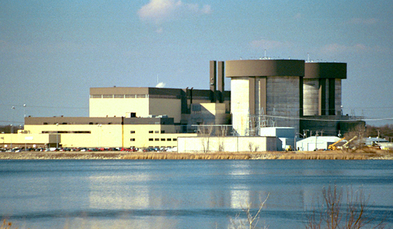
Get Ready for a Nuclear Power Plant Emergency
Stay or go?
  If you are advised to evacuate, do so immediately. Evacuation is simple and safer before the contamination spreads.
  Have your evacuation plan, and follow recommended routes.
  If you are not evacuating, shut all windows and doors, turn off the air ventilation system, and move to an interior room of your house.
Important activities
  If you live within 10 miles of the power plant, you should receive the materials yearly from the power company or your state or local government.
  Contact your local emergency management department for more information and safety materials.
Notes:
Although the construction and operation of these facilities are closely monitored and regulated by the Nuclear Regulatory Commission (NRC), accidents are possible.
Exposure to radiation is the main concern with an accident at a nuclear power plant. 3 main hazards are….

Slide 25
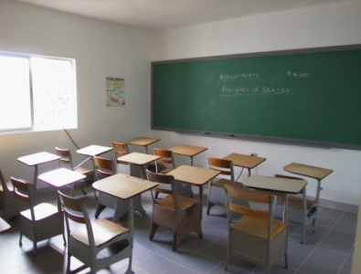
Get Ready for School and Workplace Violence
An active shooter is a person who is using a firearm or other weapon with the intent to injure or kill others. Law enforcement personnel will deploy to the location of the active shooter with the primary goal of stopping the shooter.
Evacuation with an active shooter
  Have a route planned before attempting to leave.
  Do not attempt to carry anything with you while fleeing.
  Move quickly and keep your hands visible with palms upraised, as you exit the building.
  Proceed to a safe location, but do not leave the site unless directed to do so.
  Always comply with commands from law enforcement officers.

Slide 26
Get Ready for School and Workplace Violence
Alert - Anything that makes you aware of the situation.
  Gunfire
  Witnessing the incident
  Phone, email or text alert
Lockdown- A semi-secure point from which to make survival decisions.
  If you decide not to evacuate, secure the room.
  Hide in an area out of the shooter’s view.
  Block entry to your hiding place and lock the doors if possible.
Inform- Passing on real time information through any means necessary.
  Who, what, where, when and how information
  Can be derived from 911 calls, video surveillance, etc.
Counter- Use simple techniques if confronted.
  Throw things at the shooter to disrupt their aim
  Create as much noise as possible
Escape- Remove yourself from the danger zone.
  Decide if you can safely evacuate
  Do not stop running until you are far away from the area
Notes:
ALICE is a principle you and your family can utilize in order to increase your chances of surviving a surprise attack by an Active Shooter in a school or workplace. ALICE stands for:
Alert
Lockdown
Inform
Counter
Escape

Slide 27
Get Ready for a Terrorist Attack
Terrorism is the unlawful use of force or violence by a person or group. The goal is to intimidate or coerce societies or governments.
By planning how to respond to a terrorist attack, you can greatly improve your chances of survival.
Biological | The deliberate release of germs or other harmful substances that can cause illness
Chemical | The deliberate release of toxic gases, liquids, or solids that can poison people and the environment
Radiation | The spread of harmful radiation through an explosion such as a “dirty bomb”
Nuclear | The deliberate detonation of a nuclear device resulting in intense light, heat, radiation, and collateral damage
Explosive | The use of explosions to cause mortal injury or destruction of property
Notes:
Terrorism is often used for political or ideological reasons. These attacks can take many forms. They could happen anytime and in any place.
By planning your response to an event, You can also lessen the impact of the attack by reducing the fear in the aftermath.
Terrorists typically exploit vulnerabilities caused by technological hazards and may include hazardous materials, biological agents that result in epidemics, or attempts to damage critical infrastructure including cyber attacks
High-risk targets include government facilities, large cities, airports, high-profile landmarks, utilities and the mail system.
Shelter in place - Close and lock all windows and exterior doors
Evacuate - Listen to your radio or television and follow the instructions of local emergency officials.
Bomb threat - Keep the caller on the line and record everything that is said. Notify the police and building management immediately

Slide 28

Get Ready for a Terrorist Attack
Stay or go?
  If you are advised by local officials to shelter in place, remain inside your home or office and protect yourself there.
  If you are advised to evacuate, do so immediately. Don’t forget to lock your home and take your pets with you.
Important activities
  If you see something, say something!
  If you receive a bomb threat, try to get as much information from the caller as possible. Call 911 and report it to the police immediately.
  Be wary of suspicious packages and letters. Be particularly cautious of parcels that:
    Have no return address or a return address that can’t be verified as legitimate.
    Show a city or state in the postmark that doesn’t match the return address.
    Are not addressed to a specific person.
    Have hand-written or poorly typed addresses
Notes:
Terrorism is often used for political or ideological reasons. These attacks can take many forms. They could happen anytime and in any place.
By planning your response to an event, You can also lessen the impact of the attack by reducing the fear in the aftermath.
Terrorists typically exploit vulnerabilities caused by technological hazards and may include hazardous materials, biological agents that result in epidemics, or attempts to damage critical infrastructure including cyber attacks
High-risk targets include government facilities, large cities, airports, high-profile landmarks, utilities and the mail system.
Shelter in place - Close and lock all windows and exterior doors
Evacuate - Listen to your radio or television and follow the instructions of local emergency officials.
Bomb threat - Keep the caller on the line and record everything that is said. Notify the police and building management immediately

Slide 29
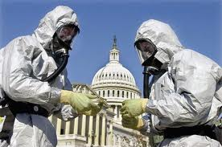
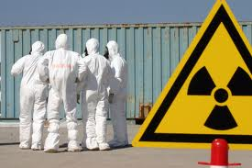
Get Ready for a Radiological Attack
A radiological attack is the spreading of radioactive material with the intent to do harm.
Radioactive materials could be used in a “Radiological Dispersal Device” (RDD).
Most dirty bombs and other RDDs have very localized effects, ranging from less than a city block to several square miles.
Radiological Dispersal Devices are most likely to be used to:
  Contaminate facilities or places where people live and work, disrupting lives and livelihoods
  Cause anxiety in those who think they are being, or have been, exposed
Notes:
Radioactive materials are used every day in laboratories, medical centers, food irradiation plants, and for industrial uses. If stolen or otherwise acquired,
RDD’s have different means of dispersal, including dirty bombs, placing a container of radioactive material in a public place, or using an airplane to disperse powdered or aerosolized forms of radioactive material.
A “dirty bomb” is one type of RDD that uses a conventional explosion to disperse radioactive material over a targeted area.
The area over which radioactive materials would be dispersed depends on factors such as:
Amount and type of radioactive material dispersed.
Means of dispersal (e.g. explosion, spraying, fire).
Physical and chemical form of the radioactive material. For example, if the material is dispersed as fine particles, it might be carried by the wind over a relatively large area.
Local topography, location of buildings, and other landscape characteristics.
Local weather conditions.

Slide 30
Get Ready for a Radiological Attack
Stay or go?
  Taking shelter during an RDD event is absolutely necessary. Appropriate shelter includes basements or the windowless center area of middle floors in high-rise buildings.
  Listen to emergency officials who will let you know it is safe to leave your home.
Use time, distance, and shielding to protect yourself and your family during an attack. Following any radiological explosion, you should:
  Minimize the time you are exposed to the radiation materials from the dirty bomb.
  Maximize your distance from the source; walking even a short distance from the scene could provide significant protection since dose rate drops dramatically with distance from the source.
  Shield yourself from external exposure and inhalation of radioactive material.
Notes:
Radioactive materials are used every day in laboratories, medical centers, food irradiation plants, and for industrial uses. If stolen or otherwise acquired,
RDD’s have different means of dispersal, including dirty bombs, placing a container of radioactive material in a public place, or using an airplane to disperse powdered or aerosolized forms of radioactive material.
A “dirty bomb” is one type of RDD that uses a conventional explosion to disperse radioactive material over a targeted area.
The area over which radioactive materials would be dispersed depends on factors such as:
Amount and type of radioactive material dispersed.
Means of dispersal (e.g. explosion, spraying, fire).
Physical and chemical form of the radioactive material. For example, if the material is dispersed as fine particles, it might be carried by the wind over a relatively large area.
Local topography, location of buildings, and other landscape characteristics.
Local weather conditions.

