Slide 1
CCMHE Quarterly Meeting
overall_0_132367198033335501 columns_1_132367198033335501
August 25th, 2025
2 p.m. – 4 p.m.

Slide 2
overall_1_132617861608743146 columns_1_132617861608743146
Welcome, Attendance, & Minute Approval
Approval of Minutes
Public Comment
Follow Up from Q2 Meeting- feedback loop
Presentations
Mayor's Office Updates
Agenda

Slide 3
overall_1_132617861608743146 columns_1_132617861608743146
Welcome, Attendance, & Minute Approval
Public Comment
Administrative Updates
Follow Up from Q1 Meeting- feedback loop
Presentations
Mayor's Office Updates
Agenda

Slide 4
overall_1_132617861608743146 columns_1_132617861608743146
Welcome, Attendance, & Minute Approval
Public Comment
Administrative Updates
Follow Up from Q1 Meeting- feedback loop
Presentations
Mayor's Office Updates
Agenda

Slide 5
overall_1_132617861608743146 columns_1_132617861608743146
Welcome, Attendance, & Minute Approval
Public Comment
Administrative Updates
Follow Up from Q1 Meeting- feedback loop
Presentations
Mayor's Office Updates
Agenda

Slide 6
overall_1_132617861608743146 columns_1_132617861608743146
Welcome, Attendance, & Minute Approval
Public Comment
Administrative Updates
Follow Up from Q1 Meeting- feedback loop
Presentations
Mayor's Office Updates
Agenda

Slide 7
Chicago Police Department Crisis Intervention Unit
Lt. Rhonda Anderson, Coordinator, Crisis Intervention Unit
Sgt. Catherine Sanchez, Crisis Intervention Unit

Slide 8

Chicago Police Department Policy Creation Overview
Sgt. Vilmarys Morales

Slide 9
What is a “policy”?
CPD General Order G01-03 “Department Directives System”
CPD’s policy and procedures will be disseminated through written directives.
Department directives establish, define, and communicate Department-wide policy, procedures, or programs.
  Issued in the name of the Superintendent of Police.
  Guide the efforts and objectives of the Department
  Direct the activities of the Department members
  Consistent with and support the vision, mission, core values, goals, and overall philosophy of the Department.

Slide 10
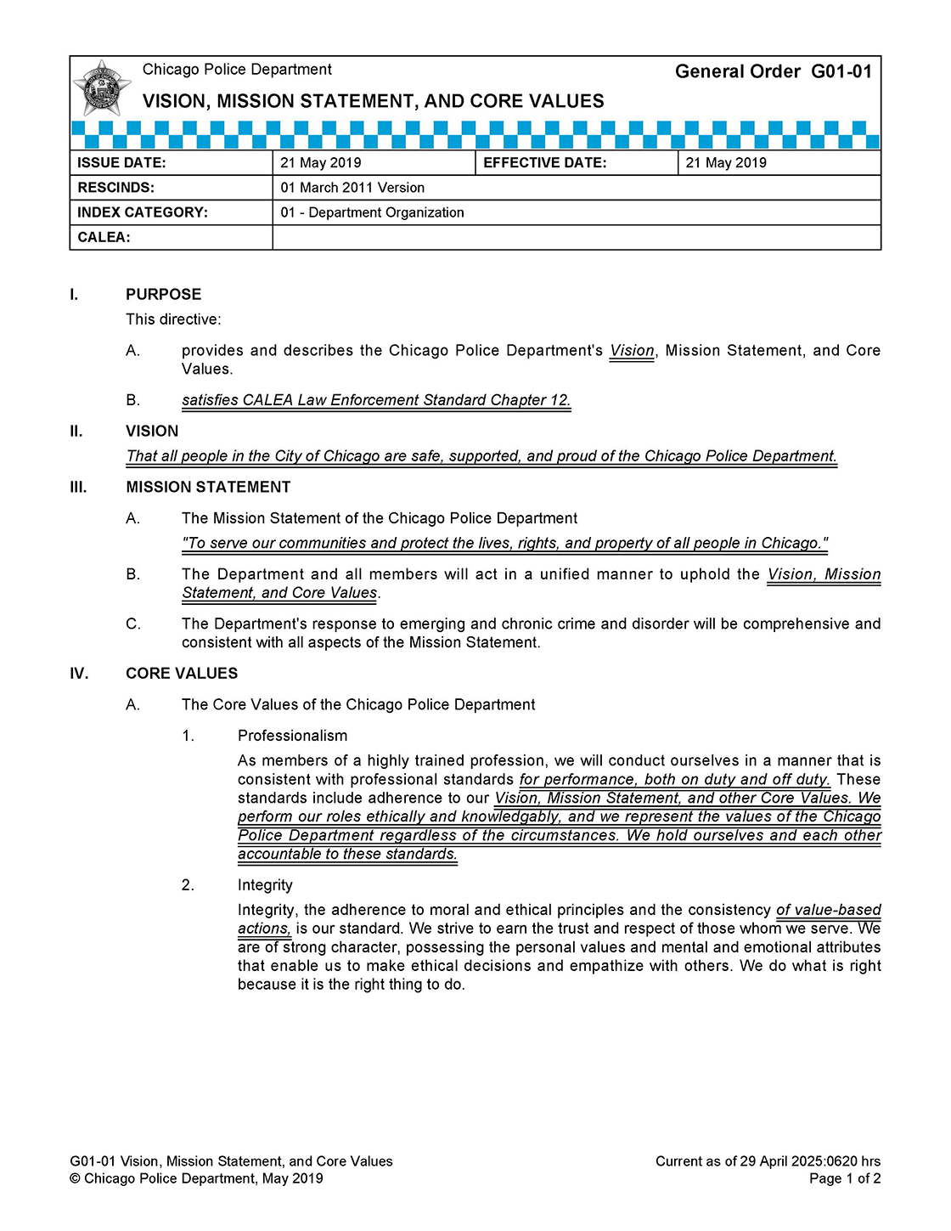
What is a “policy”?
CPD directives are issued in the following classifications:
General Orders (GO):
establish critical policies directly related to the CPD core values and functions or the broad organizational policies and key practices.

Slide 11
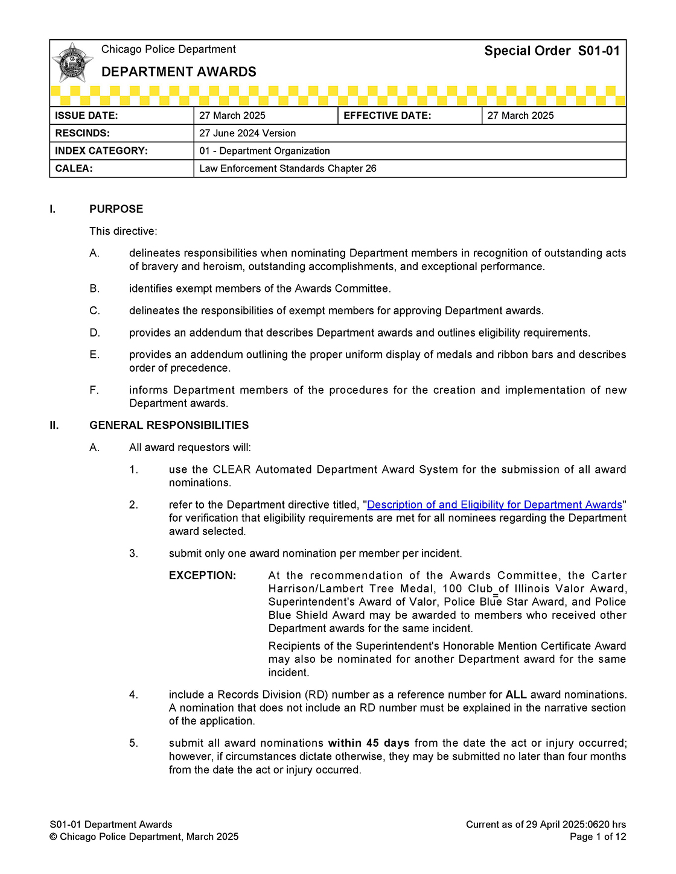
What is a “policy”?
CPD directives are issued in the following classifications:
Special Orders (SO):
are directives that establish protocols and procedures concerning specific Department functions, operations, programs, or processes.

Slide 12
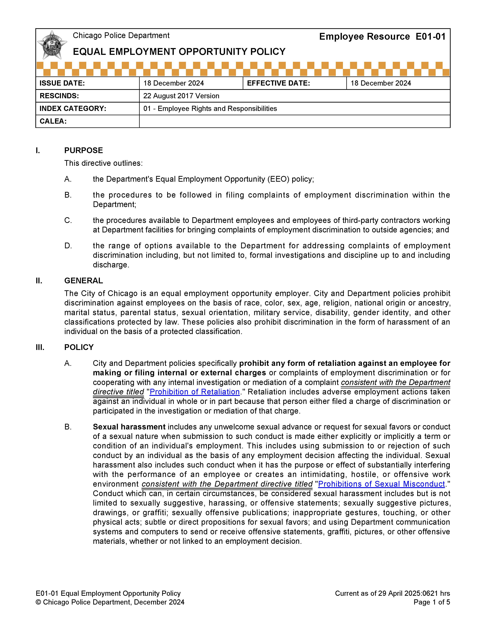
What is a “policy”?
CPD directives are issued in the following classifications:
Employee Resources (ER):
pertain to administrative functions, employment requirements, employee rights and resources, and benefit programs.

Slide 13
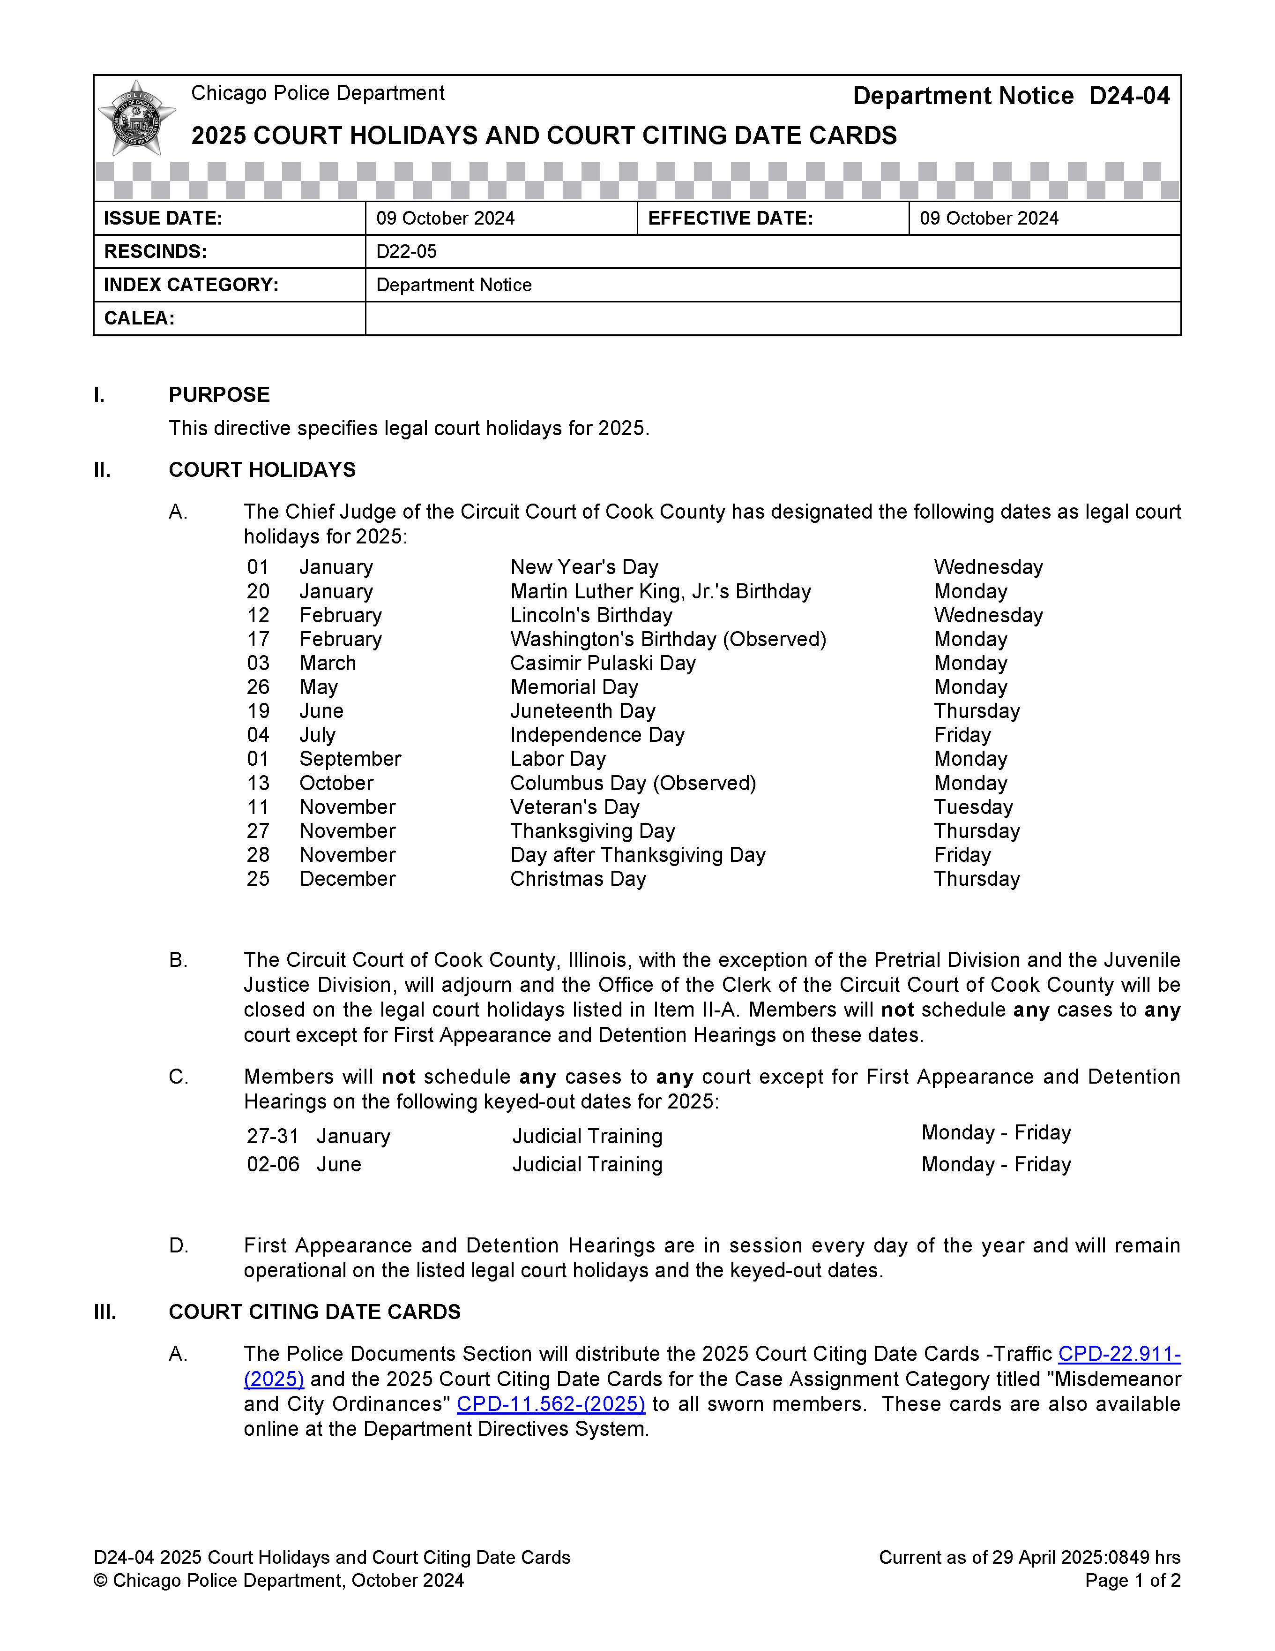
What is a “policy”?
CPD directives are issued in the following classifications:
Department Notices (DN):
anticipated to be reviewed or revised soon after publication or directives with a limited duration that:
establish procedures and assign duties for a single event.
introduce pilot programs or involve limited scope or select personnel.
provide listings, calendars, or other information of general interest.

Slide 14

How does CPD create policy?

Slide 15
Who Develops Policy?
Office of Constitutional Policing and Reform
Research and Development Division
Policy and Procedures Section
Research and Compliance Section
Development and publication of over 750 directives and resources (over 150 Consent Decree – Preliminary Compliance)
Manage Department Directives System
Engage with internal/external stakeholders
Community and officer engagement efforts with Office of Equity and Engagement
Analysis for policy development
Management/archive of policies and forms
CALEA and Consent Decree requirements

Slide 16
Policy Development Process
Administrative and Research Phase
Policy Request
Requests for new or revised policies come from various sources.
Internal Evaluation
Determination of end user need and work product.
Create Work Task
Conduct “Policy Needs Assessment” and task file.
Conduct Research
Numerous sources (both internal and external) to identify best practices and emerging trends.
Initial Internal Review
Administrative and topical review.
Policy Request
Internal (CPD)
External (Litigation/Law)
Self-Initiated
Continual Feedback
SMEs, Field Practitioners, Command Staff, and Community
Administrative
and
Research
Internal Evaluation
Appropriateness as Policy
Viability
Review Existing Policies
Feedback
Conduct Research
R&D Conceptual Plan
Model Policies (IACP)
Other Agency Review
Published Research
Data Analysis
Legal/Labor/Risk
Management Analysis
Internal SME/Training
Community Feedback
Initial Internal Review
Administrative Review
Classification/Number
Consolidation
Grammar/Format
CALEA/Forms/Unit SOs
Topical Review
Requester / SME Input
R&D Supervisor Review
Create Work Task
Identify Scope/SMEs
CALEA/Consent Decree
Consolidation Review
Revision

Slide 17
Policy Development Process
Publication and Announcement
Coordination with Other Activities (e.g., Training)
Development and Implementation Phase
Command Staff
Confirm direction of Department leadership.
Development of Final Draft
Consider additional feedback and implementation plan.
Approval
Chain of command approval.
Pre-Implementation
Consider forms, technology, resources, law, and training.
Publication and Announcement
Department Directives System
Administrative Message
Monthly eLearning
Continual Feedback
SMEs, Field Practitioners, Command Staff, and Community
Pre-Implementation
Assist with Technology, Training, Operations, and Internal/External (CBU) Communications
Development and Implementation
Submit for Approval for Publication
(Chain of Command)
Command Staff Review-14 Day Staffing
SME Requirements
Practitioner Review
Identify Procedural/
Operational Concerns
Concurrence of Legal,
Labor, Command Staff
Confirmation/Approval of Department Direction
Development of
Final Draft
Review Responses
Consider Feedback
Additional Research
Final Internal Review
SME/Advisory Group
Identify Next Steps
Implementation Plan

Slide 18
Policy Development Process
Policy Request
Internal (CPD)
External (Litigation/Law)
Self-Initiated
Continual Feedback
SMEs, Field Practitioners, Command Staff, and Community
Publication and Announcement
Coordination with Other Activities (e.g., Training)
Administrative and
Research
Development and Implementation
Pre-Implementation
Assist with Technology, Training, Operations, and Internal/External (CBU) Communications
Internal Evaluation
Appropriateness as Policy
Viability
Review Existing Policies
Submit for Approval for Publication
(Chain of Command)
Create Work Task
Identify Scope/SMEs
CALEA/Consent Decree
Consolidation Review
Feedback
Initial Internal Review
Administrative Review
Classification/Number
Consolidation
Grammar/Format
CALEA/Forms/Unit SOs
Topical Review
Requester / SME Input
R&D Supervisor Review
Command Staff Review-14 Day Staffing
SME Requirements
Practitioner Review
Identify Procedural/
Operational Concerns
Concurrence of Legal,
Labor, Command Staff
Confirmation/Approval of Department Direction
Development of
Final Draft
Review Responses
Consider Feedback
Additional Research
Final Internal Review
SME/Advisory Group
Identify Next Steps
Implementation Plan
Conduct Research
R&D Conceptual Plan
Model Policies (IACP)
Other Agency Review
Published Research
Data Analysis
Legal/Labor/Risk
Management Analysis
Internal SME/Training
Community Feedback
Revision

Slide 19
Policy Development Process
Policy Request
Internal (CPD)
External (Litigation/Law)
Self-Initiated
Continual Feedback
SMEs, Field Practitioners, Command Staff, and Community
Publication and Announcement
Coordination with Other Activities (e.g., Training)
Administrative and
Research
Development and Implementation
Pre-Implementation
Assist with Technology, Training, Operations, and Internal/External (CBU) Communications
Internal Evaluation
Appropriateness as Policy
Viability
Review Existing Policies
Consent Decree Engagement Process
Collaborative Conversations with Community and IMT/OAG
Draft for IMT/OAG Review
(30-45 days)
Comment Review and Workout Process
Officer/ Community Portal Input
(Min. 15 days)
Submit for Approval for Publication
(Chain of Command)
Create Work Task
Identify Scope/SMEs
CALEA/Consent Decree
Consolidation Review
Feedback
Initial Internal Review
Administrative Review
Classification/Number
Consolidation
Grammar/Format
CALEA/Forms/Unit SOs
Topical Review
Requester / SME Input
R&D Supervisor Review
Command Staff Review-14 Day Staffing
SME Requirements
Practitioner Review
Identify Procedural/
Operational Concerns
Concurrence of Legal,
Labor, Command Staff
Confirmation/Approval of Department Direction
Development of
Final Draft
Review Responses
Consider Feedback
Additional Research
Final Internal Review
SME/Advisory Group
Identify Next Steps
Implementation Plan
Conduct Research
R&D Conceptual Plan
Model Policies (IACP)
Other Agency Review
Published Research
Data Analysis
Legal/Labor/Risk
Management Analysis
Internal SME/Training
Community Feedback
Revision

Slide 20
CPD Community Engagement Overview
Special Order S02-08 “Community Engagement in Policy and Training Development” (as of June 2025)
The Department's community engagement efforts in the development of Department policy and training will typically consist of a three-step cycle:
Phase 1:
Outreach and Sentiment
Phase 2:
Engagement and Dialogues
CPD Development and Review
Phase 3:
Follow-up and Feedback

Slide 21
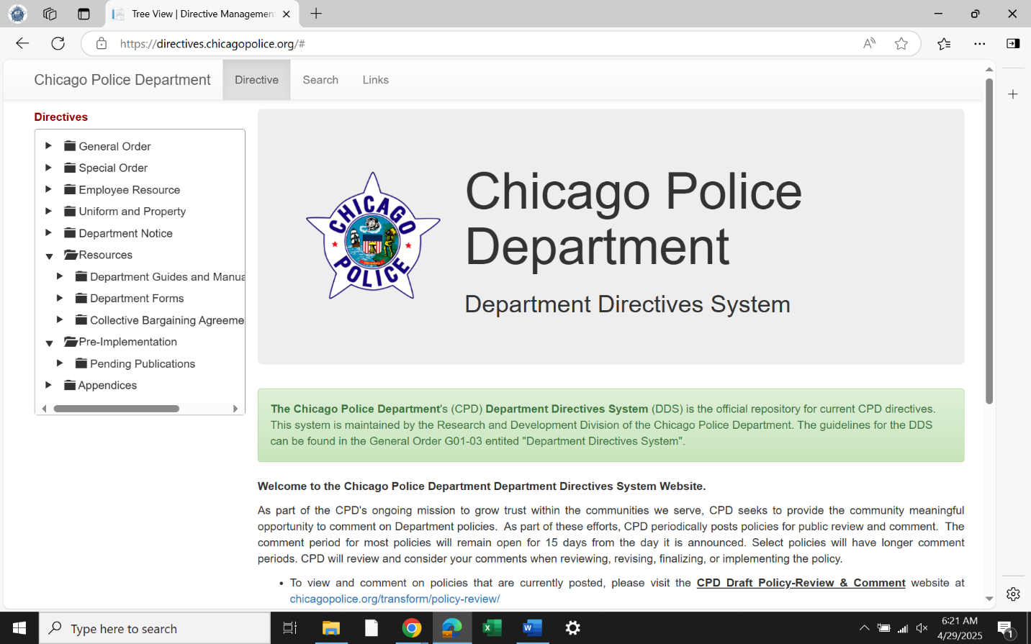
Where do I find CPD Policy?
Publicly available at http://directives.chicagopolice.org

Slide 22
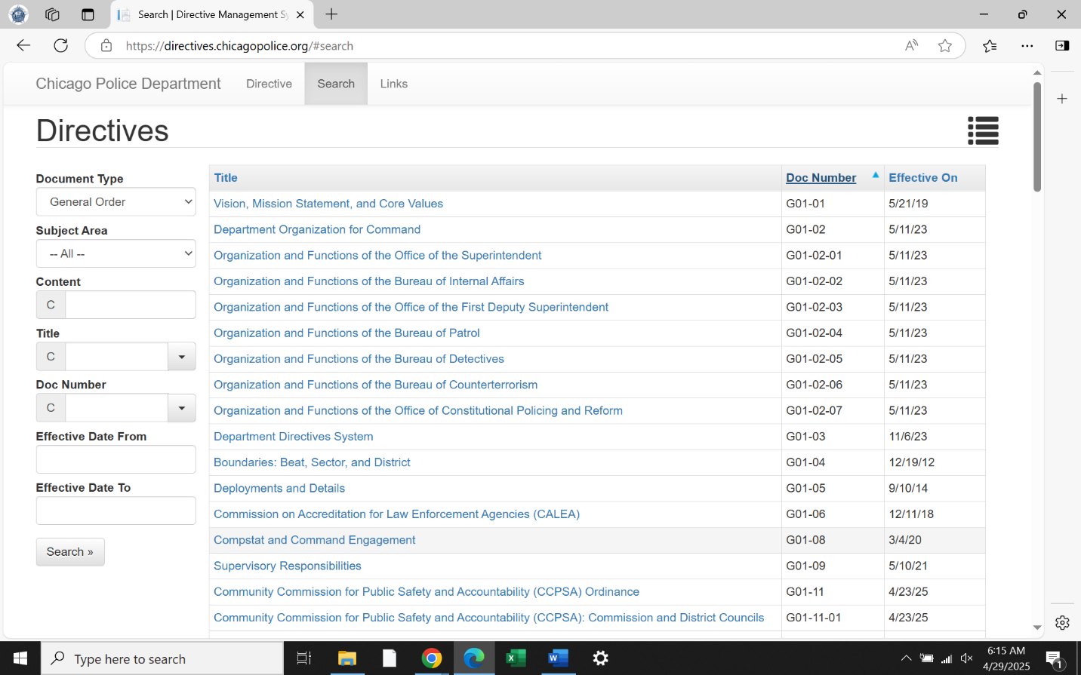
Where do I find CPD Policy?
Publicly available at http://directives.chicagopolice.org

Slide 23
Where do I find CPD policy?
CPD Resources
Department Directives System
directives.chicagopolice.org
General Order G01-03 “Department Directives System”
Research and Development Division
PSHQ – 3510 S. Michigan Ave., 4th Floor NW
312-745-6071
RandD@chicagopolice.org
Questions?

Slide 24
Crisis Intervention Unit (CIU) Policy Review
Sgt. Catherine Sanchez

Slide 25
Crisis Intervention Unit (CIU) Policy Review Requirement
Why we are here today……..
Per the Consent Decree (¶636), CPD will periodically review each policy required to be revised or developed by this Agreement. CPD will conduct an initial review of each such policy no later than two years after the policy’s implementation as provided for in this Agreement. CPD will conduct subsequent reviews every two years thereafter, although the Parties may modify the timeframe for the review of a specific policy. The purpose of the initial and subsequent reviews is to evaluate whether the policy provides effective guidance and direction to CPD members and is consistent with the requirements of this Agreement and current law.

Slide 26
Previous Crisis Intervention Unit (CIU) Policy Review
The CCMHE last reviewed the above policies in 2021/2022. The policies were updated to reflect the applicable revisions and published in the beginning of 2023.
Related policies developed from feedback from the CCMHE include #S02-01-01 “People with Disabilities”, #G02-05 “Interactions with Youth and Children”, and S06-04-06 “Youth Intervention Pathways Pilot Program

Slide 27
Crisis Intervention Unit (CIU) Policy Review - 2025
Between April and July of 2025, the CIU met with CCMHE Consent Decree subcommittee members to review the following policies:
#S04-20 “Recognizing and Responding to Individuals in Crisis”
#S04-20-02 “Persons Not Under Arrest But in Need of Involuntary or Voluntary Admission”
#S04-20-03 “Persons on Unauthorized Absence (UA) from a State-Operated Mental Health Center”
#S04-20-04 “Mental Health Transport and Related Duties Matrix”
#S04-20-05 “Persons Under Arrest in Need of Mental Health Treatment”

Slide 28
Crisis Intervention Unit (CIU) Policy Review - 2025
CIU and Research and Development (R&D) have identified the following revisions to the suite of policies:
  Any text that reads “Designated CIT Officer” will be revised to “Certified CIT Officer”
  All community resources listed in the policy suite will have contact information verified (name, location, hours of operation)
  Applicable bond procedures will be updated to reflect the Pretrial Fairness Act
  CARE Team procedures will be updated to reflect the removal of CPD and CFD from the program
  The addition of the 988 Suicide and Crisis Lifeline information (talk, text, or chat)

Slide 29
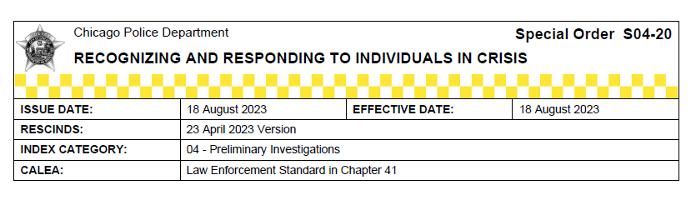
#S04-20 “Recognizing and Responding to Individuals in Crisis”
CCMHE overall themes:
CPD use its voice to note importance of service providers expanding hours of operation
Request that OEMC present to CCMHE on Smart911 (last presentation was Nov 2023)
CDPH further promote Smart911
Concern about the implementation and idle time with CARE program
Difficulty confirming what each CPD policy is for and how they fit together
Request for a one-pager for the above
CCMHE specific feedback:
Member's concern that main option for officer is arrest or hospital; consider working out more options (such as diversion)
Consider adding options for deferring to community mental health resources in section C for more “action-oriented” parts of the policy
Member's view that policy needs to mention co-occurring disorders, and Intellectual and Development Disabilities
Purpose for statement of law, request that ADA is included
Definition of crisis vs. illness in section IV; "individual in crisis" used by IACP; Substance Use Disorder (being more compulsive and conscious)
Consider adding Karina’s law (HB 4144) in section III, allowing local law enforcement agencies to confiscate (via search warrant) firearms from individual alleged to commit domestic violence who has order of protection against them

Slide 30
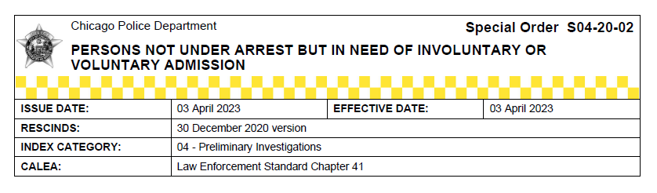
#S04-20-02 “Persons Not Under Arrest But in Need of Involuntary or Voluntary Admission”
CCMHE overall themes:
CPD to look at emerging resources such as peer-based community services as nationwide funding declines
Note that Illinois State legislature extended deadline for implementation of CESSA pilot programs to 2027 -- request the City to consider how it will advance pilot programs?
DOCS teams to help educate community that NAMI does not issue writs
CIU to research the CCBHCs that have some coverage in Chicago, include in community resources
CCMHE specific feedback:
Consider including an age range for all resources in this policy (and resources in other policies within the suite)
Consider including a sentence to ensure attempts to contact primary caregiver when interacting with minors
Consider changing “he/she” to “them”
CCMHE member to send language for 988 language to include in policy

Slide 31
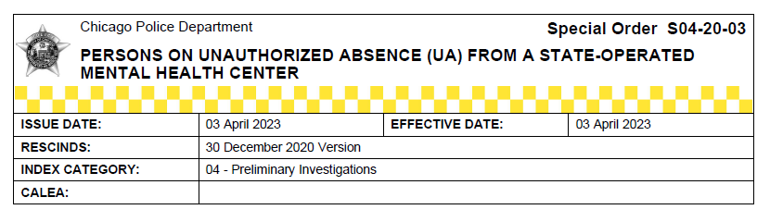
#S04-20-03 “Persons on Unauthorized Absence (UA) from a State-Operated Mental Health Center”
CCMHE overall feedback:
How is person identified as UA?
CIU explained what an unauthorized absence is and how a person is identified if absent and then found
CIU explained “protective custody”
Recommendation for CIT Coordinator to present the CPD Narcotics Diversion Program policy to the PTAC Conference in New Orleans
CCMHE specific feedback:
No applicable feedback

Slide 32
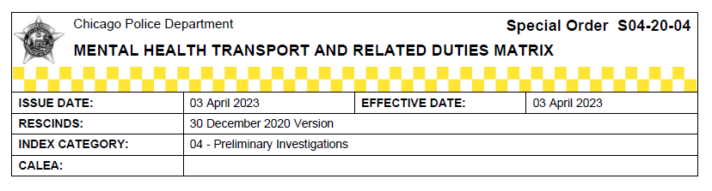
#S04-20-04 “Mental Health Transport and Related Duties Matrix”
CCMHE overall feedback:
Clarification on the supervisor approval need for a transport on a voluntary admission
Consider adding the Illinois Department of Human Services (with the Children’s Behavioral Health Transformation Initiative) BEACON (Behavioral Health Care and Ongoing Navigation) website as a resource for officers
CCMHE specific feedback:
Clarify in policy that officers transport to non-designated facilities with supervisor approval

Slide 33
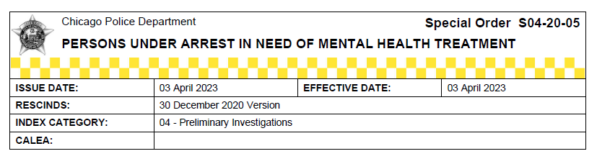
#S04-20-05 “Persons Under Arrest in Need of Mental Health Treatment”
CCMHE general feedback:
Concern raised about safety issues with restraints (minimize the risk of asphyxiation), especially those with Down Syndrome.
CPD may want to review State of Tennessee training videos around IDD
CPD should be used for safety and emergencies, not for non-compliance issues with residents living with disabilities
How will City implement CESSA?
CCMHE specific feedback:
Consider adding text to ensure explicit direction in using restraints

Slide 34
Question, Comments, and Next Steps
Questions or Comments?
CIU will work with R&D to incorporate the CCMHE feedback presented, where applicable, and within the constraints of CPD policy, law, and collective bargaining agreements.
CIU will provide a response to the feedback in advance of the fourth quarter CCMHE meeting (November 10th, 2025).

Slide 35
Office of Emergency
Management & Communications
Dr. Chenetra Washington, Deputy Director - 911 Operations

Slide 36

Notes:
For today’s CCMHE presentation, OEMC will discuss what to expect when calling 9-1-1 and the importance of having a Smart911 Safety Profile.

Slide 37
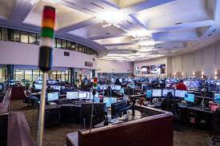



CHICAGO 9-1-1 and 3-1-1
Process 4.5 million calls a year at 9-1-1 and 3.5 million calls at 3-1-1
Call volume influenced by time of year, time of day, day of the week and weather
Busiest days of the year are NYE, 4th of July, and Halloween
.
Notes:
Call Volume at 911 vs 311 for both emergency and non-emergency services.

Slide 38
Calls for Service:
“Help Us Help You”
Relevant details that are most useful to the Call-Taker:
Where: Location of Service
What: Synopsis of what is happening/type of service needed
Who: Description of offenders, Direction of flight.
When: Is incident currently happening or has it passed
Weapons: Weapons involved, Gun, knife, bat, brick etc.
Additional Details : Physical descriptions, vehicle information, direction of flight
Call takers can use the Details To Follow feature to get an event over to the appropriate District while updating the event.
Notes:
5 W’s – with each call to the 911 system, telecommunicators need to know this pertinent information in order to effectively process the emergency calls and dispatch the correct field response.

Slide 39

Emergency Calls:
Mental Health Component
Police call-takers process all incoming calls at OEMC.
  First responder and citizen safety should never be compromised regardless of the type of emergency call.
  Calls are routed to the appropriate jurisdiction or agency contingent upon the information provided by the caller.
Calls with a mental health component are triaged accordingly.
  Call-takers must inquire about weapons, history of mental illness, and violent tendencies.
  CIT calls are forwarded to the dispatcher who then sends CIT officers

Slide 40
OEMC’s Triage Box Outlines:
  Weapons
  History of Mental Health Conditions
  Violent Tendencies
Any emergency call can have a CIT component, but these 5 events types yield the highest CIT Response totals:
  DISTME
  THREAS
  CHECWB
  SUSPER
  CRIMTI
Notes:
The OEMC CIT Triage Box has mandatory questions that are required for officer and citizen safety (purple).

Slide 41
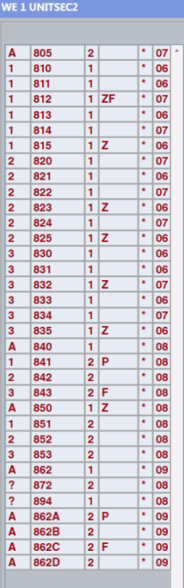
CIT Dispatch Processes
Certified CIT CPD members have received specialized training in responding to individuals in crisis.
Certified CIT CPD members are prioritized to respond to service calls classified with a mental health component.
OEMC dispatchers are trained to identify available Certified CIT CPD members contingent upon attributes.
The assigned attribute for Certified CIT CPD members is “Z”.
Notes:
Z attribute – prioritize for CIT calls

Slide 42
CIT Dispatch Processes
Dispatchers will assign a Certified CIT CPD member to any event with a mental health component.
When assigning a Certified CIT CPD member to an event, dispatchers will assign a unit bearing the Z attribute first provided the unit’s location will not delay the arrival of the CIT unit to the scene.
If there are no CIT units available, dispatchers will assign the closest 10-4 unit and a Sergeant to the scene of any CIT flagged event.
Note: At NO time will a dispatcher hold an event with a CIT component to wait for a CIT unit identified with the “Z” attribute if not readily available.

Slide 43
CIT Definitions and Dispositions
OEMC CIT Events – Calls with a mental health component generated by the OEMC call-taker and is classified accordingly based upon the information obtained from the caller.
  Field response may not observe a mental health component and subsequently issue a non-mental health related disposition.
CPD CIT Events – Calls that were not initially classified by OEMC call-taker as having a mental health component based upon the information obtained from the caller.
  Field response may observe a mental health component that warrants a mental health related disposition.
Note: The CIT response statistics as provided by OEMC and CPD will appear to be redundant at times due to the classification and disposition of CIT events.

Slide 44
OEMC/CPD CIT 2024 Statistics
In 2024, Chicago Police Officers responded to the following calls for service:
  Disturbance/Mental Health: 26,835
  Check the Well-being: 9,923 *not all are classified as having a CIT component
  Threatening Suicide: 7,680
  Attempt Suicide: 1,229
  Suspicious Person: 5,446 *not all are classified as having a CIT component
  Criminal Trespass in Progress: 2,433 *not all are classified as having a CIT component
  Mental Health Transports: 7,791

Slide 45



WHAT IS SMART911?
A free online app that allows you to create a custom 9-1-1 Safety Profile for you and your family.
The Safety Profile for residents can include as little or as much information as needed about themselves and their family members.
Smart911 has a texting feature Call takers can utilize in the event a caller can not speak
Notes:
Free online app for both Androids and I-Phone users. To start the profile, you need an address and phone number (minimum information needed). Safe and Secure – 10 Years no breach in security

Slide 46
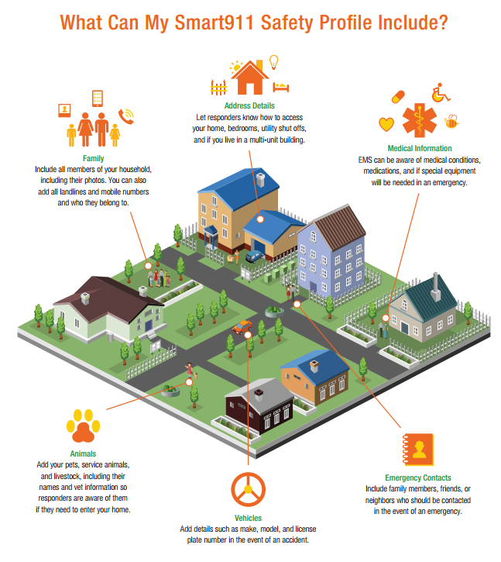
Notes:
Smart 911 is used for Family members, medical information, animals, vehicles, emergency contacts. Mental Health is also included – Misc notes can be added to the profile (Triggers, no lights and sirens, etc.)

Slide 47
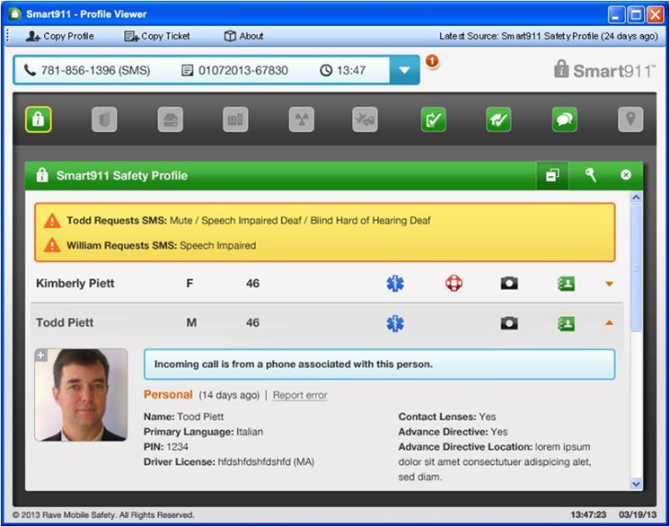
SAMPLE SAFETY PROFILE
Notes:
Sample Profile

Slide 48

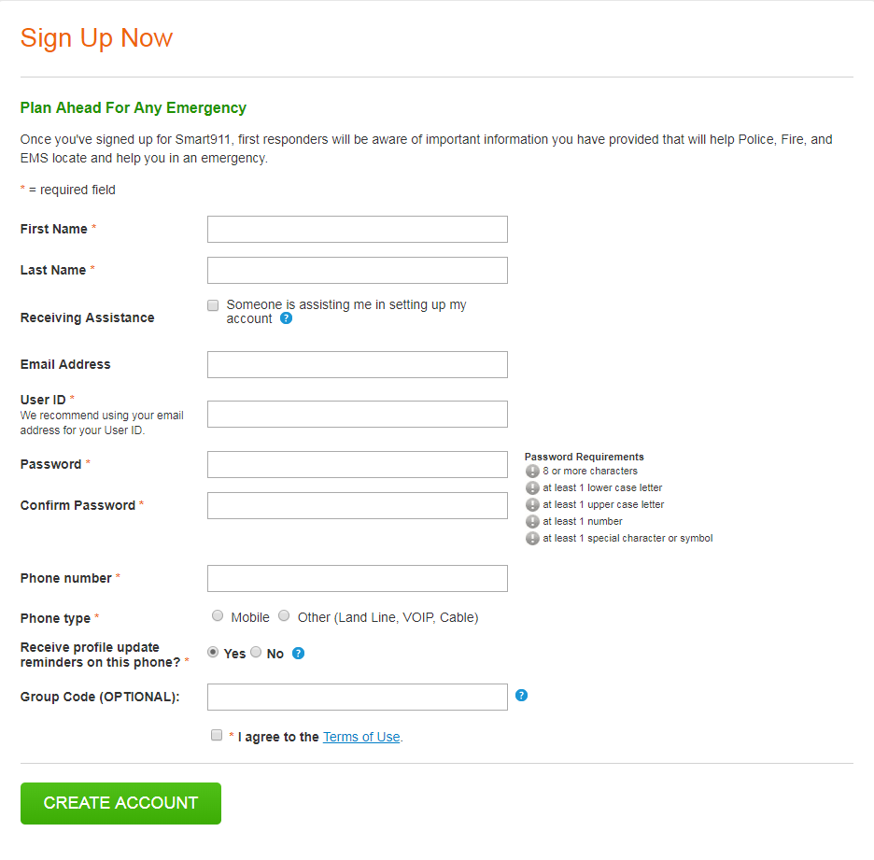
CREATE AN ACCOUNT
Go to the website “Smart911.com”
Click on the “Sign Up Today” button in the middle of the screen
Fill in the required information and click “Create Account”
Notes:
How to create a profile… let’s do it today. Currently, we have 58,000 citizens with a profile created. Remember, the profile must be updated every 6 months to remain active.

Slide 49
Chicago Department of Public Health
Dr. Miao Hua, Interim Deputy Commissioner of Behavioral Health

Slide 50
overall_1_132617861608743146 columns_1_132617861608743146
Welcome, Attendance, & Minute Approval
Public Comment
Administrative Updates
Follow Up from Q1 Meeting- feedback loop
Presentations
Mayor's Office Updates
Agenda

Slide 51

Future Meetings
2025 Quarterly Meetings
  Q4-November 10, 2025
CCMHE Website

