Slide 1
JISC Data Report
File created on: 4/13/2022 10:43:44 AM

Slide 2
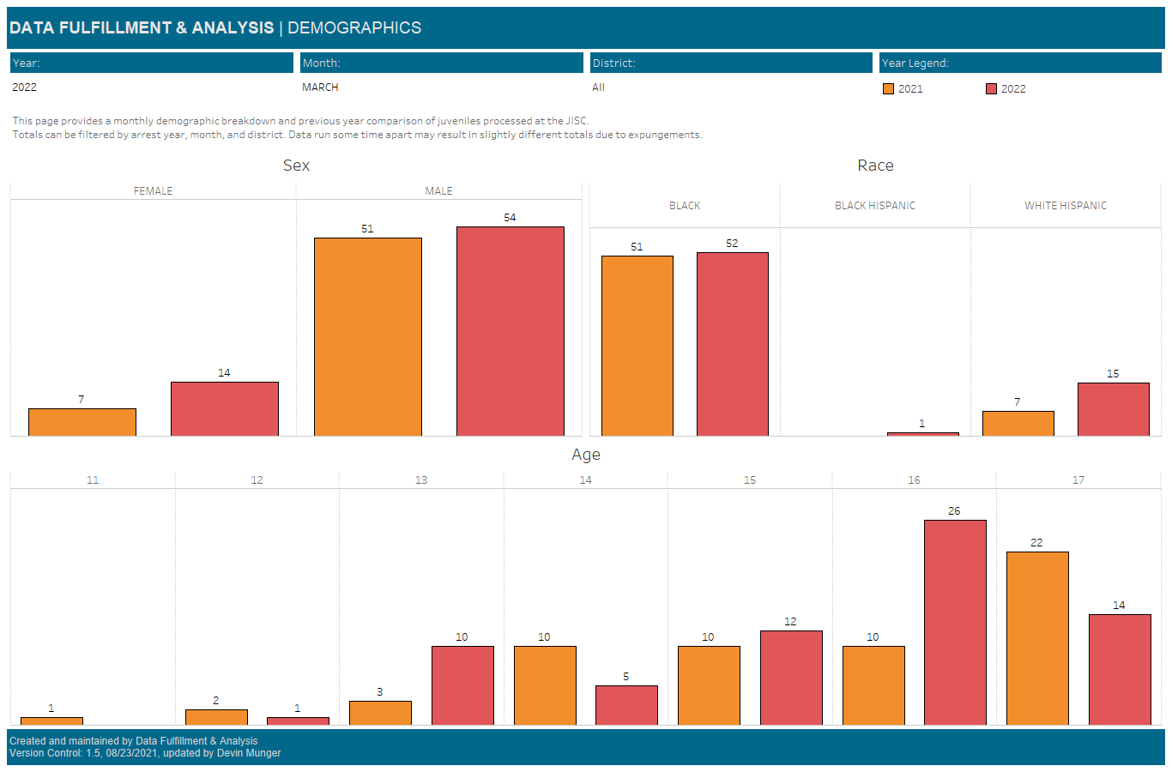

Slide 3
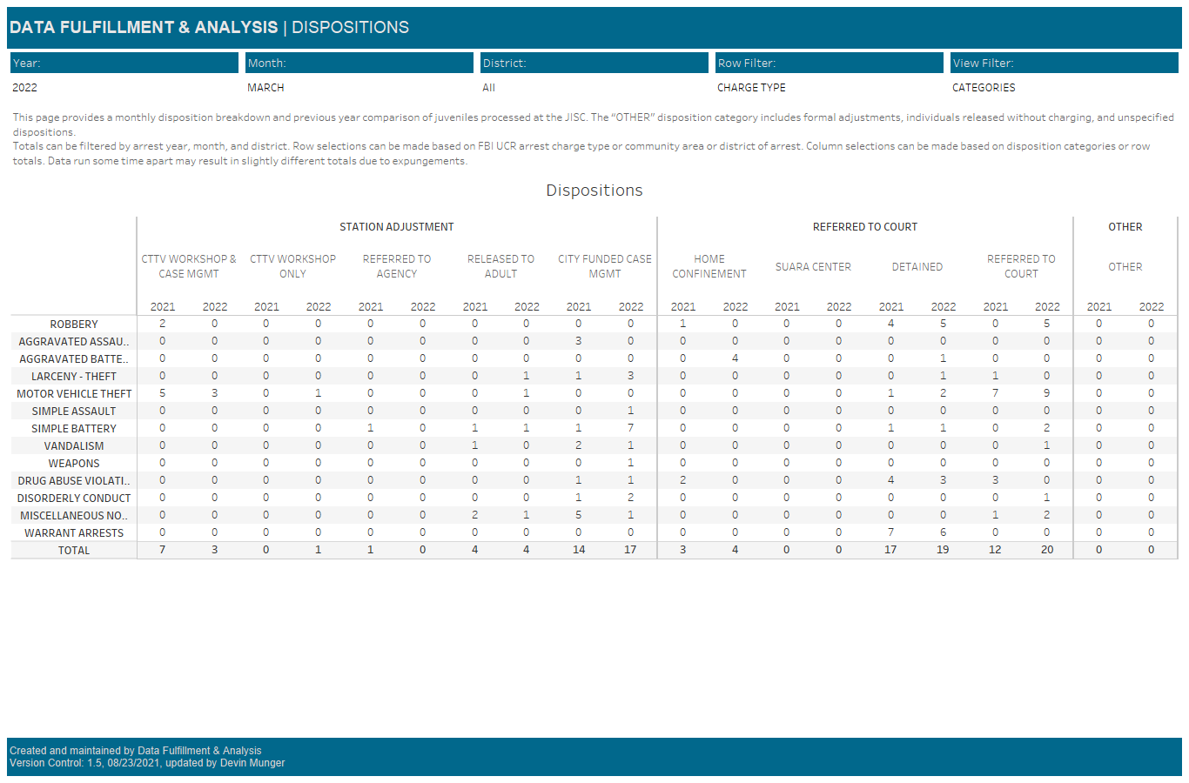

Slide 4
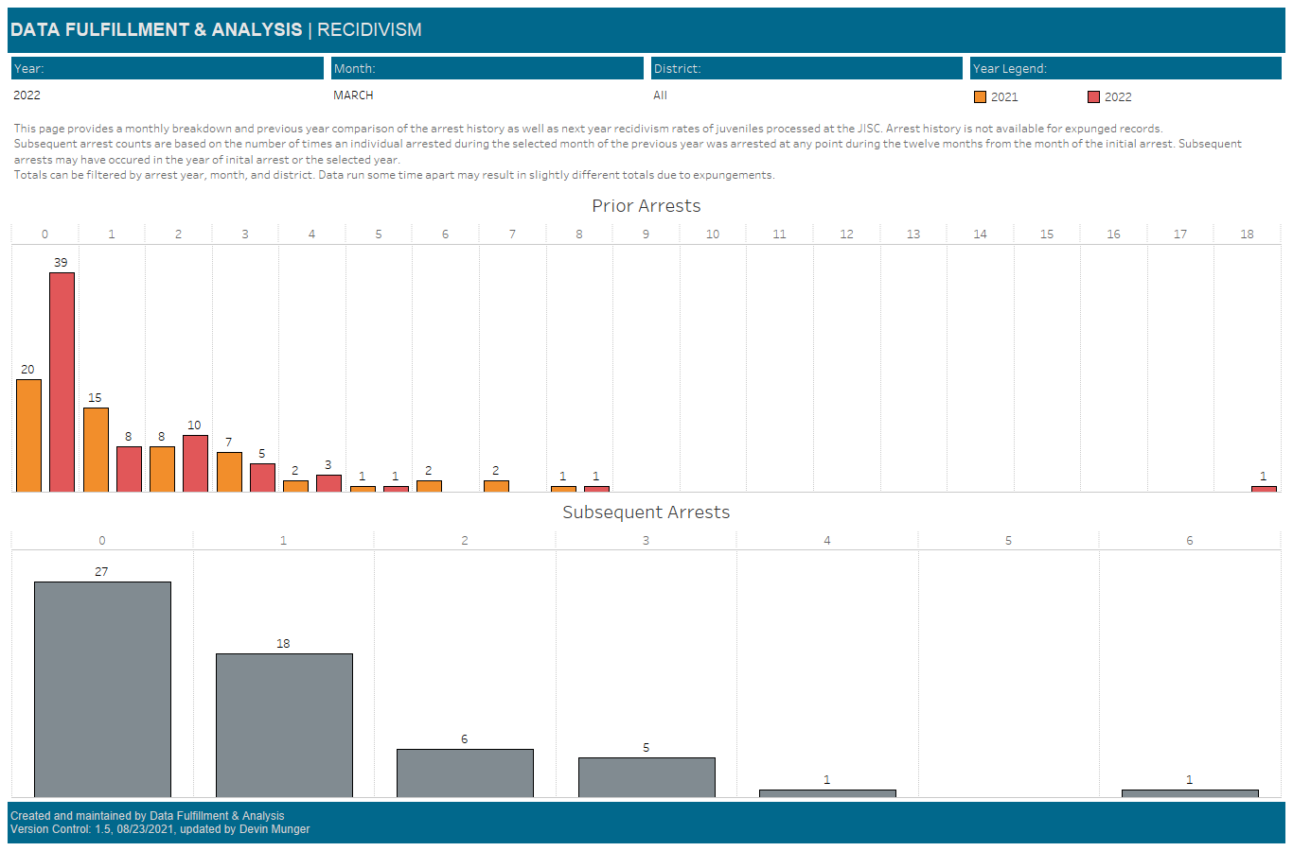

Slide 5
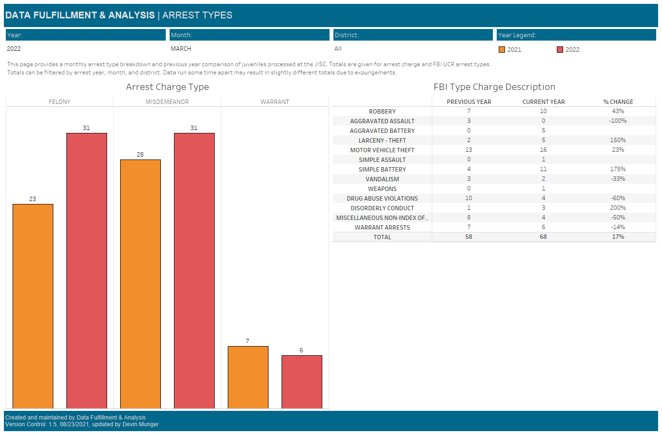

Slide 6
