Slide 1
CCMHE Quarterly Meeting
overall_0_132367198033335501 columns_1_132367198033335501
February 10th, 2025
2 p.m. – 4 p.m.

Slide 2
overall_1_132617861608743146 columns_1_132617861608743146
Welcome, Attendance, & Minute Approval
Public Comment
Administrative Updates
Follow Up from Q4 Meeting
National Association for Children of Addiction (NACoA) Presentation
CDPH Update
Feedback Look from City Departments
Mayor's Office Updates
Agenda

Slide 3
overall_1_132617861608743146 columns_1_132617861608743146
Welcome, Attendance, & Minute Approval
Public Comment
Administrative Updates
Follow Up from Q4 Meeting
National Association for Children of Addiction (NACoA) Presentation
CDPH Update
Feedback Look from City Departments
Mayor's Office Updates
Agenda

Slide 4
overall_1_132617861608743146 columns_1_132617861608743146
Welcome, Attendance, & Minute Approval
Public Comment
Administrative Updates
Follow Up from Q4 Meeting
National Association for Children of Addiction (NACoA) Presentation
CDPH Update
Feedback Look from City Departments
Mayor's Office Updates
Agenda

Slide 5
overall_1_132617861608743146 columns_1_132617861608743146
Welcome, Attendance, & Minute Approval
Public Comment
Administrative Updates
Follow Up from Q4 Meeting
National Association for Children of Addiction (NACoA) Presentation
CDPH Update
Feedback Look from City Departments
Mayor's Office Updates
Agenda

Slide 6
Breaking the Cycle: Equipping Law Enforcement to Support Children in Families Impacted by the Disease of Addiction
Jac Charier
(On behalf of the National Association for Children impacted by Addiction)
Executive Director, TASC, Center for Health and Justice
Chicago Council on Mental Health Equity
10 February 2025
www.NACoA.org

Slide 7
Founded in 1983
Mission is to mitigate the adverse effects of the disease of addiction on children and families
Raise public awareness; advance professional knowledge and skills; advocate for public policies
Provide evidenced-based training and materials; develop resources to support safe adults, practitioners; committed to solutions

Slide 8
Why This Matters for Chicago Police Department (PD)
The Need: Why Officers Must Be Equipped
Core Elements of NACoA’s Training
How This Training Benefits Chicago PD
Why NACoA?
Next Steps: Implementation for Chicago PD
Objectives

Slide 9
Why This Matters for Chicago Police Department
Daily Encounters: Officers frequently interact with children in crisis due to parental substance use disorder (SUD)
Risk Factor: Children in these situations are six times more likely to develop SUD without intervention
Current Gaps: Without training, these situations can unintentionally escalate situations, worsening trauma
Solution: NACoA’s Law Enforcement Curriculum provides skills to recognize, support, and de-escalate these interactions
Notes:
Community supports and resources:
Family Support Groups
Counseling and Therapy
Educational Programs
Mobile Apps for Recovery Support
Resource Directories
Coaching
Stress Reduction Tools
Treatment Programs

Slide 10
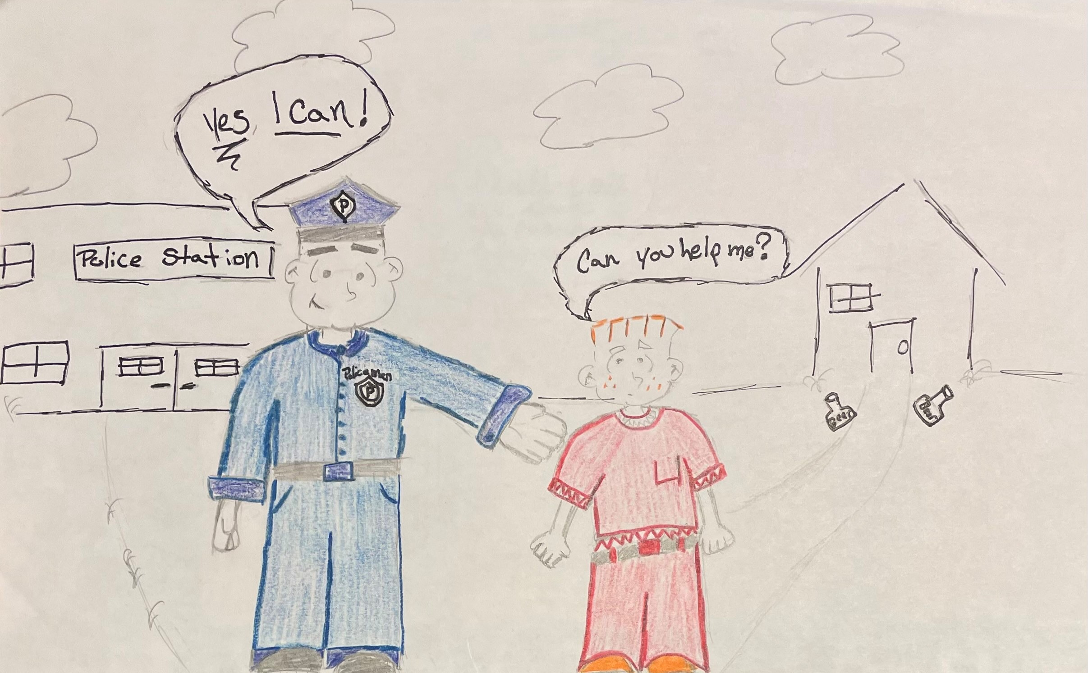
The Need: Why Officers Must Be Equipped
Exposure to Trauma: These children often experience neglect, domestic violence, and unstable environments
Intergenerational Cycle: Higher risks for the disease of addiction, mental health struggles, and criminal justice involvement
Improved Policing: Trauma-informed strategies reduce crisis calls and repeat encounters
Notes:
Community supports and resources:
Family Support Groups
Counseling and Therapy
Educational Programs
Mobile Apps for Recovery Support
Resource Directories
Coaching
Stress Reduction Tools
Treatment Programs

Slide 11
Core Elements of NACoA’s Training
Recognizing the Impact of SUD on Children
Trauma-Informed Policing & De-Escalation
Intervention & Referral Skills
Officer Well-Being & Self-Care
Long-Term Impact & Community Partnerships
Notes:
Community supports and resources:
Family Support Groups
Counseling and Therapy
Educational Programs
Mobile Apps for Recovery Support
Resource Directories
Coaching
Stress Reduction Tools
Treatment Programs

Slide 12
How This Training Benefits Chicago PD
Reduced Workload – Fewer repeat calls, freeing up resources
Enhanced Community Trust – Officers seen as allies
Safer Interactions – Reduces risk for both children, families, and officers
Crime Prevention – Early intervention leads to fewer juvenile offenses
Better Officer Well-Being – Supports emotional resilience and job satisfaction
Notes:
Community supports and resources:
Family Support Groups
Counseling and Therapy
Educational Programs
Mobile Apps for Recovery Support
Resource Directories
Coaching
Stress Reduction Tools
Treatment Programs

Slide 13
Why NACoA?
42+ years of experience in child and family support
Nationally recognized curriculum designed for real-world policing
Train-the-Trainer Model: Empowers Chicago PD’s internal trainers for sustainable impact
Proven track record with law enforcement, educators, and child welfare professionals

Slide 14
Questions?

Slide 15
National Association for Children of Addiction
www.NACoA.org
denisebepp@nacoa.org
888.554.COAS

Slide 16
CDPH Behavioral Health Initiatives Update for CCMHE
overall_0_132367198033335501 columns_1_132367198033335501
2/10/2025

Slide 17
Bureau of Behavioral Health
Violence Prevention
Victim services
Mental Health
Mental health direct services
Mental health partnerships
Substance Use
Overdose prevention and Narcan distribution
Linkages to recovery services
Street outreach
Etc.
Etc.
Etc.

Slide 18
Substance Use

Slide 19
Opioid-Related Overdose Fatalities citywide
Data from Cook County Medical Examiner Open Data Portal as of November 30, 2024. This data, particularly data from 2024, is provisional and subject to change.
Cook County Medical Examiner Data is available here: https://datacatalog.cookcountyil.gov/Public-Safety/Medical-Examiner-Case-Archive/cjeq-bs86/data.

Slide 20
Opioid-Related Overdose EMS responses citywide
20.3% Decrease from 2023-2024
Data source: Chicago Fire Department

Slide 21
Updates: Monthly CDPH Harm Reduction Training
CDPH's Office of Substance Use has started holding a monthly free virtual harm reduction training on the 4th Friday of each month from 12-1pm.
Next training is February 28 at 12pm!
No registration required, join us at the bit.ly Teams link here
Open to all in the public
Not recorded
General topics: Chicago overdose data, recognizing and responding to an overdose, fentanyl test strips, xylazine, evidence-based treatment for opioid use disorder
Questions? Email: osu.cdph@cityofchicago.org
2/28
Join here: bit.ly/NHR_Training

Slide 22
Public Health Vending Machines Data as of January 15, 2025
Products Distributed
A total of 16,886 products were distributed from all 5 machines
Optional Survey Responses: Experienced or Witnessed an Overdose
Of the 2,698 people who reported this information, 15% reported experiencing an overdose in their lifetime.
Of the 2,744 people who reported this information, 40% reported witnessing someone experiencing an overdose in their lifetime.
Optional Survey Responses: Housing
Of the 2,791 people who reported this information:
40% reported being unhoused, living with someone else, or living in a shelter
44% reported renting/owning an apartment or home
16% reported other
You can view the most recent Vending Machine Pilot Program Brief here!
2,039 kits
1100 kits
484 locks
181 locks
19 kits
78 kits
4,596 kits
2,357 kits
5,709 kits
102 kits
69 kits
124 kits
Wound Care Kits: 28 kits

Slide 23
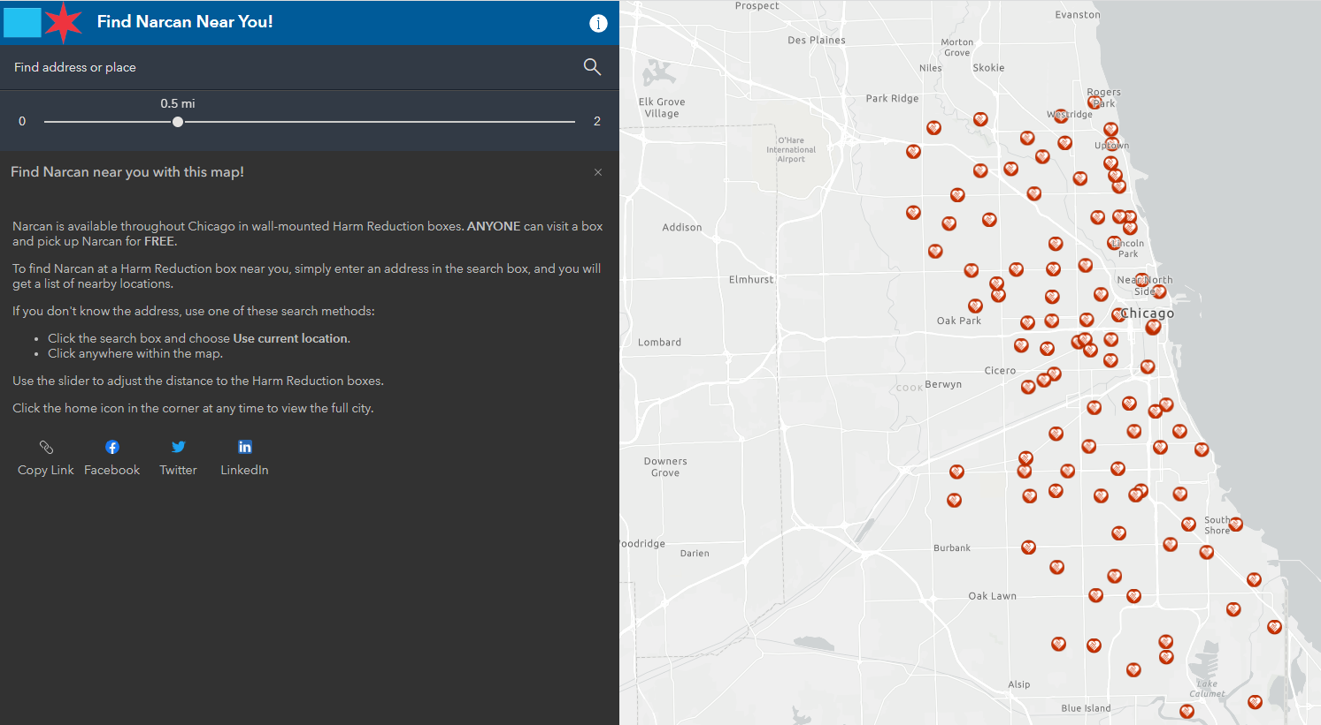
Updates – Find Narcan Near You!
CDPH Narcan finder map available via
https://arcg.is/0a1Tq9
Overcome Opioids website
Scanning the QR code below
Groups have reached out about being added to the map & I am exploring ways to do this. If you are interested, please let me know!!
Over
6,600
views!!

Slide 24
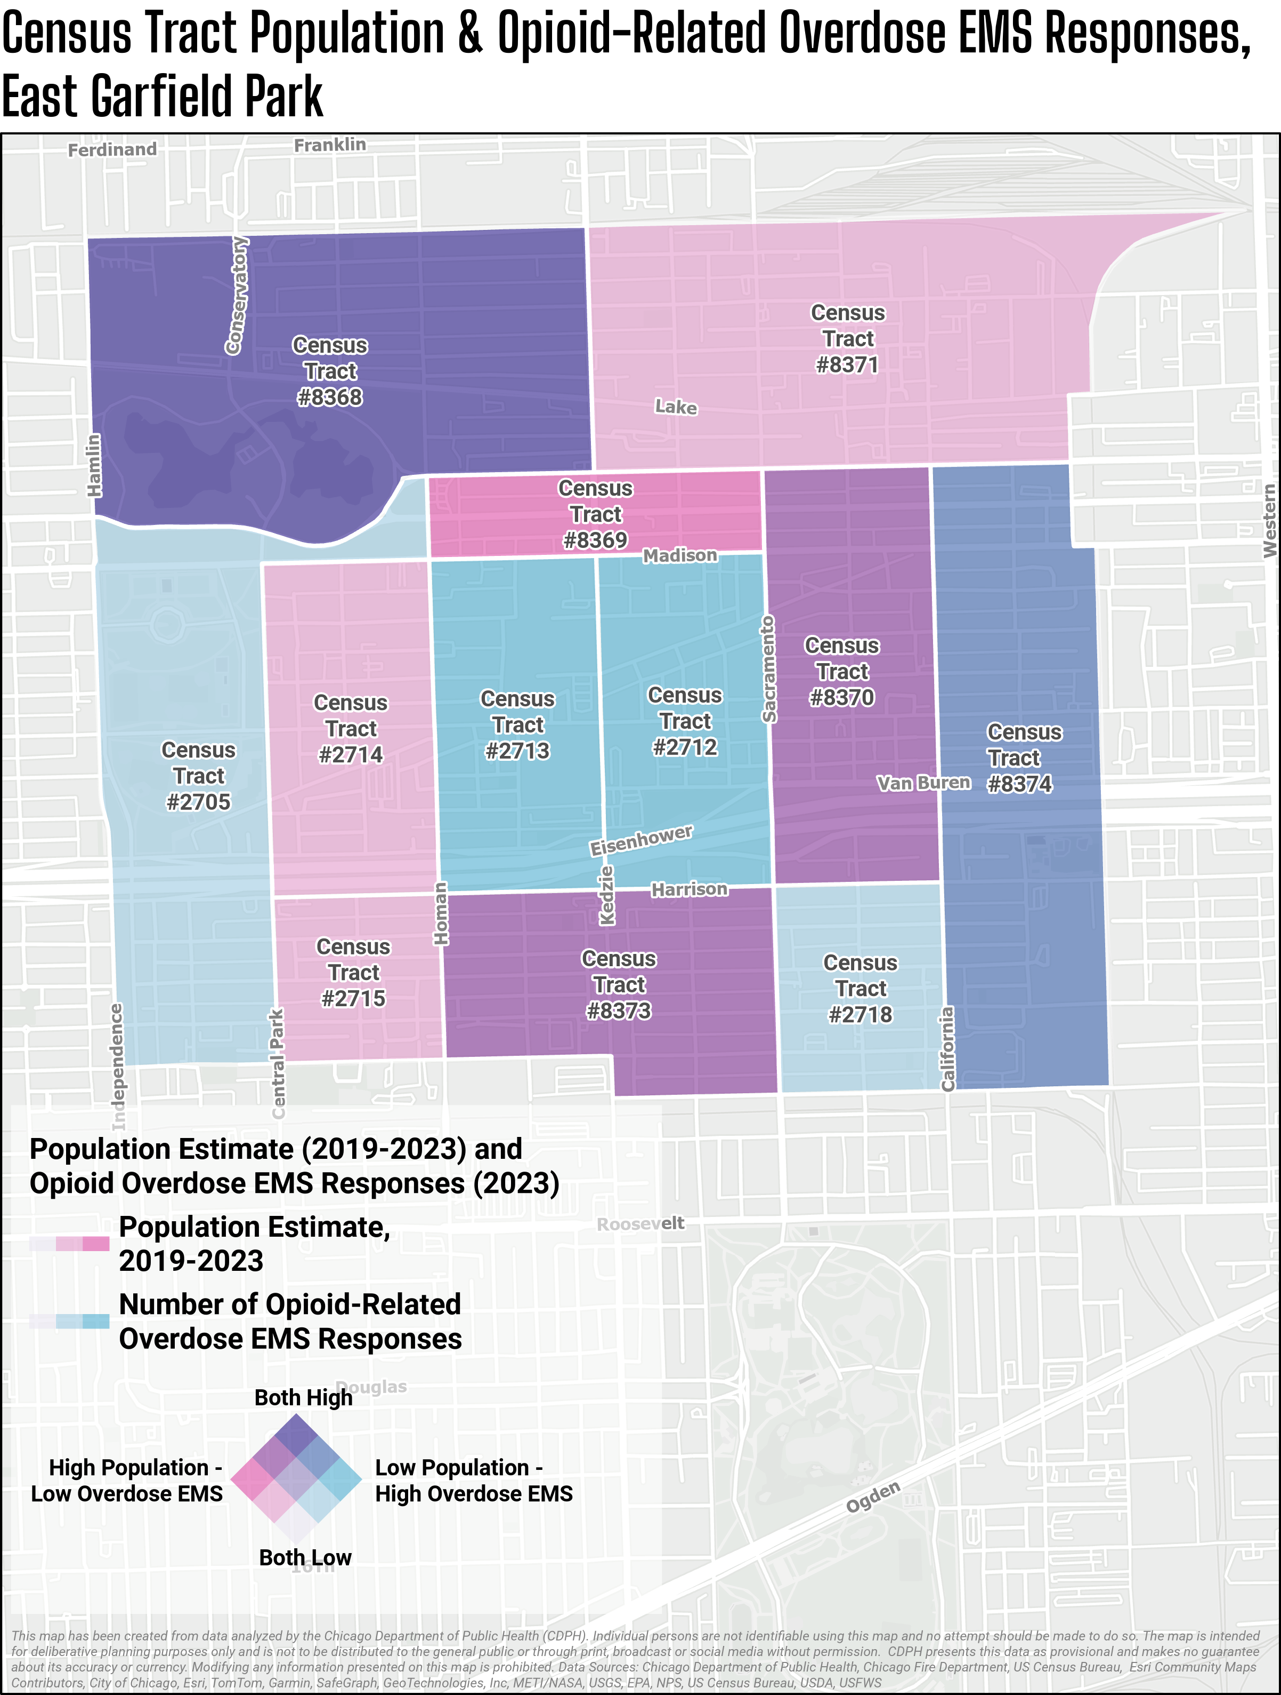
Door Knocking
Door Knocking campaign, West Side Heroin/Opioid Task Force
2,788 encounters, speaking with a total of 3,547 individuals
3,526 boxes of Narcan have been distributed
24 Census tracts in Austin

Slide 25
Violence Prevention

Slide 26
Programs and initiatives follow the CDC’s population health model, focusing on primary, secondary, and tertiary prevention to reduce health risks
Level of Intervention
Definition
Programs/Staff (draft)
Approaches to prevent violence before it occurs by decreasing “risk factors” and increasing things “protective factors”
Primary Prevention
Six programs
Approaches that focus on the more immediate responses to violence, which happen either during or immediately after it occurs.
Secondary Prevention
Four programs
Approaches that focus on the longer- term impacts and consequences of violence to either prevent further harm or to prevent repeated acts of violence.
Tertiary
Prevention
Six programs
CDC: Violence Prevention Fundamentals
Notes:
Current public health status – where are we at in the process. MH supports for CVI workers, MH skill-building/capacity building. Map programs to level of preventions and the public health approach as well as the levels of change. Level of intervention, definition, programs, and status/public health stage. Cross-Department Coordination – what have we learned and what can we show. What is MOCs doing for community safety. Community engagement to help people understand risk and protective factors to better understand what to support the community. MH support for those @ risk, what communities can do to protect & reduce risk, youth engagement. Secondary – SO, VS, HBVI, utilize evaluation and what we want to evaluation. Unique public health lane. “notifiers” of the need for intervention. Public Health is prevention – utilize data to prevent victimization versus respond. Pre position on particular days – educational activities, provide surveillance
How can we better leverage data

Slide 27
2025 Violence Prevention Investments
Primary Prevention
Secondary Prevention
Tertiary Prevention
Trauma-Informed Transformation
Restorative Practices
$1.1 million
Bullying & Suicide Prevention
Community Conveners: $1 million
Street Outreach Services: ~$20.8 million
Victims Services: ~ $7.98 million
Hospital-Based Violence Intervention: $1.5 million
Chicago Torture Justice Center
$1.175 million
People Who Cause Harm
Services for Child Sexual Assault
Notes:
SO Investments: $16,963,537
HBVI: $1,500,000
VS: $7,985,850
Community Conveners: $1 million
TI Transformation: $600,000
Bullying & Suicide Prevention: $100,000
Restorative Practices: $400,000
CTJC: $375,000
PWCH: $500,000
CCAC: $300,000
Break down between Secondary & Tertiary – 2/3 SO, 1/3 HBVI, ½ VS

Slide 28
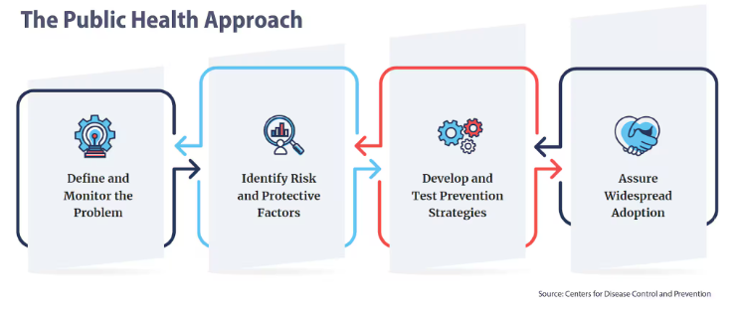
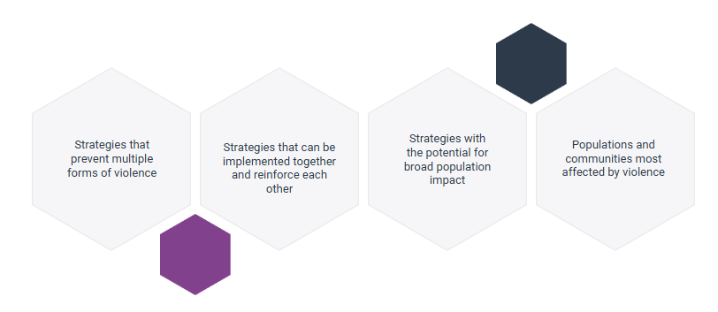
CDPH’s Violence Prevention Strategy
CDPH’s violence prevention programs are at various stages of Step 3: Develop & Test Prevention Strategies
2025 marks the launch of 2 critical programs that build essential, hyperlocal community supports ("Community Conveners") and response in hospital settings after violent injury occurs (HBVI)
Together CDPH’s OVP programs:
Address multiple forms of violence
Triage resources to community areas most impacted by violence
Prioritize coordination and partnerships to build community trust and center the community’s voice

Slide 29
CDPH’s Violence Prevention Portfolio
Since the COVID-19 Pandemic, CDPH utilized historic investments in Violence Prevention to build and launch a comprehensive portfolio of evidenced-based programs to address violence
In addition to its funding portfolio, CDPH housed the Community Safety Coordination Center (CSCC), which built infrastructure to
Engage community
Facilitate interagency coordination
Utilize data surveillance to inform response to violent incidents
Establish place-based interventions to address violence
*Programs that face a funding cliff in 2026
Notes:
SO Investments: $16,963,537
HBVI: $1,500,000
VS: $7,985,850
Community Conveners: $1 million
TI Transformation: $600,000
Bullying & Suicide Prevention: $100,000
Restorative Practices: $400,000
CTJC: $375,000
PWCH: $500,000
CCAC: $300,000
Break down between Secondary & Tertiary – 2/3 SO, 1/3 HBVI, ½ VS

Slide 30
Mental Health

Slide 31
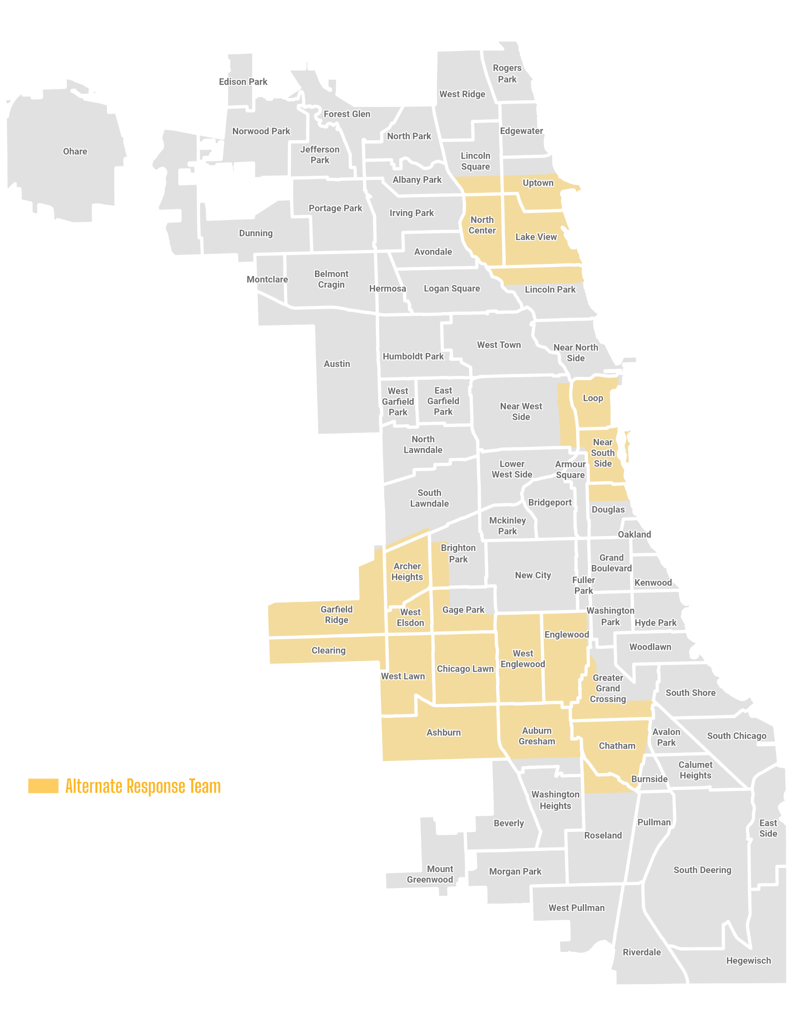
Post-Pilot Relaunch Snapshot
CARE officially "relaunched" as a fully public-health led model on Dec 16, 2024.
Responses
Unique Individuals
Follow-ups*
Total as of 1/31/25:
103
Since the program relaunched on 12/16/24
Total as of 1/31/25:
84
Since the program relaunched on 12/16/24
Total as of 1/31/25:
104
Since the program relaunched on 12/16/24
January 2025 Total:
72
January 2025 Total:
55
January 2025 Total:
67
*some individuals are followed up with multiple times based on need
Staffing as of 2/1/25
10 | Mental Health Crisis Clinicians
8 | Emergency Medical Technicians
2 | Case Managers
2 | Supervisors
Active Teams as of 2/1/25
4 | Alternate Response Teams
1 | Community CARE Team
1 | Case Management Team
CARE Coverage Map as of 2/1/25
Notes:
CDPH

Slide 32
Highlights
Follow-ups*
NEW Community CARE Team
Total as of 1/31/25:
104
Since the program relaunched on 12/16/24
1 team – 2 CDPH Crisis Clinicians – Citywide
The Community CARE Team responds to an increasing number of mental health crisis requests made outside of 9-1-1 for CARE Services
Meant to increase the pathways for residents to reach CARE services particularly those not wanting to dial 9-1-1
Currently working on optimizing this pathway through a referral form and marketing for wider visibility
January 2025 Total:
67
*some individuals are followed up with multiple times based on need
Significant reduction in van ”down-time”
Follow-up numbers have never been higher thanks to a dedicated Case Management Team.
Thanks to robust hiring in 2024 and the consolidation of CARE staff under CDPH, staffing shortages are minimal to none
This means CARE vans are going out more consistently during operation hours resulting in more residents served
Notes:
CDPH

Slide 33
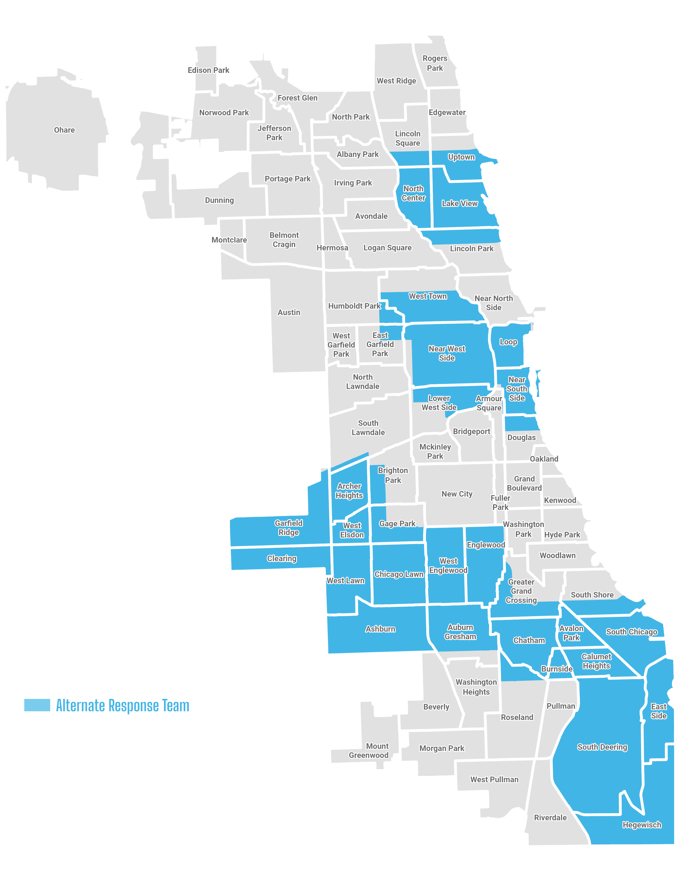
Expansion Update
CARE will officially begin operations in 2 additional police districts as of today, 2/10:
District 12
District 4
One EMT has been hired and will start on 2/18
+1 EMT
Staffing as of 2/18/25
10 | Mental Health Crisis Clinicians
9 | Emergency Medical Technicians
2 | Case Managers
2 | Supervisors
+2 AR Teams
Active Teams as of 2/10/25
6 | Alternate Response Teams
1 | Community CARE Team
1 | Case Management Team
CARE Coverage Map as of 2/10/25
Notes:
CDPH

Slide 34
Challenges
Long-Term Sustainable Funding
Most of CARE’s funding comes from one-time grant funding that is ending sooner than planned due to budget shortfalls across the City.
This abrupt announcement at the end of last year has disrupted numerous initiatives and plans for this year including:
Expansion into evenings and weekends
Expanding the number of Alternate Response and Case Management Teams
Further geographic expansion
Hiring remaining vacancies
Solutions:
All options are on the table and are being considered or actively pursued.
Notes:
CDPH

Slide 35
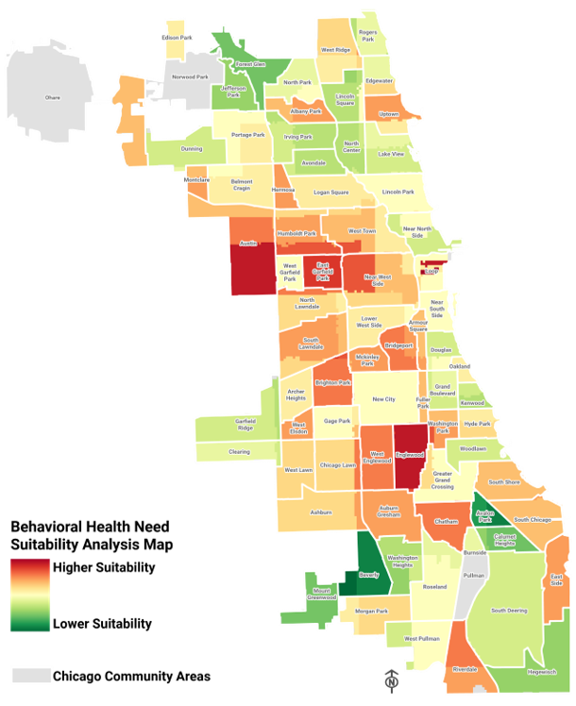
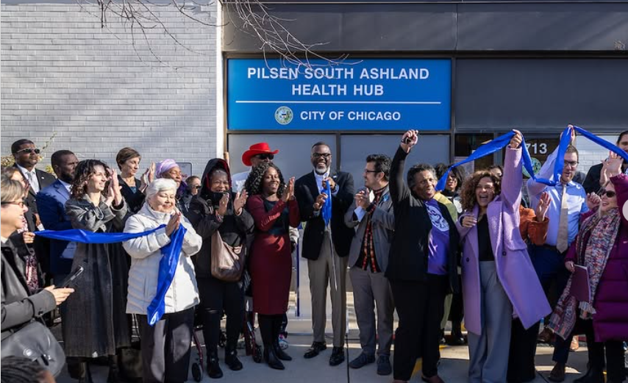
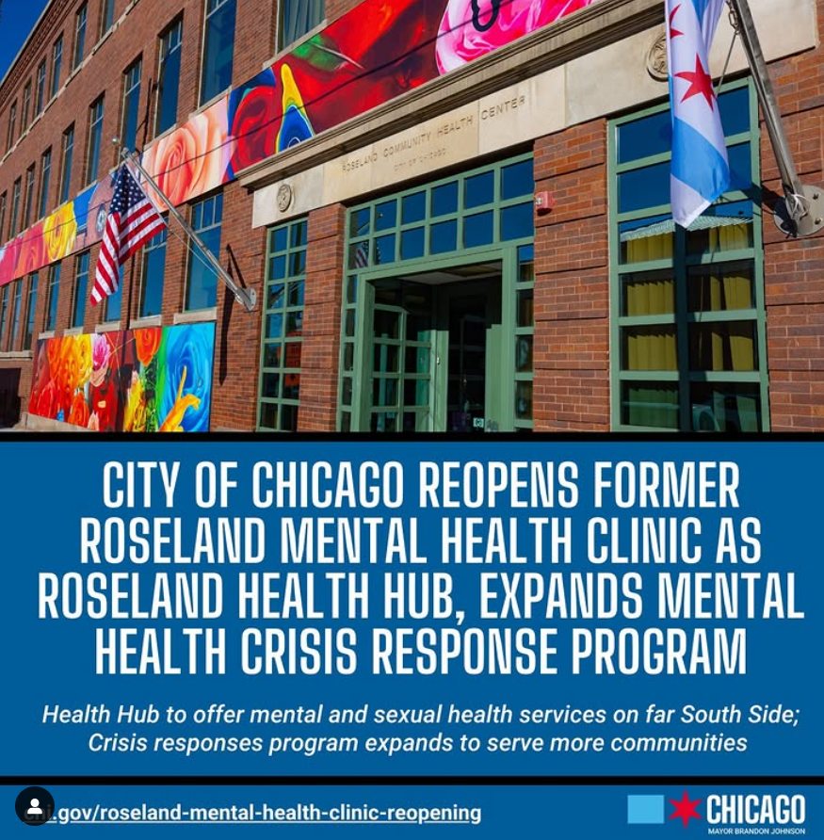
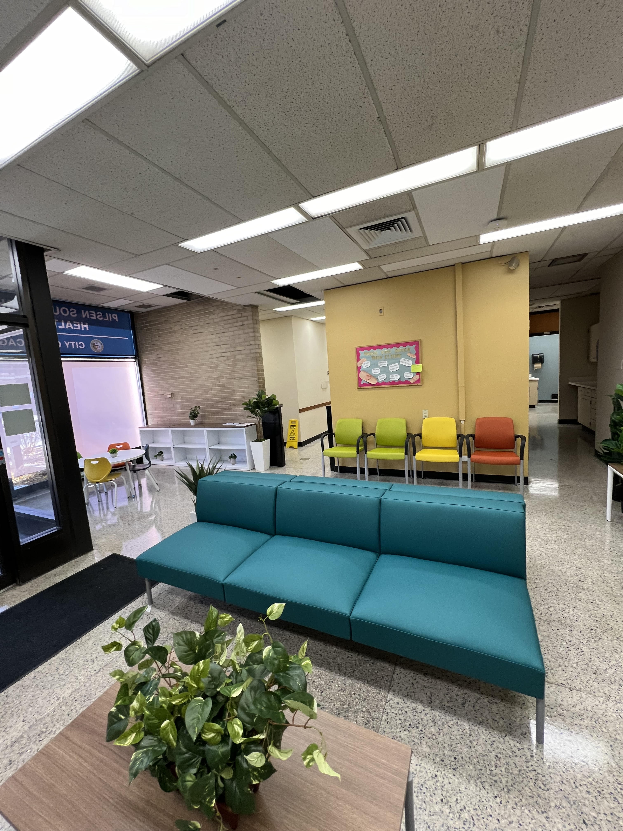
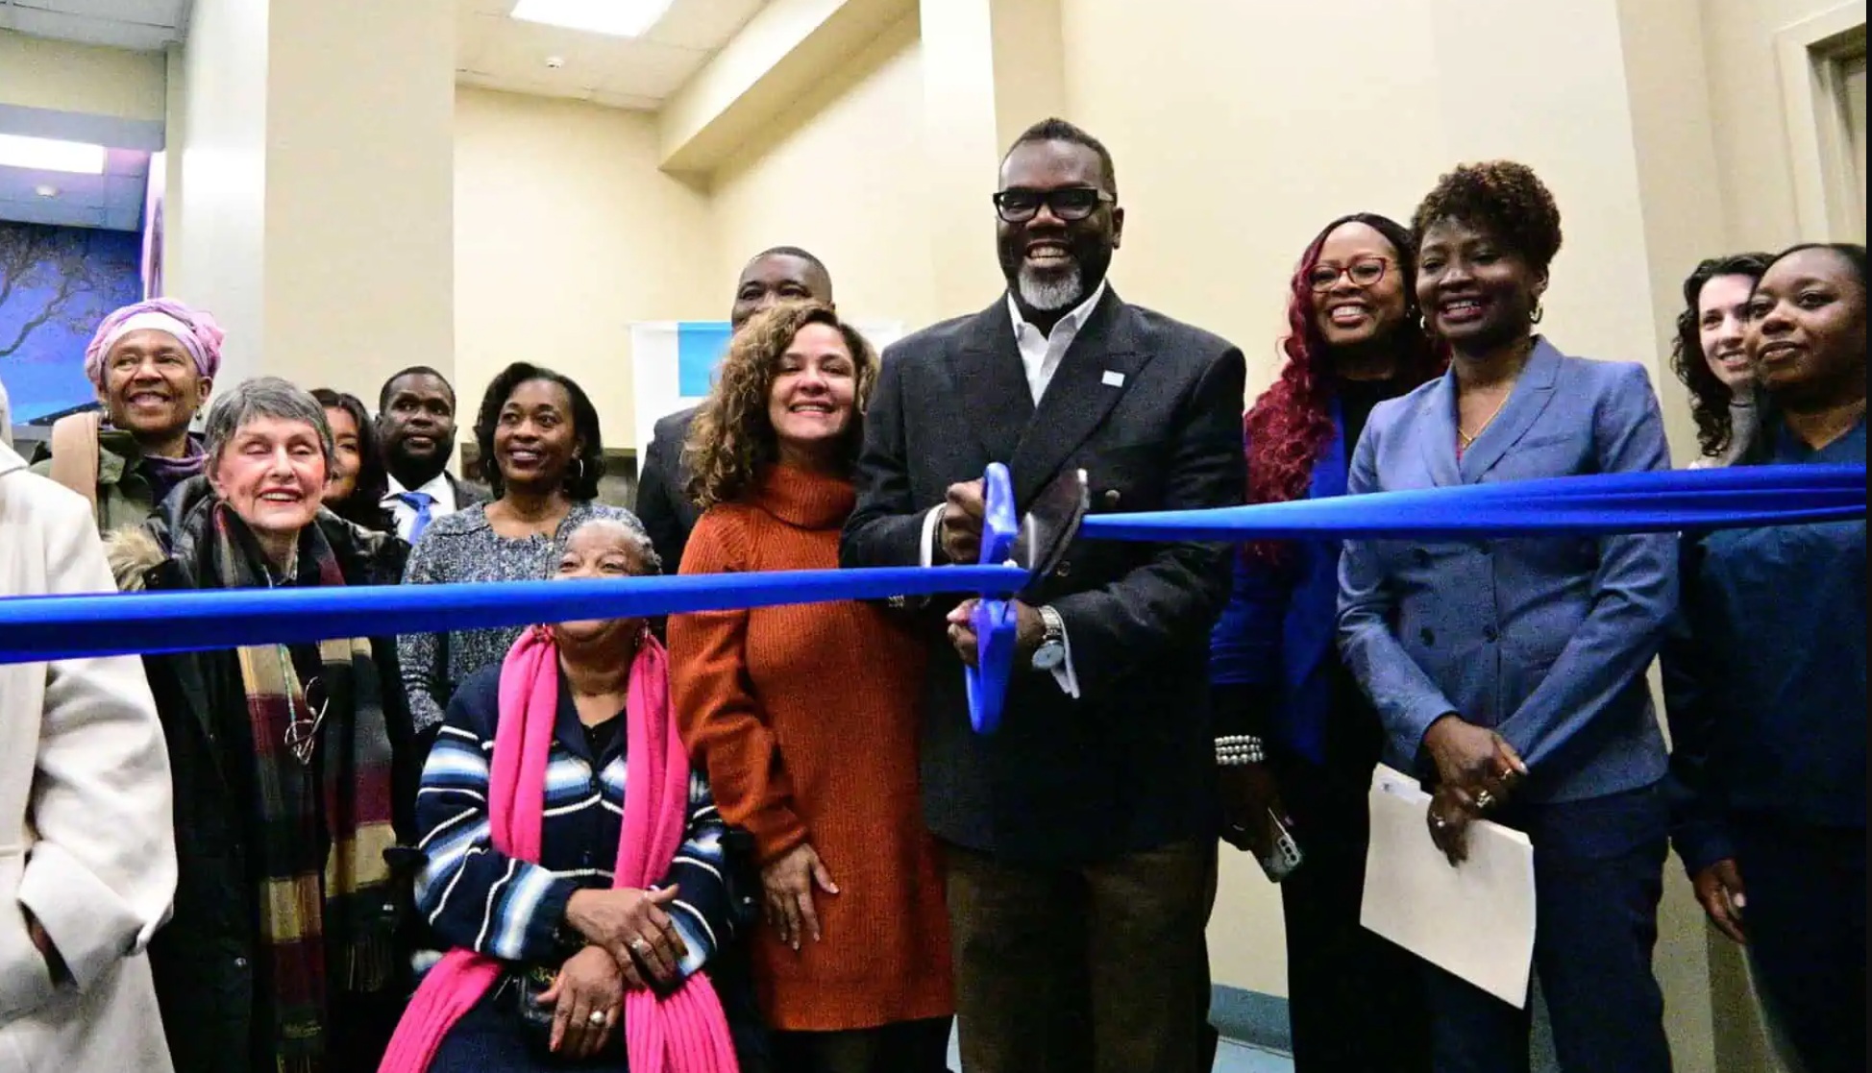
Fulfilled MHEI’s Major Milestones in 2024
Conducted suitability analyses to understand service demand gaps and accessibility problems across priority community areas
Pilsen S. Ashland Health Hub started mental health services
Roseland E 115th Health Hub reopened, starting mental health services
Oct 28
Dec 23
Jan -May
As part of the People’s Vision for Mental and Behavioral Health, the Mayor’s Office and CDPH
May 30
announced 3 new service expansions for 2024: (1) Pilsen (2) Roseland (3) Legler CPL (opened in June)

Slide 36
Operational and Programming Highlights
Centralized Intake Improvements: Updating workflow and centralizing responsibilities in order to:
Enhance intake-to-appointment conversion: Ensure clients are successfully scheduled for appointments.
Streamline client interactions: Minimize the number of calls and handoffs to improve the client experience.
Simplify intake staffing: Reduce the number of staff involved in the intake process to ensure consistent and high-quality customer service.
Extension of Healing Arts Programming: Secured 2025 funding to extend Healing Arts programming to 2025:
Partnering with 8 artists that will be designated to one of the seven clinics to hold weekly programming
Artists will actively engage in direct community outreach and cultivate new collaborations to deliver support services focused on targeted, evidence-based strategies for individuals at risk of opioid-related harms and those with co-occurring substance use disorders and mental health conditions

Slide 37
overall_1_132617861608743146 columns_1_132617861608743146
Welcome, Attendance, & Minute Approval
Public Comment
Administrative Updates
Follow Up from Q4 Meeting
National Association for Children of Addiction (NACoA) Presentation
CDPH Update
Feedback Look from City Departments
Mayor's Office Updates
Agenda

Slide 38
overall_1_132617861608743146 columns_1_132617861608743146
Welcome, Attendance, & Minute Approval
Public Comment
Administrative Updates
Follow Up from Q4 Meeting
National Association for Children of Addiction (NACoA) Presentation
CDPH Update
Feedback Look from City Departments
Mayor's Office Updates
Agenda

Slide 39
Future Meetings
2025 Quarterly Meetings
Q2-May 12, 2025
Q3-August 25, 2025
Q4-November 10, 2025
CCMHE Website

